Slide 1

26-27 CSI December Count Collection Training
New this Year and Reminders
Recorded September 2026
Notes:
Hello! Welcome to the 26-27 CSI December Count Collection Training. This training is focused on providing updates to the collection from the prior year and sharing a few reminders. It is designed for returning staff, but all staff are welcome to review this training along with the general overview training. If you have questions while reviewing this training, feel free to reach out to the CSI data submissions inbox.

Slide 2
Agenda
New/Reminders for the December Count Collection
  Addition of two new Race/Ethnicity options.
  Updates to the Hispanic/Latino field
October Count SPED Funding Factor vs December Count
The DC Record Checker Tool
Access, opening, and using the tool
Validations Checklist now included on the tool
Timelines and Deadlines
Initial submittal, Level 1, Level 2, and Signed Summary Deadlines
Notes:
So for the agenda today, we will first be looking at what is new and reminders for the collection in 26-27. The updates were relatively minimal this year, with clarifications to the Race/Ethnicity fields along with some additions. We will also look at the differences in funding between the new October Count SPED Funding Factor and December Count. After that, we’ll then jump into a reminder discussion on the resource called the SPED Record Checker Tool and finish off today’s training with the timelines and deadlines.

Slide 3
Updates for 26-27
Notes:
Now that you have an overview of what we will be discussing, let’s jump into the updates and reminders for the 26-27 December Count data collection.

Slide 4
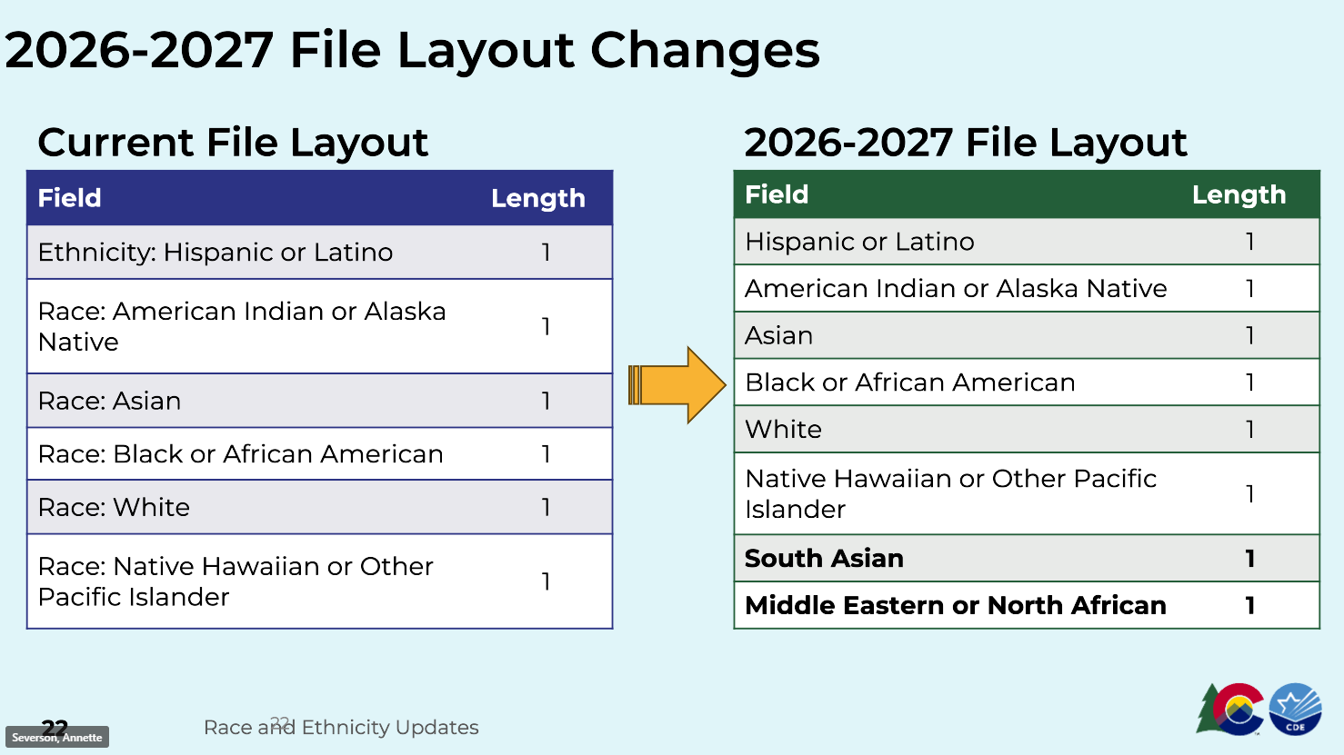
Race/Ethnicity Updates
In order to meet the requirements of SB5-050 and Federal Reporting requirements, CDE has added two new Race/Ethnicity fields as options to be selected for both Students and Staff. These include:
    South Asian
    Middle Eastern or North African
Ensure that all new and existing staff are reviewed in case they meet one of these new categories and update accordingly.
Notes:
Alright, to start out I wanted to discuss some updates to the Race/Ethnicity fields located on the Child file. Due to updated Federal and State Reporting requirements, two new Race fields were added. These would include South Asian and Middle Eastern North African. It would probably be a good idea to review all students to ensure they do not meet one of these new race fields. If so, ensure you are updating accordingly.

Slide 5
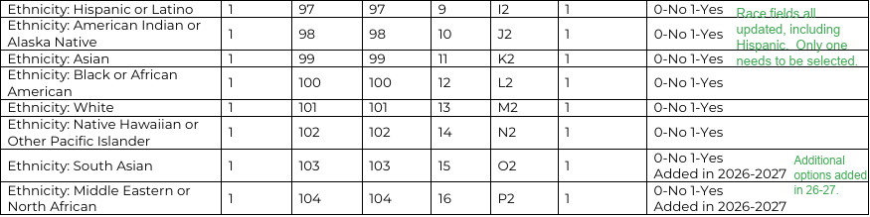
Hispanic Student Race/Ethnicity Update
Historically, schools have been required to add an additional Race when selecting the Hispanic/Latino Ethnicity. This has changed for 26-27 moving forward.
The separate Ethnicity and Race fields are now combined into one Race/Ethnicity option, which Hispanic Latino is one of them.
This can now be selected as a standalone or in conjunction with another Race/Ethnicity depending on the scenario.
Ensure you are reviewing all staff and updating their Race/Ethnicity that best fits their personal background.
All staff should have a 1 for “Yes” and a 0 for “No” in each field.
Notes:
Another update to the Race/Ethnicity fields relate to the field formerly known as Ethnicity Hispanic or Latino. This has been updated to now be a Race/Ethnicity field along with the rest of them. This means that Hispanic can now be selected as a standalone Race/Ethnicity option. Previously, if Hispanic was selected you also needed a Race. Now that is not the case. You certainly want to review all students previously coded as Hispanic or Latino to see if another Race/Ethnicity field is also applicable. If not, you can zero fill any other races. This can be done by selecting 0 for No or 1 for Yes.

Slide 6
October Count Pupil Count Vs December Count
Funded Pupil Count Details and Differences
The Special Education Pupil Count included in the Total Program funding calculation along with the associated funds are separate and unrelated to the Special Education December Count funds that come from ECEA.
Audits of CSI’s Special Education Pupil Count as it relates to the School Finance Formula, will not impact the organization’s Special Education December Count funding.
Ensure that processes are in place to check all students coded with an accurate primary disability in October Count and ensure they are also included in December Count for cross collection consistency.
There will be some students who are not included with a Disability on October Count but may have an active IEP by December Count. This is due to the differences in days when the information is collected.
Notes:
Next, lets talk about October Count vs. December Count — how the two special education pupil counts differ and why both matter.
Key points:
- The Special Education Pupil Count in the Total Program funding calculation is separate and unrelated to the December Count funds that come from ECEA.
- Audits of CSI's Special Education Pupil Count under the School Finance Formula will not affect the organization's December Count funding.
- This puts processes in place to check that every student is coded with an accurate primary disability in October Count also appears in December Count for cross-collection consistency.
- Also, keep in mind that there will be some variance: students without a disability on October Count may have an active IEP by December, simply because the two collections happen on different days.

Slide 7
OC Funded Pupil Count Vs December Count (cont.)
OC Special Ed Funded Pupil Count | Special Education December Count
Counted as of October 1st! | Counted as of December 1st!
Counts of students who have been identified as having a primary disability on Count Day and are eligible for per-pupil funding (PPR). | Counts of Students receiving Part B SPED services and the staff members who serve them.
One piece of the School Finance Funding Formula that helps determine the total program funding for each school/district. | Primarily determines state ECEA funding that helps provide services to students who qualify.
Notes:
Here is a quick table to serve as a reminder. Keep in mind that the October Count funding is as of October 1st while December Count funding is counted as of December 1st. With October, we are looking at counts of students identified as having a primary disability on count day and Special education is looking at students actively on an IEP and receiving SPED Services. When it comes to funding for October Count, this is just one piece of the school finance funding formula which aids in determining the total program funding for each school and district. December Count on the other hand, primarily determines ECEA funding that helps provide services to the students who qualify.

Slide 8
Reminder: SPED Record Checker Tool
Notes:
Now, lets revisit an important tool that CSI is providing to schools called the SPED Record Checker Tool!

Slide 9
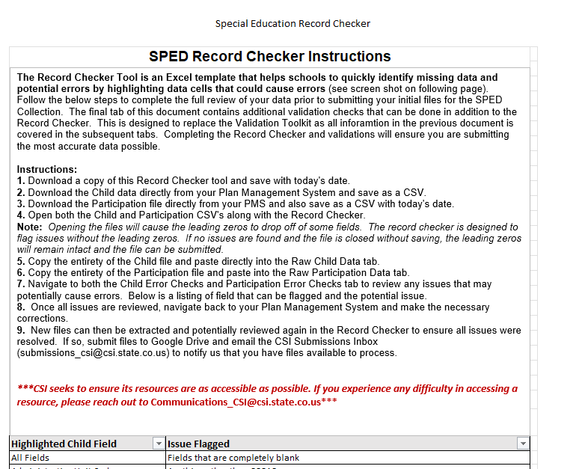
Purpose of the Record Checker Tool
Identify and correct errors prior to submittal
Fewer errors received upon initial submittal
Fewer submissions to get to error clearance
Collection errors cleared earlier in the process
For more details and information, see the Record Checker Instructions and Template Tool
Notes:
The purpose of the record checker tool is to identify and correct potential issues or errors prior to initial submittal of files to CSI. The tool is essentially an excel template that allows you to paste your raw data files into it and any potential issues will be flagged on the review tabs. This tool is not designed to catch every error, but if used properly – you should expect to see less errors on your initial submissions with the goal of less submittals to error clearance!

Slide 10
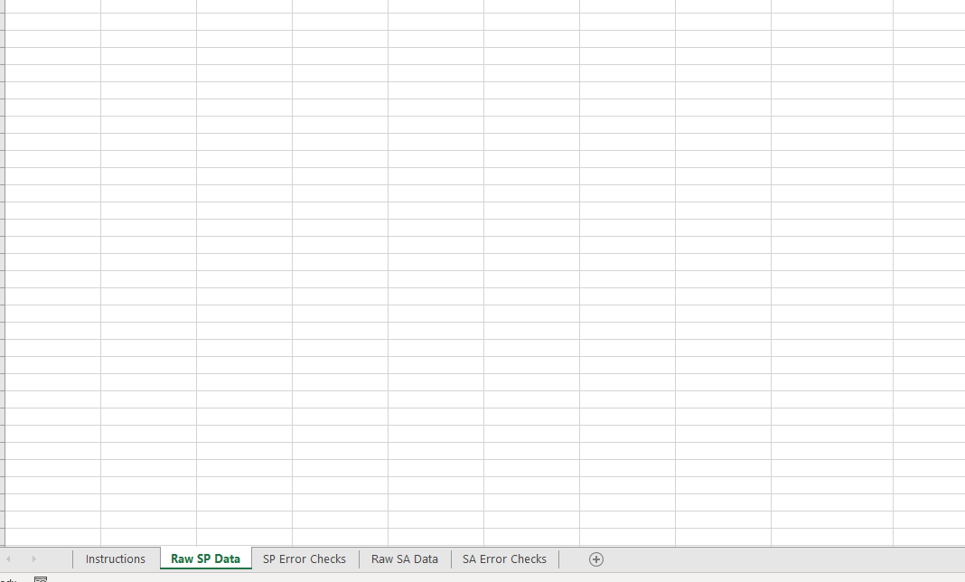
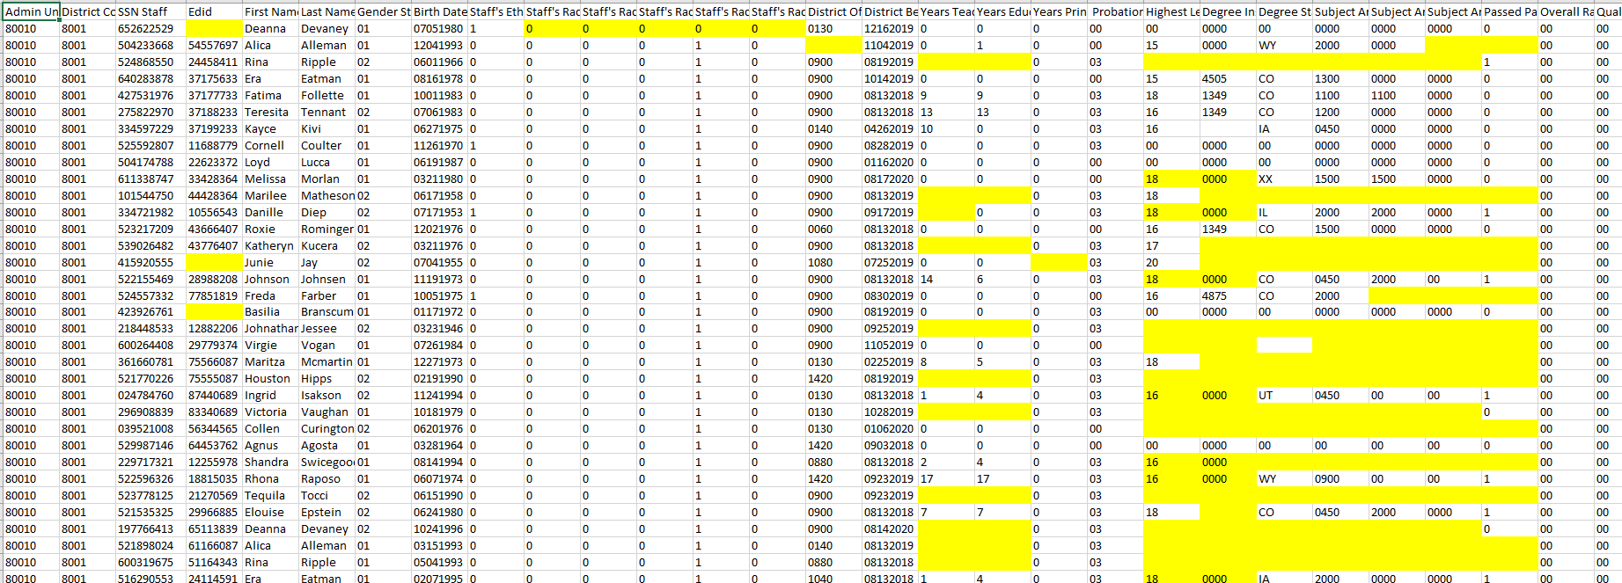
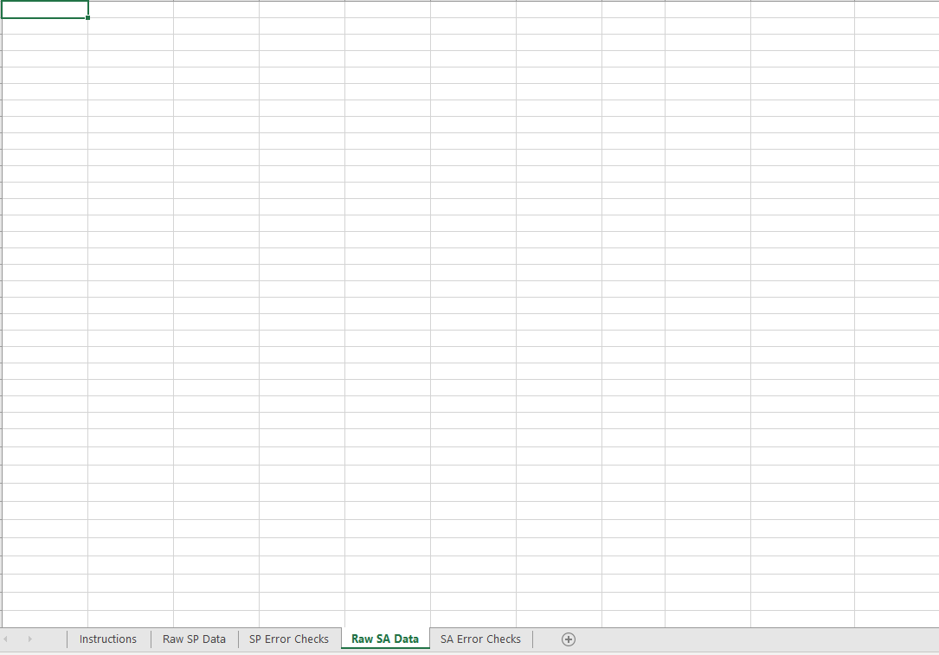
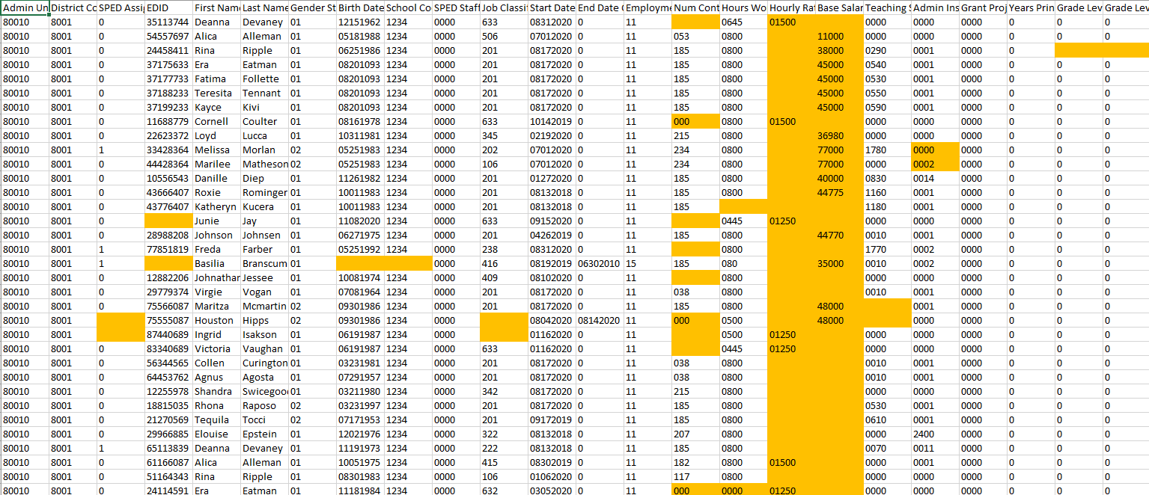
SPED Record Checker Tool
Notes:
As you can see here, the tool contains 4 main data tabs aside from the instructions tab, 2 for your raw data and 2 showing potential errors on each file. Essentially, you want to paste your raw data into each corresponding raw tab and navigate to the checks tabs. Anything that may potentially be an error will be highlighted on those. The objective would be to navigate back to your plan management system, make the corrections and create updated files for your initial submission. It is highly recommended to use this during the collection to reduce your errors making your job easier in the long run.

Slide 11
Timelines and Deadlines
Notes:
Last, lets take a look at the timelines and deadlines for this collection

Slide 12
December Count Collection Timelines and Deadlines
Deadline | Task
11/10/2026 | Submit initial files (Child and Participation Files)
12/09/2026 | Schools must have all Level 1 (Staff Profile/Staff Assignment) errors cleared
01/13/2027 | Schools must have all Level 2 (December Count and SPED Staff for HR) errors cleared
Upon Error Clearance | CSI will provide Data Summary Reports to schools
1/26/2027** | Submit Signed Certification Agreements to CSI
*Dependent upon all schools clearing errors by specified deadlines
**Any requests for changes must be received by CSI on or before 1/22/2027
Notes:
This slide lists all the deadlines that must be followed for the 26-27 December Count Data Collection. First, we have a date of 11/10 to have all your initial child and participation files submitted with level 1 error clearance for those files being on December 9th. All school must have both level 1 and 2 errors cleared by January 13th 2027 and you will receive your summary report shortly thereafter. The date to review, sign and return those is January 26th. If after reviewing, you notice some changes that need to be made to your data, please submit those updated files to CSI by January 22nd to ensure files can be processed and a new summary report delivered to meet the deadline.

Slide 13

Mid-Point Timelines and Deadlines
To avoid both the logjam that occurs and processing delays on deadline days, we are asking schools clear at least half of their errors by the below dates. These are typically the halfway point between each deadline.
  Level 1 Mid Point Deadline: 11/30/2026
  Level 2 Mid-Point Deadline: 12/30/2026
This is strongly recommended for the current 26-27 DC collection but will be required in future collections and years.
Notes:
To expand more on deadlines, we are trying out an option this year that is intended to help with the logjam and overall craziness that occurs on deadline dates. We often receive the most submissions on these days and in many cases, some of the issues experienced are more complicated and require further research. In an effort to avoid the deadline rush, we are asking schools to have at least half of their level 1 errors cleared by November 30th and half of their level 2 errors by December 30th. These certainly can be met earlier, but hopefully by implementing this, you will receive your error reports back in a more timely manner.

Slide 14


Thank you for Reviewing this Training
  Next Steps: Review the “General Overview” training on the CSI website
Contact the Submissions Inbox with Questions:
    Submissions_CSI@csi.state.co.us
Notes:
Thank you so much for reviewing this training for the 26-27 December Count Data Collection. If you have questions, don’t hesitate to reach out to CSI and we are more than happy to assist you!

