Slide 1

26-27 CSI December Count Collection Training
Data Entry Training
Notes:
Welcome to the 26-27 December Count Data Entry Training. This short recording is focused on the Who, What, When, Where and Why as it relates to data entry for the December Count Collection. As with any collection, data entry is key to accurate data and reducing the number of errors upon initial submittal. The goal of this training is to provide you the information and resources to complete accurate data entry. It is important to mention that this is not the full training for December Count, which is set to be posted on October 29th and includes a general overview and a new this year module. This should be reviewed prior to that as it really contains further information and the pre-steps necessary to set this collection off on the right foot!

Slide 2
Purpose of SPED Data Entry
What
Schools report data to CSI regarding students with disabilities and the staff that provide services
To accurately record data about students with IEPs so that schools may receive appropriate funding and resources to best support their education and services
Why
Who
A coordinated effort between the school’s special education staff, HR contact, data submissions contact and CSI
Through the collection of staff and student data in Infinite Campus, Enrich, or starting point files
Where
When
The collection consists of student IEP data as of December 1st, 2026
Notes:
In looking further into the purpose of data entry as it relates to Special Education, we wanted to cover these 5 key W’s. First, we will look further into the What in terms of data entry. Schools will be reporting to CSI data on students with Disabilities and also the Staff providing those services, which is where the HR Contact comes into play for this collection. Next, why are we entering this data? To accurately record data about students with IEPs, so that schools may receive appropriate funding and resources to best support their education and services. I could throw in the need to meet State and Federal data collection requirements as well to the Why category. As far as Who – this typically is a coordinated effort between several staff at your school. This usually involves mainly the Special Education Staff, Data Submissions Staff and the HR Contact as that collection ties to December Count through Special Education staff and could potentially produce errors that need to be corrected on the HR side. In looking at the where, CSI schools typically use one of two possible Plan Management systems for Special Education data with some minor exceptions. We will talk a little more about these later, but generally is Enrich or Infinite Campus. In discussing the When for December Count, this collection should include student IEP data as of December 1st 2025. So now that we have a general overview of the purpose as it relates to data entry, let’s look at each of these W’s a little more thoroughly, beginning with the What

Slide 3
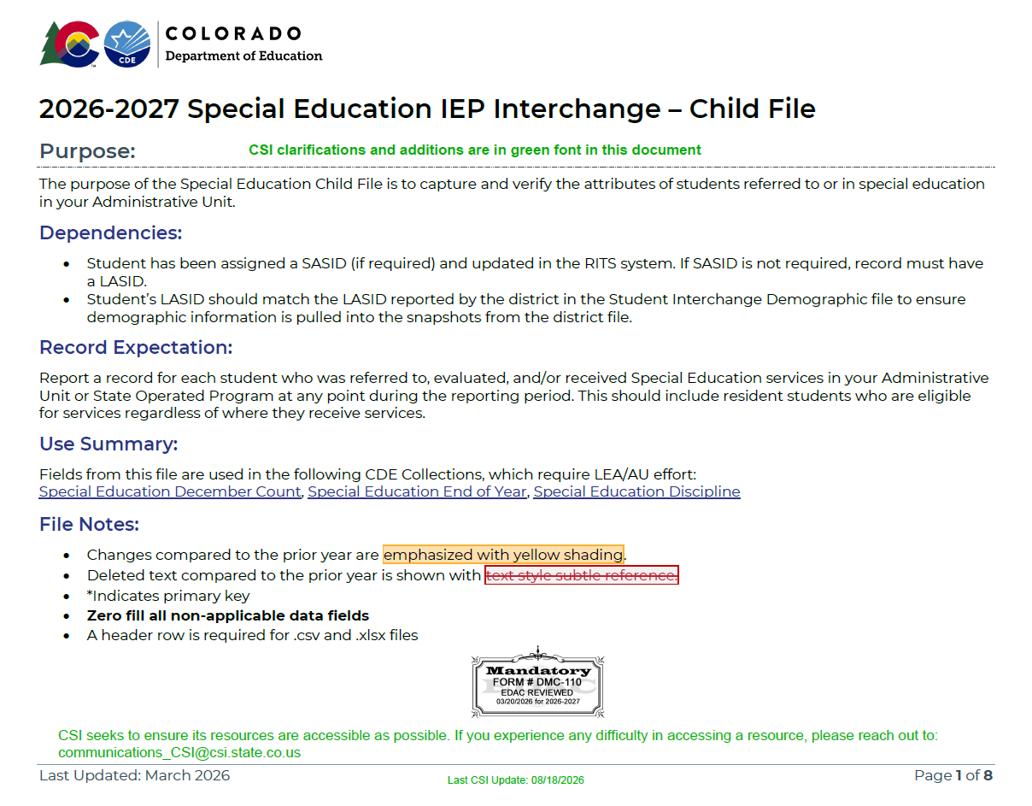
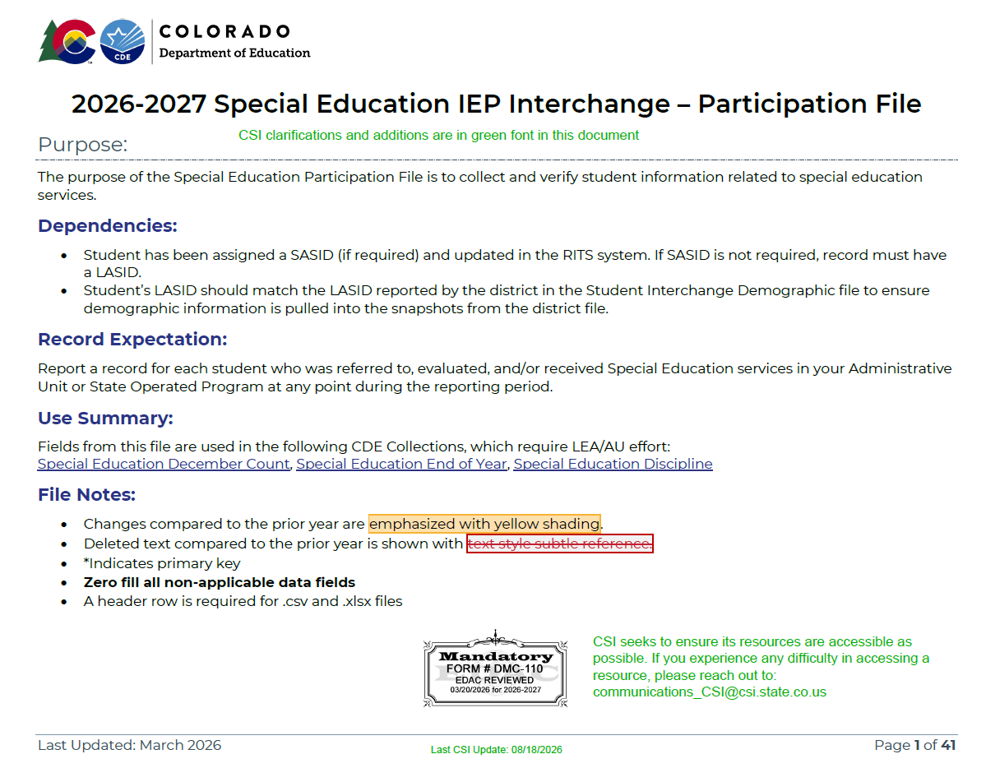
What
The December Count collection is:
An annual count of eligible special education students as of December 1st
Used to generate federal funding to provide specialized student services
Requires special education service provider data to ensure that appropriate licensure and endorsements
Notes:
So when talking about the What of the December Count collection in relation to the data entry, the December count collection is an annual count of eligible students as of December 1st used to generate federal funding to provide students specialized services. Special education service provider data is also required as of December 1st to ensure appropriate licensure and endorsement of staff can be verified. A good resource to start with when completing data entry for this collection is the File Layout and Definitions documents located on the CSI website. CDE releases these each year for every file associated with the collection, in this case the Child and Participation files. CSI adds additional notes in green that are specific to CSI schools as it relates to data entry. These documents contain each field necessary for the collection, but also provides additional details on field lengths, file location in excel, and applicable options when coding answers. I highly recommend these are used when completing your initial data entry as it will assist in providing you the background information necessary on each field to correctly and accurately enter the information.

Slide 4
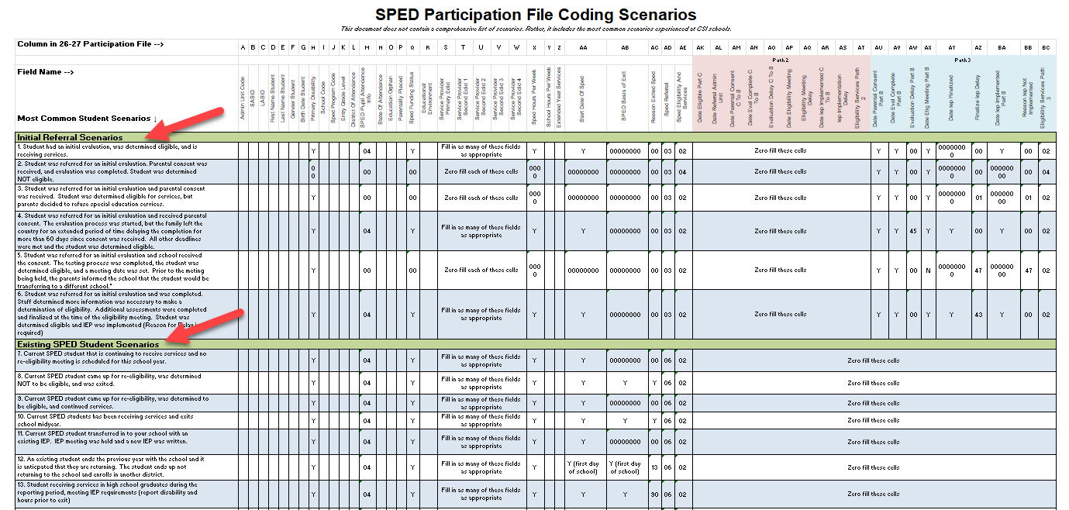
What (Continued)
Use the CSI Coding Scenarios document to identify common student scenarios you may encounter and the correct coding necessary for the Participation file.
Notes:
Continuing with the What of Data Entry, another great resource to utilize from the CSI website is the CSI Participation File Coding Scenarios Document. Essentially, this resource is split up between Initial Referrals and Existing Students and how best to code them. The document provides common scenarios that you may encounter when completing data entry and provides the correct coding for that scenario on the participation file. Due to the number of fields on the file and the complexity of entering this information, it certainly can be a huge time saver by reducing the number of errors that you will encounter upon first submittal if followed accurately. Make sure you are paying special attention to the SPED Referral Field in Column AD. In essence, this is the primary designator between New and Returning students with an 03 being New and an 06 being returning. If new and eligible, both the SPED Eligibility and Services in AE and the Path 3 Eligibility and Services in BD must be 02 with 04 used for ineligibles. If returning, only the Eligibility and Services must be completed with the Path 3 one zero filled. This was a common area of confusion last year, so it will be beneficial to keep in mind. Also, as it pertains to the SPED Referral, you can see in this document, if a student is Newly tested and coded with an 03, then all applicable dates also must be completed for Path 3. When thinking about the What for data entry, using CSI resources such as this coding scenarios document and the File Layout and Definition documents can ensure that What is being entered accurately reflects each students' unique circumstances.

Slide 5



Why
Ensures students receive timely supports by confirming compliance with process requirements
Ensures students receive services by qualified staff by confirming compliance with staff qualifications
Ensures funding to support students with IEPs through the annual count of participants in special education
Notes:
So now that you have more information on what is being collected along with some helpful resources to do this, the next question would be Why is completing data entry for your special education students so important? Really there are three main reasons that I want to discuss. First, it is necessary for funding purposes to have an accurate count of students participating in Special Education. This has funding implications that tie to the services you are providing, so ensuring each student is counted is very important. Also, this does ensure those students do receive the timely supports they need by confirming compliance with all process and timeline requirements. And lastly, this will ensure that students receive services by qualified staff by confirming the staff has appropriate qualifications. So, as you can see, it is very important this data entry is accurate, and each student is included.

Slide 6
Who
Special Education Staff
                Confirm students and service provider information is added to the school’s data system in a timely and accurate manner
                Communicates with data submissions contact when updates are made
                Reviews and signs off prior to submitting data to CSI.
                HR / Business Manager
                Ensures special education staff information is added into the HR report in a timely and accurate manner
                Reviews and signs off prior to submitting data to CSI.
                Data Submissions Contact
                Collaborates with the SPED Coordinator and HR Manager to resolve data issues and ensure accuracy
                Reviews and signs off prior to submitting data to CSI
SPED
HR
Data
Notes:
We talked a little about this in the purpose of data entry, but I wanted to dive further into the staff that will be completing this for students and the importance of coordinating with all necessary staff to ensure accurate data. Collaboration is key to the success of this or any other collection. So, when talking about December Count, who will be involved? First and foremost, the Special Education Staff at your school will be the main point of contact and data entry person as testing is completed and IEPs are being implemented. They will need to confirm the student’s information and services provided. For students receiving initial evaluations, ensuring all the necessary dates will be a very important aspect of data entry. Also, as it pertains to the services provided, the HR or Business manager will play a role in ensuring that all special education staff are accurately reported in the HR collection. We will discuss this further in the next slide. Also, the Data Submissions contact will work with both of these staff members to resolve data entry issues, ensure accuracy, and verify all timelines are met. So really, when you think about this collection, it really is a team effort as it pertains to data entry.

Slide 7
Who (Continued)
HR Staff – Add SPED Staff + Grade Levels Served
DC Staff – Add proper EDIDs to IEP
SPED Staff Included in DC Snapshot
Collaboration with Human Resources Staff
Special Education and HR staff must work closely throughout the collection
Special Education staff are included in the December Count snapshot - not HR
Level 2 Staff Errors for December Count often will need to be cleared by updating the HR files
SPED staff ensure accurate EDIDs are being provided on a student's IEP
HR staff need to ensure that all staff with those EDIDs are included with a proper SPED flag and accurate grade levels.
Notes:
To expand further on the who piece as it relates to collaboration, I really want to emphasize the need for special education staff to be in contact with HR staff on a consistent basis as you work through the collection. This is due to several reasons, but on the HR side, any staff flagged as working with special education will actually be in the December Count snapshot, not the HR snapshot. This can lead to level 2 staff errors that can only be corrected by working with your HR team and updating the staff profile or assignment files. This means that you as SPED staff should verify that all staff working with SPED students are reported as such with the correct grade levels marked, otherwise it could lead to unnecessary errors that you will have to work through.

Slide 8
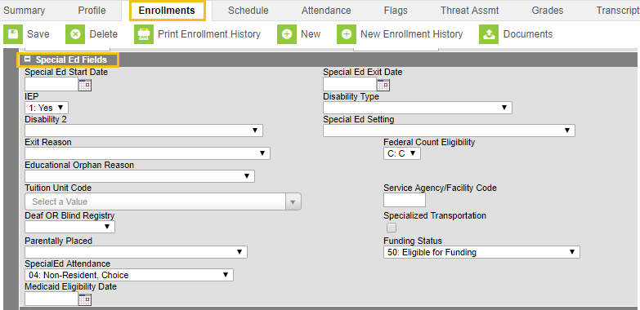
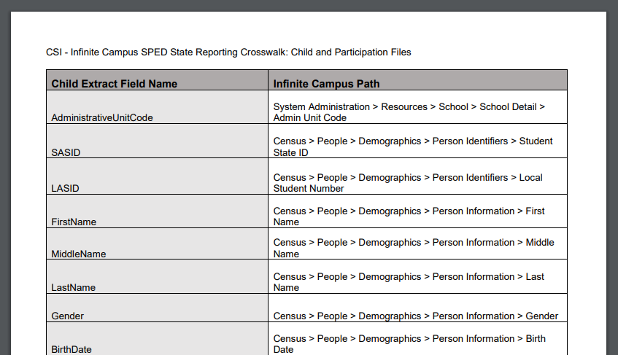
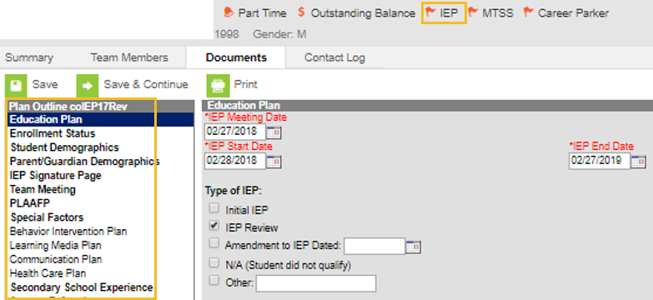
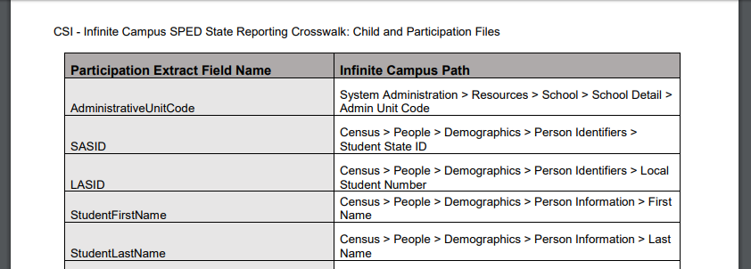
Where – Infinite Campus
CSI Crosswalk provides state reporting field names, the name of the field in Infinite Campus - as well as the path to access it.
Click HERE to access the CSI December Count Page
Student Information/General/(select calendar)/Enrollments/State Reporting Fields
Student Information/Special Ed/General/Documents/(select school year)/Plans/IEP
Notes:
When thinking about Where this data entry should occur one of the main plan management systems that many schools use would be Infinite Campus. This is where Evaluations and IEP’s are input including all necessary state reporting fields. Next to the screenshot of IC, you will notice a resource that CSI has posted on it’s website called the Infinite Campus Crosswalk. This essentially lists every State required field for both December Count and SPED End of Year, the name of the field in IC, as well as the path to access the field. This can be very important during the initial data entry or error clearance processes as it gives you a map of where to go to correct inaccurate information.

Slide 9
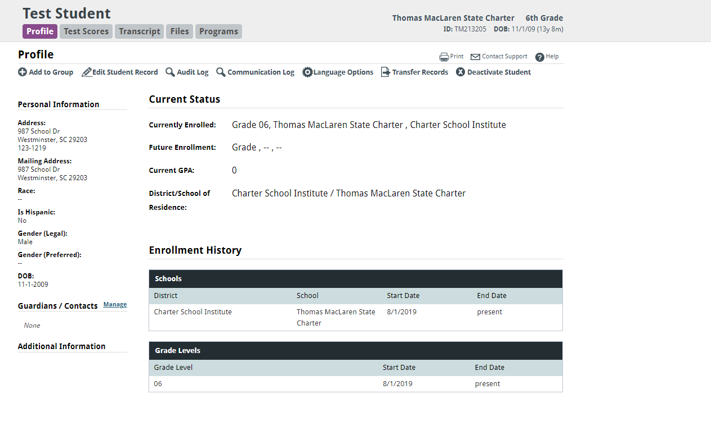
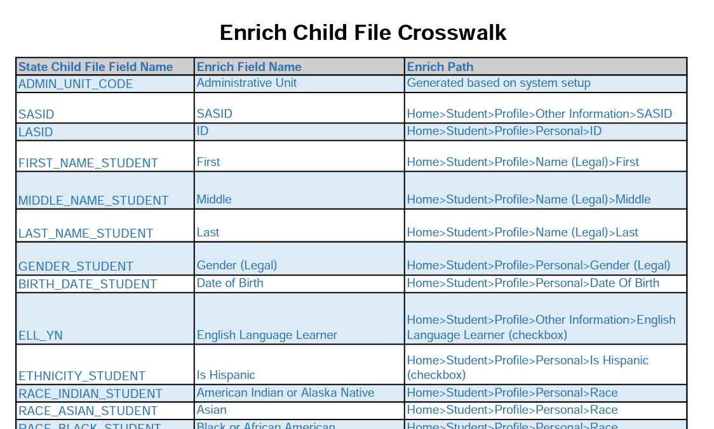
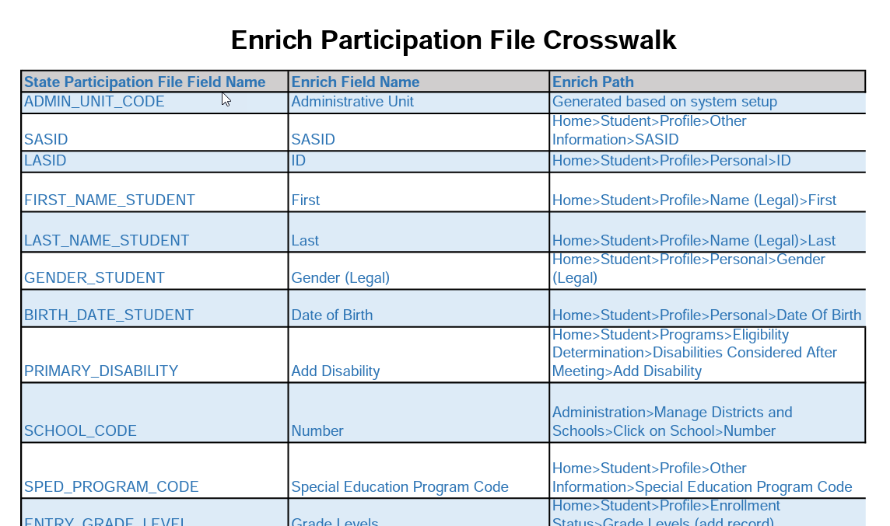
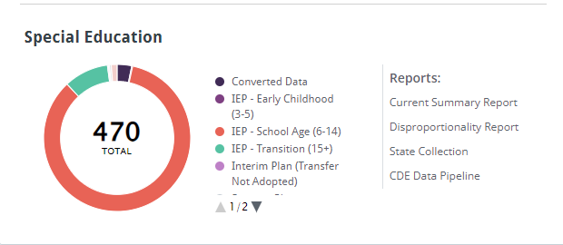
Where – Enrich
CSI Crosswalk provides state reporting field names, the name of the field in Enrich- as well as the path to access it.
Click HERE to access the CSI December Count Page
CSI December Count page
Instructions on each of these processes can be found within the Enrich Learning Center.
Notes:
The other option to consider when thinking about the Where of Data Entry is Enrich. This generally is a great option for schools using PowerSchool for their SIS as IEP’s can be created there and files can be extracted. CSI has also created a crosswalk for Enrich where it shows the field name, the name in Enrich, and the path to get to that field. To access the files, click on the CDE Data Pipeline option from the main screen.

Slide 10
When
Complete evaluations and IEP creations throughout the school year
Record students active as of Count Day (December 1st 2026)
All Initial Submissions should be sent to CSI by no later than: 11/10/2026
Staff Person | Role for December Count
Special Education Staff Contact | Enter all IEP information into your plan management system as soon as the evaluation is completed (regardless of student eligibility)
Human Resources Contact | All Special Education staff need to be entered into HR file with grades served and job classification meeting all HR Collection due dates on the CSI Data Submissions Calendar posted on the HR Page
Data Submissions Contact | Completed IEP data needs to be entered and error free by the dates listed on the 25-26 CSI Data Submissions Calendar
Notes:
When thinking about When this data entry should be completed, generally this is an ongoing process throughout the year keeping in mind that the Official Count date of students that are in Special Education for funding purposes is December 1st 2025. That being said, the initial submittals for this are due on November 10th although files can always be submitted earlier.. More specifically as it pertains to each role and When, the SPED Coordinator should enter all information into their Plan Management System as soon as the evaluation is completed. This is regardless of if a student is eligible or not. With the HR Coordinator, they will follow the required dates listed on the CSI Submissions Calendar and ensure all Special Education Staff are accurately entered meeting those deadlines. These HR dates are typically close to December Count due dates, so if deadlines are met, then the data for December Count staff should be available by the snapshot. With the data submission's role, they need to work with the SPED Coordinator to ensure all information is entered and that they are meeting all required December Count Data Submission and Error Clearance due dates. They will still need to coordinate with both SPED staff and HR Staff to clear out any remaining errors.

Slide 11


Thank you for reviewing this training!
Contact the Submissions Inbox with Questions:
    Submissions_CSI@csi.state.co.us
Notes:
Thanks so much for reviewing this training today! If questions come up after reviewing this and all December Count resources, feel free to reach out to either Matt or your SPED Coordinator or a member of the CSI Data Submissions team and we will be more than happy to assist.

