Slide 1

SPED EOY Collection
Office Hours – May 2026
Notes:
Thanks so much for meeting with me today and welcome to the Office Hours for the 25-26 SPED End of Year collection. I am hoping to keep this a bit less structured and more informal, so feel free to jump in if you have questions.
Today I will be spending about the first 10-15 minutes discussing the more common errors I am seeing for level 2, along with the SY108 process. This is separate from the traditional errors as they are students with no exit last year but not on the files this year. Once I have discussed all of these areas, the rest of the time is open to questions, concerns, or anything else you would like to discuss.

Slide 2
SY107 and SY108 Errors
SY107
All students reported on the December count as attending your AU must be reported on your Special Education Student End of Year Student file. Please refer to the Exception Request Instructions to request an exception.
Explanation:
Schools will receive this error when a student has a record on the December Count Collection but not SPED EOY.
Students receiving this error must have both a child record that are error free and pulled into the snapshot.
If your school has level 1 errors on this student, you will receive this error.
SY108
This triggers when a record is missing from the snapshot. Check the Pipeline Reports/Records Not in Snapshot Report to see if it's missing due to a criteria issue or Interchange errors. If not, it is likely a student that exited over the summer or in the prior year and has not returned to your AU this year. The system is looking for the record or an exit code. You may add in that exit code manually in the Data Pipeline screen under Special Education/EOY Summer Exits and the SY108 error should resolve after a new snapshot. The exception request may still be used for sasid merges or other unusual circumstances.
Explanation:
Students who exited over the summer or ended last year with a zero filled exit but did not return.
An SY108 Error Report will be provided separately from the typical level 2 report.
Schools are required to provide a valid Basis of Exit in the highlighted column and return the file.
CSI will update the exit type in the data pipeline.
Notes:
The first topic I want to discuss today are the SY107 and SY108 errors that I just sent out this week. As mentioned, these errors are a bit different from the other errors as there is no record to tie them to on the current data. SY107 errors flag on students who have a December Count record this year but are not currently being included in SPED EOY. All students who are reported in December Count must have a child and participation record here as well. This could flag for a number of reasons, there could be an error on this student for level 1, the student may be on one file but not the other, or the student may not be included for some unknown reason. Once a record is included on both files and is level 1 error free, this error will go away. As far as SY108, this is similar but a little different. These are students who were reported last year with a zero filled exit and no record this year. Often this is summer exits where you anticipated them on returning. The only thing that CDE needs to know is where these students exited to. You’ll see on your file that there is a highlighted column labeled Basis of Exit. If you provide the proper basis of exit for each one of these students, I can go in and update the data pipeline.

Slide 3
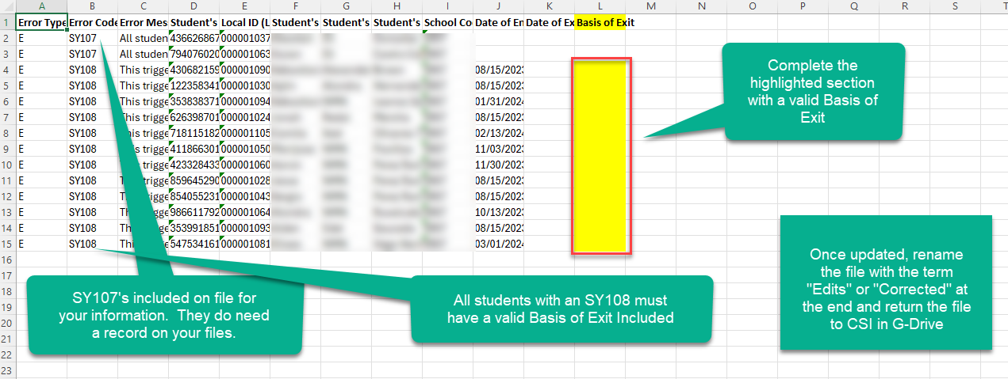
SY108 Updates
https://resources.csi.state.co.us/wp-content/uploads/2025/08/2025-2026_Participation_File_Layout_and_Definitions_CSIAdditions.pdf
Notes:
Diving into the SY108’s a bit further, here is an example of what the error report will look like. You will notice there are SY107’s and 108’s in the file with only the 108’s column highlighted. The SY107’s are included to notify you that they must have a child and participation record on this years SPED EOY. In terms of the SY108, you’ll want to include the proper Basis of Exit, resave with the term edits or corrected at the end and provide that back to us in Google Drive. If you need a list of valid exit types, see the Participation file layout linked at the bottom of this slide. Once completed, I’ll take those and update the data pipeline and the error should be clear!

Slide 4

SY065 Errors
Error Message:
If Special Education/Part C Referral is 03, 05 or 07, then Date IEP was Implemented [Path 3] must be within the current school year (Example: 07012025 - 06302026) if not zero-filled.
  Students who are newly tested in the current school year must be an 03 in the SPED Referral field. 05 and 07 are not used by any CSI school.
  Newly tested students must have all their applicable dates completed in the path 3.
  The Date IEP was Implemented must be in the current school year as only newly tested students need their Path 3 dates. Previous year dates should be zero filled.
Notes:
One of the more common errors you might see in your level 2 error report is the SY065. This error essentially says that if the student is an 03 for newly tested this year, the Date IEP was implemented must also be from the current year. If they were tested last year, then they really should be an 06 Returning Student in the SPED Referral field with zero filled dates. As you can see in this example, we have a Date IEP implemented from April of 2025, which is last year. This student may need a new IEP or Eval in the system for this year or the Referral field on the Eval must show 06.

Slide 5
SY278 Errors
Error Message:
Date of Entry to Special Education should be the same date the Path 3 Part B IEP is implemented.
  All newly tested students in the current school year must have all of their Path 3 dates completed.
  The Date IEP was Implemented (Column AV) must always equal the Start Date of SPED (Column AA) for newly tested students.
  If Path 3 dates are from a previous year, the student is considered returning and their SPED Referral should be an 06 with zero-filled dates.
X
X
Notes:
Another common error that we see is the SY278, which also relates to the Implemented Date. When you have a newly tested student this year you must keep in mind (READ BULLETS). So essentially you see in the two examples that one has the Start Date and Date IEP Implemented that match, which would not flag for an error but the second one has differing dates and would flag for an error. You’ll either need to change the implemented date on the IEP or update the start date. This can be found in the Special Ed fields on this year’s enrollment in IC and within the IEP in Enrich under the Start Date field.

Slide 6
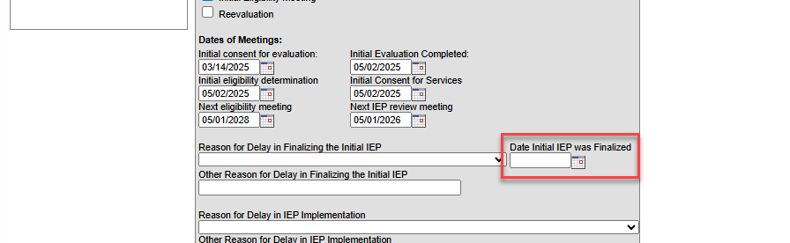
SY202 Errors
Error Message:
Reason for Delay in Finalizing the Initial IEP [Path 3] is required if the IEP was not Finalized or Date Initial IEP was Finalized [Path 3] is > 90 calendar days from the Date of Parental Consent [Path 3].
  This message typically means one of two things:
  The student either has an IEP Finalized Date after the Implemented Date OR
  The Date IEP Finalized is blank. This is much more common for IC schools as this date is harder to find and can be missed.
Notes:
The next error that I want to talk to you about is the SY202. Students receiving a 202 generally fall into one of two categories. Either their IEP Finalized Date is after the Date IEP Implemented or they are missing their Date IEP Finalized. This is somewhat common to see in IC as it is easy to miss. As you see in the screenshot here, the Date IEP Finalized was not completed, so you would expect to see a 202. To resolve this, a valid Date IEP Finalized must be included on your files and this date must be prior or on the Date IEP was Implemented.

Slide 7
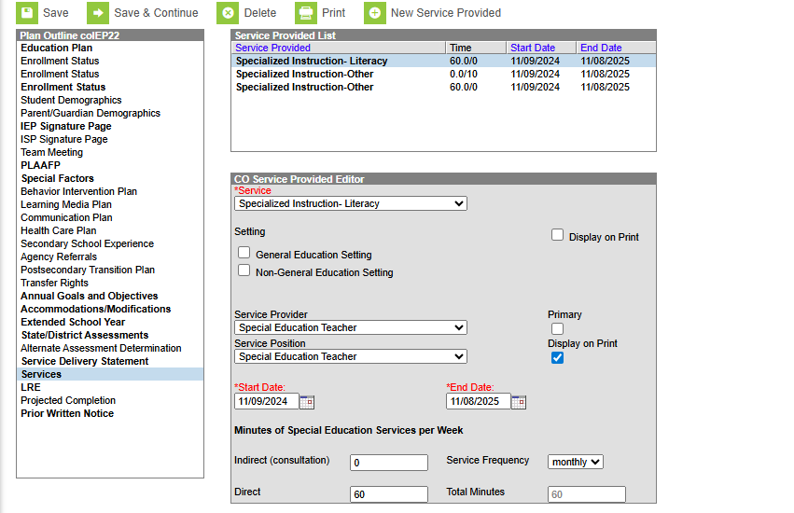
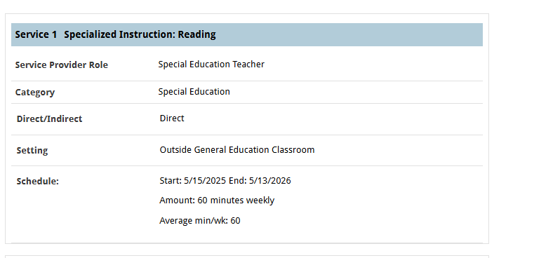
SY226 Errors
Error Message:
Hours of Special Education Services is required if Current Eligibility and Services is 02, unless an IEP was not implemented.
  Students who are in Special Education need the Hours of Services to be non-zero filled.
  Students who have exited need to have the Hours of Services completed with the amount prior to the exit.
  All students also need to have Total School Hours per Week.
Notes:
Another common error you may see in your report is the SY226. This error relates to the hours of Special Education services. It should be noted that (READ BULLETS). As you can see here, I have placed screenshots of the locations of where to enter this data in both IC and Enrich. Adding a valid number of Minutes per Week will clear up these SY226 errors.

Slide 8
SY260 Duplicates
Error Message:
Duplicate, this student is also reported as in attendance (not exited) at another AU/SOP. Please verify your records for this student and contact the other AU to determine how to resolve on both ends.
  Student’s receiving this error are being reported as attending school in another district.
  Review the Start Date of SPED and End Date of SPED to ensure these are accurately being reported. If inaccurate, update either or both dates to ensure there is no overlap.
  Student’s attending multiple CSI schools in a given year must only be reported by the latest school. A student may only have one record per district.
  If inconsistencies are still occurring across districts, CSI will contact the other district during the duplicate phase to work out any disagreements.
Tip: The Troubleshooting Errors document can help decipher the errors you are receiving with CSI-specific clearance options.
Notes:
Let’s jump into the SY260 Duplicate error. These errors were actually only warnings in previous years until we reached the duplicate phase but CDE has made them errors from the start with the hopes of clearing more of these up prior to this phase. When talking about the 260 Duplicates essentially (READ BULLETS). Another thing to mention here is that if your dates are accurate on your students, please reach out to let me know. I will make note that these errors are out of your control and it will also provide me details when reaching out to the other districts. Having an SY260 where your data is accurate will not prevent you from receiving a summary report.

Slide 9
Exit Coding Guidance
It is important to ensure that students who leave the school have both and Exit Date and Basis of Exit. This is particularly important for students who are graduating.
There has been some confusion on how best to code a student who has exited Special Education or the school mid-year. It is important that these student’s have coding that looks exactly like any active student with the exception of the Basis of Exit. Below describes some of the common mistakes seen and how best to code them.
It should also be noted that students who were newly tested last year must have a new Evaluation in IC in order to change the student from 03 – Newly Tested to 06 Returning Student (SPED Referral)
Incorrect Coding
Primary Disability = 00
Pupils Attendance = 00
Funding Code = 00
SPED Hours = 0000
Eligibility and Services = 04 (Not Eligible)
Correct Coding
Primary Disability = Not Zero Filled
Pupils Attendance = 04
Funding Code = 50
SPED Hours = Not Zero Filled
Eligibility and Services = 02 (Eligible)
VS
Notes:
Lastly, I have received a ton of questions this year on students who have exited the program mid-year either by leaving the school or just exiting out of Special Education. There is quite a bit of confusion on how to code these students best in your plan managing system. This slide covers how best to code these students in order to avoid errors. First off, I do want to mention that it is important to ensure all students exiting the school or program must be coded as such in the submitted files and in particular graduates given how late in the year this occurs.
In terms of Coding, a student who exits the program or school will have a record that looks exactly like any other active student with the exception of a non-zero filled Exit Date and Basis of Exit. In terms of specific fields and how they look when they are incorrect vs correct we have (READ SLIDE)
It should also be noted that students who were newly tested last year must have a new Evaluation in IC in order to change the student from 03 – Newly Tested to 06 Returning Student (SPED Referral)

Slide 10

Questions?
Remaining time is open for questions on these topics or anything else on your mind!
Website: https://resources.csi.state.co.us/data-submissions/sped-eoy/
Email: Submissions_csi@csi.state.co.us
Notes:
Thanks so much for listening to these areas of confusion and common mistakes. Alright, the rest of the time is dedicated to questions you may have with your own error report or coding. I will be here for the remainder of the time to help answer any questions that may have come up! Feel free to ask any questions you may have and don’t feel like you have to stay unless you are interested in questions other schools may have. You can get your question answered and log off and always pop back in if you realize you have another question. I’ll do my best to protect PII, so will not show your specific error unless otherwise stated but we can talk about specific error codes and how to generally correct. I will pull up your error on my end but it won’t be visible to the rest of the group, so ask away!

