Slide 1

25-26 SPED End of Year Training
General Overview
Recorded February 2026
Notes:
Hello All,
Thanks so much for reviewing this training for the 25-26 Special Education End of Year Collection! This short training focuses on a general overview of the collection as a whole, including all the steps of the process necessary to be successful! It is good for new staff to a submissions role and for staff who would like a refresher. Feel free to reach out to CSI if you have questions on any aspects of this!

Slide 2
Agenda
Purpose of SPED EOY
  Purpose, Required Files, and Collection Differences
File Overview
  Child File
  Participation File
  The Different Paths
SPED EOY Collection Process
Step 1: Collection Prep | Step 4: Resolve Errors
Step 2: Collect Data | Step 5: Certify*
Step 3: Submit to CSI | *Certification process covered in another training module
Timelines and Deadlines
Notes:
Here is a quick overview of the topics that we will be discussing today. First, we will look at the SPED End of Year collection as a whole and in particular the purpose of the collection, required files, and some differences between December Count and SPED EOY. We’ll then jump into a more in depth look at the child and participation files along with the three different paths. After that, we will look at the 5 steps of the collection process and some resources that can be used for each. I should mention that Step 5 – the summary certification – will be a separate module that will be posted closer to the summary review phase. Lastly, well take look at the timelines and deadlines for this collection!

Slide 3
Purpose of the SPED EOY Collection
SPED Reporting Options
Path 2 (Part B Services)
Path 3 ( Part B Services)
Dual Path Reporting
Special Education and Part C Referrals
Eligibility and Services
Exit Information: No longer receiving services
The SPED End of Year Snapshot collects the following information for students who were referred, evaluated, and/or received SPED services during the specified reporting period (July 1, 2025-June 30, 2026):
Notes:
In looking at the purpose of the SPED End of Year collection, it is designed to collect information on students who were referred, evaluated, and or received special education services during the current reporting period of July 1st 2025 to June 30th 2026. In terms of the reporting options available for this collection, we have (READ SLIDE).

Slide 4

Required Files
Snapshot
Child
Participation
Notes:
So when talking about the files that are required for this collection, it is the exact same ones that were being collected for December Count, both the Child and Participation files. Once both files are uploaded and error free, a snapshot will be run to look for any level 2 errors across both files and also which students meet the criteria to be included in the snapshot.

Slide 5

Difference Between December Count and SPED EOY
December Count
  This collection is an annual count of eligible SPED students as of December 1st used to generate funding to provide for specialized student services.
  Includes Special Education Staff data employed as of December 1st.
SPED EOY
  Collects data on students who were referred, evaluated, or received SPED services at any point throughout the year
  Information on exits from Special Education, Part C evaluations and services received.
Although the files collected are the same, the DC and SPED EOY look at very different information
courtesy of clipartkey.com
Notes:
It is important to note that although the files collected for both the December Count and SPED EOY are the same, the information that is looked at for each collection is very different. The purpose of the December Count collection is to provide a count of all Special Education students and staff as of December 1st for funding purposes while the SPED End of Year looks more specifically at the students who were referred, evaluated, and received services at any point during the year. Also, it looks at details on students exiting special education. All fields must be completed for each collection but is it important to know the difference in what information is being looked at.

Slide 6

SPED EOY File Overview
Child and Participation Files
Notes:
Now that you have a high-level overview of the collection, we thought this would be a good opportunity to take a look at the files necessary for the SPED End of Year collection in more depth.

Slide 7
Child File Overview
The purpose of the Child File is to capture and verify the attributes of students with disabilities while he/she attended your AU at any point during the current reporting period.
Dependencies
  Student has been assigned a SASID and the information must match what is in RITS (i.e. Name, Date of Birth, Gender)
  A record with the students same SASID and LASID combination must also be included on the Participation File.
Record Exception
  One record must be submitted for any student who was referred, evaluated, and/or received SPED services at any point during the current reporting period.
For more details, see the Child File Layout and Definitions Document
Notes:
As mentioned, one of the two files submitted is the Child file. In terms of what is collected on this file – the purpose is to capture and verify the attributes of students with disabilities while they are attending a CSI school during the current reporting period. This will include information such as name, SASID, Date of Birth, Gender, Ethnicity, Race etc. As far as dependencies are concerned, the student must have been assigned a SASID and the information must match what is in RITS. Also, a record must be included on both the Child and Participation file with the same SASID/LASID combination. Be sure you are including any child who was referred, evaluated and/or received special education services during the current reporting period.

Slide 8
Participation File Overview
The SPED Participation File contains data related to the student’s participation in special education, important dates, services received, and the staff who are working with them.
Dependencies
  Student has been assigned a SASID and the information must match what is in RITS (i.e. Name, Date of Birth, Gender)
  A record with the students same SASID and LASID combination must also be included on the Child File.
  School Code and Grade Level will come from the Student School Association file when the December Count snapshot is created.
  Students who were enrolled and receiving Special Ed services during the year.
Record Exception
  One record must be submitted for any student who was referred, evaluated, and/or received SPED services at any point during the current reporting period.
For more details, see the Participation File Layout and Definitions Document
Notes:
Next, let’s dive a little further into the other file, the Participation file. This file contains data related to the students Participation in Special Education and includes important dates, services received and staff who are working with them. Like the child file, this also has some dependencies to consider. Again a student must have a SASID assigned and match what is in RITS. Also, the SASID LASID combination must be included on the child file. Keep in mind that the School Code and Grade Level will come from the Student Interchange SSA file when the snapshot is created. Lastly, at a minimum, this should include all students served during the 25-26 school year if applicable exits are completed. The same record exception applies as we discussed for the Child File.

Slide 9
Importance of LASID
The LASID is the local identifier that the schools uses for an individual student. This is used in conjunction with the SASID to identify students at your school.
  Several fields, including Name, DOB, and Gender are pulled directly from the Student Interchange to the Special Education Interchange
  The LASID must match across the two interchanges (i.e. EOY→SPED EOY)
  This field must be completed with a non-zero filled LASID that matches across collections.
  CSI may have to zero fill those in cases where the same LASID is being used at another school. If you see this zero filled on an adjusted file, leave as is.
Notes:
Recently we have run into issues where schools have been zero filling the LASIDs, so I thought it may be important to discuss. This field is used in conjunction with the SASID to better identify students in both general and special education at your school. Some important details to mention are (READ BULLETS):

Slide 10
Updates for 25-26
New
This
Year!
No Updates were completed for the 25-26 School Year!
Notes:
Alright, in terms of updates for 25-26, there were little to no changes to the collection between 24-25 and now, so there are no updates. This also means that there will not be a new this year training posted for this collection.

Slide 11

Special Education Paths
Path 1
Path 2
Path 3
Referred for Part C Evaluation: Services administered for children ages 0-3 through the Department of Human Services
X
Path 2- Referred from Part C to Part B: children ages 2.5 but not yet 4 who were referred from Part C services.
X
Path 3 – Referred for an Initial Evaluation for Part B Services: children ages 2.5 through 21 who were not receiving Part C services immediately prior to being referred to Part B
Notes:
So in terms of newly tested students, we historically have had three required paths where only one needs to be competed. Path 1 is for children ages 0-3 who have been referred for Part C evaluations. This one was phased out as Path 1 evaluations will no longer be completed by the AU and has been transferred to the CCB. Another one to discuss that is not used often, would be Path 2 where students ages 2.5 to 4 that were referred to Part B from Part C. This is typically is reserved for preschoolers who are transferring from C to B and is also very uncommon. Almost all students recorded for CSI schools would fall under Path 3 (NEXT), which is students ages 2.5-21 who were referred for an initial evaluation and were not receiving part C services immediately prior to being referred to Part B. Most all circumstances you will see require the zero filling of Paths 2 and completing Path 3, but please contact your SPED Coordinator or director or refer to the SPED documentation listed here if you believe you have a qualifying Path 2 student.

Slide 12
SPED Referral Field
The SPED Referral field is the primary designator between newly tested and students returning to special education in the current year. CSI schools most commonly code students as:
03 – Newly Tested in the 25-26 School Year
  Students must have been identified and tested during the current school year.
  All Applicable dates including the Parental Consent, Evaluation Complete, IEP Meeting, IEP Finalized, and IEP Implemented must be populated with a date from the current year.
06 – Students Returning on an Existing IEP
  Students returning on an existing IEP from the previous year.
  Students who have transferred to your school and is currently being provided services based on the existing IEP.
  All Path Dates should be zero filled.
Other coding options (02 or 07) are not applicable for CSI schools. Coding options can be found on the Participation File Layout
Notes:
Let’s talk a little more in detail about the field of Special Education Referrals. In most cases, you will be coding your students with either an 03 or an 06 with an 03 being utilized for initial referrals. Due to this, all applicable dates and information should be filled out on the correct path for that student. A code 06 on the other hand, is most commonly utilized for students with no initial referrals during the current reporting period, so essentially returning students will be using this field. Students coded with an 06 would have all paths zero filled as they are existing SPED students.
You will notice that there are other coding options listed for this field at the bottom. These are used only in extremely rare circumstances and full definitions can be found on the Participation File Layout. Please reach out to CSI if you feel your student falls under one of these other options.

Slide 13

CSI Specific Reminders!
Common Fields:
  District of Attendance = 8001
  Pupil’s Attendance Information = 04 (in most cases)
  Eligibility and Services= 02 for Eligible, 04 for Ineligible
  Special Education Funding Status:
      50 = Eligible for ECEA Funding
      00 = Not Eligible for ECEA Funding
Date of Entry:
  Within current reporting period (7/1/2025 – 6/30/2026)
  Returning Students = First Day of School
  Tested and ineligible = 00000000
Disability:
  All Eligible students must have disability
  Ineligible students = 00
Courtesy of clipart-library.com
Notes:
Here are some CSI specific reminders when completing the child and participation files. The district of attendance for CSI is 8001 with the pupil's attendance information typically going to be 04. With the Special Education Funding Status, this will almost always be 50. There will be occasions where the child was tested but did not qualify for Special Education with the funding status, Attendance Information and the Start Date all zero filled.
So some additional specific reminders in terms of entry dates, all eligible students must have a date of entry within the current reporting period of 7/1/2025 to 6/30/2026. Previously identified students should report the first day of school to be most accurate. Please use the correct format for the date with any not applicable dates being 8 zeros. Also, students who are eligible must have a disability and if determined ineligible, the disability must be zero filled.

Slide 14
SPED EOY Collection Process
Notes:
Now that we have a better understanding of the purpose and files being collected, lets take a look at the overall collection process as a whole for the SPED End of Year Collection.

Slide 15
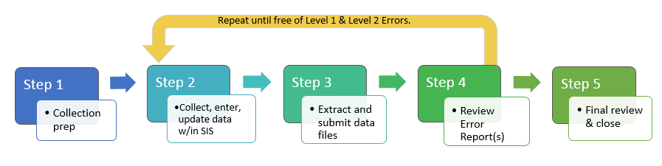
SPED EOY Data Collection in 5 Steps
Repeat steps 2-4 until data is complete and accurate!
Notes:
For those of you who have reviewed the data submissions handbook or any other of our trainings, you may be familiar with this slide. This is the 5 steps of any data collection and includes:
Step 1 – Collection prep
Step 2 - collect and enter data
Step 3 – Extract and submit files
Step 4 – Update data to resolve errors
And Step 5 – final review
We will cover each of these steps in more detail in subsequent slides of this training. One thing to keep in mind is that this really is more of an iterative process that involves the repetition of steps 2 through 4 until your school is error free. Once that happens CSI will send you a summary report to complete a final review on. As mentioned, we will be providing a separate training on step 5 later in the collection. Lets jump into a little more about each of these steps.

Slide 16
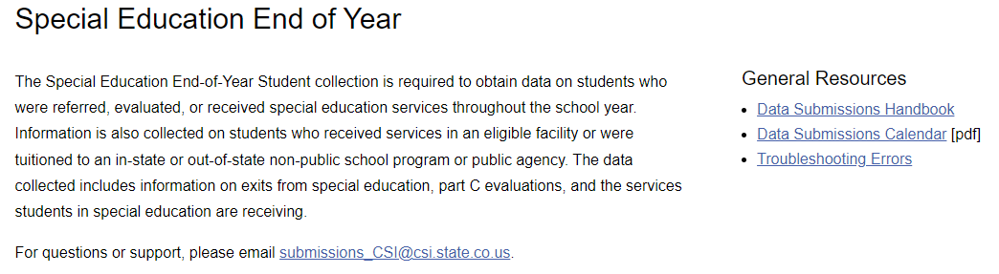

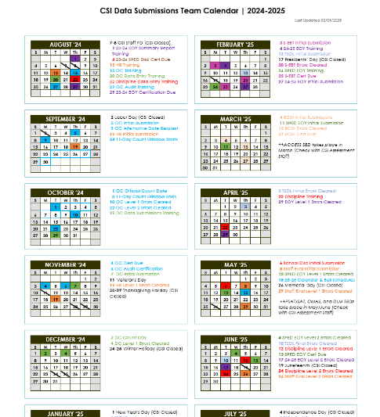
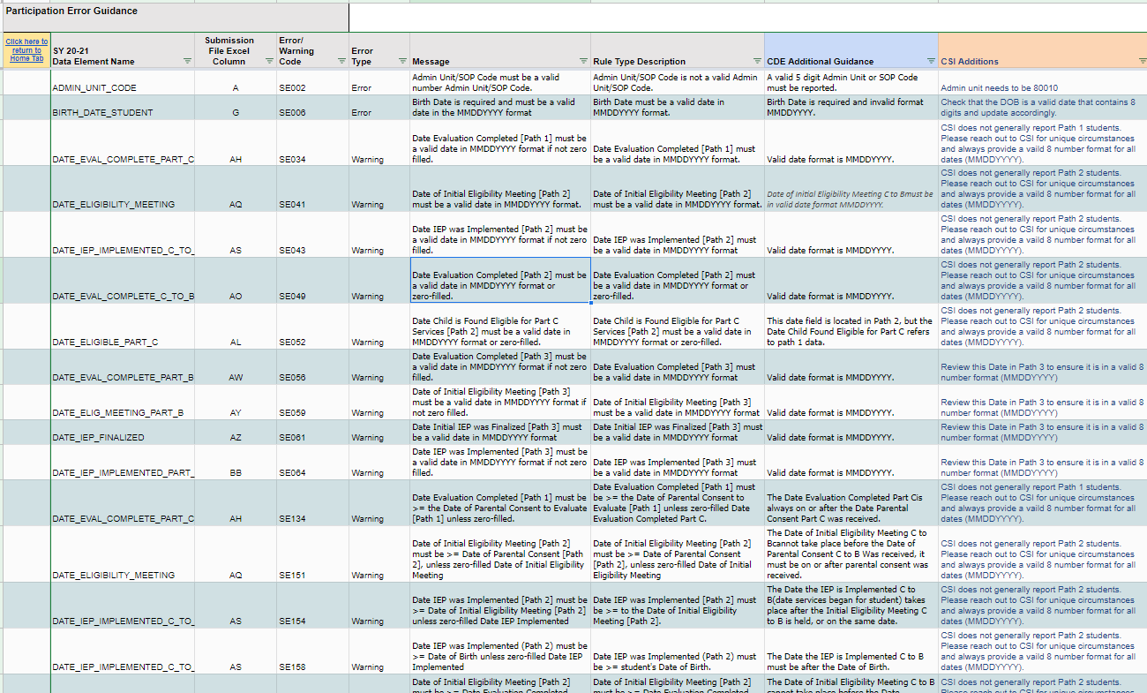
Step 1: Collection Prep Resources
Data Submissions Handbook Data Submissions Calendar Troubleshooting Errors Spreadsheet
Notes:
So step 1 really is all about the steps a school should take prior to an upcoming collection to ensure they have the general knowledge necessary to be successful. This involves the 3 main general resources listed on the CSI General Resources page, which is linked at the top of each collection page and includes the data submissions handbook, the Data submissions calendar, and the troubleshooting errors spreadsheet. It is highly recommended that all new and returning staff review the latest version of the data submissions handbook, which comes out every year. It contains helpful information on each step of the process, your role vs. CSI, various resources available to you, to do lists among many others. The next area to focus on would be the data submissions calendar, which includes all important due dates for a collection, including initial submittal, level 1 error clearance, level 2 error clearance, and signed summary dates. Printing this and reviewing it often will ensure your school is staying in compliance by meeting all necessary deadlines. The last resource that will be talking about more later is the troubleshooting errors resource. This spreadsheet contains tab for each file in a collection along with a tab for level 2 errors. The tabs are a working document and provide updated listings of each error associated with a file or level 2 and includes details regarding the error message, field impacted, and most importantly – a CSI additional notes column that provides CSI-specific details on how to correct an error. Sometimes the error messages CDE provides can be confusing, so having this will go a long way when you get to step 4 error clearance.

Slide 17
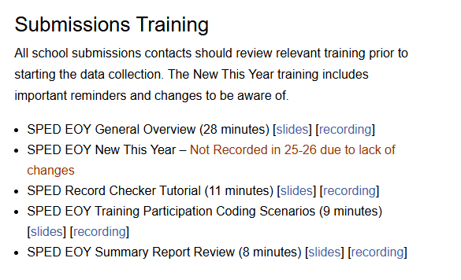
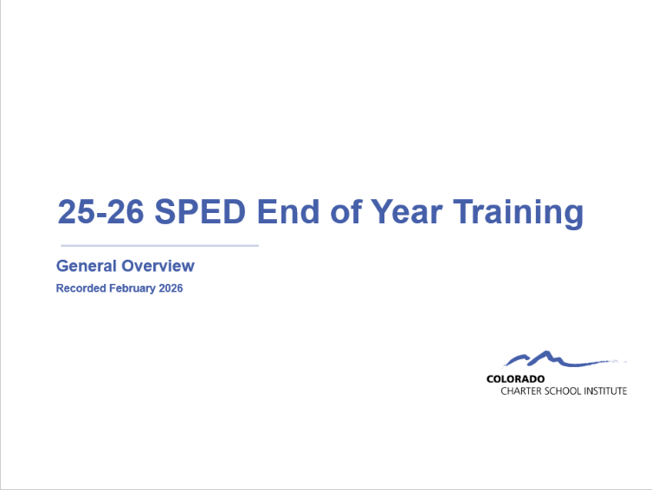
Step 1: Collection Prep Trainings
https://resources.csi.state.co.us/data-submissions/sped-eoy/
Notes:
In addition to the general submission's resources, each page also contains recorded trainings for the collection that are designed to provide you all the details necessary to complete the specific collection. This may be obvious as you are currently reviewing the training for the SPED End of Year collection, but it is important to point out that each collection has a training containing a general overview, typically designed for new submissions contacts as well as returning who would like a more comprehensive overview. Also, we always have a New this Year training that covers any changes since the previous year and some validation reminders. This one is more geared towards returning staff but is recommended for new staff as well. Given there were no changes this year, CSI will not be posting a new this year training. Some collections also contain additional trainings in addition to the usual ones, for example the SPED EOY Collection has a specific training on some of the more common scenarios you may see and how best to code them on the participation file. All applicable trainings should be viewed prior to the collection opening and may help set schools off on the right foot.

Slide 18

Step 2: Collection/Entry
What Data to Collect
Resources Utilized:
  File Layout and Definition Documents
  Record Checker and Data Validations Toolkit
  Participation File Coding Scenarios
  Enrich and Infinite Campus Crosswalks
  SPED EOY and EOY: Cross Collection Exit Coding Discrepancies
Courtesy of clipartpanda.com
Notes:
Step 2 is all about collecting and entering data for this particular collection. So, we’ll talk about it in two ways. First, we will look at what actually you should be collecting then we will jump into where you should be entering that data. With the “What” you should be collecting, we will be looking at various resources that will help with this process including the File Layout and Definitions documents, the Record Checker and Validations Toolkit, a coding scenario document,, some crosswalks of your system, and a SPED EOY and EOY Cross Collection Exit Coding Discrepancies Document.

Slide 19
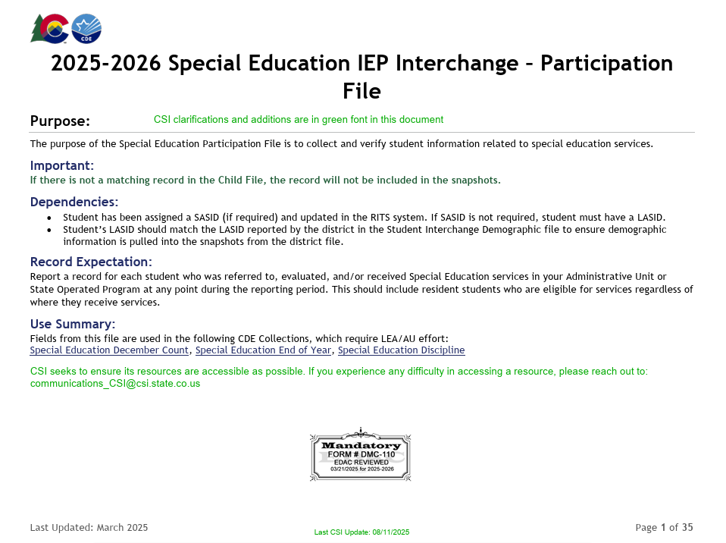
File Layout and Definition Documents – CSI Additions
https://resources.csi.state.co.us/wp-content/uploads/2025/08/2025-2026_Child_File_Layout_and_Definitions_CSIAdditions.pdf
https://resources.csi.state.co.us/wp-content/uploads/2025/08/2025-2026_Participation_File_Layout_and_Definitions_CSIAdditions.pdf
Notes:
So in terms of the previously mentioned file layout, here is a screenshot of what the Participation file layout looks like. If you were to go through this document, the first part identifies all the fields being collected in a table format and notes about what the formatting should look like for each one. This is followed by a description of each field and possible coding options. You can actually walk through this document to determine what is being collected and the correct coding.

Slide 20
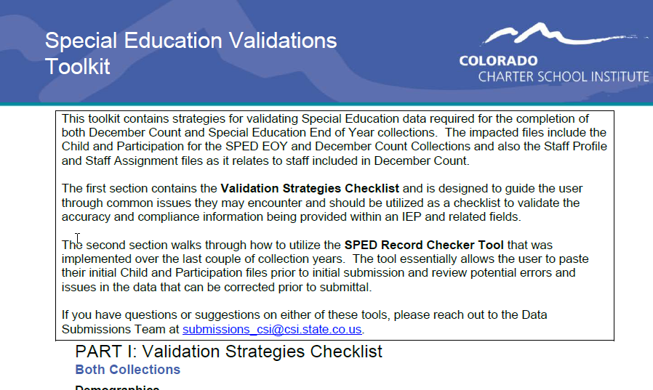
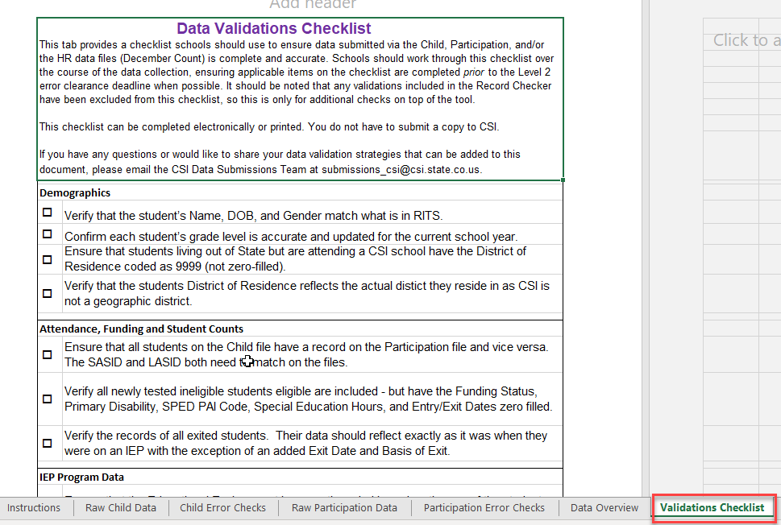
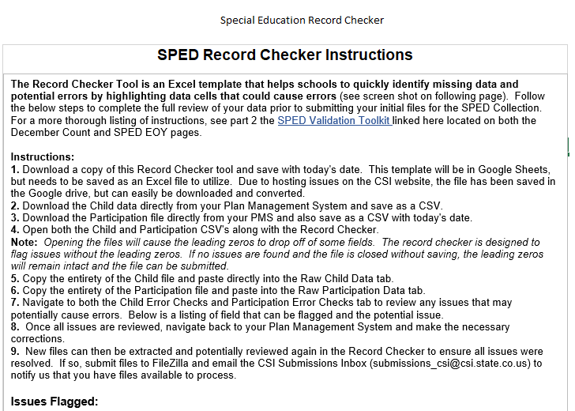
Record Checker Merge and Versions
Both the Record Checker Tool and SPED Validation Toolkit contain several helpful data entry checks and error clearance assistance tools for schools to use in previous collection years.
Many of the error clearance checks and reminders overlapped across the two resources.
Due to this, they have been combined into one document called the Record Checker and Validation Toolkit.
The original tabs of the Record Checker remain relatively unchanged; however a new validation tab was added. This is a pared down version of the Validation Toolkit containing only checks that are not being flagged in the Record Checker.
Record Checker for CSV – No Leading Zeros Record Checker Excel – No Leading Zeros
Notes:
As you may be aware, we decided to merge the validation toolkit and the SPED Record Checker Tool over the last couple of years. This was due to the overlap in many error checks and the duplication of efforts. We have streamlined the validations to only include issues that are not already being flagged in the Checker. It should also be noted that we have recently modified the SPED Record Checker. We now have two versions, one that you want to run with the leading zeros and one for CSV where the leading zeros have been dropped. This is due to the fact that schools pull and open the files in differing ways, so if you want to just open the CSV and drop the leading zeros, you can use our original version but if you are opening the CSV as an editable Excel file with leading zeros, you’ll want to use the other one.

Slide 21
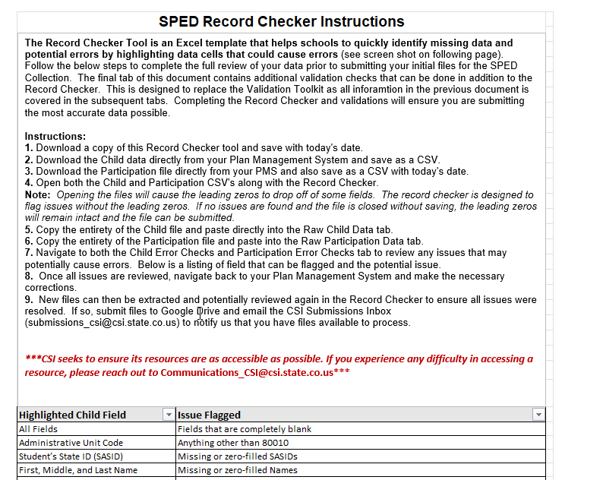
Purpose of the SPED Record Checker Tool
The purpose of the SPED Record Checker is for schools to review their initially extracted Child and Participation Files prior to initial Submittal. The template will flag for potential errors that can be corrected prior to initially submitting files. The goal of this resource is to:
Identify errors and correct prior to submittal Fewer errors received upon initial submittal Fewer submissions until error clearance Collection errors cleared earlier in the process
Notes:
The purpose of the Record Checker is to identify potential issues or errors prior to initial submittal. The tool is essentially a template that allows you to paste your raw data files into those specific tabs and any potential issues will be flagged on the review tabs. This tool is not designed to catch every error, but if used properly – you should expect to see less errors on your initial submissions with the goal of less submittals to error clearance!

Slide 22
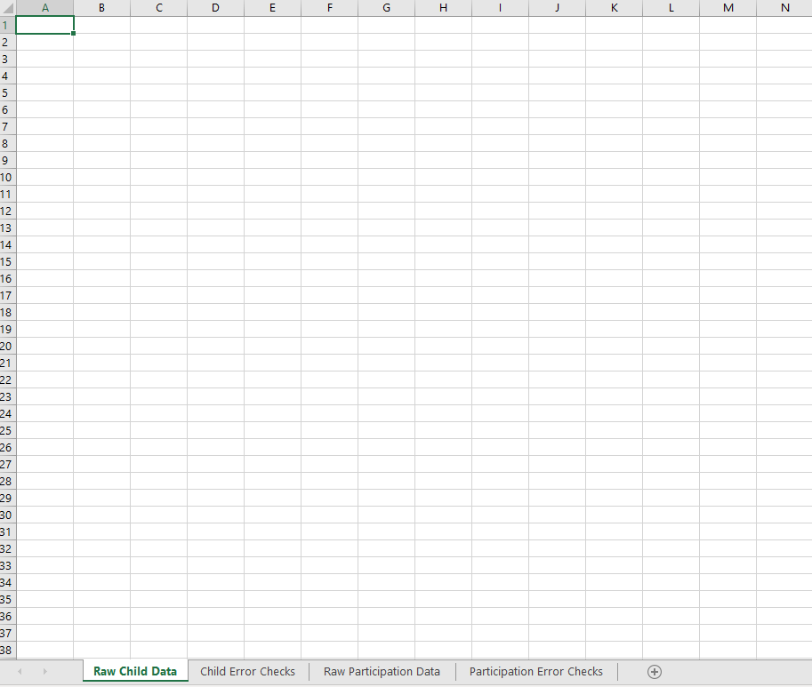
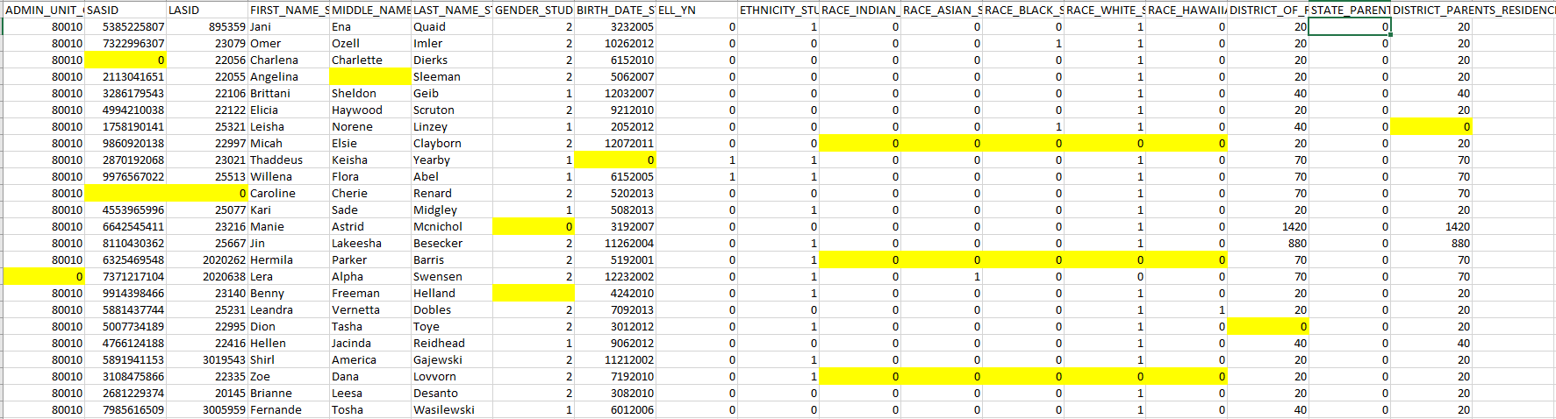
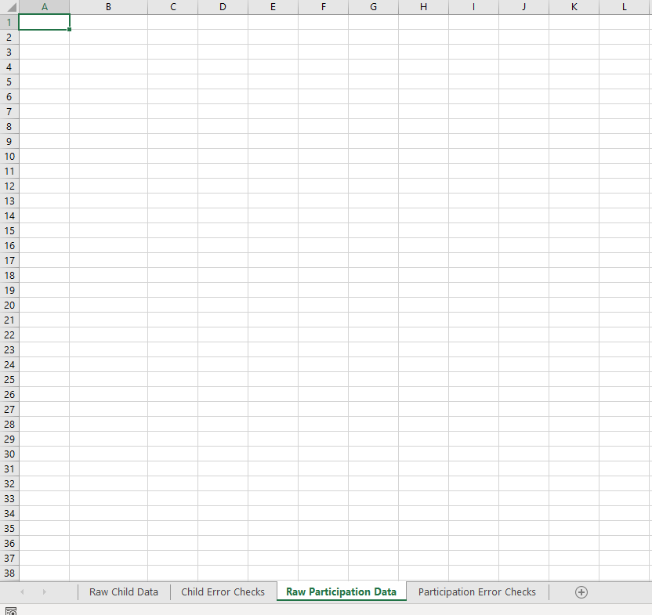
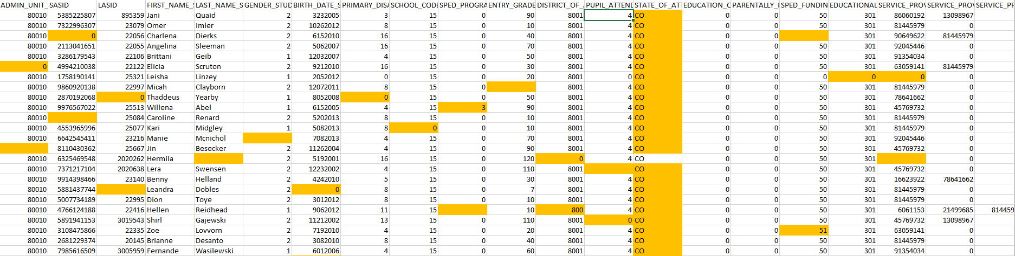
SPED Record Checker Tool
For further instructions and details on this tool, see the SPED Record Checker Tutorial
Notes:
Diving further into the record checker tool, it contains four main tabs that are used to paste raw data into and to check if there are any flags for errors. As you can see in this slide, any potential errors will be highlighted on the Error Checks tab once your files are pasted into the Raw Data tabs. These issues can be updated in your Plan Management System and new files can be extracted. In addition to this, there is an instructions tab that walks you through how to use the resource and a Data Overview tab which show you counts of specific demographic categories based on the data you provided. As mentioned previously, there now is a Validations Checks tab that provides other areas to look into based on issues we have historically seen. These are in addition to the Record Checker flags and does not contain overlaps. Hopefully using both parts of this resource will help ensure you are submitting accurate data.

Slide 23
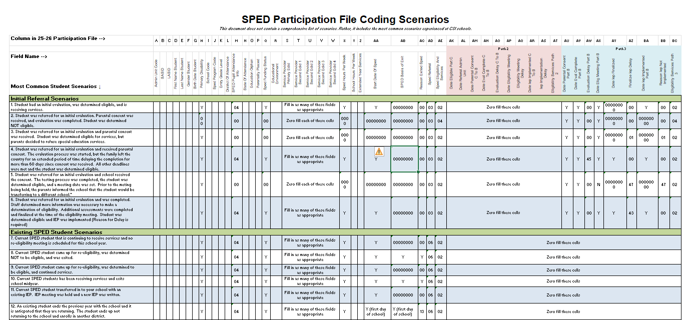
Participation File Coding Scenarios
https://resources.csi.state.co.us/wp-content/uploads/2026/02/25-26-ParticipationFileCodingScenarios_Final.xlsx
Notes:
Another great resource to utilize from the CSI website is the CSI Participation File Coding Scenarios Document. Essentially, this resource is split up between Initial Referrals and Existing Students and how best to code them. The document provides common scenarios that you may encounter when completing data entry and provides the correct coding for that scenario on the participation file. Due to the number of fields on the file and the complexity of entering this information, it certainly can be a huge time saver by reducing the number of errors that you will encounter.

Slide 24
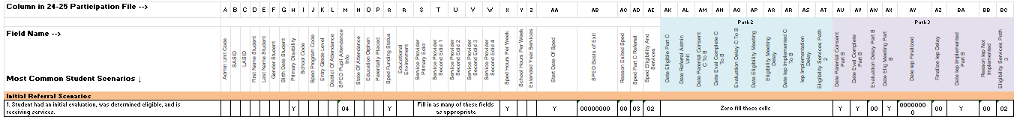
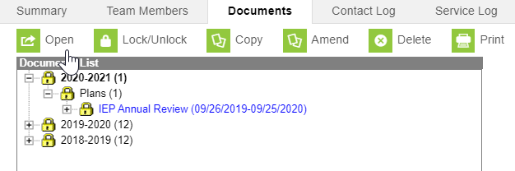
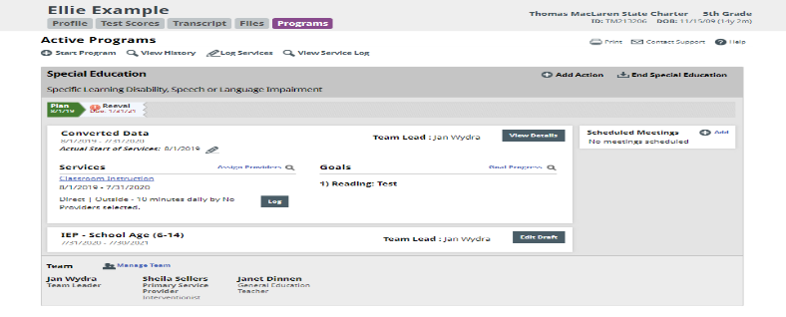
Participation File Coding Scenarios Example
You are new to working with SPED data and don’t know the correct fields to input for a new student who is receiving an initial evaluation, was determined eligible, and began receiving services (compared to a returning student). Use the Participation Coding Scenarios!
Based on this information, you know that:
  Initial evaluations that are eligible always receive an 03 – SPED Referral and 02 for Eligibility and Services
  Initial evaluations need to have Path 3 Dates completed for all CSI schools (Paths 2 zero filled)
  The Primary Disability Field is required for all SPED students along with an 04 in Pupil Attendance
  Other required fields include Service Provider EDIDs, Funding Status, Hours Per Week and Start Date of SPED
Notes:
A good example of a scenario where this resource would be helpful is if you come across an issue where initial evaluations are being completed by the SPED team and you are ready to enter information into Enrich or Infinite Campus (NEXT), but you cannot remember what fields need to be populated for a student receiving an initial evaluation, was determined eligible, and began receiving services. This document will essentially walk you through what should be entered in a variety of different scenarios including this one. As you can see in the screenshot of this scenario:
All receiving initial evaluations need to have an 03 in the SPED Referral field and 02 for Eligibility and Services if deemed eligible
Students receiving initial evaluations need to have Path 3 Dates completed for all CSI schools with Path2 zero filled
The Primary Disability Field is required for all Special Education students along with an 04 in Pupil Attendance
Other required fields include Service Provider EDIDs, Funding Status, Hours Per Week and Start Date of SPED

Slide 25
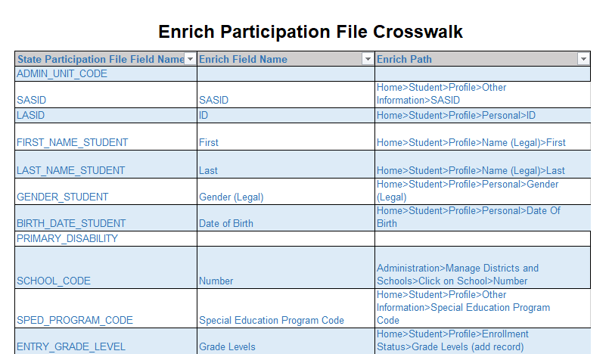
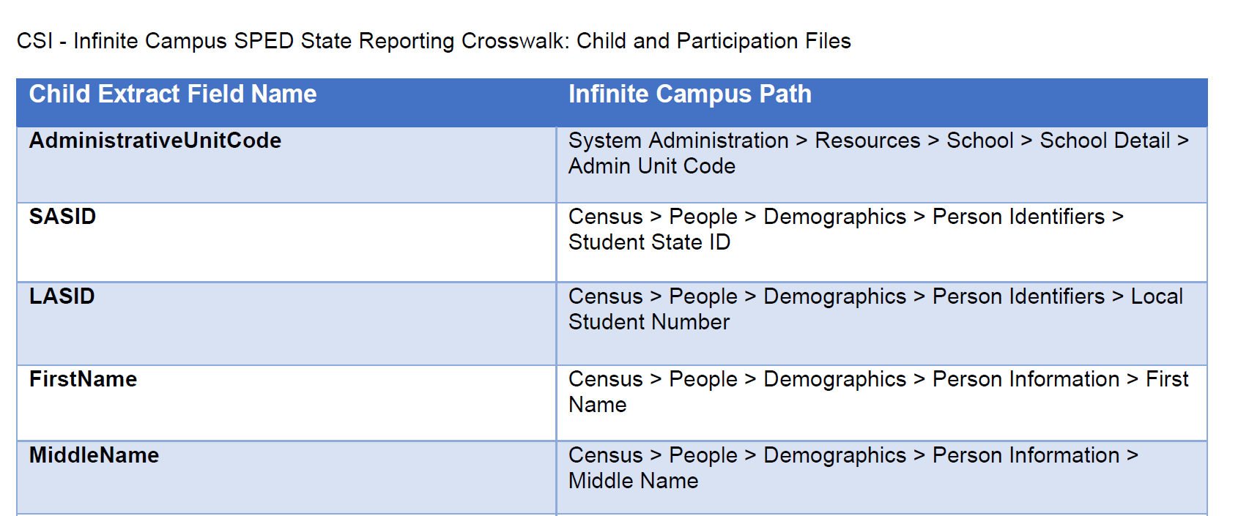
Enrich and Infinite Campus Crosswalk
Enrich SPED Crosswalk
IC SPED Collection Crosswalk
Notes:
Another great resource that you may find helpful as you are completing data entry or error clearance is the Enrich and Infinite Campus Crosswalks. Essentially these documents, which are linked here, provide the State Reportable field names, the names in your Plan Management System, and the actual path to access these fields. Sometimes as you are going through this process, it may be difficult to know where certain fields need to be entered and what is being pulled for state reporting. The goal of these documents is to provide you a crosswalk of where exactly to find those fields depending on what system you are using. Hopefully, this will reduce the time you spend looking for fields to enter or correct during the SPED EOY process!

Slide 26

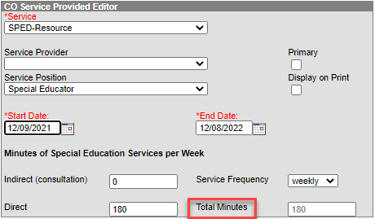
Example of Using the Crosswalk
Scenario: During data entry, you cannot remember where the SPED Hours Per Week field is. The Infinite Campus Crosswalk will be a great resource!
Based on this information, you know that:
  The Total Minutes field located within the Services section of the IEP under the section labeled CO Services Provided Editor. The minutes will convert to hours on the file.
Notes:
In terms of an example for this, let’s say you are working through data entry or error clearance, and you do not know where the SPED Hours Per Week is located in Infinite Campus. Using this resource, you can look up the field of SPED Hours, see how it is named in IC, as well as, where it is located. Based on this information, you know that:
This field is located within the Enrollment Status section of the IEP under the section labeled Special Ed State Reported Data Elements. The minutes will convert to hours on the file.
Hopefully, this resource will prove to be helpful if you are ever unsure of where to enter data for a particular field.

Slide 27
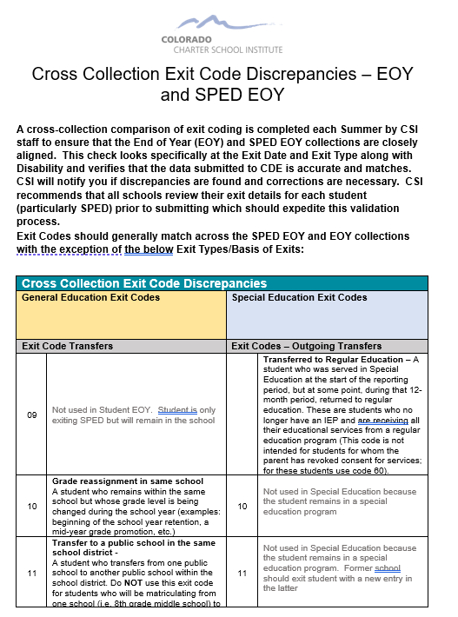
SPED EOY and EOY Cross Collection Exit Coding Discrepancies
SPED EOY and EOY Exit Coding Discrepancies Document
Notes:
The last resource that I will be discussing in this section is the SPED EOY - EOY Cross collection exit coding discrepancies. While working these collections, you will find out the importance of exiting students correctly when they exit special education or the school and how this should match up with regular EOY coding. There are some instances where the Basis of Exit will not match up exactly, for instance if a student exits to regular education, which would be a 09 in SPED EOY but no exit should show in EOY. This document will go through all the exit types that do not match up and how they should be coded. If not listed there then they should match up and CSI does a comparison of those over the summer where changes are required.

Slide 28
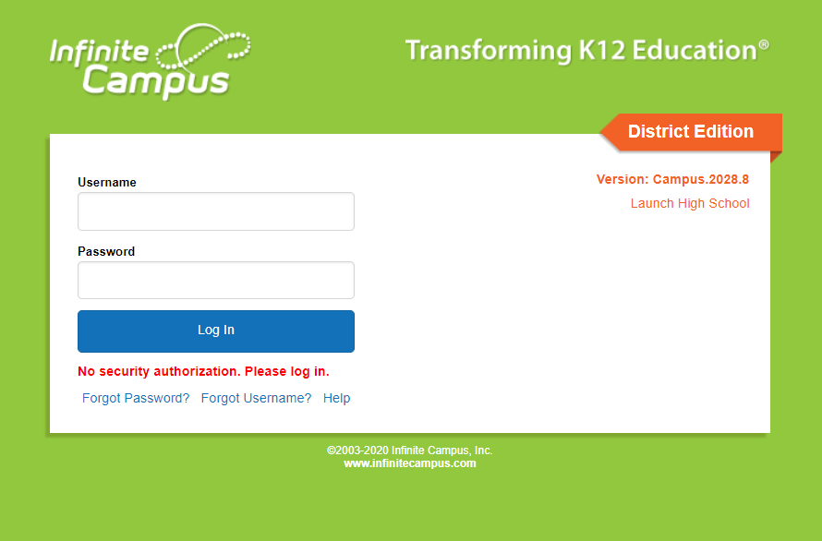
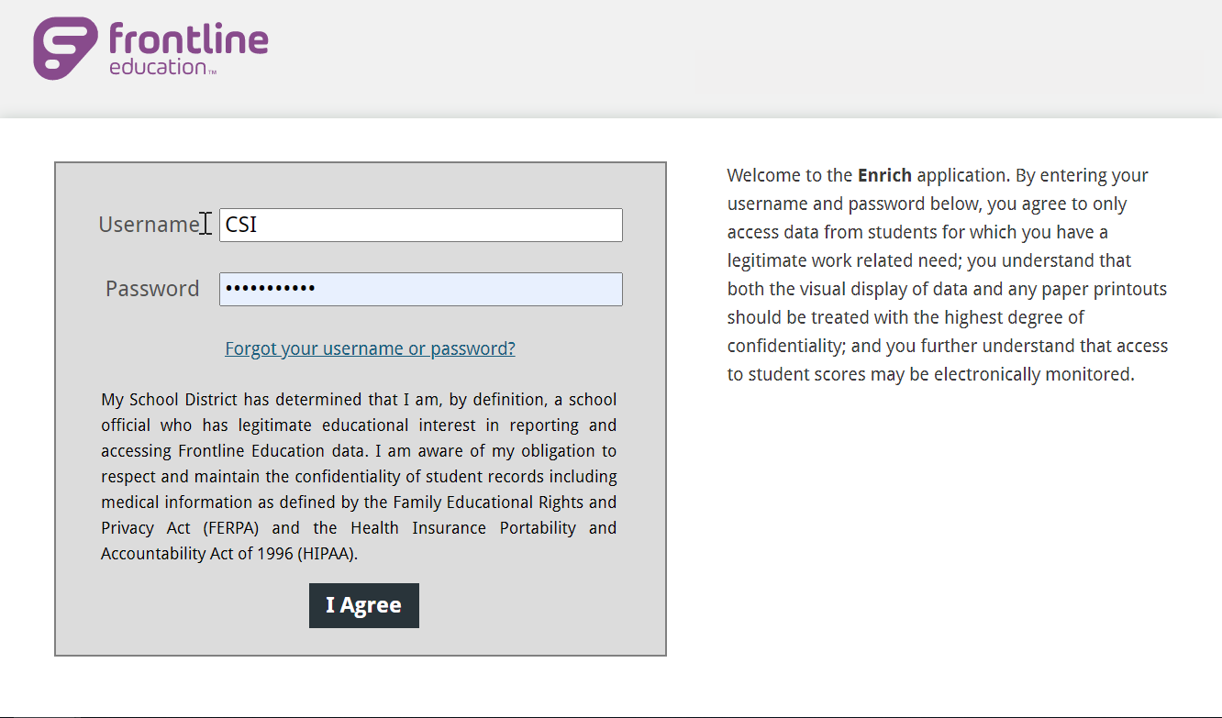
Where should Data be Entered for SPED EOY
  Infinite Campus
  Enrich
  December Count/SPED End of Year
  Infinite Campus - IEP Development [Campus Community login required]
  Enrich Learning Center Links
Notes:
Now that we have covered the What Should be Entered piece, let’s jump into the Where to Enter Data. For this there really are only 2 options for 24-25 depending on what system you are on. All IEPs should either be entered into Infinite Campus or a school specific instance of Enrich. Keep in mind that if you are using IC or PowerSchool for general collections, but another system for Special Education – you will need to complete the Special Ed fields located in the current years enrollment to ensure other collections report accurately. If you need assistance with the setup of Special Education in Enrich or IC, please refer to the setup and development guidance linked in this slide. It should walk you through the best processes as it relates the setup of the Special Education collections and IEP development.

Slide 29
Step 3: Submissions to CSI
Extract data from the plan management system:
  Infinite Campus – Campus Community
    IEP Child and Participation Guides
  Enrich
    Enrich File Extract Guidance
Notes:
So that was step 2, collecting and entering data - that really can be a time-consuming part of the process. The next step we will be looking at today is step 3 – the extraction and submission of your files to CSI. All files should be extracted directly from the State Reporting sections of IC or Enrich. To ensure you are completing this step accurately and entering the correct information in the prompts, please see the IEP Child and Participation Guides for Infinite Campus and the Enrich File Extract Guidance for that system, which are linked here.

Slide 30
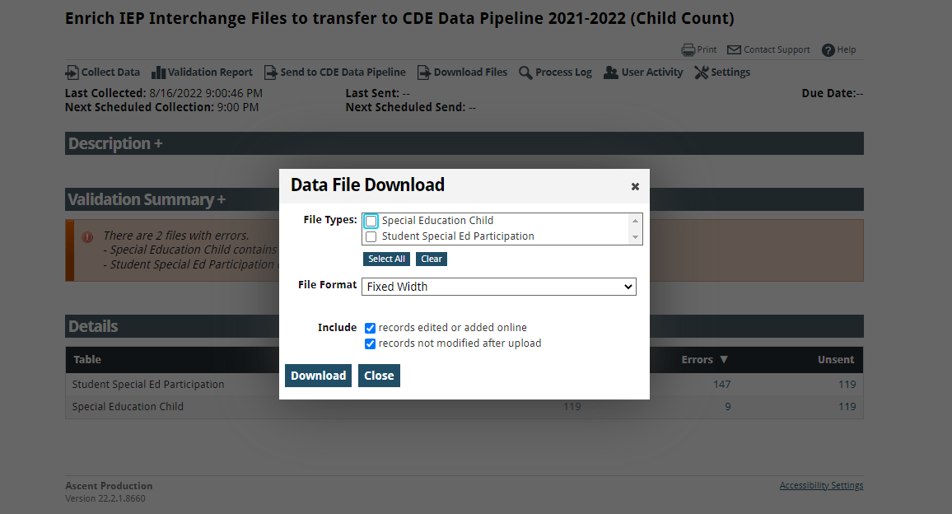
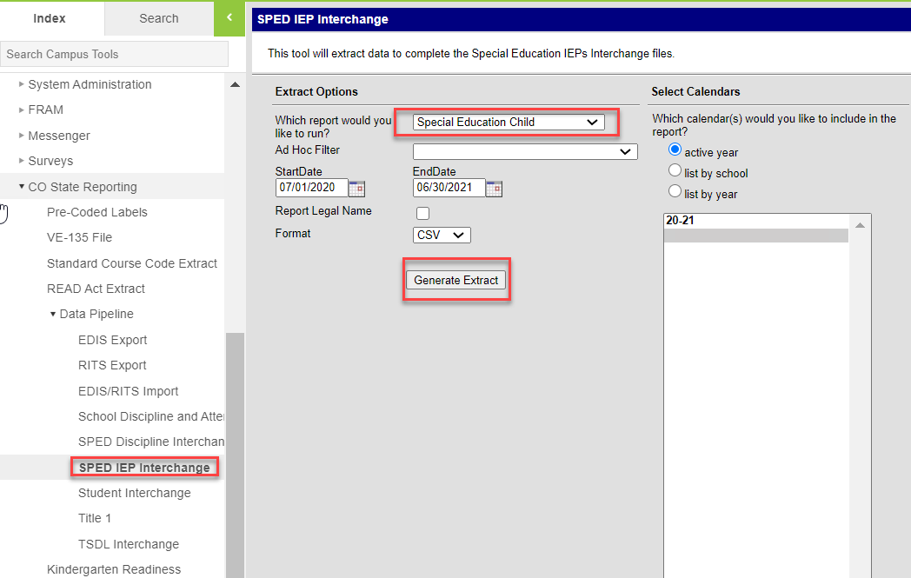
Step 3: Submission to CSI – File Extract
Extract data from the plan management system:
  Enrich – Learning Center – Colorado Data Pipeline Reporting and Resources
  Enrich File Extract Guidance
  Infinite Campus – Campus Community
  IEP Child and Participation Extract Guidance
Notes:
This slide covers the location and resources available as it relates to file extraction. All files should be extracted directly from the State Reporting sections of IC and the CDE Data Pipeline option in Enrich. To ensure you are completing this step accurately and entering the correct information in the prompts, please see the IEP Child and Participation Guides for Infinite Campus to assist with this process. As for Enrich, the Learning Center resources on the website are great, along with the file extract guidance described on the previous slide.

Slide 31
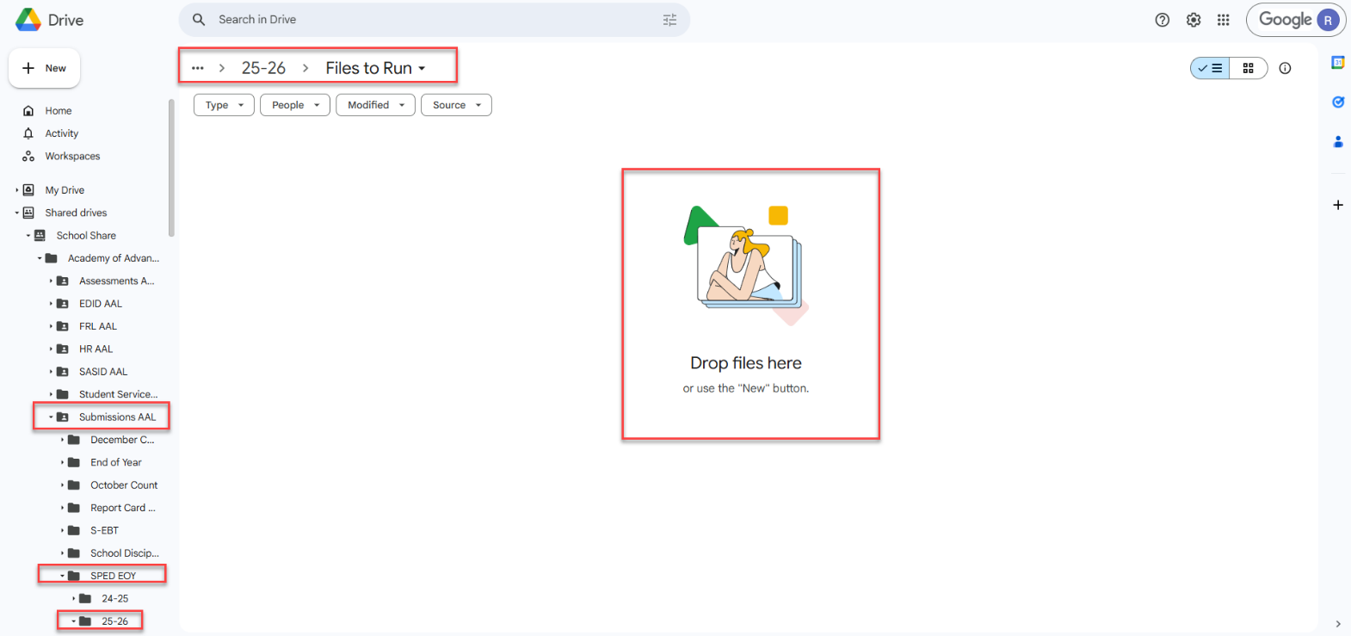
Step 3: Submission to CSI – Submittal Process
Correct Naming of Files
Examples:
  SCHOOLCODE_SCHOOLABBREV_Child_Date
  SCHOOLCODE_SCHOOLABBREV_Participation_Date
Files should not contain any spaces in order to upload to CDE
Ensure you are uploading them to the correct folder in Google Drive:
  G-Drive>December Count>25-26>Files to Run
Email the submissions inbox (Submissions_CSI@csi.state.co.us) once file is available to process
Notes:
When you are submitting your files to CSI, you are going to be opening up G-Drive and navigating to the SPED End of Year folder. Within this folder, you will see a sub folder for 25-26 that contains the following individual folders – Files to Run, Error Reports, and Summary Certification. For this part of the process, you will want to ensure you are placing those Child and Participation files into the Files to Run folder with the correct naming convention. You will see examples of this above that include: School Code, School Abbreviation, File Name and Date. If you submit multiple files in one day, you can always use a v2 at the end for version 2. This ensures that we are uploading the most recent file you submitted. You will also notice that the examples contain no spaces, so you can either separate them out by underscores or group them all together. If files contain spaces, we have to rename them prior to uploading to the Data Pipeline, which is an added extra step. Another issue that I mentioned that can delay us from sending you error reports would be adding these to the wrong folder. We often see files added to the wrong collection, year or folder and we have to jump around within G-Drive to determine where those have been placed. It is often good practice to include the path of where the files were placed into your email which you need to send to CSI to notify us that your files are ready to be processed. Issues with any of these steps can certainly lead to delays in getting your error reports and extra time to the processing, so you’ll want to be sure this is all done accurately

Slide 32
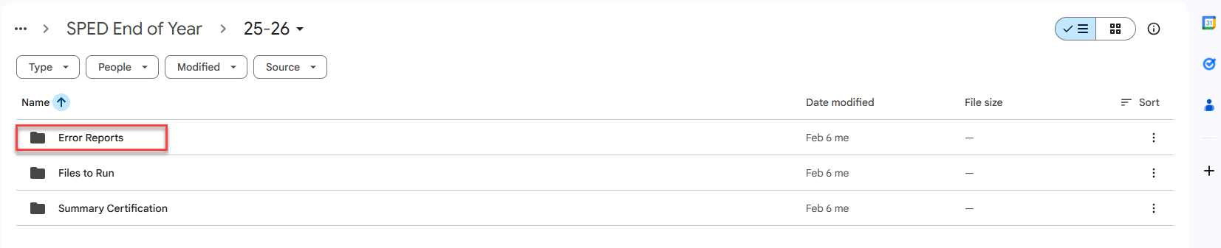
Step 4: Error Resolution
Once submitted, CSI will process the files in the Data Pipeline and extract error reports.
All Level 1 and 2 Error Reports will be available in the Error Reports folder at the following path in G-Drive:
    Submissions/SPED EOY/25-26/Error Reports
Download and save these reports from G-Drive directly to a created folder on your computer similar to the process described above, but in reverse.
Notes:
So once you have submitted and emailed CSI, we will process your files and provide you both level 1 and 2 error reports when applicable. Level 2’s will only be sent once you have cleared up all level 1 errors. These reports will be provided in Google Drive under the 25-26 Error Reports folder shown in this slide. These files can be downloaded from Google Drive and then saved directly to a folder on your computer. Once that is done, the error reports can be opened regularly. Keep in mind that corrections can only be made in your plan management system and new files extracted. Error reports should never be updated and resubmitted

Slide 33
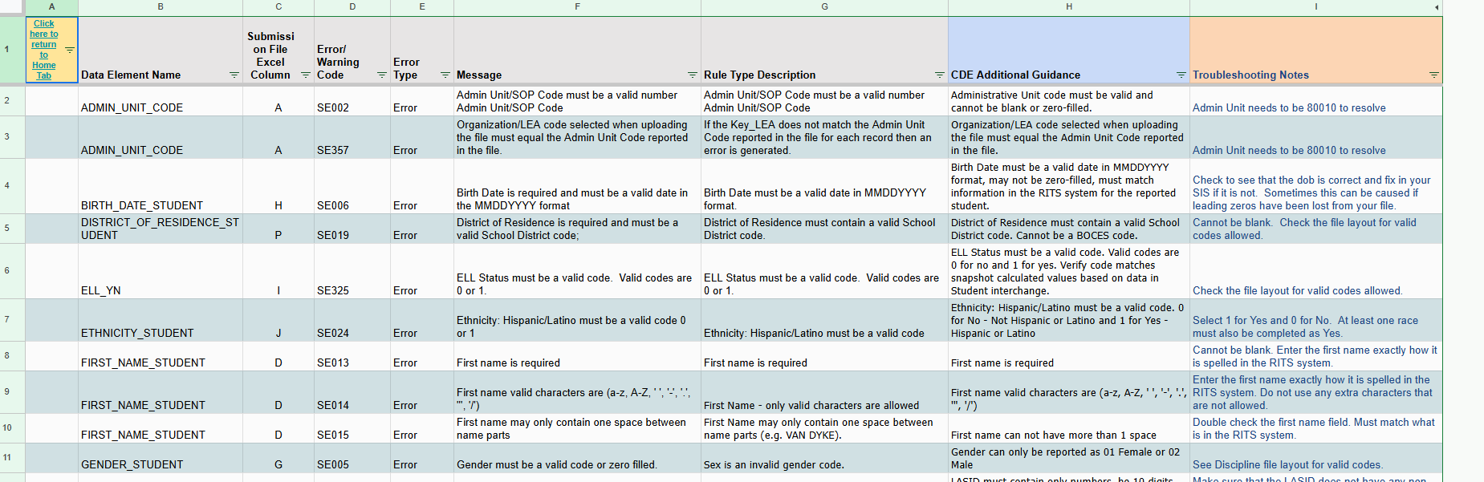
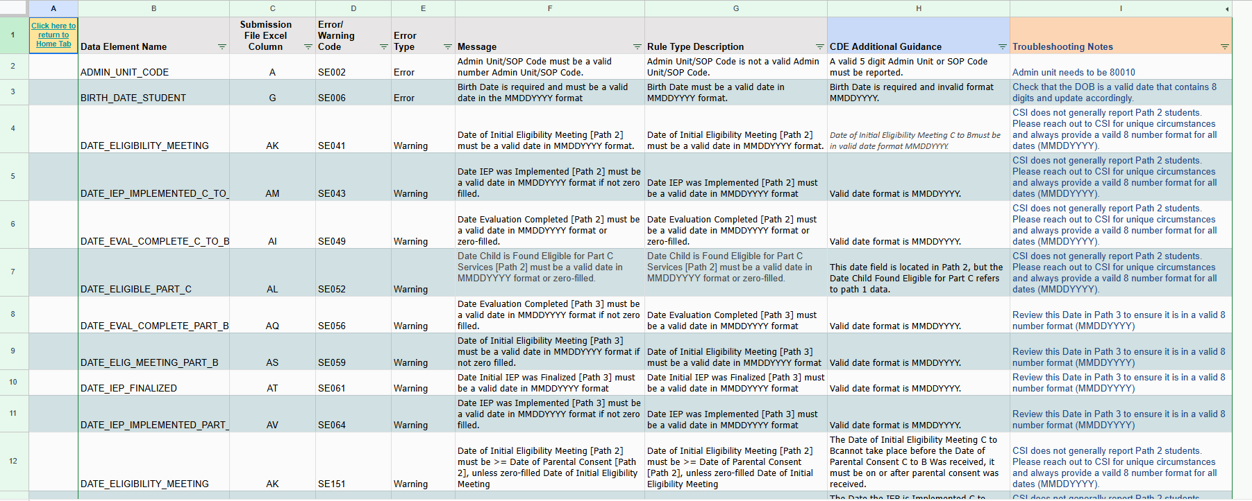
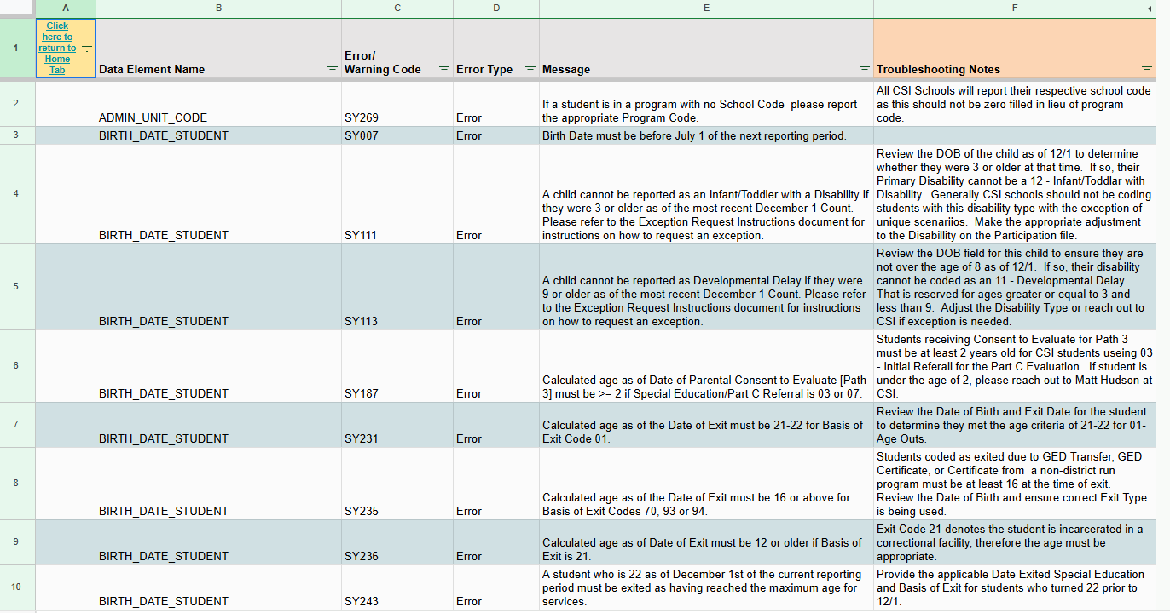
Troubleshooting Errors
Review the Child, Participation, and SPED EOY Level 2 Reports for Guidance!
Troubleshooting Errors Spreadsheets
Notes:
(NEXT) To help with this process, CSI has created the previously mentioned Troubleshooting Errors document. Here is a screenshot of all the tabs you will use in the troubleshooting document when clearing errors for the SPED EOY collection. Those tabs are the Child, the Participation, and the SPED EOY Level 2 snapshot. The goal when you go to these tabs is to further identify what is causing the error and possible solutions. Essentially it contains a listing of the Error/warning Code, related data element names, whether it is an error or warning and the message you will see in your actual error report. In addition to those, we have added CSI specific troubleshooting notes along with CDE additional troubleshooting notes. Each of these columns provide a little more clarification to the message delivered in the error report with the CSI notes being much more specific resolution options as it relates to CSI schools. CDE had created something similar to this idea that provides additional comments they can add. These are generally getting updated quite often and can certainly help provide additional information that should assist in you clearing those errors. As I have mentioned this is somewhat of an iterative process and we don’t expect all errors to be cleared on the second submittal, but using these troubleshooting resources can certainly help to reduce the number of times you have to make corrections and resubmit.
Feel free to reach out to us if you have specific questions on how to utilize this or if you have errors that you are still unable to clear and we would be more than happy to assist.

Slide 34
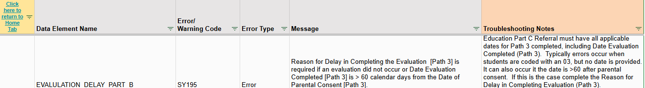
Troubleshooting Errors – Resolution Example
Your first Level 2 Error Report shows several SY195 error related to Path 3 Evaluation Delays. You are unsure the best process to code correctly and clear the error.
To assist with this, use the Troubleshooting errors document! The additional troubleshooting notes show:
Based on this, you know that either the IEP is missing some Path 3 Dates, including Date of Evaluation or the time between Parental Consent and Evaluation Complete was more than 60 days. So, either you need to add the dates into the IEP or add a Reason for Delay in Completing the Evaluation (if dates are accurate)
Notes:
A great example of using this troubleshooting resource would be if you encountered a level 2 SY195 error related to Path 3 evaluation delays. You are unsure how to code a student that has an evaluation delay, so you pull up the troubleshooting errors resource! Based on the CSI additions notes, you know that either the IEP is missing some path 3 dates, including the date of evaluation or the time between parental consent and evaluation complete is greater than the required 60 day timeframe. If all dates are input and accurate, you will need to add a reason for delay from the options listed on the participation file layout.

Slide 35

Step 5: Data Review
Summary Certification Report information detailed on an upcoming module.
Courtesy of clipartlibrary.com
Notes:
Alright, so step 5 is all about reviewing the data in a summary certification report that CSI will provide you once error free. A smaller module describing the review process will be released prior to school receiving their summary report, so check back in!

Slide 36
Timelines and Deadlines
Notes:
Next, we want to look at the timelines and due dates for this collection.

Slide 37
SPED EOY Timelines and Deadlines
Deadline | Task
03/11/2026 | Submit initial files (Child, Participation)
04/01/2026 | Level 1 Interim Deadline – Clear half of your errors by this date
04/22/2026 | Schools must have all Level 1 (Child/Participation) errors cleared
05/01/2026 | Level 2 Interim Deadline – Clear half of your errors by this date
05/20/2026 | Schools must have all Level 2 (HR and December Count-Staff) errors cleared
Last Week of May* | CSI will provide Data Summary Reports to schools
6/15/2026** | Submit Signed Certification Agreements to CSI
*Dependent upon all schools clearing errors by specified deadlines
**Any requests for changes must be received by CSI on or before 6/11//2026
For more details on this and other collection timelines, see the CSI Data Submissions Calendar
***Please be sure to meet the Interim Deadlines for both Level 1 and 2 to ensure that you are staying on track and to avoid the logjam of files on deadline days.***
Notes:
In looking at the deadlines for this collection, the first would be the initial submission which is due on March 11th but can be submitted earlier if you would like. Next, we have the level 1 error clearance set for April 22nd and Level 2 due May 20th. All signed certifications must be returned to CSI by June 15th, 2026. It is important to note that when you receive your summary reports is dependent on when the school is able to clear all errors, so the earlier the better as all changes have to be submitted by 6/11. It should also be noted that we are requiring interim deadlines this collection year. Schools should have half of their level 1 errors cleared by 4/01 and half of their level 2’s by 5/01. This is to avoid the logjam of files submitted on deadline days and hopefully keep schools in a good position to meet all deadlines.

Slide 38

Thank you for Reviewing this Training
  Next Steps: Review the “New this Year” training on the CSI website
Contact the Submissions Inbox with Questions:
    Submissions_CSI@csi.state.co.us
Notes:
Thanks again for reviewing this training for the 25-26 Special Education End of Year collection. If you have questions or concerns, don’t hesitate to contact the submissions inbox and a member of the submission team will be more than happy to assist! Have a great day!

