Slide 1

Graduation Guidelines
End of Year
Recorded February 2026
Notes:
Welcome to the Graduation Guidelines for the End of Year Submissions.
This training, recorded by the CSI data team, provides an overview on the Graduation Guidelines reporting data for the EOY collection.

Slide 2
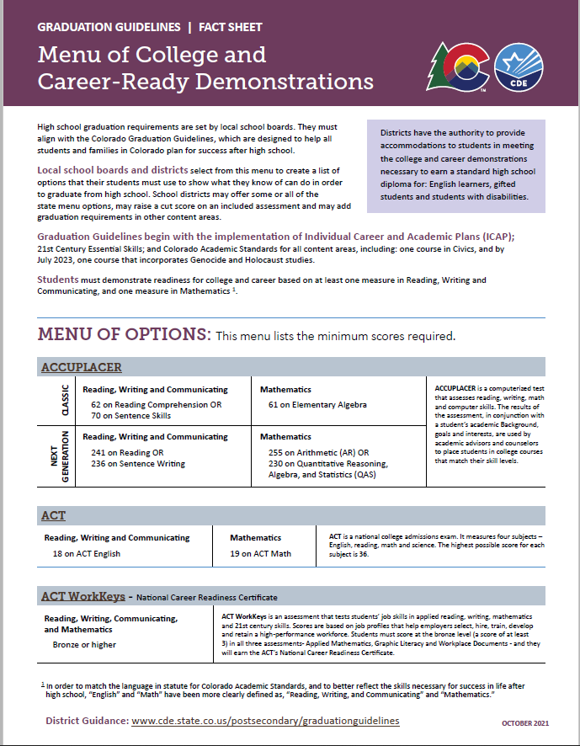
Graduation Guidelines
Graduation Guidelines are a student’s demonstration of Postsecondary and Workforce Readiness (PWR) in Reading, Writing, and Communicating (RWC) and Mathematics.
In order to graduate from high school, students choose measures from a Menu of Options – adopted at the local school board level – that show their proficiency in RWC/Math.
https://www.cde.state.co.us/postsecondary/grad-menu
2
Notes:
What are Graduation Guidelines?
Graduation Guidelines are a student’s demonstration of Postsecondary and Workforce Readiness in English and Mathematics.
In order to graduate from high school, students choose measures from a Menu of Options – adopted at the local school board level – to show their proficiency in English/Math. These options will be discussed in more depth later in this training.

Slide 3
Graduation Guidelines File
The purpose of the Graduation Guidelines Submission:
The file is part of the EOY collection and serves as a validator to cross check that any student marked as a graduate (exit type codes 90, 95, or 96) has met Graduation Guidelines (at least one in English & at least one in Math).
Student may have multiple English or Math records.
Capture any, and all, Graduation Guidelines attempted
https://resources.csi.state.co.us/data-submissions/eoy/
3
Notes:
The purpose of the graduation guidelines file submission is to cross check that any student marked as a graduate (with exit type codes 90, 95, or 96) has met at least two Graduation Guidelines. This would include at least one in English and at least one in Math guideline. It is possible for students to have multiple English and Math records. A CDE best practice suggestion includes that a student’s Graduation Guideline record capture any, and all, Graduation Guidelines attempted.

Slide 4
School Level Involvement
Who is involved in Graduation Guidelines reporting?
Program/Policy Staff
Data Submissions Respondents
CDE Suggested Best Practice
  Data Respondents: Pull a list of students who are likely to graduate in the current year
  Program/Policy Staff: Check which students have met Graduation Guidelines with which guideline name from the menu of options
  Data Respondents: Input Graduation Guidelines in SIS
  Repeat as needed
4
Notes:
Who is involved in reporting Graduation Guidelines at the school level?
Schools should work together internally to make sure to report Graduation Guidelines accurately and effectively.
CDE best practice suggests that Data Respondents pull a list of students who are likely to graduate the current year. The school’s Program/Policy Staff check which students have met the Graduation Guidelines and with which guideline name from the menu of options. The Data Respondent can then input these Graduation Guidelines in the Student Information System. This process should be repeated as needed.

Slide 5
Who & What is Reported?
What is Reported:
All schools with students in grades 9th - 12th should submit a Graduation Guideline file as part of the EOY data collection.
Who is Reported:
All students that have completed a Graduation Guideline should be reported in the file.
  4th year seniors (AYG 2026)
  5th (AYG 2025), 6th (AYG 2024), and 7th (AYG 2023) year seniors; and
  Including 3rd year graduates
5
Notes:
All schools with students in grades 9th - 12th should submit a Graduation Guideline file as part of the EOY data collection.
All students that have completed a Graduation Guideline should be reported in the file. This includes:
4th year seniors
5th , 6th , and 7th year seniors; and
including 3-year graduates

Slide 6
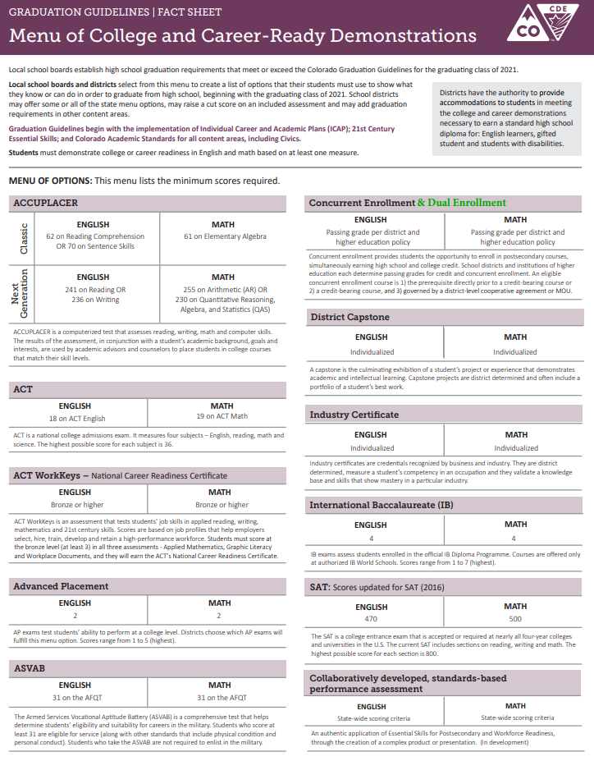
Graduation Guidelines -
Menu of Options
A student CAN be tested in more than one category.
A student CAN fulfill more than one requirement in English and/or Math readiness
A student CAN fulfill one or more requirements over multiple academic years
https://www.cde.state.co.us/postsecondary/grad-menu
6
Notes:
In the Graduation Guidelines Menu of Options, there are eleven options for measuring Math and English, including measures like: Accuplacer, Advanced Placement, Concurrent Enrollment, SAT and ACT, Industry Certificates, Capstone and/or Performance Assessments.
A student CAN be tested in more than one category. For example, A student, may receive an Industry Certificate, which the school has agreed is a Math metric and this student may complete a Capstone project to fulfill an English metric.
It is also possible for a student to fulfil more that one requirement in English and/or math AND over the span of multiple years.

Slide 7
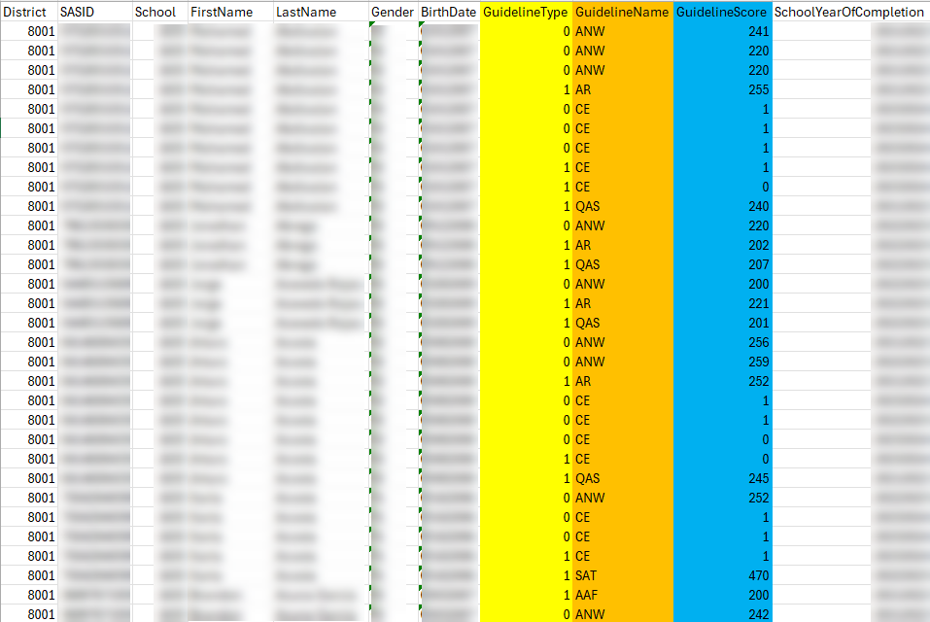
Grad. Guidelines – Data
https://resources.csi.state.co.us/data-submissions/eoy/
7
Notes:
Three of the fields captured in the Graduation Guideline file submission will be: Guideline Type, Guideline Name, and Guideline Score.
All of these code options can be found on the Graduation Guideline File Layout. More information about the file layout is mentioned in a later slide.
The ‘Guideline Type’ denotes Math (1) or English (0). While a graduating student can have many record entries, they will need to have at least two record entries with a passing score- ONE entry for Math, and ONE entry for English.
‘Guideline Name’ will include a 2 to 3-letter code for one of the eleven metrics in the Menu of Options on the Graduation Guideline Menu or File Layout.
And “Guideline Score” will include the coding needed to indicate how the student scored in each metric.

Slide 8
Resources
8

Slide 9
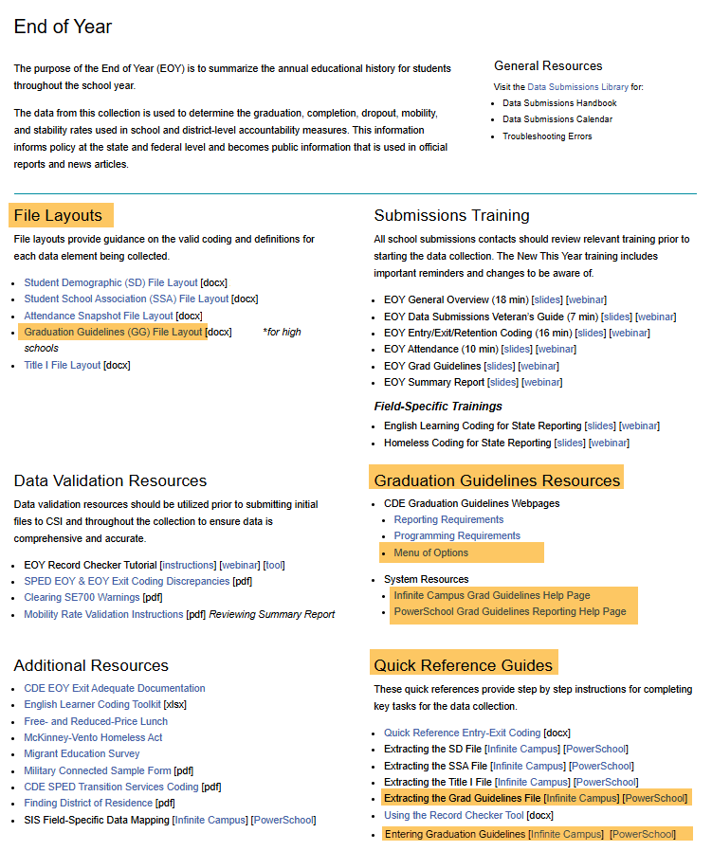
EOY Website Resources
https://resources.csi.state.co.us/data-submissions/eoy/
9
Notes:
For Graduation Guideline Resources, please visit the CSI website, EOY resource page which will include the File Layout, Quick Reference Guides, Menu of Options, and SIS system resource links.

Slide 10
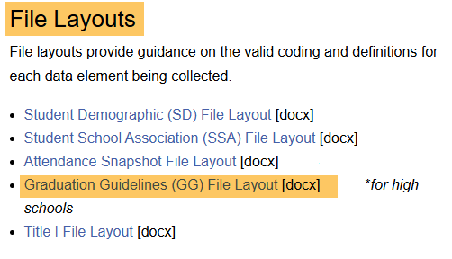
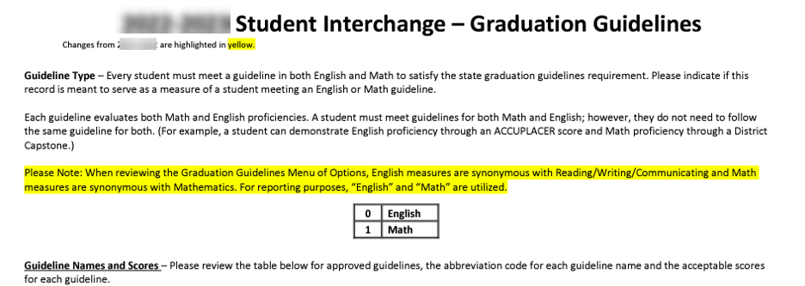
Grad. Guidelines – File Layout
https://resources.csi.state.co.us/data-submissions/eoy/
10
Notes:
The File Layout is one of the strongest resources available for file submissions as it contains all the codes, formats, and descriptions used for data entry.

Slide 11
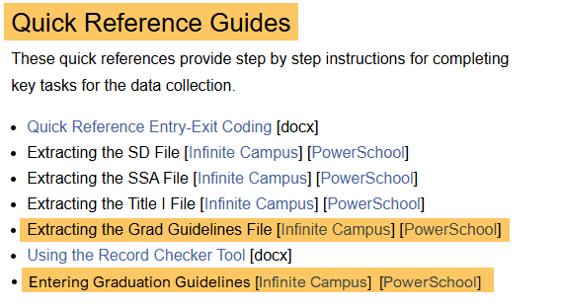
Quick Reference Guide
Entering Grad Guidelines (in Infinite Campus and PowerSchool)
Extracting the Grad Guidelines (from Infinite Campus and PowerSchool)
https://resources.csi.state.co.us/data-submissions/eoy/
11
Notes:
The Quick Reference Guides offer a step by step instructions on entering Graduation Guidelines in Infinite Campus and PowerSchool and Extracting the Graduation Guidelines file from your SIS.

Slide 12
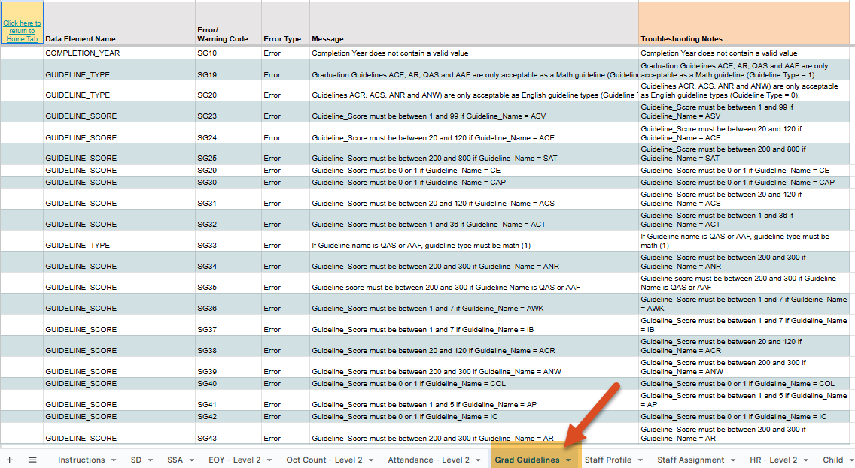
Troubleshooting GG Errors
https://resources.csi.state.co.us/data-submissions/
12
Notes:
Once your file is extracted and submitted to CSI through the G-Drive, the Data Submission Team will process your file and upload any errors back to the G-Drive. The Graduation Guideline tab on the CSI troubleshooting spreadsheet will be your best source for troubleshooting Graduation Guideline errors. Please note: One of the most common errors in the Graduation Guideline file are from Graduation Guideline scores out of range for a Graduation Guideline type. Be sure to review the Graduation Guidelines File Layout when you set up your SIS and enter data. It is also important to note: The Graduation Guidelines tab identifies level 1 errors in the Graduation Guidelines file.

Slide 13
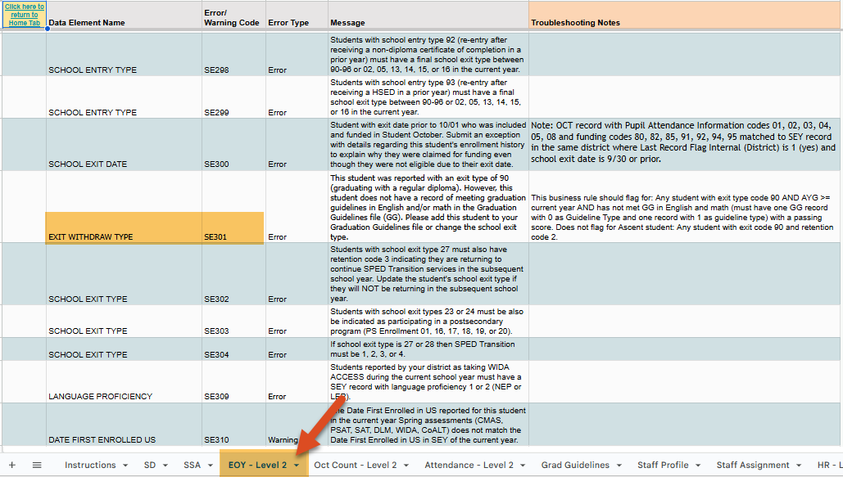
Troubleshooting L2 Errors
https://resources.csi.state.co.us/data-submissions/
13
Notes:
Level 2 errors often come up later in the EOY. The EOY – Level 2 TAB, found at the bottom of the CSI troubleshooting spreadsheet, will be your best source for troubleshooting Level 2 Graduation Guideline errors. The most common Level 2 error is the SE301 error. This error is caused when a student has an exit code of 90, graduated, but has not met the Graduation Guidelines in English and/or Math. Be sure to review these errors with your school team to provide accurate information.

Slide 14
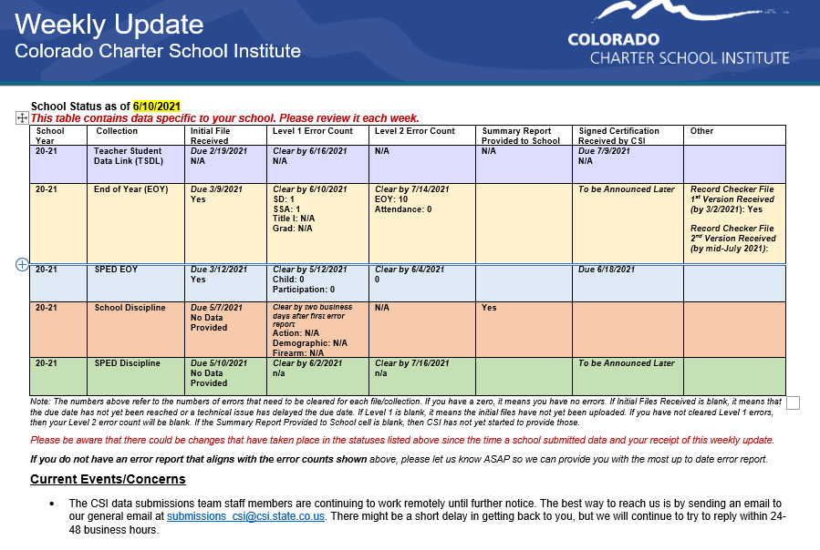
Weekly Update Email
14
Notes:
Please review the Weekly Update which includes important, updated information, highlighted in yellow for easy reference.

Slide 15
Thank you!
Data & File Questions submissions_csi@csi.state.co.us
Program Questions:
https://resources.csi.state.co.us/school-programs/pswr/
15
Notes:
Thank you for watching this training. For support with Graduation Guidelines, CSI has two departments that can assist you.
For any questions regarding Graduation Guidelines data and file submission, you may reach out to the CSI Data Submission team.
If you have questions about Graduation Guidelines programming, you may reach out to CSI School Program team.

