Slide 1

End of Year Attendance Collection - New This Year
Recorded January 2026
Notes:
This training recorded by the CSI data team provides an overview of the Attendance Collection.
This training is designed for experienced data submission contacts and provides a basic updates and changes to the Attendance Collection this year.
New or less experienced school data submissions contacts should review the Attendance – General Overview training module, which covers the collection process in more depth.

Slide 2
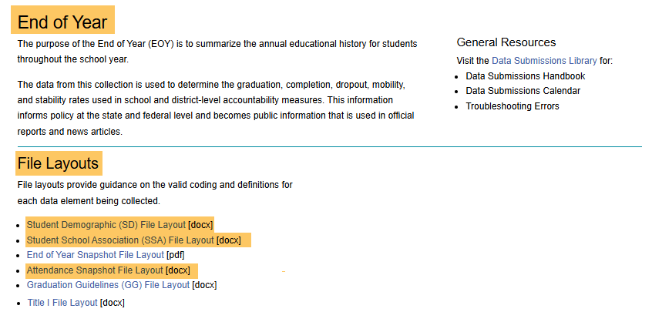
Attendance Fields
Attendance Data = SD & SSA files for the EOY Collection.
See the Attendance, SD, & SSA file layout for valid coding and field definitions.
https://resources.csi.state.co.us/data-submissions/eoy/
2
Notes:
The Attendance Collection has a quick turnover and requires no additional files for this collection. Instead, the Attendance collection pulls attendance data reported directly from the End of Year collection’s, Student Demographic or (SD) and the Student School Association or (SSA) file. Field definitions and coding information are on the File Layouts located on the CSI EOY Resource Webpage.

Slide 3
Attendance Submission Deadlines
2/28 – Initial EOY Submission (SD & SSA files)
4/15 – Attendance Collection Opens
4/21 – EOY Level 1 Error Clearance Deadline
4/30 – Initial Attendance Error Clearance Deadline
6/16 – Final Level 2 Error Clearance Deadline
6/16 – Attendance Error Clearance Deadline
6/30 – CSI Closes Attendance Collection
Printable Calendar: https://resources.csi.state.co.us/data-submissions/calendar/
Online Calendar: www.csi.state.co.us/calendar/
3
Notes:
It is important that EOY SD and SSA files are level 1 free. The reason is that any student SASID that has Level 1 errors, will be excluded from the snapshot. Cleared Level 1 errors will both include all students for this collection and help ensure the data used in the collection pulled from the SD and SSA files are as accurate as possible.
Key dates for the Attendance Collection are listed on this slide. Please note the initial attendance error clearance deadline at the end of April.
As a reminder, you can access the CSI Online Calendar. The online calendar is updated regularly throughout the year if timelines change.
Be sure to review the Weekly Update emails sent to all school submission contacts for the latest announcements and other details related all collections.

Slide 4
Attendance Fields - SSA File
CSI schools required to report attendance data on SSA file
Six attendance related fields:
Total Days Attended,
Total Days Excused,
Total Days Unexcused,
Total Possible Days (based on school calendars, not 365 days),
Habitually Truant Status,
Total Days Missed for Out of School Suspensions,
*New - Abbreviated School Day Schedule Status,
*New - Total Days on an Abbreviated School Day Schedule.
Quick Reference Guides for Extracting an SSA File:
https://resources.csi.state.co.us/data-submissions/eoy/
4
Notes:
This slide consists of the 8 attendance specific fields located on the on the SSA file.
All CSI schools are required to report attendance data on all students for the October Count and EOY collection. This means that each time a school extracts an SSA file from their SIS, they must include attendance. For step-by-step instructions for extracting and SSA file from PowerSchool, Infinite Campus, or Alma, please visit the CSI EOY Webpage and select the appropriate Quick Reference Guides. These will include the needed dates & selections when extracting files.

Slide 5
New This Year.
5

Slide 6
New This Year
HB 24-1063 – Addresses Abbreviated School Days
Two new Fields on the SSA file:
Abbreviated School Day Schedule Status
Total Days on an Abbreviated School Day Schedule
Data Contacts will update data in their SIS as needed
Work closely with 504 and SPED Leads for data accuracy
6
Notes:
The last two attendance fields located on the SSA file are New This Year.
Because of the implementation of House Bill 24-1063 which addresses Abbreviated School Days,
There are Two new Fields on the SSA file:
Abbreviated School Day Schedule Status AND
Total Days on an Abbreviated School Day Schedule
The next couple of slides will provide a little more context about the new fields along with reporting information.
The most important for data contacts is to know about these new fields is that they will need to be updated in the SIS when instructed by 504 and SPED Leads.
In addition, Data Contacts will need to work closely with 504 and SPED Leads for data accuracy related to the new fields.

Slide 7
What is HB 24-1063?
Clarifies what constitutes an Abbreviated School Day Schedule:
Describes the effects of placing students with disabilities on Abbreviated School Day Schedules
Reinforces current legal requirements that require school personnel to conduct IEP or 504 meetings PRIOR to placing students with disabilities on an Abbreviate School Day Schedule
HB24-1063 includes components impacting more than one data collection:
EOY / Attendance Collection (EOY SSA File)
Instructional Days and Hours (New Collection)
Discipline Reporting (Discipline Actions)
7
Notes:
House Bill 24-1063 clarifies what constitutes as an abbreviated school day schedule and describes the effects of placing students with disabilities on such schedules.
The bill reinforces existing legal requirements that school personnel must conduct IEP and/or 504 meetings PRIOR to placing students with disabilities on an abbreviate school day schedule.
HB24-1063 includes components impacting more than one data collection.
EOY Attendance Collection
Instructional Days and Hours
Discipline Reporting

Slide 8
HB 24-1063 - Permissible Uses
Abbreviated School Day Schedules:
Can only be determined by an IEP or 504 Team.
For students who would not benefit from a full-time schedule.
Are based on individualized student needs.
Requires documentation, parent input, and regular review.
Requires tracking and state reporting.
May not be classified as truant or chronically absent.
Cannot be used for disciplinary reasons.
Cannot be Parent-initiated to pick up or drop off outside of the set school schedule including for illnesses or to attend outside therapies.
8
Notes:
Your school’s IEP/504 teams will be leading decisions on when and which students should be identified, however, we want to highlight some of the permissible uses to provide more context for Data Submission Contacts.
Abbreviated School Day Schedules:
Can only be determined by an IEP or 504 Team
For students would not benefit from a full-time schedule
Are based on individualized student needs
Requires documentation, parent input, and regular review.
Requires tracking and state reporting
May not be classified as truant or chronically absent.
Cannot be used for disciplinary reasons.
Cannot be Parent-initiated to pick up or drop off outside of the set school schedule including for illnesses or to attend outside therapies.
The Data Submission contacts should support the reporting on this data.

Slide 9
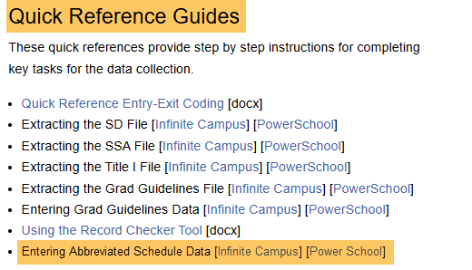
HB 24-1063 - Data Reporting
Data Contacts should update this information in the SIS.
Infinite Campus – Student’s Enrollment Page
PowerSchool – Student’s Enrollment Page
ALMA - Student’s Bio>Additional Fields
https://resources.csi.state.co.us/data-submissions/eoy/
9
Notes:
Once a schools IEP/504 team has determined that a student is eligible for an Abbreviated School day Schedule and the IEP/504 has been updated, Data Contacts can update this information in their SIS.
This information will be found under the student’s enrollment page in both Infinite Campus and PowerSchool and under the student’s Bio-Additional Fields within in Alma.
There are Quick Reference Guide’s available for step-by-step information on updating these fields in IC, PS, and ALMA located on the CSI EOY Resource Webpage.

Slide 10
HB 24-1063 - Data Reporting Abbreviated School Day Schedule Status
Field Length: 1
0- No, Not Applicable (Blank and SIS Default)
1- Yes, the student is 504 or Special Education and was on an abbreviated school day schedule at any time during the year.
10
Notes:
Within a school’s SIS, the first new field, Abbreviated School Day Schedule Status, if left blank will default to a 0 or NO (no applicable) within the SIS and on state reports.
When a student is found to be eligible for an Abbreviated School Day Schedule, this field will require a 1 or YES, for the student is 504 or Special Education and was on an abbreviated school day schedule at any time during the year as noted on an IEP/504.

Slide 11
HB 24-1063 - Data Reporting Total Days on an Abbreviated School Day Schedule
Field Length: 5
Must be formatted as a decimal (000.0)
Aggregate number of days the student was placed on an abbreviated school day schedule within the school year.
Calculate partial days as whole days.
11
Notes:
The second new field, Total Days on an Abbreviated School Day Schedule, requires a calculation based on date the student was placed on an abbreviated school day schedule as part of their IEP/504 and when/if their eligibility ends.
The field length is 5 characters and must be formatted as a decimal
The total days will be the Aggregate number of total days the student was placed on an abbreviated school day schedule within the school year.
These totals should be calculate as whole days regardless of partial day attendance.

Slide 12
HB 24-1063 – Teamwork
IEP/504 Teams & School Programs:
Ensure that Abbreviated School Day Schedules are appropriately used and reviewed.
Data Submission Contacts:
Support with the data entry for state reporting on this data.
Communication between teams will be essential is confirming, updating, and maintaining data accuracy.
12
Notes:
Teamwork will be an important for the state reporting of these new fields.
IEP/504 Teams & School Programs:
Ensure that abbreviated school day schedules are appropriately used and reviewed.
Data Submission Contacts:
Support with the data entry for state reporting on this data.
Communication between teams will be essential is confirming, updating, and maintaining data accuracy.

Slide 13
SIS Tips
13

Slide 14
Important Tips
Missing attendance for students or courses?
Confirm that when extracting the SSA files from SIS, the attendance dates are entered correctly.
Check SIS to confirm courses and sections are not checked as exclude from state reporting.
14
Notes:
If a school appears to have missing attendance for some students or courses that should be included, school should:
Confirm that when extracting the SSA file from the SIS, the attendance dates are entered correctly including the correct year.
Check your SIS to make sure that the course and sections are not marked as exclude from state reporting.
It is important that all courses and sections in which attendance is taken are always included in state reporting.

Slide 15
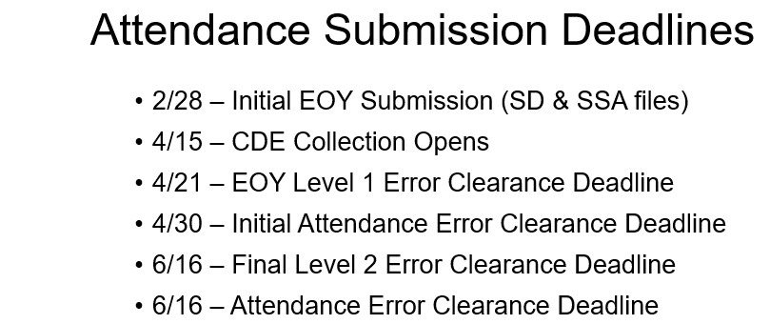
Other Tips
SIS Roll Over Time
SIS Rollover – After All Collections Level 2 Errors are Cleared
-Typically, late June/July
Difficult to correct attendance data after the SIS is rolled over to the next school year
Please plan to have all attendance errors and issues cleared prior to your school roll over
15
Notes:
This slide shows again the dates and deadlines that impact the Attendance Collection. To the left you will notice the approximates the window of time that most schools roll over their SIS to the next school year, typically between late June and July.
Once a school rolls over to the new year, CSI may not accept new submission files from schools as data exports are often impacted and any changes to the data must be made manually to the most recent files at CSI.
With this being the case, it’s difficult to correct attendance data after the roll over.
Schools should plan to have all attendance errors and issues cleared prior to completing their roll over.

Slide 16
Thank you
Send questions to: submissions_csi@csi.state.co.us
Notes:
Thank you for watching this training on reporting attendance data. Please send any questions you have to the CSI data team at the email address noted in this slide.

