Slide 1

2025-26 Teacher Student Data Link (TSDL)
General Overview Training
Notes:
Welcome to the TSDL collection recorded by the CSI data submission team.

Slide 2
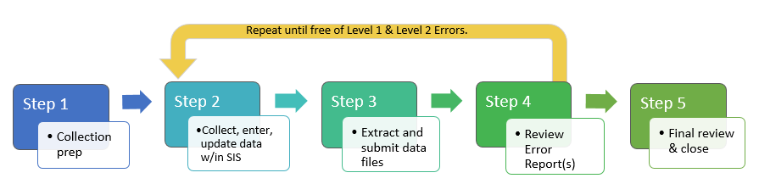
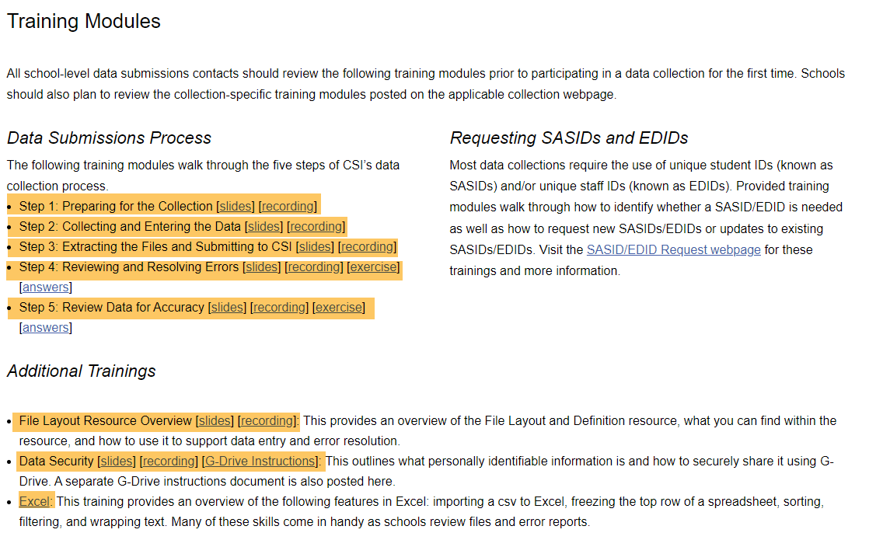
The Data Submissions Process
https://resources.csi.state.co.us/data-submissions/training/
2
Notes:
This training is just one element of Step 1 of the Data Submission Process, which focuses on collection prep. If you are a new data submissions contact or a returning contact wanting a review of the data submission process, please review the training modules on the General Data Submissions Resources page on our website that focus on the Data Submission Process.

Slide 3
Purpose of TSDL
The TSDL file captures data that link students to courses and instructors (if available) for the reported school year.
  CDE relies on the TSDL data for the following reporting requirements: student course participation and achievement report, migrant student tracking/reporting, educator preparation program outcomes, 9th grade success & performance reporting and prepopulating the Civil Rights Data Collection (CRDC) report.
  CSI looks at course completion as part of school performance, so accuracy and completeness has become even more important in reporting the TSDL collection.
  The data collected by the CRDC plays a pivotal role in assisting policymakers, researchers, and others in the education community
Notes:
The purpose of the TSDL collection is to link students to courses and instructions (if available) for each school year. CDE uses this data for multiple reasons included on this slide including tracking for student course participation and achievement, migrant student reporting, the 9th grade success and performance reporting, and for prepopulating for the CRDC collection.
CSI views this data as part of school performance.
Data accuracy is important for this collection and impacts the accuracy of the CRDC collection.

Slide 4
Requirements of TSDL
Data to Report:
  All 6th through 12th grade students enrolled in “Core Courses” including mathematics, English language arts/literacy, science, computer science, and/or social studies course for 6 weeks or more must be included in the TSDL file.
  All 8th through 12th grade migrant students enrolled in any course for 6 weeks or more must be included regardless of subject area.
  For ease of extracting data, you may include all courses for all grades.
Data NOT Required:
  CSI schools are not required to report Teacher/Instructor information.
  Summer School enrollment
  NOTE: Do not exclude any courses from state reporting in which attendance is taken regardless of course’s grade range or course subject.
Notes:
The TSDL file is required to contain data for:
All students grades 6th through 12th enrolled in core courses including mathematics, English or language arts, science, computer science, and/or social studies and humanities courses for 6 weeks or more.
In addition , all 8th through 12th grade migrant students that have been verified by the state as participating in the Migrant Education Program enrolled in ANY courses for 6 weeks or more, regardless of subject area.
For ease of file extracting, the TSDL file can contain all subjects for all grades, but they are not required.
The file does not need to include teacher/instructor information or summer school courses.
IMPORTANT NOTE: Due to the collection time overlap of the TSDL and EOY Attendance collection, please do NOT exclude any courses from state reporting within your SIS in which attendance is taken regardless of course’s grade range or course subject.

Slide 5
Timeline

Slide 6
TSDL Timeline
January:
  1/8: TSDL Online Trainings Available
  TSDL files can be submitted to CSI
  1/21: CDE Opens Collection
February:
  2/12: Initial Submission Deadline
  April:
  4/2: Initial Errors Cleared (Clear all errors excluding TD087 errors)
  May/June:
    Submit Updated TSDL File to CSI
    (As soon as the school year ends, and final grades are posted)
June:
  6/9: Final Errors Cleared
July:
  7/8: Certifications Due
Printable Calendar: https://resources.csi.state.co.us/data-submissions/calendar/
Online Calendar: www.csi.state.co.us/calendar/
Notes:
Please view this timeline slide for important deadlines. Notice the Initial Error Clearance deadline set for April. All TSDL errors, excluding any TD087 errors that pertain to course completion, should be cleared. This deadline will help schools decrease the number of end of school year TSDL errors during the busy year end time that includes other collection deadlines like the EOY, SPED EOY, Staff Eval, and Discipline collection deadlines.
Please note that schools will need to submit a new file after the school year ends and all final grades are complete. For data submission contacts that leave for summer break, the TSDL certifications are required to CSI before leaving for the summer.

Slide 7
Meeting TSDL Deadlines
Submit TSDL files prior to deadline day!
  Format issues and missing data fields may not allow file to process and generate an error report.
  Schools may need multiple attempts at updating SIS and submitting new files for a “working” file to process.
  Because of the quantity of TSDL data, files can take 1-3 hours to process.
Notes:
CSI always encourages early file submissions, but for the TSDL collection in particular, it is highly recommended to submit files well before the deadline to ensure school deadline expectations are met.
This is one of the few collections where, if a file contains certain formatting issues or is missing required fields, it will not process through CDE’s Pipeline, and no error report will be generated.
As a result, schools may need to make multiple attempts to correct data within their SIS before even a working file is produced that generates an error report.
Additionally, because the TSDL file is often large containing data for each student and each course for the academic year, processing through CDE can take at times an hour or more to process. Please plan accordingly and ensure a working file is submitted to CSI by the deadline.

Slide 8
New This Year

Slide 9
9th Grade Success & Performance Reporting
For High Schools with 9th Graders ONLY:
ACTION REQUIRED
New field – (Core Credits Course) has been added to the TSDL collection for 9th graders only.
This field must be updated in school’s SIS for any CORE course that are available for 9th grader enrollment, PRIOR to initial submission.
  Core courses include mathematics, science, social studies, English language arts, and computer science.
  Priority is to update all CORE courses that 9th graders are currently enrolled.
  In addition, updating any courses that a 9th graders can enroll to support future data.
  IC users, if schools have calendars created for next school year with attached courses, you will need to update those courses as well.
Notes:
A new data field has been added to the TSDL submission this year that applies to high schools only. The new Core Credits Course field supports data collection for the 9th Grade Success Grant Program.
This field must be updated in the school’s SIS for all core courses that 9th graders can enroll in, including math, science, social studies, English/language arts, humanities, and computer science.
Data contacts should plan to partner with school content experts to accurately identify and update these courses prior to the initial TSDL submission deadline in February. Schools may begin by focusing on core courses in which 9th graders are currently enrolled and then include additional core courses that 9th graders can enroll in to support accurate TSDL data in future years.
For IC schools that have already created calendars for the 2026–27 school year with courses included, please be sure to update both this year’s courses and next year’s courses.

Slide 10
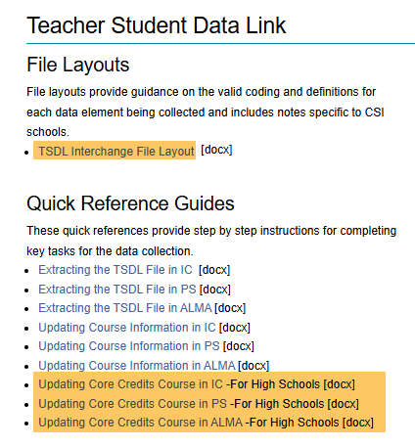
9th Grade Success & Performance Reporting-Cont.
For High Schools with 9th Graders ONLY:
  New Quick Reference Guide Available – Updating Core Credits Courses in IC and PS
    https://resources.csi.state.co.us/data-submissions/tsdl/
Notes:
There are new Quick Reference Guides available on the CSI TSDL webpage that include a step-by-step for finding the Core Credits Course data field within IC, PS and ALMA.
After viewing the quick reference guide, please reach out to CSI prior to deadline if you would like additional support.

Slide 11
Resources

Slide 12
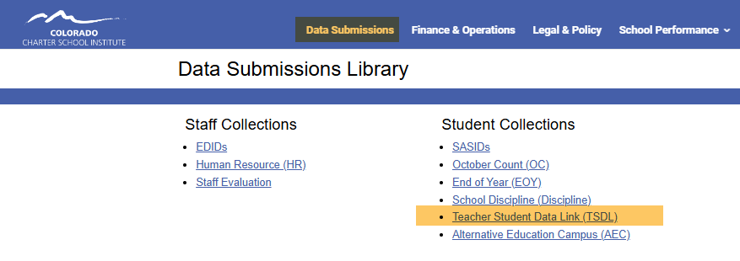
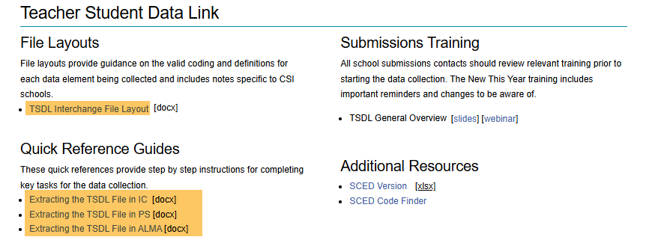
TSDL Data
https://resources.csi.state.co.us/data-submissions/tsdl/
Schools should download:
  TSDL File Layout (with CSI additions)
  Quick Reference Guide for Extracting the TSDL File from your SIS
    NOTE: When extracting your files, CSI is asking schools to use 6/30/YYYY as the “Effective Date” in IC or “Snapshot Date/End Date” in PS so all courses are included in the initial file.
Notes:
To get started on the TSDL collection, please view the TSDL webpage located in the Data Submission Library. This webpage offers important information and resources. For this collection, schools should download the TSDL File Layout as well as the Quick Reference Guides for extracting the TSDL file from IC and PS.
As a reminder, CSI is asking schools to extract TSDL files using the Effective or End date as 6/30 and the current year. This date will allow your file to include all scheduled courses for the student for the entire school year (not just the first semester or first 2 terms).
After extracting your file, please follow the instructions outlined on the Quick Reference Guide for naming the file, submitting your file to CSI through the G-Drive, and emailing CSI once your file has been submitted.

Slide 13
Errors

Slide 14
Resolving Errors
Error reports will be loaded to G-Drive under Submissions>TSDL>School Year>Error Reports
Schools will be expected to make changes directly in their SIS to resolve errors and then submit a new files to CSI
Consult the Troubleshooting Errors resource for help in clearing errors.
Early in the collection, schools will typically see the Course Completion Status field with codes 0, 6, or 7 causing TD087 errors until the end of the school year. Until final grades are completed and a new TSDL file is submitted to CSI, the TD087 errors can be ignored.
After grades are posted at the end of the school year, schools will submit a new file with final completion statuses.
Notes:
Once CSI has processed your file, you will receive an update email. If there are any errors, an error report will be placed in the G-Drive>Submission>TSDL>Error report folder.
Schools are expected to make changes directly in their Student Information System (IC, PS) to resolve errors and then extract and submit a new files to CSI.
For help with errors, consult the Troubleshooting Errors resource located in the Data Submission Library for help in clearing errors.
Early in the collection, schools will typically see the Course Completion Status field with codes 0, 6, or 7 causing TD087 errors until the end of the school year. Until final grades are completed and a new TSDL file is submitted to CSI, the TD087 errors can be ignored.
After grades are posted at the end of the school year, schools will submit a new file with final completion statuses.

Slide 15
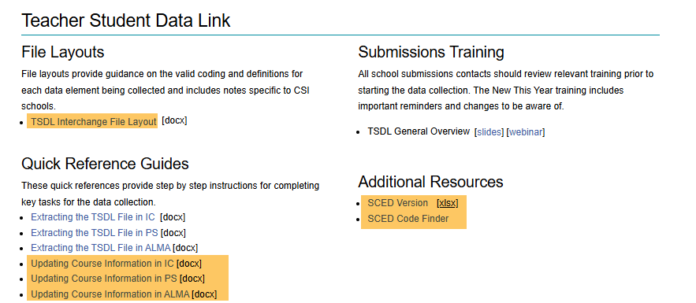
Common Errors
TD100 Errors
The Quick Reference Guide for “Updating Course Information” includes step-by-step instructions for updating the code in your SIS.
The SCED state code resources and Quick Reference Guides can be found on the CSI TSDL Resource Webpage.
Update the State Course Code in your SIS to a more current code using SCED version 12 (or higher).
https://resources.csi.state.co.us/data-submissions/tsdl/
Notes:
The most common errors are TD100 errors. This error occurs when an out-of-date state course code is used. For correcting these errors, please utilize Quick Reference Guides for Updating Course Information in IC or PS which includes a step-by-step process for locating the state course code in your SIS and how to update the code.
You will also need access to the newest SCED codes. The newest version is found on the TSDL webpage under “Additional Resources”.

Slide 16
Data Review

Slide 17
Certification
TSDL Summary Report
CSI will upload a copy of the Summary Report to G-Drive>Submission>TSDL>school year>Summary Report for schools to review and sign off on the Certification tab.
This will be the final opportunity for schools to review their data for accuracy and resubmit if needed.
CSI will send schools a Google Form Certification
Due July 8, 2026
For data submission contacts that leave for summer break, the TSDL certifications are required to CSI before leaving for the summer.
Notes:
Once your final TSDL file is submitted after the school year ends, and is error free, CSI will send a Summary Report to the G-Drive>Submission>TSDL>Summary Report. This will be your school’s final opportunity to review the data, make changes, and upload new files if needed. Once your school has confirmed accuracy, you will complete the TSDL Certification found on a Google Form Survey by the certification deadline concluding the TSDL collection.
As a reminder, for data submission contacts that leave for the summer, the TSDL certifications are required to CSI before leaving for the summer.

Slide 18
Thank you!
Email Submissions_CSI@csi.state.co.us
Notes:
Thanks so much for reviewing this training! If you have questions on any of this information, please reach out to the CSI Data submissions inbox.

