Slide 1

2025-2026 Student Conduct Files
Overview - Student Discipline, SPED Discipline, Prevent Harassment or Discrimination, and Student Restraint and Seclusion
Notes:
Welcome to the training overview for the upcoming 25-26 Student Conduct Files. This training is designed to review the Student Discipline, SPED Discipline, Prevent Harassment or Discrimination, and NEW THIS YEAR Student Restraint and Seclusion.

Slide 2
Purpose of the Student Conduct Files
Discipline Action
  Reports on student level information for both general ed and SPED students
  Students disciplined, type of behavior and resulting disciplinary action
  Data on file is used to pre-populate the Civil Rights Data Collection (CRDC – every other year)
Prevent Harassment or Discrimination
  Reports on incident level information
  Tracks number of formal reports
  Types of bias reported
  Time duration for investigation
Student Restraint and Seclusion
  Reports on student level information
  Reports on students who were handcuffed, restrained and/or secluded
Notes:
Student Conduct data is now collected in three files. The Discipline Action Interchange file reports student-level data for all state-reportable student conduct incidents. This information is used in the Student Discipline Snapshot for all students and Special Education Discipline Snapshot for students with an active IEP. Data from the Student Discipline collection is used to populate the General Resources Civil Rights Data Collection (CRDC) for LEAs, a collection that occurs every other year.
The Prevent Harassment or Discrimination (PHD) periodic collection file tracks the number of formal reports received by the school, the types of bias identified, and the time taken to investigate and finalize findings for each report. Senate Bill 23-296 defines harassment or discrimination as any unwelcome physical or verbal conduct, or any written, pictorial, or visual communication by a student or employee that is directed at a student or group of students because of their actual or perceived membership in a protected class. The data reported is incident-level data, not student-level.
The Student Restraint and Seclusion (SRS) data file will collect data previously included in the Discipline Interchange and Snapshot. Beginning in 2025-26, data on students who are restrained or secluded will be collected in a separate file, as this data is not related to student conduct disciplinary events.

Slide 3
Discipline Action File, Process, and Preparation
Notes:
Now that we have a better understanding of the purpose and files being collected, let’s take a deeper look at the Discipline Action file, the process and how you can prepare the Student Information System (SIS).

Slide 4
Discipline Action File Changes
Removed Fields
  Physical Restraint
  Mechanical Restraint
  Placed in Seclusion
Added Field
  Off Campus Behavior Flag
Updated requirements
  Discipline Start Date required for all records with a non-zero discipline action type.
  Discipline Action Type must be 00 for CRDC records
Codes
  Removed Behavior Type Code 00
Notes:
This school year, several changes have been made to the Discipline Action file.
To begin with, three fields have been removed from the file: Physical Restraint, Mechanical Restraint, and Placed in Seclusion. While this data is still being collected, it is no longer reported in the Discipline Action file. These three fields are now reported exclusively in the Student Restraint and Seclusion file.
This year, CDE has added a new field called the Off-Campus Behavior Flag. This flag can be used ONLY with Behavior Types (08, 11, and 12) when a behavior occurres off the school property.
In addition, CDE has updated requirements for existing fields:
The Discipline Start Date is now required for all records with a Discipline Action Type other than “00.”
For CRDC records (if collected in your SIS), the Discipline Action Type must be “00.”
In past years, Behavior Type Code “00” was available and commonly used. However, Behavior Type Code “00” will no longer be accepted on the Discipline Action file.

Slide 5
Discipline Snapshots – error reports
One Discipline Action Interchange file – includes all students
Two Snapshots
Level 1
Level 2
Student Discipline Snapshot
SPED Discipline Snapshot
Discipline Interchange
5
Notes:
Schools submit a single file—the Discipline Action file—which reports all discipline incidents that occurred at the school. Submitting this file generates a one Level 1 error report.
Once all Level 1 errors are resolved, two snapshots are created:
The Student Discipline Snapshot, which includes all students; and
The SPED Discipline Snapshot, which includes only students who had an active IEP at the time of the discipline incident.
New this year, CDE has moved many business rules to the Level 1 error report. As a result, schools may see an increase in Level 1 errors that must be resolved. Clearing more errors at Level 1 will reduce the number of errors that appear in the Level 2 reports. This allows for more timely error corrections earlier in the submission process.
Schools will also now see SPED-related errors on the Discipline error report. Data contacts should plan to collaborate with SPED reporting staff to resolve errors related to SPED students who had an active IEP at the time of the discipline incident.

Slide 6
Discipline Snapshots – Files Involved
Discipline Snapshot data is derived from the Discipline Interchange and other end-of-year (EOY) files.
Student Discipline Snapshot
Student School Association File
Student Demographic File
Discipline Action File
SPED Discipline Snapshot
Student School Association File
Student Demographic File
Discipline Action File
SPED Participation File
SPED Child File
Notes:
Snapshots incorporate data from the initial Discipline Action Interchange file submitted, combined with data from other sources.
For the Student Discipline snapshot, data is combined from the Discipline Action file, as well as Student Demographic and Student School Association files from the End of Year collection.
The SPED Discipline snapshot includes additional data from the SPED Child and Participation files.
This means each student with a discipline incident must be included on the schools EOY files and be Level 1 error free. Completing this collection will require some collaboration with the staff at your school responsible for the regular EOY collection and the SPED EOY collection, since a Level 2 error may require correction in other files.

Slide 7
Preparing your SIS
Ensure your Student information is on the most up-to-date version
Review vendor’s state reporting references
Review the available state reportable Behavior Codes in the SIS
  Behavior codes 01-43 should be listed in your SIS and linked to state reporting
Review the available state reportable Action/Resolution Codes in the SIS
  Action/Resolution codes 00, 10-14 should be listed in your SIS
Student Discipline - Behavior Codes
01 Drug Violation Use
02 Alcohol Violation Use
03 Tobacco Violation Use
04 1st, 2nd Degree or Vehicular Assault
05 Dangerous Weapons Carrying
06 Robbery
07 Other Felony
08 Disobedience/ Defiant or Repeated Interference
09 Detrimental Behavior
10 Destruction of School Property
11 Bullying
12 Other Violation of Code of Conduct
13 3rd Degree Assault/Disorderly Conduct
14 Marijuana Violation
15 Sexual Violence/ Battery (other than Rape)
16 Rape or Attempted Rape
Student Discipline – Action/Resolution Codes
00 N/A (used when reporting a Unilateral Removal or CRDC allegations)
10 Classroom Removal
11 In-School Suspension
12 Out-School Suspension
13 Expulsion
14 Any other form of discipline
Notes:
Ensure the Student Information System(SIS) is updated to the current version. As of January 13, some vendors are still developing the required fields, report logic and reports. Once the vendor updates are completed, vendors will release the update for your SIS.
Another great way to prepare for the Student Conduct files, is it ensure data is being entered in the SIS on a regular basis. You can do this a few different ways. Pull reports and check for entries now. Follow up with the staff member(s) entering data. If there is ever a question on data entry, please don’t hesitate to email the submissions inbox.
It’s also important to ensure your (SIS) is ready and able to report the state required information. Colorado requires that incidents with Behavior codes 01-16, be reported for the Student Discipline Snapshot and the SPED Discipline Snapshot. These behaviors require a state reportable Action code.
Behavior codes 17-43, listed in the File Layout document, are used for pre-populating CRDC data. These behaviors can only have a resulting Action code ’00’.
Each incident with a state reportable Behavior code (01-16) must have a state reportable Action code. A state reportable Behavior without a state reportable Action, or vice versa, is a very common cause of Discipline Errors. Please review this requirement with the person who enters discipline incidents.
There is a possible exception with Special Education students who have a state reportable Behavior but experiences a Unilateral Removal (00) instead of a state reportable Action (10-14). These are very rare and will be covered in more detail on the next slide. The Action code field may also be 00 filled when reporting CRDC allegations that did not result in the school choosing a discipline action.

Slide 8
Unilateral Removal Clarification
Unilateral Removal
Instances when a Special Education student is removed to an Interim Alternative Education Setting (IAES) by order of school personnel or a hearing officer, for 45 days or less. This order is not from the IEP team.
Data Reporting
Unilateral removals are very uncommon for CSI schools, maybe 1-2 per year across the portfolio.
The Discipline Action field will be zero-filled
The Removal Type and Removal Reason fields will have non-zero values
Notes:
The Unilateral Removal of a Special Education student involves unique coding requirements. This slide aims to provide some clarification. Please reach out to the Submissions inbox for additional help if you have a discipline incident you believe includes a Unilateral Removal.
By way of definition, a Unilateral Removal occurs when a Special Education student is removed to an Interim Alternative Education Setting (IAES) by order of school personnel or a hearing officer, for 45 days or less. This order is not from the IEP team.
These discipline incidents are very uncommon in CSI schools. PowerSchool and Infinite Campus have very different ways of collecting the required information. Please ask for help if you are unsure how to complete data entry. In the extracted file, the Discipline Action will be zero-filled. The Removal Type and Removal Reason will have non-zero values.

Slide 9
Determining “Most Serious” Incident
Incident Ranking: Most Severe to Less Severe (a guide)
This ranking is intended as guidance only. Incidents can vary in seriousness on a case-by-case basis that would deviate from the order listed.
1st, 2nd Degree or Vehicular Assaults
Rape or Attempted Rape
Dangerous Weapons - Unless weapon was used to inflict death or serious bodily injury in which case it would be reported under the 1st, 2nd Degree or Vehicular Assaults category.
Sexual Violence/Battery (other than Rape)
3rd Degree Assaults/Disorderly Conduct
Robbery
Other Felony (not reported in another descriptive category)
Bullying (New code for 2022-2023 Collection)
Detrimental Behavior
Drug Violations
Marijuana Violations
Alcohol Violations
Destruction of School Property
Disobedient/Defiant or Repeated Interference
Tobacco Violations
Other Violations of Code of Conduct
Notes:
When an incident includes multiple violations, school officials must use local judgment to determine which behavior is the most serious for reporting purposes. While the Colorado Department of Education provides guidance, final discretion rests with the school. Generally, criminal code violations are more serious than non-criminal behaviors; crimes against persons are more serious than crimes against property; and felonies are more serious than misdemeanors. The guidance applies only to incidents with multiple violations and is intended to support decision-making, not to rigidly rank all incidents.

Slide 10
Discipline Action Timeline

Slide 11
Discipline Action File Timeline
  3/3: Initial File Submittal
  4/1: Updated Discipline Action file submittal
  5/13: Discipline Level 1 Errors Cleared
  6/2: Level 2 Errors Cleared
  Last Day of School – Review last file submitted and resubmitted file if there have been changes since level 2 Errors were cleared
  June 8-15 – CSI will provide Data Summary Report to School
  6/19: Any Changes must be received by CSI
  6/23: Submit Signed Certification Agreement to CSI
Be sure to review the 25-26 Data Submissions Calendar for all collection deadlines and watch the Weekly Update email for the latest announcements and other details related to the Discipline collections.
Printable Calendar: https://resources.csi.state.co.us/data-submissions/calendar/
Online Calendar: www.csi.state.co.us/calendar/
Notes:
CDE has moved up the deadline for the initial Discipline Action file by nearly two months compared to last year. The initial file is now due on March 3rd, followed by Level 1 error clearance by May 13th and Level 2 error clearance by June 2nd. Schools should use this earlier timeline to ensure sufficient time for reviewing and correcting data throughout the spring.
For schools that have cleared all errors prior to the last day of school, it is critical to review the most recently submitted and resubmitted a file IF any additional discipline incidents have occurred since the last submitted file. CSI will provide a Data Summary Report to schools between June 8th and June 15th. Any changes to the data must be submitted to CSI by June 19th, and the signed Certification Agreement is due no later than June 23rd.
Please be sure to monitor the Weekly Update email for the most current announcements and additional details related to the Student Discipline collection.

Slide 12
Prevent Harassment or Discrimination File, Process, and Preparation
Notes:
Now, let’s review the Prevent Harassment or Discrimination (PHD) file and process, and how to prepare your Student Information System (SIS). There are no changes to the file layout or reporting requirements from last year to this school year. This is the second year of PHD reporting, and all vendors should have the required fields and reports in place. The data collected is reported at the incident level, not the student level.
Harassment or discrimination means any unwanted physical or verbal behavior, or any written, visual, or online message, by a student or employee that targets a student or group of students because of their actual or perceived membership in a protected group. Protected groups include disability, race, creed, color, sex, sexual orientation, gender identity or expression, family composition, religion, age, national origin, or ancestry. The behavior must be offensive to a reasonable person from the same protected group, and it does not have to be severe or repeated to be considered harassment or discrimination.
The Prevent Harassment or Discrimination (PHD) periodic collection file tracks the number of formal reports received by the school, the types of bias identified, and the time taken to investigate and finalize findings for each report. Public schools must accept formal reports of harassment or discrimination in writing or in person, as well as by phone, email, or online form. All formal reports received by the school must be reported, even in cases where no bias is ultimately found.

Slide 13
Preparing your SIS
Ensure your Student information is on the most up-to-date version
Review vendor’s state reporting references
Review the available state reportable Behavior Codes in the SIS
  Behavior codes 18-43 should be listed in your SIS and linked to state reporting
  For Infinite Campus: Make sure the Behavior Event Category ‘Investigation’ is available.
Review the available state reportable Action/Resolution Codes in the SIS
  Action/Resolution options are listed in your SIS.
  For PowerSchool: Check to see if the Bias lists appears when behavior Codes Bully/Harassment 18-43 is selected
  For Infinite Campus: Make sure the Behavior Resolution Category ‘Investigation’ is available.
Notes:
Ensure the SIS is updated to the current version. Check that all required fields are available and functioning as expected.
Last year, many schools using the Infinite Campus (IC) SIS experienced issues pulling PHD data into the report. Please verify that PHD information has been entered and test running the report.
If the data does not appear as expected, you may want to review the step-by-step document CSI created on completing the PHD setup and data entry: “IC-Prevent-Harassment-or-Discrimination-Setup-and-Data-Entry-Entering.” This document is available under Systems Resources on the Student Conduct page.
Opening a support ticket with Infinite Campus is always an option; however, resolution can sometimes take time. Testing your IC report as early as possible will help ensure you stay on track with PHD deadlines.
Another important way to prepare for the Student Conduct files is to ensure data is being entered into the SIS on a regular basis. You can do this by pulling reports and checking for entries now, and by following up with staff members responsible for data entry. If questions arise about data entry, please don’t hesitate to reach out.

Slide 14
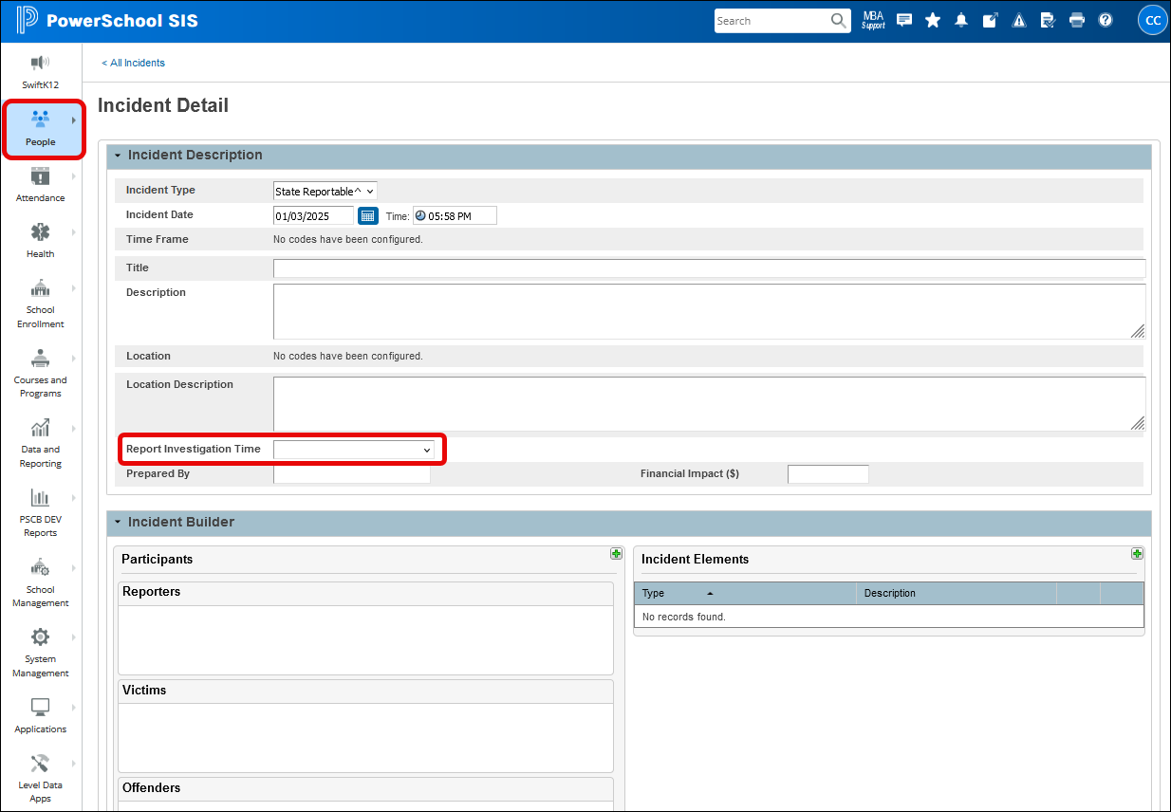
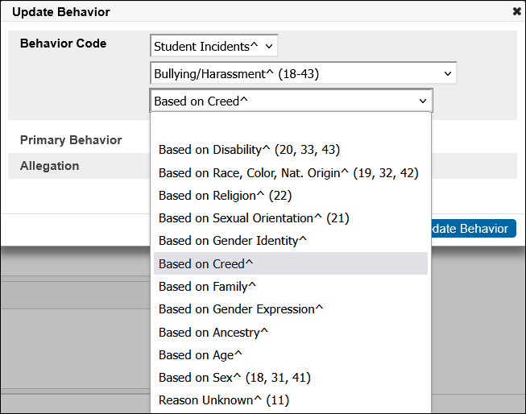
PowerSchool data entry –
Prevent Harassment or Discrimination
14
Notes:
In PowerSchool the data is collected in one place and reported as needed in each file extract.
The Report Investigation Time field is found in the Incident Description area, when creating an Incident Report.
They have incorporated the required Bias Types within the Behavior Code element, under Bullying/Harassment codes 18-43. These were originally set up for CRDC reporting and now include additional sub codes for Prevent Harassment or Discrimination.
14

Slide 15
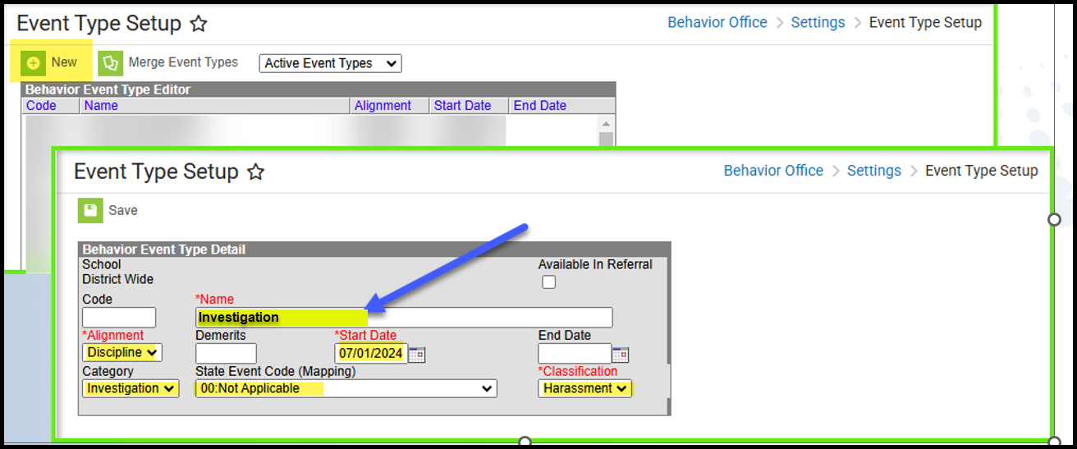
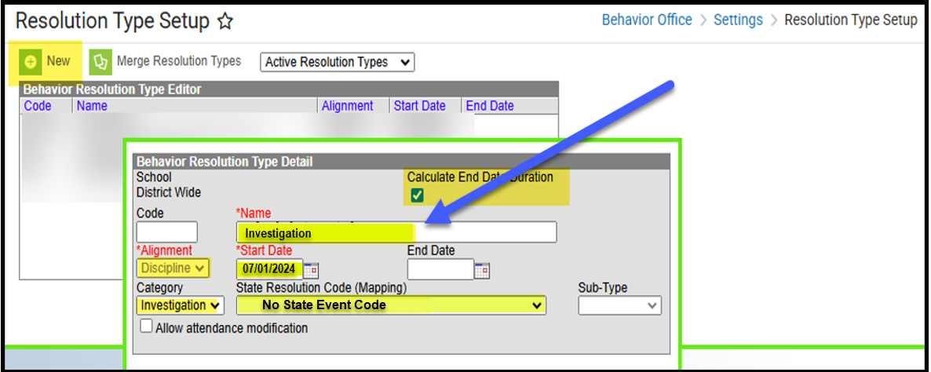
Infinite Campus data entry –
Prevent Harassment or Discrimination
15
Notes:
In Infinite Campus, you will need to create an Event and then add a Resolution. All highlighted fields are required and must be completed.
If you do not see the correct options in the dropdown menus, there is a strong possibility that your IC system is not fully set up. CSI has created a step-by-step guide on completing the PHD setup and data entry titled “IC-Prevent-Harassment-or-Discrimination-Setup-and-Data-Entry-Entering.” This document is listed under Systems Resources on the Student Conduct page.
15

Slide 16
Prevent Harassment or Discrimination Timeline

Slide 17
PHD File Timeline
  4/28: Initial File Submittal
  6/3: Errors Cleared
  Last Day of School: Review last file submitted and resubmitted file if there have been changes
  June 8-15 – CSI will provide Data Summary Report to School
  6/18: Any Changes must be received by CSI
  6/23: Submit Signed Certification Agreement to CSI
Be sure to review the 25-26 Data Submissions Calendar for all collection deadlines and watch the Weekly Update email for the latest announcements and other details related to the Discipline collections.
Printable Calendar: https://resources.csi.state.co.us/data-submissions/calendar/
Online Calendar: www.csi.state.co.us/calendar/
Notes:
The initial PHD file is due on April 28th, with all identified errors required to be cleared by June 3rd. This timeline allows schools time to review and correct their data before the close of the school year.
For schools that have cleared all errors prior to the last day of school, it is critical to review the most recently submitted and resubmitted the file IF any additional PHD entries have occurred since the last submission. CSI will provide a Data Summary Report to schools between June 8th and June 15th. Any final changes must be received by CSI no later than June 18th. The process concludes with the submission of the signed Certification Agreement, which is due to CSI by June 23rd.
Please continue to monitor the Weekly Update emails for important reminders and additional information related to the PHD data collection.

Slide 18
Student Restraint and Seclusion File, Process, and Preparation
Notes:
Finally, let’s review Student Restraint and Seclusion. During the 2024–25 school year, Student Restraint and Seclusion (SRS) data was collected through the Student Discipline snapshot. Beginning in the 2025–26 school year, restraint and seclusion data will be collected through a separate Student Restraint and Seclusion data file. This new file will include data previously reported through the Discipline Interchange and Snapshot, as well as data collected under the Protection of Persons from Restraint Act (PPRA). The change reflects that restraint and seclusion incidents are not disciplinary events and should be reported separately.
Restraint and seclusion are not forms of discipline. They may be used only in emergency situations when a student’s behavior poses an immediate risk of harm. These actions should be used only after less restrictive options—such as positive behavior supports, verbal de-escalation, or changes to the environment—have been tried and did not work, or when those options are clearly not appropriate for the situation.
Restraint or seclusion must never be used to punish a student or to force compliance. If they are used, school staff must use the least amount of force necessary, use them only for as long as needed, and always focus on keeping the student safe and preventing harm.

Slide 19
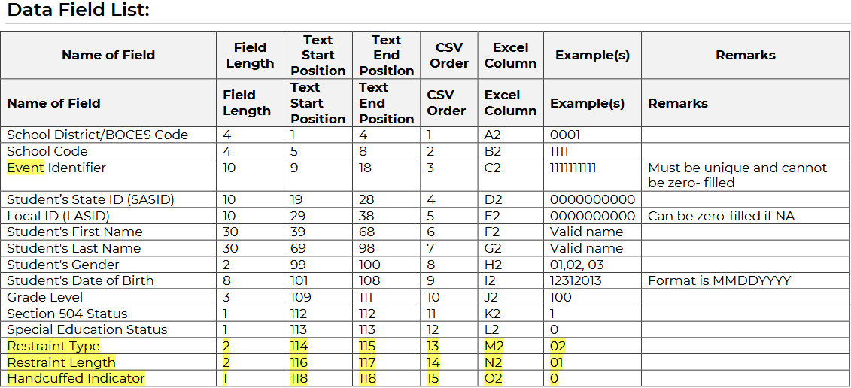
File Layout and Requirements
Notes:
The Student Restraint and Seclusion file reports student-level data. Each record (Event Identifier) represents a student restraint whether it be physical, seclusion, mechanical, or prone. Each occurrence represents one record in the data file.
Many of the required fields should already be stored in your SIS as they are used for multiple data submissions.

Slide 20
Codes and Descriptions
Restraint Type
Physical restraint is when someone uses their body to restrict a student’s movement for more than one minute.
01 – Physical
02 – Seclusion
03 – Mechanical
04 – Prone
Restraint Length
00 – N/A (less than one minute)
01 – More than one minute but less than five minutes
02 – Five minutes or more
Handcuffed Indicator
Handcuffed indicator is required to be reported with code 0 or 1 for records where restraint type is mechanical (code 03). For all other Restraint Types, use code 2 for N/A.
0 – No (handcuffs not used)
1 – Yes (handcuffs used)
2 – N/A
Notes:
To ensure consistent reporting and compliance, it’s important to understand how restraint types, restraint length, and handcuff use are defined for reporting purposes.
Physical restraint occurs when staff use their body to restrict a student’s movement for more than one minute. Interventions lasting one minute or less, holding a student to calm or comfort them, or minimal contact used to escort a student or help them complete a task are not considered physical restraint and should not be reported as such.
Seclusion occurs when a student is placed alone in a room or area they cannot leave. Seclusion is considered a type of restraint. It does not include a time-out, where a student is removed from a situation but remains free to leave.
Mechanical restraint involves using a physical device to restrict a student’s movement or the normal function of part of their body. This does not include medical, protective, adaptive, or positioning devices that are recommended by a licensed professional and approved through the student’s IEP or Section 504 plan.
Prone restraint means holding or restraining a student face-down.
In addition to restraint type, schools must report the length of the restraint, using the appropriate code based on whether it lasted less than one minute, more than one minute but less than five minutes, or five minutes or more.
Finally, the handcuffed indicator is only required when the restraint type is mechanical. Use code 0 if handcuffs were not used, code 1 if handcuffs were used, and code 2 for not applicable when reporting any other restraint type.

Slide 21
Preparing your SIS
Ensure your Student information is on the most up-to-date version
Review vendor’s state reporting references
Review the available state reportable fields in the SIS
Note: Vendors are still working to update their SIS functions to accommodate this new data file.
Notes:
As of January13th, PowerSchool has scheduled the release update for the Student Restraint and Seclusion fields and report for January 28, 2026. Infinite Campus has yet to confirm a release date. ALMA is on track to have their report ready in April.

Slide 22
Student Restraint and Seclusion Timeline

Slide 23
Student Restraint and Seclusion File Timeline
  4/29: Initial File Submittal
  6/3: Errors Cleared
  Last Day of School: Review last file submitted and resubmitted file if there have been changes.
  June 8-15 – CSI will provide Data Summary Report to School
  6/18: Any Changes must be received by CSI
  6/23: Submit Signed Certification Agreement to CSI
Be sure to review the 25-26 Data Submissions Calendar for all collection deadlines and watch the Weekly Update email for the latest announcements and other details related to the Discipline collections.
Printable Calendar: https://resources.csi.state.co.us/data-submissions/calendar/
Online Calendar: www.csi.state.co.us/calendar/
Notes:
The initial SRS file is due on April 29th, with all identified errors required to be cleared by June 3rd. Again, this timeline allows schools to review and correct their data before the close of the school year.
For schools that have cleared all errors prior to the last day of school, it is critical to review the most recently submitted and resubmitted the file IF there have been any additional SRS occurrences since the last submitted file. CSI will provide a Data Summary Report to schools between June 8th and June 15th. Any final changes must be received by CSI no later than June 18th. The process concludes with the submission of the signed Certification Agreement, which is due to CSI by June 23rd.
Please continue to monitor the Weekly Update emails for important reminders and additional information related to the SRS data collection.

Slide 24
Resources

Slide 25
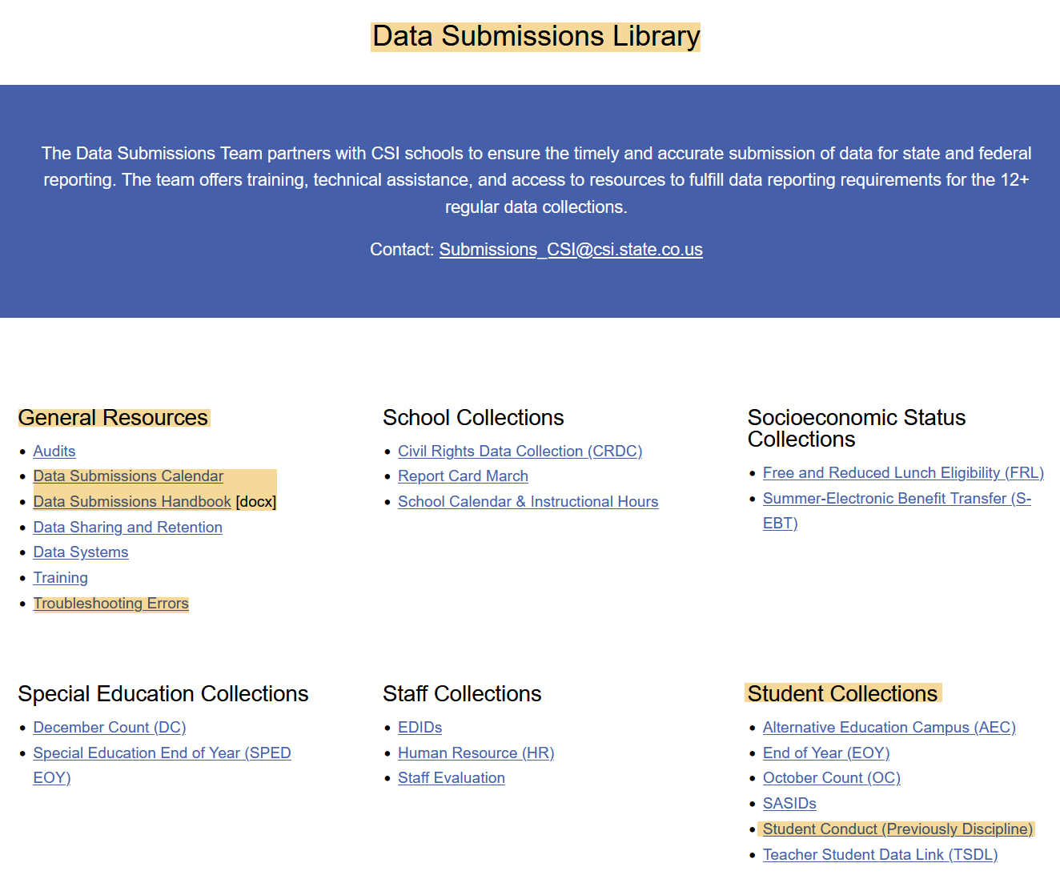
Collection Prep Resources
https://resources.csi.state.co.us/data-submissions/
25
Notes:
Collection Prep refers to the steps taken before an upcoming data collection to ensure you have the knowledge needed for success. Key resources, found under General Resources on the Data Submission Library webpage, include:
Data Submissions Calendar: Lists important dates such as initial file submission, Level 1 and 2 error clearance, and signed certification. Reviewing it regularly helps you stay on track with deadlines.
Data Submissions Handbook: Updated annually, this comprehensive guide is recommended for all new and returning staff.
Troubleshooting Errors spreadsheet: Provides a current list of possible errors and tips for correcting them; details will be discussed later.
Additional Resources are available on the Student Conduct page.

Slide 26
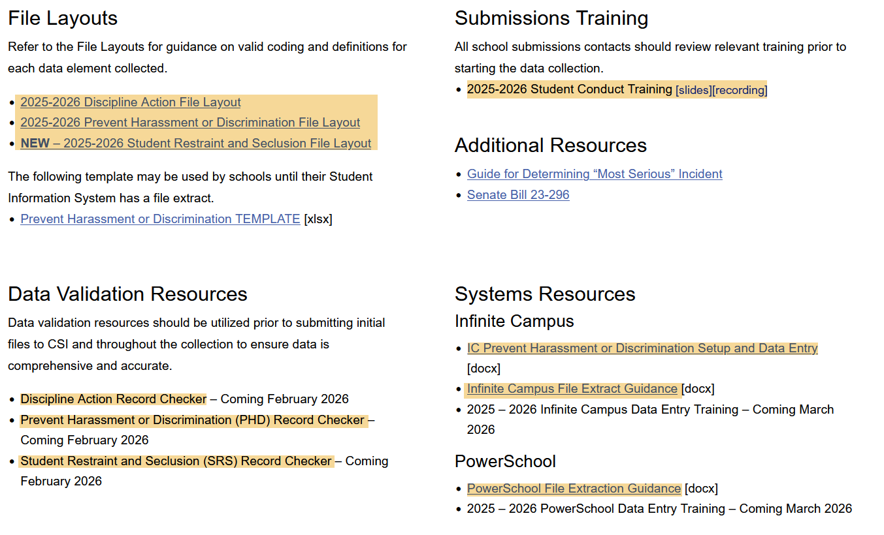
Student Conduct Page
https://resources.csi.state.co.us/data-submissions/student-conduct/
26
Notes:
On this page, you will find the File Layout and Definition documents for all three files. These documents provide detailed guidance to support you through data collection and reporting.
You will also find the training slides, which include clickable links, and some System Resources for Infinite Campus and PowerSchool. Once vendors have the required fields and reports ready, CSI will quickly develop data entry trainings.
Finally, a Record Checker Tool (RCT) is available for all three files. The RCT flags missing data and potential errors to help reduce mistakes and save time on initial submission.

Slide 27
File Extraction, Naming and Sharing
School Code_School name/abbreviation_interchange type_date
1234_XYZ_DisciplineAction_03182026
1234_XYZ_PHD_04282026
1234_XYZ_SRS_04292026
  In Google Drive:
  Submissions → School Discipline → 25-26 → Files to Run
  Submissions_CSI@csi.state.co.us
Notes:
After extracting your file, locate it in your Downloads folder. Do not open the file directly, as this can remove leading zeros and cause errors. Move the file to your desired folder and rename it following the CSI naming convention: start with the school code, school abbreviation, file type, and date. If submitting a second file the same day, add V2 at the end. Do not use spaces in file names—files with spaces cannot be processed in CDE’s Data Pipeline.
Next, you can run the file through the Record Checker Tool before submission. Then, copy the file to the CSI Google Drive and notify CSI via the Submissions email.

Slide 28
Errors

Slide 29
Resolving Errors
Error reports will be loaded to G-Drive under Submissions → School Discipline → School Year → Error Reports
Consult the Troubleshooting Errors resource for help in clearing errors.
Schools will be expected to make changes directly in their SIS to resolve errors and then submit a new file to CSI
Notes:
After files are submitted to CSI, they are processed through the CDE Data Pipeline, and an Error Report is generated. The report is placed in the Error Reports folder, and an email notification is sent when it’s ready for review.
For help resolving errors, consult the CSI Troubleshooting Errors resource, which is updated as CDE releases new Business Rules. If you still need assistance, contact Submissions email.
Schools are expected to make changes directly in their Student Information System to resolve errors and then extract and submit a new file to CSI.

Slide 30
Final Data Review
Summary/certification report will be provided once error free
Steps to complete:
  Review each tab thoroughly to determine accuracy of data
  If accurate, ensure all parties have signed and return signed Certification
      School Leader, Data Submissions Coordinator, SPED Coordinator (SPED Discipline), and Primary Discipline Contact (School Discipline)
  If errors are found reach out to CSI for assistance
  Once data is accurate, sign and return prior to the due date.
  Summary reports for School Discipline:
  School Discipline→25-26→ Summary Certification
Notes:
After all errors are cleared, CSI will provide a Summary and Certification Report in the G-Drive. Completing the Summary report is required, but it’s also a valuable opportunity to review your data in full. The report should be reviewed by the Data Submissions contact, the School Leader, and any other relevant staff. This is the final chance for edits. Once the review is complete, print, sign, and return the Certification tab by the due date.

Slide 31
Thank you for reviewing this training.
Submissions_CSI@csi.state.co.us
Notes:
Thank you for reviewing this training. If you have questions on any of this information, please reach out to the CSI Data submissions inbox.

