Slide 1

NUTRITION & WELLNESS
GRADES 9-12

Slide 2
Introduction
Welcome to Nutrition & Wellness.
What we will cover:
FOOD GROUPS: Food science divides food into categories; macronutrients and micronutrients.
BRAIN FUEL: What does your brain need to function properly.
HOW TO READ LABELS: Reading about calories, nutrients, serving sides and daily percentages.
HOW MUCH SUGAR IS TOO MUCH?: Recommended daily limits and looking for “added sugars”.
EXERCISE; Just move your body, choose an activity that you prefer.
WATER; How much to drink.
HEALTH AT EVERY SIZE (HAES) Acceptance of all body sizes and shapes.

Slide 3
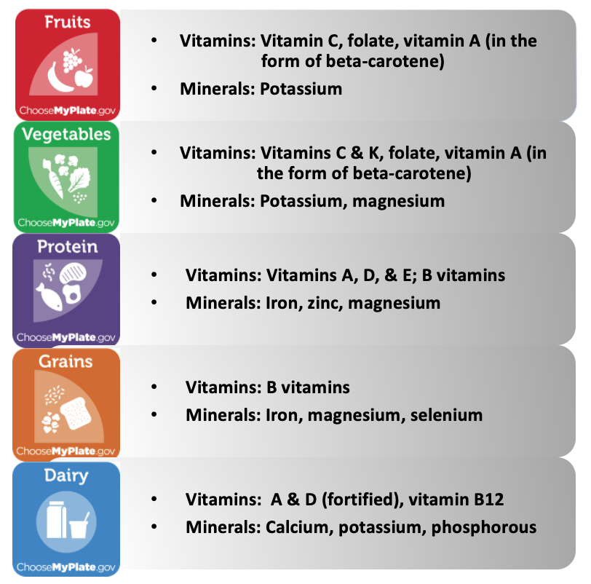
FOOD GROUPS

Slide 4
NUTRITION
Nutrition is broken into two categories;
MACRONUTRIENTS
Protein
Fat
Carbohydrates
MICRONUTRIENTS
Vitamins
Minerals

Slide 5


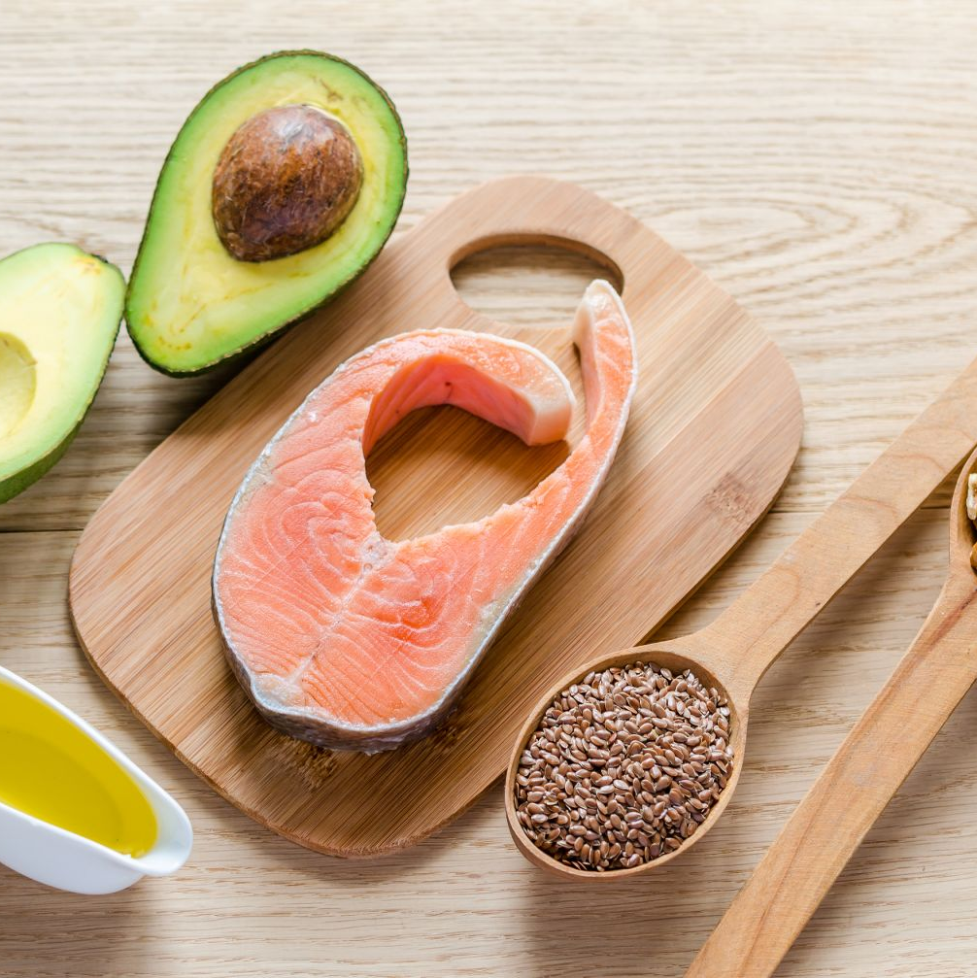
Macronutrients
PROTEIN (amino acids)
Carbohydrates
fats

Slide 6
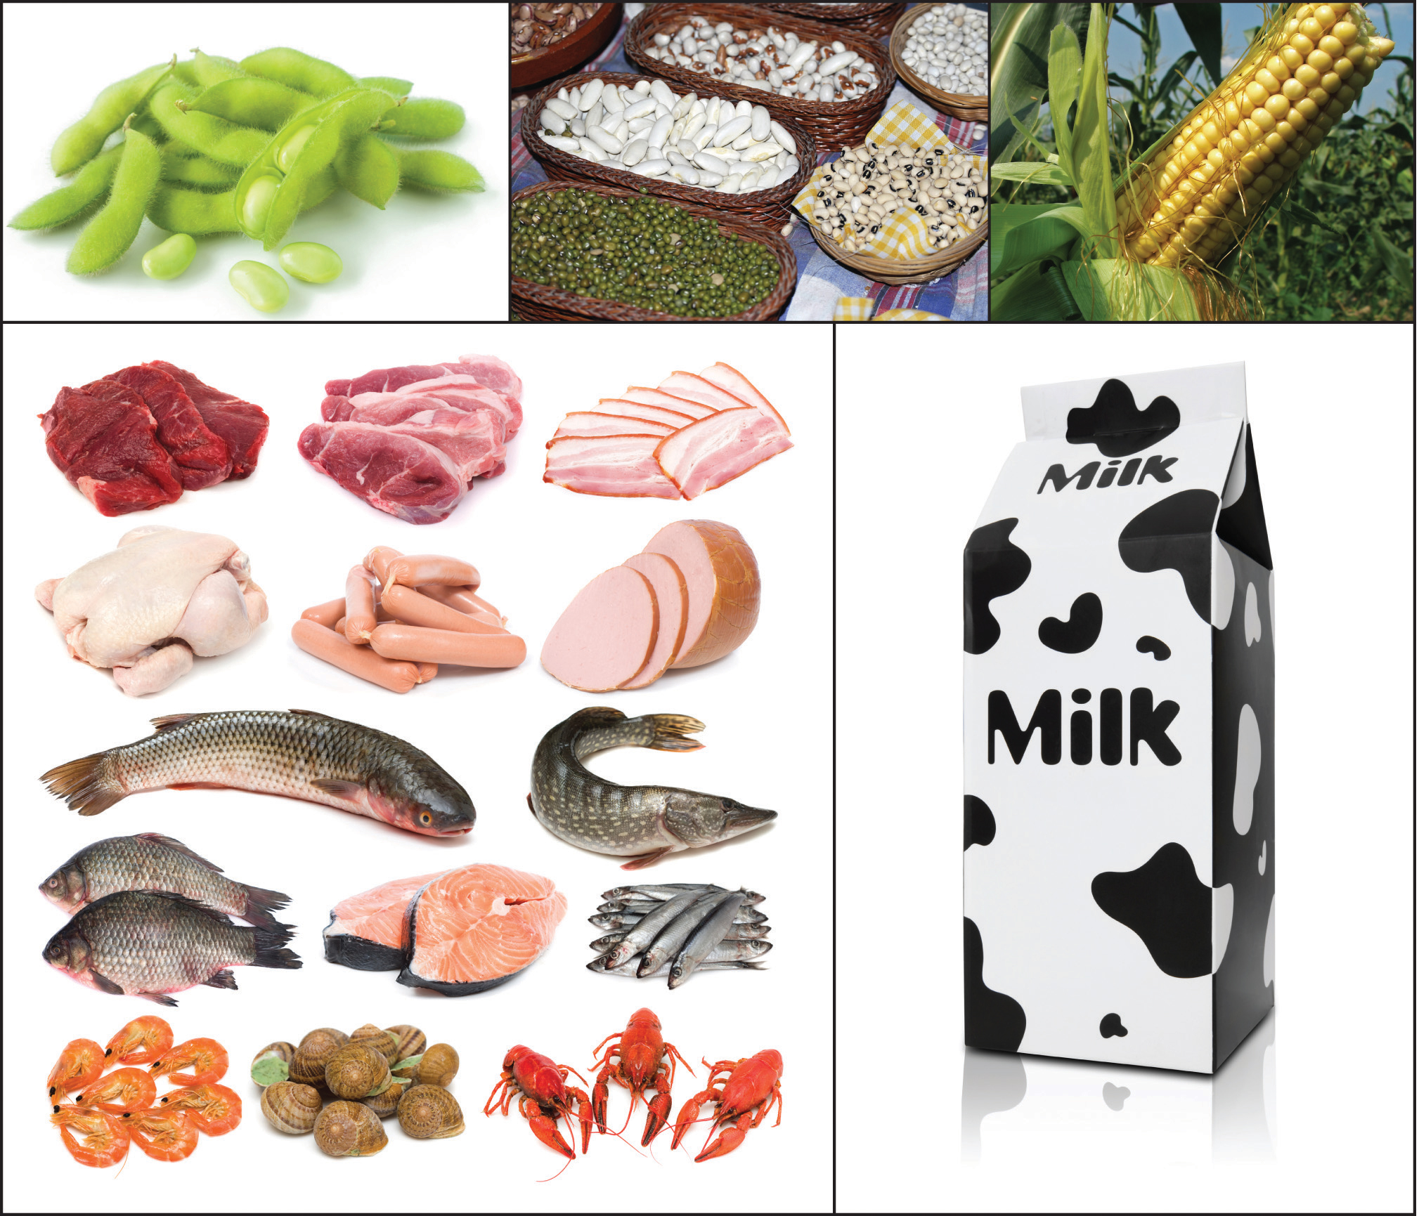
Proteins
ESSENTIAL AMINO ACIDS; Essential amino acids are amino acids that the human body cannot synthesize and must be obtained from the diet. They are crucial for various bodily functions, including protein synthesis, tissue repair, and nutrient absorption.
1) Histidine, isoleucine, leucine, lysine, methionine, phenylalanine, threonine, tryptophan, and valine.
NON-ESSENTIAL AMINO ACIDS; Nonessential amino acids are amino acids that the human body can synthesize (produce) on its own, so they do not need to be obtained from the diet. There are 11 nonessential amino acids:
1) Alanine, arginine, asparagine, aspartic acid, cysteine, glutamic acid, glutamine, glycine, proline, serine, and tyrosine.
Notes:
Essential amino acids are amino acids that the human body cannot synthesize and must be obtained from the diet. They are crucial for various bodily functions, including protein synthesis, tissue repair, and nutrient absorption.
Nonessential amino acids are amino acids that the human body can synthesize (produce) on its own, so they do not need to be obtained from the diet. There are 11 nonessential amino acids:

Slide 7
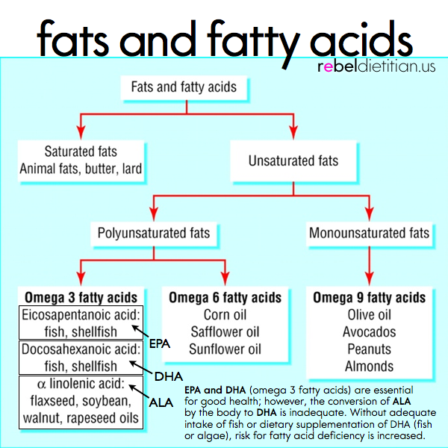
Fatty acids
“GOOD FATS”: UNSATURATED FATS
“BAD FATS”: SATURATED AND TRANS FATS
Notes:
Fats are broken down into saturated and unsaturated fats. Good fats, also known as unsaturated fats, are essential for overall health and well-being. They include:
Monounsaturated Fats (MUFAs):
Olive oil
Avocados
Nuts (e.g., almonds, peanuts)
Seeds (e.g., sunflower seeds, flaxseeds)
Polyunsaturated Fats (PUFAs):
Omega-3 fatty acids (found in fatty fish like salmon, tuna, and walnuts)
Omega-6 fatty acids (found in vegetable oils like sunflower oil, soybean oil)
Benefits of Good Fats:
Reduce the risk of heart disease by lowering bad (LDL) cholesterol and increasing good (HDL) cholesterol
Improve brain function and cognitive health
Reduce inflammation
Support hormone balance
Promote satiety and help control weight
Sources of Good Fats:
Plant-based foods: nuts, seeds, fruits (e.g., avocados, olives), vegetables (e.g., broccoli, cauliflower)
Animal-based foods: fatty fish, eggs
Note: It's important to consume good fats in moderation as they are still high in calories. Additionally, avoid trans fats, which are unhealthy and linked to an increased risk of heart disease.

Slide 8
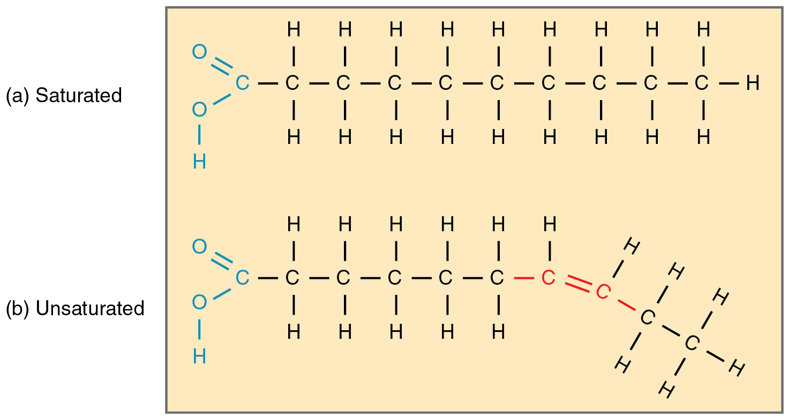
ORGANIC STRUCTURE OF FATTY ACIDS
Notes:
Just for fun! Look at the carbohydrate backbones. Saturated fats are “FULL” of hydrogens, there are no double bonds. Due to the chemistry of their makeup, this determines how they get broken down in the digestive system and why we see them as good or bad. Unsaturated fatty acids have one or more double bonds in their carbon chain, causing a "kink" that makes them liquid at room temperature and better for heart health by preventing artery clogs. They are broken down through a hydrolysis reaction that uses enzymes and water to separate the fatty acids from the glycerol backbone.

Slide 9
SATURATED FATS – “Bad” fats
Structure: Have no double bonds between carbon atoms and are saturated with hydrogen atoms, giving them a straight, linear shape.
Properties: Typically solid at room temperature.
Sources: Found in butter, fatty cuts of meat, cheese, and palm and coconut oils

Slide 10
UNSATURATED FATS-”good fats”
Structure: Contain one or more double bonds between carbon atoms.
Properties: Typically liquid at room temperature due to a bent or "kinked" formation caused by the double bonds.
Types:
Monounsaturated: Have one carbon-carbon double bond. Examples include olive oil and canola oil.
Polyunsaturated: Have more than one double bond. Examples include omega-3 and omega-6 fatty acids.
Essential fatty acids: A type of polyunsaturated fatty acid that the body cannot produce on its own and must get from the diet, such as alpha-linolenic acid (ALA) and linoleic acid.

Slide 11
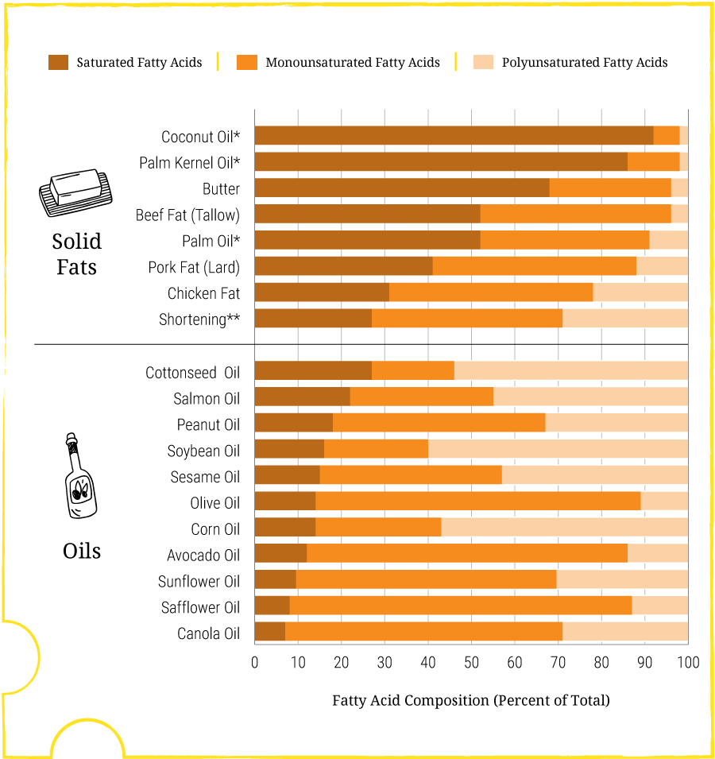
SATURATED AND UNSATURATED FATS
Notes:
Solid fats tend to have more saturated fatty acids. Whereas, liquid fats, also known as oils, contain higher amounts of Mono- and Poly-unsaturated fatty acids. In this representation, the solid fats have higher amounts of bad fat and liquid oils tend to have more of the good fats. Thus, the solid fats are higher in saturated fatty acids.

Slide 12
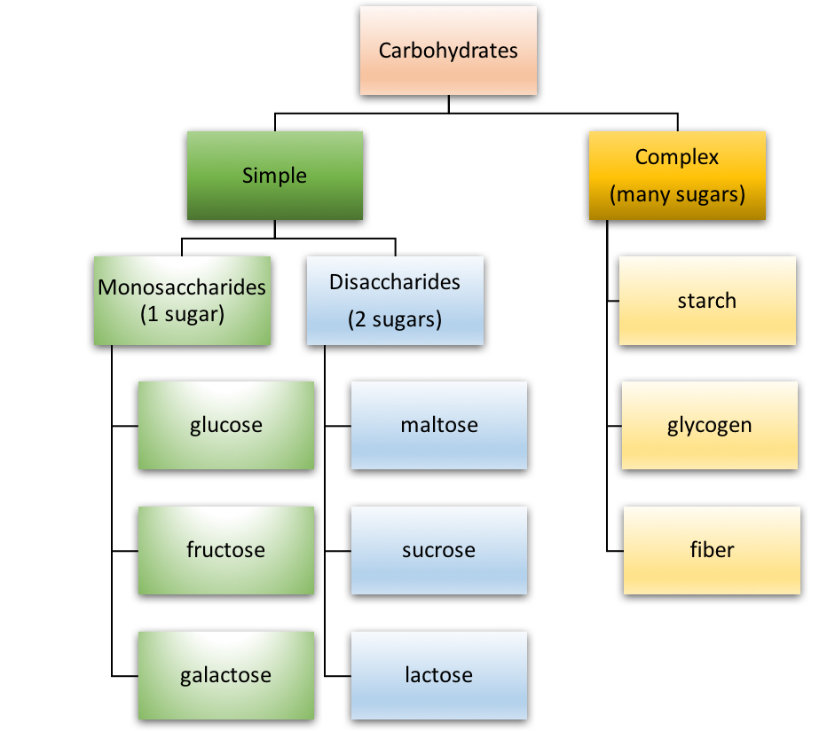
Carbohydrates
Notes:
Carbohydrates, also known as sugars, are essential nutrients that provide energy to the body. They can be classified into two main types: simple sugars and complex sugars.
Simple Sugars
Also called monosaccharides and disaccharides
Consist of one or two sugar units
Easily digested and absorbed by the body
Examples: glucose, fructose, sucrose (table sugar), lactose (milk sugar), maltose
Complex Sugars
Also called polysaccharides
Consist of multiple sugar units linked together
Take longer to digest and absorb
Examples: starch (found in potatoes, rice, and bread), fiber (found in fruits, vegetables, and whole grains)

Slide 13
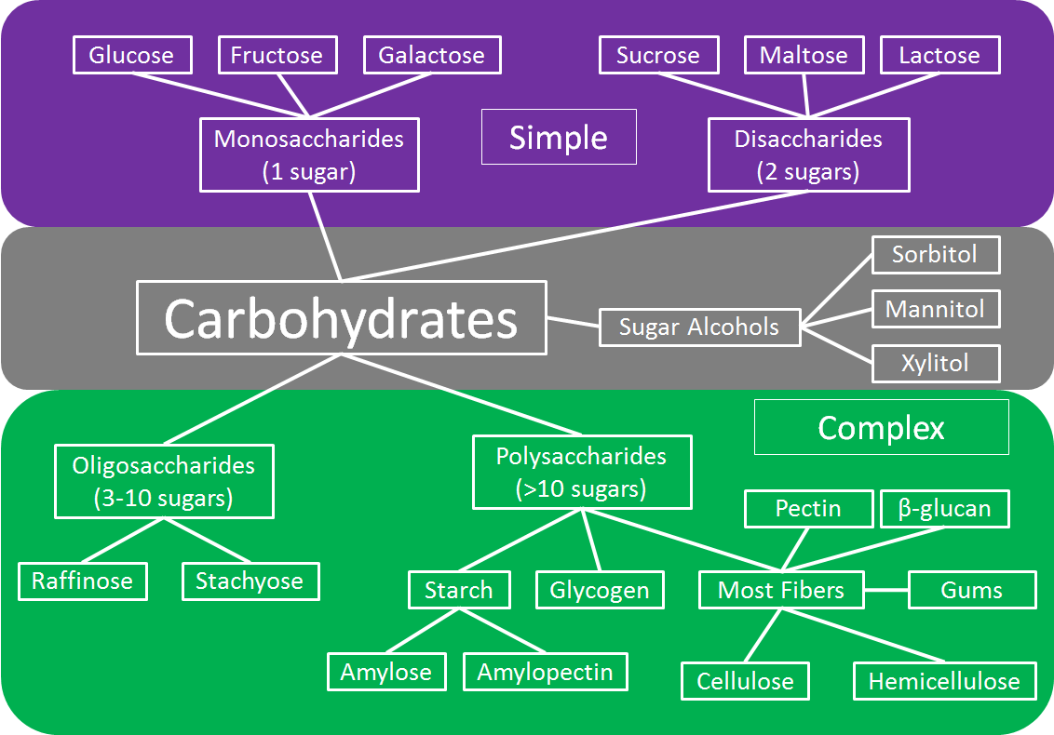
Carbohydrates cont.
Carbohydrates;
Complex
Oligosaccharides
Polyscharrides
Simple
Monosaccharides
Disaccharides
Notes:
Carbohydrates, also known as sugars, are essential nutrients that provide energy to the body. They can be classified into two main types: simple sugars and complex sugars. Simple Sugars
Also called monosaccharides and disaccharides
Consist of one or two sugar units
Easily digested and absorbed by the body
Examples: glucose, fructose, sucrose (table sugar), lactose (milk sugar), maltose
Complex Sugars
Also called polysaccharides
Consist of multiple sugar units linked together
Take longer to digest and absorb
Examples: starch (found in potatoes, rice, and bread), fiber (found in fruits, vegetables, and whole grains)

Slide 14
Micronutrients
1) VITAMINS: Vitamins are substances that your body needs to grow and develop normally. There are 13 vitamins your body needs. They are: Vitamin A. B vitamins (thiamine, riboflavin, niacin, pantothenic acid, biotin, vitamin B-6, vitamin B-12 and folate)
2) MINERALS: Minerals are naturally occurring, inorganic solids with a specific chemical composition and crystal structure that are the building blocks of rocks. They are used in a wide range of applications, from construction and electronics to jewelry, and are also essential nutrients for the human body, supporting functions like bone health, muscle contraction, and nerve transmission.

Slide 15
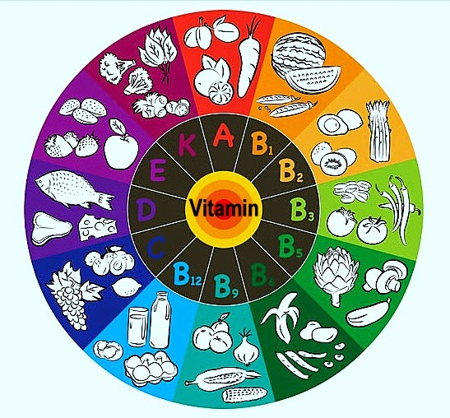
Vitamins
Notes:
Good visual for what vitamins you can find in different foods. Go through and talk about the foods you see in the different vitamins.

Slide 16
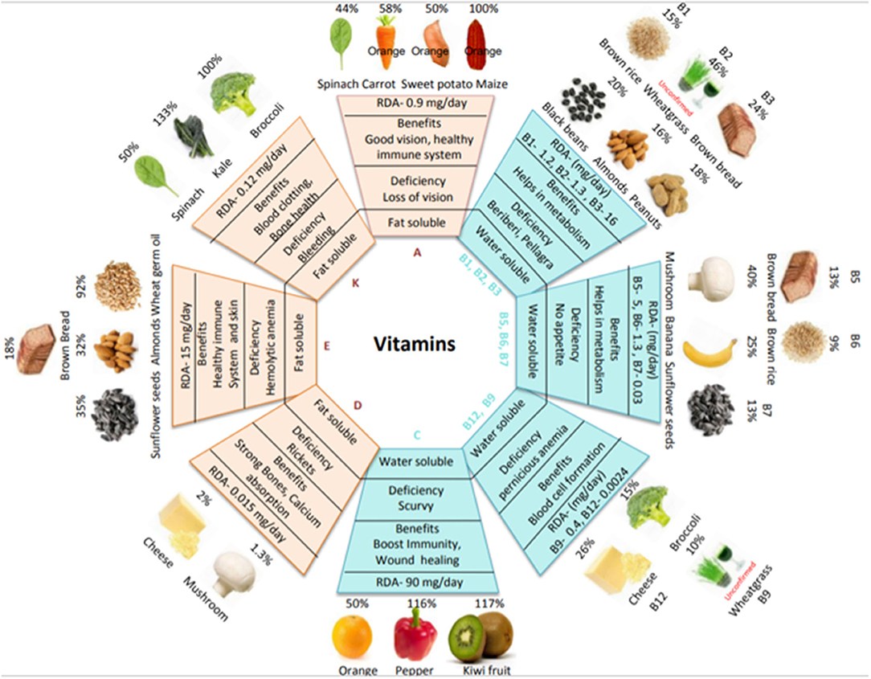
Vitamins cont.
BENEFITS,
Deficiencies &
Daily
recommendations

Slide 17
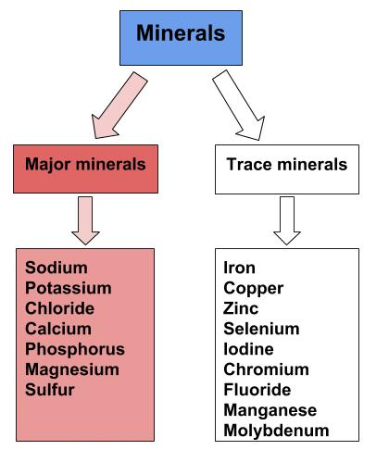
minerals
Notes:
Minerals are divided into two groups; major minerals and trace minerals. Major minerals can affect the physiological processes of the body. For example, sodium is a mineral that we have to watch, especially in any population that has heart or kidney disease, because it raises blood pressure, which can put you at risk for these diseases and be harmful to kidneys, blood vessels and heart. When there is too much pressure in the hose (blood vessels), the heart has to pump harder and the very tiny capillaries of our blood vessels can be damaged, causing damage in organs and extremities. Major minerals are also known as macrominerals and are required in larger amounts (over 100 mg per day). They are essential for building and maintaining bones, teeth, muscles, and regulating fluid balance. Major minerals are primarily involved in structural and skeletal functions, while trace minerals have diverse physiological roles.

Slide 18
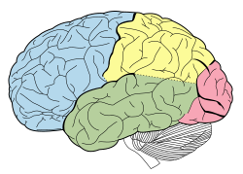
FUEL YOUR BRAIN WITH NUTRIENTS
Glucose is the MAIN FUEL SOURCE for your brain
Simple sugar derived from carbohydrates that you eat.
Your brain requires a steady supply of glucose from the blood stream, because your brain cannot store it.
Under certain conditions, such as fasting, the brain can switch to KETONES as an alternative fuel.
Complex carbs, like whole grains, are broken down into glucose
The brain is a very energy-intensive organ, using about 20-25% of the body’s total glucose supply, even at rest.

Slide 19

OTHER NUTRIENTS YOUR BRAIN NEEDS
OMEGA-3 FATTY ACIDS: Found in fatty fish, walnuts and flaxseeds. These are critical for brain cell structure and support memory and learning.
B VITAMINS: Essential for energy production and synthesizing neurotransmitters. B vitamins (B6, B12 and folate) may help prevent cognitive decline and improve mood. Good sources include leafy greens, eggs, lean meats, and whole grains.
ANTIOXIDANTS: Vitamins C and E, along with other compounds found in fruits and vegetables, like berries, help protect the brain from damage caused by oxidative stress.
PROTEIN: The building blocks for neurotransmitters that affect mood, focus and cognitive abilities.
MINERALS: Zinc is important for nerve signaling. Iron is vital for many brain functions. Magnesium helps regulate neurotransmitter release.
VITAMIN D: Helps brain produce mood stabilizing neurotransmitters.
WATER: Dehydration can lead to fatigue, brain fog and difficulty concentrating, so staying hydrated is crucial for cognitive function.

Slide 20

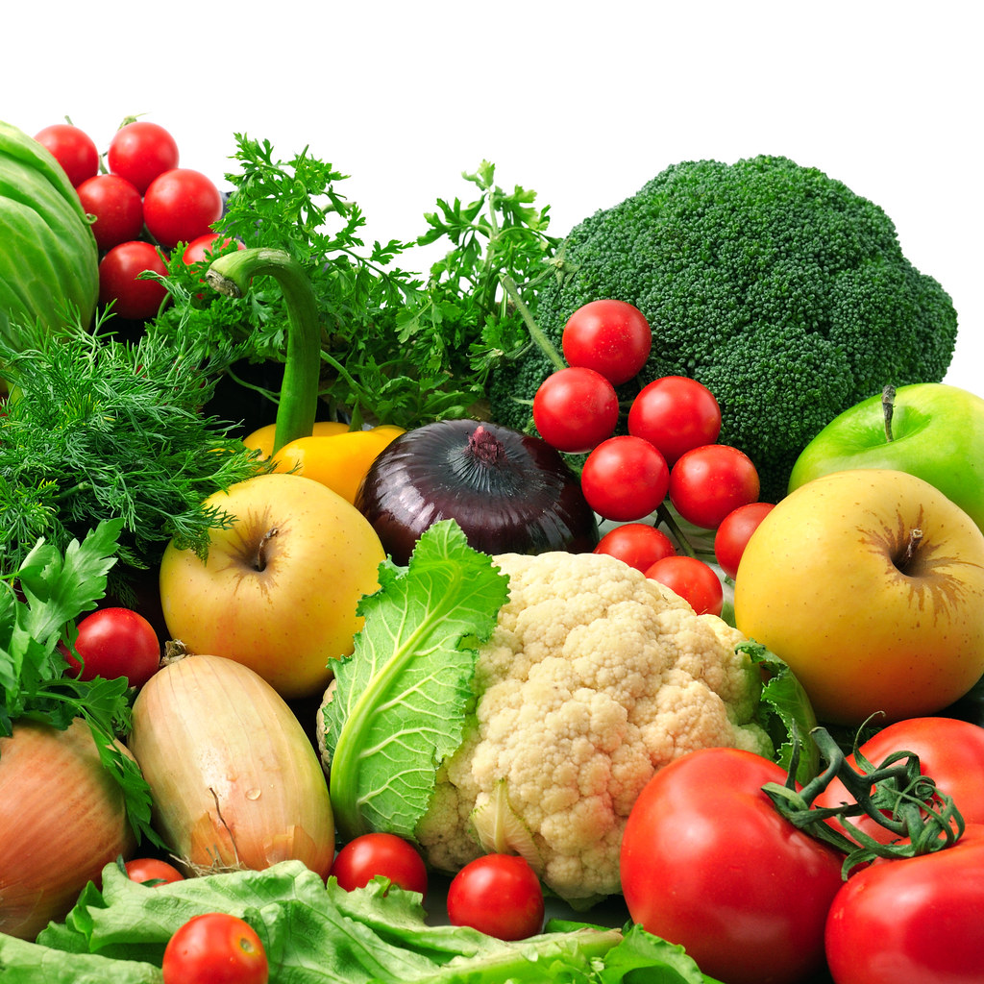
EAT THE RAINBOW
DIFFERENT COLORS SIGNIFY DIFFERENT NUTRIENTS.
Eat all of the colors to get all of your nutrients.
This Photo by Unknown Author is licensed under CC BY
Notes:
Eating all of the different colors of fruits and vegetables ensures that you get all of your nutritional needs. They each specifically contain different nutrients according to the color. For example, beta-carotene is the reason that carrots (and oranges, etc.) are orange. To ensure that you get all of your vitamins and minerals, you have to rotate and vary the fruits and vegetables that you eat. They each have health benefits, just like those carrots with the beta-carotene are important for vision.

Slide 21



Eat the rainbow; The nutrients in the different colors
Orange/Yellow
PuRPle/BLue
Green
Rich in beta-carotene (converts to vit A) and vitamin C
Rich in antioxidants, fiber, vitamin A, and other phytonutrients such as beta-carotene
Rich in vitamins (like A, C, K, and folate), minerals (such as potassium, iron, and magnesium), fiber, and beneficial phytonutrients like lutein, chlorophyll, and isothiocyanates.
Notes:
ORANGE/YELLOW; Fruits and vegetables in the orange and yellow color are rich in beta-carotene (converts to vit A) and vitamin C. PURPLE/BLUE; Fruits and vegetables that are blue/purple contain high amounts of antioxidants, fiber, vitamin A, and other phytonutrients such as beta-carotene. GREEN; Green fruits and vegetables are Rich in vitamins (like A, C, K, and folate), minerals (such as potassium, iron, and magnesium), fiber, and beneficial phytonutrients like lutein, chlorophyll, and isothiocyanates.

Slide 22
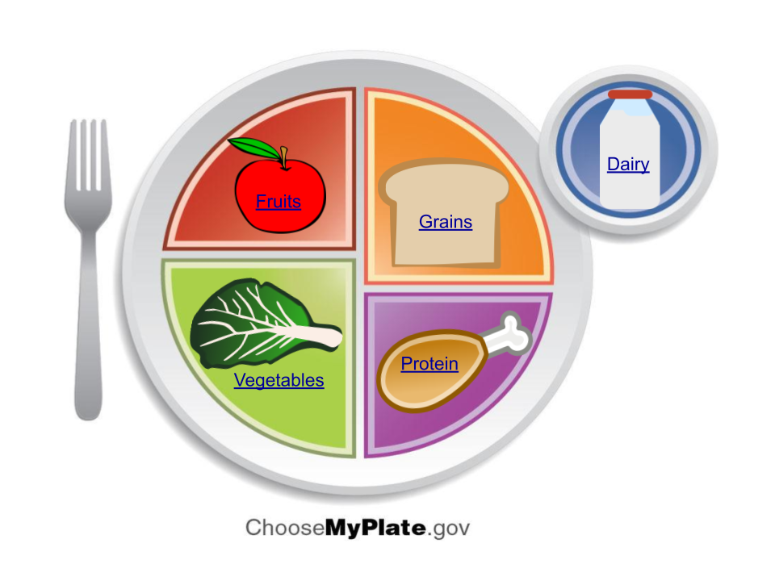
MY PLATE: how to build your plate with these portion sizes. Myplate.Gov
Notes:
This is the visual portions of each food group, representing how much you should eat of each type. Visualize what you want to put on your plate and how you can fill these categories.

Slide 23
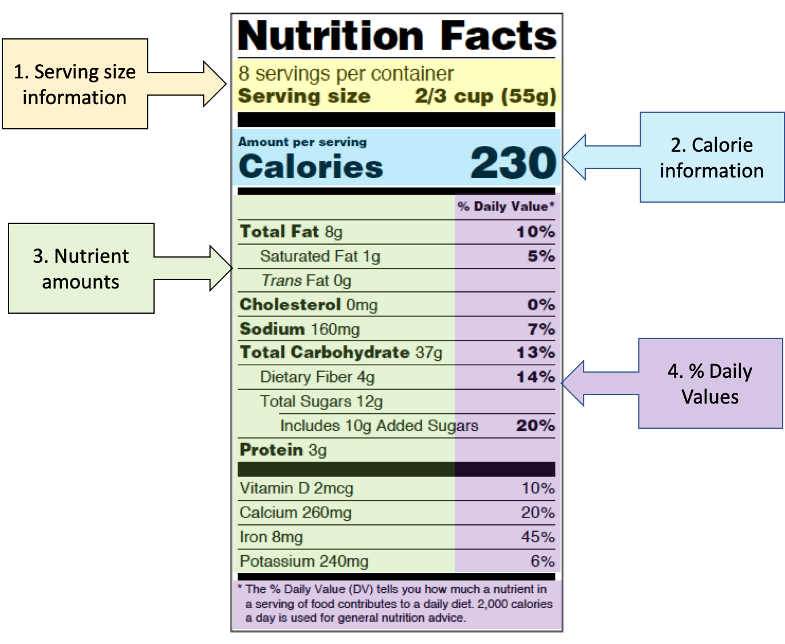
HOW TO READ FOOD LABELS
Notes:
1) serving size; this information can tell you how much is in each serving. For this case, it is 2/3 cups or 55g. The nutritional information to follow is all based off of this serving size. Therefore, for every 2/3 cup of this item, you get calories, nutrients and daily values. 2) Calories; Per serving of 2/3 cups, you get 230 calories. If you were to eat 2 servings, that would be 460 calories (in 1 ½ cups). 3) Nutrients; this tells you how many grams of the different nutrients there are in the food. It includes macronutrients (protein, fat, carbohydrates) and micronutrients (vitamins and minerals). 4) Daily Values; This is how much of this specific nutrient you are getting per serving of the daily recommended amounts for the whole day. If it says 10%, it means that you ate 10% of your daily needs in this specific nutrient (for example fat) for the day for every serving you eat.

Slide 24
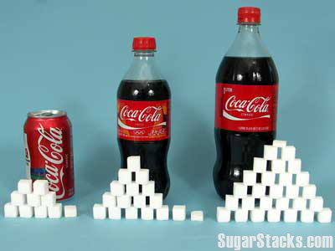
HOW MUCH SUGAR?
For teenagers, it is recommended to limit added sugar intake to less than 10% of daily calories, or about 25 grams (6 teaspoons) for a 2,000-calorie diet.
One 12 oz. can of coke contains 39 grams of sugar.
WATCH OUT FOR ADDED SUGARS ON LABELS.

Slide 25

WATER
Daily; 6.5-8.5 cups (approximately 1.6-2 L)
Our bodies are made up of 50-70% water.
Functions; hydration, regulating temperature, lubricating joints and tissues, and transporting nutrients and oxygen to cells.
Notes:
For teenagers (ages 14–18), the recommended total daily fluid intake is generally 6.5 to 8.5 cups (approximately 1.6–2.0 liters) for girls and 8.5 to 11 cups (approximately 2.0–2.6 liters) for boys. These amounts are guidelines and vary based on individual factors such as activity level, climate, and overall health. To ensure adequate hydration, encourage drinking water throughout the day, especially before, during, and after exercise, and consume fruits and vegetables to supplement water intake.

Slide 26



EXERCISE: GET 30 MINUTES OF MOVEMENT EACH DAY
YOGA
WALKING
WEIGHTS
Notes:
Reinforce that any type of exercise, activity or movement is positive. How do the different students enjoy physical activity?

Slide 27
Exercise
Engaging in 30 minutes of regular exercise daily offers numerous benefits for both physical and mental health.
Physical Health:
Weight management: Exercise burns calories and helps maintain a healthy weight.
Improved cardiovascular health: Reduces the risk of heart disease, stroke, and high blood pressure.
Stronger bones and muscles: Exercise strengthens bones and muscles, reducing the risk of fractures and osteoporosis.
Reduced pain: Exercise can help manage chronic pain conditions, such as arthritis and back pain.
Increased flexibility and mobility: Regular movement improves flexibility and range of motion.

Slide 28
Benefits
EXERCISE BENEFITS
Mental Health:
Reduced stress and anxiety: Exercise releases endorphins, which have mood-boosting effects.
Improved sleep quality: Exercise promotes deeper and more restful sleep.
Enhanced cognitive function: Exercise can improve memory, attention, and problem-solving skills.
Reduced risk of depression and mood disorders: Regular physical activity has been shown to have antidepressant effects.

Slide 29
EXERCISE BENEFITS
Other Benefits:
Increased energy levels: Exercise boosts energy levels and improves overall vitality.
Improved immune function: Exercise can strengthen the immune system and reduce the risk of illness.
Prolonged lifespan: Studies have shown that regular exercise can increase life expectancy.

Slide 30
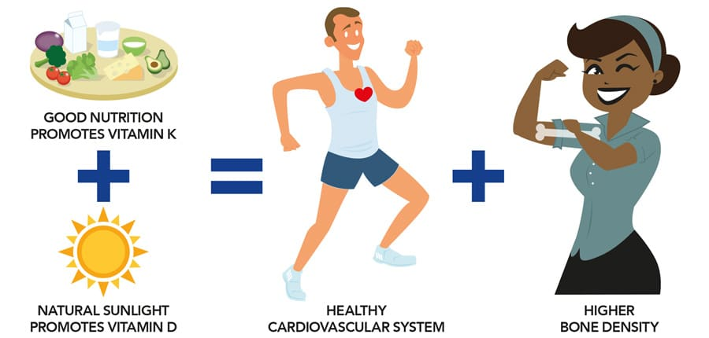
Health

Slide 31
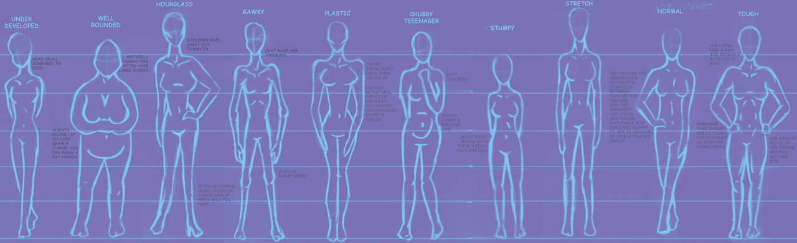

HEALTH AT EVERY SIZE (HAES)
Anti-fat and Anti-diet belief system
Finding health and self-acceptance at all sizes
Skinny doesn’t always mean healthy, just like large sizes don’t always equal unhealthy. Everyone has a unique body and healthy weight point.
Making progress to phase out fat bias (that people of all sizes experience in the medical field). Everyone deserves equal healthcare without bias.
Notes:
Promoting positive body image in a society that emphasizes ”skinny”. Health and worth does not depend on the number on the scale, but how you feel energetically and about yourself. HAES is working to combat these stigmas by emphasizing anti-fat and anti-diet ideas and movements. The overweight population encounters bias from the community and health care providers. The idea is that all deserve equal healthcare, regardless of their size.

Slide 32
Video
https://www.youtube.com/watch?v=ATlf99m0Hfs

Slide 33

Questions?
“Health is Wealth”

Slide 34
Non-discrimination Statement
In accordance with federal civil rights law and U.S. Department of Agriculture (USDA) civil rights regulations and policies, this institution is prohibited from discriminating on the basis of race, color, national origin, sex (including gender identity and sexual orientation), disability, age, or reprisal or retaliation for prior civil rights activity.
Program information may be made available in languages other than English. Persons with disabilities who require alternative means of communication to obtain program information (e.g., Braille, large print, audiotape, American Sign Language), should contact the responsible state or local agency that administers the program or USDA’s TARGET Center at (202) 720-2600 (voice and TTY) or contact USDA through the Federal Relay Service at (800) 877-8339.
To file a program discrimination complaint, a Complainant should complete a Form AD-3027, USDA Program Discrimination Complaint Form which can be obtained online at: https://www.usda.gov/sites/default/files/documents/USDA-OASCR%20P-Complaint-Form-0508-0002-508-11-28-17Fax2Mail.pdf, from any USDA office, by calling (866) 632-9992, or by writing a letter addressed to USDA. The letter must contain the complainant’s name, address, telephone number, and a written description of the alleged discriminatory action in sufficient detail to inform the Assistant Secretary for Civil Rights (ASCR) about the nature and date of an alleged civil rights violation. The completed AD-3027 form or letter must be submitted to USDA by:
mail: U.S. Department of Agriculture Office of the Assistant Secretary for Civil Rights 1400 Independence Avenue, SW Washington, D.C. 20250-9410; or
fax: (833) 256-1665 or (202) 690-7442; or
email: program.intake@usda.gov
This institution is an equal opportunity provider.

