Slide 1

2025-2026 Summer EBT Submissions Information
Notes:
Welcome to the S-EBT collection recorded by the CSI data submission team.

Slide 2
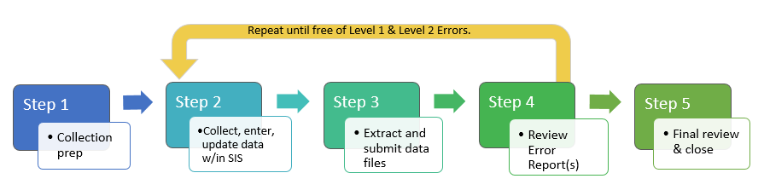
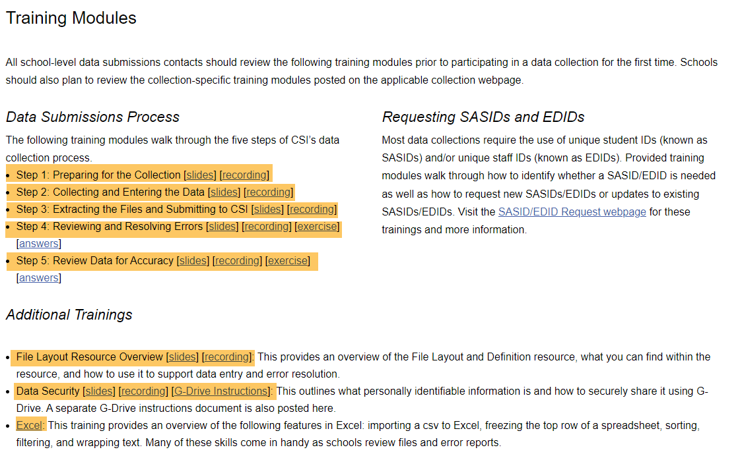
The Data Submissions Process
https://resources.csi.state.co.us/data-submissions/training/
2
Notes:
If you are new to data submissions or returning and would like a refresher, we encourage you to review the training modules on the General Data Submissions Resources page of our website. These trainings are designed to guide you through the data submission process.

Slide 3
Purpose of S-EBT
To reduce hunger over the summer when school is not in session.
Summer EBT helps qualifying families buy food during the summer months when school is not in session. Eligible families with receive $40/month per child ($120 total) to purchase groceries with funds placed on an EBT card.
Some Requirements of S-EBT
All students enrolled during the school year up through February 25, 2025, should be reported regardless of their FRL status for the initial submission.
FRL status must be establish in the current school year. Carryover status will not be accepted.
Notes:
This is the third year for Summer EBT. S-EBT helps qualifying families buy food during the summer months when school is not in session.
All students currently enrolled in your school must be included on your data file regardless of their FRL status. For a student to qualify for S-EBT the FRL status must be established in the 25-26 school year. For more details on requirements please see the 25-26 S-EBT Instructions for Schools located on the CSI website.

Slide 4
How to Prepare Your SIS for S-EBT
Review student data in your SIS:
Student Primary Mailing Address
Primary Student Contact is accurate
First and Last name, Phone Number,
Student’s Language background in completed
Ensure your SIS is updated to the latest version
Pull a test file to ensure the reports is available and reporting the correct information
Confirm families that think they may qualify, complete a federal meal application for NSLP participating schools or a free and reduced-price meal program or family economic data survey (FEDS form).
Make sure you have the latest FRL statuses are entered in your SIS
Confirm carryover status from October Count have been updated to the accurate coding. *Carryover statuses do NOT qualify for S-EBT.
Notes:
Here are a few things you can do to ensure your SIS is ready for the S-EBT submission. Please be sure to review the students’ primary mailing addresses and the students' primary contacts. Confirming the primary mailing addresses are accurate will be an important step to ensure the benefit card will be received by mid May. Likewise, double checking the students’ primary contact’s phone number will be important if there is an issue with mailing the benefit card. This will ensure the state has a way to reach out to the family during the summer.
You can also be proactive by confirming your SIS is updated to the latest version and by pulling a test file to confirm the report is working accurately within your SIS.
CSI schools should also ensure families complete the applicable forms and updated the SIS prior to submitting the file.
Please note, student carryover status from the 24-25 school year will NOT qualify for S-EBT. Carryover statuses from October Count should be updated in your SIS prior to submitting your first file.

Slide 5
Timeline

Slide 6
S-EBT Timeline
February:
2/5: Initial Submission Deadline
2/19: Errors Cleared
2/26: Certifications Due
Printable Calendar: https://resources.csi.state.co.us/data-submissions/calendar/
Online Calendar: www.csi.state.co.us/calendar/
Notes:
This collection has a tight turn around. CDE made this adjust to the timeline to ensure benefits could be received by mid May.
We are asking our schools to submit their initial file by February 5th. Clear all errors by February 19th and review data and sign the Certification of Assurance by February 26th.

Slide 7
Resources

Slide 8
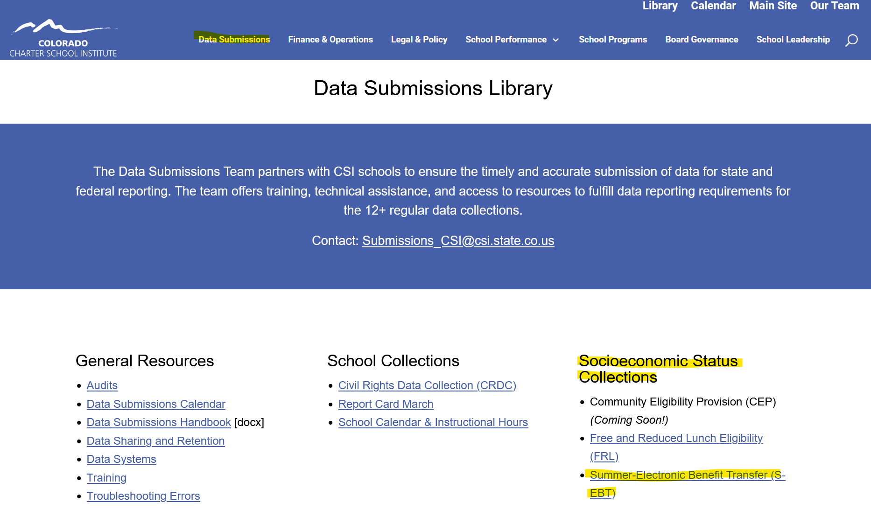
S-EBT Data
https://resources.csi.state.co.us/data-submissions/sebt/
Schools should download:
S-EBT File Layout
Quick Reference Guide for extracting the S-EBT file from your SIS
Name the file with the following format: school code_schoolAbbreviation_SEBT_currentdate. Example: 1234_XYZ_SEBT_02052026
Notes:
To get started on the S-EBT collection, please view the S-EBT webpage located in the Data Submission Library on the CSI site. This webpage offers important information and resources. For this collection, schools should download the S-EBT File Layout as well as the Quick Reference Guides for extracting the S-EBT file from IC and PS.
After extracting your file, please follow the instructions outlined on the Quick Reference Guide for naming the file, submitting your file to CSI through the G-Drive, and emailing CSI once your file has been submitted.

Slide 9
Errors

Slide 10
Resolving Errors
Error reports will be loaded to G-Drive under Submissions>S-EBT>School Year>Error Reports
Schools will be expected to make address changes directly in their SIS to resolve errors and then submit a new file to CSI
Consult the Troubleshooting Errors resource for help in clearing errors.
Notes:
Once CSI has processed your file, you will receive an update email. If there are any errors, an error report will be placed in the G-Drive>Submission>S-EBT>Error report folder.
Schools are expected to make changes directly in their Student Information System to resolve errors and then extract and submit a new file to CSI.
For help with errors, consult the Troubleshooting Errors resource located in the Data Submission Library for help in clearing errors.

Slide 11
Data Review

Slide 12
Certification
S-EBT Summary Report
CSI will upload a copy of the Summary Report to G-Drive>Submission>S-EBT>school year>Summary Report for schools to review and sign off on the Certification tab.
This will be the final opportunity for schools to review their data for accuracy and resubmit if needed.
CSI will send schools a Google Form Certification
Due February 26, 2026
Notes:
Once your final S-EBT file is submitted and is error free, CSI will send a Summary Report to the G-Drive>Submission>S-EBT>Summary Report. This will be your school’s final opportunity to review the data, make changes, and upload new files if needed. Once your school has confirmed the data is accurate, you will need to complete the S-EBT Certification via a Google Form Survey by February 26, 2026. This will conclude the initial phase of the S-EBT collection.

Slide 13
Correction Period
Students enrolled after you have completed the submission and signed off on the data, can be submitted during a corrections period expected to take place May 19, 2026 - September 3, 2026.
Benefits will be delayed for any student submitted in the correction period.
Plan to submit the file for students enrolled after February 25th prior to leaving for the Summer.
An email reminder will go out the beginning of May to all Data contacts.
Notes:
The corrections period will open May 2026 and remain open until early September 2026. This correction period is for students becoming eligible after you have completed the initial submission and signed off on the data in February, and before the end of the school year. These correction files will need to be submitted via G-Drive S-EBT folder files to run. Please notify CSI Submissions once new files has been placed.
We will send out an email reminder of the correction period at the beginning of May. Please plan to submit corrections prior to leaving for summer break to better ensure students and families can received the needed benefits.

Slide 14
Thank you!
Email Submissions_CSI@csi.state.co.us
Notes:
Thank you for reviewing this training. If you have questions on any of this information, please reach out to the CSI Data submissions inbox.

