Slide 1

School Assessment Coordinator Orientation
2025-26

Slide 2

Agenda
SAC Role
SAC Logistics
Training Requirements
State Assessments
Misadministrations & Current Research
Q&A

Slide 3
Objectives
Understand the role and responsibilities of a SAC
Identify required trainings
Understand assessment management systems
Recognize upcoming state assessment updates and timelines

Slide 4
Assessment Resources
School Assessment Coordinator Guide – The “need-to-know” essentials for SACs
State Assessments Quick Reference – Overview of state assessments
Critical Dates and Deadlines – Some dates to take note of throughout the year
School Training Checklist – Content requirements and considerations for training school staff
State Assessment Calendar – Annual assessments and tentative testing windows

Slide 5
SAC Resources
SAC Training Schedule – Required sessions with dates, times, and registration links
LearnWorlds Quick Reference – Quick steps for signing up and accessing courses

Slide 6
SAC Role

Slide 7
Role Overview
Primary contact for all state-mandated assessments; liaison between schools and CSI/CDE
Ensures compliance with policies, test security, and ethical practices
Requires dedicated time, especially Jan-May
Each school must designate at least one SAC (recommended: one primary who delegates or very close communication between two)
May overlap with ELD, SPED, or Data Respondent(s) but SAC remains ultimately responsible for coordination and compliance

Slide 8
Core Responsibilities
Compliance & Security – Test security, irregularities, chain-of-custody, documentation
Training & Communication – Train staff, share updates, maintain calendar
Preparation – Schedules, rosters, accommodations, tech readiness
Administration – Day-of logistics, troubleshooting, monitor security
Post-Testing – Materials return, verification, share results

Slide 9
Training Requirements
Annual training required for all personnel involved in state assessments
SACs should create a plan for training all staff early in the school year to map out logistics and timelines
Trainings must include state guidance and school-specific policies (e.g., Electronic Device Policy)
Signed documentation of completion is required

Slide 10
Annual Coordinator Trainings
SAC Orientation
State Assessment Accommodations
WIDA ACCESS
Additional training in WIDA Secure Portal
CMAS
CoAlt
Additional training in Kite Educator Portal
PSAT/SAT completed in College Board professional account
All trainings virtual on Zoom (check spam folder for email invitations)
LearnWorlds training modules available

Slide 11
Systems & Structures

Slide 12
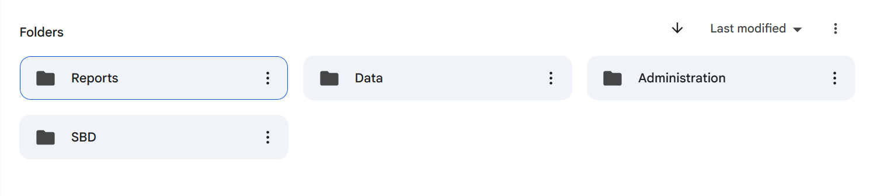
Google Drive (G Drive)
Use:
Share information or data with student Personally Identifiable Information (PII)
Content:
Assessment data files (e.g., growth, achievement, School Performance Framework (SPFs) Reports)
SBD files
Documents with student first and last names, SASIDs, birthdates, or other PII (e.g., testing irregularity forms, Unique Accommodation Requests)
Please do NOT email

Slide 13
Epicenter
CSI’s system for school operations, compliance, and contact information
School Leaders upload key documents (e.g., handbooks with assessment policies, school assessment calendars)
SAC contact roles are managed in Epicenter – check with Kali if unsure who’s listed

Slide 14

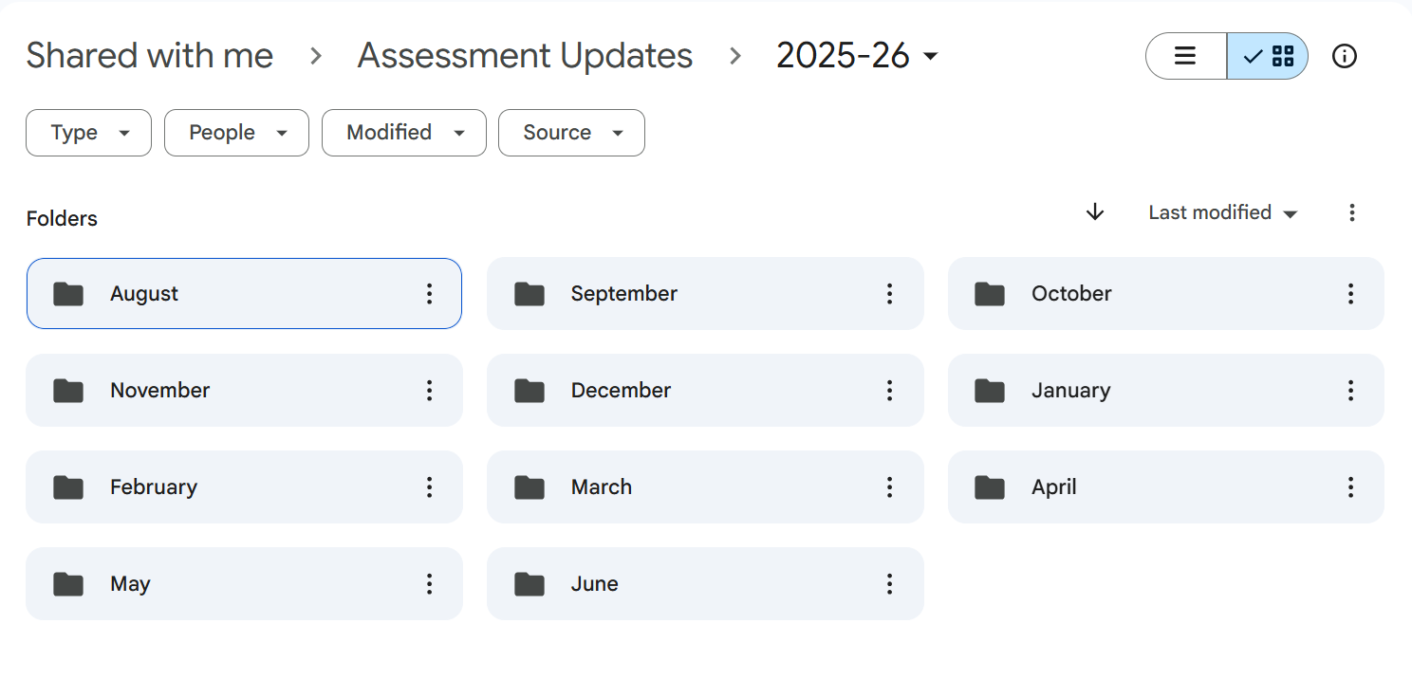
Assessment Updates
Contain important dates, deadlines, reminders, changes, and resources
Sent most Mondays at 8:00 a.m. to Epicenter SACs (increased frequency January – May)
Archived in G Drive by month for easy reference

Slide 15
State Assessment System

Slide 16
Purpose of State Assessments
Required by federal and state law for accountability and student data
Provide comparable measures of student achievement and growth across Colorado
Support CSI in evaluating school performance and growth
Inform families, communities, and the state about school performance
Offer a snapshot of how students are doing on specific measures

Slide 17
Impact of State Assessments
Accountability – Informs School Performance Framework (SPF) ratings across academic achievement, growth, and postsecondary readiness
Drive improvement planning
Provide transparent data for families making school decisions
Shape statewide policy and funding

Slide 18
State Assessments
CMAS
CoAlt
PSAT & SAT
WIDA ACCESS
NAEP
Colorado Measures of Academic Success (CMAS)
Math, ELA, Science, Social Studies
Colorado Alternate
Math (DLM)
ELA (DLM)
Science, Social Studies
Evidence-based Reading and Writing (optional essay)
PSAT 8/9 for grade 9
PSAT 10 for grade 10
SAT for grade 11
K-12 Multilingual Learners (NEP or LEP)
Alternate assessment available for grades 1-12
National Assessment of Educational Progress (NAEP)
Math and Reading
Sampling basis in Grades 4, 8

Slide 19
Spring 2026 Testing Windows
WIDA ACCESS: January 12 – February 13, 2026
NAEP: January 26 – March 20, 2026
CMAS/CoAlt: April 6 – April 24, 2026
PSAT/SAT: April 13 – 24, 2026

Slide 20
Assessment Rosters
Pre-ID student data pulled from October Count (OC) collection
Ensure Data Respondent(s) have all NEP and LEP students + alternate testers identified
Not identified = not loaded to testing roster
If not complete or students identified after OC, contact Kali

Slide 21
School Assessment Calendar
(§ 22-7-1013)
Requirements:
Annual calendar of all state and local assessments
Must be distributed to parents and posted on school website
Epicenter submission due September 1
Include:
All assessments (CMAS/CoAlt, WIDA ACCESS, PSAT & SAT, Universal Gifted Screening, interim, etc.)
Grades/subjects tested
Testing window and estimated testing time
Whether assessment is federally required, state required, or locally selected
Purpose and how results are used

Slide 22
Parent Excusals
(§22-7-1013(8)(a-c))
Parents/guardians may excuse their child from participating in (a) state content area assessments
Each school must have a clear written policy and procedure for parent excusals
If excused, schools may not impose negative consequences, such as:
Prohibiting attendance or marking unexcused absences
Limiting extracurricular activities
Denying rewards/activities tied to test participation
Schools may not create policies or burdens that:
Discourage participation in testing
Encourage excusals from testing
Schools must follow state excusal coding guidance for each assessment

Slide 23
Last Spring’s Results

Slide 24
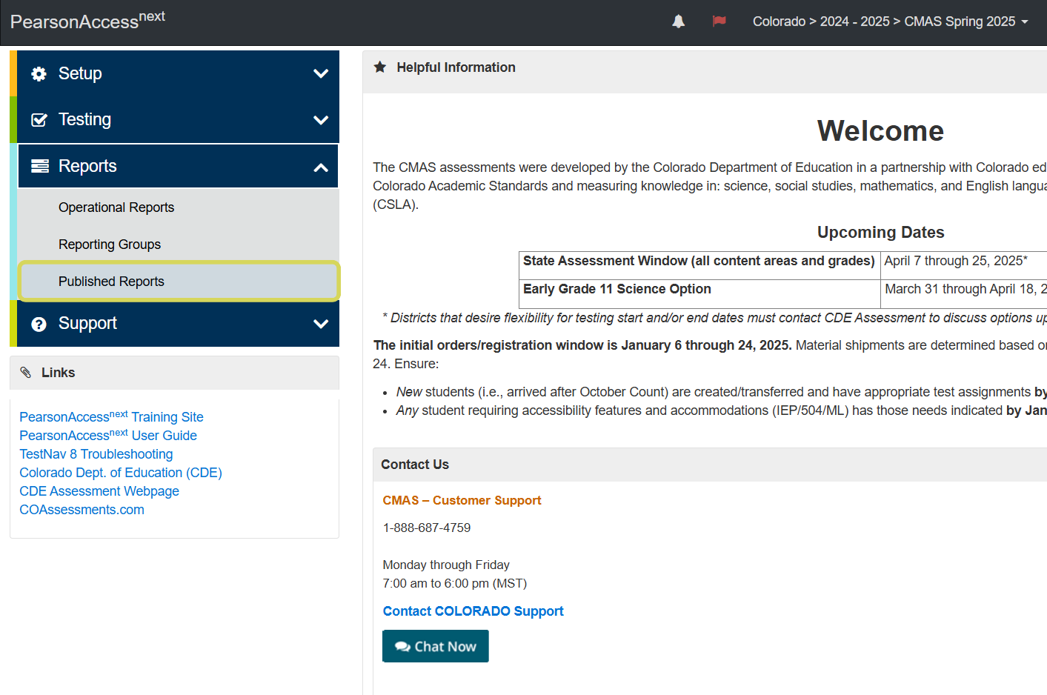
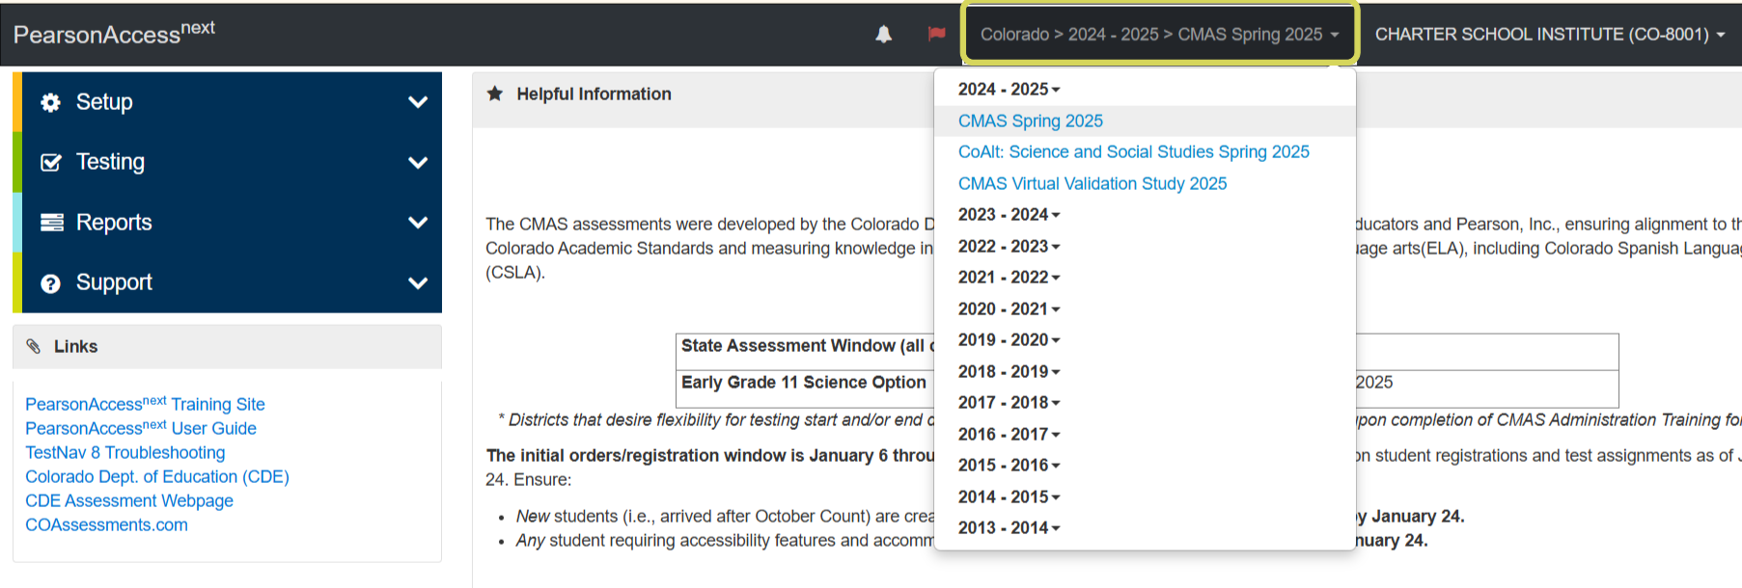
CMAS
Insert Text

Slide 25
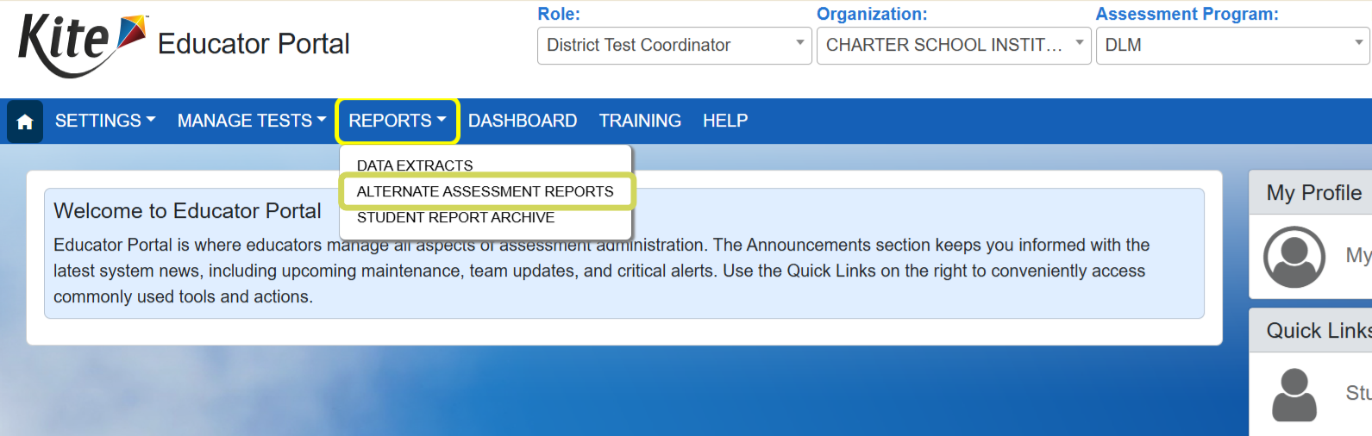
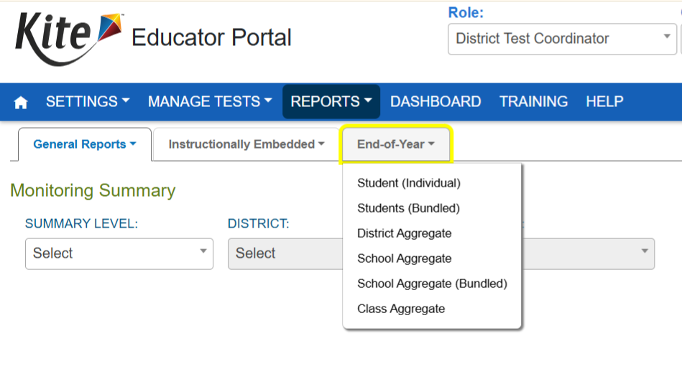
CoAlt Math & ELA
Insert Text

Slide 26
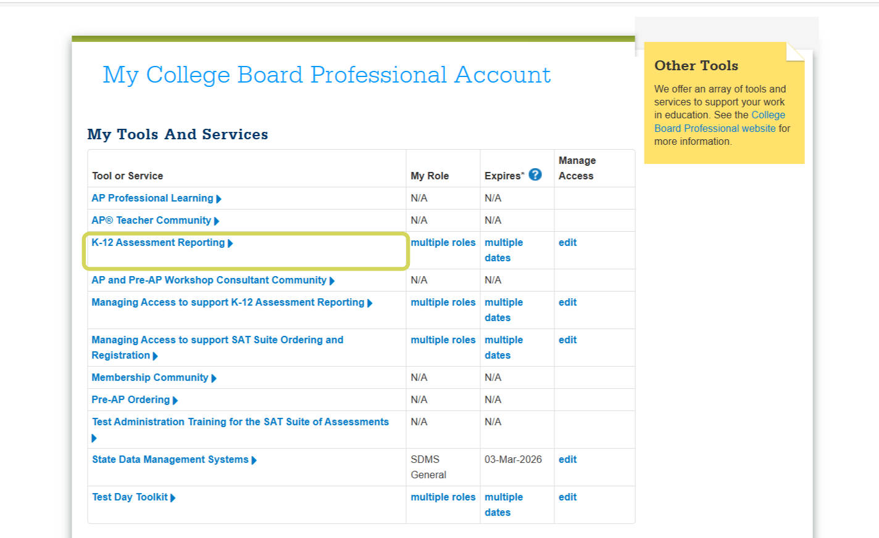
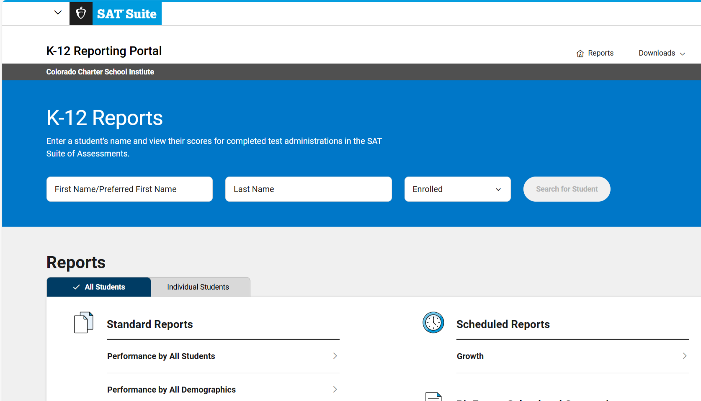
PSAT/SAT
Insert Text

Slide 27
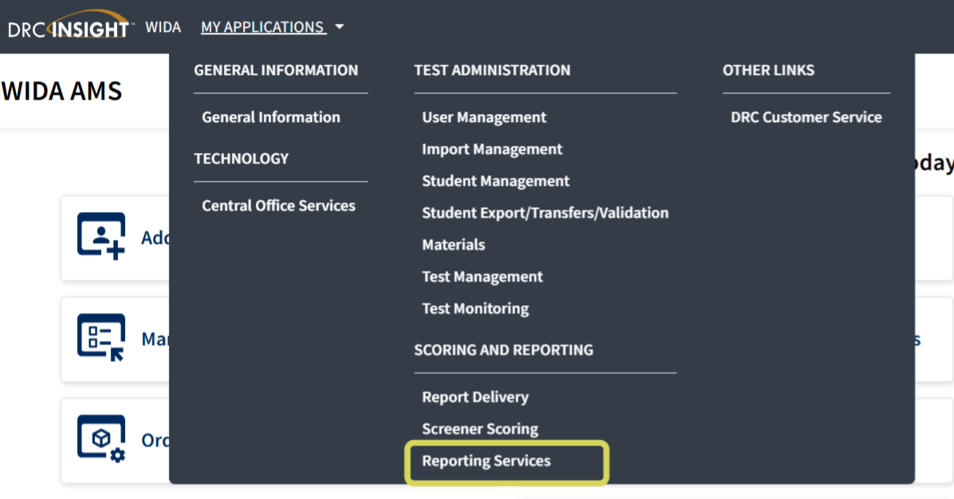
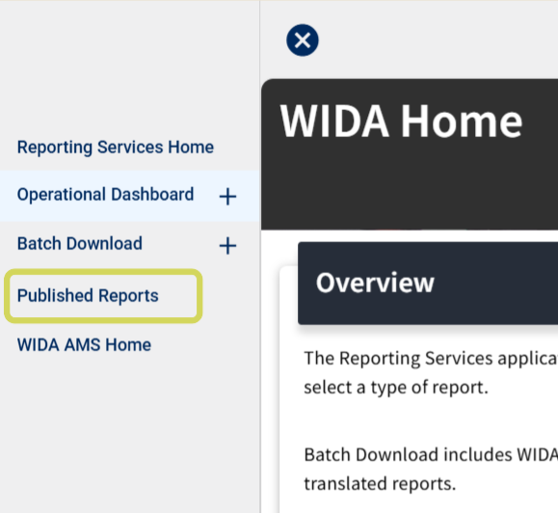
WIDA ACCESS
Insert Text

Slide 28
Interpretation Resources
WIDA ACCESS:
Interpretive Guide for Score Reports
NAEP: January 26 – March 20, 2026
Understanding Results
CMAS/CoAlt:
CMAS and CoAlt Interpretive Guide to Assessment Reports
CMAS and CoAlt Guide to Social Studies Assessment Reports
CMAS Performance Levels and Policy Claims
PSAT/SAT:
Understanding Scores for Students & Families – SAT
Understanding Scores for Students & Families – PSAT 8/9
Understanding Scores for Students & Families – PSAT10

Slide 29
Family Portals
Pearson Family Portal (CMAS/CoAlt)
Kite Parent Portal (DLM ELA and Math)

Slide 30
Downloading Assessment Results
Always download and save results from assessment management systems (e.g., PearsonAccessnext, WIDA AMS) locally
Do not rely on management systems as long-term storage
Maintain a local copy to ensure records are complete and accessible

Slide 31
Accommodations & Supports

Slide 32
Accommodation & Accessibility Requirements
All students may receive Accessibility Features or Administrative Considerations
Students with IEPs or 504 plans may receive allowable accommodations on a case-by-case basis
Accommodations must be written into the IEP or 504 plan to be used on state assessments
Accommodations and supports used on assessments must reflect those regularly provided in daily instruction and classroom assessments
Schools should review assessment-specific accommodation guidance to ensure proper implementation
Teams must ensure accommodations:
Do not alter the construct being measured
Provide access without giving unfair advantage
Are consistent across classroom, interim, and state assessments

Slide 33
Accommodations Crosswalk
State-provided resource outlining allowable Accessibility Features, Administrative Considerations, and Accommodations across all state assessments
Organized by assessment
Use the crosswalk when finalizing accommodations to ensure alignment with state policy
Accommodations in assessment-specific manuals may differ– always follow state guidance

Slide 34
Unique Accommodation Requests
A limited number of students who meet specific criteria may qualify for unique accommodations
Require additional documentation for approval consideration
Use without CDE approval may result in score invalidation
Accommodation must be listed in IEP and tied to instructional goal
Accommodations:
Scribe for WIDA ACCESS Writing
Scribe for CMAS ELA/CSLA Constructed Responses
CMAS Calculator on Non-Calculator Sections
More details shared in State Assessment Accommodations training

Slide 35
WIDA ACCESS

Slide 36
WIDA ACCESS Updates
ACCESS for ELLs > WIDA ACCESS
Required DRC app update for Chromebooks
Redesigned Kindergarten ACCESS; Alternate Kindergarten may become available in Colorado

Slide 37

DRC INSIGHT Update
Student testing app
Released as a Progressive Web Application (PWA)
Must uninstall the current app and install the PWA version
DRC INSIGHT Technology User Guide

Slide 38
Test Forms
Kindergarten: Paper-based
Grades 1-12: Online
Grades 1-3 Writing: Paper-based
Grades 1-12: Alternate ACCESS
Grades 1-12: Paper-based available as accommodation

Slide 39
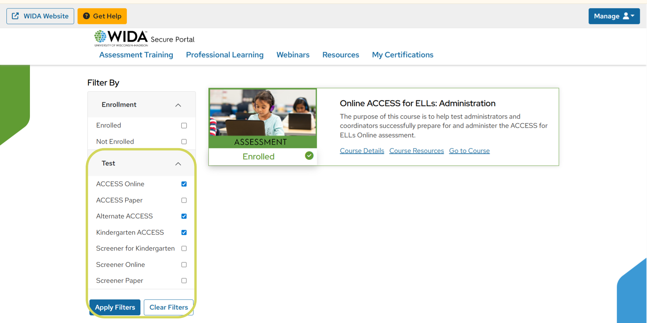
Test Administrator Training
All Test Administrators (TAs) must pass WIDA’s online modules and participate in SAC-led training
Monitor completion in the WIDA Secure Portal
Optional webinars for coordinators, TAs, and tech staff
Training window: October 1

Slide 40

Materials
Tentative Paper Test Ordering Window: October 1-31
Delivered to schools in January 2026

Slide 41
WIDA Screener
Used to identify students who may be Multilingual Learners (MLs)
Administered if Home Language Survey determines a language influence other than English
Determines language designations (NEP or LEP) for ACCESS for ELLs
Administered:
30 days from first day of school (prior to October Count)
Late registration/enrollment = 14 days (after October Count)
Contact CSI’s ELD Coordinator Rachel Franks for support | rachelfranks@csi.state.co.us

Slide 42
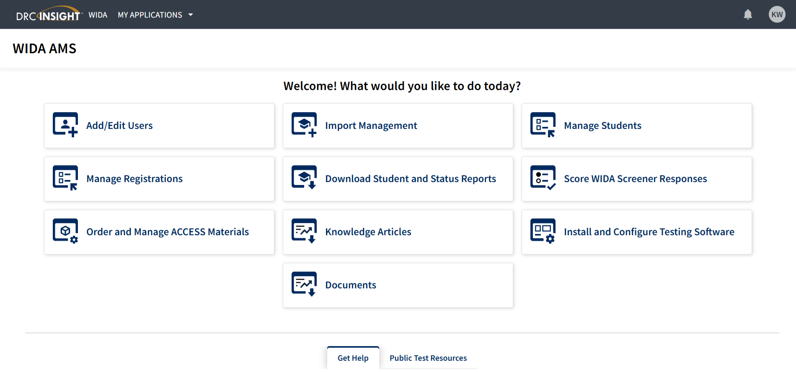
WIDA AMS
Assessment management system for WIDA Screener and WIDA ACCESS
DRC operates technology; WIDA AMS is the specific system
https://www.drcedirect.com/all/eca-portal-v2-ui/#/login

Slide 43
CMAS & CoAlt

Slide 44
CMAS Updates
Paper testing discontinued
CSLA
CDE CMAS webpage redesign

Slide 45
Paper Testing Update
HB 25-1278
Paper-based testing only available as accommodation
May require updating school testing policy
Training modules and resources to support transition will be provided this fall

Slide 46
CSLA Update
Colorado Spanish Language Arts
Eligible MLs in grades 3, 4 who are currently receiving or recently received Spanish language arts instruction
NEW: Online in spring 2026; paper-based available as accommodation
CMAS Spanish Assessments Decision Making Flowchart
Contact Kali and Rachel with questions

Slide 47
Content Areas
Math – Grades 3-8
CSLA (eligible) – Grades 3, 4
ELA – Grades 3-8
Science – Grades 5, 8, 11
Social Studies (sample) – Grades 4, 7

Slide 48
Early Testing Window
Tentative Early Window: March 30 – April 17, 2026
Grade 11 Science only
No extended window
Contact Kali for more details

Slide 49
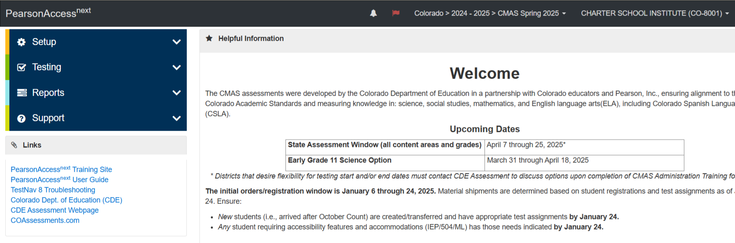
PearsonAccessnext
Assessment management system for CMAS and CoAlt Science/Social Studies
Students test using TestNav app
https://co.pearsonaccessnext.com/cas/login?service=https%3A//co.pearsonaccessnext.com/customer/j_spring_cas_security_check&renew=true

Slide 50
Secondary Devices
Any program accommodation requiring a secondary device requires CDE approval:
Speech-to-Text
Word Prediction
Generative Text
Security agreement and supporting documentation tentative deadline: December 8

Slide 51
Braille Accommodation
Braille Colorado Practice Resources (CPRs) orders due September 14; contact Kali

Slide 52
CoAlt
Colorado alternate state assessment
Most significant cognitive disabilities
Qualifying students must receive instruction on Extended Evidence Outcomes; IEP must specify alternate assessments
Alternate Standards and Assessment Participation Guidelines Worksheet
Companion Document
ELA and Math – Dynamic Learning Maps (DLM)
Computer-based; 1:1 administration
Science and Social Studies – Colorado-developed
Paper-based; 1:1 administration
Grades 3-11; alternate for CMAS, PSAT, and SAT
Same window as CMAS, PSAT, and SAT

Slide 53
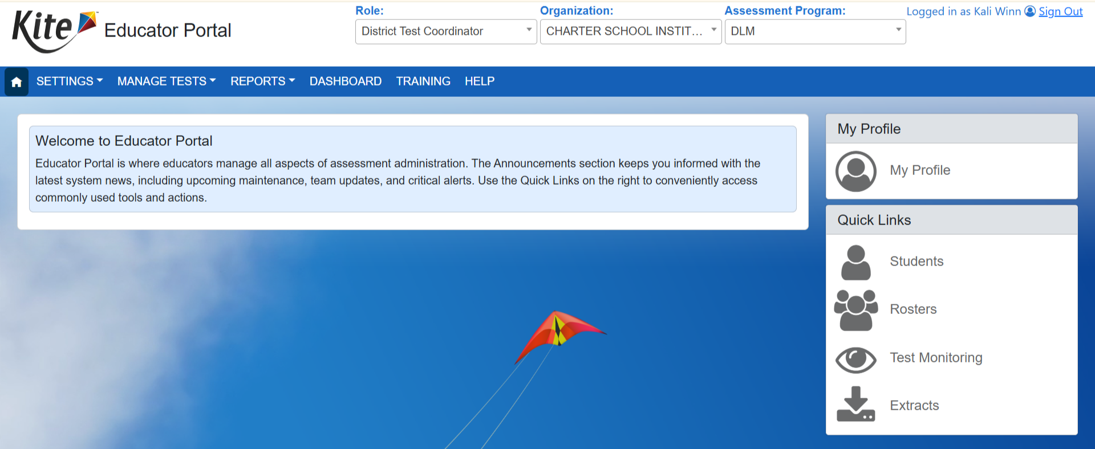
Kite Educator Portal
Assessment management system for CoAlt DLM Math & ELA
TA training; must pass quiz
Math, ELA, Science
Social Studies separate
SAC module separate
https://educator.kiteaai.org/AART/logIn.htm

Slide 54
PSAT & SAT

Slide 55
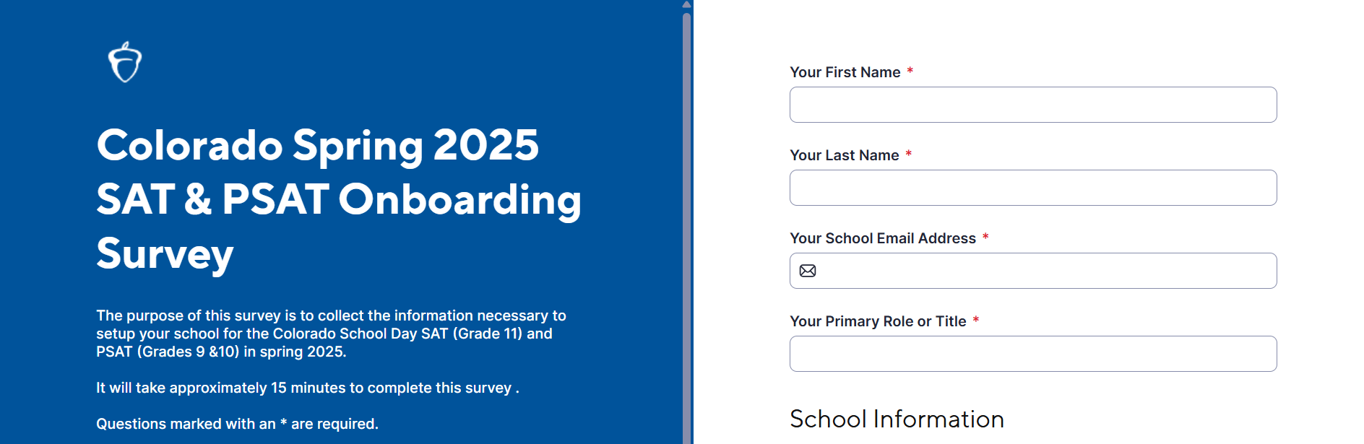
School Onboarding Survey
Form to collect information and update school contacts
Required for all schools who have students enrolled in grades 9, 10, and/or 11
Deadline typically October

Slide 56
PSAT/SAT Test Forms
Evidenced-based Reading & Writing; optional essay
Essay scores not forwarded to colleges
Online; paper available as accommodation

Slide 57
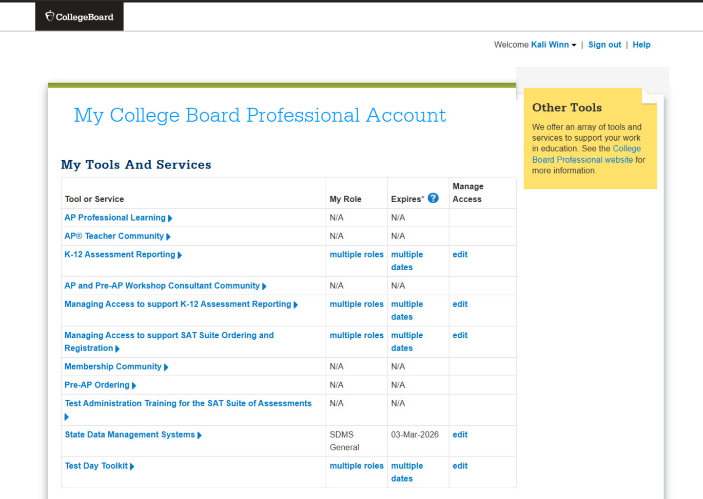
PSAT/SAT Training
College Board requires coordinators, proctors, hall monitors, and room monitors to pass quiz in the spring
Completed in professional College Board accounts
Staff must create an account to access training

Slide 58

PSAT/SAT Platforms
K-12 Reporting Portal – Used to access individual and aggregate student score reports and download data
Test Day Toolkit – Test administration website for testing staff
SDMS – Student data management system
Bluebook – Testing app for students

Slide 59
Fee Waivers
Available September 13
Access Options:
SACs – K-12 Reporting Portal > Downloads
Students request from College Board
SAT Fee Waiver Codes
Getting Fee Waivers and Distributing to Students

Slide 60
PSAT/SAT Accommodations
Accommodations submitted in SSD Online by SSD Coordinator
Accommodation requests submitted for:
Students in grade 9
Students whose accommodations needs have changed
Students whose accommodations have not been previously approved
Students approved last year continue to be approved unless changes to IEP/504 or primary disability

Slide 61
PSAT NMSQT
School choice; schools coordinate administration and cover associated costs
National Merit Scholarship Program Qualification
Can track improvement from PSAT 8/9 or PSAT 10
Test Dates
Student Guide

Slide 62
NAEP

Slide 63
NAEP Overview
Purpose:
NAEP = The Nation’s Report Card
Federally mandated, administered by NCES (National Center for Education Statistics) under the U.S. Department of Education
Assesses what students know and can do in reading & math in grades 4, 8
Provides national and state-level data on student achievement over time
Not tied to state standards or individual student/school results
Provides data to track trends and inform education policy nationally and by state

Slide 64

NAEP Details
Selection is random and based on statistical sampling
If your school is selected, your School Leader will be contacted by CDE in fall 2025
No prep is needed but positive encouragement is key
Use released NAEP questions for instructional insight (via the NAEP Questions Tool)
No individual results; NAEP does not report on students, classes, or schools
Digitally-based, approximately 90 minutes
School NAEP Coordinator designation
NAEP staff oversee administration
Reports expected Winter 2026
NAEP Data Explorer: Explore past results by student groups, subject, and state/district

Slide 65
NAEP Links
NAEP website: https://nces.ed.gov/nationsreportcard/
Tutorials: https://nces.ed.gov/nationsreportcard/dba/
Parent Letter: https://nces.ed.gov/nationsreportcard/parents/parentletter.aspx
Student Resources: https://nces.ed.gov/nationsreportcard/students/
NAEP Results: https://www.nationsreportcard.gov/

Slide 66
SBD Reviews

Slide 67
SBD Overview
SBD = Student Biographical Data
Verify student demographic and testing information after testing windows have closed
WIDA ACCESS, CMAS, CoAlt, PSAT, & SAT
Required for all CSI schools
May be responsibility of SAC or Data Respondent(s)
Not correcting data could result in lowered participation rates on state accountability

Slide 68
Insights

Slide 69
3 Common Misadministrations
Accommodations (not provided or provided incorrectly)
Incorrect timing procedures
Cell phone usage or notes

Slide 70
Misadministration Prevention
Double check accommodations in management system prior to testing—cannot be changed once testing begins
Train TAs administering accommodations thoroughly
TA reminders before sessions
Countdown clocks
Reminder sticky notes in TAMs
Write end time on the board
Multiple reminders to students about policy
Collect phones or instruct to put away
Monitor students who may be looking around or down at their lap
TAs should walk around the room regularly

Slide 71
Research from the Field
A review of recent advances in adaptive assessment (2017)
Computer-adaptive testing: Implications for students’ achievement, motivation, engagement, and subjective test experience (2018)
Education system alignment for 21st century skills: Focus on assessment (2018)
The effectiveness and features of formative assessment in US K-12 education: A systematic review (2020)
Exploring the potential of artificial intelligence tools in educational measurement and assessment (2023)
K-12 education in the age of AI: A call to action for K-12 AI literacy (2023)
A systematic review of meta-analyses on the impact of formative assessment on K-12 students’ learning (2024)
Assessing the effectiveness of adaptive learning systems in K-12 education (2024)
Artificial intelligence (AI) learning tools in K-12 education: A scoping review (2025)

Slide 72
Assessment Trends
Through-year assessments – Models administer multiple tests during school year and aggregate results into single summative score; 13 states exploring options
Performance-based assessments – Task-based, open-ended, rubric-graded measures of student learning; more holistic review of student work
2025 Evaluating Performance Based Demonstrations of Graduation Readiness in a Competency-based and Personalized Learning Environment (case study report)
CDE partnering with University of Colorado Boulder to study the implementation of Capstone Assessments and Performance Assessments
Colorado Capstone Implementation Criteria
Colorado Performance Assessment State-Wide Scoring Criteria Framework
Reframing graduation requirements – Consideration of eliminating high-stakes standardized testing in high school graduation requirements and pursuing more holistic measures of college and career readiness
https://www.americanprogress.org/article/fact-sheet-3-trends-in-k-12-assessments-across-the-country/

Slide 73

STAY CONNECTED
Email: kaliwinn@csi.state.co.us
Phone (call or text): 303-532-7403
Thank you!

