Slide 1
25-26 December Count Collection
General Overview
Recorded: September 2025
Notes:
Hello All,
Thanks so much for reviewing this training for the 25-26 December Count collection. This particular training covers a general overview of the collection including the 5 steps of the submissions process. If questions come up while reviewing this overview, feel free to reach out to the submissions inbox and we’ll be more than happy to help!

Slide 2
Agenda
Purpose of December Count
Purpose, Required Files, and Collection Differences
File Overview
Child File
Participation File
SPED EOY Collection Process
Step 1: Collection Prep | Step 4: Resolve Errors
Step 2: Collect Data | Step 5: Certify*
Step 3: Submit to CSI | *Certification process covered in another training module
Timelines and Deadlines
Notes:
Here is a quick overview of the topics that we will be discussing today. First, we will look at the December Count Collection as a whole and in particular the purpose and required files for the collection. We’ll then jump into the 5 steps of the submissions process and some available resources for each step and scenarios on how to use them. Lastly, well take look at the timelines and deadlines for this collection!

Slide 3

Purpose of December Count Collection
The December Count collection's purpose is to accurately record data about students with IEPs as of December 1st so that schools may receive appropriate funding and resources to best support their education and services. This information is used for:
Funding for special education students EDFacts Report on educator effectiveness Medicaid Draw random samples for parent survey Compliance record review Monitoring Provide information regarding the fiscal impacts of the numbers Indicator reporting Public reporting Legislature requests Research requests Consultant analysis to support technical assistance needs in the state
courtesy of dreamstime.com
Notes:
To begin, I want to talk about the purpose of the December Count Collection. The purpose is to accurately record data about special education students with IEPs as of December 1st , so that schools may receive appropriate funding and resources to best support their education and services. This information is used for all the listed options here, but most importantly would be the funding for special education students. Also, it is used for Compliance Review, Monitoring, Reporting, educator effectiveness among several others.

Slide 4

Required Files
Snapshot
Child
Participation
Notes:
So, when talking about the files that are required for this collection, it is the Child and Participation files. Once both files are uploaded and error free, a snapshot will be run to look for any level 2 errors across both files and also which students meet the criteria to be included in the snapshot.

Slide 5

Child Overview
The purpose of the Child File is to capture and verify the attributes of students with disabilities while he/she attended your AU at any point during the current reporting period. Dependencies Student has been assigned a SASID and details must match what is in RITS (i.e. Name, Date of Birth, Gender) If a student has been assigned a LASID, then that SASID/LASID combination must appear on the Participation file and match what is in the student interchange. Record Exception One record must be submitted for any student who was referred, evaluated, and/or received special education services during the current reporting period.
Notes:
As mentioned, one of the two files submitted is the Child file. In terms of a little more information on this file – the purpose is to capture and verify the attributes of students with disabilities while they are attending a CSI school during the current reporting period. This will include information such as name, SASID, Date of Birth, Gender, Ethnicity, Race etc. As far as dependencies are concerned, the student must have been assigned a SASID and the information must match what is in RITS. Also, if a LASID has been assigned to a student, then that SASID/LASID combination must match the Participation file and what is in the student interchange.. Be sure you are including any child who was referred, evaluated and/or received special education services during the current reporting period.

Slide 6

Participation Overview
The Special Education Participation File contains data related to the student’s participation in special education, important dates, services received, and the staff who are working with them.
Dependencies -Student has been assigned a SASID and details must match what is in RITS (i.e. Name, Date of Birth, Gender) -A record containing a students SASID/LASID combination must also be included on the Child File and the Student Interchange. -School Code and Grade Level will come from the Student School Association file when the December Count snapshot is created. -Student also are being served as of December 1st. Record Exception - One record must be submitted for any student who was referred, evaluated, and/or received special education services during the current reporting period.
Notes:
Next, let’s dive a little further into the other file, the Participation file. This file contains data related to the students Participation in Special Education and includes important dates, services received and staff who are working with them. Like the child file, this also has some dependencies to consider. Again, a student must have a SASID assigned and match what is in RITS. Also, the SASID LASID combination must be included on the child file and the Student Interchange. Keep in mind that the School Code and Grade Level will come from the Student Interchange SSA file when the snapshot is created. Lastly, at a minimum, this should include all students served as of December 1st but may include any student served in the 24-25 school year if applicable exits are completed. The same record exception applies as we discussed for the Child File.

Slide 7
Updates for 25-26
New
This
Year!
No Updates for the Child or Participation files this year!
New this Year training not needed given no changes.
Notes:
As for the 25-26 updates, there have been no changes to the file layouts for the current year. Also, there really have not been any overall collection changes. Due to this, we will not be recording a new this year training for 24-25.

Slide 8
December Count and HR Collection Files
SPED Child
SPED Participation
December Count Snapshot
**December Count contacts are responsible for resolving Level 1 and Level 2 DC errors IN CONJUNCTION WITH working with the Human Resources Staff to Clear Level 2 Staff errors.**
Staff Profile
Staff Assignment
Human Resource Snapshot
SPED Staff
Notes:
This graphic is a break down of the files required for both the December Count and the Human Resources collections. As we just mentioned, the students with matching SASIDs and LASIDs get pulled into the December Count Collection while the Staff Profile and Assignment files get pulled into the HR snapshot. I mention the HR Side because as you can see (NEXT), Special Education Staff actually are pulled into the December Count snapshot, not HR. This means, you may receive level 2 staff errors for December Count that can only be corrected by updating the HR files. I’ll mention this a lot moving forward, but there definitely is a need for the HR and SPED staff to work together as the collections actually are closely tied.

Slide 9

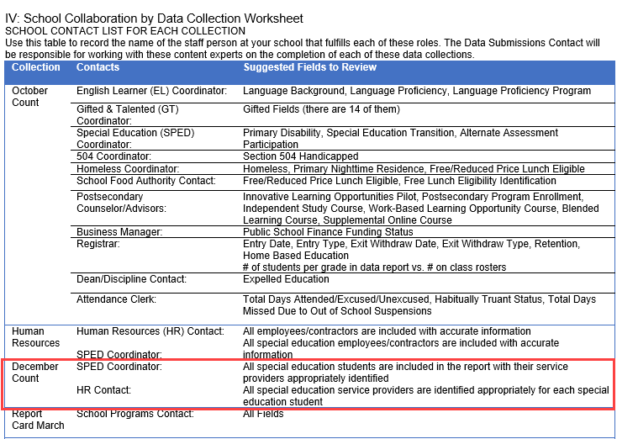
Across Collection Collaboration
School SPED Staff must collaborate with the Human Resources Staff at your school completing December Count. This is due to:
December Count errors may require changes to either the SP or SA files to resolve
Involves inconsistencies with data entered by HR Staff, including:
SPED Flag
Grade Levels Taught
FTE and Funding Source issues
Be sure you are reaching out to your schools HR Staff to inquire about any cross-collection errors that may have occurred
Available in the Data Submissions Handbook
Notes:
Now you may be asking yourselves, what is the best approach to take keeping in mind that both collections are being impacted? During this collection, we really want to emphasize the necessity of you as Special Education Staff to collaborate with your schools Human Resources staff to clear errors. As Special Education staff are working through their collection, they may encounter errors particularly on the Level 2 Staff error files that will require changes to the HR files, so being proactive and reaching out to them early in this process is especially important. In terms of HR issues, we generally see issues come up with staff not being flagged for Special Education, errors in grade levels taught, licensing issues, and FTE/Funding Source issues. CSI does try to provide both contacts this information throughout the process, particularly when issues are discovered, but collaborating with those staff and developing a plan of attack will be key to the success of both collections.

Slide 10

Criteria for Staff Addition to the December Count Snapshot vs. HR Snapshot
Human Resources
December Count
Files must be Level 1 Error Free
Special Education Flag = 0 (Non-SPED)
Start date is December 1st or prior to that date
End Date is either blank or post 12/01 of the reporting school year
Job class codes are not equal to 632 (Temporary/Part-time Worker As Needed) or 634 (Student Worker)
Employment Status Code = 11, 12, 13, 23, 25 or 26
EDID is reported in both Staff Profile and Staff Assignment Association files for reporting district.
Files must be Level 1 Error Free
Special Education Flag = 1 (SPED)
Start date is December 1st or prior to that date
End Date is either blank or post 12/01 of the reporting school year
EDID is reported in both Staff Profile (Profile and educational background) and Staff Assignment Association files for reporting district.
Employment Status Codes will be included: 11, 12, 13, 23, 25 or 26.
Administrative Unit code cannot zero-filled in either staff profile or staff assignment files
Notes:
This slide really covers a broad overview of what needs to be done to ensure that the records get included in the Human Resources vs. the December Count snapshot in terms of staffing. Many of these are very similar, but the main take home point here is that for SPED Staff to be included in the December Count collection, they must have a special education flag of 1, a valid administrative unit code of 80010, and actively employed as of December 1st. This is why it is so important to review the snapshot data and work with your HR staff to ensure each staff person who works with Special Education students is coded as such. If these fields are not coded correctly, the staff EDID being used on a student's record will flag for an error and need to be updated to ensure they are pulling into the December Count Snapshot.

Slide 11

Difference Between December Count and SPED EOY
December Count This collection is an annual count of eligible Special Education students as of December 1st used for funding purposes that provide specialized student services. Includes Special Education Staff data employed as of December 1st. SPED End of Year Collects data on students who were referred, evaluated, or received Special Education services throughout the yes Information on exits from Special Education, Part C evaluations and services received. Although the files collected are the same, the DC and SPED EOY look at very different information
courtesy of clipartkey.com
Notes:
It is important to note that although the files collected for both the December Count and SPED EOY are the same, the information that is looked at for each collection is very different. The purpose of the December Count collection is to provide a count of all Special Education students and staff as of December 1st for funding purposes while the SPED End of Year looks more specifically at the students who were referred, evaluated, and received services at any point during the year. Also it looks at details on students exiting special education. All fields must be completed for each collection but is it important to know the difference in what information is being looked at.

Slide 12
December Count Collection Process
Notes:
Now that we covered the purpose, files necessary and some collaboration details, let’s jump into the 5 steps of the submissions process!

Slide 13
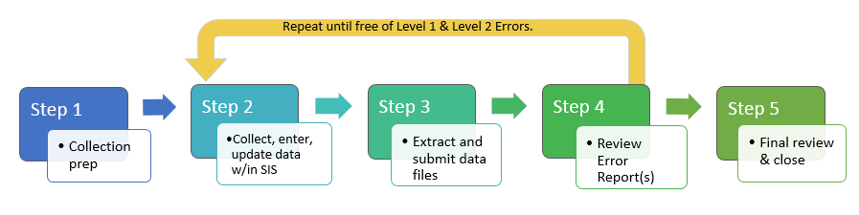
DC Data Collection in 5 Steps
Repeat steps 2-4 until data is complete and accurate!
Notes:
(NEXT)Generally when we look at the December collection or any other collection, it can be broken down into 5 distinct steps. Step 1 – Collection Prep, Step 2 - Data Collection and Entry, Step 3 Submission to CSI, Step 4 Error Resolution and Step 5 Data review. This really is an iterative process of steps 2 through 4 of entering data or making corrections, submitting to CSI and we will provide error reports where you will need to make more updates to your files. Once all errors have been resolved, we would jump to step 5 where the data is reviewed for accuracy and either signed off on or more changes would be necessary. With that information in mind, we will be looking more into each step in greater detail.

Slide 14
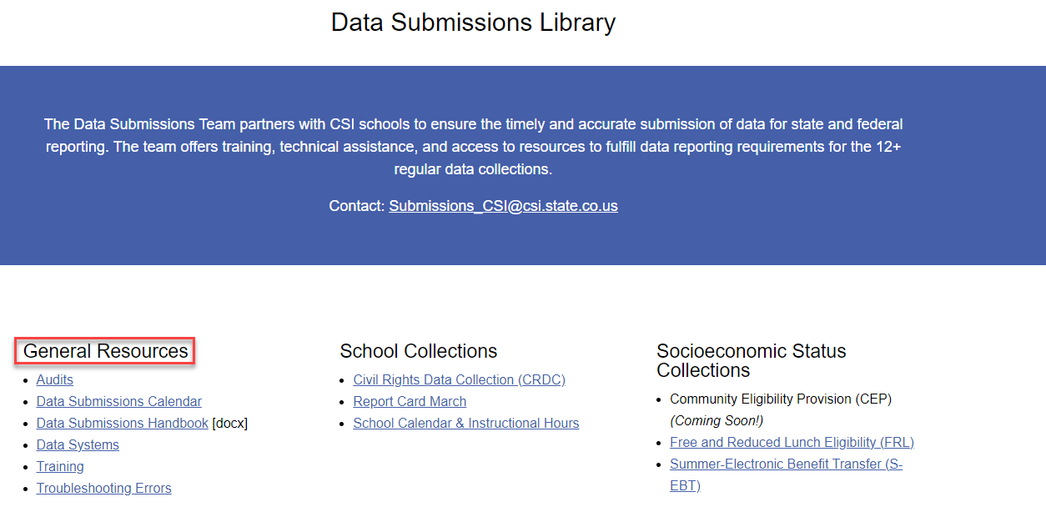

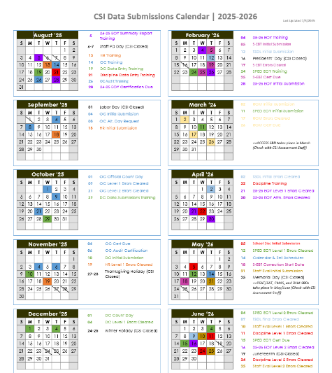
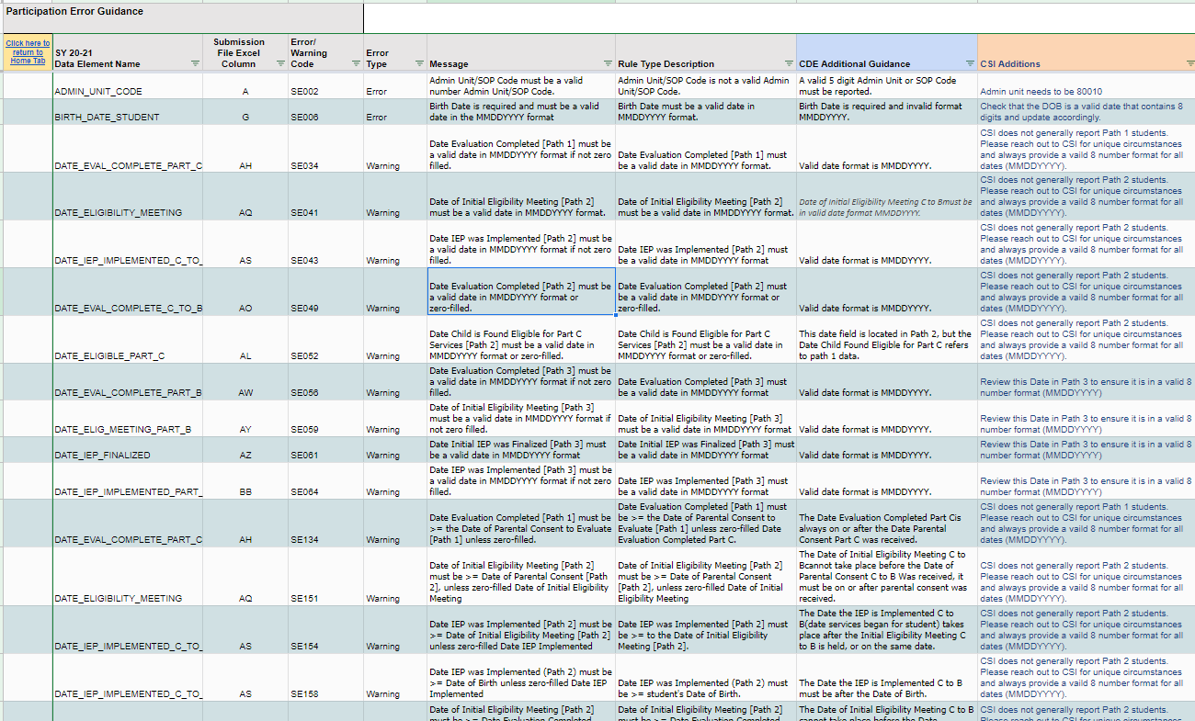
Step 1: Collection Prep Resources
Data Submissions Handbook Data Submissions Calendar Troubleshooting Errors Spreadsheet
14
Notes:
So step 1 really is all about the steps a school should take prior to an upcoming collection to ensure they have the general knowledge necessary to be successful. This involves the 3 main general resources linked at the top of each collection page on the CSI website and includes the data submissions handbook, the Data submissions calendar, and the troubleshooting errors spreadsheet. The link takes you directly to the General Resources section on the CSI website, which is where several helpful resources are located. It is highly recommended that all new and returning staff review the latest version of the data submissions handbook, which comes out every year. It contains helpful information on each step of the process, your role vs. CSI, various resources available to you, to do lists among many others. The next area to focus on would be the data submissions calendar, which includes all important due dates for a collection, including initial submittal, level 1 error clearance, level 2 error clearance, and signed summary dates. Printing this and reviewing it often will ensure your school is staying in compliance by meeting all necessary deadlines. The last resource that will be talking about more later is the troubleshooting errors resource. This spreadsheet contains tab for each file in a collection along with a tab for level 2 errors. The tabs are a working document and provide updated listings of each error associated with a file or level 2 and includes details regarding the error message, field impacted, and most importantly – a CSI additional notes column that provides CSI-specific details on how to correct an error. Sometimes the error messages CDE provides can be confusing, so having this will go a long way when you get to step 4 error clearance.

Slide 15
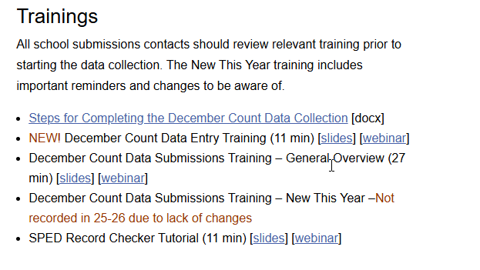
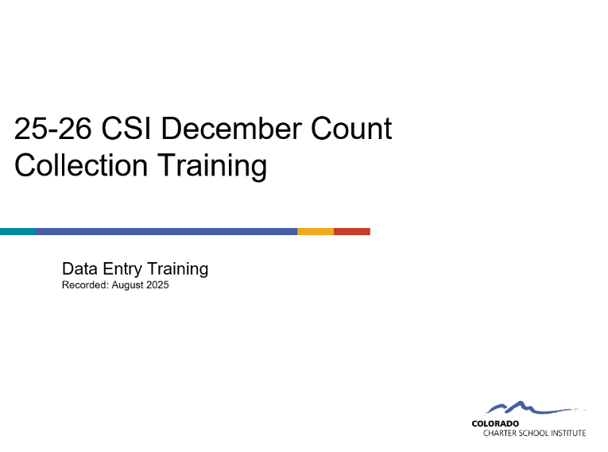
Step 1: Collection Prep Trainings
https://resources.csi.state.co.us/data-submissions/december-count/
Notes:
In addition to the general submission's resources, each page also contains recorded trainings for the collection that are designed to provide you all the details necessary to complete the specific collection. This may be obvious as you are currently reviewing the training for the December Count collection, but it is important to point out that each collection has a training containing a general overview, typically designed for new submissions contacts as well as returning who would like a more comprehensive overview. Also, we generally have a New this Year training that covers any changes since the previous year and some validation reminders. This one is more geared towards returning staff but is recommended for new staff as well. As previously mentioned, there will not be a new this year training given the collection has not changed at all from last year. Some collections also contain additional trainings in addition to the usual ones, for example the December Count collection has a data entry training (NEXT) on the who, what, when, where and why of data entry as it relates to the collection. This should be viewed prior to the collection opening and may help set schools off on the right foot.

Slide 16

Step 2: Data Collection/Entry
What Data to Collect
Resources Utilized:
File Layout and Definition Documents
Record Checker and Validation Toolkit
Participation File Coding Scenarios
Plan Management System Crosswalks
Courtesy of clipartpanda.com
Notes:
Step 2 is all about collecting and entering data for this particular collection. So, we’ll talk about it in two ways. First, we will look at what actually you should be collecting then we will jump into where you should be entering that data. With the “What” you should be collecting, we will be looking at various resources that will help with this process including the File Layout and Definitions documents, the Record Checker and Validation Toolik, a coding scenario document, and some crosswalks of your system.

Slide 17
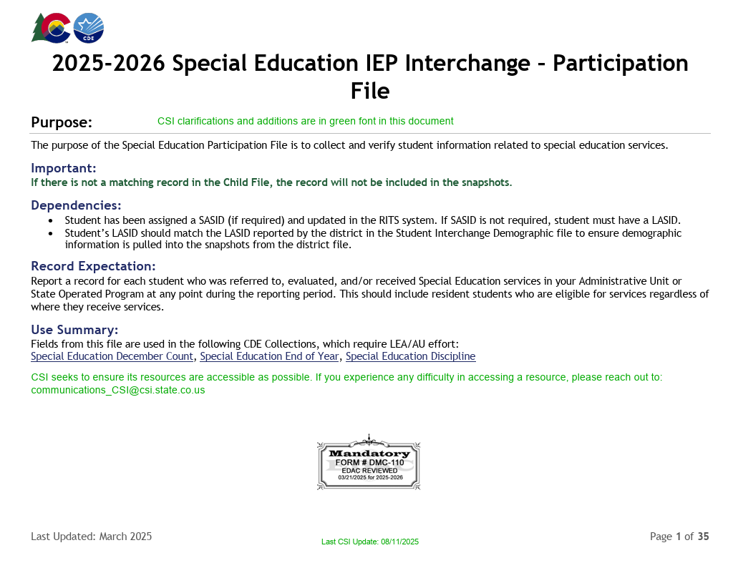
File Layout and Definition Documents – CSI Additions
Child File Layout and Definitions Document Participation File Layout and Definitions Document
Notes:
CSI has a variety of resources available that should assist with the process of what you should be collecting. The first resource that I previously mentioned are those file layout and definitions documents for both the Child and Participation files. These documents were created by CDE to include information on details of the collection itself, the fields that should be collected including field lengths and corresponding excel columns, as well as more specific details on the fields themselves and what coding options are available. The screenshot here comes directly from the Participation file layout for 24-25 and you’ll notice that each file includes a table at the top that contains what fields need to be collected, for example Admin Unit Code is first followed by the Students SASID. If you look to the right side of the table, you will notice additional information in green. What CSI does is take these file layouts from CDE and adds additional notes specific to CSI schools. This really is to provide CSI schools additional details that may be helpful as it pertains to your school. For example, you’ll see in the Admin Unit Code, this should always be 80010 for all CSI schools. So, I really recommend that as you go through this collection for the first time, that you keep these documents handy and reference them whenever there is a question.

Slide 18
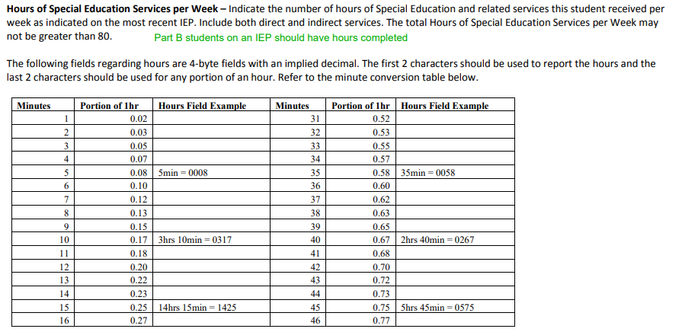
Using File Layout and Definition Documents Example
Your first error report is showing some students do not have the correct number of Special Education Hours per Week based on the SE358 error you are receiving.
You know the number of hours each student receives but are unsure how to code them. Use the Participation File Layout!
Upon review of the File Layout, you notice that the Hours of Special Education Service per Week contains a table that will guide you to code correctly as it contains 4 digits and an implied decimal!
Notes:
Here is an example of how to use the file layout to your advantage, in this case we will be looking at an error clearance scenario. So, after completing your initial submittal and have received your first error report, you notice that all the students do not have the correct number of Special Education Hours per Week based on the SE358 error you are receiving. You know the number of hours each student receives on a weekly basis but are unsure how to code them. Your best option in this circumstance is to use the Participation File Layout!
Upon review of the File Layout, you notice that the Hours of Special Education Service per Week contains a table that will guide you to code correctly as it should contain 4 digits and an implied decimal! For example, 3 and ½ hours would be coded as 0350.

Slide 19
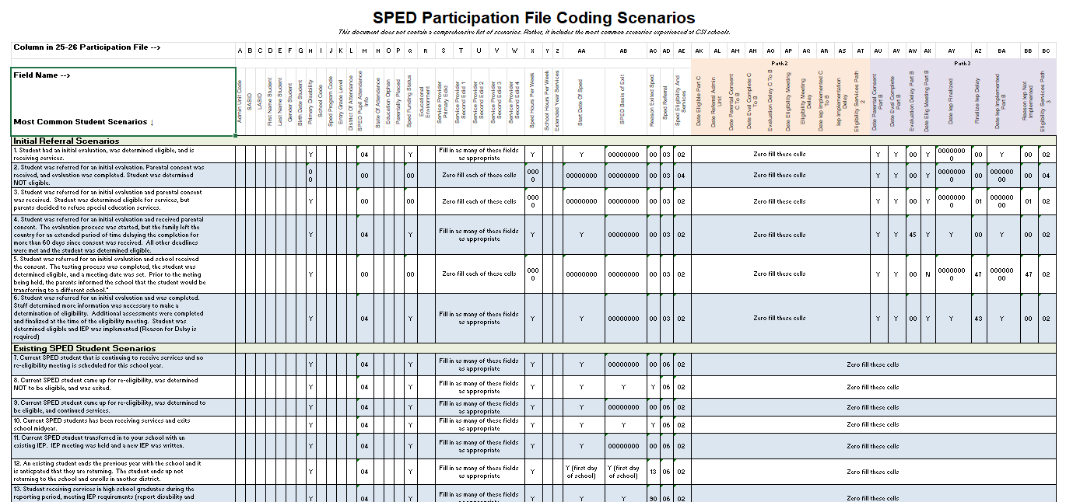
Participation File Coding Scenarios
Participation File Coding Scenarios Document
Notes:
Continuing with the “What to Collect” piece of Data Entry, another great resource to utilize from the CSI website is the CSI Participation File Coding Scenarios Document. Essentially, this resource is split up between Initial Referrals and Existing Students and how best to code them. The document provides common scenarios that you may encounter when completing data entry and provides the correct coding for that scenario on the participation file. Due to the number of fields on the file and the complexity of entering this information, it certainly can be a huge time saver by reducing the number of errors that you will encounter upon first submittal if followed accurately. Make sure you are paying special attention to the SPED Referral Field highlighted here in Column AD. In essence, this is the primary designator between New and Returning students with an 03 being New and an 06 being returning. As you can see in this document, if 03 is utilized, then all applicable dates must be completed for Path 3. When thinking about the What for data entry, using CSI resources such as this coding scenarios document, the File Layout and Definition documents, and others mentioned can ensure that What is being entered accurately reflects each students unique circumstances.

Slide 20
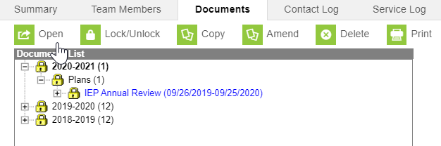
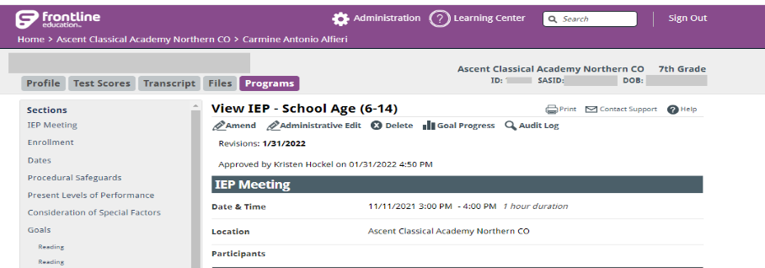
Participation File Coding Scenarios Example
When working with IEP data you are unsure the correct fields to input for a new student who is receiving an initial evaluation, was determined eligible, and began receiving services (compared to a returning student). Use the Participation Coding Scenarios!
Based on this information, you know that:
Initial evals that are eligible always receive an 03 – SPED Referral and 02 for Eligibility and Services
Initial evals need to have Path 3 Dates completed for all CSI schools (Paths 1 and 2 zero filled)
The Primary Disability Field is required for all Special Education students
Other required fields: Service Provider EDIDs, Funding Status, Hours Per Week, and Start Date of SPED
Notes:
A good example of a scenario where this resource would be helpful is if you come across an issue where initial evaluations are being completed by the SPED team and you are ready to enter information into Enrich or Infinite Campus (NEXT), but you cannot remember what fields need to be populated for a student receiving an initial evaluation, was determined eligible, and began receiving services. This document will essentially walk you through what should be entered in a variety of different scenarios including this one. As you can see in the screenshot of this scenario:
All receiving initial evaluations need to have an 03 in the SPED Referral field and 02 for Eligibility and Services if deemed eligible
Students receiving initial evaluations need to have Path 3 Dates completed for all CSI schools with Path 2 zero filled
The Primary Disability Field is required for all Special Education students along with an 04 in Pupil Attendance
Other required fields include Service Provider EDIDs, Funding Status, Hours Per Week and Start Date of SPED

Slide 21
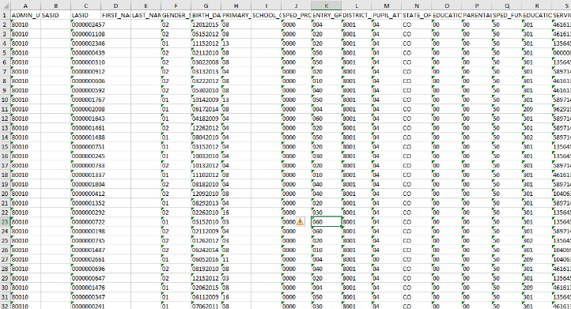
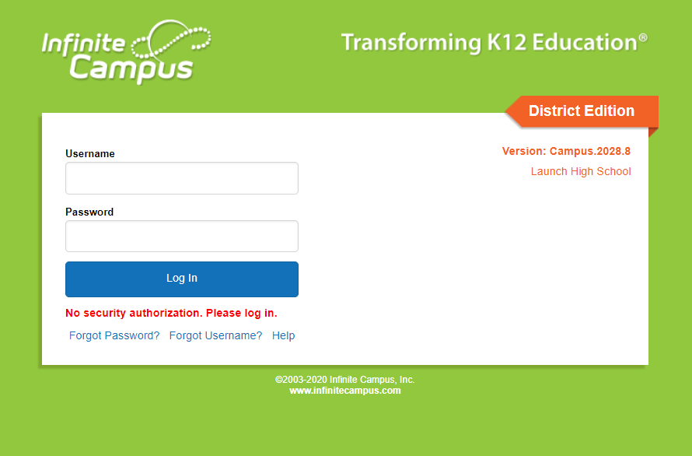
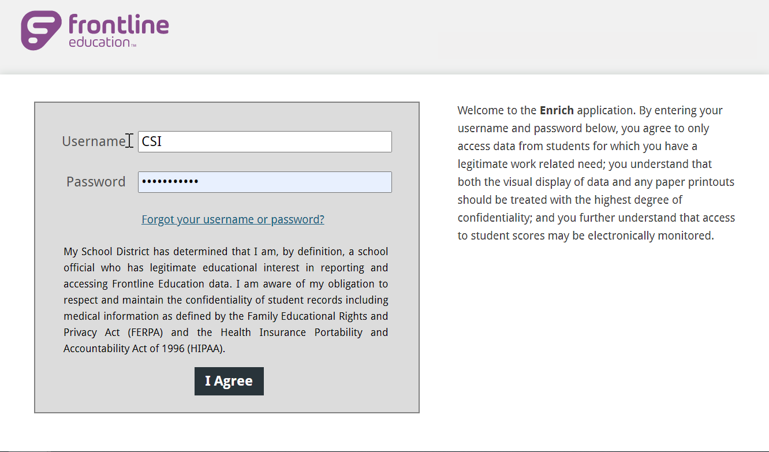
Where should Data be Entered for December Count?
Infinite Campus
Enrich
Starting Point Files
December Count/Special Education End of Year Frontline Enrich Learning Center (login required) Infinite Campus - IEP Development [Campus Community login required]
Notes:
Now that we have covered the What Should be Entered piece, let’s jump into the Where to Enter Data. For this there really are only 2 options depending on what system you are on with the 3rd option of Starting Point files only rare cases. All IEPs should either be entered into Infinite Campus or Enrich as soon as the IEP process completes in order for data to be up to date and accurate. To help with all processes related to your plan management systems, feel free to review the resources linked in this slide.

Slide 22

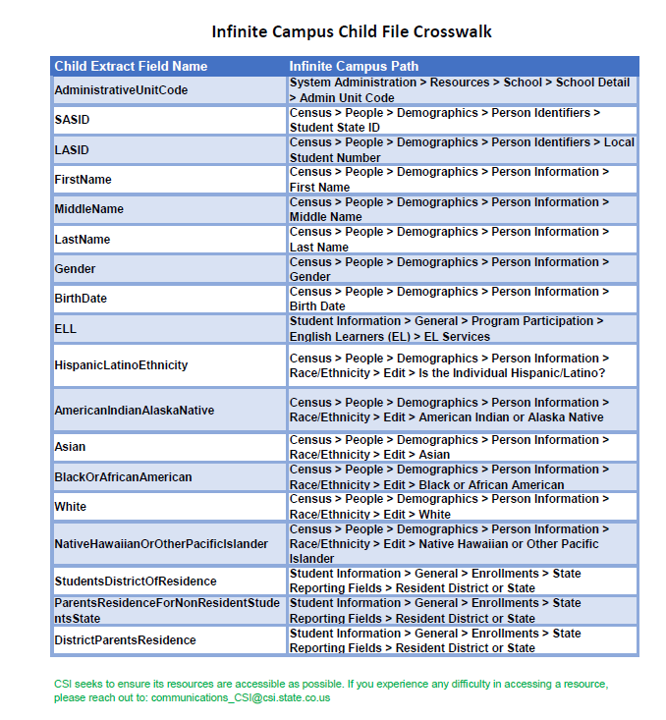
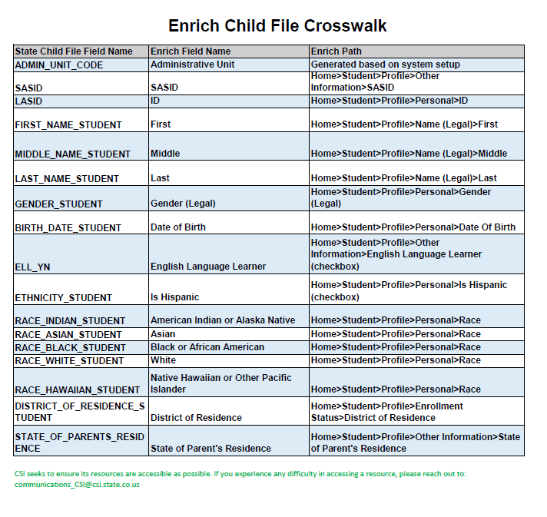
Infinite Campus/Enrich Crosswalks
Infinite Campus Collection Crosswalk
Enrich SPED Collection Crosswalk
Notes:
Another great resource that can be used when determining where to enter data is the Plan Management Crosswalks. These documents can be used during the initial entry or error clearance phases of the collection. Essentially these documents provide the State Reportable field names, the names in your Plan Management System, and the actual path to access these fields. Sometimes as you are going through this process, it may be difficult to know where certain fields need to be entered and what is being pulled for state reporting. The goal of these documents is to provide you a crosswalk of where exactly to find those fields depending on what system you are using. Hopefully, this will reduce the time you spend looking for fields to enter or correct during the December count process!

Slide 23
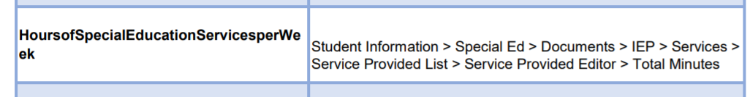
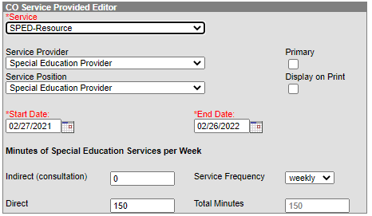
Example of Using the Crosswalk
You are working on adding information into IC and need to enter the SPED Hours Per Week for students but are unsure on where to find this field. The IC Crosswalk will be a great resource!
Based on this information, you know that:
This field is located within the IEP under Services→Service Provider List→Service Provided Editor→Total Minutes
Notes:
In terms of an example for this, let’s say you are working through data entry or error clearance, and you do not know where the SPED Hours Per Week is located in Infinite Campus. Using this resource will point you to the exact location in IC where this information needs to be added.

Slide 24
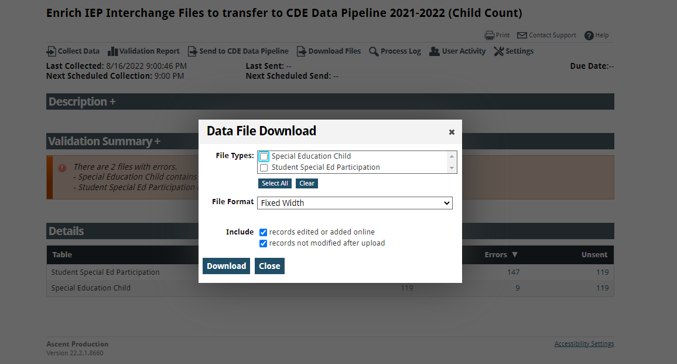
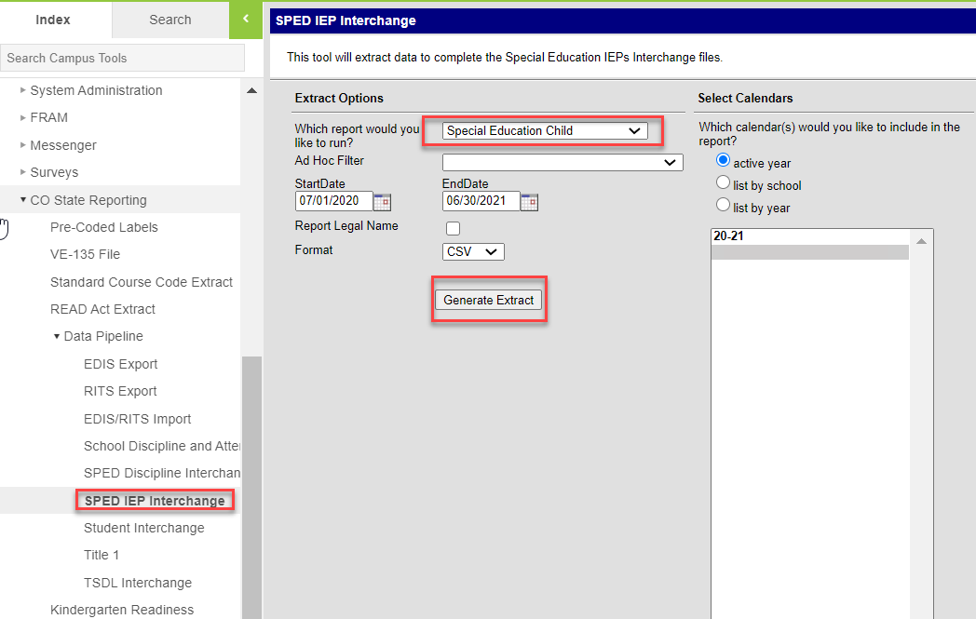
Step 3: Submission to CSI – File Extract
Extract data from the plan management system:
Enrich File Extraction Instructions
IC Special Education File Extract Guidance
Notes:
So that was step 2, collecting and entering data - that really can be a time-consuming part of the process. The next step we will be looking at today is step 3 – the extraction and submission of your files to CSI. All files should be extracted directly from the State Reporting sections of IC and the CDE Data Pipeline option in Enrich. To ensure you are completing this step accurately and entering the correct information in the prompts, please see the IEP Child and Participation Guides for Infinite Campus to assist with this process. As for Enrich, we have a newly created Enrich File Extraction instructions document located on the December Count webpage and linked here. Hopefully, using these guides and documents will aid in the file extraction process.

Slide 25
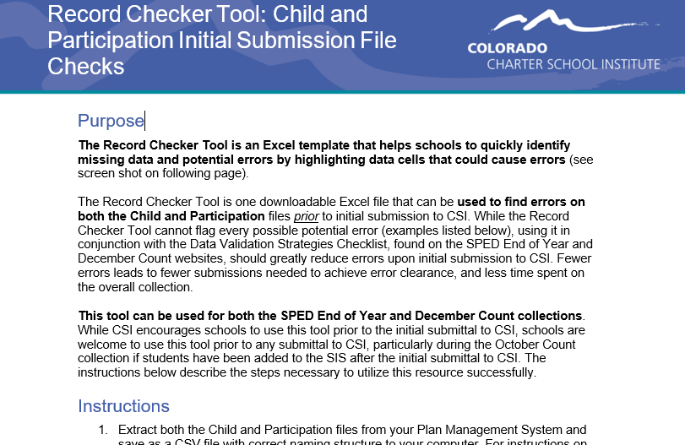
The Record Checker Tool
The purpose of the SPED Record Checker is for schools to review their initially extracted Child and Participation Files prior to initial Submittal. The template will flag for potential errors that can be corrected prior to initially submitting files. The goal of this resource is to:
Purpose
Identify errors and correct prior to submittal Fewer errors received upon initial submittal Fewer submissions until error clearance Collection errors cleared earlier in the process
Record Checker Tool Version Access:
Leading Zeros (XLSX)
Without Leading Zeros (CSV)
Notes:
Alright now that you have extracted your first files, lets talk about a great validation tool that CSI has developed for Special Education called the Record Checker. So really the purpose of this new tool is to identify potential issues or errors prior to initial submittal. The tool is essentially a template that allows you to paste your raw data files into it and any potential issues will be flagged on the review tabs. It is not designed to catch every error, but if used properly – you should expect to see less errors on your initial submissions with the goal of less submittals to error clearance!

Slide 26
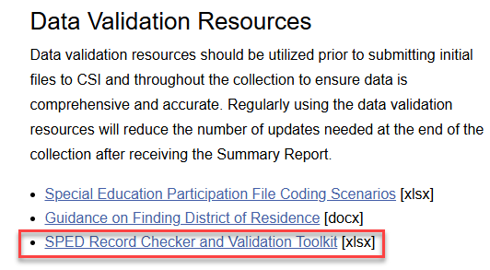
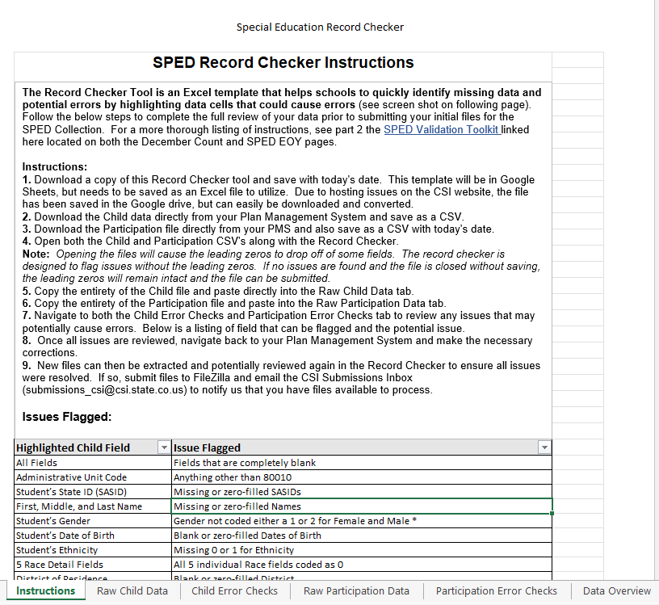
Record Checker Quick Steps Reminder
Record Checker Steps
Download the Record Checker tool and save to your computer Also, download your Child and Participation files from your Plan Management System Open the files either by retaining the leading zeros (select Don’t Convert) or dropping them depending on the RC selected Copy each file and paste into the raw data tabs on the file Navigate to the error checks tabs and review the highlighted fields Make the appropriate changes in your system and extract new files. These can be submitted or run again through the Record Checker Submit your initial submittal to CSI when issues have been resolved
For further instructions and details on this tool, see the SPED Record Checker Tutorial located on the December Count page
Notes:
This slide covers a high-level overview of the steps necessary to successfully utilize the SPED Record Checker Tool. There also is a link to the training tutorial at the bottom. Essentially you want to (READ Steps). This definitely is an underutilized tool that every school should be running on their files prior to initial submittal.

Slide 27
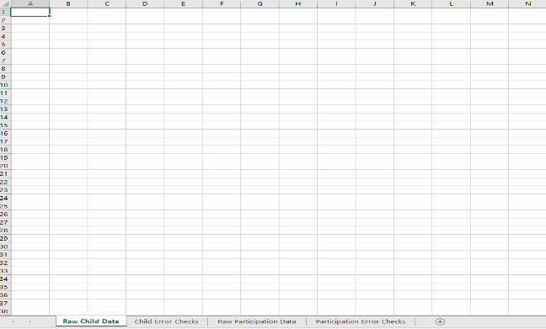
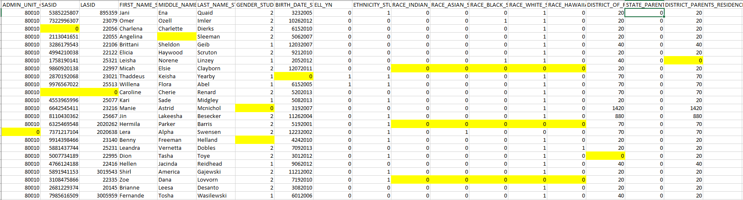
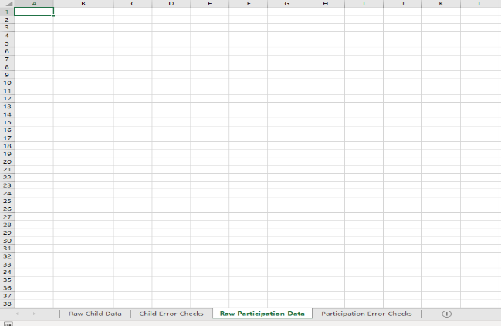
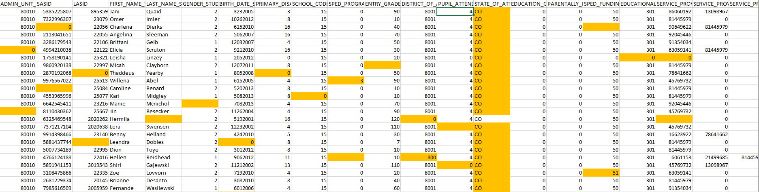
SPED Record Checker Tool
Notes:
This slide shows the 4 major tabs of the record checker tool and how it looks when used. Essentially, you want to paste your raw data to the raw data tabs shown on the left and navigate to the checks tabs to see what is highlighted, displayed on the right.

Slide 28
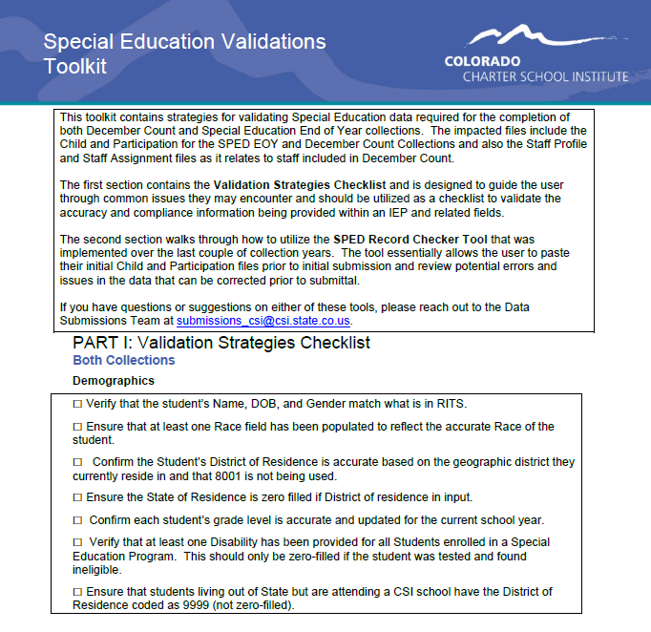
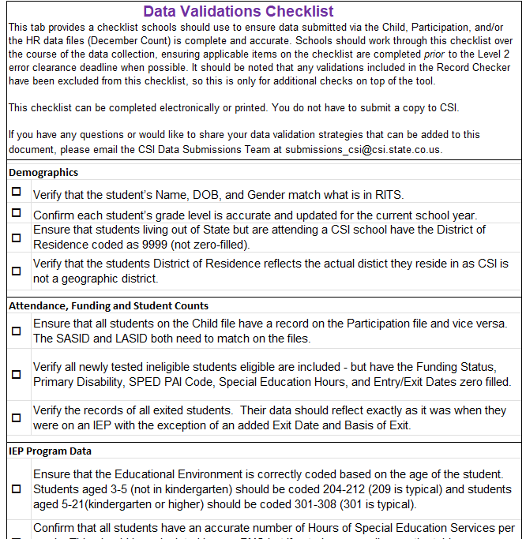
Data Validation Strategies included in the Record Checker
Notes:
A recent change that has occurred with the Record Checker is the addition of an additional validations tab to check on additional areas to review that are not included in the checker. Historically, we have had a separate validation toolkit but found it to be repetitive with many of the flags from the Record Checker. To avoid duplicated efforts, we took the most applicable validation checks from the toolkit that were not being flagged on the Checker and added an additional tab. This shows areas to check in addition to what you are seeing while using the record checker.

Slide 29
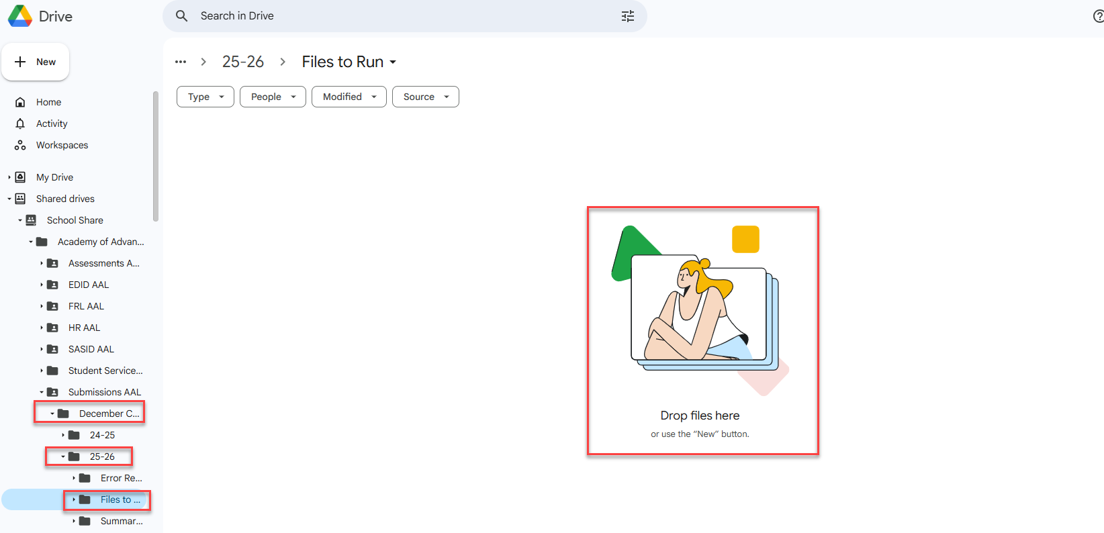
Step 3: Submission to CSI
Correct Naming of Files
Examples:
SCHOOLCODE_SCHOOLABBREV_Child_Date
SCHOOLCODE_SCHOOLABBREV_Participation_Date
Files should not contain any spaces in order to upload to CDE
Ensure you are uploading them to the correct folder in Google Drive:
G-Drive>December Count>25-26>Files to Run
Email the submissions inbox (Submissions_CSI@csi.state.co.us) once file is available to process
29
Notes:
So that was step 2, collecting and entering data - that really can be a time-consuming part of the process. The next step we will be looking at today is step 3 – submission of your files to CSI. When you are submitting your files to CSI, you are going to be opening up G-Drive and navigating to the December Count folder. Within this folder, you will see a sub folder for 24-25 that contains the following individual folders – Files to Run, Error Reports, and Summary Certification. For this part of the process, you will want to ensure you are placing those Child and Participation files into the Files to Run folder with the correct naming convention. You will see examples of this above that include: School Code, School Abbreviation, File Name and Date. If you submit multiple files in one day, you can always use a v2 at the end for version 2. This ensures that we are uploading the most recent file you submitted. You will also notice that the examples contain no spaces, so you can either separate them out by underscores or group them all together. If files contain spaces, we have to rename them prior to uploading to the Data Pipeline, which is an added extra step. Another issue that I mentioned that can delay us from sending you error reports would be adding these to the wrong folder. We often see files added to the wrong collection, year or folder and we have to jump around within G-Drive to determine where those have been placed. It is often good practice to include the path of where the files were placed into your email which you need to send to CSI to notify us that your files are ready to be processed. Issues with any of these steps can certainly lead to delays in getting your error reports and extra time to the processing, so you’ll want to be sure this is all done accurately.

Slide 30
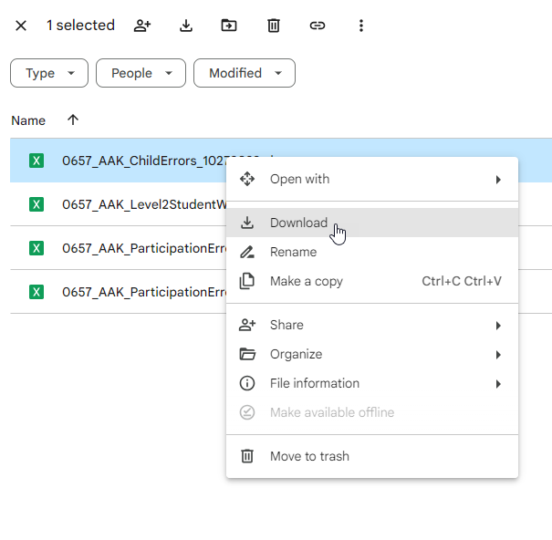
Step 4: Error Resolution
Once submitted, CSI will process the files in the Data Pipeline and extract error reports.
All Level 1 and 2 Error Reports will be available in the Error Reports folder at the following path:
Submissions/December Count/25-26/Error Reports
Right click on the file and download these reports from Google Drive directly to your downloads folder on your computer and save to an appropriate folder similar to the process described above, but in reverse.
Notes:
So once you have submitted and emailed CSI, we will process your files and provide you both level 1 and 2 error reports when applicable. Level 2’s will only be sent once you have cleared up all level 1 errors. These reports will be provided in G-Drive under the 24-25 Error Reports folder shown in this slide. These files can be downloaded and saved to your computer for use in the error clearance process. This process is similar to the transfer process described in the previous slide, but in reverse. Once downloaded, you can open your error reports and make the necessary changes in your plan management system to correct the issues.

Slide 31
Level 1 vs. Level 2 Errors
Level 1 Errors
First error reports you receive will contain level 1 errors.
These errors are file specific, so you should receive a Child and Participation Error Report.
Clearing Level 1 is necessary to receive your level 2 error reports.
Once level 1 is cleared, a snapshot of the data is run and schools can receive level 2 reports.
Level 2 (Snapshot) Errors
Level 2 errors look for inconsistencies across the files or even other collections.
December Count has 2 Level 2 reports, one for students and another for SPED Staff.
Correcting these errors may require updates to one or both SPED files along with HR.
The SPED staff in HR pull into the December Count snapshot, so may require HR updates to clear December Count errors.
Notes:
As I mentioned, you will receive both Level 1 and Level 2 snapshot errors, so I figured it may be helpful to explain the differences. First, level 1 errors are file specific, so there are two separate reports, one for child and one for participation. This means it is much easier to determine which fields need to be updated to correct the error. These errors also prevent students from pulling into the snapshot, therefore you must clear those prior to receiving level 2 errors. As far as level 2, once schools have cleared level 1 errors – CSI can run a point in time snapshot. These errors look for inconsistencies across the files in the collection and even other collections. In this case, you will receive a level 2 student and a level 2 staff error report. Correcting these errors may require more effort to determine which field is causing the issues and even may require updates to your schools HR Collection. All staff working in Special Education are pulled into the December Count snapshot instead of HR. This means you may have to work with the schools HR staff to clear SPED errors.

Slide 32
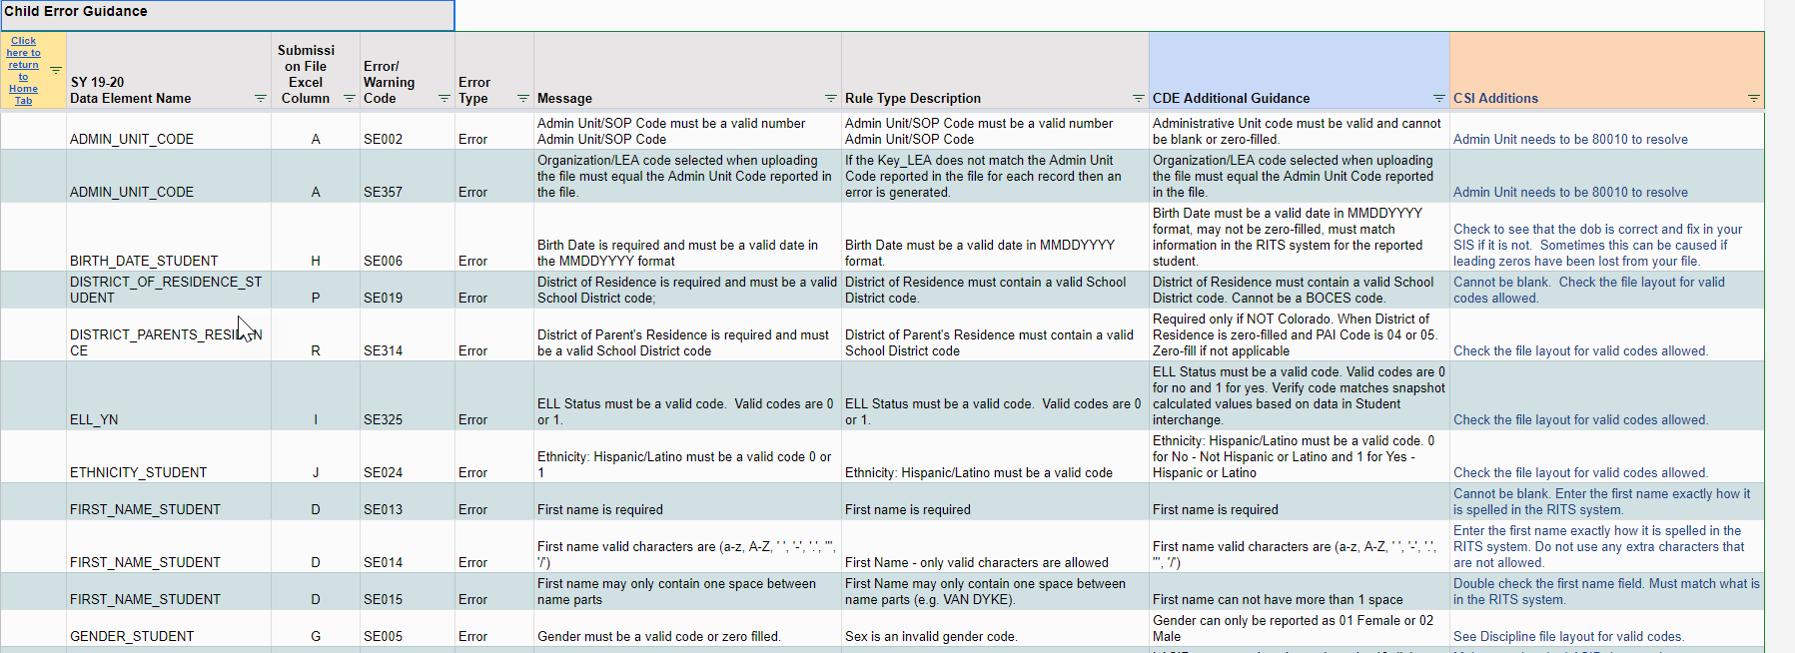
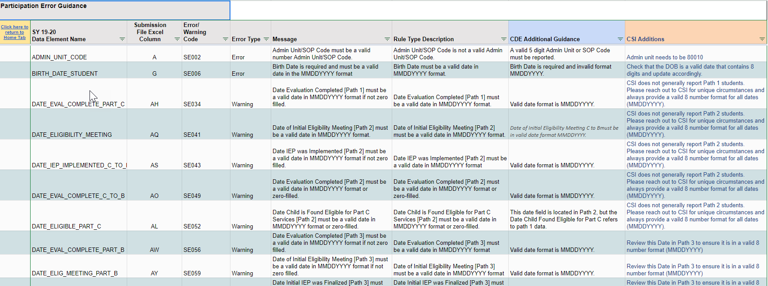
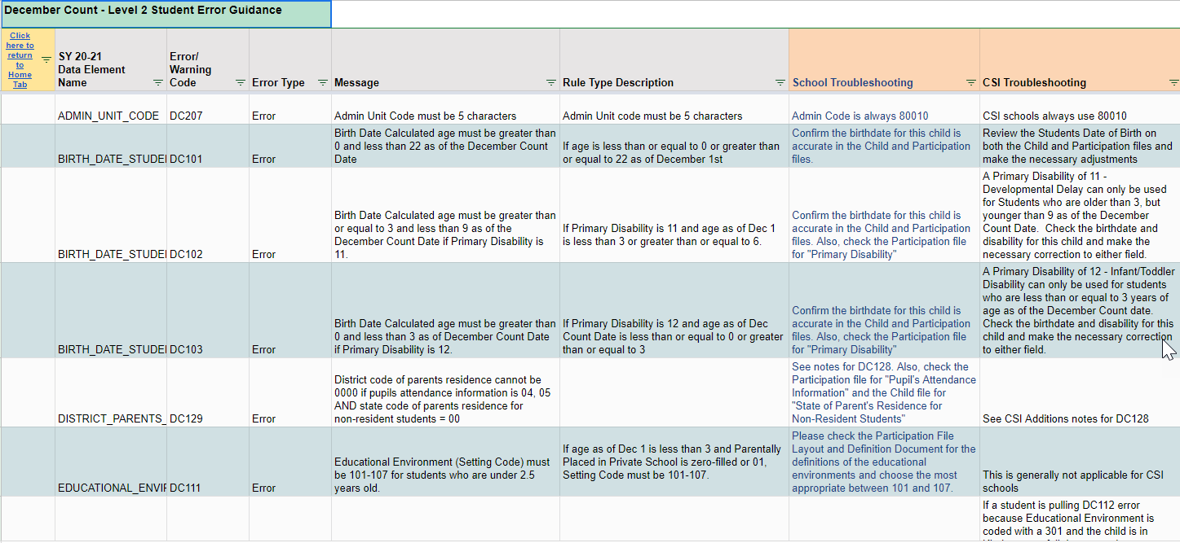
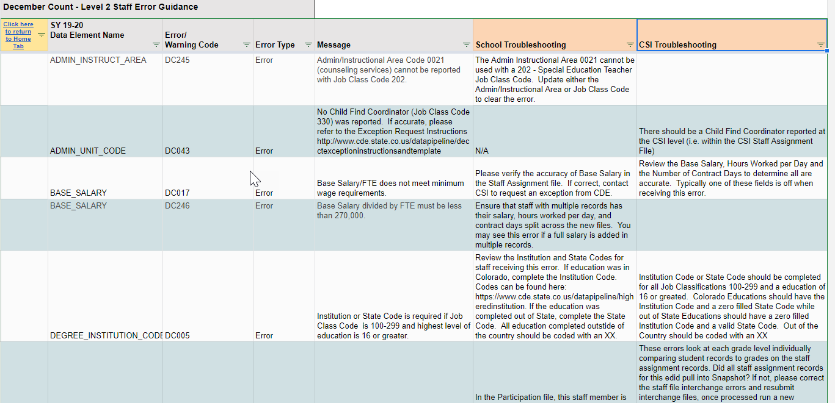
Troubleshooting Errors
Review the Child, Participation, Level 2 Staff, and Level 2 Student Reports for Guidance!
https://resources.csi.state.co.us/troubleshooting-errors/
Notes:
(NEXT) To help with this process, CSI has created the previously mentioned Troubleshooting Errors document. Here is a screenshot of all the tabs you will use in the troubleshooting document when clearing errors for the December count collection. Those tabs are the Child, the Participation, Level 2 Staff and Level 2 Student. The goal when you go to these tabs is to further identify what is causing the error and possible solutions. Essentially it contains a listing of the Error/warning Code, related data element names, whether it is an error or warning and the message you will see in your actual error report. In addition to those, we have added CSI specific troubleshooting notes along with CDE additional troubleshooting notes. Each of these columns provide a little more clarification to the message delivered in the error report with the CSI notes being much more specific resolution options as it relates to CSI schools. CDE had created something similar to this idea that provides additional comments they can add. These are generally getting updated quite often and can certainly help provide additional information that should assist in you clearing those errors. As I have mentioned this is somewhat of an iterative process and we don’t expect all errors to be cleared on the second submittal, but using these troubleshooting resources can certainly help to reduce the number of times you have to make corrections and resubmit.
Feel free to reach out to us if you have specific questions on how to utilize this or if you have errors that you are still unable to clear and we would be more than happy to assist.

Slide 33

Step 5: Data Review
Summary Certification report will be provided to all
schools once they are error free
Steps to Complete:
Review each tab thoroughly to determine accuracy of data
If accurate, ensure all applicable parties (below) have signed and return scanned version of the signed Certification tab to CSI
School Leader, Data Submissions Coordinator, HR Contact, and the SPED Contact
If errors are found, modify most recent error free files or reach out to CSI for assistance
Changes will be uploaded to the Data Pipeline and a new summary report provided
Once data is accurate, sign and return prior to the due date.
Courtesy of clipartpanda.com
Notes:
Once you have gone through this iterative process and are able to clear all level 1 and 2 errors, you are ready for step 5 Data Review. All schools who have been able to clear their errors will receive a December Count Summary Certification Report, which will be located in the Summary Certifications folder in Google Drive. Once you have received your report, you will want to follow the steps listed here. First you want to (READ SLIDE). As we had mentioned in the beginning of this training, December Count data is tied directly to Special Education funding and necessary reporting among other areas, so accuracy is key!

Slide 34
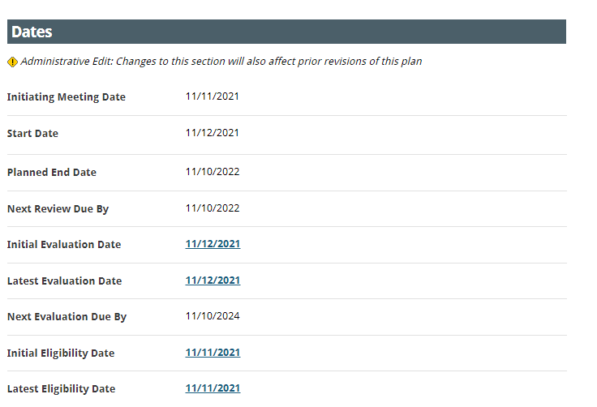
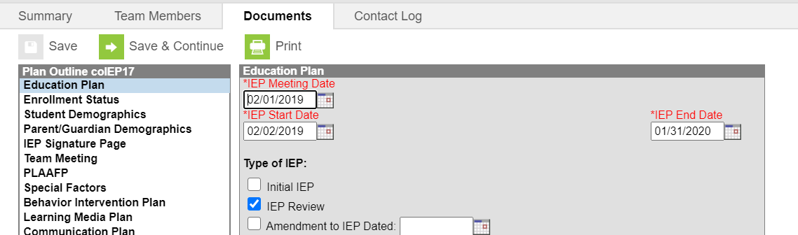
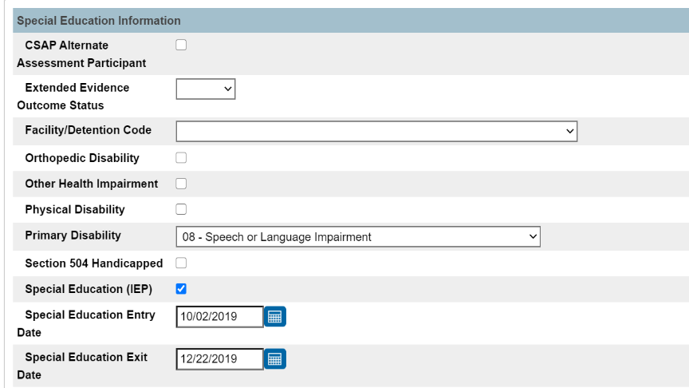
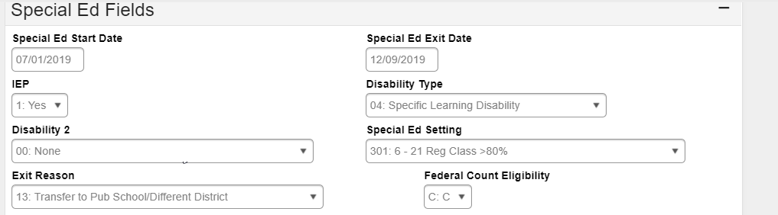
Special Education Exits
Ensure you are completing the Exit Date and Basis of Exit fields anytime a student exits Special Education. New files should be submitted and match what is being reported in the Student Interchange (OC, EOY).
Update the Additional State Reporting fields in Enrich and the Special Ed fields in PowerSchool
Update the IEP Exit fields and the Enrollment Special Ed Fields in Infinite Campus
34
Notes:
It should be noted that whenever a student exits the Special Education program at your school, they must be reported as such. This means all the applicable fields in both your Plan Management System and SIS must be updated. For IC, update the IEP with the applicable exits and ensure you are updating the Special Ed fields on this year's enrollment to complete the process. Screenshots of what to update are provided here. If working with PowerSchool and Enrich, make sure to update the Special Education fields in both systems. These entry and exit dates have important implications in many collections, so ensuring they are completed with an accurate date is vital to the success of accurate student reporting.

Slide 35
Timelines and Deadlines
Notes:
Now that we have discussed the 5-step process of data submissions, let’s jump into timelines and deadlines collection!

Slide 36

SPED EOY Timelines and Deadlines
Deadline | Task
11/10/2025 | Submit initial files (Child, Participation)
12/04/2025 | Schools must have all Level 1 (Child/Participation) errors cleared
01/15/2026 | Schools must have all Level 2 (HR and December Count-Staff) errors cleared
Second week of Jan* | CSI will provide Data Summary Reports to schools
1/27/2026** | Submit Signed Certification Agreements to CSI
*Dependent upon all schools clearing errors by specified deadlines
**Any requests for changes must be received by CSI on or before 1/23/2026
For a full listing of calendar dates and deadlines, see the CSI Data Submissions Calendar
Notes:
In terms of timelines and deadlines that must be met for the 24-25 December Count collection. First, we have a date of 11/07 to have all your initial child and participation files submitted with level 1 error clearance for those files being on December 4th. All school must have both level 1 and 2 errors cleared by January 16th, 2025, and you will receive your summary report shortly thereafter. The date to review, sign and return those is January 28th. If after reviewing, you notice some changes that need to be made to your data, please submit those updated files to CSI by January 24th to ensure files can be processed and a new summary report delivered to meet the deadline.

Slide 37
Mid-Point Timelines and Deadlines
To avoid both the logjam that occurs and processing delays on deadline days, we are asking schools clear at least half of their errors by the below dates. These are typically the halfway point between each deadline.
Level 1 Mid Point Deadline: 11/21/2025
Level 2 Mid-Point Deadline: 12/30/2025
This is strongly recommended for the current 25-26 December Count collection but will be required in future collections and years.
Notes:
To expand more on deadlines, we are trying out a option this year that is intended to help with the logjam and overall craziness that occurs on deadline dates. We often receive the most submissions on these days and in many cases, some of the issues experienced are more complicated and require further research. In an effort to avoid the deadline rush, we are asking schools to have at least half of their level 1 errors cleared by November 21st and half of their level 2 errors by December 30th. These certainly can be met earlier, but hopefully by implementing this, you will receive your error reports back in a more timely manner.

Slide 38

Thank you for Reviewing this Training
Contact the Submissions Inbox with Questions:
Submissions_CSI@csi.state.co.us
Notes:
Thank you so much for reviewing this training for the 24-25 December Count Data Collection. If you have questions, don’t hesitate to reach out to CSI and we are more than happy to assist you!

