Slide 1

Multilingual Learner Coding for State Reporting
Recorded August 2025
Notes:
Welcome to the Multilingual Learner Coding for state reporting recorded by the CSI Data Submission Team.

Slide 2
Who are Multilingual Learners (MLs)?
Also known as English Learners (ELs) or English Language Learners (ELLs)
Refers to students who are:
  linguistically diverse,
  identified using the state-approved English language proficiency assessment
  identified as having a level of English Language Proficiency that requires language support to achieve standards in grade-level content in English.
CSI schools receive funding based on the counts of MLs - the two main funding streams are ELPA and the ELL Funding Factor (ELL funding factor discussed here: https://www.cde.state.co.us/cdefinance/auditunit_ell_count)
2
Notes:
"Multilingual Learners, or MLs — sometimes referred to as English Learners (ELs) or English Language Learners (ELLs) — are students who are linguistically diverse. They are identified through the state-approved English language proficiency assessment as having a level of English proficiency that requires language support to meet grade-level academic standards in English.
CSI schools receive funding based on the number of ML students they serve. The two main funding sources are ELPA and the ELL Funding Factor. For more details about the ELL Funding Factor, please visit CDE’s School Audit Office webpage."

Slide 3
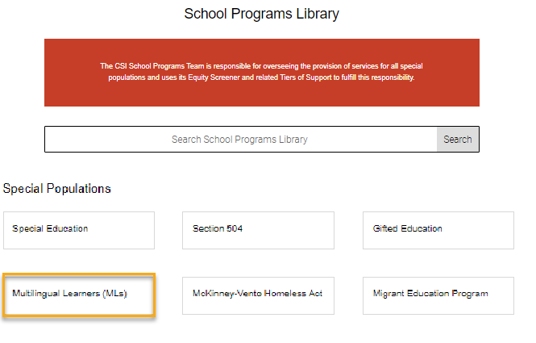
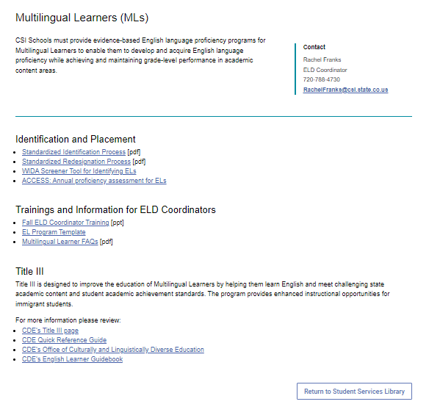
ML Programming Resources
https://resources.csi.state.co.us/multilingual-learners/
Notes:
"CSI’s Resource Site contains several tools and guides to support Multilingual Learner programming and coding.
You can find information about identification, programming, and evaluation for Multilingual Learners under the Multilingual Learner section of the School Programs page. If you already have the Data Submissions Resource Library bookmarked, simply navigate to ‘School Programs’ and select the Multilingual Learners option.
These resources are typically used by your school’s designated Multilingual Learner Coordinator. If you’re unsure who that is for your school, please reach out to your school leader or to CSI’s School Programs and Equity Initiatives Manager — their contact information is posted on the ML page of the Resource Site.
Multilingual learner identification will be determined by your school’s ML Coordinator, based on state-level requirements and the process outlined in your school’s Multilingual Learner Program Plan."

Slide 4
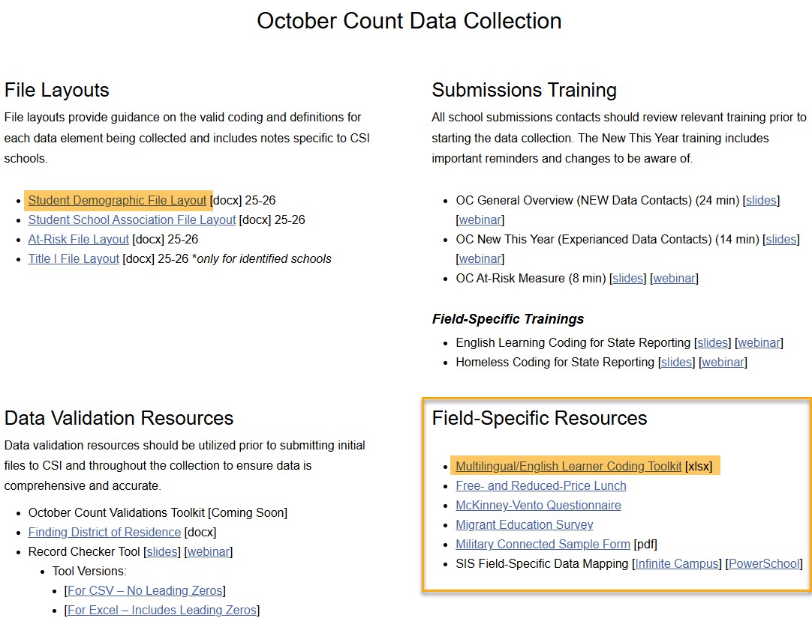
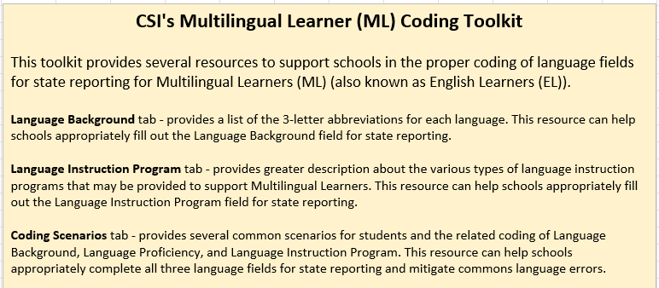
Data Submissions ML Resources
https://resources.csi.state.co.us/data-submissions/october-count/ OR
https://resources.csi.state.co.us/data-submissions/eoy/
Notes:
"Information about data entry and coding for Multilingual Learners can be found on each applicable data collection’s resource page.
For example, on the October Count resource page, the ‘Field-Specific Resources’ section includes the Multilingual Learner Coding Toolkit. This toolkit provides guidance to ensure proper coding of Language Background, Language Proficiency, and Language Instruction Program fields for state reporting.
The toolkit should be used alongside the SD file layout for accurate reporting."

Slide 5
Language Fields in State Reporting
Located in the Student Demographic (SD) File
Language Background
Language Proficiency
Language Instruction Program (LIP)
https://resources.csi.state.co.us/data-submissions/october-count/ OR
https://resources.csi.state.co.us/data-submissions/eoy/
- File Layouts/Student Demographic File Layout
5
Notes:
There are three language fields collected for state reporting: language background, language proficiency, and language instruction program.
The three ML fields are all found on the SD File so if you have questions about definitions or are looking to troubleshoot errors related to these fields, please review the SD File Layout!

Slide 6
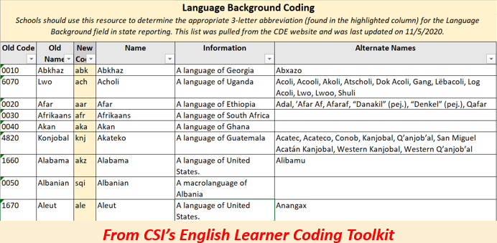
1. Language Background
6
Notes:
The first of the three language-related fields is the Language Background field. Language Background refers to the primary or home language of a student and is typically determined by a parent or guardian’s completion of the Home Language Survey.
For example, students with a home language background of English would be coded as ENG. Students with a home language background of Spanish would be coded as SPA.
This is a 3-letter code that must be completed for all students, and a list of these codes can be found on each collection’s resource library within CSI’s Multilingual Learner Coding Toolkit.

Slide 7
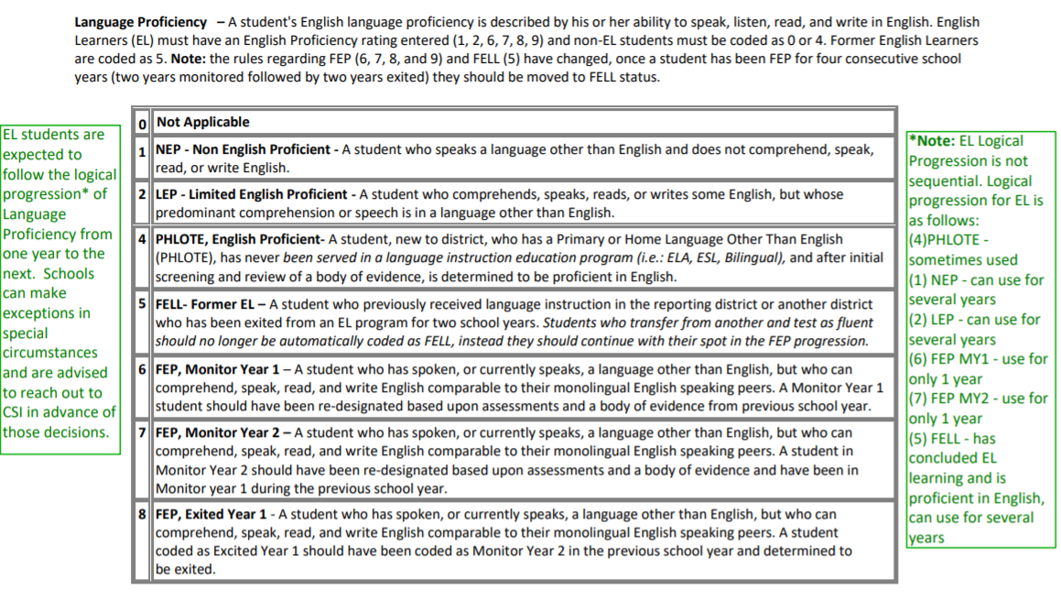
2. Language Proficiency
7
Notes:
"The second language-related field for state reporting is the Language Proficiency field. This field reflects a student’s ability to speak, listen, read, and write in English. Proficiency status is determined at the school level using ACCESS testing or WIDA screening, along with a body of evidence. Your school’s ML Coordinator leads this process.
Students who are not Multilingual Learners should be coded as:
0 for Not Applicable,
4 for PHLOTE — a student with a primary or home language other than English who has never been served in a language instruction program, or
5 for FELL — a student with a primary language other than English who previously received ML instruction and has exited from ML programming.
Students who are Multilingual Learners should be coded as 1, 2, 6, 7, 8, or 9, based on the definition provided."

Slide 8
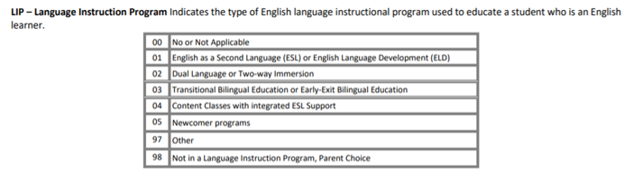
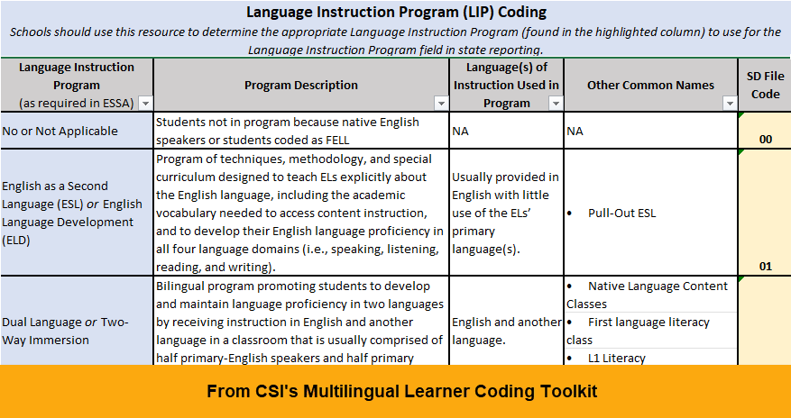
3. Language Instruction Program
https://resources.csi.state.co.us/data-submissions/october-count/ OR
https://resources.csi.state.co.us/data-submissions/eoy/
8
Notes:
The third and final language-related field is the Language Instruction Program, or LIP field. This field identifies the type of program your school is using to educate Multilingual Learners. This information should be available in your school’s ML Program Plan and can be confirmed by your school’s ML/EL Coordinator.
More details about each of these Language Instruction Program options can be found in CSI’s Multilingual Learner Coding Toolkit found on the October Count and End of Year resource pages.
Please note, students that are opted out of ML services, must still be coded as an ML Learner and take ACCESS testing annually. However, since the student was opted out of services, the LIP code would be 98 for –Not in Language Program, Parent Choice.

Slide 9
Common Errors – Logical Sequence
Error: The student does not follow the logical sequence for ML.
Sequential Order
on SD File Layout
Logical Sequence
for ML Progression
0 – N/A
1 – NEP: Non-English Proficient
2 – LEP: Limited English Proficient
4 – PHLOTE: Primary Home Language Other than English
5 – FELL: Former Multilingual Language Learner
6 – FEP: Full English Proficient, Monitor Year 1
7 – FEP: Full English Proficient, Monitor Year 2
8 – FEP: Full English Proficient, Exited Year 1
9 – FEP: Full English Proficient, Exited Year 2
0 – N/A
4 – PHLOTE: Primary Home Language Other than English
1 – NEP: Non-English Proficient
2 – LEP: Limited English Proficient
6 – FEP: Full English Proficient, Monitor Year 1
7 – FEP: Full English Proficient, Monitor Year 2
8 – FEP: Full English Proficient, Exited Year 1
9 – FEP: Full English Proficient, Exited Year 2
5 – FELL: Former Multilingual Language Learner
Notes:
Now that we’ve reviewed the language-related fields for state reporting and the resources available to schools, let’s turn our attention to some of the common ML errors that pop up in state reporting.
Some of the most common ML errors are due to students not following logical ML sequence. It is important to note that the sequential order, seen on the left of the slide and the order of options seen in the SD File Layout is not the same as the Logical ML order, seen on the right.
Students are generally expected to following the logical sequence for ML progression on the right side of this slide.

Slide 10
Language Proficiency: PHLOTE
0 – N/A
4 – PHLOTE: Primary Home Language Other than English
1 – NEP: Non-English Proficient
2 – LEP: Limited English Proficient
6 – FEP: Full English Proficient, Monitor Year 1
7 – FEP: Full English Proficient, Monitor Year 2
8 – FEP: Full English Proficient, Exited Year 1
9 – FEP: Full English Proficient, Exited Year 2
5 – FELL: Former Multilingual Language Learner
PHLOTE is used for students new to the district, who has a Primary or Home Language Other Than English (PHLOTE), has never been served in a language instruction education program (ex. ELA, ESL, Bilingual), and after initial screening and review of a body of evidence, is determined to be proficient in English.
Important Notes:
If a student has any ML history, they should NOT be coded as PHLOTE.
Language proficiency and language instruction programs codes should not be added into your SIS for students UNTIL screening and identification has occurred.
IC Users: Be aware that IC will default code PHLOTE 04 when a student is entered as having a home language other than ENG. Continue ML process and update this code if needed.
Notes:
Now that you know that the Logical ML coding Sequence is not numerically sequential in the SD File Layout, let’s review these language proficiency coding options.
PHLOTE code 4 is used for a student new to the district, who has a Home Language Other Than English), has never been served in a language instruction education program (ex. ELA, ESL, Bilingual), and after initial screening and review of a body of evidence, is determined to be proficient in English.
It is important to note that if a student has a history of ML coding, in any school or district, then they should never be coded as PHLOTE. In addition, language proficiency and language instruction programs codes should not be added into your SIS for students UNTIL screening and identification has occurred.
Important note for IC users, when a student is entered into Infinite Campus with a home language of anything other than ENG, IC will automatically code the student's proficiency to be PHLOTE code 4. Regardless of IC's default proficiency coding, it is important that this student continues in the ML screening process and coding is updated in IC if determined applicable. CSI will be conducting an ML verification prior to OC and EOY for IC users.

Slide 11
Language Proficiency: NEP & LEP
0 – N/A
4 – PHLOTE: Primary Home Language Other than English
1 – NEP: Non-English Proficient
2 – LEP: Limited English Proficient
6 – FEP: Full English Proficient, Monitor Year 1
7 – FEP: Full English Proficient, Monitor Year 2
8 – FEP: Full English Proficient, Exited Year 1
9 – FEP: Full English Proficient, Exited Year 2
5 – FELL: Former Multilingual Language Learner
Designations based on WIDA testing and a body of evidence.
While note following the logical sequence,
NEP students can skip LEP and move to the beginning of FEP
LEP student can move back down to NEP
However, both require an exemptions request and should be done in coordination with your school’s ML/EL Coordinator.
Notes:
NEP refers to non-English proficient students and LEP refers to limited English proficient students. A student can stay in these designations for years, even their whole ML career.
A student can move back and forth from LEP to NEP or can skip from NEP to the beginning of the 4 year process of the FEP monitor/exit steps.

Slide 12
Language Proficiency: FEP
0 – N/A
4 – PHLOTE: Primary Home Language Other than English
1 – NEP: Non-English Proficient
2 – LEP: Limited English Proficient
6 – FEP: Full English Proficient, Monitor Year 1
7 – FEP: Full English Proficient, Monitor Year 2
8 – FEP: Full English Proficient, Exited Year 1
9 – FEP: Full English Proficient, Exited Year 2
5 – FELL: Former English Language Learner
A student must go through the full FEP process sequentially.
A student may only be coded as FELL after completing the 4-year FEP process.
Notes:
Many ML Errors occur in FEP, or fully-English proficient, coding. A student must go through the full FEP process sequentially having a full year of Monitor Year 1; Monitor Year 2; Exit Year 1 and Exit Year 2.
During the FEP process students cannot skip any FEP step; students cannot repeat a FEP step; and students cannot move back a FEP step. If needing to repeat or move back a FEP step, students will instead need to move all the way back to NEP or LEP.
ML students should be coded as FELL only once they’ve stepped through the 4 year FEP process.

Slide 13
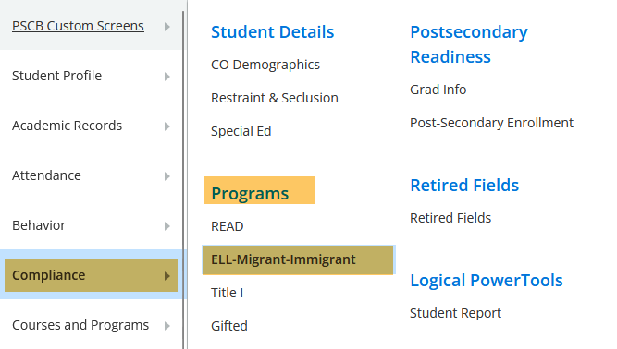
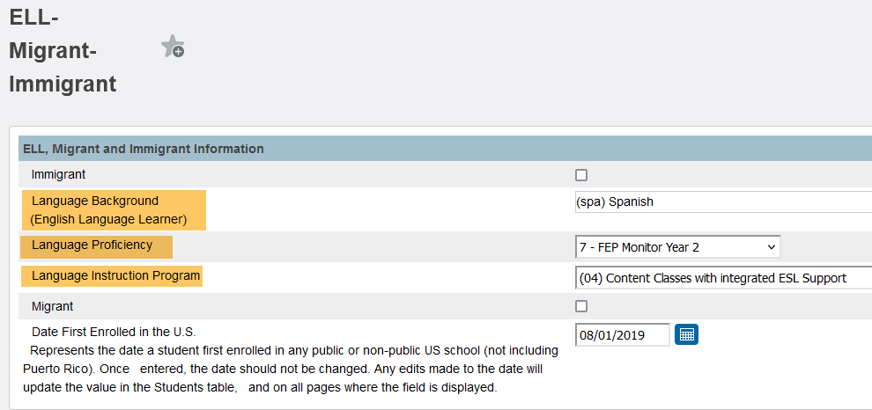
Coding in PowerSchool
Start Page > Student Selection > Compliance > ELL-Migrant-Immigrant
13
Notes:
In PowerSchool, all three ML fields are found under the EL-Migrant-Immigrant tab of Compliance side menu.

Slide 14
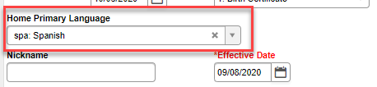
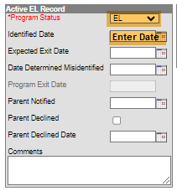
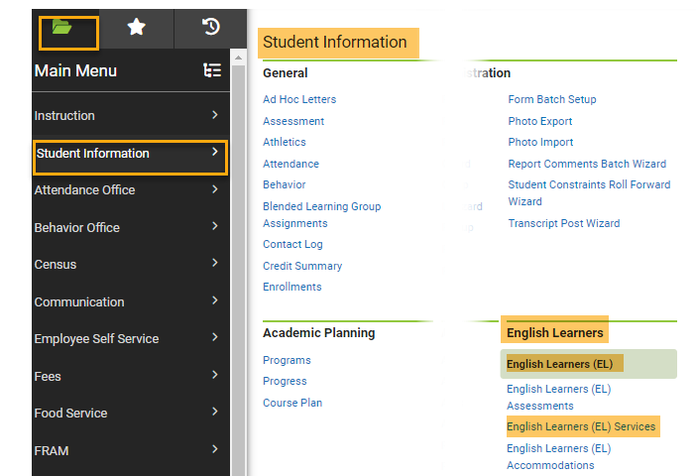
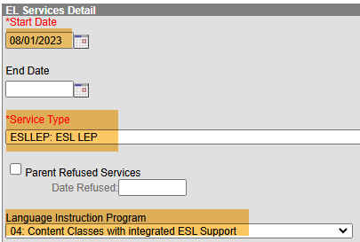
Coding in Infinite Campus
1) Language Background
Census > People > Identities > Home Primary Language
2) Language Proficiency
Student Information > English Learners> English Learners (EL) > English Learners (EL) Services
3) Language Instruction Program
14
Notes:
In Infinite Campus, Language Background (or Home Primary Language) can be found under Census>People>Identities.
Language Proficiency and Language Instruction Program can be found under the English Learners section of Student Information.

Slide 15
Validating ML Data
CSI validation resources
  Record Checker Tool
  Data Validations Checklist
Running ad hoc reports or SD files
Partnering with the ML Coordinator to double check the list of students served and compare to the data in your schools SIS.
Carefully review OC and EOY Summary Report
https://resources.csi.state.co.us/data-submissions/october-count/ OR
https://resources.csi.state.co.us/data-submissions/eoy/
16
Notes:
It is a CSI expectation that data contacts work closely with their ML Coordinators to validate ML data through out the year.
There are several resources available to validate your ML data.
Use CSI Validation resources such as the Record Checker Tool and the Data Validations Checklist, which include an audit for ML students. These resources can be found on the CSI OC and EOY webpages.
Run Ad Hoc Reports from your SIS throughout the year to pull a list of students identified as ML. You can also extract an SD file that includes ML identification columns. Filtering these columns to include all students with the exception of students with code 0 (not applicable), 4 (PHLOTE), or 5 (FELL) will include all students that are identified as ML.
Share this list with your school’s ML/EL Coordinator. Your ML/EL Coordinator should check the list of students served and compare it against the data in your SIS.
Lastly, Carefully review this demographic group when reviewing your EOY and OC Summary Reports.

Slide 16
ML Count Funding
CDE ELL Audit Resource Guide
http://www.cde.state.co.us/cdefinance/2324_ell_audit_resource_guide
Separate October Count funding stream for NEP and LEP students meeting certain criteria
Schools must submit documentation to CSI at the time of any state ELL Count audits where sample students are selected
Ensure that all ML data is reported accurately in the October Count!
16
Notes:
A new language proficiency funding factor was added to the October Count funding formula beginning for the first time in school year 21-22 and will continue indefinitely.
This is a separate funding stream for NEP and LEP students meeting certain criteria.
More detail on the criteria is outlined in the CDE ELL Count Audit Guide linked on this slide. The CSI October Count Audit resources will also have information.
Schools must submit documentation to CSI at the time of any state ELL Count audits where sample students are selected.
Like all other data that schools report in the October Count, it has to be accurate, and schools must be able to provide supporting documentation as proof for funding awarded.
School submission contacts should be working together with their ML/EL coordinators to ensure the have checks in place.

Slide 17
Thank you for viewing this training!
For questions on ML identification, programming and evaluation, contact Rachel Franks:
RachelFranks@csi.state.co.us
For questions on data entry and coding, please reach out to the CSI Data Submissions Team:
submissions_CSI@csi.state.co.us
Notes:
For questions on the identification, programming, and evaluation of Multilingul Learners, please reach out to CSI’s School Programs & Equity Initiatives Manager.
For questions on data entry and coding for English Learners, reach out to the CSI Data Submissions Team.
Thank you.

