Slide 1

Homeless Coding in State Collections
Recorded August 2025
Notes:
Welcome to this training, recorded by the data submissions team, on how to code McKinney Vento students, or students experiencing homelessness for state reporting .

Slide 2
McKinney-Vento Homeless Assistance Act
Primary piece of legislation related to the education of children and youth experiencing homelessness
Provisions ensure the enrollment, accessibility, and educational stability for qualifying students
Although CSI schools receive their initial allocation of McKinney-Vento funding based on counts of students experiencing homelessness as identified on the October Count data collection, McKinney-Vento Eligibility continues throughout the year
2
Notes:
The McKinney-Vento Homeless Assistance Act is the primary piece of legislation related to the education of children and youth experiencing homelessness.
Specific provisions ensure the enrollment, accessibility, and educational stability for qualifying students.
Although CSI schools receive their initial allocation of McKinney-Vento funding based on counts of students experiencing homelessness as identified on the October Count data collection, McKinney-Vento Eligibility continues throughout the year.

Slide 3
Who Qualifies for McKinney-Vento?
Any student who lacks a nighttime residence that is fixed, regular, and adequate.
  Fixed: A residence that is stationary, permanent, and not subject to change.
  Regular: A residence that is used on a nightly basis.
  Adequate: A residence that is sufficient for meeting both the physical and psychological needs typically met in home environments.
3
Notes:
Who qualifies for McKinney-Vento? The next two slides will help schools in identifying students that may qualify for MKV including:
Any student who lacks a fixed, regular and adequate nighttime residence qualifies for McKinney-Vento.
‘Fixed’ is defined as a residence that is stationary, permanent and not subject to change.
‘Regular is defined as a residence that is used on a nightly basis.
And ‘Adequate’ is defined as a residence that is sufficient for meeting both the physical and psychological needs typically met in home environments.

Slide 4
Qualifying Living Situations
Sharing the housing of others due to loss of housing, economic hardship, or similar reason – a.k.a. ‘double-up housing’
Youth on their own who lack a fixed, adequate and regular primary nighttime residence (unaccompanied youth). *May include students living with a non-legal or temporary guardian.
Living in motels, hotels, trailer parks, camping grounds due to lack of adequate alternative accommodations
Living in emergency or transitional shelters or are abandoned in hospitals
Living in a public or private place not designed for humans to live
Living in cars, parks, abandoned buildings, bus or train stations, etc.
4
Notes:
Alternative living situations that qualify for McKinney Veto may include those listed on this slide.
However, of these alternative living situations, there are two that we would like to highlight because they are common and sometimes overlooked situations. The first is “Sharing the housing of others due to loss of housing, economic hardship, or similar reason” – a.k.a. ‘double-up housing’. Roughly 75% of McKinney Vento students are in double-up living situations and while not all double-up situations are a cause of a housing crisis, the key phrase to pay attention to when identifying is ‘due to loss of housing, economic hardship, or similar reason’.
The second living situation is “Youth on their own who lack a fixed, adequate and regular primary nighttime residence” – or ‘unaccompanied youth’. Unaccompanied youth is a group that often gets missed or overlooked. This group is typically comprised of high schoolers and teenagers ‘crashing’ with friends, living with a significant other, runaways, or students living with a grandparent or other non-legal or temporary guardian.
It is important to note that the cause of homelessness does not matter (choice or non-choice). Schools will provide access to the MKV form.

Slide 5
Educational Rights of McKinney-Vento Students
For students grades Pre-K – 12th:
Immediate enrollment with full and equal opportunity to succeed in school even with lack of documentation or missed deadlines during homelessness period
Access to a McKinney-Vento Homeless Educational Liaison in their school district
Identification through outreach and coordination activities
Choice between the neighborhood school or the school of origin (school last enrolled in or attended)
Can remain in their school of origin for the duration of homelessness and until the end of an academic year in which they obtain permanent housing, if it is in their best interest
Transportation to the school of origin (including preschool)
Automatic eligibility for Title I, Part A of the Every Student Succeeds Act of 2015
Immediate access to free school meals and educational services for which they are eligible
Referrals to health care, dental, mental health and substance abuse, housing, and other appropriate services
Unaccompanied youth are informed of their status as independent students on the Free Application for Federal Student Aid (FAFSA)
Notes:
The educational rights of McKinney-Vento students' grades PreK – 12th include areas of school stability, school enrollment and participation, College Readiness and Title I funds. Please pause this slide to review a number of the rights available through McKinney-Vento. Please note that students that may qualify for McKinney-Vento must be enrolled in school immediately, even if they lack documents or have missed application or enrollment deadlines during any period of homelessness.
Schools must develop, review, and revise policies to remove barriers to the identification, enrollment, and retention of homeless students in school, including barriers due to fees, fines, and absences.

Slide 6
MKV Form & Enrollment
Schools will provide access to the MKV form to all students through the enrollment or re-enrollment process.
MKV Forms Completed by:
Parents, Guardians, or Students
School Representative may complete a MKV form on behalf of the student
MKV Students Enrolled Immediately:
Even if MKV form is in process and not yet approved
Student lacks documentation or misses deadlines during homelessness.
A dispute arises and resolution/appeal is pending
When in doubt, enroll the student immediately. Researching and reaching out to CSI for additional questions and support will take place after the student is enrolled.
https://resources.csi.state.co.us/mckinney-vento-homeless-act/
Notes:
Schools will provide access to the MKV form to all students through the enrollment or re-enrollment process.
Parents, guardians, students may complete the MKV forms found on the CSI resources website under School Programs. A school representative may also complete a MKV form on behalf of a student. These forms must be submitted by your McKinney-Vento Liaison to CSI through the G-Drive.
While the form is in process the student must be enrolled in school immediately, even if they lack documents or have missed application or enrollment deadlines during any period of homelessness.
If a dispute arises over eligibility, school selection or enrollment, the child or youth must be immediately enrolled in the school in which the parent, guardian or unaccompanied youth seeks enrollment, pending resolution of the dispute, including all available appeals.
When in doubt if a student qualifies or should be enrolled, enroll the student immediately. Researching and reaching out to CSI for additional questions and support will take place after the student is enrolled.

Slide 7
EmpowerEd
State-funded in partner with CDHE, to provide financial assistance at participating higher education institutions to students who experienced homeless (approved MKV form) while enrolled in high school.
What students receive:
How schools can help
Help identify students that may qualify for MKV,
Submit forms right away for CSI approval,
Once approved, update SIS to include MKV data for state reporting.
Program covers full tuition,
Books,
School Supplies,
Housing,
Food,
Transportation,
Childcare,
Computer Allowance, and more.
For more information, including access to application and student verification forms:
https://cdhe.colorado.gov/empowered
Notes:
EmpowerEd is a state-funded program, administered by the Colorado Department of Higher Education, that provides financial assistance at participating higher education institutions to students who experienced homelessness, as defined by the McKinney-Vento Homelessness Assistance Act, while enrolled at a Colorado high school.
This means that students who had a MKV form submitted and approved by CSI (or another CO school district) at anytime between their 9th and 12th grade year, is a CO resident, ages 17-26, and has been accepted into a participating college or technical institute to complete a first-time bachelor’s degree, associates degree, or certificate of completion qualifies for this program.
The EmpowerED program covers the remaining balance of the total tuition after any private, state or federal financial aid, books, school supplies, reasonable living expenses (on and off campus), food, local transportation, limited personal expenses, childcare, a computer allowance and medical insurance.
School’s and data contacts can support student’s that have experience homelessness in Colorado to access this opportunity by:
Helping to identify students that may qualify for MKV,
Ensuring MKV forms are submitted timely for CSI approval,
And once approved, updating your school’s SIS to include MKV data on state reporting for October Count and/or End of Year collections.
For more information, including EmpowerED applications, and EmpowerED student verification forms can be found on the EmpowerED website.

Slide 8
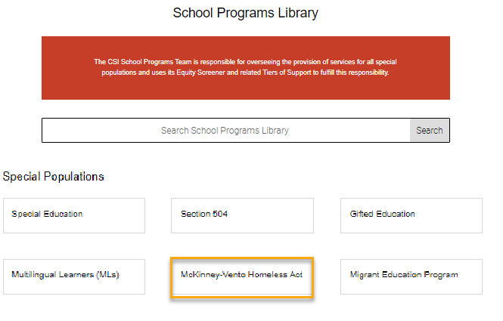
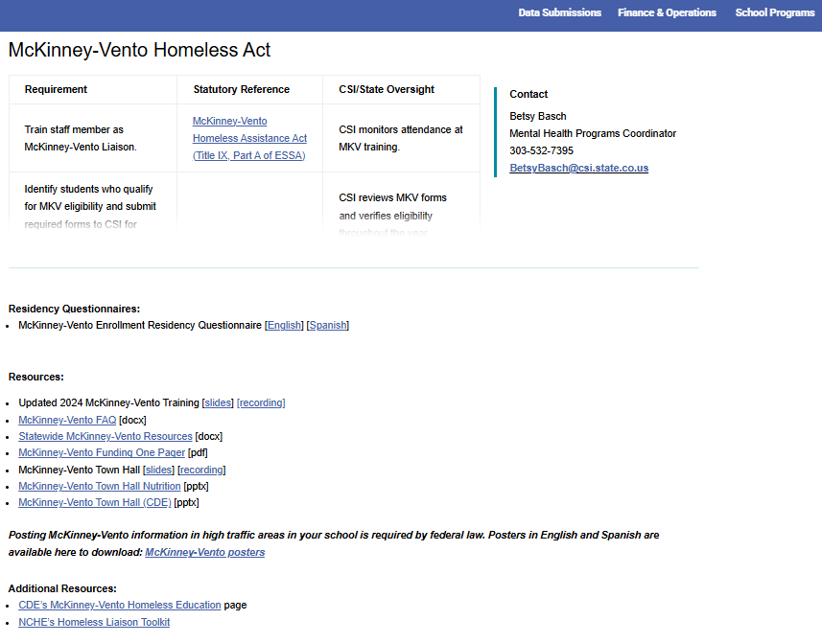
Resources
https://resources.csi.state.co.us/mckinney-vento-homeless-act/
5
Notes:
Each school has a school-level McKinney Vento Liaison, and that liaison should already be working with CSI’s McKinney Vento Liaison to identify students experiencing homelessness. However, I will go over a few of the resources available to schools when identifying homeless students.
From the Data Submissions Library Home page, click on School Programs menu header. Here you will find a link to the McKinney Vento Homeless Assistance page.
This page links to several resources, specifically the McKinney-Vento Residency Questionnaire (often referred to as McKinney-Vento Form) that qualifying families will need to fill out, available in both English and Spanish.
This page includes contact information for CSI’s McKinney Vento Liaison. CSI’s McKinney Vento Liaison is who your school will reach out to with questions related to McKinney Vento and students experiencing homelessness.

Slide 9
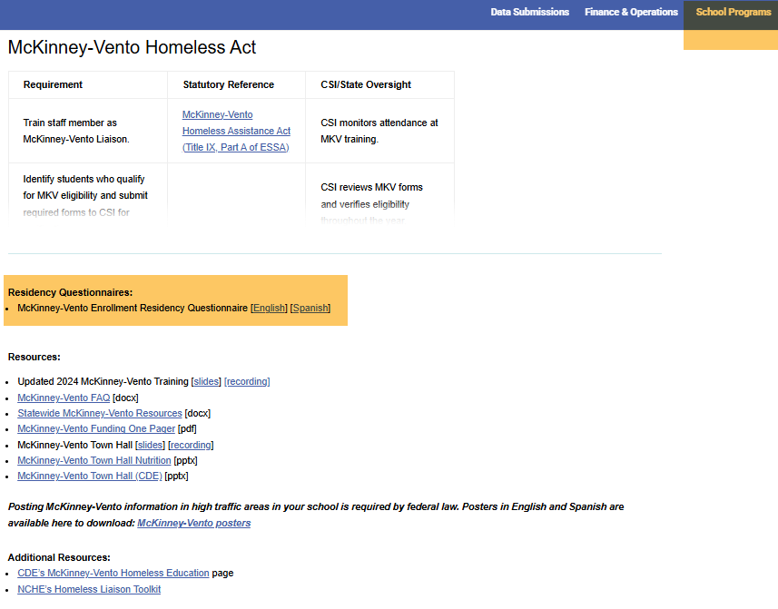
Resources Cont.
Completed forms due to CSI by Sept 26th for identification in
October Count data collection.
6
Notes:
Any completed McKinney Vento questionnaires can be submitted to CSI via G-Drive by the date indicated on this slide. This deadline allows CSI time to process and approve McKinney Vento applications for identification in the October Count Collection, which is the primary method by which McKinney-Vento funding is allocated to CSI schools. CSI will process forms submitted after the deadline to be included in the October Count but can not be guaranteed.
MKV forms can still be submitted after the deadline and throughout the school year.
Submission to G-Drive and connecting with CSI is the responsibility of your MKV Liaison. If you do not know who your school’s liaison is, then please find out through your school leader or through CSI’s McKinney Vento Liaison. You will need to work with your school’s liaison to ensure all McKinney Vento students are being appropriately reported.

Slide 10
Homeless Fields in State Reporting
Located in the Student Demographic (SD) File
Homeless
Cause of Housing Crisis
Additional Cause of Housing Crisis
Primary Nighttime Residence
Free/Reduced Price Lunch
FRL Eligibility Identification
7
Notes:
Once McKinney Vento students have been identified and have approved by the CSI McKinney Vento Liaison, data will need to be entered into six places in your SIS to properly code the student: homeless, cause of housing crisis, additional cause of housing crisis, primary nighttime residence, FRL lunch, and FRL Eligibility identification. These fields will extract to the Student Demographic, or SD, file that is used for state reporting. We will walk through each of these fields and allowable coding on the next slides.

Slide 11
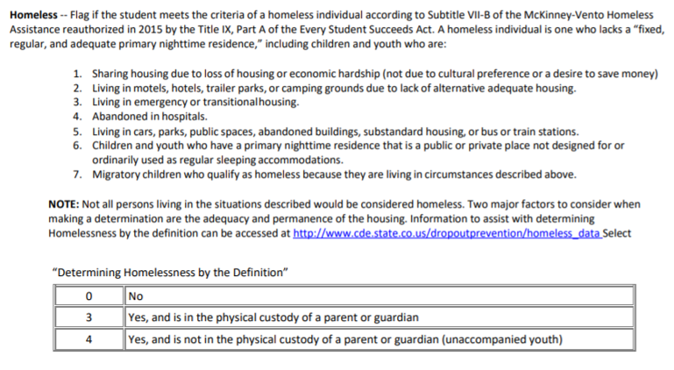
1. Homeless
8
Notes:
First, is the homeless field.
All students, whether they are experiencing homelessness or not, will have data in the Homeless field. Students who are not experiencing homelessness would use the 0 (or No) coding. Students experiencing homelessness who have a completed form that has been approved by CSI’s MKV Liaison should either be coded as 3, yes, in custody of a parent or guardian, or 4, yes, not in the custody of guardian (i.e., the student is an unaccompanied youth).
If a student is coded as either a 3 or a 4 in the Homeless Flag Field, then they must also have specific data included in the, the Cause of Housing Crisis Field, Primary Nighttime Residence Field, and the Free/Reduced Price Lunch Field.

Slide 12
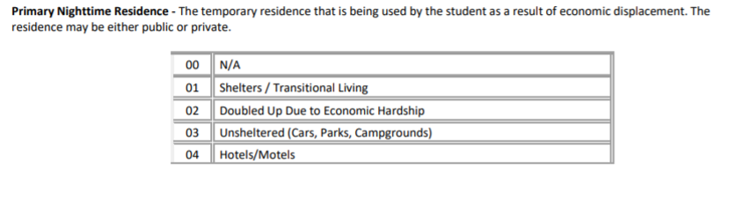
2. Primary Nighttime Residence
9
Notes:
The second field that is related to homeless identification is primary nighttime residence.
When a student is coded as not Homeless (or Homeless = 0), then it is expected that Primary Nighttime Residence is coded with a 00 (for Not Applicable).
When a student is coded as Homeless (or Homeless = 3 or 4), then it is expected that Primary Nighttime Residence is any of the available options other than 00.
This information can be found on the approved MKV form. Please partner with your MKV liaison for receiving this information for SIS coding.

Slide 13
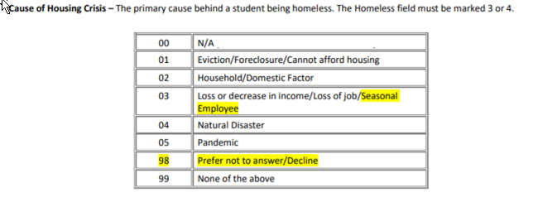
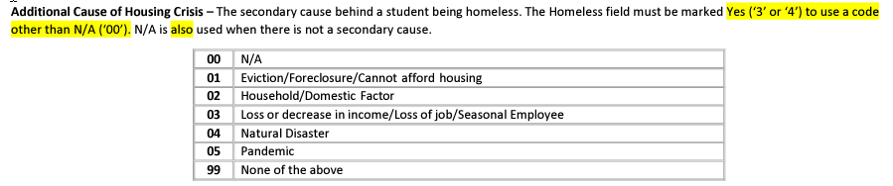
3. & 4. Cause of Housing Crisis
10
Notes:
The third and fourth fields are Cause of Housing Crisis and Additional Cause of Housing Crisis.
When a student is coded as not Homeless (or Homeless = 0), then the it is expected that the Cause of Housing Crisis are coded with a 00 (for Not Applicable).
When a student is coded as Homeless (or Homeless = 3 or 4), then it is expected that the Cause of Housing Crisis field includes one of the options other than 00. However, the Additional Cause of Housing Crisis can be completed if indicated on the MKV form or it can be populated to 00-not applicable or left blank.

Slide 14
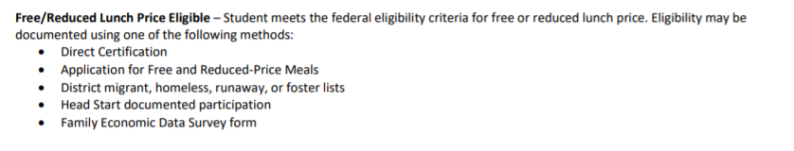

5. Free/Reduced Price Lunch Eligible
11
Notes:
The fifth field that is related to homeless identification is FRL. When a student is identified as MKV, then it is expected that Free/Reduced Price Lunch is coded as 01, Free Lunch Eligible.

Slide 15
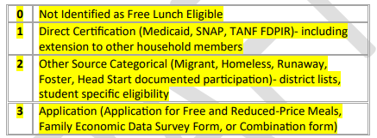
6. FRL Eligibility Identification
Creates a new At-Risk measure in the school finance formula
  Schools should plan to record Free Lunch Eligibility Identification eligibility criteria in their SIS
Reminder:
  Do not identify students as homeless in your SIS without CSI approval
15
Notes:
The 6th and final field is FRL Eligibility Identification.
In 2022, legislation was passed to establish a new at-risk measure that would replace the current practice for determining at-risk status. Students who are MKV identified, will be coded as 2 – Other Source Categorical on the Free Lunch Eligibility Identification field in your SIS.
And, as a reminder, homeless identification should only be updated in your SIS once your school’s MKV liaison have received confirmation from CSI that the student has met eligibility criteria.

Slide 16
Other MKV Considerations
DO NOT code a student as homeless in your SIS until CSI has approved and signed the MKV form.
Connect regularly with your school’s MKV liaison.
Do not alter text or codes on the MKV forms.
New MKV forms are required each school year.
Homeless status remains the same throughout the school year, regardless of change in housing.
For students to be eligible to MKV funding, MKV forms must be signed and dated by the CSI MKV liaison on or before October 1st.
Homeless students automatically qualify for the free lunch eligibility status for the duration of the school year, even if housing situation improves.
15
Notes:
Here are a few coding considerations to keep in mind regarding homeless coding.
First, be sure that whoever is entering McKinney-Vento information into your SIS is doing so once they receive signed approval from CSI’s McKinney-Vento Liaison. Connect with your school’s McKinney-Vento contact regularly, particularly at the start of the year for October Count, to ensure this identification process is taking place appropriately and student data is only being updated once the school receives confirmation from CSI.
Second, please do not edit or alter the text on MKV forms in any way. These forms are created to match required state reporting data and since they require signatures from both school and CSI representatives, it is important the forms are consistent for all schools. You can, however, add additional notes if needed.
Third, New MKV application are required each year.
Fourth, once a student has been identified as experiencing homelessness, they will keep that status throughout the school year, even if housing status changes. However, if a student is not identified as homeless at the beginning of the year but then is later identified, their homeless coding should change accordingly during the school year.
Last, MKV eligible students automatically qualify for the free lunch eligibility status. This free lunch status remains in place throughout the school year, regardless of changes in housing situation. Be sure that when you code the student as homeless, you also update the record to free lunch eligibility also. An error will generate for the EOY and October Count collections if you do not do this.

Slide 17
Validating Homeless Data
CSI validation resources
  Record Checker Tool
  Data Validations Checklist
Running ad hoc reports or SD files
Partnering with the MKV liaison to double check the data reported and compare to CSI-approved MKV forms
Carefully review OC and EOY summary report
https://resources.csi.state.co.us/data-submissions/october-count/ OR
https://resources.csi.state.co.us/data-submissions/eoy/
16
Notes:
It is a CSI expectation that data contacts work closely with their MKV liaisons to validate homeless data through out the year.
There are several resources available to validate your homeless data.
Use CSI Validation resources such as the Record Checker Tool and the Data Validations Checklist, which include an audit for MKV students. These resources can be found on the CSI OC and EOY webpages.
Run Ad Hoc Reports from your SIS throughout the year to pull a list of students identified as homeless. You can also extract an SD file that includes homeless identification columns. Filtering these columns to only include students with code 3 or 4 will include all students entered in your SIS as homeless.
Share this list with your school’s McKinney Vento Liaison. Your liaison should check the data being reported and compare it against the CSI-approved MKV forms for the school year.
Lastly, Carefully review this demographic group when reviewing your EOY and OC Summary Reports.

Slide 18
Thank you for viewing this training!
For questions on the McKinney Vento Forms, identification, and approval please
contact Rachel Franks:
rachelfranks@csi.state.co.us
For questions on data entry and coding, please reach out to the CSI Data Submissions Team:
submissions_CSI@csi.state.co.us
17
Notes:
Thank you for viewing this training!
For questions on McKinney Vento forms, identification, and approval please contact the CSI McKinney Vento Liaison.
For questions on data entry and coding for MKV students and FRL, reach out to the CSI Data Submissions Team.

