Slide 1

October Count
Record Checker Tool
Recorded August 2025
Notes:
This training, recorded by the CSI Data Team, provides an overview of how schools will use the Record Checker Tool to review source data extracted from the school’s student information systems (SIS) prior to submitting October Count files to CSI.

Slide 2
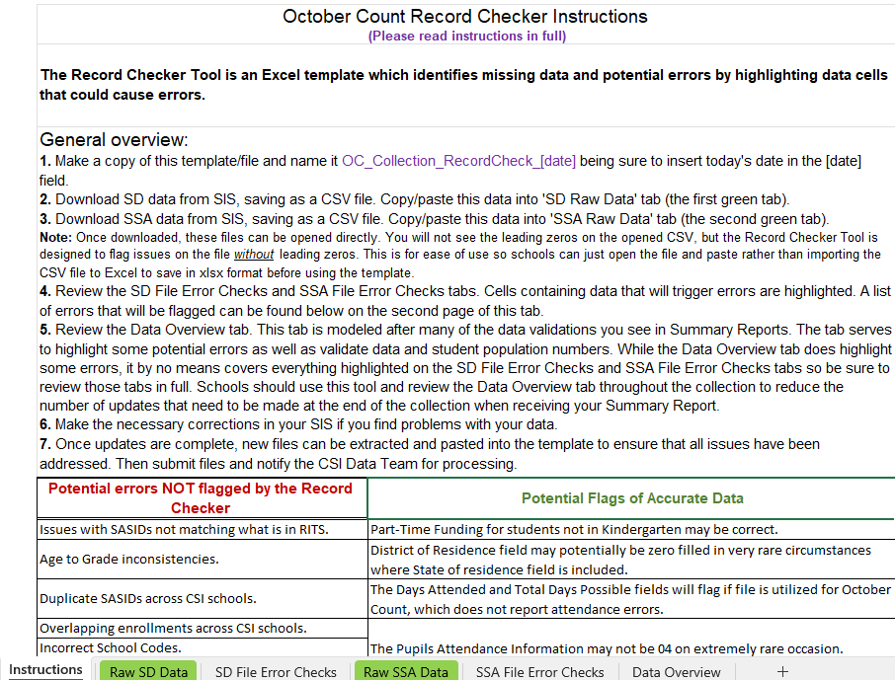
What is the Record Checker Tool?
Excel file with multiple tabs, content will vary somewhat by collection
Instructions tab included for all collections and should be the starting point
Schools should plan to use 1-2 weeks prior to initial file submission deadlines
Printable Calendar: resources.csi.state.co.us/data-submissions-calendar/
Online Calendar: www.csi.state.co.us/calendar/
2
Notes:
The Record Checker Tool (or RCT) is an Excel file available for several different state collections, including ones for the EOY, October Count, Human Resources, and SPED collections.
The intent of the tool is to help schools identify possible errors and inaccurate or missing data and correct those issues before submitting initial collection files to CSI.
Each version will have multiple tabs that will vary somewhat according to the collection it was designed for.
In addition, every version will have an Instructions tab that is the starting point for schools. Always review the instructions prior to getting started. Schools should plan to use this tool at least 1-2 weeks prior to the initial submission deadline for a collection. This gives adequate time to run the RCT, correct flagged data in your SIS, and continue the process (potentially multiple times) until the flags are cleared.
For submission deadline dates, please see the data submissions calendars available online.

Slide 3
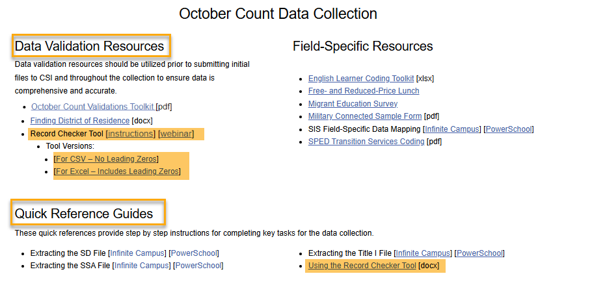
RCT Download
Download the RCT file from each CSI collection page
Quick Reference Guide – “Using the Record Checker Tool” is available
https://resources.csi.state.co.us/data-submissions/october-count/
Data Validation Resources/Record Checker Tool
3
Notes:
To begin using the RCT, simply go to the main collection webpage on the CSI website and find the links to the Record Checker Tool resources.
The screenshot shows the October Count main webpage and the location of the Data Validation Resources section as well as the Record Checker Tool location. There are resources for the RCT AND the tool file itself. This year there are two available Excel download tool versions: one tool is for schools using an CSV file (with no leading zeros) and the second tool is for schools using an EXCEL file that has leadings zeros. If one version is not working for your school, I suggest trying the other version.
Once indication that the wrong RCT is being used in your will find errors for complete columns of data. For more information about the step-by-step process for using the record checker tool and downloading a CSV file, please use the Quick Reference Guide document named “Using the Record Checker Tool”, found on the CSI October Count webpage under the Quick Reference Guides section.

Slide 4
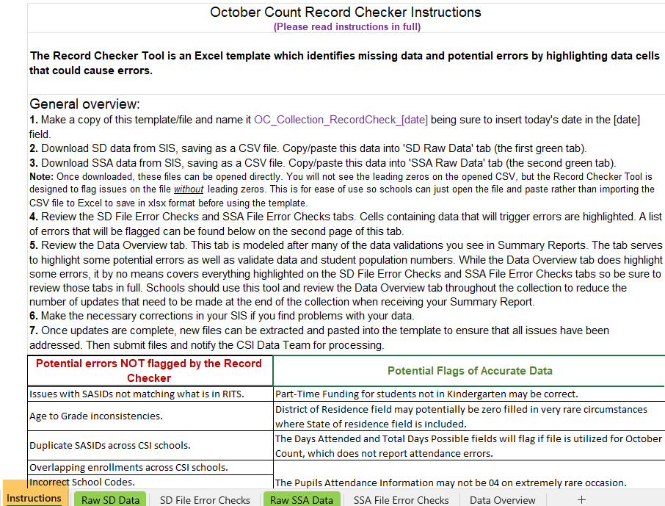
Instructions Tab
Fully review the Instructions tab before getting started
4
Notes:
After downloading a copy of the RCT file to your computer, simply open it and make sure you are on the Instructions tab.
Please take the time to fully review all of the content here.
You will next follow the General Steps section in the Instructions tab.

Slide 5
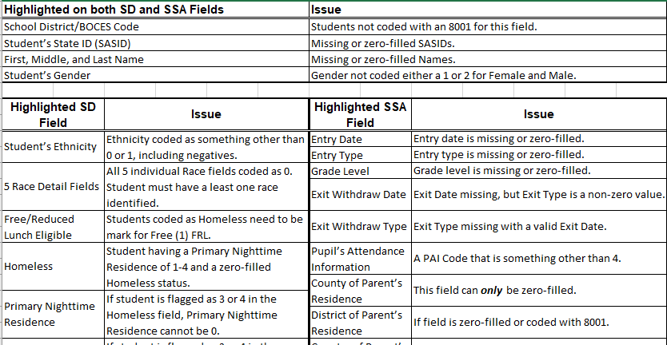
Instructions Tab Cont.
Multiple pages on Instructions tab are present—scroll down to see them
Oct Ct second page pictured here, listing possible data issues that will be identified later using the RCT
5
Notes:
Please be aware that there are multiple pages of information on the Instructions tab of the RCT depending on the collection. So, be sure to scroll down the page to check for additional pages.
For this demonstration using the October Count collection, there is a second page with a table listing possible data issues that will be discussed later using the RCT.

Slide 6
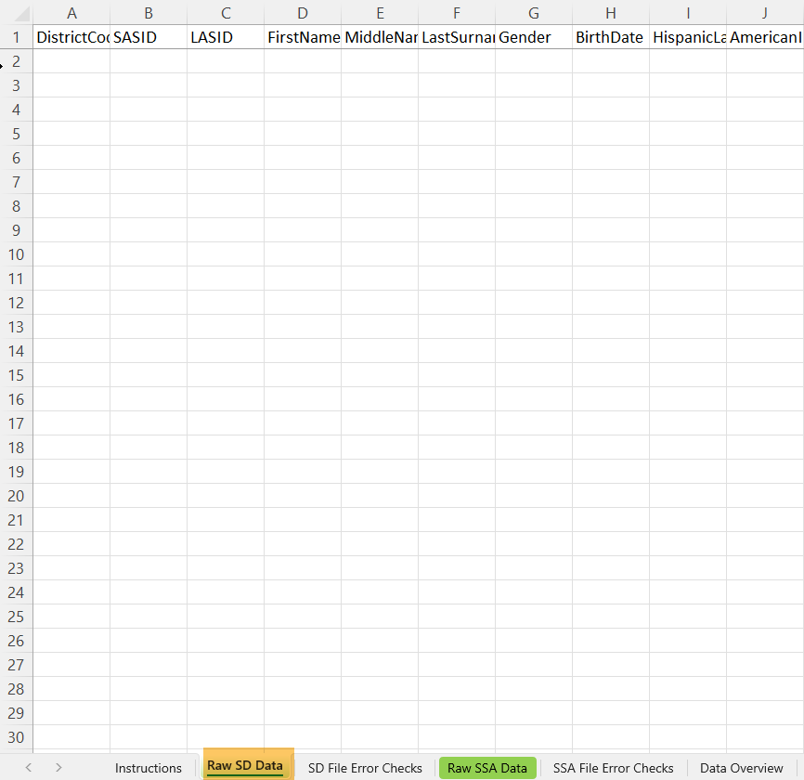
SD & SSA Raw Data Tabs
Extract SD and SSA files from your SIS. *Always include legal names & attendance dates when extracting these files.
Copy/Paste exported SD and SSA file data from your SIS into the respective “Raw SD Data” and “Raw SSA Data” tabs
6
Notes:
As explained in the Instructions tab, you will extract the SD and SSA files from your SIS. Be sure to include legal names and attendance dates when extracting. Though the RCT does not analyze these data areas, it is a good habit to always include these as they are needed for all SD and SSA data submissions to CSI. Next, copy then paste data from the SD then the SSA files you exported from your SIS into the respective “Raw SD Data” and “Raw SSA Data” tabs.

Slide 7
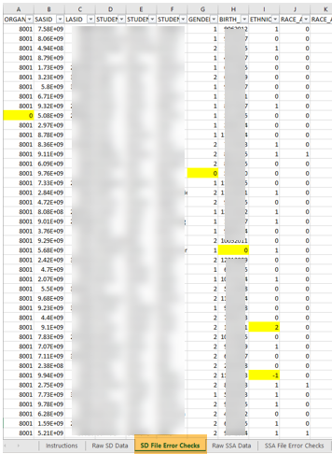
SD File Error Checks Tab
Highlighted cells indicate potential problem data
View the table of issues that the RCT checks, on the second page of the Instructions tab
7
Notes:
As soon as you have pasted the content of your SD data into the “SD Raw Data” tab, then look at the “SD File Error Checks” tab where you will see the data displayed with highlighted cells that the RCT automatically identifies as being problematic, triggering potential errors in your initial SD file.
The screenshot illustrates several cells that the RCT has identified as potential problem data which are highlighted in yellow.
View the table of issues located on the Instructions tab.
If the Error Checks tab is displaying multiple all yellow columns, then you may have used an excel data opposed to the required CSV data to run this file. For the RCT to properly display errors, a CSV file must be used in the SD Raw Data tab. Please delete the current data, run a new file converted to a CSV file, and try again.

Slide 8
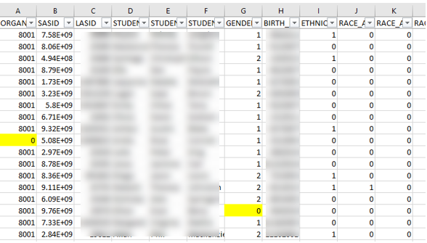
SD File Error Checks Tab Cont.
Highlighted records to correct in your SIS:
Organization (district code) value of 0 should be updated to 8001 in your SIS
Gender value 0 should be updated to a valid code in your SIS
Then a new extract placed in the RCT
https://resources.csi.state.co.us/data-submissions/october-count/
File Layout/Student Demographic File Layout
8
Notes:
Let’s take a closer look and review the yellow highlighted cells. These cells determine what you might need to correct in your SIS for that student record.
In the slide example, column A has a record with a value of 0 for the organization or district code. You’ll need to check why the student is not flagged with the correct 8001 district code in your SIS.
The second record has a gender value of 0. You will need to correct the student record in your SIS by entering one of the valid gender codes.
Please remember, a great resource to correcting flags and errors on your SD and SSA files will be the File Layouts. These are located on the CSI October Count Resource webpage and can help navigate the correct format and value for missing or incorrect data.
After changes are made in your SIS, extract new files and repeat the RCT process.

Slide 9
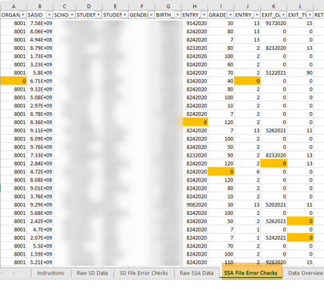
SSA File Error Checks Tab
The process works the same for the SSA File Error Checks tab
Highlighted cells indicate potential problem data
View the table of issues on the Instructions tab
https://resources.csi.state.co.us/data-submissions/october-count/
File Layout/Student School Association File Layout
9
Notes:
The process you just completed for the SD file works the same for the SSA file. However, you will see orange highlighted cells for potential errors.
Repeat the steps by reviewing each record with highlighted cells, making corrections within your SIS where needed until cells are not longer highlighter on the RCT. If you are having trouble correcting the issue, please view the File Layout located on the CSI October Count resource webpage. If you are still having trouble clearing flags, please send a message to the data submissions inbox for support.

Slide 10
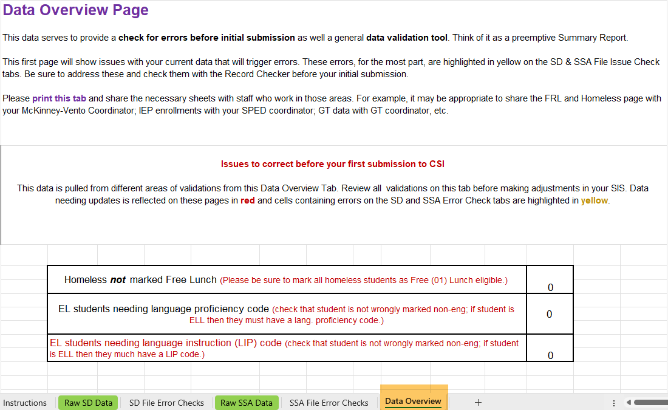
Data Overview Tab
Primarily consists of combined data counts by various populations
10
Notes:
Another method by which the Record Checker Tool can help identify potential problem data is with the “Data Overview” tab.
The top of the tab provides a brief overview of the content. Please take the time to review this.
You can then proceed through each section of the tab, reading through the instructions provided so that you have a good understanding of how to interpret the counts that are displayed in each section.
The data within this tab is substantial for most collections and consists primarily of combined counts by the various populations and attributes found from the data pasted into the raw data tabs. Sections include combined counts for enrollments, funding codes, attendance, SPED, EL, GT, FRL, and many other attribute types.
Be sure to partner with content experts at your school for their review and verification of this data. This partnership will ensure accurate data which directly affects your school’s funding.

Slide 11
Data Overview Tab Cont.
Tips and Reminders
Review instructions for each section
  For October Count, sections include combined counts for enrollments, attendance, SPED, EL, GT and many other attribute types
Identify all potential data issues
  Share the file with content experts at your school
  Make corrections needed in your SIS
11
Notes:
Here are some tips and reminders as you work with the Data Overview tab.
Be sure to review instructions for each of the sections which include combined counts for enrollments, attendance, SPED, EL, GT many other attribute types.
Be sure to identify where your school has potential data issues.
For the success of the collection, partner with content experts at your school for their review and verification of data, and then make corrections needed in your SIS.

Slide 12
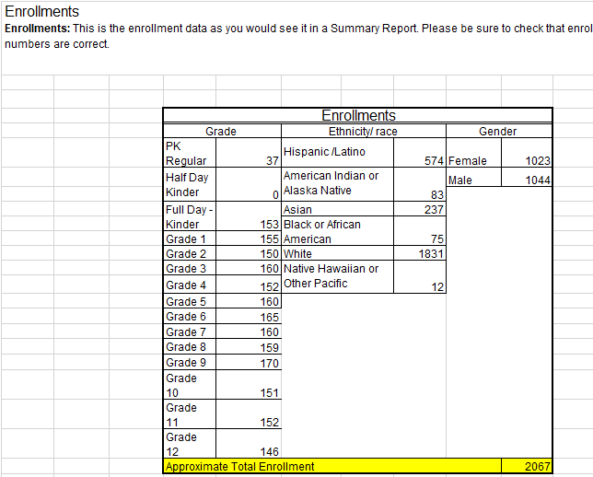
Data Overview Tab
Enrollments
Please be aware that the total enrollment figure is approximate
An anomalous count likely means you have not extracted the correct students in your SD or SSA
12
Notes:
When looking at the Enrollment section in the Data Overview tab, please be aware that the total enrollment figure is approximate.
There are many reasons why the figure might not match your expected total enrollment count.
This figure serves more to alert you when counts are highly off, which likely means you have not extracted the correct students in your SD or SSA.

Slide 13
Final Steps
Repeat General Steps on the Instructions tab as many times as needed to correct all flagged data
Use the RCT throughout the collection
Update data in SIS only, not directly in the file
Notify the data team when a file is ready to process in the G-Drive
13
Notes:
For final steps in using the Record Checker Tool, you’ll want to repeat the General Steps on the Instructions tab as many times as needed to correct all flagged data.
You’ll also want to use the RCT throughout the collection to recheck your data periodically.
An important reminder, when clearing flags and errors, be sure to update the data in your SIS. Do not update the data on the file itself. There are few circumstances, that you and CSI may agree that a manual file edit is the only option to correct data. Otherwise, update all data in SIS, extract new files, run them through your RCT, repeat as needed. Once flags are cleared, then submit to CSI through the G-Drive. Email the submissions inbox to notify the data team that a file submission is ready to process.

Slide 14
Thank you
Send questions to: submissions_csi@csi.state.co.us
Notes:
Thank you for viewing this Record Checker Tool training.
Please reach out to the submissions inbox if you have any questions or suggestions on what additional features might be helpful in the future.

