Slide 1

October Count General Overview Training
Recorded August 2025
Notes:
Welcome to the general overview training for the October Count collection recorded by the CSI data submission team.
For details about the October Count Audit process, please access the separate October Count Audit General Overview Training in the Data Submissions Resource Library.

Slide 2
Purpose of October Count
Collect student data for students in PK-12th grade
Fulfills state and federal requirements
Data collected in Student October is used for:
  Determining funding (PPR, ELL Count, At-Risk Count, GT, etc.)
  Reports, grants, improvement planning, accountability, etc.
2
Notes:
The October Count data collection serves many purposes.
First, the October Count Collection is a requirement for Colorado public schools based on the Public-School Finance Act. Data collected for public school Prek-12th grade students. This is used to determine the level of funding to provide each school or district for grades K-12th based on the count of students and particular special populations to which students may belong.
Additionally, data is used for student demographic reporting and comparisons, grant eligibility, improvement planning, and accountability.
Because of the high-stakes nature of this data collection, it is extremely important that data is comprehensive and accurate. We’ll discuss a variety of resources that can support data quality.

Slide 3
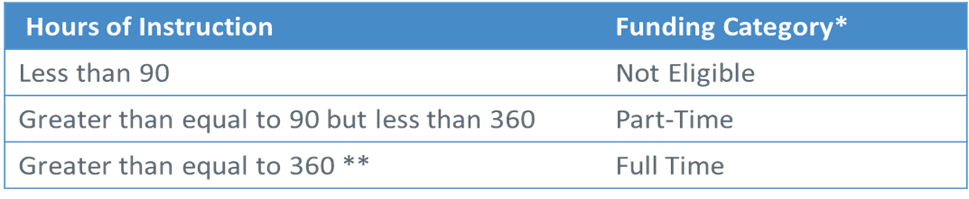
Funding Requirements:
Membership
In order to be eligible for funding in the Student October count, students must meet the membership (enrollment and attendance) requirements.
Schedule
Once membership requirements are met, funding level is determined based on the student's scheduled instructional hours in the semester of the count date.
3
Notes:
The Colorado Department of Education has clear requirements for students to qualify for full or part-time funding.
First, students must meet membership requirements.
That means they need to be enrolled and in attendance on Count Day.
If they’re absent that day, they can still qualify—as long as they attended at least once before Count Day and again within 30 days after.
Once those membership requirements are met, funding levels—full time or part time—are based on the number of student’s scheduled instructional hours in the semester of Count Day.
CDE also requires schools to keep supporting documentation showing that each student meets the funding level you’ve reported. This proof will be reviewed during October Count audits.
For now, the most important takeaway is this:
Before your initial submission to CSI, make sure every student in your report has the right documentation—and is coded correctly for funding.

Slide 4
Timeline
4

Slide 5
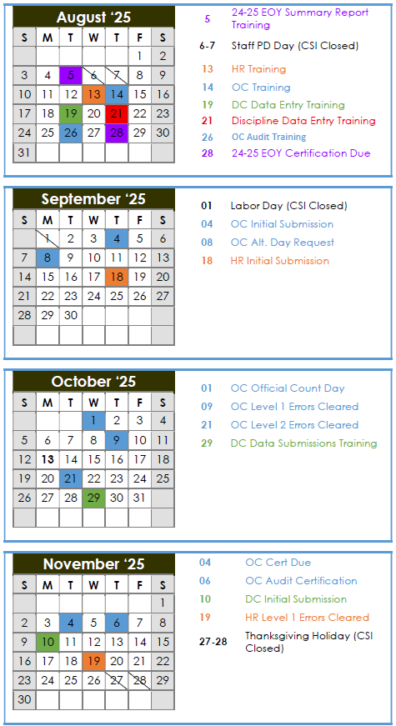
OC Submissions Deadlines
8/14 –Recorded Training
9/4 – Initial Submission
(SD, SSA, Title I)
9/15 – At-Risk Submission/Audit
10/1 – Count Day
10/9 – Level 1 Cleared
10/21 – Level 2 Cleared
11/4 – Certification Due
11/6 – Signed Audit Checklist
Access the OC Audit Training :
https://resources.csi.state.co.us/data-submissions/audits/
Access the At-Risk Training :
https://resources.csi.state.co.us/data-submissions/october-count/
Printable Calendar: https://resources.csi.state.co.us/data-submissions/calendar/
Online Calendar: www.csi.state.co.us/calendar/
2
Notes:
At the top of the October Count Resource page is a link to the Data Submission calendar. This calendar is printable and color coded by collection. The October Count and October Count Audit dates are all marked in blue.
As a reminder, you can also access the CSI Online Calendar. The online calendar is updated regularly throughout the year as timelines change. Users can subscribe to the calendar to have deadlines synced to their google calendars.
The October Count is one of the shortest collections, lasting roughly 12 weeks and overlapping with other first semester collections, as well as End of Year wrap up. Given this, it is important to begin reviewing October Count Recourses, which we’ll discuss shortly, as soon as possible in order to say on top of the collection. And, it is important to set internal deadlines for yourself and colleagues to ensure your school is able to meet CSI deadlines.
Key dates for the October Count submissions are listed on this slide.
Please keep close track of all deadline dates starting with the initial submission. Of course, the CSI Data Submissions Team welcomes earlier submissions! Remember, before submitting files to CSI, schools should be using the Record Checker Tool and updating their data as much as possible based on any errors generated in the tool.
Be sure to review the Weekly Update emails sent to all school submission contacts for the latest announcements and other details related to the October Count collection.
Most of these deadlines are specific to the October Count Submissions. For more details on dates associated with the October Count Audit, please review the October Count Audit resources.

Slide 6
Additional OC Deadlines
August 26th
Recommended date to complete the Record Checker data
September 8th
Deadline to request alternative count date
September 26th
Deadline to submit McKinney-Vento (homeless forms) for approval prior to count day
September 23rd
ALP approval deadline for early access students
Due to the critical nature of the deadlines, CSI’s School Compliance Policy will be exercised for missed error clearance deadlines
7
Notes:
In addition to the October Count submissions related dates, there are other dates to keep in mind. These are not on the calendar because they are not submission dates.
Schools are expected to use the Record Checker Tool prior to submitting initial submissions. It is highly recommended that schools complete the Record Checker Tool by the date indicated on the slide which allows time to clear the basic errors that arise from this check prior to the initial submission date.
Schools, in rare circumstances, have the opportunity to request an alternative count day. This typically is considered for schools that are not in session for Count Day and/or are not in sessions for multiple days within the count window. If you are interested in learning more about whether an alternative count date may be necessary for your school, please email the submissions inbox. If an alternative date is approved, all data (including FRL eligibility and transportation data) must be based off of your school’s alternative count date instead of October 1st.
There is a deadline to submit the McKinney-Vento forms for homeless students and families for inclusion in the October Count data collection. Although these forms can be submitted anytime through the year as living status’ change, the majority of these forms need to be submitted by the date indicated on the slide, so there is enough time to get approval before the October Count date.
Lastly, there is also an ALP approval deadline for Early Access students. Kindergarteners who are under the age of 5 are eligible for a maximum of full-time funding if they meet the related state requirements. Because of this, ALPs have to be approved by the date indicated on the slide in order to claim extra funding for those students.
Since the October Count collection has a relatively short turnaround time and the data is used for several high stakes purposes, CSI will utilize the School Compliance Policy for schools missing October Count deadlines.

Slide 7
Timeline Considerations
Is your SIS up to date?
New fields/codes should show up in your SIS
Do the SD and SSA files successfully extract from your system?
File extracts should include data in general, and data for new fields if applicable
Have you used the Record Checker Tool yet?
Schools should address flags in data from the Tool prior to submitting files to CSI
Notes:
Please be aware of additional considerations as you prepare for the first October Count deadline, the initial file submission.
Is your SIS up to date? You can check by reviewing the vendor’s release notes to confirm whether you are on the latest version. You can also check any fields that have been updated for this school year (which we’ll discuss later in this training in the “New This Year” section). If there’s a new code added to a field, you’ll want to check whether your SIS has that new code available for you to use.
Do the SD and SSA files extract successfully from your system? That is, when you extract a file, is student data coming out or is the spreadsheet blank? Additionally, does the extract include any new fields that have been added for this year’s collection “also found below in the “New this Year” section? This is especially important for new schools and new contacts.
Finally, have you used the Record Checker Tool yet? This tool will save significant time during the October Count collection if it is used prior to submitting any files to CSI. If you are new to the Tool, please review the training on the October Count resource page prior to using the tool. Additionally, note that in addition to using the tool to identify potential errors, it is expected that schools are addressing those possible errors in their SIS prior to submitting initial files to CSI so be sure you are building time in to do this before the initial file submission deadline.

Slide 8
October Count Resources
8

Slide 9
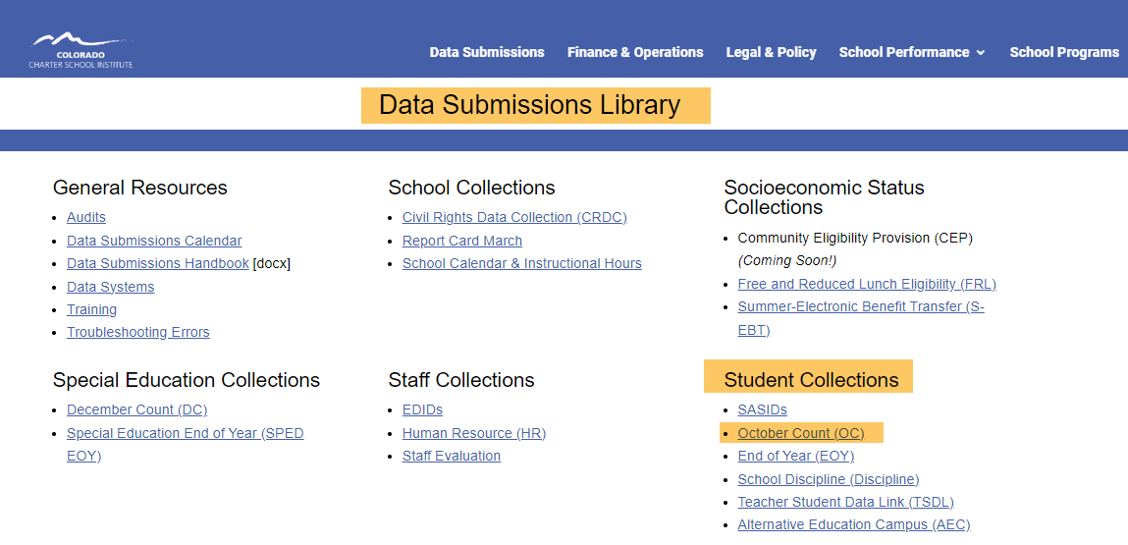
October Count Resources
https://resources.csi.state.co.us/data-submissions/october-count/
9
Notes:
Most of the resources you will need to reference for the October Count Collection will be found on the October Count Resource page on the Data Submissions Library.
The link to the October Count Resource page is at the bottom of the Data Submission Library Home page, under ‘Student Collections.’

Slide 10
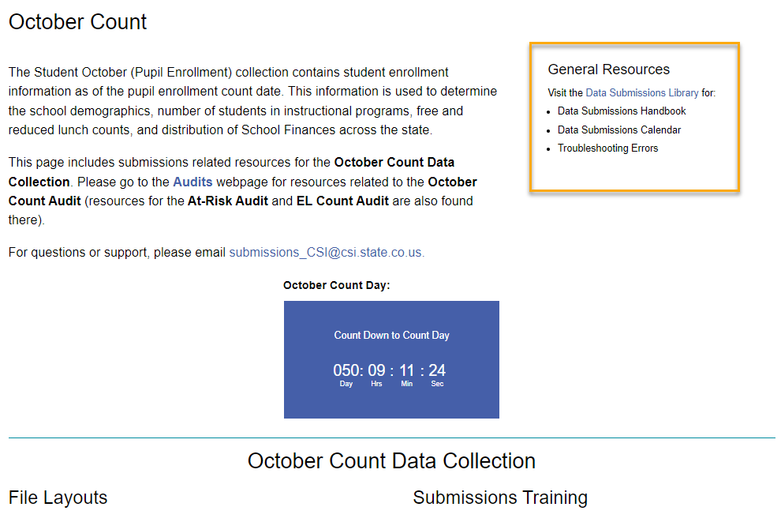
General Submissions Resources
https://resources.csi.state.co.us/data-submissions/october-count/
10
Notes:
The General Submissions Resources provides quick links to frequently accessed resources source as the Data Submissions Handbook, Calendar, and Troubleshooting Errors tool.

Slide 11
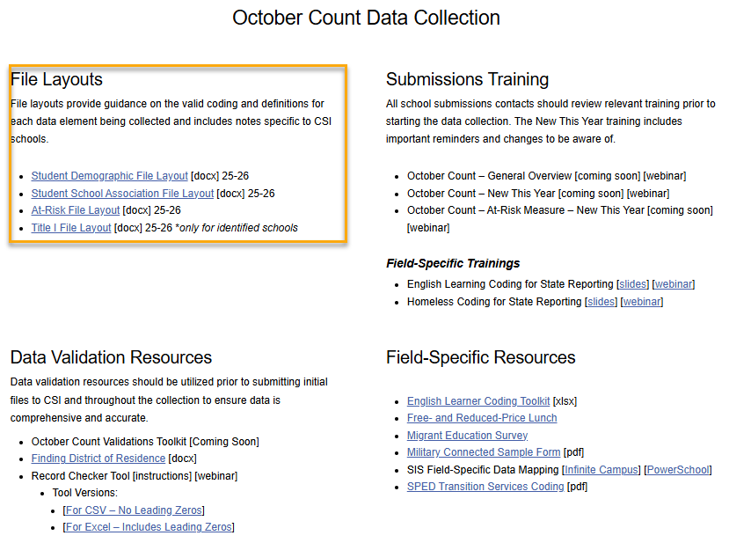
File Layouts
October Count: https://resources.csi.state.co.us/data-submissions/october-count/
General Data Submissions Resources: https://resources.csi.state.co.us/general-submissions/
Notes:
The next group of resources on the October Count page are the File Layouts.
There are a total of three files that can be submitted for October Count: Title I, Student Demographic, and Student School Association files. While every school will be submitting SD and SSA files, only a handful of schools will need to submit a Title I file and we will be reaching out to those schools individually.
File Layouts can support schools with data collection, data entry, and troubleshooting data errors. If you are unfamiliar with how you can use File Layouts, please access the File Layout training module on the General Data Submissions Resources website page.

Slide 12
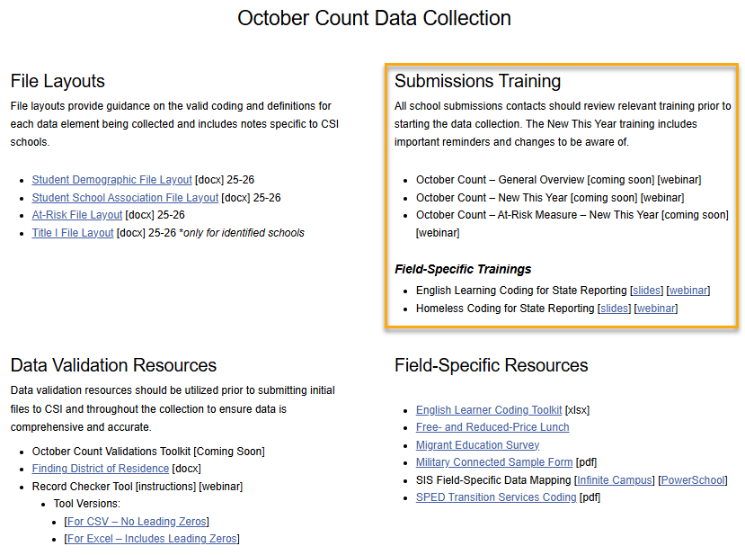
Trainings
https://resources.csi.state.co.us/data-submissions/october-count/
Notes:
In addition to this general overview training, there are several additional trainings available. The Weekly Update will also include notifications on new trainings. These trainings can be reviewed as many times as needed.

Slide 13
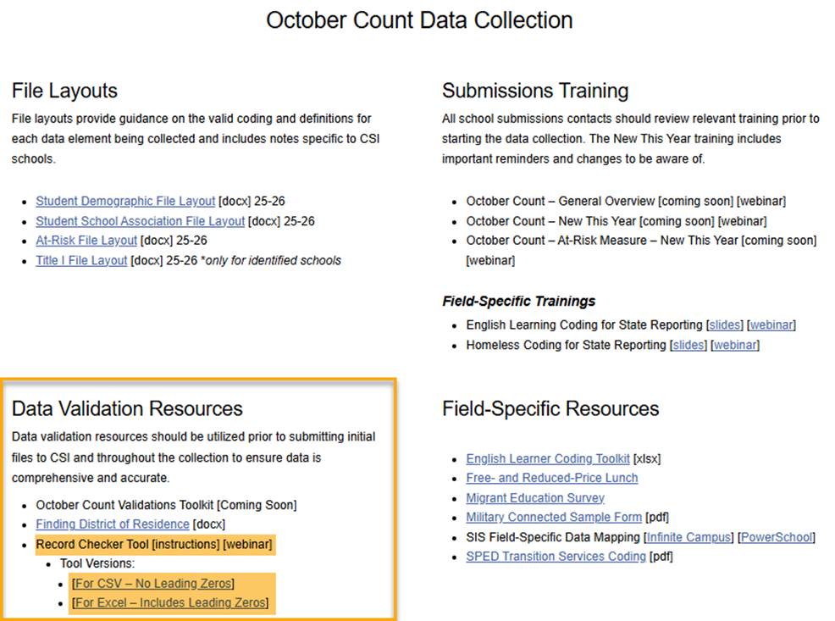
Data Validation Resources
https://resources.csi.state.co.us/data-submissions/october-count/
Notes:
The next group of resources are the data validation resources available to your school, including the October Count Record Checker Tool. Please be sure to review the October Count Validations toolkit and walk through the RCT steps in full before the initial submission deadline.

Slide 14
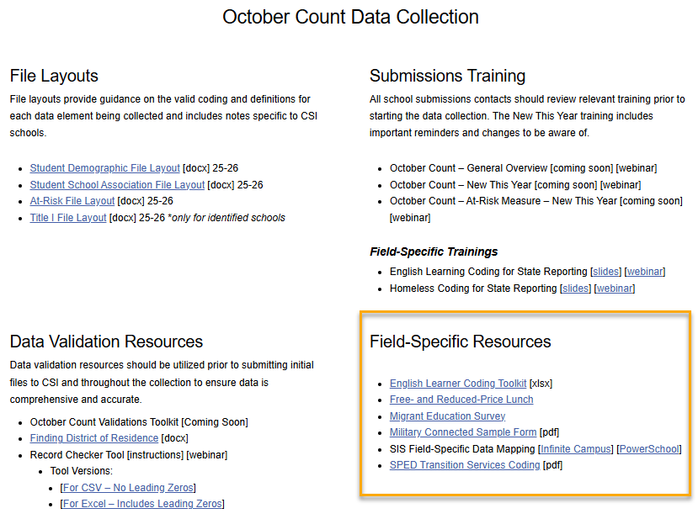
Field-Specific Resources
https://resources.csi.state.co.us/data-submissions/october-count/
Notes:
Another type of resource available to you are field-specific resources, which are specific to special population fields.
Here is a screen shot of the October Count field specific resource section which includes documentation and forms that help with the data entry of specific fields found in the Student Demographic and Student School Association files. This section includes migrant student and military connected forms along with English Learner programs and codes. There is also a link to another resource site that exclusively covers Free and Reduced lunch eligibility and resources.
New this year is the SIS Field Specific Data Mapping resource. This includes links for both Infinite Campus and PowerSchool and navigates users to specific and sometimes harder to find fields within their SIS.

Slide 15
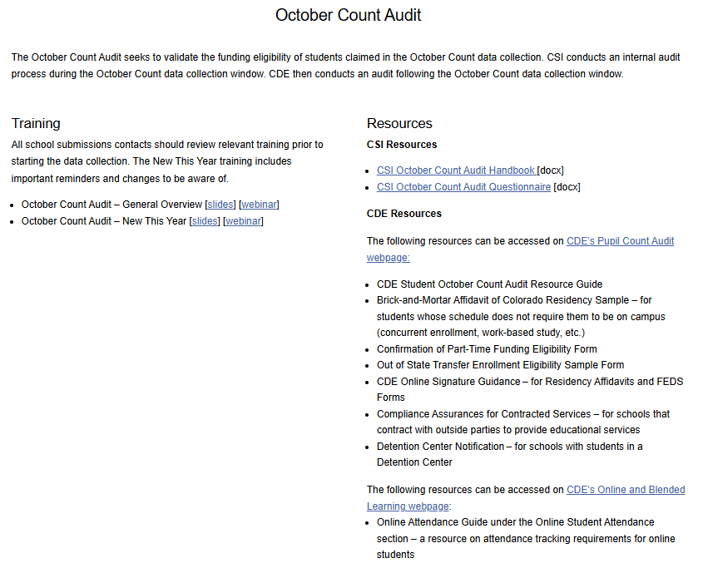
OC Audit Resources
https://resources.csi.state.co.us/data-submissions/audits/
15
Notes:
The October Count Audit Resource page is found in the Data Submission Library under General Resources/Audits. Here you will find separate trainings related to the October Count Audit process and resources.

Slide 16
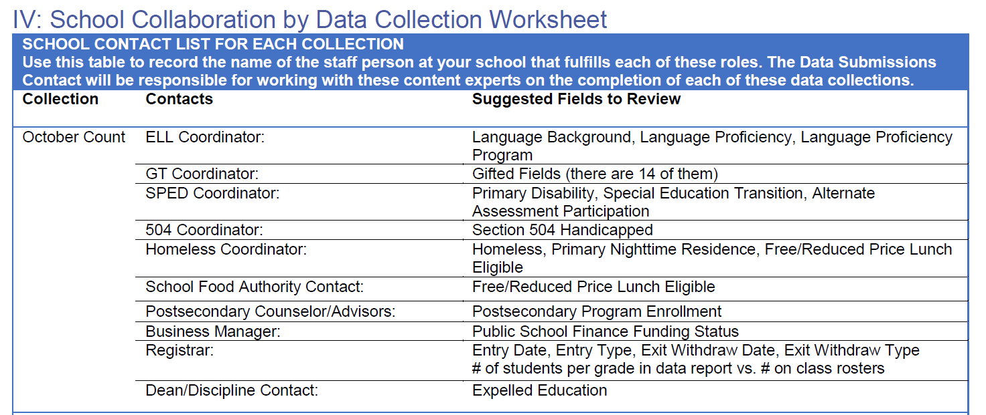
Collaboration is Key
Available in Appendix of the CSI Data Submissions Handbook
https://resources.csi.state.co.us/data-submissions/
16
Notes:
Last but not least, one of the most important resources available to you are the content-experts at your school!
The CSI Data Submissions Team expects school data submissions contacts to be experts in the data submissions process. We expect school data submissions contacts to also work closely with content-experts as their schools in reviewing data for accuracy.
Because October Count collection pulls in a variety of data about students, it is essential that data submissions contacts are working closely with school-level content experts in the collection, reporting, and verification of October Count data.
We’ve provided a list of key types of data in the October Count collection, and particular fields where they can be found. This information is included in the Appendix of the Data Submissions Handbook and identifies that roles at your school that will be helpful to collaborate with during the October Count data collection.
It might be a good idea to go ahead and reach out to the subject experts in your school to let them know that October Count is underway and you will be needing their input and expertise in the coming weeks.

Slide 17
New This Year
17

Slide 18
Updates to the SD & Title I File Layout
SD File
  No Big Changes
Title I File (For only a few Title I schools)
  No Changes
https://resources.csi.state.co.us/data-submissions/october-count/
6
Notes:
This year, there are no updates to the SD or Title I files.

Slide 19
Updates to the SSA File Layout
Fields Removed:
Innovative Learning Opportunities Pilot (ILOP)
  Program has ended & field removed from SSA file
Fields Added:
Abbreviated School Day Schedule Status
  Students reported 1 (YES) if the 504 or SPED student was placed on an abbreviated school ay at any point during the school year
    Not including disciplinary action
    Not including parent removing student from school without school/district input
Total Days on an Abbreviated School Day School Schedule
  The aggregated number of days the student was placed on an abbreviated school day.
https://resources.csi.state.co.us/data-submissions/october-count/
6
Notes:
There are several updates to the SSA file. Please see the file layout for all changes.
There has been one field has been removed from the SSA file. The Innovated Learning Opportunities Pilot has ended and the ILOP field has been removed.
The SSA file includes two new fields in response to CO House Bill – 4063. For the new field Abbreviated School Day Schedule Status students will be reported 1=YES for students on a 504 or IEP placed on a abbreviated schedule at any point during the school year. This does not include schedule changes due to disciplinary action or parents removing a student from school without school input.
The new field Total Days on an Abbreviated School Day Schedule will include the aggregated number of days the student was placed on an abbreviated school day.

Slide 20
Updates to the SSA File Layout Cont.
New Exit & Entry Code:
Entry/Exit Code 60
  The entry/exit code 60 is designed to use when a student within your school, changes programs during the school year and does not have an attendance gap of 10 or more days.
    Schools formerly had to use entry/exit 11 in these instances.
  Examples:
    Student enrolled in Homebased program, them moves to the same school’s full time in person program
    Changes in Postsecondary Program within the same school.
https://resources.csi.state.co.us/data-submissions/october-count/
6
Notes:
One additional SSA update for October Count is the new Entry/Exit Code 60.
This code is used when a student changes programs within your school during the school year, without an attendance gap of 10 or more days.
In the past, these situations used Entry/Exit Code 11. Now, you’ll use Code 60 instead.
For example, this applies when a student moves from your school’s home-based program to the full-time program — or vice versa. It can also be used when a student changes Postsecondary Programs within the same school during the school year.

Slide 21
Updates for OC Audit
The “11-day Count Window” – no longer referenced
  Pursuant of SB25-125
  All students are required to meet the specific enrollment and attendance requirements found in the OC Audit Resource Guide.
Transfer Enrollment Exceptions - has been discontinued
  New CDE Rule
  All students must be enrolled and attending in their reporting district on or prior count day
https://resources.csi.state.co.us/data-submissions/audits/
CSI October Count Audit Handbook
CDE’s Pupil Count Audit Webpage
2025-2026 Student October Count Audit Resource Guide
6
Notes:
There are a couple of notable October Count Audit updates this year.
First, starting this year, there will no longer be any reference to the “11-day Count Window.”
Under Senate Bill 25-125, all students must meet the enrollment and attendance requirements outlined in the corresponding sections of CDE’s 2025–26 Student October Count Audit Resource Guide.
Second, the Transfer Enrollment Exception has been discontinued.
All students must now be enrolled and attending in their reporting district on or before the applicable pupil enrollment count date — regardless of whether they transferred from another district or moved to Colorado from another state or country during the five school days following Count Day, as was previously allowed.
These are just two of the October Count Audit updates for this year. For more information, visit the CSI October Count Audit Resource webpage, where you can find CSI’s OC Audit Resource Guide as well as additional links to CDE’s audit resources.

Slide 22
Updates School Finance Rule
New SPED Funding
  Based on state reported primary disability
  Active IEP as of Count Day
https://resources.csi.state.co.us/data-submissions/audits/
6
Notes:
There are a few updates this year to School Finance rules, and one in particular is important to highlight.
Beginning this school year, District Special Education funding will be incorporated into the October Count funding formula. Special education students are eligible for October Count funding if they have a state-reported primary disability and an active IEP as of Count Day. The reported Primary Disability field in the October Count Student Demographic (SD) file will be used to identify these students.
This new School Finance rule is a good example of why it is essential to work closely with your SPED Leads to obtain and enter accurate data including SPED disability codes.
More information about the updated School Finance rules will be coming soon and will be posted on the CSI October Count Audit resource webpage.

Slide 23
Important Reminders
23

Slide 24
SASIDs and October Count
Every student needs a SASID.
Follow CSI’s SASID training for information on requesting and updating SASIDs.
Request SASIDs and SASID updates as needed and as soon as possible.
https://resources.csi.state.co.us/data-submissions/SASIDs/
Notes:
One of the highest (and earliest) priorities is to ensure that all students have a SASID. We recognize the beginning of the year is busy, but staying on top of SASID requests and updates is essential for a smooth October Count data collection. If you submit an October Count file with missing SASIDs, the expectation is that the SASID will have been requested and entered into your SIS for your next submission.
If you need a review on how to request SASIDs or SASID updates, please review the SASID resources and trainings on the SASID webpage.

Slide 25
Free/Reduces Lunch (FRL)
FRL updates are required throughout the year and for October Count (OC) collection, may impact funding.
Expect monthly FRL reports from CSI
Make updates each month in your school’s SIS
If FRL updates are made, new OC files will need to be submitted to CSI.
https://resources.csi.state.co.us/data-submissions/frl/
Notes:
Free and Reduced Lunch updates are required throughout the year, and for October Count, these updates may impact your school’s funding.
You’ll receive monthly FRL reports from CSI, so be sure to make any needed updates in your school’s SIS right away each month.
Please keep in mind that if updates are made to FRL data during the OC collection, a new OC (SD files) submission to CSI is needed to capture the latest FRL data to submit to CDE.

Slide 26
At-Risk Measure File
Required for the At-Risk Measure File
  All students must be assigned a SASID in the SIS
  All students must have a current physical address listed in the SIS unless the following apply.
    McKinney Vento students identified in the SIS
    Identify students participating in the Address Confidentiality Program, migrant status, or attending a detention center in the SIS
https://resources.csi.state.co.us/data-submissions/october-count/
Notes:
At-Risk measure collection, will entail SIS data entries that schools are already doing.
The requirements for schools in preparation for the At-Risk file are:
All students must have an assigned SASID entered into your SIS,
In addition, most students must have a current, physical address listed in the SIS. PO Box numbers and mailing addresses are NOT allowed.
Next, McKinney Vento students must be identified and entered in your SIS,
Lastly, Schools will identify students participating in the Confidentiality Program, migrant program, and students attending a detention center in your SIS.
More information and instructions specific to the At-Risk collection will be emailed to data contacts.
Please see the At-Risk training located on the OC Resource webpage for more information.

Slide 27
Universal Preschool (UPK)
Student October
Regardless of UPK funding status, required to include all PK students receiving educational services by the reporting entity
All PK students will be indicated with a Public-School Finance Funding Status of ‘86’, ’87’, or ‘96’ (not eligible) due to enrollment purposes.
27
Notes:
Universal Preschool UPK impacts some of our student collections within Student October, Special Education December Count, and Student Discipline.
For October count, all PK students receiving educational services will be included on this collection. Student October Count, in particular, will have the most impact when reporting PK students as schools will report all PK students receiving services regardless of UPK funding status. All PK students will need a Public School Finance Funding Status code of ‘86’, ’87’, or ‘96’ (not eligible) due to enrollment purposes.

Slide 28
Validaionts & Additional Reminders
28

Slide 29
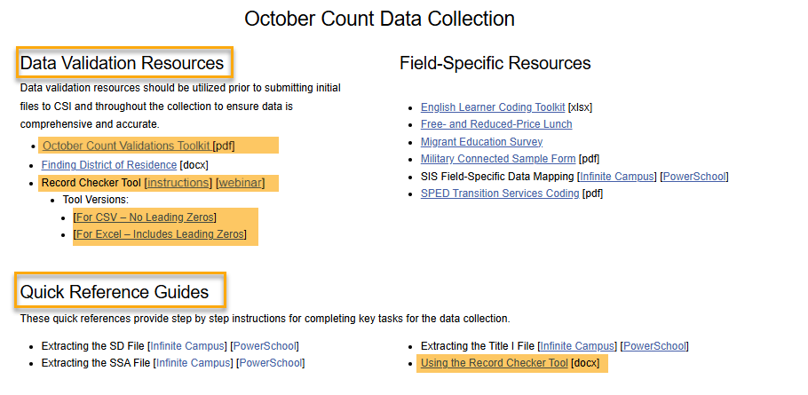
Data Validation Resource
https://resources.csi.state.co.us/data-submissions/october-count/
Notes:
The two validation tools you will want use prior to your initial submission are first the October Count Validations Tool kit and then the Record Checker Tool.
The October Count Validations Toolkit will help walk you through identifying and checking special population groups such as McKenny Vento, EL learners, ASCENT students, and more.
The Record Checker Tool will help you identify potential errors PRIOR to submitting your files to CSI. If you would like the Data Submission Team to review your Record Checker data, please upload the file to your October Count Files to Run folder in G-Drive and send an email to CSI.

Slide 30
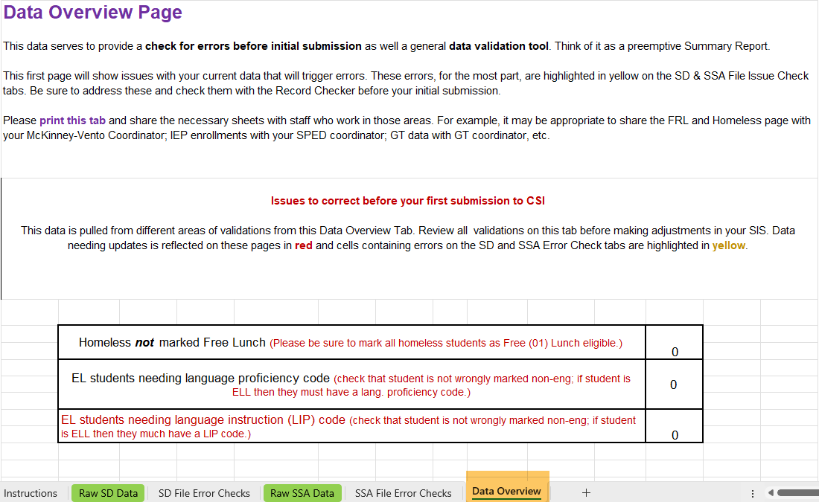
Record Checker Tool
https://resources.csi.state.co.us/data-submissions/october-count/
Notes:
The Record Checker Tool (or RCT) is an Excel file available for several different state collections, including ones for the EOY, October Count, Human Resources, and SPED collections.
The intent of the tool is to help schools identify possible errors and inaccurate or missing data and correct those issues before submitting initial collection files to CSI.
Schools should plan to use this tool at least 1-2 weeks prior to the initial submission deadline for a collection. This gives adequate time to run the RCT, correct flagged data in your SIS, and continue the process (potentially multiple times) until the flags are cleared.
Another method by which the Record Checker Tool can help identify potential problem data is with the “Data Overview” tab located in the record Checker Tool. Sections include combined counts for enrollments, funding codes, attendance, SPED, EL, GT, FRL, and many other attribute types.
Be sure to partner with content experts at your school for their review and verification of this data. This partnership will ensure accurate data which directly affects your school’s funding.

Slide 31
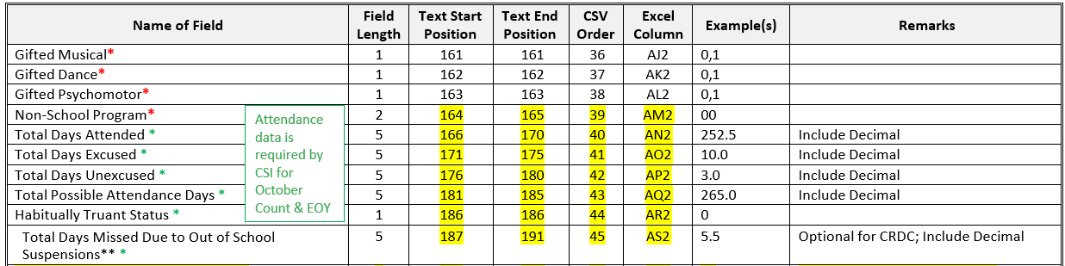
Attendance Reminder
Student Interchange – Student School Association
All attendance fields should be populated accurately
This helps to ensure your SIS is set up correctly at the beginning of the year.
Notes:
The record checker tool will help you identify where your attendance data is populating correctly. While attendance data is not required by the state within the October Count collection, it is a CSI requirement that schools report the data for the October Count as an assurance that attendance is properly set up at the beginning of the school year. Be sure to check that each of the attendance data fields are extracting correctly before submitting your first SSA file.

Slide 32
School Data Validations
Validate Data for All Special Populations – SPED, EL, GT, 504, MKV, FRL, etc.
Conduct internal audits of your school’s SIS SPED data and your SPED management system.
Compare your SIS data with your School Content expert’s list of students being served.
  Check that students are not only identified as SPED, GT, EL, etc, in your SIS, but also have the correct identification codes (disability code, language proficiency, Area of GT, etc).
  More information can be found in the SD and SSA File Layouts.
Run the Record Checker Tool and share the “Data Overview” tab with content experts.
Review the CSI-provided list of SPED, EL, GT and 504 students and their detailed coding data which will be sent to data submission contacts in early September. Share this list with your Content Experts immediately for validation.
Check the October Count Summary Reports carefully — this is your last opportunity to confirm accurate data before signing off.
6
Notes:
Accuracy is important for October Count and your school’s funding counts on it. It is important for you to create a process for sharing SIS state reportable data with the appropriate school experts serving special population students including SPED, English Learners, Gifted and Talented, 504, McKinney-Vento (homeless), and Free and Reduced Lunch populations. This allows comparison of the data within your SIS with the list of students actually being served.
There are several opportunities to confirm accurate reporting for October Count and throughout the year:
1) Conduct internal audits of your school’s SIS SPED data and your SPED management system.
2) Compare your SIS data with your School Content expert’s list of students being served
Check that students are not only identified as SPED, GT, EL, etc, in your SIS, but also have the correct identification codes (disability code, language proficiency, Area of GT, etc).
More information can be found in the SD and SSA File Layouts fond on the CSI Resource webpage.
4) Run the Record Checker Tool and share the “Data Overview” tab with content experts.
3) Review the CSI-provided list of SPED, EL, GT and 504 students and their detailed coding data which will be sent to data submission contacts in early September. Share this list with your Content Experts immediately for validation.
5) Check the October Count Summary Reports carefully — this is your last opportunity to confirm accurate data before signing off.

Slide 33
SIS Audit
Data Submission Team has begun auditing
The Start of School CSI SIS Audit is underway for PowerSchool and Infinite Campus. An email from Sheila Sellers will be coming soon with more information.
Please see the Data Management Systems page on the Data Submission Library website
  Infinite Campus Setup Self-Audit Guide
  PowerSchool Setup Self-Audit Guide
https://resources.csi.state.co.us/data-submissions/data-systems/
33
Notes:
To help ensure correct start of year SIS set-up, the Data Submission Team will be auditing your SIS.
We will let you know if we find anything that needs updating.
Be sure to review the materials on CSI’s Data Management Systems webpage, paying close attention to the Infinite Campus Set Up Self-Audit Guide or the PowerSchool Setup Self-Audit Guide – depending on which SIS you use.

Slide 34
Best Practices & Helpful Hints
Collaborate with colleagues
Contact the subject area experts of your school
“Heads up OC is kicking off”
Verify data and resolve issues
Keep up with SASID requests and updates
Search RITS for existing SASIDs
Request new SASIDs or Updates a.s.a.p.
No reason SASIDs should be zero-filled past initial submission
Add OC dates to your work calendar
Add all October Count deadlines
Work calendar
Shared school calendars
Set deadline dates earlier
34
Notes:
Some final thoughts as we wrap up the October Count General Overview Training.
First, it’s extremely important to collaborate with the content experts at your school. Take time to introduce yourself, let them know the collection is kicking off, and let them know that you’ll be leaning on their expertise to verify data and resolve issues.
Second, keep up with SASID requests and updates. For new students to your school, check whether there is already a SASID for them in the RITS system and request one if there isn’t. While we recognize there may be times when students have missing SASIDs in the initial file submission, it is expected that those particular errors are resolved prior to the next submission.
Finally, make sure you have a system that works for you for staying on top of the various deadlines associated with the collection. Add deadlines (or even set earlier, internal deadlines) to your calendar. Share deadlines with colleagues that you’ll be collaborating with.
These practices will support you in a smooth October Count data collection process.

Slide 35
Thank you for Reviewing this training.
Submissions_CSI@csi.state.co.us
35
Notes:
Thanks so much for reviewing this training! If you have questions on any of this information, please reach out to the CSI Data submissions inbox.

