Slide 1

October Count Audit
General Overview
2025-2026
Recorded August 2025
Notes:
This training provides a broad overview on the October Count Audit for the current school year and is aimed at new school submission contacts or those with more experience who would like a review or who are looking for specific topic information.
There is also an audit related training named “New This Year” on the CSI Audits webpage that focuses only on important highlights and changes for the current year.
Separate trainings specific to October Count submission related tasks are available on the CSI October Count webpage.

Slide 2
October Count Submissions & Audit
Main components (for both schools and CSI) to complete the October Count collection annually
Submissions
  Submitting student data files to CSI from SIS file exports, clearing errors, validations and certification
Audit
  Ensuring accurate funding levels claimed for students based on state guidance, collecting and submitting supporting documentation, and resolving any audit exceptions
Notes:
If you are brand new to the October Count collection, there are two main components to completing the entire annual cycle for both schools and CSI. The work we all do on both the school end and at CSI are very closely interrelated throughout the entire collection window.
One thing to be aware of is that the collection window is very short, yet it is the most impactful state collection for the school year.
The first component is often referred to as the Submissions side and the main tasks associated with it are for schools to submit student data files to CSI from SIS files exports, clearing any errors on the data, and then validating and certifying the accuracy of the data reported.
The second component is the Audit side of things. Main tasks associated with it are ensuring accurate funding levels claimed for students based on state guidance, collecting different types of supporting documentation from schools and submitting those to the state, and once CDE engages CSI in an official audit of the October Count data, then there is a phase of resolving any audit exceptions they might find.
If all stakeholders have diligently followed the rules and best practices for ensuring that accurate data was reported, then the hope is that any audit exceptions can be cleared without having funding return to the state.

Slide 3
Internal Audit Goals for CSI
Report accurate data
Secure maximum potential funding
Avoid repayment of funds back to the state
Reduce burden on schools
Notes:
CSI has 4 main internal audit goals that we hope to accomplish each year.
Report accurate data — we want all stakeholders to feel CONFIDENT that the October Count data is complete and accurate
CSI evaluates our audit check processes each year and work toward continuous improvement where we can
Schools also must be sure to check data on their end for accuracy to meet this goal
Secure maximum potential funding – we want to obtain the highest funding possible for every student enrolled
Avoid repayment of funds back to the state – hopefully if the first two goals are accomplished, then this one will follow
Reduce burden on schools– We try to limit adding tasks to schools around the audit unless it’s absolutely necessary

Slide 4
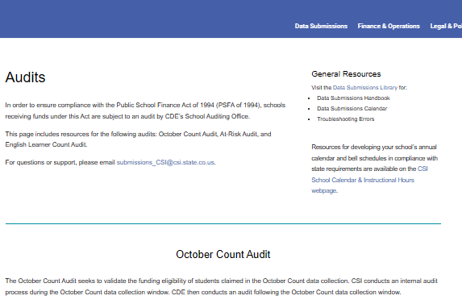
CSI Website
Audit resources are once again found on the Audits webpage
Main Sections:
October Count Audit
At-Risk Count Audit
English Learner Count Audit
SPED Count Audit (NEW ADDITION IN 25-26)
Notes:
As a reminder, CSI moved the audit related resources from the main October Count collection webpage to a new “Audits” webpage last year.
The main October Count collection webpage still houses only the data submission related resources.
The Audit webpage is again divided into separate sections, reflecting the main types of audits that CDE conducts on data submitted for the October Count collection.
These sections are the October Count Audit, the At-Risk Count Audit, the English Learner Count Audit, and the NEW for 25-26 SPED Count Audit.

Slide 5
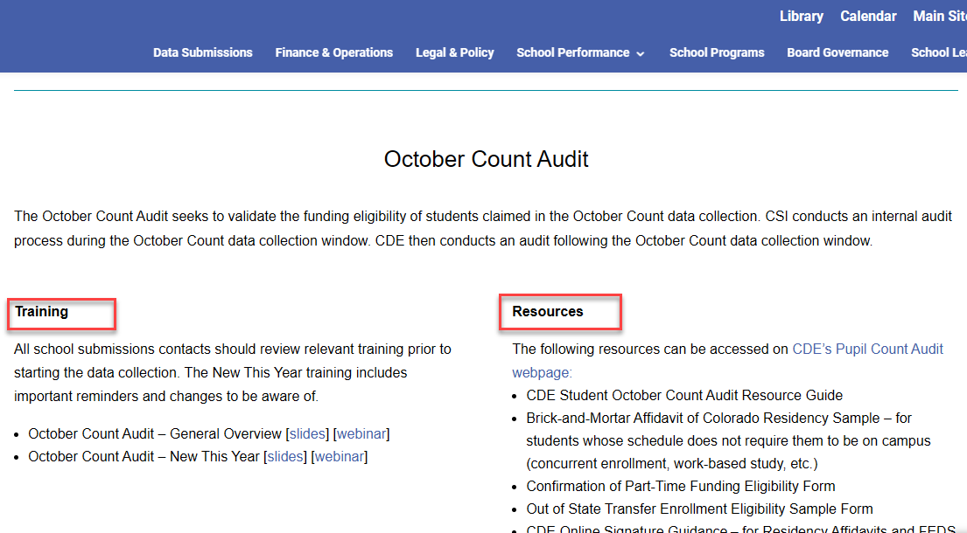
October Count Audit Section - Audits webpage
Notes:
Under the October Count Audit section of the Audits webpage you will see that it is divided into Training links and Resources links.
The screenshot in this slide may appear slightly different than what is currently included on the webpage.
Several references to CDE resources that schools will commonly need to consult, or use will also be listed under the Resources section.

Slide 6
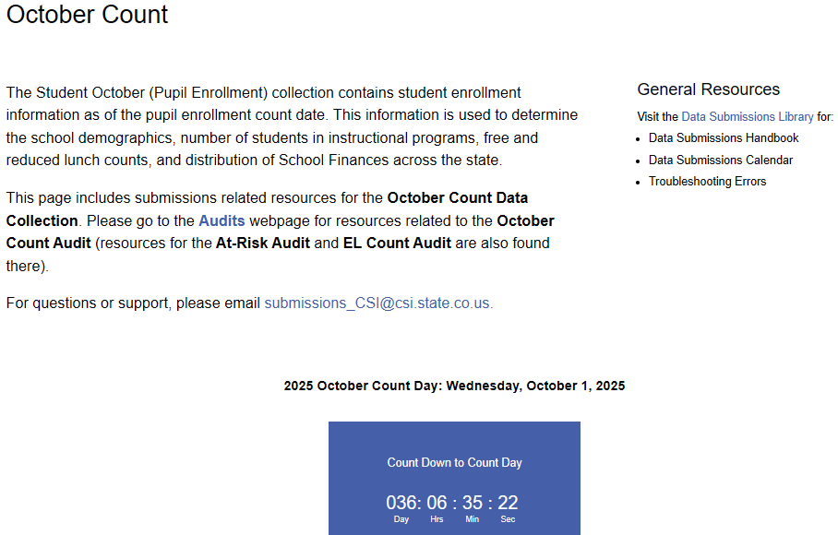
October Count Submissions Webpage
Notes:
We just covered where the CSI Audit related webpage content is, you’ll want to also know where the Submissions (or sometimes called the Collections) related webpage is located.
This slide has a screenshot and link to that page, and you’ll know you are there once you see the blue October Count Date countdown clock.
This location is where you’ll find student data specific resources for reporting your data to CSI for the collection.

Slide 7
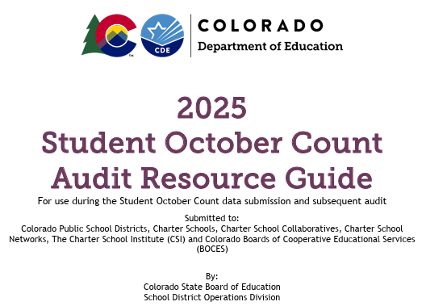
CDE October Count Audit Resource Guide
Most important CDE audit resource schools will need to review, and consult will be the 2025 CDE Student October Count Audit Resource Guide
Notes:
Once again, the most important resource that the state provides, covering the funding rules that all districts and schools must follow is the CDE Student October Count Audit Resource Guide.
Because the funding rules can change from year to year, be sure that you always use the current version for the school year.

Slide 8
Additional Resources
  CSI October Count Audit Handbook (link posted on the CSI Audits webpage)
  CSI October Count Submissions
  CSI Legal and Policy Guidance
  Other CSI Webpages (EL, FRL, McKinney-Vento, Migrant, SPED, etc.)
  CSI Weekly Update Emails
Notes:
There are once again several other helpful additional resources for audit purposes.
The first listed resource in this slide, which is the CSI October Count Audit Handbook is one that all schools will need to review as soon as possible and follow closely to ensure that you are reporting funding correctly and that you will be collecting and submitting the correct audit supporting documentation to CSI.
The second link listed is to the main CSI October Count Submissions webpage where you’ll find the general data reporting resources.
The CSI Legal and Policy Guidance webpage again has general policy documents on topics like attendance, admissions & enrollment, home school programs and others related to data impacted or reported by schools.
Some of these documents may have been updated since last school year, so please be sure to check for the newest versions.
CSI also has several other helpful webpages dedicated to different student programs and processes like EL, FRL, McKinney-Vento, Migrant, and SPED among others. These webpages could also have been updated since last year.
Finally, be sure to review the Weekly Update emails CSI will send in school year 25-26.

Slide 9
CSI October Count Audit Handbook
General Overview – Finance Act Rule Changes Summarized
SIS Attendance, Enrollment, and Schedule Report Section Updates
Return of the Audit Checklist
Reminder to use the FRL Checklist
Notes:
Here are the main changes to the CSI October Count Audit Handbook for this year.
The General Overview section has been updated to summarize the Finance Act rule changes for this year, which will have some impact on every school.
The SIS report section on attendance, enrollment, and schedules has had several updates, which are mainly clarifications on how to pull reports that are formatted for improved readability. We have also provided new information about how to best set up reporting segments based on audit rule changes for this year.
For 25-26, there will be a return of the “Audit Checklist” similar to what we have had in prior years. It will once again consist of a list that schools will checkmark to identify each of the types of special program and student types they will report this year. The list will again need to be signed and returned to CSI the first week in November.
The FRL Checklist will again be included, and all schools should complete it to ensure accurate FRL data. However, the FRL Checklist does not need to be signed and returned to CSI.

Slide 10
Key Audit Dates
Pupil Count Grades | Pupil Count Date
PK-12 | Wednesday, October 1, 2025
IMPORTANT CHANGE: The 11-day count period/window reference HAS ENDED! (This included the 5 school days before and 5 days after the count date)
  Found to conflict with statute and any rule related to it expired on May 15, 2025
The 30-day attendance resume date will be October 31
Notes:
This year the official count day will be on October 1st.
Any CSI Schools that may have an approved alternative count date will substitute that date for October 1st.
THERE IS ONE VERY IMPORTANT CHANGE THAT WENT INTO EFFECT for 25-26.
The state Legislative Legal Services determined that the 11-Day count period or window conflicted with statute and any rule related to it expired on May 15, 2025.
Historically, the primary purpose of the 11-day window was to provide a timeframe for students qualifying as a transfer enrollment exception for funding purposes in the October Count collection.
It has also served to provide a method of defining a timeframe of data to provide for proof of attendance documentation. We’ll visit more in this training about what this means for providing attendance reports for this reporting year.

Slide 11
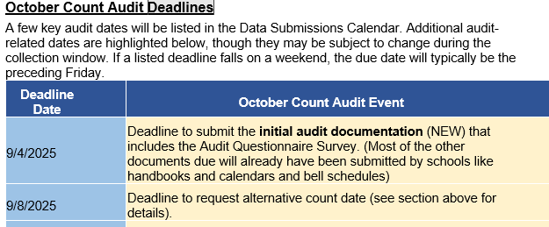
Additional Audit Dates
See the full “October Count Audit Deadlines” section in the CSI October Count Audit Handbook for a table of dates
Notes:
Not all current year audit related dates are posted to the Data Submissions calendar simply because it would be difficult to fit them all in.
This slide shows only a portion of the additional audit related deadlines table listed in the CSI October Count Audit Handbook.
There have been changes from last year, so please be sure to download a copy of the handbook and check out the rest of the dates listed there.

Slide 12
Student and Instruction Types
Various unique student and instruction types impacting funding
  Based on CDE interpretations of the Public-School Finance Act
  Can be exceptions to the general funding rule(s)
  Affects types of supporting documentation necessary to prove funding eligibility
Full details available in
2025 CDE Student October Count Audit Resource Guide
Also review “New This Year” CSI Oct Count Audit Training
Notes:
The CDE Student October Count Audit Resource Guide was mentioned earlier in this training.
Schools will want to review that resource along with the “New This Year” CSI October Count Audit training to find out about the important changes for the current year.
The main purpose of the CDE Audit Guide is to provide details to districts and schools on general funding rules based on CDE interpretations of the Public-School Finance Act.
Depending on the unique student and instruction types, there can be exceptions to the general funding rules.
The rules can also affect the types of supporting documentation schools will need to submit to prove funding eligibility claimed on students.

Slide 13



Audit Supporting Documentation
Documentation that’s required by the state providing proof of funding claimed on each student and their unique enrollment situation for the year
Notes:
If the concept of “supporting documentation” for the October Count is new to you, it’s simply the documentation required by the state which provides proof of funding claimed on each student and the unique enrollment situation for each student.
This is one of the primary requirements for the October Count audit and every CSI school will be required to submit at least some pieces of supporting documentation to CSI for the current school year.

Slide 14
Audit Document Retention
CSI Data Submissions Handbook – Records and Documentation Retention section
Be prepared to provide all audit documentation in electronic format
Notes:
For information on how long to keep documents related to state reporting, including the October Count, please see the Records and Documentation Retention section in the CSI Data Submissions Handbook.
Schools will need to be prepared to provide all audit documentation in electronic format to CSI because this is the format that the state expects it in.

Slide 15
Membership Requirements
To be eligible for any funding, all students must meet basic MEMBERSHIP requirements
MEMBERSHIP
Enrollment
Attendance
Student must be enrolled as of Count Day
Student must be present on Count Day, or present prior to Count Day and resume attendance within 30 calendar days of Count Day
New attendance rule changes in 25-26. Watch the “New This Year” audit training for details.
Notes:
Supporting documentation is intended to support or prove the funding claimed for each student a school reports in the October Count and funding can be either part or full time.
Students can also be not eligible if they do not meet the requirements for either part- or full-time funding.
ALL students must meet membership requirements—if they don’t then they are NOT eligible for funding.
The graphic in this slide shows how enrollment plus attendance equate to membership.
Students must be enrolled as of count day AND students must meet specific attendance rules.
The general attendance rule is that a student must be present on count day, and if they are absent, then they must have been present at least one day prior to count day this year and resume attendance within 30 calendar days after count day.
IMPORTANT: There are new attendance rule changes in 25-26. Watch the “New This Year” audit training for details.

Slide 16
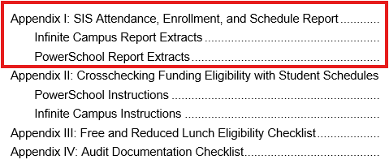
Attendance and Student Schedule Reports
CSI October Count Audit Handbook
Secondary level (grades 9-12) individual student schedules due to CSI on count day!
Notes:
Two types of supporting documentation for the audit that all CSI schools will provide to CSI are the Attendance and Student Schedule Reports.
The current Appendix I of the CSI October Count Audit handbook contains instructions for pulling the attendance reports plus individual student schedules from both Infinite Campus and PowerSchool.
Instructions are also included for extracting enrollment reports, which are sometimes also needed depending on student and instruction types. They can also be a helpful tool for schools to pull to double check their enrolled students for the year.
Just a reminder on how important it is that attendance is taken correctly in your SIS so that the attendance reports show correct proof of students attending.
For any students who are absent on count day, you will need to provide extended attendance reports for them to show that they were present a day prior to count day and resumed attendance within 30 calendar days after count day.
It’s also extremely important that bell schedules are set up correctly in your SIS AND that those match what have been submitted to CSI for supporting documentation.
CDE will be closely comparing your bell schedules with actual student schedules, so they need to align.

Slide 17
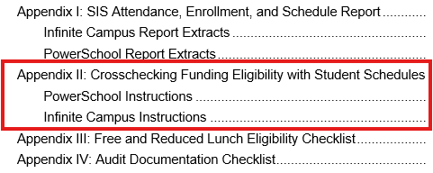
Checking Funding Status
CSI October Count Audit Handbook
Crosschecking Funding Eligibility with Student Schedules
Notes:
The current Appendix II of the CSI October Count Audit Handbook includes instructions on crosschecking funding codes claimed on students by comparing them to student schedules in PowerSchool and Infinite Campus.
This is one of many important checks that schools will want to complete when validating that funding claimed for students is accurate for all.

Slide 18
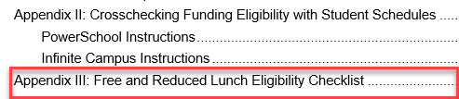
Free and Reduced Lunch Checklist
CSI October Count Audit Handbook
Notes:
Appendix III is a checklist schools should all use in determining the accuracy of free and reduced lunch eligibility for students reported in the October Count.
Though this checklist is not required to be completed, we hope that each school will use it to ensure that all students are being identified and reported correctly for the school year.
Both accountability reports and funding streams are impacted by the FRL data reported in the October Count collection.
If schools do not have adequate documentation or proof to support the eligibility status reported in the October Count, then the state will require repayment of At-Risk funds awarded. This is why we caution all schools to be very careful that the FRL data is reported accurately.

Slide 19
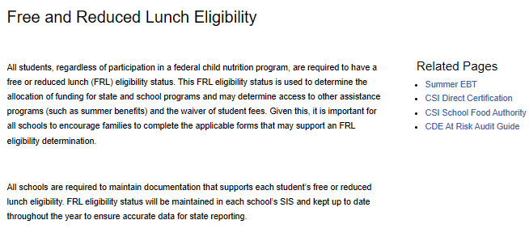
Free and Reduced Lunch Resources
CSI Free and Reduced Lunch Eligibility webpage
Notes:
The main CSI Free and Reduced Lunch Eligibility webpage on the CSI website has multiple resources available to understand more about FRL.
Submission contacts are highly encouraged to review this webpage to help ensure you are following best practices for determining and reporting FRL statuses on all enrolled students.

Slide 20
Free and Reduced Lunch Reminders
Healthy School Meals for All program (HSMA) continues for 25-26.
Schools that opt in still need to collect, retain, and provide student eligibility documentation for audit purposes.
Only students with qualifying eligibility documentation may be reported as free or reduced lunch eligible in the October Count.
Notes:
The Healthy School Meals for All Program will continue into 25-26.
This is a very important reminder that if schools opt in will still need to collect, retain, and provide student eligibility documentation on every student reported as free or reduced lunch eligible in the October Count for audit purposes.
Only students with qualifying eligibility documentation may be reported as free or reduced lunch eligible in the October Count.

Slide 21
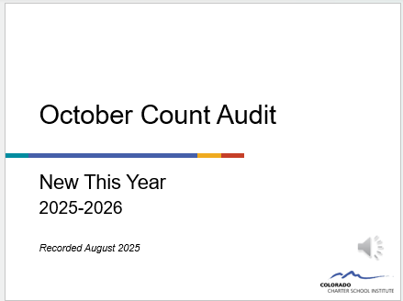
Next Step
Watch the “New This Year” October Count Audit training for important reminders and changes for 25-26!
Notes:
Now that you’ve completed this CSI General Overview training for the October Count Audit, we strongly encourage you to watch the “New This Year” training that will cover the important reminders and changes taking place for 25-26, which there are quite a few to know about.

Slide 22
End of Training
Thank you for watching this recording!
Send questions to submissions_csi@csi.state.co.us
Notes:
Thank you very much for watching this recording.
If you have questions or if you would like to meet with a CSI staff member to dive deeper into the October Count reporting or audit related information, please be sure to send those requests to our submissions email listed on this slide.

