Slide 1
25-26 CSI Human Resource Collection Training
New this Year and Reminders
Recorded August 2025
Notes:
Hello! Welcome to the 25-26 CSI Human Resource Collection Training. This training is focused on providing updates to the collection from the prior year and sharing a few reminders. It is designed for returning staff, but all staff are welcome to review this training along with the general overview training. If you have questions while reviewing this training, feel free to reach out to the CSI data submissions inbox.

Slide 2
Agenda
New/Reminders for HR Collection
Grant/Project Funding Source field Change to Funding Source Network Staff Reporting Requirements Demonstrates In-Field Status Reminders Manual Entry Coding
The HR Record Checker Tool
Access, opening, and using the tool
Validations Checklist now included on the tool
Timelines and Deadlines
  Initial submittal, Level 1, Level 2, and Signed Summary Deadlines
2
Notes:
So for the agenda today, we will first be looking at what is new and reminders for the collection in 25-26. The updates were relatively minimal this year, with changes to how Funding is being coded this year. We’ll also discuss some Network reporting requirements, details on the Demonstrates In-Field Status field, and manual entry coding. After that, we’ll then jump into a reminder discussion on the resource called the HR Record Checker Tool and finish off today’s training with the timelines and deadlines.

Slide 3
Reminder: Starting Point Files and Template Available
Returning CSI schools can access Starting Point Files
  Contain the last submitted file data from 24-25 with some CSI updates***
  Accessible in Google Drive (G-Drive): /HR/25-26/Starting Point
New schools can fill out blank templates
  Staff Profile Template
  Staff Assignment Template
For more information
  HR Data Collection Prep Overview
  HR Collection Training – General Overview (on HR Page)
***Staff using Starting Point files are encouraged to review the HR Quick and General Overview trainings as they detail all the CSI updates that were made prior to providing school's access
3
Notes:
Prior to jumping into the 25-26 updates, I wanted to remind all CSI schools some details regarding the Starting Point files and templates available to them. The Staff Profile and Staff Assignment Starting Point files are currently available in your shared folder in Google Drive. They are the last files submitted from 24-25 with some CSI updates and flags for inaccurate data. For a full listing of the flags and updates, you’ll want to review the General Overview training or the HR Data Collection Prep Overview document to ensure you are not updating something CSI has already done for you. Also in this slide, there are links to the blank templates that can be used. The templates for the Staff Profile and Staff Assignment files are primarily designed for new schools or new to CSI schools that don’t have this existing information readily available in this format. These can also be used for schools with a significant amount of staffing changes over the last year. Please be sure to review the other HR trainings and resources available if you need additional details on these topics.

Slide 4
Updates for 25-26
Notes:
Now that you have an overview of what we will be discussing, let’s jump into the updates and reminders for the 25-26 HR data collection.

Slide 5
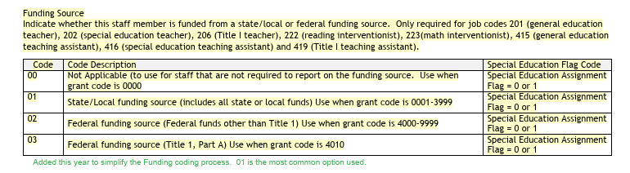
Funding Source Coding Update
The Grant Project Funding field has been removed and replaced by the Funding Source Field.
  CDE decided to simplify the process of coding funding for staff by removing all the specific grant coding options.
  Codes have been replaced with the simple 00-03 options to select from.
5
Notes:
Alright, jumping into the biggest change for the collection this year. CDE has removed the Grant/Project Funding Source field, choosing to replace it with a more simplified Funding Source field. The coding options for this new field are 00-03 and remove a lot of the confusing grant coding that was previously included. The goal of CDE in this change was to further simply the process and avoid unneeded confusion.

Slide 6
Funding Source Coding (Continued)
Prior Code (24-25) New Code (25-26)
Not Applicable
0000
00
0001-3999
01
State/Local Funding
4000-9999 (not 4010)
02
Federal Funding (other than Title 1)
4010
03
Federal Funding (Title 1)
6
Notes:
Continuing with the new Funding Code field. This left side of this slide shows the old coding options for State/Local Funding, Federal Funding and Title 1 Federal Funding. As you can see, this left a lot open to interpretation. The right side show the new coding options are in relation to the old coding. I should mention that the Starting Point files were modified this year to include the new coding options, but be sure to follow this for any newly added staff or changes.

Slide 7
Adding Network Staff
With the addition of more Network schools to the CSI Portfolio, CDE has provided guidance on if/how to report those staff:
  CDE confirmed all network, collaborative, CMO staff should be included on their respective Staff Profile and Assignment Files.
  This includes all staff who may not work for a particular school, but the network as a whole.
  Staff can be coded in one of two ways:
    One school code can be selected where all hours and salary for that staff member can be added to both files.
    One record on the Staff Profile but the Staff Assignment may have a record on each school that they provide support for. Ensure that the Hours Per Day and Salary are split across the SA records to add up to the total.
7
Notes:
Another topic I wanted to discuss is not necessarily new, but wanted to provide some clarification. CDE has confirmed that all Network staff must be included on both the Staff Profile and Staff Assignment files for this collection. Over the past few years, CSI has been gaining more network schools, so we reached out to CDE to clear this up. If you are not a network school, you can disregard this slide. Adding network staff can get confusing as it relates to school code, so we have provided two possible ways to include them. First, you can select one school code and place all your network staff under that code ensuring they have all the hourly and salary details regardless of who they are working with. The other option would be to provide one staff profile record for the network staff and then include a record for each school code in the network. This gets a bit tricky as their hours and salary must total up to the actual full amount across all the records. Feel free to reach out to CSI if you have questions on this!

Slide 8
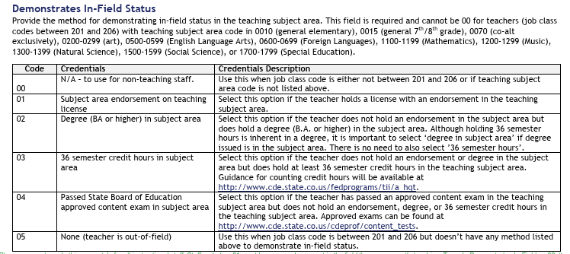
Demonstrates In-Field Status
  The Demonstrates In-Field Status field is an area of confusion for many schools and attributes to the most level 2 errors. Below are tips and details regarding this field to provide some clarity:
  Required for all teachers with Job Classification Codes 201-206.
  In order to code staff an 01 – Subject Area Endorsement on License, the staff member must be endorsed in the subject area they are current teaching (Teaching Subject Area field). To look this up, navigate to the Colorado Online Licensing page.
  Coding staff as an 02 – Degree in Subject Area, they must be currently teaching (Teaching Subject Area – Staff Assignment) in the same field they received their degree (Subject Area of Degree – Staff Profile). Check both files to ensure they match.
  Use the ESSA In-Field Crosswalk to filter on the Teaching Subject Area (or vice versa) and see the allowable coding options on the Subject Area of Degree.
  Work your way from top to bottom on the coding options (01→05) moving down if they don’t meet those requirements. If none are applicable, use 05 – Teacher is out of field.
8
Notes:
Next, I wanted to discuss a field that is not new but every year produces the most level 2 errors for our schools, which is the demonstrates in-field status field. This field is required for all teachers in job codes 201-206 and requires a bit of research in some cases. In order to code staff an 01 – Subject Area Endorsement on License, the staff member must be endorsed in the subject area they are current teaching (Teaching Subject Area field). To look this up, navigate to the Colorado Online Licensing page. As far as far as coding a staff person as an 02 – Degree in subject area, you must utilize both files. You’ll want to first check the subject area of their degree on the staff profile and compare that to their current teaching subject area. These two need to match or fall within a strict set of coding options in order to use this 02 option. To help with this, you can use the ESSA In-Field Crosswalk linked here and filter by one or the other field and see what options work together. Another detail that is important is that you want to start at the top and work you way down as a staff person does not meet certain requirements to ensure you are coding them with the highest applicable option. If none work, you may need to code them as an 05 – out of field. This is not uncommon and usually is not an issue as long as a school does not have a ton of them.

Slide 9
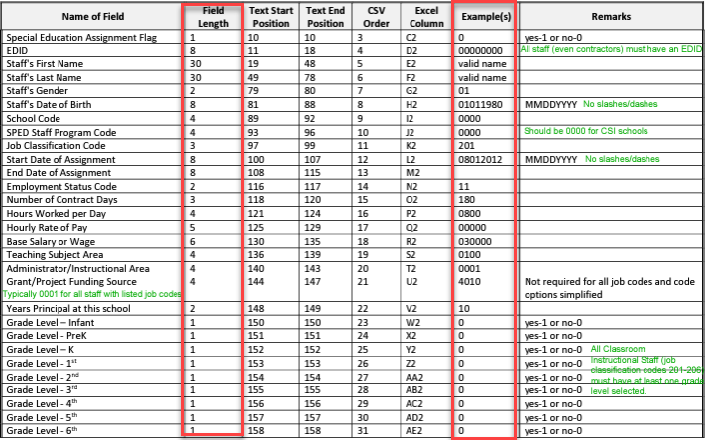
Manual Entry – Proper Coding and Field Lengths
Since most schools are completing manual updates to their files, it is important to understand that all fields must be the length posted in the file layout. Also, utilizing allowable coding, including leading zeros, for each field is necessary. Failure to do each of these can result in a file not processing properly.
See the Staff Profile and Staff Assignment File Layouts located on the CSI HR Submissions Page.
9
Notes:
Lastly, given this collection is different from others with manual entry being completed, as opposed to SIS extraction, it is extremely important that schools verify the fields are being coded properly. This means including any leading zeros and ensuring all fields are the proper length. To assist with this, the File Layouts have a table at the top showing the necessary field lengths and examples of how they should look. In prior years, I have encountered many instances of files not processing and we end up having to dig through the file to determine the reason. Most commonly, it relates to fields not being coded properly. To avoid delays in processing, ensure you review the file layouts to determine both that your fields are the correct length and that the coding option used is applicable as it relates to that field.

Slide 10
Reminder: HR Record Checker Tool
Notes:
Now, lets revisit an important tool that CSI is providing to schools called the HR Record Checker Tool!

Slide 11
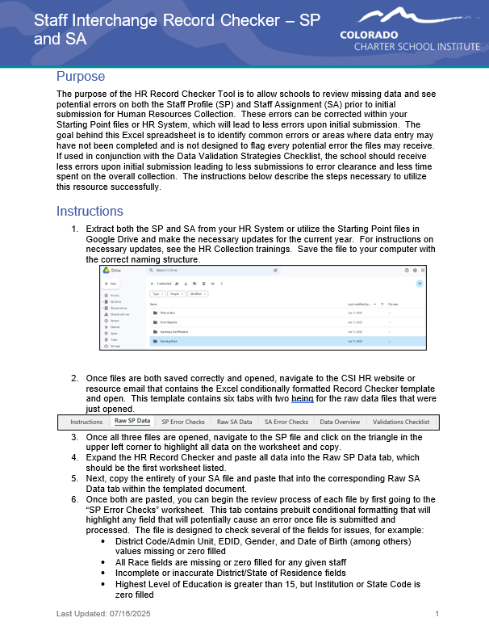
Purpose of the Record Checker Tool
Identify and correct errors prior to submittal
Fewer errors received upon initial submittal
Fewer submissions to get to error clearance
Collection errors cleared earlier in the process
For more details and information, see the Record Checker Instructions and Template Tool
Notes:
The purpose of the record checker tool is to identify and correct potential issues or errors prior to initial submittal of files to CSI. The tool is essentially an excel template that allows you to paste your raw data files into it and any potential issues will be flagged on the review tabs. This tool is not designed to catch every error, but if used properly – you should expect to see less errors on your initial submissions with the goal of less submittals to error clearance!

Slide 12
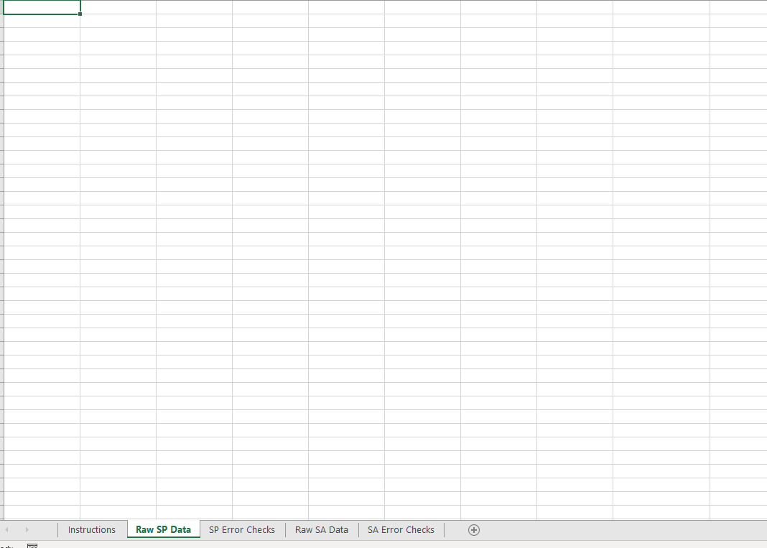
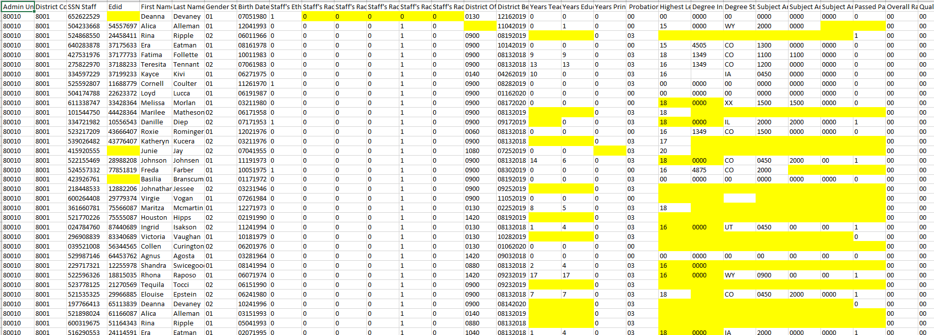
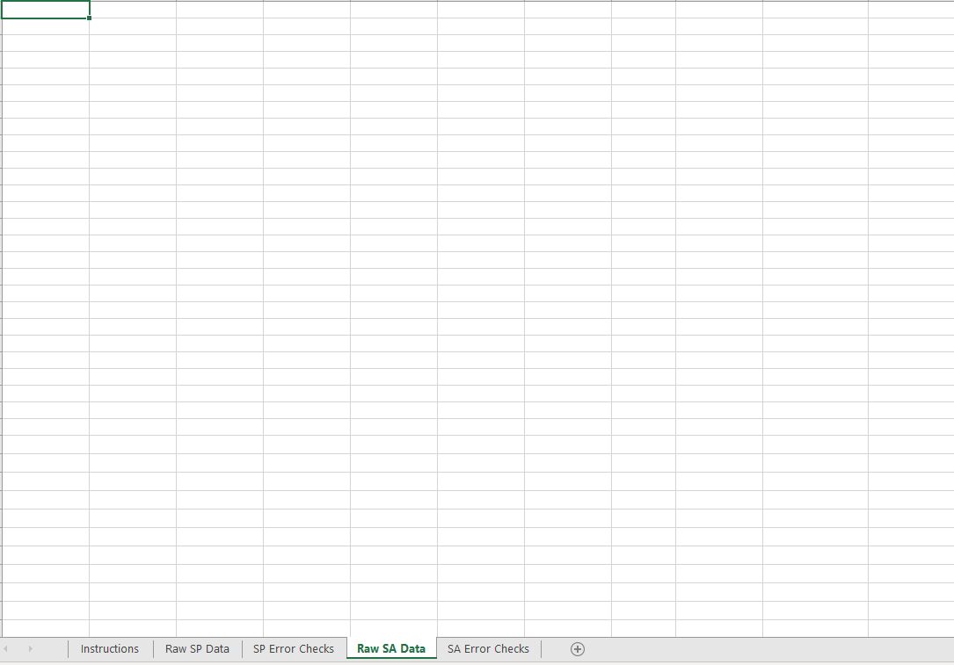
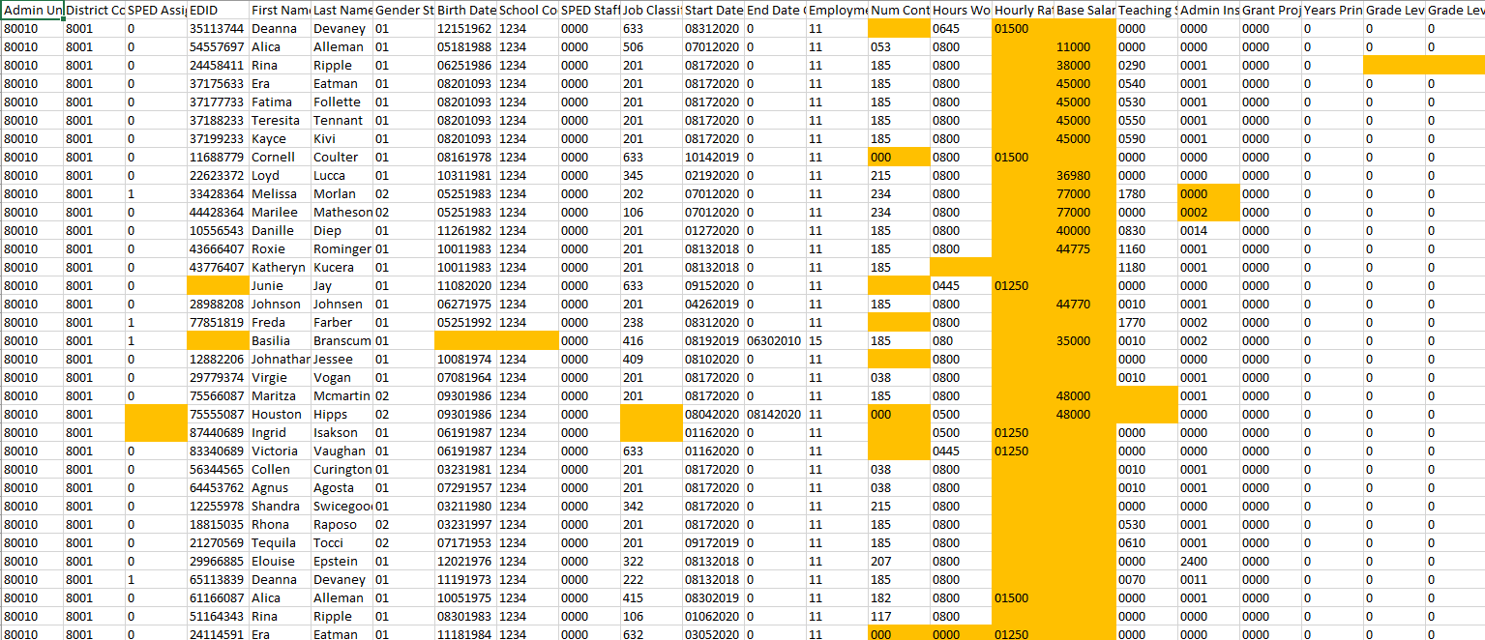
SPED Record Checker Tool
Notes:
As you can see here, the tool contains 4 main data tabs aside from the instructions tab, 2 for your raw data and 2 showing potential errors on each file. Essentially, you want to paste your raw data into each corresponding raw tab and navigate to the checks tabs. Anything that may potentially be an error will be highlighted on those. The objective would be to navigate back to your files or HR system, make the corrections and create updated files for your initial submission. It is highly recommended to use this during the HR collection to reduce your errors making your job easier in the long run.

Slide 13
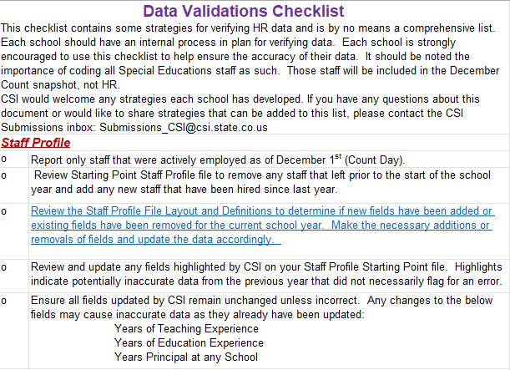
SPED RC Tool Addition – Validations Checklist
Both the Record Checker Tool and Validation Toolkit contain several helpful data entry checks and error clearance assistance tools for schools to use in previous collection years.
Many of the error clearance checks and reminders overlapped across the two resources.
Due to this, they have been combined into one document called the Record Checker and Validation Toolkit.
The original tabs of the Record Checker remain relatively unchanged; however, a new validation tab was added. This is a pared down version of the Validation Toolkit containing only checks that are not being flagged in the Record Checker.
Notes:
CSI provides schools with several resources to help out with the HR Collection, with two of them being the Record Checker Tool and the Data Validation Document. What we found is that many of the details to check in the Validations Document repeat some of the flags you are seeing on the Record Checker. To avoid this overlapping of details, CSI has now included an additional tab on the Record Checker Tool for additional validations. These are the validations that are not being flagged on the tool. If you open the Record Checker, navigate to the last tab and you will see some helpful tips and historical concern areas to check that differ from what you are seeing when you run the checker on your files. Hopefully, this will avoid any overlap and decrease the time spent checking your data prior to submittal.

Slide 14
Timelines and Deadlines
Notes:
Last, lets take a look at the timelines and deadlines for this collection!

Slide 15
HR Collection Timelines and Deadlines
Deadline | Task
09/18/2025 | Submit initial files (Staff Profile, Staff Assignment for HR)
11/19/2025 | Schools must have all Level 1 (Staff Profile/Staff Assignment) errors cleared
01/21/2026 | Schools must have all Level 2 (HR and December Count-Staff) errors cleared
Upon Error Clearance | CSI will provide Data Summary Reports to schools
1/29/2026** | Submit Signed Certification Agreements to CSI
*Dependent upon all schools clearing errors by specified deadlines
**Any requests for changes must be received by CSI on or before 1/27/2026
Notes:
This slide lists all the deadlines that must be followed for the 25-26 HR Data Collection. First, we have a date of 9/18 to have all your initial staff profile and staff assignment files submitted with level 1 error clearance for those files being on November 19th. All school must have both level 1 and 2 errors cleared by January 21st, 2025 and you will receive your summary report shortly thereafter. The date to review, sign and return those is January 30th. If after reviewing, you notice some changes that need to be made to your data, please submit those updated files to CSI by January 27th to ensure files can be processed and a new summary report delivered to meet the deadline.

Slide 16

Thank you for reviewing this training!
Contact the Submissions Inbox with Questions:
    Submissions_CSI@csi.state.co.us
Notes:
Thank you so much for reviewing this training for the 25-26 HR Data Collection. If you have questions, don’t hesitate to reach out to CSI and we are more than happy to assist you!

