Slide 1
25-26 CSI Human Resource Collection Training
General Overview
Recorded August 2025
Notes:
Hello all,
Thanks so much for reviewing this training for the 25-26 Human Resources collection. This particular webinar covers a general overview of the collection including the 5 steps of the submissions process. If questions come up while reviewing this training, feel free to reach out to the submissions inbox and we’ll be more than happy to help!

Slide 2
Agenda
Purpose of HR Collection
Purpose, Collaboration, Who to Include/Exclude
File Overview
  Staff Profile File
  Staff Assignment File
HR Collection Process
Step 1: Collection Prep | Step 4: Resolve Errors
Step 2: Collect Data | Step 5: Certify
Step 3: Submit to CSI
Common HR Questions/Issues
2
Timelines and Deadlines
Notes:
Here is a quick overview of the topics that we will be discussing today. First, we will look at the Human Resources Collection as a whole and in particular the purpose and required files for the collection. We’ll then jump into the 5 steps of the collection process and some available resources for each step followed by assistance with some common questions or issues. Lastly, well take look at the timelines and deadlines for this collection!

Slide 3
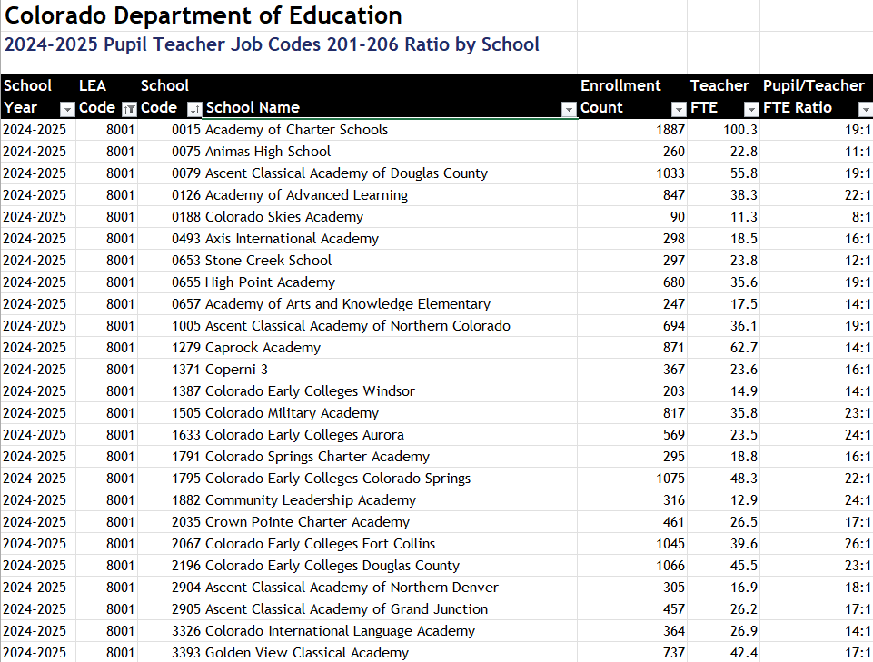
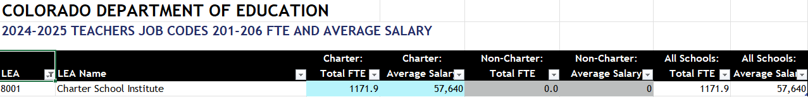
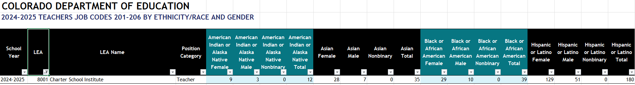
Purpose of HR Collection
The Human Resources collection contains all general education staff information as of the official staff count date. This information is used for:
HR Data used for:
School Staff Demographics | Turnover Rates
Average Salaries by Position/Education level | Educator Effectiveness Ratings
Highly Qualified Status
3
https://www.cde.state.co.us/cdereval/staffcurrent
Notes:
Let’s jump into the purpose of the Human Resources Collection. The HR Collection contains general education staff information as of the official staff count day of December 1st. This is information that is used for the reporting of school staff demographics, average salaries by position and education level, highly qualified status, turnover rates and educator effectiveness ratings. It should be noted that when we are talking about the HR Data Collection, we are not only talking about general education staff, but also special education staff. The staff with a SPED flag of 1 will automatically be pulled into the December Count snapshot, while all other general education staff will be pulled into the HR snapshot.
In terms of the screen shots located on this slide, they all come from the CDE Education Statistics page and provide the latest information that CDE has on both a school level and CSI as a whole. This is all the information that was obtained during the 24-25 collection. You will notice these three cover pupil teacher ratio, average salaries, and teachers by ethnicity and gender. These are just a few reports created by CDE using the data from this collection, which is why I want to emphasize the importance of reporting accurate data regarding your staff. Feel free to review all the reports located on the CDE website link provided here and reach out to CSI with questions.

Slide 4


Who to Include in HR Collection?
Include:
  All general/special education staff employed as of 12/01
  Full or Part time Staff
  Office/Clerical, teachers, principals, administrators etc.
  Contracted/Purchased Service Staff
  Network Staff
Exclude:
  Substitutes unless contracted permanent (Paid regardless of filling substitute role)
  Temporary workers (after school coaches etc.)
  Staff not employed as of December 1st
  Student interns under the age of 18
4
Notes:
Now that we have discussed the purpose, I wanted to address a question that I received every year which is “who exactly should I be including for the HR Collection?” This slide breaks down generally who should be included and who can be excluded from the Human Resources Collection. In terms of who to include, you want to ensure you are including all general and special education staff that were employed at your school as of December 1st. This includes full or part time staff who work in the office, teachers, principals, contracted/Purchased Service staff, Network staff, really anyone working for the schools. You can exclude substitutes unless they are considered contracted permanent and are being paid regardless of filling that role. Also, you can exclude temporary workers, staff not employed as of December 1st and student interns under the age of 18. With anything in data submissions, unique scenarios may pop up that do not fall into these categories, so if you encounter these – feel free to reach out to CSI and we can help provide clarification.

Slide 5
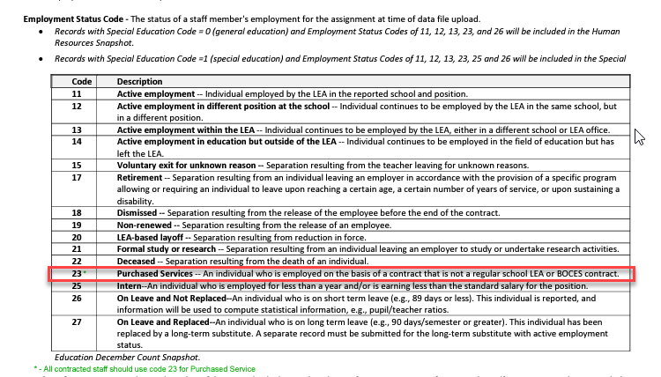
Contractors and Purchased Service - Employment Status Code Clarification
Schools should be using Employment Status Code of 23 for all Contracted and Purchased Service Staff. Historically, 11 has most commonly bee used for all staff.
5
Notes:
Jumping further into the Contractor/Purchased Service bullet, I wanted to provide some additional information regarding how specifically they should be coded and in particular, the Employment Status Code. Historically, schools have always just used the 11 code which is Active Employment. This is not the most accurate way to reflect the actual employment of some staff. If you have staff that are contracted with the school, you should be using code 23 – Purchased Services. This could include bus drivers, kitchen staff, or even contracted special education staff. Updating this way may go against what you are used to for this field, but it is the most accurate reflection of those types of staff working at schools.

Slide 6
Adding Network Staff
With the addition of more Network schools to the CSI Portfolio, CDE has provided guidance on if/how to report those staff:
  CDE confirmed all network, collaborative, CMO staff should be included on their respective Staff Profile and Assignment Files.
  This includes all staff who may not work for a particular school, but the network as a whole.
  Staff can be coded in one of two ways:
    One school code can be selected where all hours and salary for that staff member can be added to both files.
    One record on the Staff Profile but the Staff Assignment may have a record on each school that they provide support for. Ensure that the Hours Per Day and Salary are split across the SA records to add up to the total.
6
Notes:
In addition to Contractors, I also wanted to touch on Network Staff a little more. CDE has confirmed that all Network staff must be included on both the Staff Profile and Staff Assignment files for this collection. Over the past few years, CSI has been gaining more network schools, so we reached out to CDE to clear this up. If you are not a network school, you can disregard this slide. Adding network staff can get confusing as it relates to school code, so we have provided two possible ways to include them. First, you can select one school code and place all your network staff under that code ensuring they have all the hours and salary details regardless of who they are working with. The other option would be to provide one staff profile record for the network staff and then include a record for each school code in the network. This gets a bit tricky as their hours and salary must total up to the actual full amount across all the records. Feel free to reach out to CSI if you have questions on this!

Slide 7
Inclusion in the HR vs. December Count Snapshots
Human Resources
Files must be Level 1 Error Free
Special Education Flag = 0 (Non-Special Education)
Start date is December 1st or prior to December 1st of reporting school year
End Date is either blank or post December 1st of the reporting school year
Job class codes are not equal to 632 (Temporary/Part-time Worker As Needed) or 634 (Student Worker)
Employment Status Code = 11, 12, 13, 23, 25 or 26
EDID is reported in both Staff Profile and Staff Assignment Association files for reporting district.
December Count
Files must be Level 1 Error Free
Special Education Flag = 1
Start date is December 1st or prior to December 1st of reporting school year
End Date is either blank or post December 1st of the reporting school year
EDID is reported in both Staff Profile (Profile and educational background) and Staff Assignment Association files for reporting district.
Employment Status Codes will be included: 11, 12, 13, 23, 25 or 26.
Administrative Unit code cannot zero-filled in either staff profile or staff assignment files
7
Notes:
This slide really covers a broad overview of what needs to be done to ensure that the records get included in the Human Resources vs. the December Count snapshot. Many of these are very similar, but the main take home point here is that for SPED Staff to be included in the December Count collection, they must have a special education flag of 1 and a valid administrative unit code of 80010. The job class code will further differentiate them as special education staff, for example 202 is for Special Education Teachers and 238 is a Speech Language Pathologist or SLP. If these fields are not coded as such, the staff person may not be included in their appropriate snapshot.

Slide 8
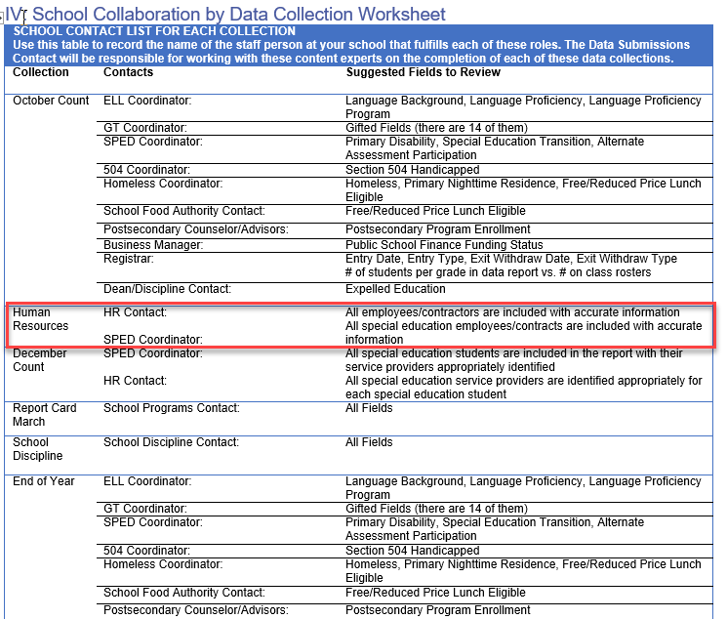
Cross-Collection Collaboration
School HR Staff must collaborate with school SPED Staff when completing December Count. Why?
    December Count errors may require changes to HR staff records to resolve
    Involves inconsistencies with SPED Staff data, including:
        SPED Flag
        Grade Levels Taught
        FTE and Funding Source issues
Reach out to your school’s SPED Staff to discuss any cross-collection errors that may have occurred
Available in the Data Submissions Handbook
8
Notes:
During this collection, we really want to emphasize the necessity of you as HR staff to collaborate with your schools special education staff to clear errors. As Special Education staff are working through their collection, they may encounter errors particularly on the Level 2 Staff error files that will require changes to the HR files, so being proactive and reaching out to them early in this process is especially important. In terms of issues, we generally see these come up with staff not being flagged for Special Education, errors in grade levels taught and FTE/Funding Source issues. CSI does try to provide both contacts this information throughout the process, particularly when issues are discovered, but collaborating with those staff and developing a plan of attack will be key to the success of both collections.

Slide 9
HR File Overview
Notes:
Now before we jump into the specific steps of the submissions process, I thought it would be helpful to provide a brief overview of the required files for this collection!

Slide 10

Required Files
Snapshot (HR or DC)
Staff Profile
Staff Assignment
10
Notes:
So when talking about the files that are required for this collection, it is the Staff Profile and Staff Assignment files. Once both files are uploaded and error free, a snapshot will be run to look for any level 2 errors across both files and also which staff meet the criteria to be included in the snapshot.

Slide 11
Staff Profile (SP) Overview
One record per staff employee
EDID cannot be zero filled and must match what is in EDIS (Last Name, First Name, Date of Birth, and Gender)
Search prior to requesting an EDID and use existing if available: https://www.cde.state.co.us/idm/edis
Race must be provided for all staff
    Ethnicity – Hispanic or Latino is an ethnicity, and a race must also be reported
No fields can be left blank except for End Date of Assignment (Zero-fill all non-applicable fields)
11
Notes:
So lets look further into the first file that schools need to submit, the Staff Profile. Here is a high-level overview of the file itself and some important details. As mentioned, there should be only one record per employee or contactor at your school. Also, the EDID field cannot be blank and must match what is in EDIS for that staff member, which can easily be checked by going to the link to the CDE EDIS page provided here. If a staff person’s information differs from what EDIS has, you either need to update your record or request an EDID update to CSI in the submission's inbox depending on which one is not correct. A couple other important notes to mention on this is that at least one race must be provided for all staff, which differs from ethnicity. I have historically seen schools only complete the ethnicity thinking that covers the necessary information, but a valid race must be completed, as well. Lastly, no fields on the files can be left blank with the exception of the End Date of Assignment for staff who are currently working at your school. Every other field must have each field zero filled with the correct number of zeros based on the field requirements.

Slide 12
Staff Assignment (SA) Overview
Multiple Records are allowed per person based on: When reporting multiple records for a staff member: Contract Days would not be split Base Salary should be split, but hourly should not Split hours per day based on time spent in each role
Special Education Status | Location
Job Class Code | Grant Code
Teaching Subject Area | Grade Levels
12
Notes:
Next, lets talk a little more thoroughly about the Staff Assignment file! This file can contain multiple records per staff person based on the 6 categories provided here: Special Education Status, Location, Job Class Code, Grant Code, Teaching Subject Area, and grade levels. If a staff member has multiple roles at the school and information differs in any of these categories, they may need to have multiple records to differentiate the data. Also when reporting these records, keep in mind – contract days would not be split, but the base salary and hours per day would be split across roles dependent on the amount of time spent in each role. We will be talking more about this in a later slide.

Slide 13
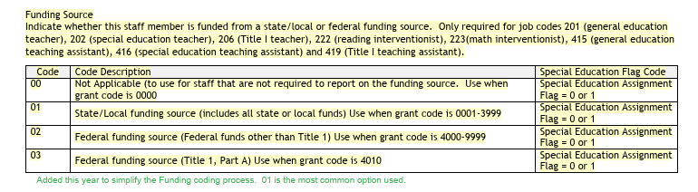
File Layout Updates for 25-26
Funding Coding Updates – The Grant/Project Funding Source field was removed and replaced by the Funding Source. This more basic version has options 00-03.
  This more simplified version was updated to streamline the process and ensure that all staff are coded more accurately.
For further details, see the HR Collection – New This Year Training on the HR Collection Page
Notes:
Prior to jumping into the collection process itself, I thought it may be important to mention the updates that were made to the file layouts for the 25-26 school year. There really were not many updates to the file layouts, only one. The Grant/Project Funding Code field was removed and replaced with Funding Source. The coding options for this are much simpler and easy to follow with the old options being a bit confusing. CDE’s overall goal with this change was to streamline the process and ensure more accurate coding. For further details on this, see the New This Year training.

Slide 14
HR Collection Process
Notes:
Now that we have discussed the purpose, files necessary and some 25-26 updates, let’s dive into the HR collection process as a whole. This is the process we go through with all the state data collections each year, but we will also get into some specifics of how this relates to the HR collection.

Slide 15
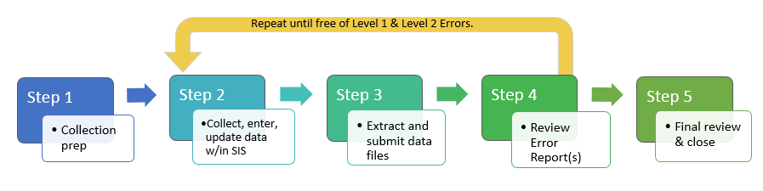
HR Data Collection in 5 Steps
Repeat steps 2-4 until data is complete and accurate!
15
Notes:
Generally, when we look at the HR collection or any other collection, it can be broken down into 5 distinct steps. Step 1 – Collection Prep, Step 2 - Data Collection and Entry, Step 3 Submission to CSI, Step 4 Error Resolution and Step 5 Data review. This really is an iterative process with steps 2 through 4 of entering data or making corrections, submitting to CSI and we will provide error reports where you will need to make more updates to your data. Once all errors have been resolved, we would jump to step 5 where the data is reviewed for accuracy and either signed off on or more changes would be necessary. With that information in mind, we will be looking more into each step in greater detail.

Slide 16
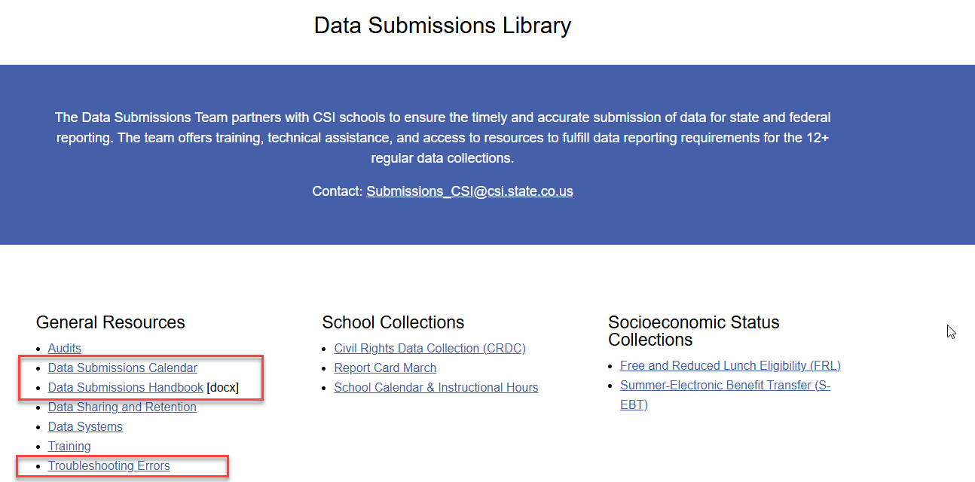
Step 1: Collection Prep Resources
https://resources.csi.state.co.us/data-submissions/
16
Notes:
So step 1 really is all about the steps a school should take prior to an upcoming collection to ensure they have the general knowledge necessary to be successful. This involves the 3 main general resources listed on the Data Submissions Library page on the CSI website and includes the data submissions handbook, the Data submissions calendar, and the troubleshooting errors spreadsheet. It is highly recommended that all new and returning staff review the latest version of the data submissions handbook, which comes out every year. It contains helpful information on each step of the process, your role vs. CSI, various resources available to you, to do lists among many others. The next area to focus on would be the data submissions calendar, which includes all important due dates for a collection, including initial submittal, level 1 error clearance, level 2 error clearance, and signed summary dates. Printing this and reviewing it often will ensure your school is staying in compliance by meeting all necessary deadlines. The last resource that will be talking about more later is the troubleshooting errors resource. This spreadsheet contains tab for each file in a collection along with a tab for level 2 errors. The tabs are a working document and provide updated listings of each error associated with a file or level 2 and includes details regarding the error message, field impacted, and most importantly – a CSI additional notes column that provides CSI-specific details on how to correct an error. Sometimes the error messages CDE provides can be confusing, so having this will go a long way when you get to step 4 error clearance.

Slide 17
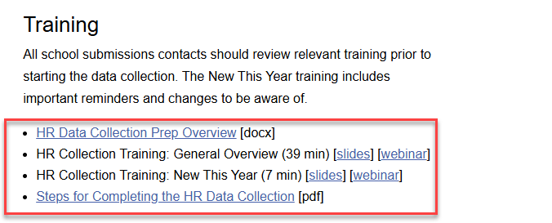
Step 1: Collection Prep Trainings
https://resources.csi.state.co.us/data-submissions/hr/
17
Notes:
In addition to the general submission's resources, each collection has it’s own page that contains recorded trainings and resources for the collection that are designed to provide you all the necessary details to complete the specific collection. This may be obvious as you are currently reviewing the training for the HR collection, but it is important to point out that each collection has a general overview training for new submissions contacts or ones that would like a comprehensive overview and a New This Year training for experienced staff that shows what has changed over the past year. Some other resources on the HR page include a HR Data Collection Prep Overview and Steps for Completing the HR Collection. The collection prep overview replaces a recorded training and is a document that provides the steps necessary to get the collection started each year. The steps for completing the collection includes all the steps necessary from start to finish and is more high level. If all these resources are reviewed, it will go a long ways towards successfully completing this collection.

Slide 18

Step 2: Data Collection/Entry
What Data to Collect
  File Layout and Definition Documents
  Optional forms
  Record Checker and Data Validations Tool
Freepic.com
Notes:
Next, lets talk about Step 2, which is about collecting required information on staff and entering data into your starting point files or other HR system. So we’ll talk about it in two ways. First we will look at what actually you should be collecting then we will jump into where you should be entering that data.

Slide 19
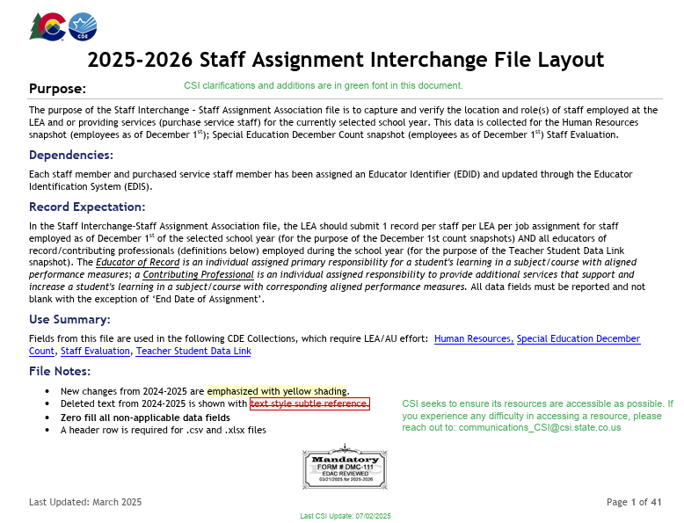
File Layout and Definition Documents – CSI Additions
Staff Profile File Layout Staff Assignment File Layout
Notes:
Let’s talk about what you should be collecting. CSI has a variety of resources available that should assist with the process of what you should be collecting. The first resource that I previously mentioned are those file layout and definitions documents for both the Staff Profile and Staff Assignment file. These documents were created by CDE to include information on details of the collection itself, the fields that should be collected including field lengths and corresponding excel columns, as well as, more specific details on the fields themselves and what coding options are available in answering these for a staff member. The screenshot here comes directly from the Staff Profile file layout and you’ll notice that each file includes a table at the top that contains what fields need to be collected, for example Admin Unit Code is first followed by the School District and Social Security Number. If you look to the right side of the table, you will notice additional information in green. What CSI does is take these file layouts from CDE and adds additional notes specific to CSI schools. This really is to provide CSI schools additional details that may be helpful as it pertains to your school. For example, you’ll see in the Admin Unit Code, this should always be 80010 for all CSI schools. So I really recommend that as you go through this collection for the first time, that you keep these documents handy and reference them whenever there is a question.

Slide 20
Using File Layout and Definition Document Example
There are ST053 and ST054 errors on the initial error report pertaining to incorrectly coding the Hours Worked per Day Field.
Most staff are coded as working 8 hours per day if only in one role and you have each one coded 8.00.
Why are you receiving these errors? Use the Staff Assignment File Layout!
Upon review of the resource, you can see Field Length=4 and Example=0800
The “8.00” in your data is not the correct format. There should be no decimals (implied) and there should be 4 digits, which means it should have a leading 0
Notes:
So here is a great example of how the File Layout and Definitions documents can be used throughout the submissions process, in this case error clearance. Let’s say you have submitted your files and received your first error reports that you are beginning to work through. You notice that several staff have received ST053 and ST054 errors pertaining to incorrectly coding the Hours Worked per Day field. Typically staff are working 8 hours per day and you have recorded that on your files as 8 dot zero zero, so why are you receiving these errors? Use the staff assignment file layout! Upon reviewing the top table of the file layout, you see the field length is actually 4 and the example is 0800. Based on this knowledge, you know your data is entered in the wrong format as there should be a leading 0 and the field contains an implied decimal. Using this knowledge from the resource, you are able to quickly clear up those errors!

Slide 21
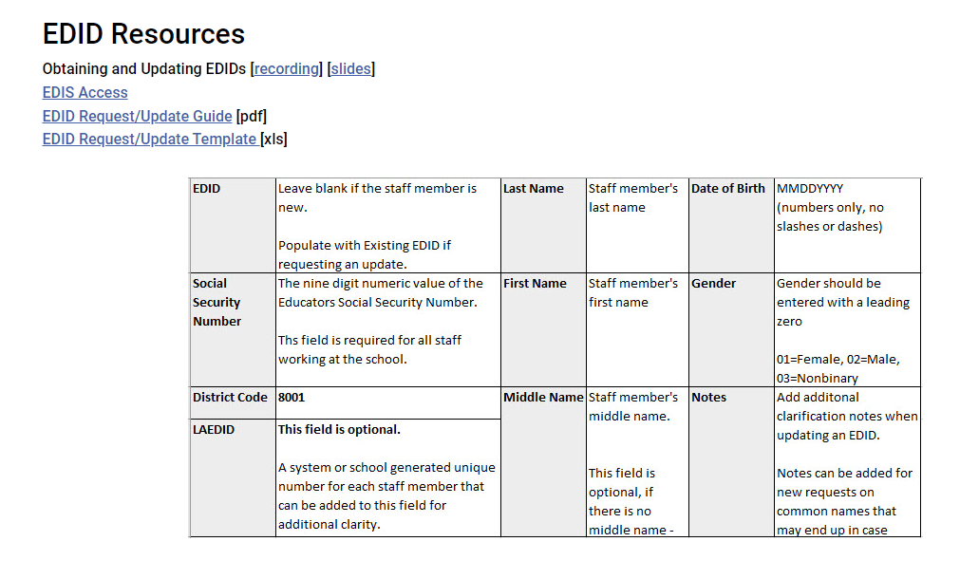
Educator Identifiers (EDIDs) –
EDID = unique state identifier for staff
Errors flag if a staff record does not precisely match the EDIS system
  Must match on EDID; First and Last Names; DOB; and Gender
If the EDIS system is wrong or if you need to request an EDID, please follow the process on the CSI webpage
Request early to avoid the bottleneck as collection progresses
CSI EDIS page: https://resources.csi.state.co.us/data-submissions/edids/
EDIS log in: https://www.cde.state.co.us/idm/edis
EDIS Guidance: https://resources.csi.state.co.us/wp-content/uploads/2025/07/SY25-26-EDID_Attainment-Guide_07252025_Final.docx
EDID Request/Update Template: https://resources.csi.state.co.us/wp-content/uploads/2025/07/EDID-Request-Template_rev07252025.xlsx
Notes:
The next topic I want to discuss as we are looking at what to collect would be Education Identifiers or EDIDS. All staff must have an EDID as it is a unique identifier for all staff working at your school. So if a staff person has worked in the public education system here in Colorado for awhile, they should already have an EDID that can be used when completing your data entry. Conversely, if a staff member has not worked in the public education system, they will need to have a new EDID generated for them. You’ll notice at the bottom of this slide, there are links to CSI resources on the SASID/EDID process, links to the login page to search for staff EDIDs, as well as, an additional guidance guide created by CSI.
I cannot stress enough the need to search for Staff prior to requesting an EDID for them. This should be done in a variety of ways using different combinations of their name, SSN, and Date of Birth. If a staff member already has an EDID and you request one, it really slows down the process on both ends when really you could just be inputting the EDID found during the search.

Slide 22
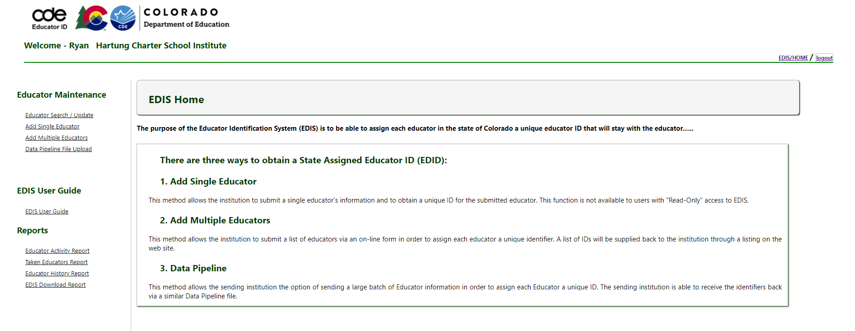
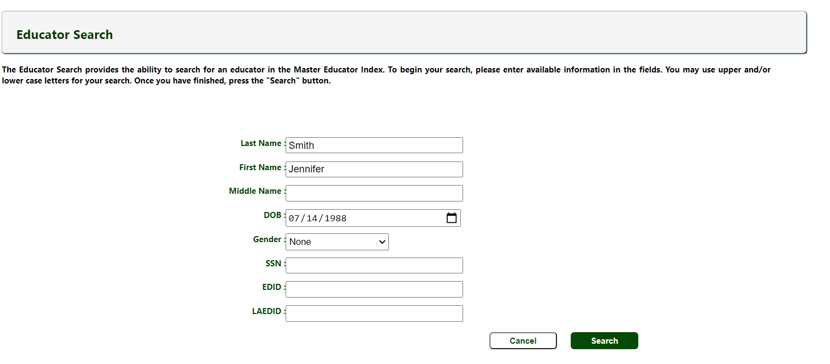
Search from EDIS Home Page
Ensure you are thoroughly searching for Staff in EDIS prior to submitting a new request
https://www.cde.state.co.us/idm/edis
Notes:
Let’s take a look at an example of the search process in EDIS. Once you have logged on to the system, you’ll see a page like this.
To see if a new staff already has an existing EDID, you’ll select the topmost option “Educator Search/Update”. [click] Please note that your access permissions are restricted from making edits and updates, but you will be able to search staff.
One of the most important steps a school can do for the EDID request process is to search for the staff member in EDIS prior to requesting. In many cases, staff have already had an EDID assigned to them previously, so you want to be sure to do a thorough search. This involves searching by a combination of name, date of birth, and SSN etc. In some cases, a staff member may have an EDID, but some of the details of their record may be incorrect and would just require an EDID update. This is why searching in a variety of ways is so important. If you request an EDID for someone who already has one, if could lead to the request going into CDE’s case review or potentially a duplicate, so being thorough in this step is important.

Slide 23
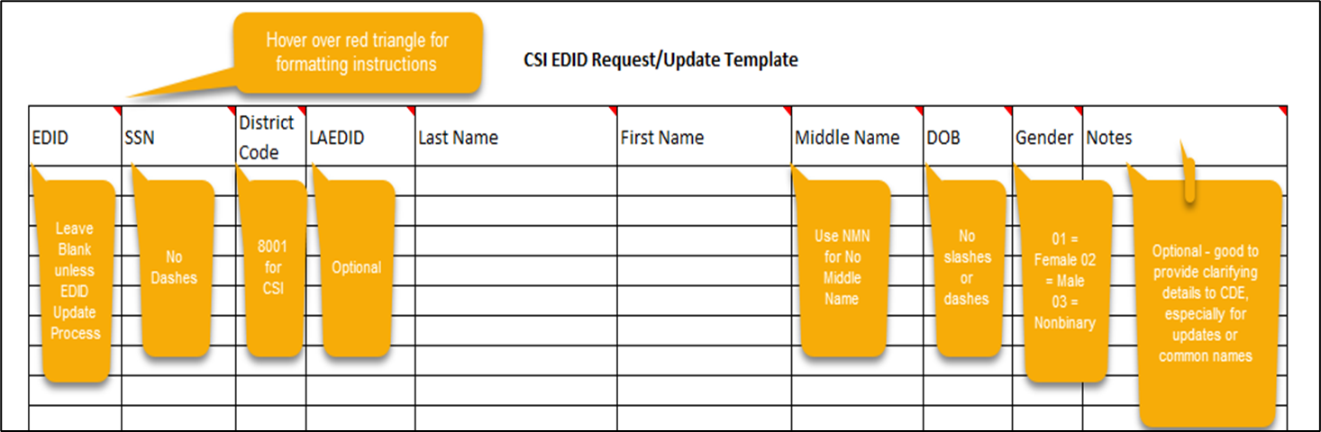
EDIS Template
Complete the EDIS Request Template to Google Drive when requesting new EDIDs or making updates to existing ones. These should be submitted separately
23
Link to CSI EDIS Template: https://resources.csi.state.co.us/wp-content/uploads/2025/07/EDID-Request-Template_rev07252025.xlsx
Notes:
Once you have done a detailed search and have confirmed the staff member does not have an EDID, the next step in the process would be to request one using CSI’s request/update template. This is located on the CSI website at the provided link. Keep in mind when you are completing this that the formatting of the data is very important. Ensure you are keeping leading zeros and not using slashes or dashes. Within the template headers you will see notes were added. Hovering over each field of the header will provide you additional details on what is necessary to help with the formatting. For example, all dates of birth must have 8 digits, so if it is before October, you must have a leading zero. The only fields that may be left blank are the EDID field, the LAEDID and the notes section. The LAEDID is an identifier schools use internally, which can be added or not and the notes can be used to provide additional details if there is a similar staff member already in EDIS. Ensuring this is filled out correctly will save time and allow you to get your EDID results back much more quickly.

Slide 24
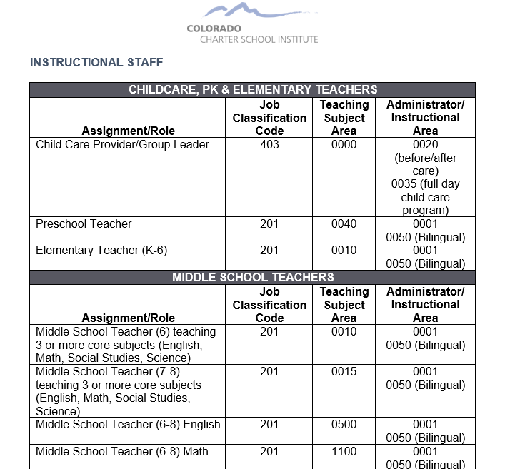
HR Coding Scenarios
24
https://resources.csi.state.co.us/wp-content/uploads/2025/07/25-26-HR-Coding-Scenarios.docx
Notes:
The next resource that I would like to discuss is the Coding Scenarios document located on the CSI website. This is a document designed to best assist you in the correct coding as it relates to Job Classification, Teaching Subject Area, and the Administrator Instructional Area. As you are going through the Staff Profile and Staff Assignment files, it may seem a little daunting to figure out what should be coded for each of these three fields. That is why the HR coding Scenarios document was developed. It essentially allows you to look at the role of each staff person and it lays out in detail what the coding of those fields should be. For Example, when you are at a K-6 Elementary teacher in this table, you know that their Job Classification Code should be 201, their Teaching Subject Area should be 0010, and their Administrator Instructional area should be 0001 if not bilingual. This can be extremely helpful in determining correct coding, particularly for some of those more unusual circumstances.

Slide 25
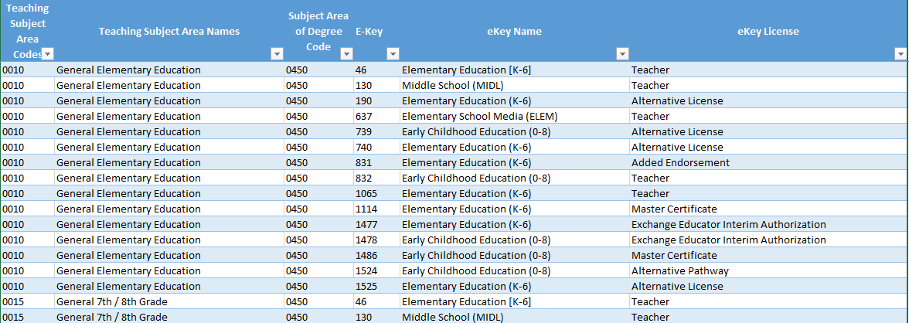
ESSA In-Field Crosswalk
https://resources.csi.state.co.us/wp-content/uploads/2022/06/ESSA-In-Field-Endorsement-Crosswalk.xlsx
25
Notes:
Next, I want to talk more about a great resource provided by CDE and is also linked on our CSI website called the ESSA In Field Crosswalk. The vast majority of errors we see at CSI are related to the Demonstrates In-Field Status field located on the Staff Assignment file. This field essentially provides data on the most applicable method for demonstrating the In-Field status for staff in their teaching subject area. This can range from an 01 for Subject Area Endorsement on their Teaching License all the way to 05 - None teacher is out of field. Ensuring that the most applicable option is selected in the current teaching subject area is necessary to provide accurate and error free data in this field. One issue that has traditionally tripped people up in previous years is that the information must match between teaching subject area and subject area of degree to select 02 for example, degree in the subject area. If their degree does not match the current field they are teaching, then that code cannot be selected. This is where the ESSA In-Field Crosswalk comes into play. This spreadsheet provided in the link at the bottom allows you to find the correct teaching subject area and filter on that corresponding code. Once done, you will see the options that can be selected for subject area of degree that match their teaching subject area. If you do not see the code for the degree the staff member has, then you cannot select either 01 or 02 for In-Field Status and you will have to select the next most applicable option using the file layout and definition document.

Slide 26
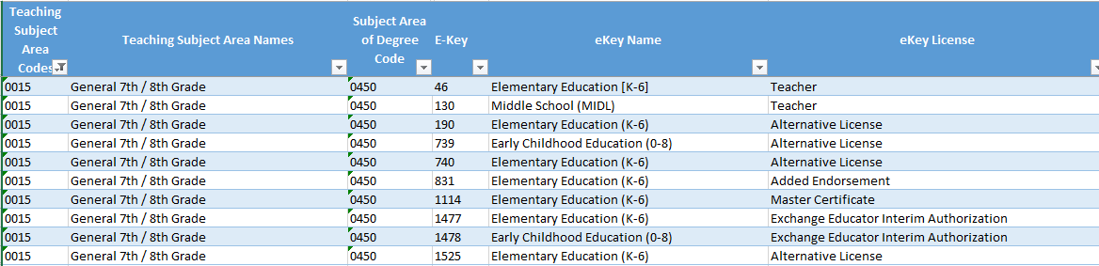
Using the ESSA In-Field Crosswalk Example
You have a staff member who teaches 8th grade, and you are unsure what to code for Demonstrates In-Field Status.
Filter the Crosswalk using the Teaching Subject Area and Subject Area of Degree Fields!
Based on this, a staff member teaching 7th/8th grade must have their degree in 0450 – Elementary Education in order to code their In Field Status as 02 – Degree in Subject Area or higher.
If not, the staff member must be coded with the next highest applicable option (03, 04, 05)
Teaching Subject Area is on the Staff Assignment file and the Subject Area of Degree is on the Staff Profile
26
Notes:
So for an example of this, we want to look at an 8th grade general education teacher. Because of this, you first want to filter the table for the Teaching subject area 0015 or General 7th/8th Grade. In doing so, you will see all of the subject area options that can be selected in order to code the staff member as 02 – degree in subject area. Based on this staff members records, you know their degree is in Elementary Education 0450. Because of this, you know what coding options work in order to code the in-field status of this staff member as an 02. If they had a bachelors degree in something not listed in these options, then the In-Field would be an 03, 04, or 05. Keep in mind that the subject area of degree is on the Staff Profile File and the Teaching Subject area is on the Staff Assignment file.

Slide 27
HR Forms for Schools
CSI SPED Form (IDEA School Instructor Form***)
  Required for special education staff being funded through
  Submit to Marcie Robidart (marcierobidart@csi.state.co.us)
CSI HR Form (HR Editable New Hire Form)
*** - A New Hire form can be submitted in lieu of completing the IDEA Instructor Form if all applicable information is collected.
Notes:
We also have some forms available for schools to use. The first one is the CSI Special Education Form. This is required for any special education staff being funded through IDEA. As you have special education staff at your school who are being funded through IDEA, please fill this out and submit it to Marcie Robidart here at CSI. The next form is an optional form, it’s an editable new hire form and contains most of the fields needed for the Staff Profile file. Again, the Staff Profile contains a lot of the employees demographic information, so as you have new staff on board having a form available to populate this information can make your life a lot easier. If your school already has a form in place, I would suggest just comparing it to this form to ensure you are collecting all the fields necessary.

Slide 28
Where should Data be Entered for HR?
Data Management System OR
Excel Starting Point Files OR
Blank Templates (New Schools)
28
Notes:
Now that we have covered the What Should be Entered piece, let’s jump into the Where to Enter Data. For this there really are 3 options. The first would be a Data Management System. Some schools actually have a system that collects HR information and has the ability to extract the Staff Profile and Staff Assignment files. If your school has a system like this, then that should be where this information should come from. If you don’t have this type of system in place, but have been a CSI school in previous years, we have created Excel Starting Point files, which we will talk about here shortly. The 3rd option is generally reserved for if you are a new school or have had significant staffing changes over the past year. Essentially, these are blank templates located on the HR page of the CSI website that can be used to manually create records for all staff.

Slide 29
School Starting Point Files – CSI Updates
25-26 Staff Profile and Staff Assignment starting point files can be found here: Google Drive → HR → 25-26 → Starting Point
Files Include:
  Final data from the 24-25 HR collection
  Formatted to align with 25-26 requirements
Staff Profile Updates/Flags
Staff Assignment Updates/Flags
1 year added to non-zero filled Years of Teaching Experience, Education Experience, and Principal Experience
All Teacher, SSP, and Principal Evaluation Ratings removed from the files
One year added to non-zero filled Years of Principal at School
All Grant/Project Funding Sources changed to the new Funding Source field along with coding options 00-03
All Demonstrates In-Field Status rows where the Job Classification is not 201-206 are highlighted
29
Notes:
So in terms of the Starting Point files, this is what the bulk of our schools use to submit data for this collection. What we have done is provide these files to every school working with CSI in the 24-25 school year and placed them in Google Drive. These files are essentially your final files submitted in 24-25 that have been modified to reflect any 25-26 changes that have occurred to the staff profile or staff assignment files since last school year.
The bottom of this slide contains a listing of all the fields that were either updated by CSI through a macro or flagged as being incorrect, so will need to be changed. In terms of the Staff Profile, we have the:
One year added to non-zero filled Years of Teaching, education and Principal Experience fields
All Teacher, SSP, and Principal Evaluation Ratings removed last school year
As far as the Staff Assignment, we have:
One year added to non-zero filled Years of Principal at School
All Grant/Project Funding Sources have been changed to reflect the new Funding Source field with the new 00-03 options.
Highlighted all SPED Staff Program Codes not coded as 0000
All Demonstrates In-Field Status rows where the Job Classification is not 201-206 are highlighted.
Keep this all in mind when updating your files as you don’t want to update something that has already been updated by CSI, which would make the information incorrect.

Slide 30
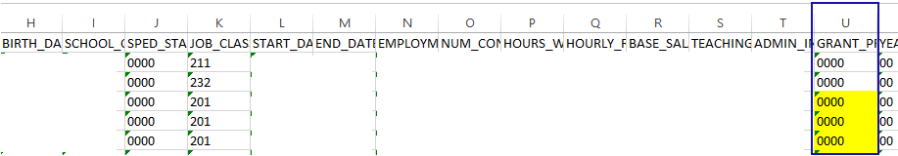
School Starting Point Files – School Updates
When opened, you will see the highlighted fields that need to be changed. Along with this, please follow the below editing steps:
Staff Assignment Starting Point File Example
General Editing Steps
  Remove rows for staff that won’t be employed in 2025-2026.
  Add rows for staff that are either new or are taking on an additional role.
  Change key fields (salary, assignments, etc.) for returning staff as appropriate.
  Populate newly required/clarified fields.
  Consider who your contract workers are and make sure they are accounted for.
  Do not update Years of Experience or any other field CSI has already updated for you.
Notes:
Once you have moved the CSI modified files onto your computer and you are ready to start updating, keep in mind the general editing steps listed on this slide. Be sure to:
Remove rows for staff that won’t be employed at the school in 25-26.
Add rows for staff that are either new to the school or are taking on an additional role at the school.
Change key fields (salary, assignments, etc.) for returning staff as appropriate.
Populate newly required/clarified fields.
Consider who your contract workers are and make sure they are accounted for.
Do not update Years of Experience or any other field CSI has already updated for you.

Slide 31
New HR File Creation Tips
  Excel or CSV files can be uploaded to the data pipeline
  New schools need to manually create a Staff Profile and Staff Assignment file separately
  1st record/row must always contain headings or titles
  Header Row can be kept the same as in template or tailored for your needs
  Codes must match what is in the File Layout, including field lengths
  Blanks are not allowed except for Staff End Date of Assignment (blank or 00000000)
  Newly opened or new to CSI schools must create these files using the template
Staff Profile Template Staff Assignment Template
Notes:
For those schools who are new this year or new to CSI and do not have these files from previous years, you will have to manually create both the staff profile and staff assignment files in excel using the templates provided on the CSI website. Keep in mind that the first row is always the header row for the files and formatting can be either CSV or excel. This header row can be kept the same as the template has them listed or modified to what makes the most sense. The second row contains details about the field and how it should be coded, this should be removed prior to submittal. As you begin the file creation process, the file layout and definition documents will be a vital resource to the success. They contain all coding options and correct field lengths with examples to ensure what you are using as coding will work for the file. It should be noted, that all fields with the exception of the Staff End Date of Assignment cannot be blank for files to successfully process. Please zero fill with the appropriate number of zeros where necessary.

Slide 32
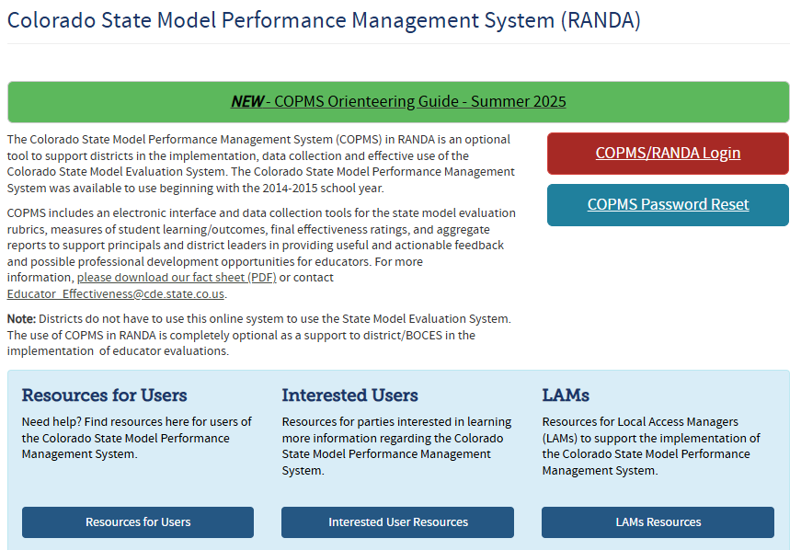
RANDA for New File Creation
CSI schools using RANDA have the option of exporting data from the system to populate HR Files.
  Staff with SI/AS/HR for RANDA can run the export.
  Click on the “Reports” option and ensure you are selecting the current academic year.
    The “Report Type” should be “Exports”.
  Select the “HR Collection Template” within the dropdown
  Can be used to Populate the Staff Profile file.
https://www.cde.state.co.us/educatoreffectiveness/randa
Notes:
Another option schools have to pull necessary HR information is from RANDA or the Colorado performance Management System. Schools must currently be using the RANDA system and the files extracted will assist with populating the data necessary on the Staff Profile. Please see the RANDA website in the link provided and the instructions here if you are a school who is interested in using this as an option.

Slide 33
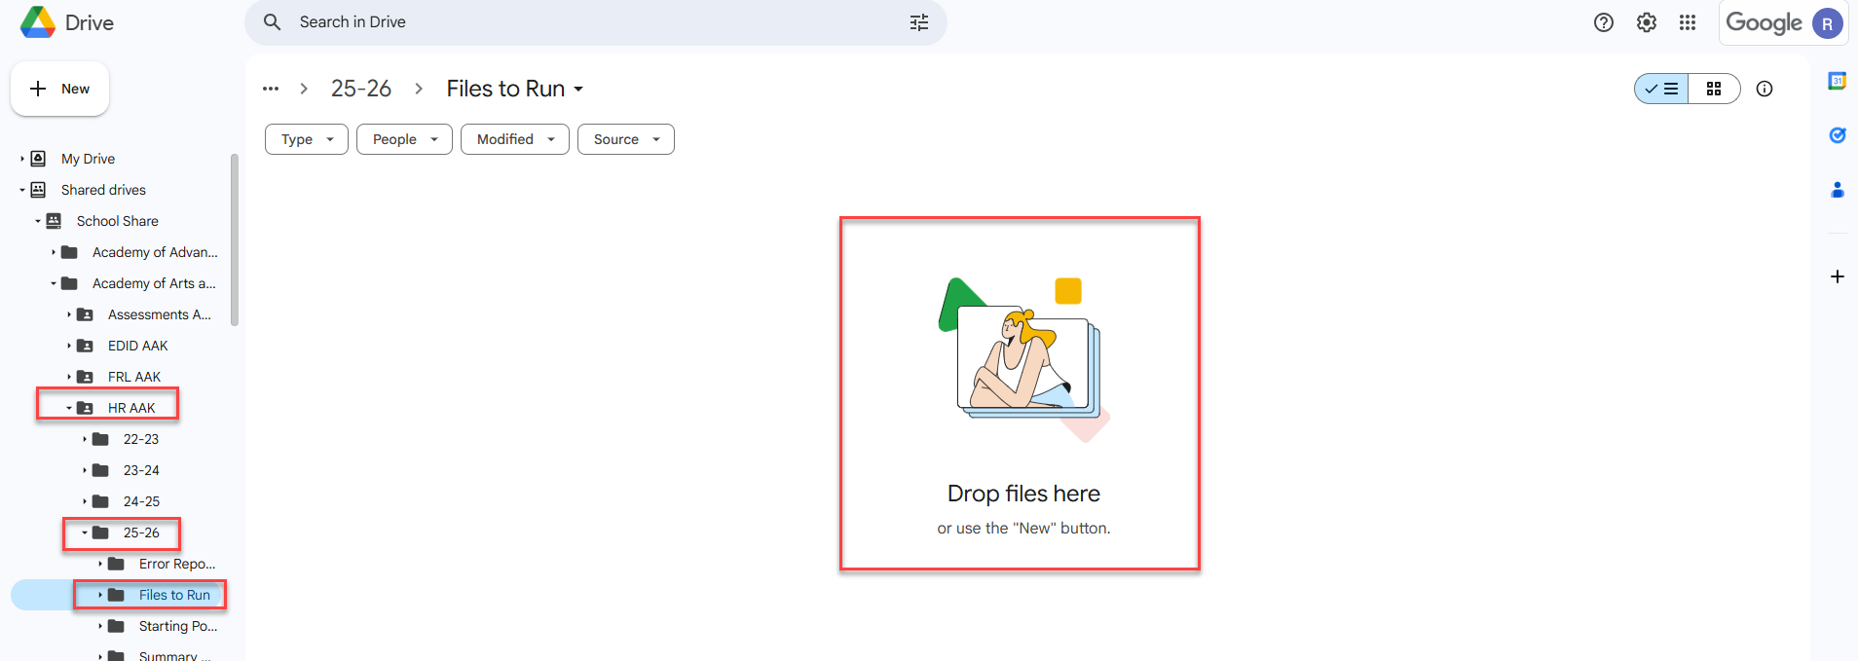
Step 3: Submission to CSI
Correct Naming of Files
Examples:
  SCHOOLCODE_SCHOOLABBREV_StaffProfile_Date
  SCHOOLCODE_SCHOOLABBREV_StaffAssignment_Date
Files should not contain any spaces in order to upload to CDE
Ensure you are uploading them to the correct folder in Google Drive:
  G-Drive>HR>25-26>Files to Run
Email the submissions inbox (Submissions_CSI@csi.state.co.us) once file is available to process
33
Notes:
So that was step 2, collecting and entering data - that really can be a time consuming part of the process. The next step we will be looking at today is step 3 – submission of your files to CSI. When you are submitting your files to CSI, you are going to be opening up G-Drive and navigating to the HR folder. Within this folder, you will see a sub folder for 25-26 that contains the following individual folders – Files to Run, Error Reports, Starting Point and Summary Certification. For this part of the process, you will want to ensure you are placing those Staff Profile and Assignment files into the Files to Run folder with the correct naming convention. You will see examples of this above that include: School Code, School Abbreviation, File Name and Date. If you submit multiple files in one day, you can always use a v2 at the end for version 2. This ensures that we are uploading the most recent file you submitted. You will also notice that the examples contain no spaces, so you can either separate them out by underscores or group them all together. If files contain spaces, we have to rename them prior to uploading to the Data Pipeline, which is an added extra step. Another issue that I mentioned that can delay us from sending you error reports would be adding these to the wrong folder. We often see files added to the wrong collection, year or folder and we have to jump around within G-Drive to determine where those have been placed. It is often good practice to include the path of where the files were placed into your email which you need to send to CSI to notify us that your files are ready to be processed. Issues with any of these steps can certainly lead to delays in getting your error reports and extra time to the processing, so you’ll want to be sure this is all done accurately.

Slide 34
Step 4: Error Resolution
Error Reports loaded to HR → Current Year → Error Reports
CSI Troubleshooting Errors Resource
  Staff Profile Errors tab
  Staff Assignment Errors tab
  HR – Level 2 Errors tab
  December Count – Level 2 Errors tab
Notes:
Once you have submitted your files to G-Drive and emailed CSI, we can begin processing your files, which essentially means we will be uploading your Staff Profile and Staff Assignment files to the CDE system and generate error reports for each file. We’ll then name those error reports similar to what you saw on the previous slide, so you’ll know which error report goes with which file. We will then place those reports in the Error Reports folder and notify you that they are available for review. As you get your first error report, it certainly can seem a bit overwhelming, so we are happy to walk through that first error report with you. Just reach out to schedule a time to go through that process. The other tool that we listed in the general submissions resources section of the HR page should help with error resolution is the CSI Troubleshooting Errors Resource. If you click on that link, it will take you to a google doc that contains tabs for every file that is submitted for state data submissions, as well as tabs for the level 2 snapshot errors. When talking about the HR Collection, the applicable tabs you’ll want to utilize for error clearance are the Staff Profiles Errors tab, the Staff Assignment errors tab, the HR Level 2 errors tab, as well as the December Count Level 2 Staff Errors tab. As I have previously mentioned, you will have to work with your Special Education Staff to clear December Count Staff errors.

Slide 35
Step 4: Error Resolution Cont.
Level 1 vs Level 2 Errors
Staff Profile Errors
Errors related to input data on the Staff Profile file. Corrections should be made on the SP file directly.
Staff Assignment Errors
Errors related to input data on the Staff Profile file. Make corrections on the SA file and resubmit.
Level 2 Staff Errors
General Education Staff errors identified when the two files are combined. Error clearance could be on either file.
December Count Level 2 Staff Errors
Staff errors only pertaining to Special Education staff and pulled into the December Count snapshot. Often clearing DC errors requires HR file updates.
Notes:
This slide is designed to show you exactly what types of errors you should expect to receive and when it the process you’ll receive them. After initial submittal, you should expect to receive level 1 errors on the staff profile and assignment files. These are individual files reporting errors on their specific file. Schools should continue to submit until level 1 is error free. Once that has been completed, you should expect to see Level 2 Staff errors along with Level 2 December Count staff errors. Level 2 staff errors are a little more difficult to correct as the errors can be on either the Staff Profile or Assignment file. Level 2 looks across files and even across collections in some cases, so it may be difficult to determine what needs correcting. In addition to the Level 2 Staff Errors, you may encounter Level 2 December Count staff errors. This is typically given to the SPED Contact, but often requires updates to the HR files to clear up December Count staffing issues. This is because all staff coded as working in Special Education actually go into the December Count snapshot and not HR. This part of the process does require collaboration with the schools SPED team.

Slide 36
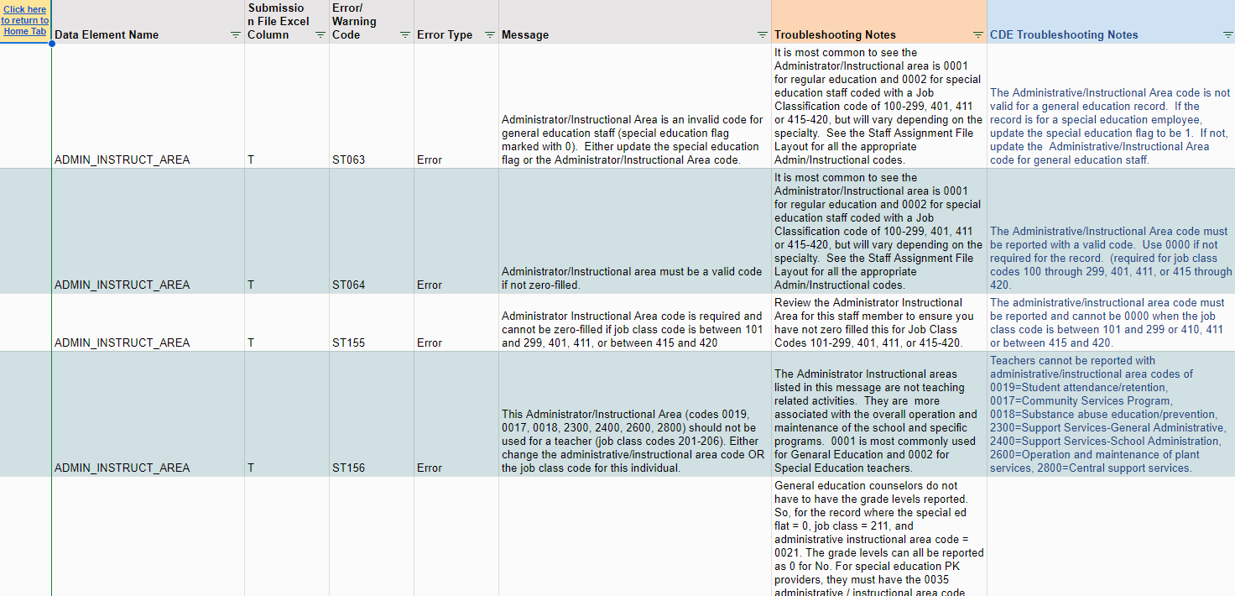
Step 4: Error Resolution Cont.
36
Notes:
Jumping back to the Troubleshooting Errors document, here is a screenshot of the Staff Assignment errors tab, so you can get a better idea of the layout and what it looks like. The goal when you go to these tabs is to further identify what is causing the error and possible solutions. Essentially it contains a listing of the Error/warning Code, related data element names, whether it is an error or warning and the message you will see in your actual error report. In addition to those, we have added CSI specific troubleshooting notes along with CDE additional troubleshooting notes. Each of these columns provide a little more clarification to the message delivered in the error report with the CSI notes being much more specific resolution options as it relates to CSI schools. CDE has created something similar to this that provides additional comments they can add. These are generally getting updated quite often and can certainly help provide additional information that should assist in you clearing those errors. As I have mentioned this is somewhat of an iterative process and we don’t expect all errors to be cleared on the second submittal, but using these troubleshooting resources can certainly help to reduce the number of times you have to make corrections and resubmit.
Feel free to reach out to us if you have specific questions on how to utilize this or if you have errors that you are still unable to clear and we would be more than happy to assist.

Slide 37
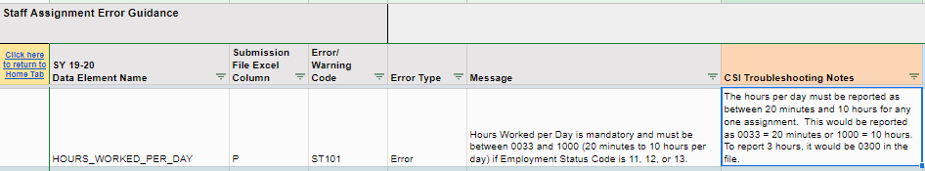
Step 4: Error Resolution Example
A staff member works 3 hours and 20 minutes a day and you are receiving an ST101 error that you are unsure how code correctly. The message states:
Hours Worked per Day is mandatory and must be between 0033 and 1000 (20 minutes to 10 hours per day) if Employment Status Code is 11, 12, or 13.
To help clarify coding, use the Troubleshooting Errors Resource!
Based on this information and examples, you now understand that the field must be coded 0333!
37
Notes:
Here is a great example of using the Troubleshooting errors resource to help clear out an error. So, upon initial submittal, you are receiving a Staff Assignment error on one staff member who works 3 hours and 20 minutes a day in their role. The error pertains to the Hours Worked per Day field and you are unsure on how to properly code this. The message states (READ Bullet). The best option to assist in correcting this issue is to utilize the Troubleshooting errors resource! In looking at the additional troubleshooting notes from CSI, you see that hours must be reported between 20 minutes and 10 hours per day with specific examples of how to code certain timeframes. Using this, you know that the staff member must be coded as 0333 to correct the error!

Slide 38
Step 5: Data Review
Summary/certification report will be provided once error free
Steps to Complete:
  Review each tab thoroughly to determine accuracy of data
  If accurate, ensure all applicable parties (below) have signed and return scanned version of the signed Certification tab to CSI
        School Leader, Data Submissions Coordinator and the HR Contact
  If errors are found, modify most recent error free files or reach out to CSI for assistance
  Changes will be uploaded to the Data Pipeline and a new summary report provided
  Once data is accurate, sign and return prior to the due date.
Note: Special Education staff will not be included on your snapshot as they are pulled into the December Count snapshot!
38
Notes:
Once you have gone through this iterative process and are able to clear all level 1 and 2 errors, you are ready for step 5 Data Review. All schools who have been able to clear there errors will receive an HR Summary Certification Report, which will be located in the Summary Certifications folder on G-Drive. Once you have received your report, you will want to follow the steps listed here. First you want to (READ SLIDE). As we had mentioned in the beginning of this training, the HR data is tied directly to staff salary, turnover rates, and educator effectiveness among other information, so please review your report carefully to ensure your data is accurate.

Slide 39
Common HR Questions and Issues
Notes:
The next area I want to discuss is the Common HR Questions and issues that you may encounter while working through this collection.

Slide 40

Salary/Hourly Pay Examples
Hourly Employee
Salaried Employee
Bob serves as Bus Driver and Custodian.
He gets paid $12.50/hour
Bob should have:
    1 row of data in the SP file.
    2 rows of data in the SA file.
        In each row’s Hourly Rate of Pay field, it should have 01250 (decimal is implied).
Tom serves as Assistant Principal 60% of the time and Counselor 40% of the time.
He gets a salary of $50,000.
Tom should have:
  1 row of data in the SP file.
  2 rows of data in the SA file.
    In the Principal row of data, Base Salary or Wage field should be 30000 (.6*50,000)
    In the Counselor row of data, Base Salary of Wage field should be 20000 (.4*50,000)
Notes:
Let’s talk through an example scenario for types of income options, starting with an hourly employee. Bob at your school serves both as a bus driver and custodian and gets paid 12.50 per hour for each assignment. In terms of your files, Bob should have 1 row of data on the Staff Profile, but two rows of data on the Staff Assignment – one for each of his roles. Since he is paid hourly in each of the roles he serves in, the hourly rate of pay field should be 1250 for each as the field has an implied decimal. As for a Salaried employee, Tom serves as the assistant Principal 60 percent of the time and a counselor for the other 40 percent. He will also have 1 row of data on the Staff Profile file and two rows of data on the Staff Assignment file. Since Tom is salaried, you would want to split that salary among the two rows at a ratio that relates to the amount of time spent at each. His overall salary is 50,000 per year and since he spends 60 percent of his time as assistant principal, you would want 60% of his salary on that row of data or 30,000. The remaining 20,000 should go on the row of data corresponding to his counselor role, which he spends 40% of his time completing. In previous years, we have noticed issues with the Salary field, particularly the entirety of the salary being put on both roles, which will lead to errors, so ensure you are recording this accurately to avoid errors.

Slide 41
Staff Assignment Fields
Special Education Assignment Flag – Must be “1” if staff is serving any special education students. (i.e. If staff member’s EDID is on the December Count Participation file, then Special Education Assignment flag on the Staff Assignment file should be 1.)
End Date of Assignment – can be blank (i.e. NO ZEROES) or contain zeros (00000000) if staff is currently in position. Only include valid dates if staff is no longer in the position.
Notes:
Just a couple more potential issues to keep in mind when working with the Staff Assignment fields. I know I mentioned this earlier, but any staff member serving Special Education students must have a 1 for the Special Education Assignment flag. Also, something a little different when it comes to End Dating, if a staff member has not left the school, you want to have the End Date of Assignment blank or zero-filled. Only add a valid date if the staff person has left the school

Slide 42
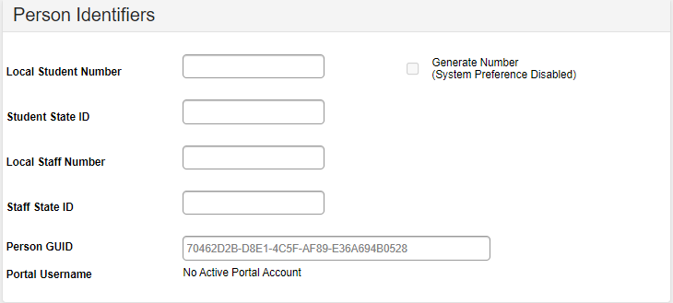
EDIDs not Showing up in the Participation File – Infinite Campus
Adding Special Education staff correctly to HR and IC is important to ensure they show up on the Participation file and avoids errors for both collections.
Follow these Steps:
    Verify all Special Education staff are included on both files with the correct EDID
    Verify their Special Education Assignment =1
    Provide a Job Classification, Teaching Subject Area (1700) and Admin/Instructional Area (0002) that is applicable for SPED Staff
    Ensure the EDID is added to the Staff State ID section in IC by going to:
    Census→People→District Assignment
42
***Share this with applicable SPED Staff if IC updates are completed by them***
Notes:
So, our schools ran into this issue in the past in IC so I thought I should mention it. We have previously seen the staff persons EDID not showing up on the December Count files as an EDID provider. This has caused both December Count and HR issues. To ensure that the EDID populates correctly on the files, please follow all the bulleted steps, which include(READ STEPS). Adding the correct EDID in this IC setup as mentioned in the last bullet definitely was the primary issue, but if all are followed, the EDID should successfully show up. I should note that if you are not the one completing updates on the staff records in IC, please mention this to the applicable staff member.

Slide 43
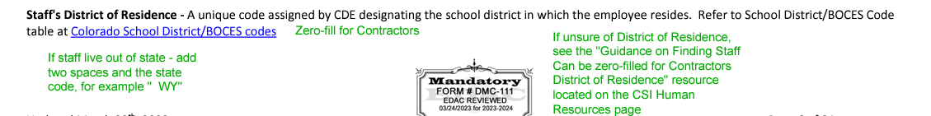
District of Residence Field
  For Out of State Staff:
  Schools that have staff that work for the school remotely and live in a different State must code the District of Residence field with two spaces and the State Code. For example: “--WY” (dashes show where the spaces should go)
  Contracted Staff:
  Contracted staff will occasionally get errors when zero filling the District of Residence field. Per CDE’s guidance, this field should have two zeros (00) rather than the typical four. This should correct the issue.
43
Notes:
Next, I wanted to discuss the District of Residence field as there has been some questions in the past related to errors. It has become more prevalent for a staff member to work remotely for a school , in some cases - out of state. This presents issues for coding the district where the staff member resides. If a staff member is out of state, you want to code this field with two spaces and then the state code. For example, space space WY. The dashes in the example represent spaces so it is easier to see. Also, we have historically seen issues with coding this field for contracted staff. They should be able to zero fill this with 4 zeros but we have still seen errors flag. To avoid this, CDE recommends just adding two zeros and we have had some success with this. This only needs to be done if you encounter errors related to the district of residence on contracted staff.

Slide 44
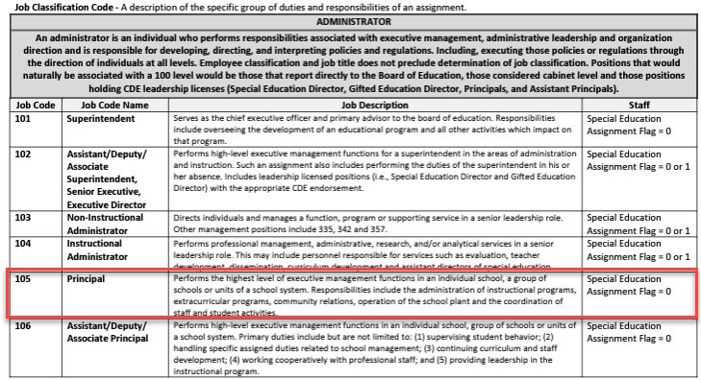
School Leader Coding - Principal
It was discovered during the Staff Evaluation Collection that many schools have not been including a 105 – Principal in their HR Collection, opting for codes 101-104.
This caused errors on the Staff Evaluation Collection that required some exception requests.
All schools should be reporting their School Leader as 105 instead of the other coding options.
Options 101-104 are generally reserved for more higher-level administrators and district staff and are most applicable for Network schools. These schools still should be reporting a 105 along with any other staff options.
44
Notes:
During the current Staff Evaluation Collection, it was discovered that several school were not coding any staff as a 105 – Principal. Many utilized codes 101-104 instead of the 105 principal option. All schools should have at least one staff member coded as a Principal, typically their school leader. The coding options 101-104 are generally higher-level administrators and district staff, which is not the most accurate. The main exception I see is for Network schools where they have staff overseeing several schools. Verify that you are including at least one Principal at your school to avoid future issues.

Slide 45
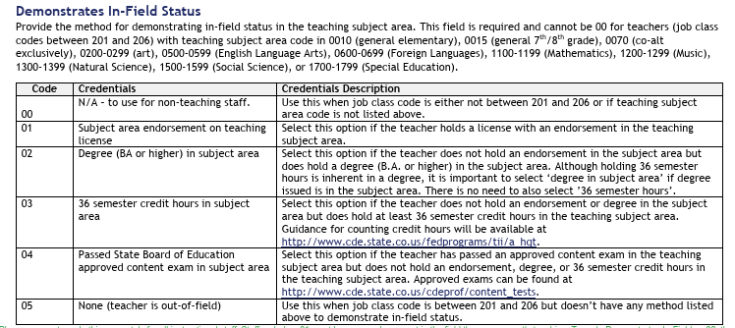
Demonstrates In-Field Status
  The Demonstrates In-Field Status field is an area of confusion for many schools and attributes to the most level 2 errors. Below are tips and details regarding this field to provide some clarity:
  Required for all teachers with Job Classification Codes 201-206.
  In order to code staff an 01 – Subject Area Endorsement on License, the staff member must be endorsed in the subject area they are current teaching (Teaching Subject Area field). To look this up, navigate to the Colorado Online Licensing page.
  Coding staff as an 02 – Degree in Subject Area, they must be currently teaching (Teaching Subject Area – Staff Assignment) in the same field they received their degree (Subject Area of Degree – Staff Profile). Check both files to ensure they match.
  Use the ESSA In-Field Crosswalk to filter on the Teaching Subject Area (or vice versa) and see the allowable coding options on the Subject Area of Degree.
  Work your way from top to bottom on the coding options (01→05) moving down if they don’t meet those requirements. If none are applicable, use 05 – Teacher is out of field.
45
Notes:
Next, I wanted to discuss a field that is not new but every year produces the most level 2 errors for our schools, which is the demonstrates in-field status field. This field is required for all teachers in job codes 201-206 and requires a bit of research in some cases. In order to code staff an 01 – Subject Area Endorsement on License, the staff member must be endorsed in the subject area they are current teaching (Teaching Subject Area field). To look this up, navigate to the Colorado Online Licensing page and search for that staff member. As far as far as coding a staff person as an 02 – Degree in subject area, you must utilize both files. You’ll want to first check the subject area of their degree on the staff profile and compare that to their current teaching subject area. These two need to match or fall within a strict set of coding options in order to use this 02 option. To help with this, you can use the ESSA In-Field Crosswalk linked here and filter by one or the other field and see what options work together. Another detail that is important is that you want to start at the top and work you way down as a staff person does not meet certain requirements to ensure you are coding them with the highest applicable option. If none work, you may need to code them as an 05 – out of field. This is not uncommon and usually is not an issue as long as a school does not have a ton of them.

Slide 46
HR Collection Timelines and Deadlines
Deadline | Task
09/18/2025 | Submit initial files (Staff Profile, Staff Assignment for HR)
11/19/2025 | Schools must have all Level 1 (Staff Profile/Staff Assignment) errors cleared
01/21/2026 | Schools must have all Level 2 (HR and December Count-Staff) errors cleared
Upon Error Clearance | CSI will provide Data Summary Reports to schools
1/29/2026** | Submit Signed Certification Agreements to CSI
*Dependent upon all schools clearing errors by specified deadlines
**Any requests for changes must be received by CSI on or before 1/27/2026
Notes:
Last, I want to discuss the timelines and deadlines for the collection. This slide lists all the deadlines that must be followed for the 25-26 HR Data Collection. First, we have a date of 9/18 to have all your initial staff profile and staff assignment files submitted with level 1 error clearance for those files being on November 19th. All school must have both level 1 and 2 errors cleared by January 21st, 2026 and you will receive your summary report shortly thereafter. The date to review, sign and return those is January 30th. If after reviewing, you notice some changes that need to be made to your data, please submit those updated files to CSI by January 27th to ensure files can be processed and a new summary report delivered to meet the deadline.

Slide 47

Thank you for reviewing this training!
Contact the Submissions Inbox with Questions:
    Submissions_CSI@csi.state.co.us
Notes:
Thank you so much for reviewing this training for the 25-26 HR Data Collection. If you have questions, don’t hesitate to reach out to CSI and we are more than happy to assist you!

