Slide 1

At-Risk Measure
Recorded August 2025
Notes:
Welcome to the At-Risk Measure overview.
This presentation will outline the At-Risk Measure required for the 2025-2026 school year. The At-Risk Measure will again be part of the October Count (OC) collection and will follow the October Count deadlines.
All CSI school submissions staff are encouraged to watch this overview and prepare your Student Information Systems (SIS) to collect the required information.
Infinite Campus does not have the tools that are needed for this submission. Therefore, the CSI submission team will assist in collecting the census block data for the At-Risk Measure for all IC schools. IC Schools will have access to all the files we pull in the Google October Count folder.
PowerSchool campuses will run the At-Risk report from their SIS and then submit the file to CSI along with all other files for this collection.

Slide 2
Purpose for At-Risk Measure
Obtain student-level information, based on a student’s primary physical residential address needed to implement the new at-risk measure established in law.
Data provided through the At-Risk Measure will be included in each district’s Student October Snapshot. As such, the timeline associated with the At-Risk Measure file aligns with the Student October Snapshot timeline.
Notes:
For the second year the At-Risk Measure file is required. This data will be collected during the October Count submission along with the school’s SD and SSA files.
The purpose of the At-Risk Measure file is to obtain student-level information, based on a student’s primary physical residential address.
Data provided through the At-Risk Measure will be included in each district’s Student October Snapshot. As such, the timeline associated with the At-Risk Measure file aligns with the Student October Snapshot timeline.

Slide 3
Student Information Systems Data
Required for the At-Risk Measure File
How you can prepare for the data export:
  All students must be assigned a SASID in the SIS
  All students must have a current physical address listed in the SIS linked to them unless the following apply.
    McKinney Vento students identified in the SIS
    Identify students in special groups:
      McKinney Vento (Homeless)
      Confidentiality Program
      Foster
      Migrant
      Attending a Detention Center
    *For students in the above group – CDE recommends using 1575 Sherman St, Denver, CO 80203
Currently only PowerSchool has developed tools and a report to gather the needed information into a report.
Notes:
Preparing for the At-Risk Measure collection includes SIS data entries schools are already doing. However, schools must be extra diligent in gathering and entering this information to ensure highest possible accuracy for the At-Risk Measure file.
The requirements for schools in preparation for the At-Risk file are:
All students must have an assigned SASID entered in your SIS.
In addition, all students MUST have a current, physical address listed in the SIS. We must emphasize that the requirement is a physical address. PO Box numbers are NOT allowed. This may require schools to reach out to families to obtain their current physical address if this has not already been a requirement at your school.
McKinney Vento students need to be identified within the SIS. These are families who have filled out a McKinney Vento form and it been finalized and approved.
Finally, students participating in the Confidentiality Program, have a Migrant status or are attending a detention center must be identified and entered in your SIS.
If a student is identified as McKinney Vento, Migrant, attending a detention center or participating in the Confidentiality Program, CDE recommends using the 1575 Sherman St, Denver, CO 80203 as the student’s physical address.
Please note: For students that are participating in the Confidentiality Program, SIS vendors are currently working on adding a location within the system to identify these families. If this option is not currently available within your SIS, please prepare a list by October 1^{st.}. We are requesting schools to placed the list in the Shared Google Drive – in the ‘Other’ folder located with the OC Audit Documents.
The CSI Submissions team will start auditing student addresses the week of September 15th and provide error reports for additional or corrected information needed.

Slide 4
How the CSI Submission Team Will Help
Week of 9/15
  CSI will collect all student SASIDs and Physical Addresses
  CSI will complete address/SASID audits of all students by September 18th and provide an ‘error’ file to schools
  Schools will correct errors within the SIS by 9/26
  CSI will audit the information again and work with schools to corrected any additional errors leading up to October Count
Count Day
  CSI will collect all data for the At-Risk Collection
  CSI will run address files through the Geo Census tool, to collect Census Block data for all non-PowerSchool sites
  CSI will summit manually created At-Risk Interchange files to the CDE Pipeline
NOTE: Schools will be able to view all data files in the Share Google folder under October Count.
This data will be part of your October Count Snapshot and will show errors if the student information isn’t gathered.
Notes:
CSI submissions team we'll start auditing the Student Information Systems on September 15th. In this audit we are looking for each student to have an assigned SASID and for every student to have a physical primary address listed and linked to that student.
Once we have determined which addresses need corrected, we will place an Address Error file in the Google shared October Count ‘Error Reports’ folder. This file will contain a list of students that are missing data or need to have data updated. CSI will send an email notifying the schools there is a file ready for their review and corrections are needed.
It’s important to make the corrections in the SIS, as this is where we will pull new files on Count Day.

Slide 5
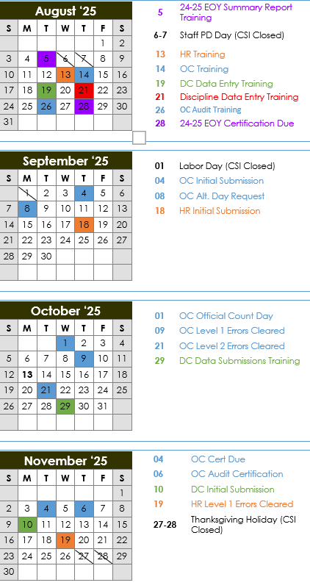
At-Risk Collection Deadlines
8/14 – Recorded Overview
9/2 – Initial Submission
(SD, SSA, Title l)
9/15-9/18 – Initial Submission Audit
9/26 – Addresses Gather/Corrected
10/1 – Count Day
10/9 – Level 1 Cleared
10/21 – Level 2 Cleared
11/4 – Certification Due
11/6 – Signed Audit Checklist
Printable Calendar: https://resources.csi.state.co.us/data-submissions/calendar/
Online Calendar: www.csi.state.co.us/calendar/
2
Notes:
At the top of the October Count Resource page is a link to the Data Submission calendar. This calendar is printable and color-coded by collection. The October Count and October Count Audit dates are all marked in blue.
As a reminder, you can also access the CSI Online Calendar. The online calendar is updated regularly throughout the year as timelines change. Users can subscribe to the calendar to have deadlines synced to their Google calendars.
As mentioned earlier, the At-Risk Measure collection is part of the October Count and will follow the deadlines for the OC collection. The October Count is one of the shortest collections, lasting roughly 12 weeks and overlapping with other first-semester collections, as well as End of Year wrap-up. Given this, it is important to begin reviewing your student data within the SIS as soon as possible to stay on top of the collection. It is also important to set internal deadlines for yourself and your colleagues to ensure your school can meet CSI deadlines.
Key dates for the At-Risk and October Count submissions are listed on this slide. Please keep close track of all deadline dates starting with the initial submission.
Be sure to review the Weekly Update emails sent to all school submission contacts for the latest announcements and other details related to the October Count and At-Risk collection.

Slide 6
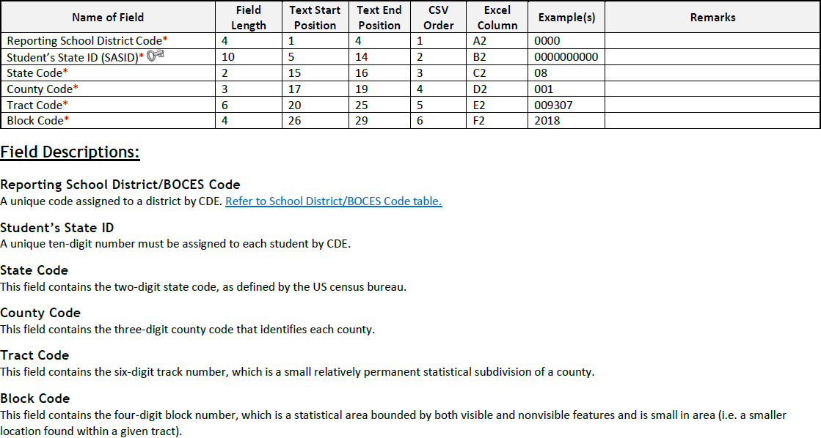
At-Risk File Layout
Notes:
Here is the At-Risk file layout to help you understand the At-Risk Interchange file that will be manually be built on behalf of each non-PowerSchool SIS. The process described in earlier slides results in a file with the four Census Block Data fields for each student. The State, County, Track and Block Codes associated with a student’s primary physical address are required for this collection.

Slide 7
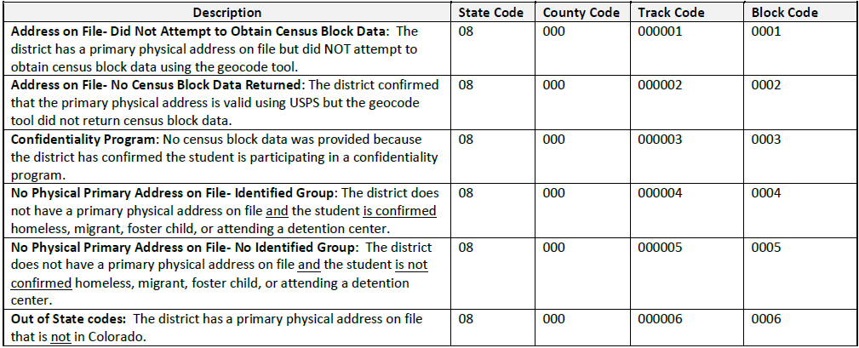
Missing Census Block Data
Notes:
In some cases, census block data will not be available for students. This chart gives guidelines on how we will code census block data fields when we are unable to collect the information through the Geo Census tool. As you can see on this slide there is also a way to identify students in the Confidentiality Program. This is why we are requesting those students are identified in your SIS or a list of those students participating in the program are provided to the CSI team.

Slide 8
Thank you for reviewing this training
Submissions_CSI@csi.state.co.us
12
Notes:
Thank you for reviewing this new At-Risk Measure Collection.
If you have questions on any of this information, please reach out to the submissions inbox at the email address listed here.

