Slide 1

Summary Report
Training - EOY
Recorded July 2025
Notes:
Welcome to the EOY Summary Report Training for the End of Year Submissions.
This training, recorded by the CSI data team, provides information on the importance of the End of Year Summary Report, what’s included in the report, and how to review it.

Slide 2
How is EOY data used?
Used by CDE in determination of a school’s plan type
Used by CSI in determination of a school’s accreditation rating
Considers student demographic information as well as exit data used to calculate completion, graduation, dropout, and mobility rates.
Notes:
As a reminder, the End of Year (EOY) data collection collects generally the same type of student data that is collected during the October count data collection at the beginning of the school year.
Instead of showing enrollment through the Fall for OC, the EOY data collection shows student enrollment through the course of the whole school year.
This data is used by both the Colorado Department of Education and CSI for accountability purposes. Specifically, EOY data helps calculate completion, graduation, dropout, and mobility rates. Portions of these rates will be reflected in your EOY Summary Report data, therefore, reviewing the EOY Summary Report data is very important.

Slide 3
EOY Summary Deadlines
Summary Review
  Last chance for schools to review and update all data fields
  Partner with relevant staff to review
  If updates are needed email CSI
  CSI internal checks still in progress and may require limited updates in Fall
  Graduate records should be updated before this deadline
  Summary Assurance Report due in August*
  Electronic Summary Assurance Report in replace of signed certification
*For specific deadlines, check one of the following resources:
-CSI online calendar -Weekly Update email
Notes:
The End-of-Year Summary Review is your school’s final opportunity to update most EOY data fields.
Because of that, it’s expected that schools carefully review all data in the Summary Report before the Summary Certification deadline when the Summary Assurance Report is due. These reviews should be done in partnership with the right staff—like your data submissions contact, your school leader, and any other relevant team members.
If updates are needed, schools must email CSI with the requested changes and also update the data in their SIS within the timeline provided. CSI will manually update your school’s EOY files—so in most cases, schools will not need to resubmit new files. We'll go over more details about that later in this training.
Keep in mind, CSI is also conducting internal data validations during this time. So, even after your review, we may still reach out to confirm or clarify any discrepancies we find.
For schools with graduates, it’s especially important to make sure all graduate records are updated by the EOY certification deadline.
And once everything has been reviewed and any updates are complete—both in your SIS and with CSI—the final step is to submit your Summary Assurance Report. This confirms that you’ve reviewed all your data and believe it to be accurate.
Please note: a signed certification is no longer required

Slide 4
Sample Report Walk Through

Slide 5
Summary Report Contents
  Admin Tabs
  Instructions
  Summary Assurance Report
  CDE Calculations
  Membership
  Attendance & Truancy
  For High Schools Only
  Grad Complete
  AYG Records
  School Data
  Warnings
  Snapshot - Filter to find data causing issues.
  New Tabs :
  School Program Specific
  EL
  SPED (IEP)
  GT (ALP)
  Homeless/McKinney Vento
Notes:
The End-of-Year Summary Report, like most CSI summary reports, has several tabs along the bottom.
The first and middle tabs are administrative—they're there to guide you through the review process. It’s very important to start with the Instruction tab before completing your Summary Assurance Report.
Next, you’ll see tabs related to membership, and attendance and truancy, based on CDE’s calculations. These give you a detailed look at your student population by grade, gender, FRL status, retention, and attendance or truancy rates.
For high schools, there’s a set of tabs with additional data. These include graduation and completion rates for 3 to 7 year cohorts and detailed Anticipated Year of Graduation records for the current year.
You’ll also find tabs with your school’s raw data, including the Warnings and Snapshot tabs. The Snapshot tab combines your submitted SD and SSA EOY files with state data—like foster and migrant status. If you spot errors, you can use this tab to filter and find the specific records.
But just a reminder—if you notice any issues in your summary data, do not make changes in the Summary Report directly. Instead, email the Submissions inbox, and CSI will make the updates manually to your SD and/or SSA EOY files then process new files with CDE. CSI will then send you a new Summary Report version to review.
And finally, new this year, we’ve added tabs for EL, SPED, 504, Gifted and Talented, and MKV—homeless data. These include student lists that are easy to review or share with your program leads.

Slide 6
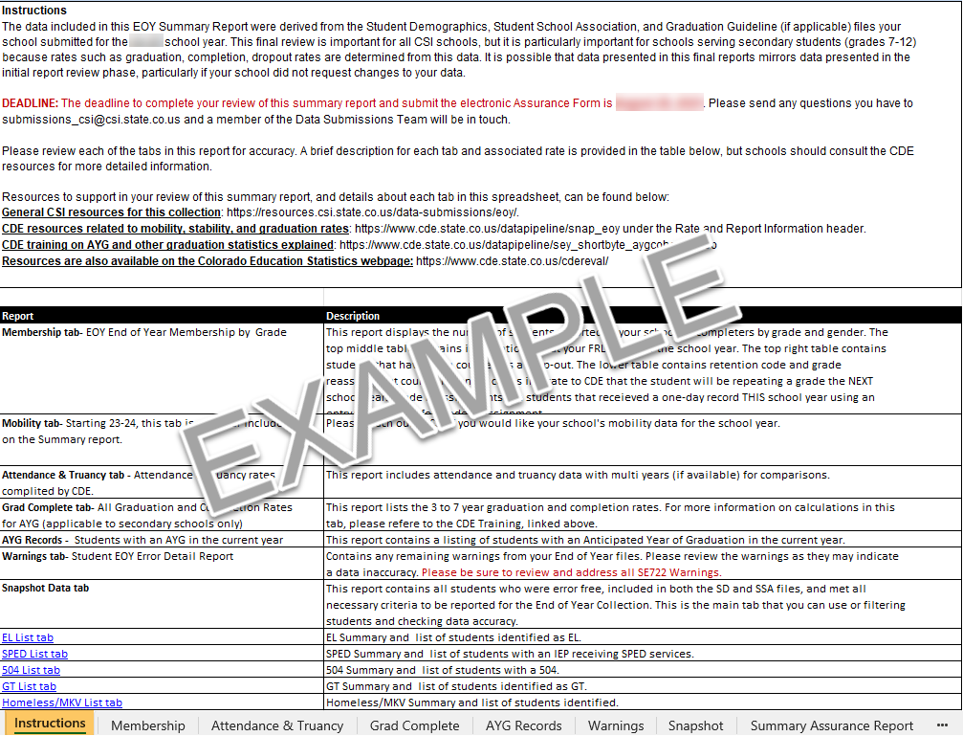
Instructions Tab
This information should be read in its entirety since it provides all the instructions and deadlines schools.
Notes:
The first tab contained in your Initial Summary Report is the Instructions tab. This information should be read in its entirety since it provides all the instructions and deadlines schools should follow when reviewing the data on the later tabs.

Slide 7
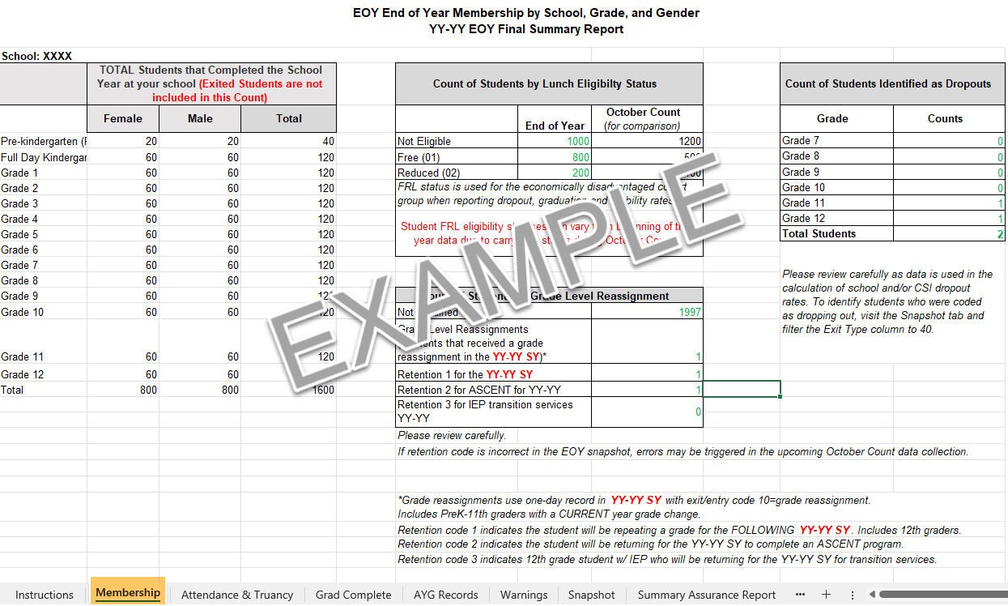
Membership Tab
This student data by grade shows the total students that COMPLETED the school year at your school.
All other data including FRL, Grade Reassignment/Retention, and Dropout counts reflect the associated number of students who attended your school at any point during the year.
Notes:
The Membership tab provides a breakdown of your school’s student population by grade and gender.
The totals by grade represent only the students who completed the school year at your school. These totals do not include students who exited during the year.
However, all other data shown—like FRL status, grade reassignments, and dropout counts—reflect all students who attended your school at any point during the year, not just those still enrolled on the last day.
For the Grade level reassignments and retention code data, it is important to note that grade level reassignments happen in the current school year. Schools use a one-day enrollment record to show that a student was either accelerated or retained. This is tracked when a student has both an exit code 10 and an entry code 10 on their SSA file that is captured on the Snapshot tab. Reassignments can be used for students in PreK through 11th grade.
Now, retention codes are different—they indicate a student will repeat a grade in the following school year. Retention is marked with a retention code of 1. This will include 12th graders. This tells CDE that the student is expected to repeat their current grade next year. Retention code 2 indicated a student will be participating in an Ascent program in the following school year, and retention code 3 indicated that a 12 grade IEP student will be returning for transition services.
Please check retention codes carefully. If retention codes in your EOY file, it can trigger errors in next year’s October Count.
If a student ends up advancing grades the next year instead of repeating, please notify CSI as soon as possible at the start of the school year so we can make the necessary correction.

Slide 8
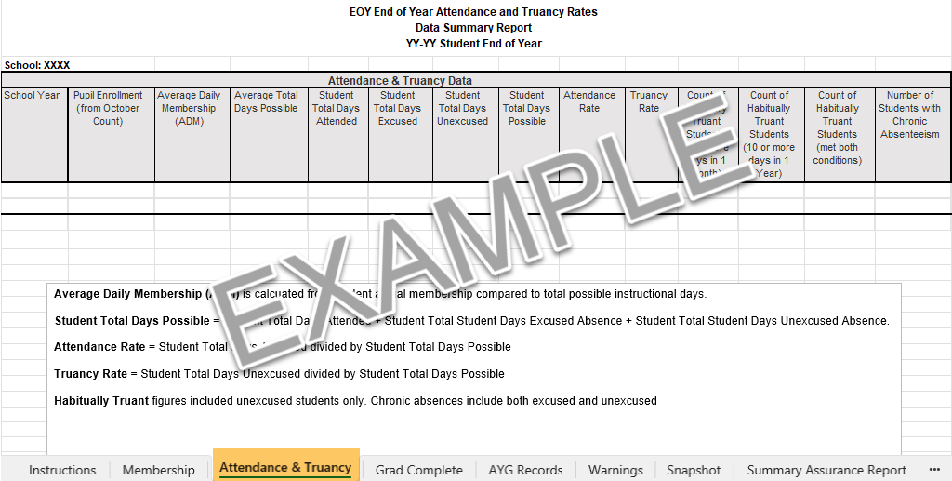
Attendance & Truancy
Overall calculations for school wide Attendance and Truancy.
For more support: access the EOY Attendance Training: https://resources.csi.state.co.us/data-submissions/eoy/
Notes:
The Attendance & Truancy tab provides you with your overall calculations for school wide Attendance and Truancy. For more information about the Attendance & Truancy calculations, please review the EOY Attendance training provided by CSI on the End of Year resource webpage.

Slide 9
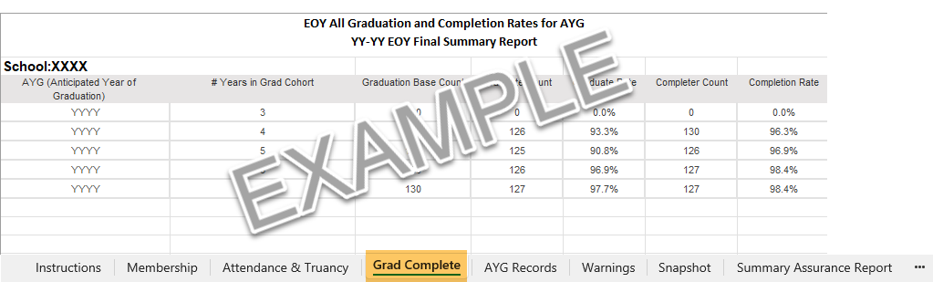
Grad Complete Tab
Only for schools with 9th-12th grades.
Provides the 3-, 4-, 5-, 6-, and 7-year graduation and completion rates for students.
  Graduate: a student receiving high school diploma.
    Graduated, exit code = 90
    Graduated current year and received GED in previous year, exit code = 95
    Graduated and completed Postsecondary Program, exit code = 96
  Completer: a student receiving high school diploma, GED, or certificate of completion.
    Exit code = 90, 92, 93, 94, 95, 96
Notes:
The Grad Complete tab applies only to high schools for grades 9-12 only. This tab provides the 3rd, 4th, 5th, 6th, and 7th year graduation and completion rates for students.
The graduate column is defined by CDE as any student who receives a high school diploma (that is, has an exit code of 90, 95, or 96).
CDE defines completers as students from the Graduate Count column and students who received a high school diploma, GED, certificate of completion which includes exit 92, 93, 94.
All graduation and completion rates are based on the student’s anticipated year of graduation or AYG.

Slide 10
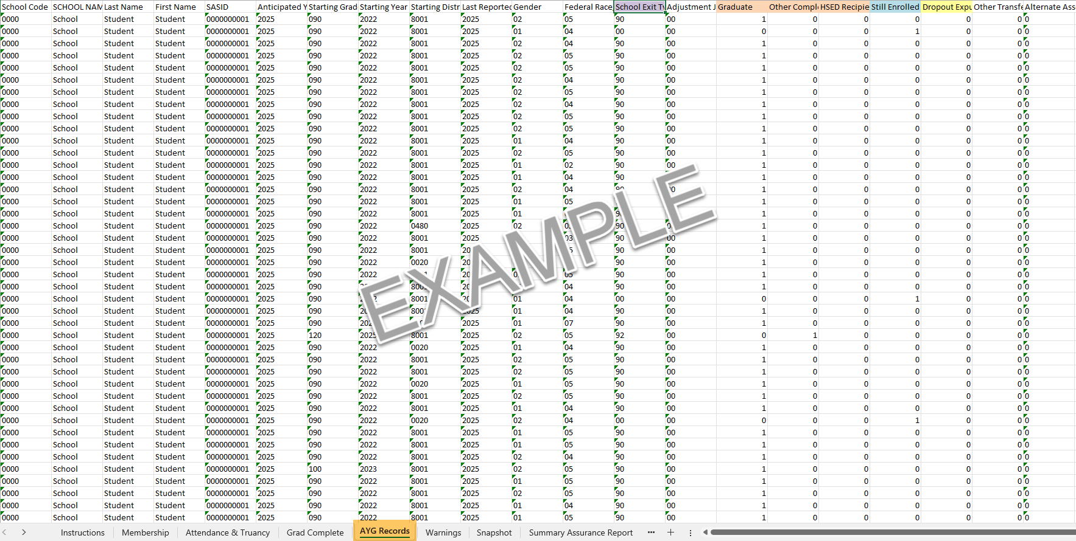
AYG Records Tab
Only for schools with 9th-12th grades.
Checks graduation exits, retention exits, and dropout numbers.
Notes:
Like the Grad Complete tab the Anticipated Year of Graduation or AYG Records tab only applies to high schools only for grades 9-12. This tab is a more extensive record then the previous Grad Completer tab.
Be sure to review this tab carefully by checking graduation exits, retention found in the “Still Enrolled” column, and dropout numbers. This can be done by filtering columns for the particular validation check you are performing.

Slide 11
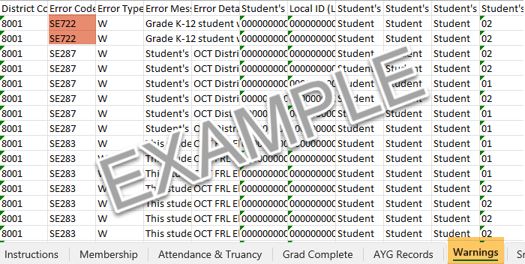
Warnings Tab & SE722
Warnings should always be reviewed to determine the accuracy of your data, if the data is accurate, then no further action needs to be taken.
Play special attention to any SE722 warnings. These warnings will become errors later in the collection (September-November)
SE722 will turn into Errors!
Collect Adequate Documentation from receiving school to address these future errors: https://www.cde.state.co.us/datapipeline/seyadequatedocs
For SE722 Support: Use the “Cleaning SE700 Warnings” Data Validation Resource on the EOY webpage: https://resources.csi.state.co.us/data-submissions/eoy/
Notes:
The Warnings tab in the initial Summary Report lists all Level 2 Snapshot Warnings that your school is still receiving from the most recent EOY file submission.
Warnings can also point to inaccuracies, so reviewing and correcting them when needed is an important part of the validation process.
While most warnings don’t need to be fixed, there are important exceptions. The SE722 warnings will turn into errors once CDE begins their validation process in September - November.
SE722 warnings indicate that a student was exited from your school using Exit Type 13—which means your school coded them as transferred to another Colorado district—however no receiving record at another CO district. That makes your school the last school accountable for that student. These warnings must be addressed as soon as possible.
To resolve SE722 warnings, review any Confirmation of Enrollment and Attendance from the receiving school. If you don’t yet have this documentation, reach out to the receiving district for the COE. You may also need to reach out to the student’s guardians to verify where the student enrolled after attending your school. They may have moved out of state, out of country, transferred to a private school, or homeschool program. Once you determine the correct exit coding for the students, please email CSI. CSI will make manually updates to your EOY SSA file.
For additional help clearing the SE722 warnings, CSI also has a support resource to help guide you available on the EOY resource webpage under the Data Validations section. This slide includes a link to the list of what qualifies as Adequate Documentation.

Slide 12
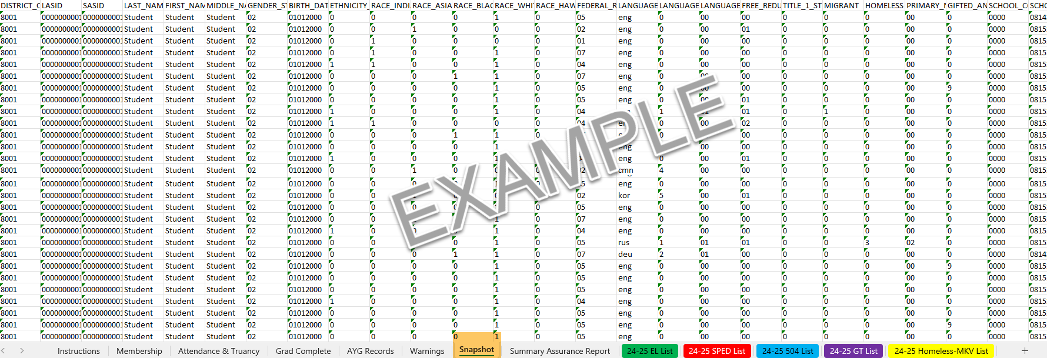
Snapshot Tab
The Snapshot tab includes all of the Error Free data from your school that CDE recognizes as being valid and on record at the close of the collection. This includes:
Student Demographic (SD) file,
Student School Association (SSA) file,
Title I (For Some Schools),
Graduation Guideline (For High Schools),
Other State Entities.
This Snapshot tab can be used to filter for validating data!
Notes:
The Snapshot tab contains all of the error-free data that CDE recognizes as official to date.
This tab is a combination of your school’s submitted records across all EOY collection files—including the Student Demographic file, the Student School Association file, and, for some schools, the Title I and Graduation Guidelines files.
It includes key data like demographic identifiers, entry and exit dates and codes, and any programs or services students received at your school. It also pulls in some state-derived data, such as foster and migrant status.
The data in the Snapshot tab generates much of the information displayed on the EOY Summary Report tabs. Therefore, it is important to review this data carefully—to make sure all students who attended your school during the year are being reported, and reported accurately.
In addition, you can also use the Snapshot tab to filter for specific groups or scenarios—like any combination of grade level, gender, dropout status, retentions, homebased status, or postsecondary programs, to name a few. This is helpful for validating counts and confirming in-depth which students make up those counts.
If you find something that looks incorrect on any tab of the EOY Summary Report, this tab makes it easy to filter and find the specific records.
Remember: accuracy is key for End-of-Year reporting and the utilizing the Snapshot tab is a great resources for ensuring the data is not only error free, but accurate.

Slide 13
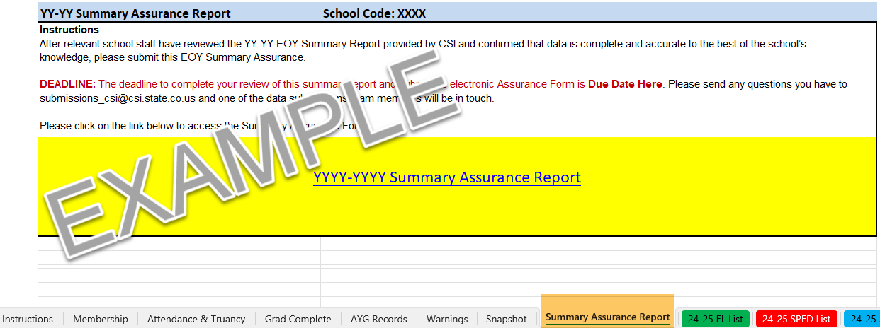
Summary Assurance Report
The Summary Assurance Report indicates that the report has been fully reviewed, corrected as needed by contacting CSI for requested updates, and you approve your school’s data for final submission to CDE.
Notes:
The Summary Assurance Report is the final step of the EOY Summary Report. This report is in lieu of a signed summary report and indicates that the report has been fully reviewed, corrected as needed by contacting CSI for requested updates, and you approve your school’s data for final submission to CDE. Again, it is important that all relevant school staff review the EOY Summary Report information before completing the Summary Assurance Report.
CSI internal checks are still in progress and there may be additional changes needed based on findings later in the Fall. In these cases, school will NOT need to complete new Summary Assurance Reports. This is a one-time report.
To submit your Assurance Report, a data submission contact or another school representative may click the link provided on the Summary Assurance Report tab. Complete the form and send. CSI will be notified once this is complete.

Slide 14
New Tabs for the 24-25
EOY Summary Report
Notes:
To help support the easy of confirming and validating your school’s data on the EOY Summary Report, Special Program tabs have been added. These tabs contain a summary of student counts as well as a list of students.
Use these tab to verify both program participation and student status for accurate end-of-year reporting.

Slide 15
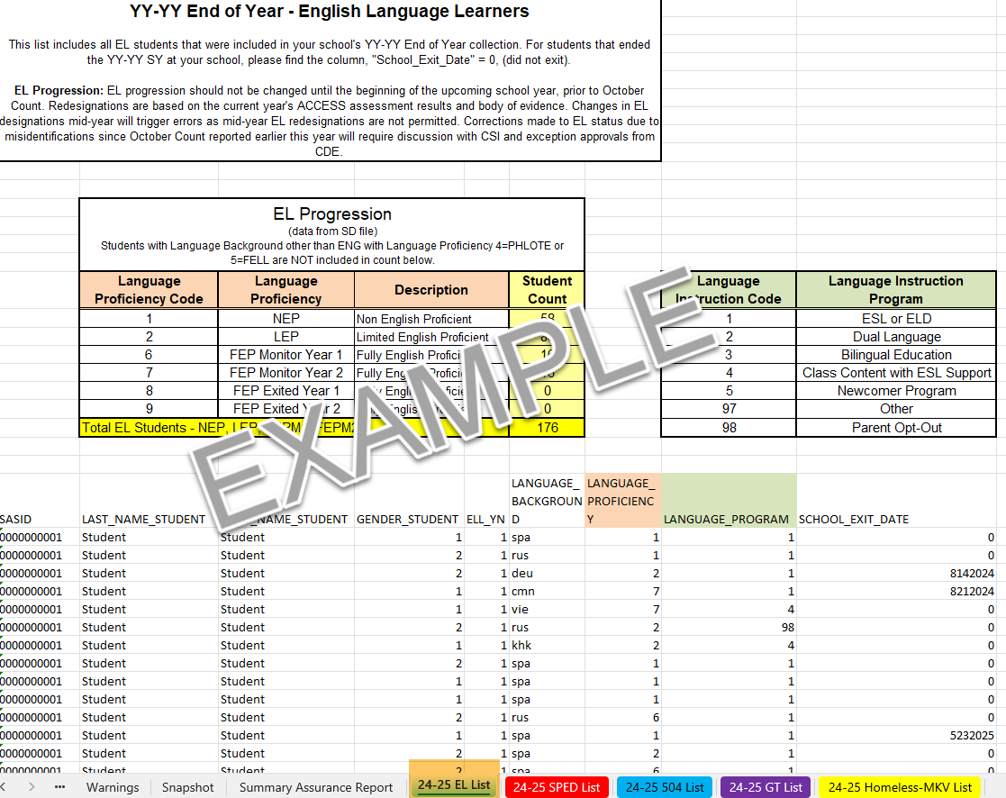
EL List
The EL List tab provides a summary and list of students who participated in an English Learner (EL) Language Proficiency Program at any point during the school year.
Please Note: If you believe that your EL data is not accurate, please contact CSI before making any updates in your SIS.
Notes:
The EL List tab provides a summary and list of students who participated in an English Learner (EL) Language Proficiency Program at any point during the school year. This includes both the language proficiency types and language instruction types, aligned with the appropriate state reporting codes.
The Student Count includes all students who participated in an EL program, including students with a one-day record.
FELL and PHLOTE students are not included in this tab. To find those students, you’ll use the Snapshot tab and filter by language proficiency.
At the bottom of the tab, you’ll find a detailed student list showing each student’s language, program information, and—if applicable—an exit date. This exit date can help identify students who received EL services and remained enrolled through the end of the school year.
Please note: EL progression should not be changed until the beginning of the upcoming school year, prior to October Count. Changes in EL designations now will trigger new. If you believe that your EL data is not accurate, please contact CSI before making any changes n your SIS.

Slide 16
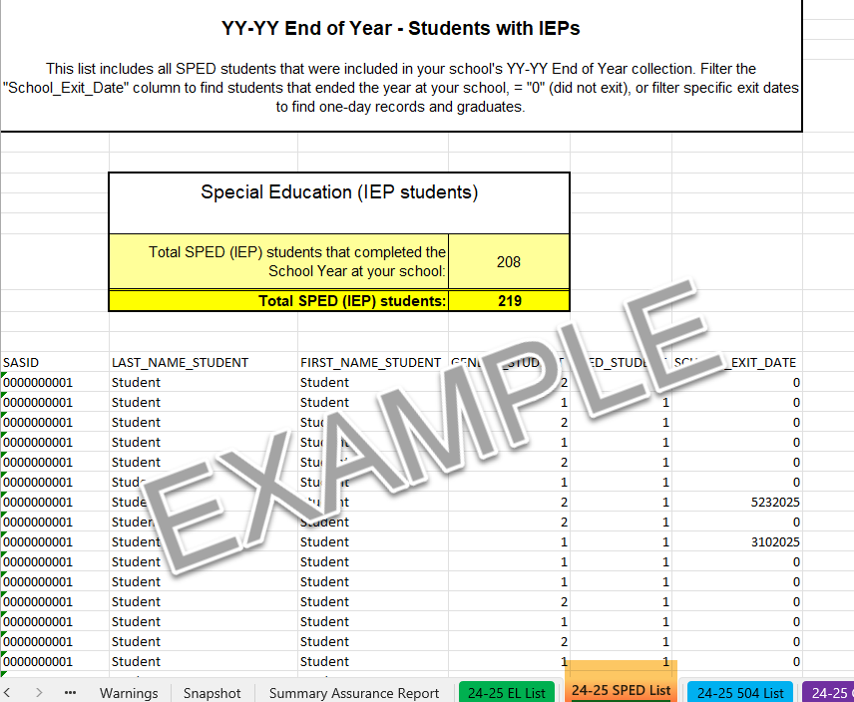
SPED List
The SPED List tab provides a summary and list of students with an IEP at any point during the school year.
Notes:
The SPED List tab provides a list of students with an IEP and identified as Special Education at any point during the school year.
You’ll see a summary count of not only all students identified as SPED, which includes students with a one-day record, but also the total number of Special Education students that completed the school year at your school.
At the bottom of the tab, you’ll find a student list and—if applicable—an exit date. This exit date can help identify students who received SPED services and exited during the school year.

Slide 17
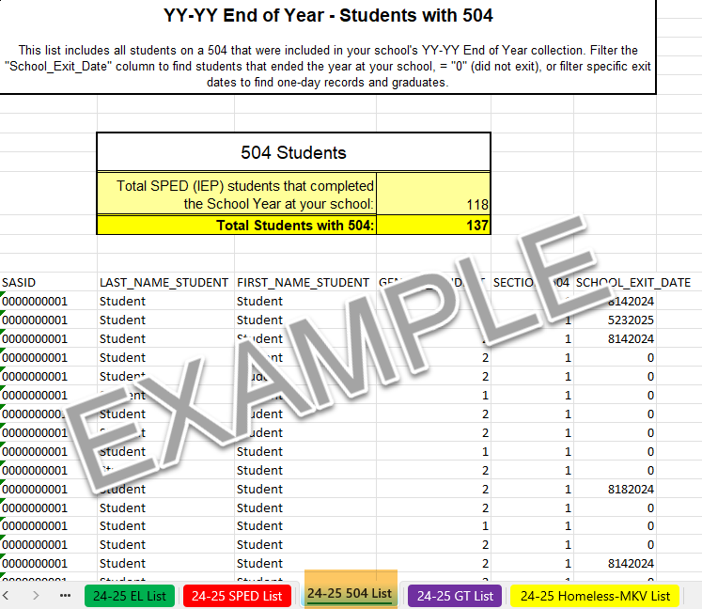
504 List
The 504 List tab provides a summary and list of students with a 504 at any point during the school year.
Notes:
The 504 List tab provides a list of students with a 504 at any point during the school year.
You’ll see a summary count for all students that had a 504, which includes students with a one-day record, AND the total number of students with a 504 that completed the school year at your school.

Slide 18
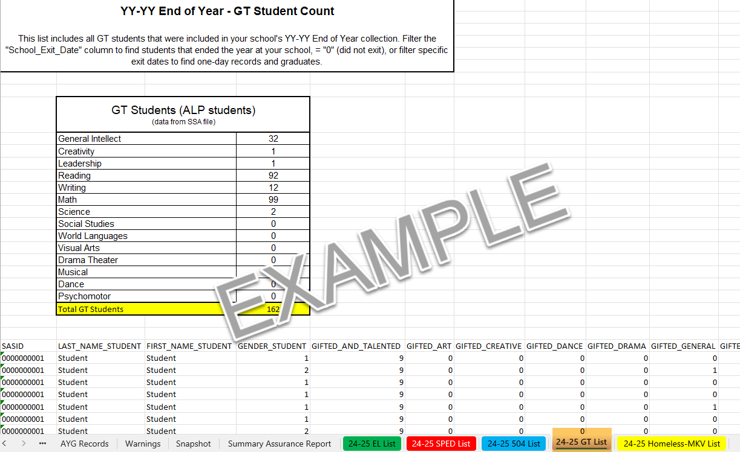
GT List
The GT List tab provides a summary and list of students with an ALP or identified as GT at any point during the school year.
Notes:
The GT List tab provides a list of students with an ALP at any point during the school year.
You’ll see a summary count for all students identified as GT, which includes students with a one-day record.

Slide 19
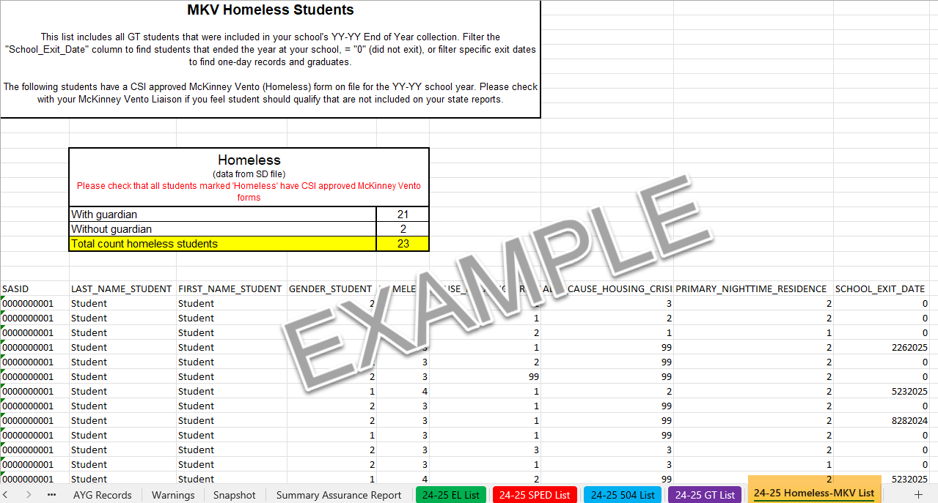
Homeless/MKV List
The EL List tab provides a summary and list of students who participated in an English Learner (EL) Language Proficiency Program at any point during the school year.
Notes:
The Homeless/MKV List tab provides a list of students with a CSI approved McKinney-Vento form at any point during the school year.
You’ll see a summary count for all students that qualify for MKV, which includes students with a one-day record.

Slide 20
Resources and Final Steps

Slide 21
EOY Resources
CSI End of Year resources https://resources.csi.state.co.us/data-submissions/eoy/
CDE End of Year resources https://www.cde.state.co.us/datapipeline/snap_eoy
CDE Colorado Education Statistics https://www.cde.state.co.us/cdereval/
Refer to links on left of this webpage—graduation, completion, and mobility/stability statistics
Notes:
As you are going through your reports, there are many resources that you may find beneficial. This includes the CSI End of Year Resources located on the EOY resource webpage of the CSI website and the CDE website. In addition, the Colorado Education Statistics from the CDE website provides details on graduation, completion, mobility and stability.

Slide 22
Final Steps
Retrieve your Summary Report from:
G-Drive>Submissions>EOY>YY-YY>Summary Report.
Review and validate data
  If data needs to be updated, do one of the following by the Initial Summary Review deadline:
    Send an email to submissions_csi@csi.state.co.us with a SASID and description of the edits needed; OR
    Update a copy of your most recent file submission (highlighting edited cells), upload to G-Drive & email CSI; OR
    Request to walk through changes needed with a CSI staff member
Once data has been deemed accurate, complete the Summary Assurance Report Form located on the Summary Report tab.
Notes:
If you haven’t already, retrieve your EOY Summary Report located in your G-Drive folder>EOY folder. You will then review the data and verify its accuracy. It is important that relevant school staff review portions of the data including school leaders. Relevant staff may include EL, SPED, GT, Nutrition, McKinney Vento coordinators, registrars, and councilors. Because of the extensive amount of data for this important school accountability collection, it is recommended to break up the review into smaller increments to ensure accuracy.
Please pay close attention to graduation codes, drop out and retention codes. If these are incorrect for EOY reporting, they will cause errors in your upcoming October Count.
If data issues and errors are discovered, you have one of three options to update your data.
You can send an email to the submissions inbox with a SASID and description of the edits needed;
You can update a copy of your most recent SD, SSA, or GG submission. Be sure to highlight in yellow the updated cells, upload to G-drive & notify CSI of new files; OR
You can request to walk through changes needed with a CSI staff member.
When requesting EOY data updates, it is important to update your SIS data to match. Remember, August is the last chance schools have to update EOY data, so be very diligent in making sure it is correct.

Slide 23
Thank you
Send questions to: submissions_csi@csi.state.co.us
Notes:
Thank you for watching our training of the EOY Summary Report review process. For questions, please reach out to the CSI Data Submissions Team! If you would like more information about how to use the Snapshot tab for filtering and validating your school’s data, please reach out to CSI.

