Slide 1

Special Education End of Year Training
Summary Certification Report Review
Notes:
Hello All,
Thanks so much for reviewing this recorded training for the Special Education End of Year Collection! This module focuses on the summary certification report and how best to review it! Feel free to reach out to CSI if you have questions on any aspects of this webinar!

Slide 2
Agenda
Importance of SPED EOY
Collection Details
Confirmation of Data Accuracy
Example Report – Tab Walk through
Review Each Tab and Discuss Importance
Notes:
Here is a quick overview of the topics that we will be discussing today. First, we will be looking at the importance of the collection as a whole and more importantly, the submission of accurate data. We’ll then jump into an example report, walking through what each of the report tabs contain and what to keep an eye out for. Last, we’ll provide our contact information in case any questions have come up during this review.

Slide 3
Importance of SPED EOY
Notes:
Alright, lets jump into the importance of the Special Education End of Year collection.

Slide 4

Purpose of the SPED EOY Collection
The SPED End of Year Snapshot collects information on the following:
  Students who were referred, evaluated, and/or received services during the current school year of July 1st to June 30th.
  The specific services the students received.
  Dates of parental consent, evaluations completed, and meetings.
  Information on students exiting Special education and the basis for the exit.
courtesy of clipart.email
4
Notes:
In looking at the purpose of the SPED End of Year collection, it is designed to collect information on students who were referred, evaluated, and or received special education services during the current reporting period of July 1st to June 30th. In terms of information that is being collected on each student - it looks at entries and exits in the special education program, hours of service, and also important evaluation and meeting dates among many others. For full details see the general overview training for this collection.

Slide 5

Importance of Reviewing Data for Accuracy
Verify… All students who have an active IEP and receiving services are being reported as such. Students who have exited Special Education and reason for the exit (including Graduates/Completers). Services provided and hours SPED Team has spent working with the students. Newly tested students for the current year versus returning students. The path student is being reported on for newly tested (typically path 3 for CSI)
It is important that this information is reviewed by the school and CSI prior to submitting to the State – Accuracy is Key!
courtesy of clipartkey.com
Notes:
A significant step to this and any other collection is ensuring the data you are submitting is accurate. That is why CSI provides summary reports for every collection that must be reviewed and signed off on prior to CSI completing its final submittal to the State. The points of emphasis will vary from collection to collection, but in terms of SPED EOY, you want to verify: (READ BULLETS). These are just a high-level summary of the most important areas to review, but accuracy is key in all information input, so take some time to review it in its entirety.

Slide 6
Example Report Tab Walkthrough
Notes:
Now that we have had a high-level overview of the collections and the importance of accuracy, let’s take a look at each tab of the report and what should be reviewed.

Slide 7

Summary Report Tabs
  Instructions
  Certification
  “1” Tab
  “2” Tab
  Program Participation
  Student Snapshot Records
  Warnings
Notes:
The summary report itself contains several tabs with the headings listed in this slide. Each report you receive for the collection will include tabs on instructions, certification, tab 1, tab 2, program participation, student snapshot records and warnings. We will now go through each of these in greater detail on subsequent slides. Hopefully, this additional information will allow you to further validate your data!

Slide 8
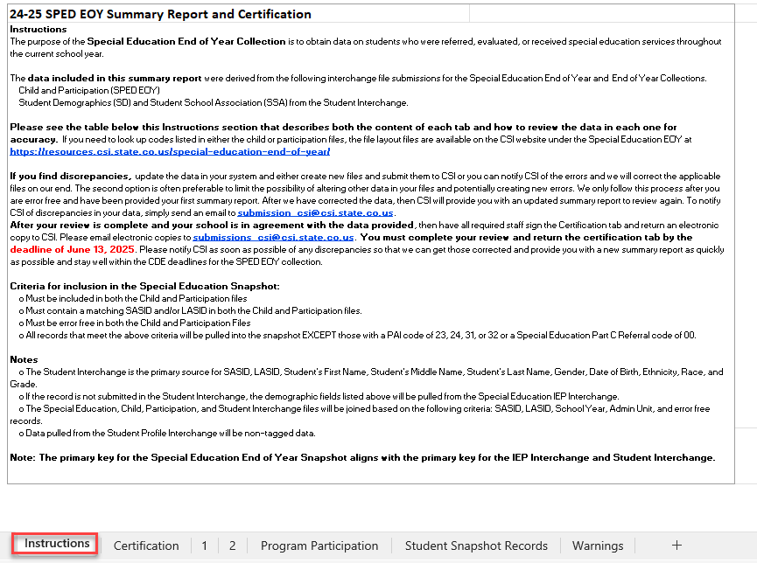
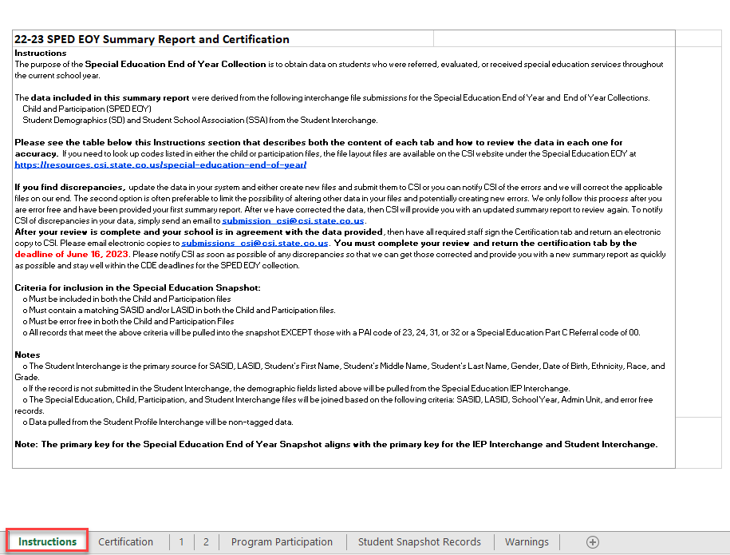
Instructions Tab
Notes:
The first tab contained in your Initial Summary Report is the instructions tab. This information should be reviewed thoroughly to ensure you are understanding what details are contained in the report and other helpful resources provided by CSI or CDE.
The upper portion of this tab contains information on what the report is, where the information is coming from, what information is outlined and what to do if you find inaccuracies. While the lower section provides additional details on each tab within the report. It also contains links to helpful CSI and CDE resources as previously mentioned. Lastly, it contains the review deadline date and what steps the schools need to take by this date.

Slide 9

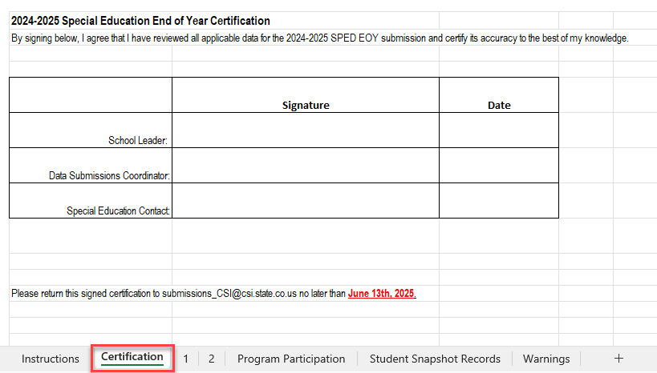
Certification Tab
Notes:
Next, we have the certification tab. The tab essentially ensures all applicable parties have reviewed your report and can attest to its accuracy. For SPED End of Year, the school leader, data submissions coordinator, and the special education contact should all be reviewing the data for accuracy and reaching out to CSI with questions. If no issues are discovered, this needs to be signed and returned by the collection year deadline.

Slide 10
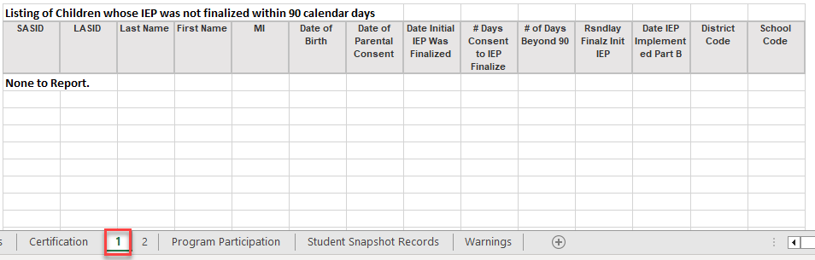
“1” Tab – IEP Not Finalized within 90 Days
Notes:
The “1” tab is a listing of students who did not have their IEP finalized within 90 days of parental consent. Keep in mind, the date of parental consent is the date on the signed copy of the form and not the date provided to the parents. IDEA regulation requires that the IEP must be finalized within this timeframe, so seeing this should be somewhat of an uncommon situation and all will need a delay code to provide a reason why this was not completed in time. The implications for not meeting timelines can be big for special education, so if you do have students listed on this tab, you’ll want to review them thoroughly to ensure all dates are accurate. If that is not the case, then a new participation file must be submitted to correct inaccurate dates.

Slide 11
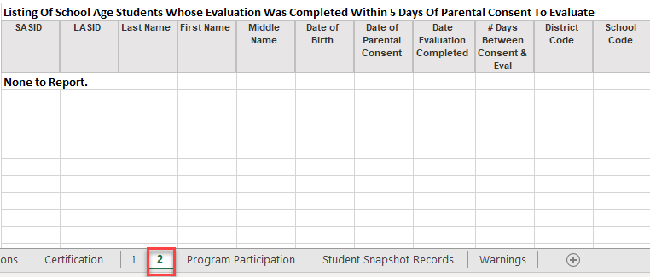
“2” Tab – IEP Completed within 5 Days
Notes:
Tab 2 looks at a similar situation, but just the opposite. This is a listing of students whose parental consent and evaluation complete were within 5 days of each other. This is also is a very uncommon situation as it should take more time than that to complete an evaluation on a student with parental consent. In most cases that I see this, it generally is data entry errors where the same day is used for each path 3 date field, but that is incorrect. If you do have students on this tab, you’ll need to review thoroughly to correct dates and resubmit if necessary. If you do believe your data is accurate, be sure you have a solid explanation ready as our SPED Director reviews each of these and we will be contacting you.

Slide 12
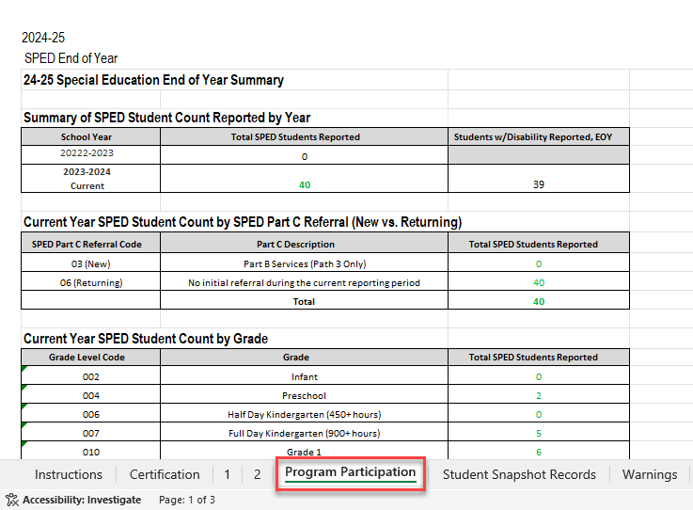
Program Participation Tab
Notes:
The Program Participation tab essentially takes all the information contained within the Student Snapshot tab and summarizes it into more easily digestible counts. The top portion shows the count of students reported compared to last year and then breaks that down by newly tested 03 students versus returning 06 students. Be sure those overall counts match what you have as far as the number of Special Education students. As you proceed down this tab, it breaks down that overall count by various demographics including grade, gender, disability, and exit type. Be sure you are paying special attention to the number of students coded with a 90 as a graduate. This is often an area that gets missed when completing data entry for special education students.

Slide 13
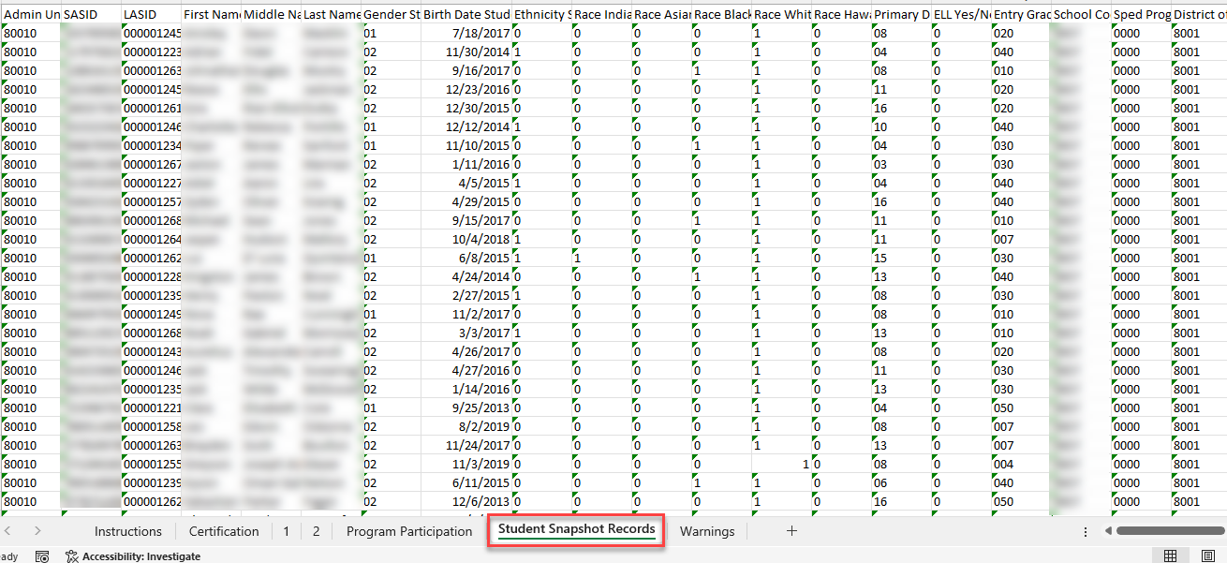
Student Snapshot Records Tab
Notes:
Now that the previous tab has provided you aggregate counts based on several demographic details, you may want to see which subset of students make up those counts. That is where the Student Snapshot Records comes into play. I recommend adding a filter to the header row and filtering based on any of the number of categories previously listed. This will give you the actual student names that make up those breakdowns and can be very helpful to find which students are missing if you believe the numbers are off. This and the program participation tabs are by far the most important in the report to determine the accuracy of your data and should be reviewed thoroughly to ensure all active students on an IEP are being reported as such.

Slide 14
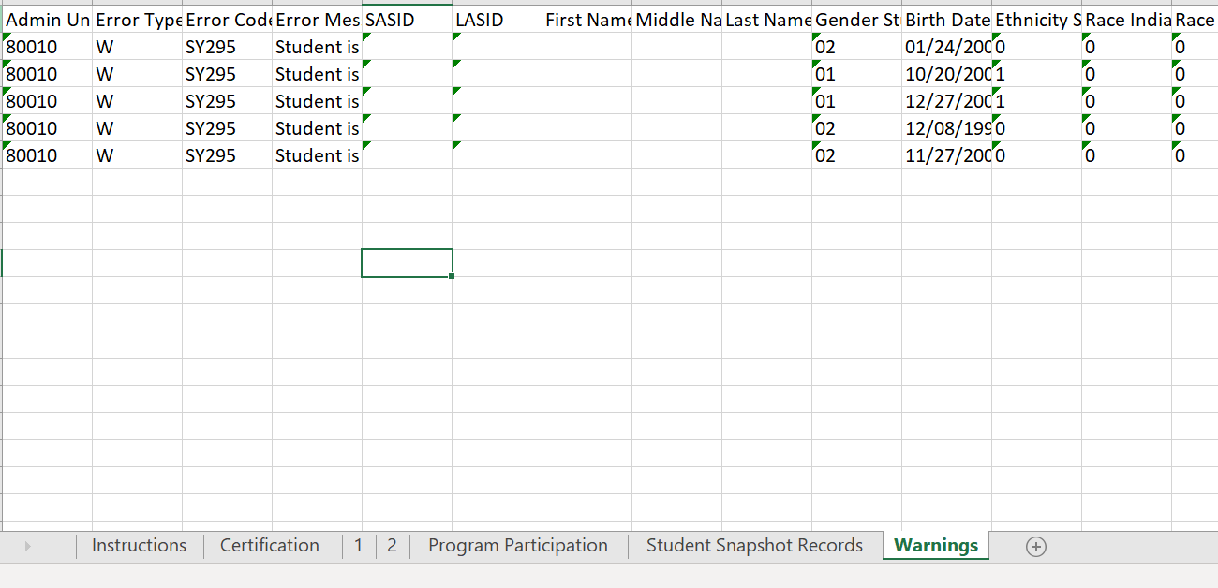
Warnings Tab
Notes:
The last tab on the report lists the warnings that your school is receiving on your special education end of year data. Keep in mind that warnings don’t necessarily mean the data is wrong, it is just a good indicator of possible inaccurate data. This is why each warning should be reviewed thoroughly, and updated files can be submitted to correct. Often these warnings can show if a student is being reported in another district, which will need to be addressed during the duplicate phase, so it is much better to correct now if the student left your school for another district this year. The warnings can also show things like students being exited from regular EOY, but not Special Education End of year. Making all of these corrections now will certainly save time during the duplicate phase and the validation checks we complete.

Slide 15

Thank you for Reviewing this Training
Contact the Submissions Inbox with Questions:
    Submissions_CSI@csi.state.co.us
Notes:
Thanks again for reviewing this module for the Special Education End of Year collection. If you have questions or concerns, don’t hesitate to contact the submissions inbox and a member of the submission team will be more than happy to assist! Have a great day!

