Slide 1
SPED Record Checker Tool
Notes:
Hello All,
Thanks so much for reviewing this training module for the Special Education Collections. This particular webinar is intended to instruct schools on how to use the error check resourced called the SPED Record Checker. It is designed to allow schools to review potential issues or errors prior to your initial submittal. If you have questions at any point while reviewing this webinar, feel free to reach out to the submissions inbox and we will be happy to support!

Slide 2
Purpose and Validation Resources
Notes:
So, prior to diving into the steps to use the SPED Record Checker, I thought it would be beneficial to discuss the purpose of the tool in more detail and other resources that can also be used along with the file to ensure the initial files submitted have all fields completed and are accurate.

Slide 3
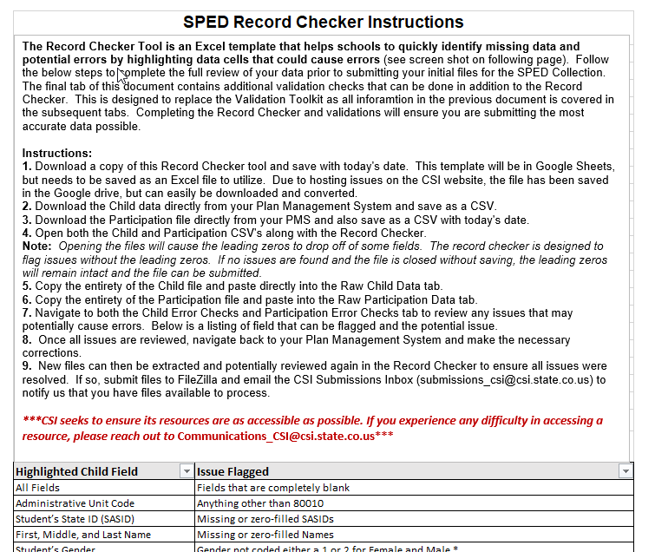
Purpose of the Record Checker Tool
The purpose of the SPED Record Checker is for schools to review their initially extracted Child and Participation Files prior to initial Submittal. The template will flag for potential errors that can be corrected prior to initially submitting files. The goal of this resource is to:
Identify errors and correct prior to submittal Fewer errors received upon initial submittal Fewer submissions until error clearance Collection errors cleared earlier in the process
Notes:
So in talking about the purpose of the Record Checker tool, it really is a resource that should be used on both the Child and Participation files prior to initial submittal of both the December Count and SPED End of Year collections. The goal of the template is to flag for missing data fields, potential errors, and issues that can be corrected prior to submitting. Completing this quick check and making necessary updates will reduce the overall number of errors received on your initial submittal and lead to less overall submissions to clear out all errors. The hope is that this will save time for both the schools and CSI and assist in better meet error clearance deadlines.

Slide 4
Initial Submission Data Validation Resources
CSI has two main resources that have been combined into one called the SPED Record Checker and Validations Toolkit.
Run the record checker early in data entry and prior to submittal.
This Record Checker resource is not designed or capable to catch every potential error, but more common data entry issues.
The Validations tab on the Record Checker contains a checklist of potential issues and data entry reminders that are not being flagged in the Checker.
Both webpages contain other resources that will assist in this process as well (File Layouts, Training Modules, Participation Coding scenarios etc.).
SPED Validation Toolkit
Record Checker Tool
SPED RC and Validations Toolkit
Notes:
In talking about the Record Checker, it really is a great resource to catch errors and issues but should not be the singular validation technique schools should use prior to initial submittals. CSI has many resources located on its website that will help in this process, including coding scenarios, file layouts, and the troubleshooting document. Along with the Record Checker, we also have historically had a SPED Validation Toolkit. We found that there was quite a bit of overlap between the two resources which may cause confusion and duplicate work. Since both do contain very helpful details, we decided to merge the Record Checker and the Validation Toolkit into one resource called the Record Checker and Validation Toolkit. The resource is essentially the Record Checker tool, but the last tab is the Validations tab. This tab contains a pared down version of the Validation Toolkit that only covers areas to look into that are not already being flagged in the checker. Using all tabs of this resource will ensure that the data being submitted is as accurate and error free as possible.

Slide 5
SPED Record Checker Instructions
Notes:
Alright, now that we have discussed the overall purpose of the checker and other CSI resources that should be used in conjunction with it, lets jump into the specific instructions on how to access and use the SPED Record Checker!

Slide 6
Record Checker Instruction Overview
Follow these steps to complete a review on initial SPED Interchange data files: Extract both the Child and Participation files directly from your schools Plan Management System and save as a CSV Navigate to the CSI website and open the Record Checker Tool Open both the Child and Participation files and paste into the Raw Data tabs in the template Review the “Child Error Checks” and “Participation Error Checks” tabs in the template paying attention to any highlighted fields that indicate errors Make updates directly in the school's PMS and extract new files. These can be pasted into the template again to double check nothing has been missed Once all are corrected, the newly extracted files can be submitted to CSI for processing Instructions can also be found: https://resources.csi.state.co.us/sped-record-checker-tutorial/
Notes:
This slide is a high-level overview of the 6 steps that need to be completed in order to successfully utilize the Record Checker piece of the tool and submit your initial files for the SPED EOY or December Count Collections. These steps include (READ STEPS). Each step will be covered in greater detail on the subsequent slides in this training.

Slide 7
Steps to Utilize the File Check Template
Notes:
Alright, let's jump into each step further and discuss what is needed to complete each starting with Step 1!

Slide 8

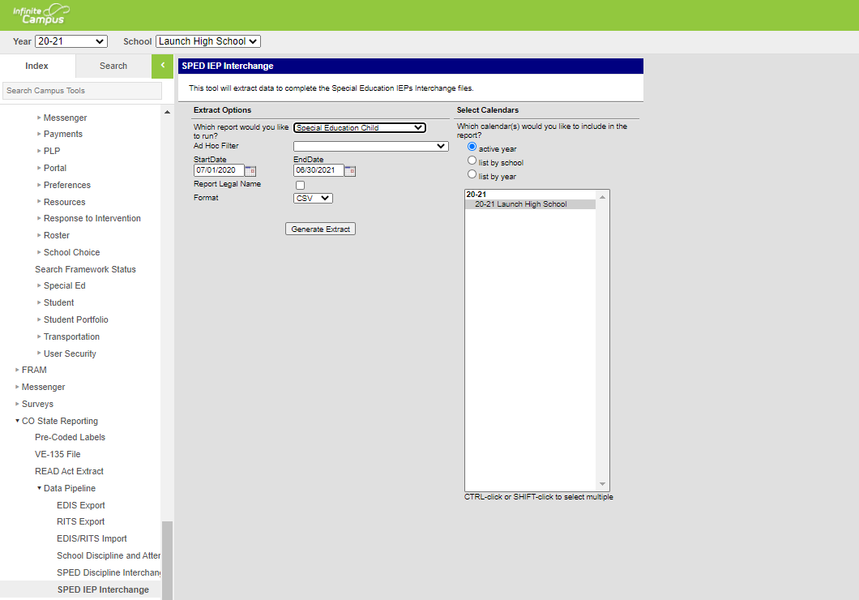
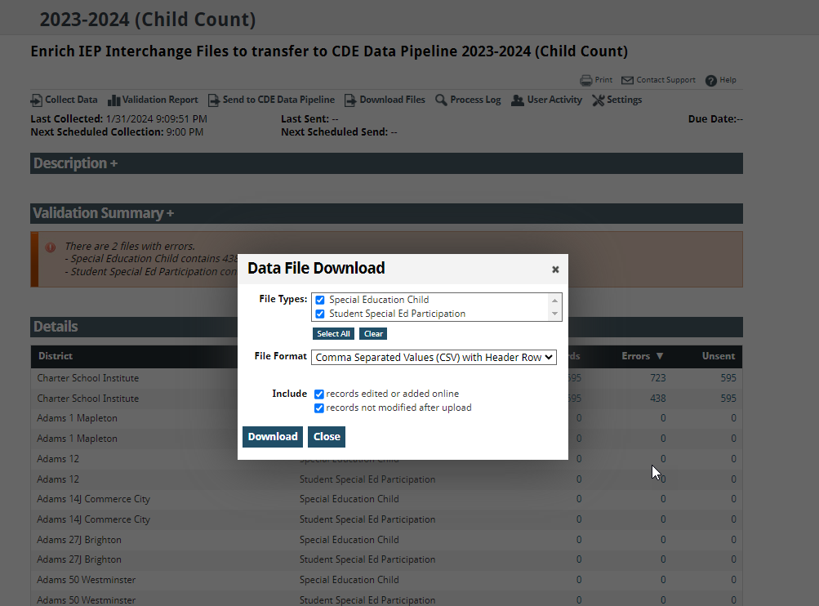
Step 1: Extract Files from Schools SIS
Navigate to Infinite Campus, Enrich or other school system used and extract both the Child and Participation files directly from the applicable Colorado State Reporting/CDE Data Pipeline section. Files must be saved prior to opening as usual procedure. The correct naming structure should be used in case files will be submitted (ex. 3326_CILA_Child_03012024) Files must be saved as a .CSV for file check template to work properly.
Notes:
Prior to jumping into the first step, ensure that all data entry is completed on all students in your Plan Management System and that the Data Validation Checklist section of the toolkit has been utilized to clear up any common issues. Once completed, you want to extract both the Child and Participation files directly from your system. These files can be extracted directly from the State Reporting sections in your system as you normally would for any file submittal. These files should be saved with the correct naming structure as shown in bullet 2 in case the files contain no issues and you are ready to submit. All files must be saved as a CSV prior to opening as is common practice and for the record checker to work properly. Once this has been completed, you can jump to step 2.

Slide 9
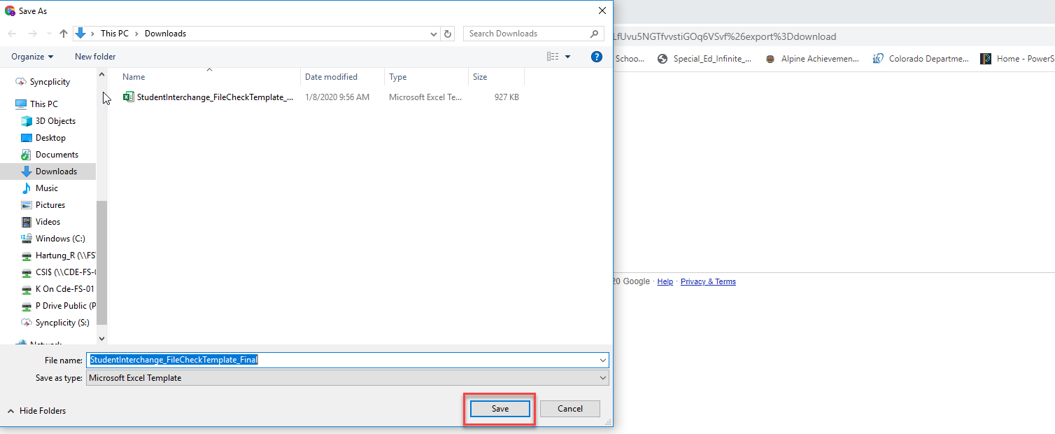
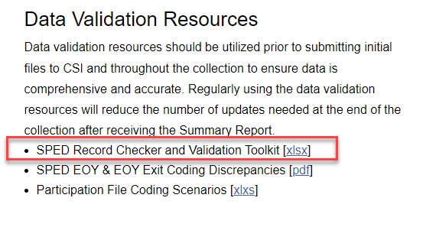
Step 2: Access the Tool
The Record Checker is currently located on the CSI SPED End of Year homepage under the Data Entry and Validation Resources header. It will also be included on future December Count updates. The Excel file link has also been emailed to schools prior to the initial submittal due date. Once Open has been clicked on, click the download and save to your computer as an Excel file, which can be utilized as often as needed. The file contains 4 primary worksheets with 2 being for pasting raw data and the others displaying potential errors. Additional Instructions, Data Overview, and Validations tabs have recently been added to assist with the process and verifying counts look accurate. https://resources.csi.state.co.us/wp-content/uploads/2024/02/Record_Checker-Validations_Finalv7.xlsx
Notes:
Step 2 is all about accessing the tool and saving it to your personal computer. To access you must first go to either the December Count or SPED EOY pages on CSI’s resource site. Then click on the link for the SPED Record Checker tool. A new window will pop up allowing you to save the file to the desired location on your computer. Once this is complete, you can open the file and begin utilizing. You’ll notice that the file contains 7 overall tabs, 4 primary ones where data will be pasted and errors checked and three others added that contain instructions, validation details, and aggregate counts based on various demographic categories to ensure the data pasted looks accurate. We will cover these tabs more thoroughly on the subsequent slides in this training.

Slide 10
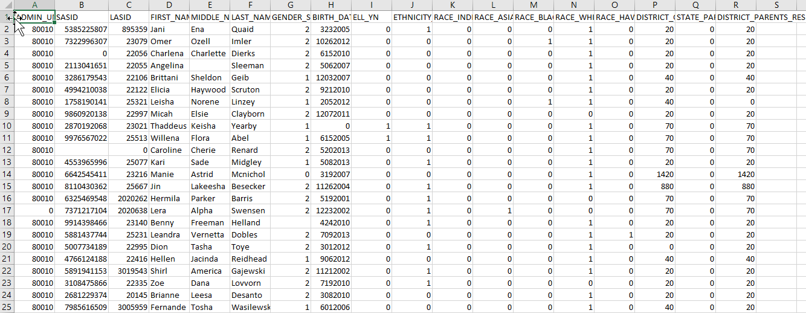
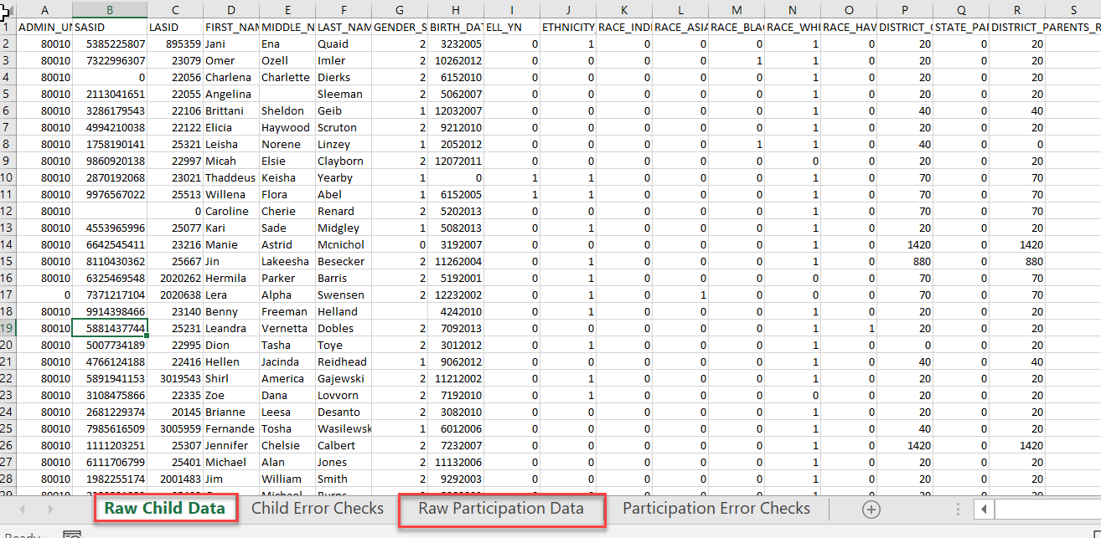
Step 3: Open and Paste Data Files
Once the Template file has been downloaded and saved to your computer. Open the file to begin the check process. Navigate to the saved Child and Participation files and open them as well. The files will lose their leading zeros, which are not needed during checks. Copy the entirety of the raw Child file and paste directly into the Raw Child Data tab located in the template. Complete the same process for the Participation file pasting into the Raw Participation Data tab.
Notes:
Next, lets discuss step 3. So once the file is saved to your computer, you’ll want to open it up to begin the file check process. This file contains 4 primary tabs, two of which are labeled as Raw Child and Raw Participation Data and this is where the recently extracted files will be pasted. The other two worksheet tabs will display the issues and errors based on the pasted raw data. The first and last tab contain instructions and a data overview tab as previously mentioned. And the last tab is the newly added Validations tab Once the template is open, you’ll also want to open both the Child and Participation data files you recently extracted. This will result in a loss of leading zeros but are not necessary for the record checker to be successful. If check results in no issues, you can close your original files without saving and the leading zeros will remain intact. Highlight all rows of data located on the child file and paste it directly into the Raw child Data tab in the checker. Complete this same process for the Participation files. Once completed, you can move on to Step 4 and review potential issues and errors related to your data files.

Slide 11
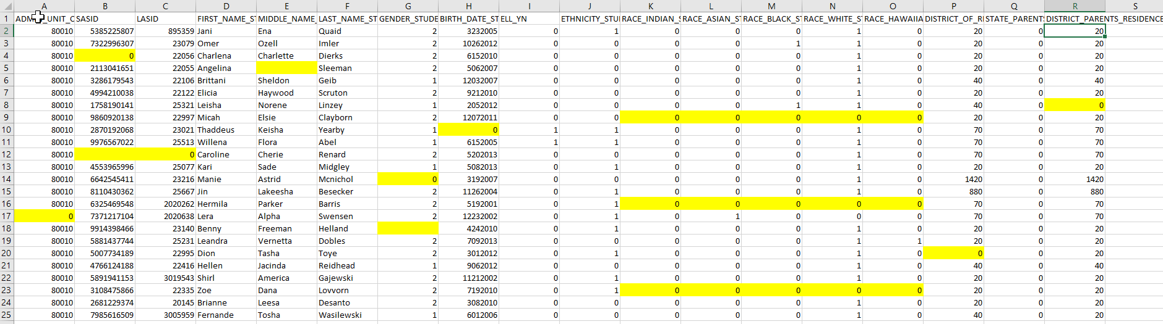
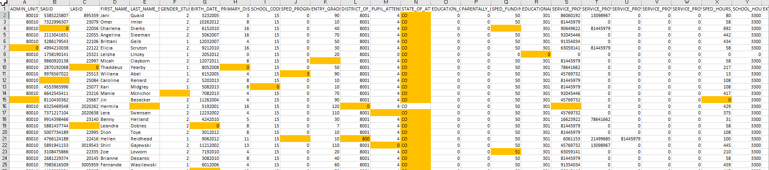
Step 4: Review Error Check Tabs
After pasting, navigate to both the Child and Participation File Checks tabs located in the template. Any field that may present an issue or potential error will be highlighted directing the user what needs to be updated. This tool is not designed to catch every error or issue, but many of the common data entry errors a student may have within their PMS.
Child Error Checks Tab
Participation Error Checks Tab
Notes:
So the Child and Participation files checks tabs are the other two primary worksheets on the file and will contain the errors and issues that you may encounter. Step 4 is all about reviewing these checks tabs and in particular the highlighted fields as they may present an issue or error upon submittal. As you can see here in our example files, there are many fields that are highlighted including zero filled cells that should contain data and other flags for inconsistencies. You’ll want to review these tabs thoroughly to ensure that you fully understand what is missing in your data, the next couple slides provide a summary of the data fields that will be highlighted broken out by file type.

Slide 12
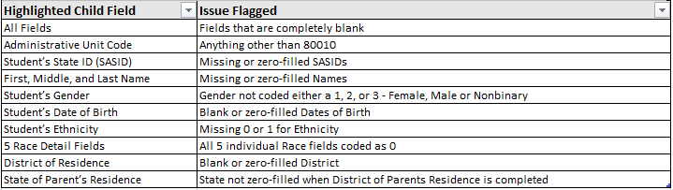
Step 4: Review Error Check Tabs Cont.
Below is a listing of potential Child errors or issues that you may encounter upon pasting your raw data files: *Message shows how flag looks on check template but does not reflect the leading zero intended in the field.
Notes:
So when looking at the Child file, here is a full list fields that may be flagged and what the actual issue may potentially be. As you can see there are several general demographic fields included here that will flag if the information has not been input in your system, including areas such as SASID, name, gender, date of birth etc. These are fairly straightforward at what to update in your system. In some cases, it may not be as clear to why the field is highlighted as it may relate to how another field was answered, so I am hoping this table will help with that. A good example of this would be the five Race fields. CDE requires that at a minimum one non-zero filled Raced must be completed. .So, the validation check will highlight all the Race fields even though only one needs to be completed. These kind of checks are available throughout this resource, so it is important to review these tables carefully to determine why a specific cell may be highlighted.

Slide 13
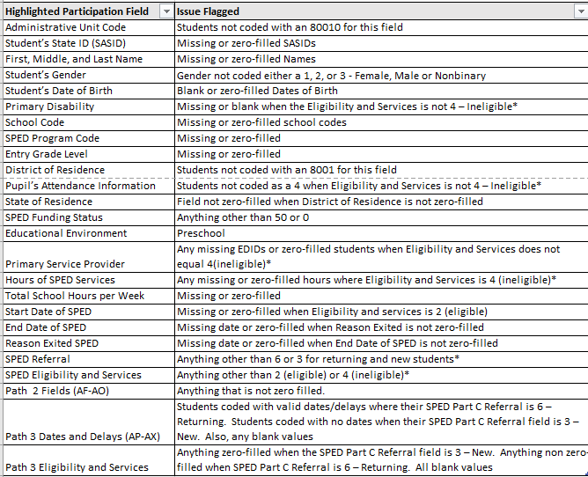
Step 4: Review Error Check Tabs Continued
Below is a listing of potential Participation errors or issues that you may encounter upon pasting your raw data files:
*Message shows how flag looks on check template but does not reflect the leading zero intended in the field.
Notes:
Similar to the previous slide, this one shows a listing of highlighted fields and why they may be flagged, but this time for the Participation file. Again, these include more common missing data entry issues, such as SASID, Name, Gender and Date of birth, but also reflects missing information in areas such as Entries and Exits, grade level and residence information, among others. Flags on this file are also dependent on how other fields are completed, primarily both the SPED Referral Field and the Eligibility and Services. For example, if someone is coded as a Newly tested student or 3, then the Path three fields will highlight if there is not a valid date. Another example would be if the Eligility and Services is coded as a 4, then several fields including disability and funding status should be zero-filled and will flag if not. Pay close attention to this table to determine the cause of the flag and feel free to reach out to the submissions inbox if you have questions on these.

Slide 14
Error Check Limitations
Not designed to catch every error you may encounter Potential flags of valid data in unusual scenarios
Errors Not Flagged | Potential Flags of Accurate Data
Issues with SASIDs not matching what is in RITS | Students identified as being in Path 2
Age to Grade inconsistencies | Tuition Contract Scenarios
Duplicate SASIDs across CSI schools | Funding statuses other than 50 or 0
Overlapping enrollments across schools
Incorrect Delay Codes
Notes:
Also, as I have previously mentioned that for both files, the Record Checker is not designed to flag every potential error, just the more prevalent ones that only relate to the current data in the file being looked at. Issues related to other files, data from other schools, or prior year information is not pulled into this check, therefore cannot be flagged. Areas such as SASIDs not matching RITS, age/grade inconsistencies, overlapping enrollments, and incorrect delay codes will not flag. You also may encounter unusual scenarios where data is being flagged but is accurate. This could include students are identified as path 2, tuition contract scenarios, or funding statuses other than 50 or 0. These are all unusual situations, but do happen from time to time, so if you know you have an unusual situation and it is being flagged, please disregard.

Slide 15
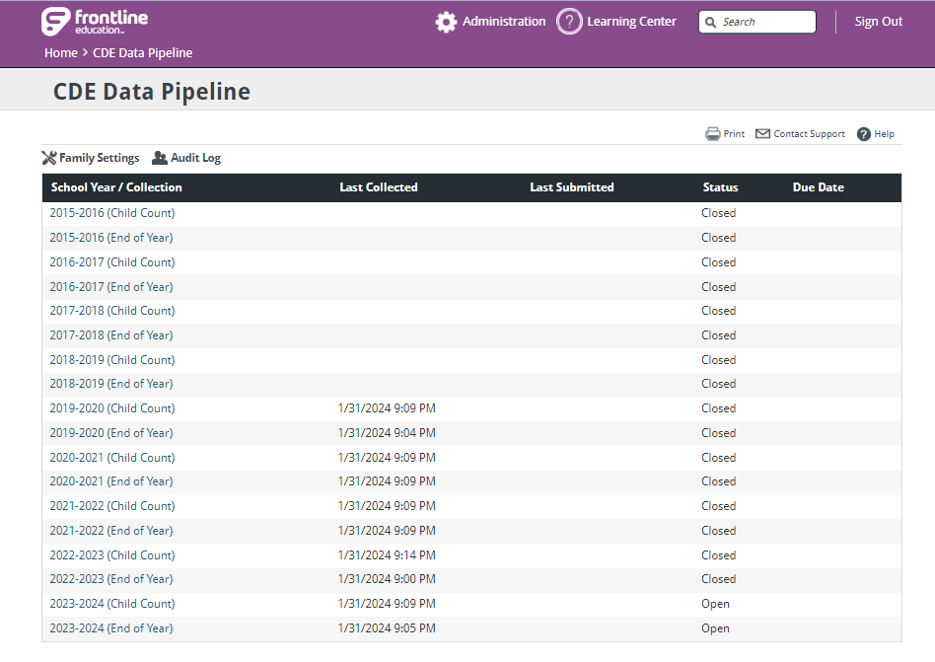
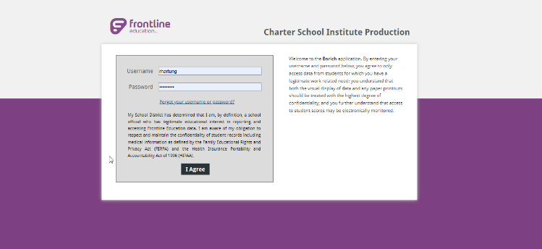
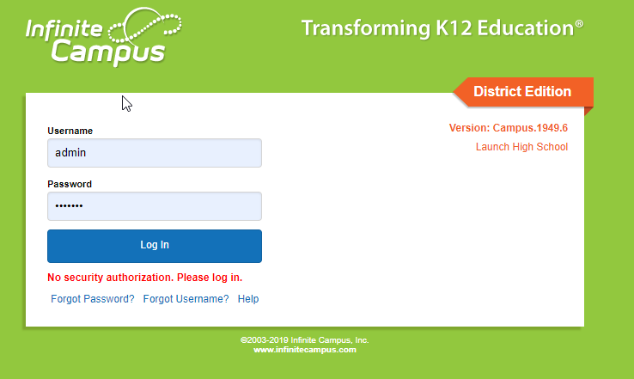
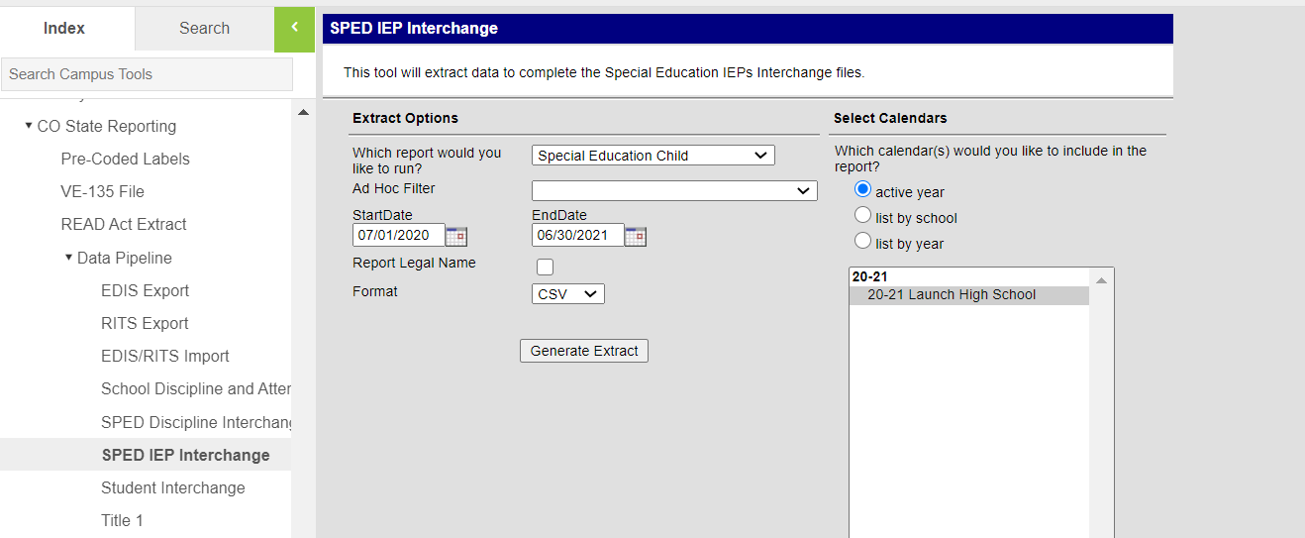
Step 5: IEP Updates
Once issues are reviewed and identified, navigate back to your PMS and make any necessary updates and corrections to the students record. As all highlighted issues have been updated, new files can be extracted from your system. Repeat process, if necessary, to ensure that all issues have been resolved
Notes:
Once you fully understand all issues that are being highlighted in the SPED Record Checker, you want to navigate back to your schools plan management system and log in. With both the file checks template and the system open, the next step would be to search for impacted students and make the appropriate corrections. Be sure not to miss any as they most likely will flag for errors upon initial submittal, but keep in mind this process can be completed on newly extracted files once changes have been made to ensure all issues have been resolved. Once you are confident in your corrections, extract the files that you are ready to submit to CSI!

Slide 16
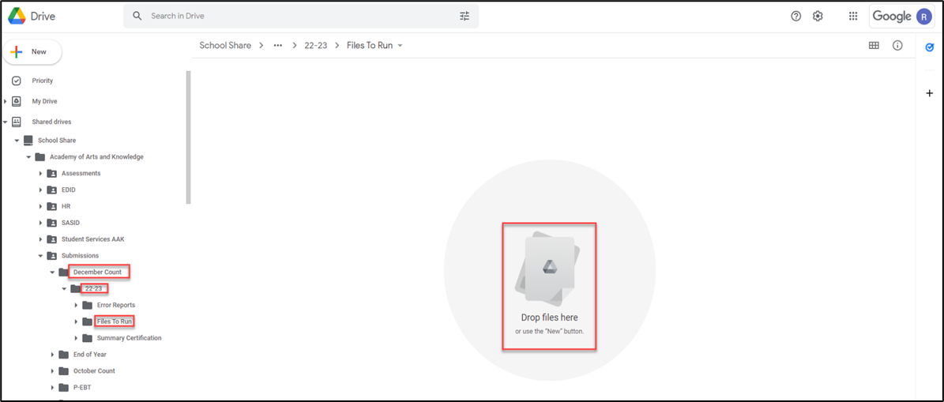
Step 6: Submit Initial Files to CSI
After newly extracted files have been reviewed and correctly named, submit your initial files to Google Drive and email the Submissions Inbox (Submissions_CSI@csi.state.co.us) CSI will process the files and provide you initial error reports. The goal of this process will be less errors upon initial submittal leading to less submittals to error clearance saving both the school and CSI time in the process!
Correct Naming of Files
Examples:
  SCHOOLCODE_SCHOOLABBREV_Child_Date
  SCHOOLCODE_SCHOOLABBREV_Participation_Date
Files should not contain any spaces in order to upload to CDE
Ensure you are uploading them to the correct folder in Google Drive:
  G-Drive>December Count>23-24>Files to Run
Notes:
Once the newly extracted files have been saved to your computer and renamed to include school code, school abbreviation, file name, and date – you want to add those into Google Drive. Most of you may be familiar with this process, but in case you need a refresher, the above screenshot should help. You’ll want to navigate to where the files are saved on your computer and drag them directly into the Files to Run folder for the collection on Google Drive. Once successfully transferred, email the submissions inbox at the email address in this slide to notify us they are available to process.
Again, this process may take a little extra time on the front end but will lead to less file submittals to error clearance saving time in the long run. All schools will be expected to complete this process for future collections prior to submitting initial files, so please plan accordingly.

Slide 17

Thank you for Reviewing this Module
Contact the Submissions Inbox with Questions:
    Submissions_CSI@csi.state.co.us
Notes:
Thanks so much for reviewing this module and completing the SPED Record Checker prior to initial submittal. If you have any questions or issues with the steps outlined in this training, please reach out to the submissions inbox and we’ll be more than happy to help!

