Slide 1
SPED End of Year Training
Participation File Coding Scenarios
Recorded February 2025
Notes:
Hello All,
Thanks so much for reviewing this training for the Special Education End of Year Collection! This short webinar focuses on some different common scenarios that you may encounter with students related to Special Education and how best to code each field in those scenarios. The participation file contains many fields and can be confusing, so the goal is to hopefully clarify some of the situations. Feel free to reach out to CSI if you have questions on any aspects of this webinar!

Slide 2
Agenda
Participation Coding Scenarios
6 scenarios and how best to code them
Resources for Coding Students
Participation File Coding Scenarios Document
File Layouts
Timelines and Deadlines
Training reflects data from the 24-25 school year, but the scenarios are relevant and can be used for any school year
2
Notes:
Here is a quick overview of the topics that we will be discussing today. First, we will look at six different common scenarios that you may encounter with students and how best to code the participation file. We’ll then jump into some resources that will be helpful when completing the correct coding of IEPs in your plan management system related to the participation file extract. Keep in mind that the dates and scenarios used in this training are for the 24-25 school year, but could be used for any year with just minor date adjustments.

Slide 3
SPED EOY Scenarios
Notes:
Next, lets take a look at those common scenarios and how to code them!

Slide 4
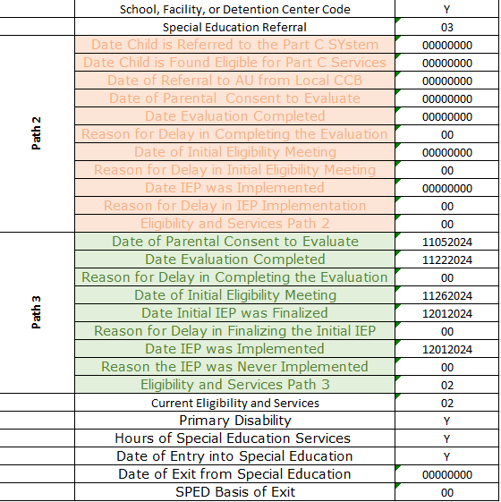
Scenario 1
Path 3 Jenny, age 11, was referred for a Part B initial evaluation. Parental consent was received on 11/5/2024 and the Evaluation was completed on 11/22/2024. Jenny was determined to be eligible on 11/26/2024 with the IEP being fully implemented on 12/1/2024 and she began receiving services immediately.
Notes:
The first scenario for Path 3 student. We have Jenny, age 11 who was referred for a Part B initial evaluation. The parental consent was received on November 5th 2024 with an evaluation completed on November 22nd. Jenny was determined be eligible on November 26th, with the IEP finalized and implemented on December 1st 2024. This table here shows a very common scenario and how to code this student. Since this is a newly tested student, her Special Education Referral field is coded as 03. With the student being eligible, the Eligibility and Services field is 02 for eligible. Jenny also has a valid primary disability, Hours of Special Education Services and a Date of Entry. As you can also see all appliable dates are added in path 3. You will see this scenario for many of the students that you test, so be sure to code them accurately!

Slide 5
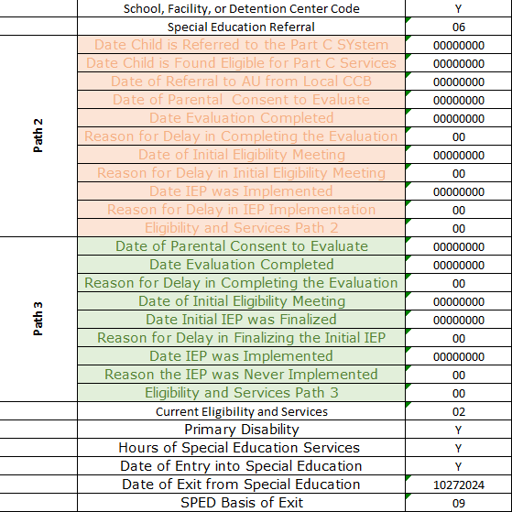
Scenario 2
No Path (continuer who exited) Tayler was receiving special education services. On 10/27/2024 the IEP team had an eligibility review meeting and determined that Tayler no longer qualified for special education. (Primary Disability and Hours of Special Education Services are required because Tayler received services during the reporting period. Use the disability and hours on the IEP that was in effect prior to Tayler being staffed out.)
Notes:
So in Scenario 2, we have continuer who exited, therefore has no path. So, this particular student -Tayler was receiving special education services. On October 27 2024, the IEP had an eligibility review meeting and they determined that Tayler was no longer qualified for Special Ed. The primary disability and hours of Special Education services are required because Tayler received services during the reporting period. You must report the disability and hours on the IEP that was in effect prior to Taylor being staffed out. Since she was a returning student, you will have a Special Education Referral as 06 with most other fields being zero filled with the exception of the date of exit and basis of exit, which is an 09 – exiting to regular education.

Slide 6
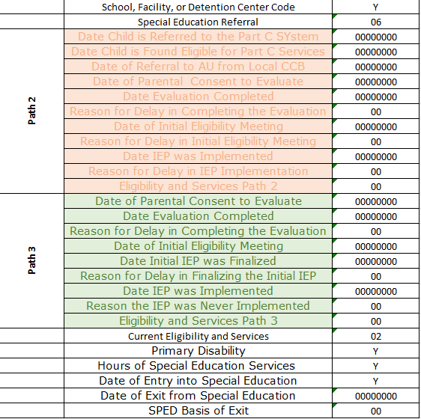
Scenario 3
Path 3 Collin, age 7, transferred into your school mid-year with an existing IEP from a previous school. A meeting was held and determined that Collin would continue working with existing IEP. Collin began receiving services immediately.
Notes:
In the next scenario we are looking at another Path 3 student. We have Collin, Age 7 who transferred to your school mid-year with an existing IEP. A meeting was held and it was determined that Collin would continue with his existing IEP and began services immediately. Since this student came into your school with an existing IEP, his Special Education referral field is 06 and considered a continuer. The state reporting coding for this student would be similar to any student continuing from a previous year on a valid IEP with all path dates zero filled and a current eligibility of 02 for eligible. He would also need to have a valid disability, hours of SPED services and a date of entry.

Slide 7
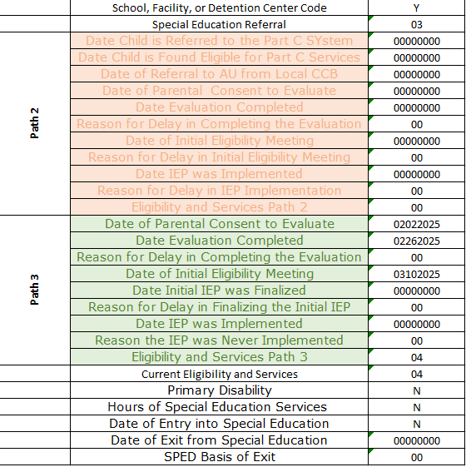
Scenario 4
No Path Avery, age 9, was referred for a Part B evaluation. Parental consent to evaluate was received on 2/2/2025 and the evaluation was completed on 2/26/2025. Avery was determined to not be eligible on 3/10/2025. (The process is stopped because the student was not found to be eligible.)
Notes:
Next, we have Avery, age 9 who was referred for a Part B evaluation. The parental consent was received on February 2 2025 with an evaluation completed on February 26th. Avery was determined not to be eligible on March 10th 2025, therefore the process was stopped. The table on the right reflect how to accurately code a student that falls within this type of scenario. You’ll notice that almost all fields are zero filled with the exception of the Dates of Parental Consent, Evaluation Complete, and Initial IEP meeting. Also both Eligibility and Services fields are coded with an 04 – Not Eligible. This scenario is relatively common and the coding here shows how best to code those students who were tested, but not eligible.

Slide 8
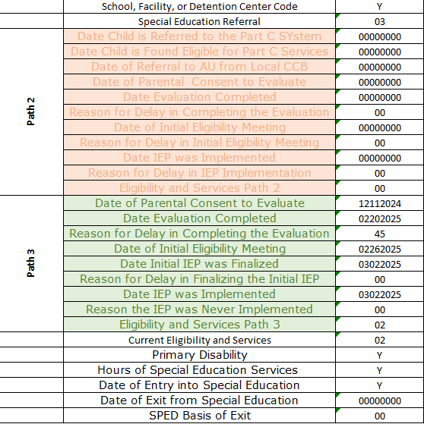
Scenario 5
Path 3 Grant, age 12, was referred for an initial evaluation and received parental consent on 12/11/2024. The evaluation process was started, but family left the country for an extended period of time delaying the completion of the evaluation until 2/20/2025. Grant was determined to be eligible on 2/26/2025 and began receiving services on 3/2/2025. (Reason for evaluation delay required as the time between parental consent and evaluation complete was more than 60 days)
Notes:
The next scenario we have for you today will be looking at a Path 3 student named Grant – age 12. He was referred for an initial evaluation and the school received parental consent on December 12th, 2024. The evaluation process started, but was delayed as the family ended up leaving for an extended period of time over the holidays, so was not completed until February 20th 2025. Grant ended up being determined eligible on February 26th and began receiving services on March 2nd 2025. The coding is very similar to any traditional new student found eligible, but the big take home point was that the Evaluation was not completed within the required 45 days from the signed Parental Consent. Due to this a Reason for Delay in Completing Evaluation is required. In this case, we used the best valid option available within the new delay coding options, which is 45 – Parent repeatedly failed or refused to produce child, give consent, respond to meeting requests, attend scheduled meetings. Includes delays due to illness and requested meeting delays from parent. This appears to be the best delay coding given the circumstance. All other fields align with any other newly tested student who was determined eligible as in Jenny’s case in scenario 1.

Slide 9
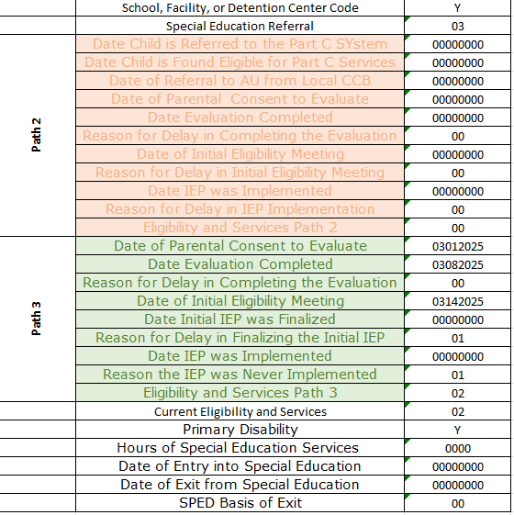
Scenario 6
Path 3 Melanie, age 10, was referred for an initial evaluation and received parental consent on 03/01/2025. The parental consent was received, and the evaluation was completed in early March 2025. The student was determined eligible with a meeting scheduled the following week. However, the parents decided to refuse Special Education services.
Notes:
In this last scenario we look at a student name Melanie who went in for an evaluation on March 1st. The parental consent was received, and the evaluation took place on March 8th. It was determined that she was eligible for SPED Services. In the end, the parents ended up refusing these services. This is a great example of how to code a student where the parents have refused services. You’ll notice that she is marked 02 as eligible in the eligibility and services field but the Date of Entry is zero filled. Also, you will see that the dates of parental consent, evaluation complete, and eligibility meeting have been input, but the IEP finalized and implemented are zero-filled. The 01 in the delay on finalizing the IEP pertains to parental refusal. This would be a great reference if you encounter this type of situation.

Slide 10
Student Coding Resources
Notes:
As you know, the coding a student correctly for State Reporting can be a confusing process. The next few slides outline a couple of resources you may find helpful when completing this.

Slide 11
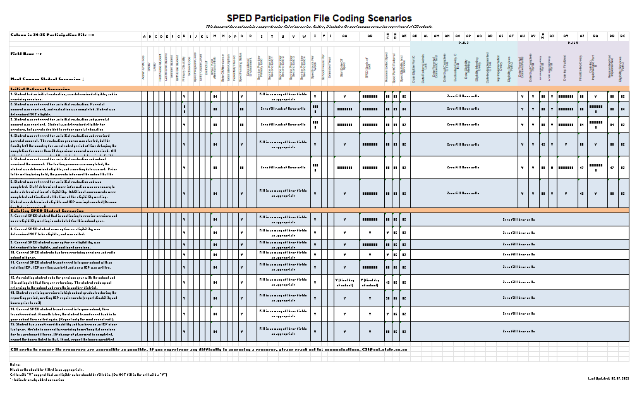
Participation File Coding Scenarios
https://resources.csi.state.co.us/wp-content/uploads/2025/02/24-25-SPEDEOYParticipationFileCodingScenarios_Final.xlsx
Notes:
The first helpful resource I want to discuss is the CSI Participation File Coding Scenarios Document. Essentially, this resource is split up between Initial Referrals and Existing Students and how best to code them. The document provides many of the common scenarios outlined in this training and includes several more that you may encounter when completing data entry and provides the correct coding on the participation file. Due to the number of fields on the file and the complexity of entering this information, this resource can certainly be a huge time saver. Make sure you are paying special attention to the SPED Referral Field in Column AD. As the previous scenarios we discussed show, this is the primary designator between New and Returning students with an 03 being New and an 06 being returning. As you can see in this document, if 03 is utilized, then all applicable dates must be completed for Path 3. There are many unique situations and scenarios that come up for students in special education, so the Participation File Coding Resource can be extremely helpful in knowing how best to code each.

Slide 12
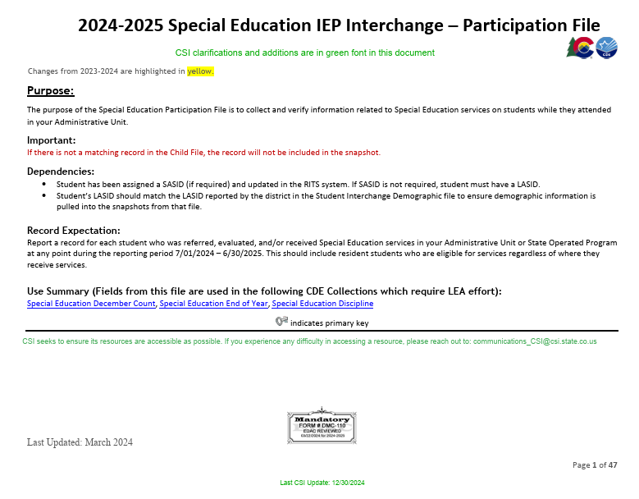
File Layout and Definition Documents – CSI Additions
https://resources.csi.state.co.us/wp-content/uploads/2025/02/2024-2025-SPED-Child-File-Layout_CSIAdditions.pdf
https://resources.csi.state.co.us/wp-content/uploads/2025/02/2024-2025-SPED-Participation-File-Layout_CSIAdditions.pdf
Notes:
Another great resource to utilize while completing data entry of students into your Plan Management System is the Child and Participation File Layouts and Definitions Documents. Essentially, these documents go through each individual field that is being collected for the file and provides definitions and appropriate coding options for each. We have also added several CSI specific notes in green that help clarify coding specific to the schools we serve. With the number of fields being collected for SPED End of Year, having a resource such as this to clarify what is needed for each field can prove to be invaluable.

Slide 13
Thank you for Reviewing this Training
Contact the Submissions Inbox with Questions:
Submissions_CSI@csi.state.co.us
Notes:
Thanks again for reviewing this coding scenarios module for the Special Education End of Year collection. If you have questions or concerns, don’t hesitate to contact the submissions inbox and a member of the submission team will be more than happy to assist! Have a great day!

