Slide 1
Entry, Exit, and Retention Coding and Dates
General Collection Training
Recorded February 2025
Notes:
Welcome to the Entry/Exit/Retention Coding Training for General Collections.
This training, recorded by the CSI data team, provides an overview of the appropriate use of Entry, Exit, and Retention codes.

Slide 2
Entry/Exit/Retention Codes & Dates
Entry, exit, & retention codes are data fields collected through the Student School Association (SSA) file.
Entry codes and dates show how and when the student enters a school
Exit codes and dates show how and when they have left a school.
Retention codes and dates show the student’s retention or promotion status for the upcoming school year. (12th Graders)
Grade Reassignments show a student’s retention or promotion status throughout the school year. (PreK – 11th Graders)
These codes collectively can be used to document a student’s educational movement throughout a school year.
Entry Date | Entry Type
08222024 | 02
Exit Date | Exit Type
03052025 | 11
2
Notes:
Entry, exit, and retention codes are all data fields collected in the October Count and Student End of Year collection through the Student School Association (or SSA) file.
Entry codes show when and how a student enters a school and district.
Exit codes show when and how a student left a school or district.
Retention codes show the student’s retention status for the upcoming school year for 12th Grade students that did not graduate.
Grade Reassignments show a student’s retention or promotion status throughout the school year.
Entry, exit, and retention coding is used to document a student’s educational movement throughout the school year.
The purpose of the Entry, Exit, and Retention Codes and Dates is to capture where a student came from before entering a school or district and where they go after leaving a school or district.

Slide 3
The Importance: How Data is Used
By CDE
Graduation & Completion Rates
Dropout Rates
Mobility / Stability Rates
By CSI
CSI Annual Review of Schools (CARS)
Other Analysis & Interim Assessments
3
Notes:
The Entry/Exit/Retention fields become very important in the October Count and End of Year collection as they show the history of a student's educational progress throughout the school year.
Accuracy of this data is important. CDE compiles this information and uses it to generate statewide graduation rates, completion and dropout rates, mobility rates, and school funding. These rates are largely compiled from the data in the Exit fields.
CSI also generates reports using this data for the CSI Annual Review of Schools (CARS), as well as provides schools with analytics, and more.
The following CDE links are provided to show how CDE interprets school Entry/Exit and Retention data and how the data is used and calculated by the state.
The following CSI links show how CSI uses this school data for a variety of purposes, including to determine state performance ratings and accreditation ratings.
Given the high-stakes nature of data from the End of Year and October Count, ensuring coding accuracy is a top priority.

Slide 4
Coding Resources
4

Slide 5
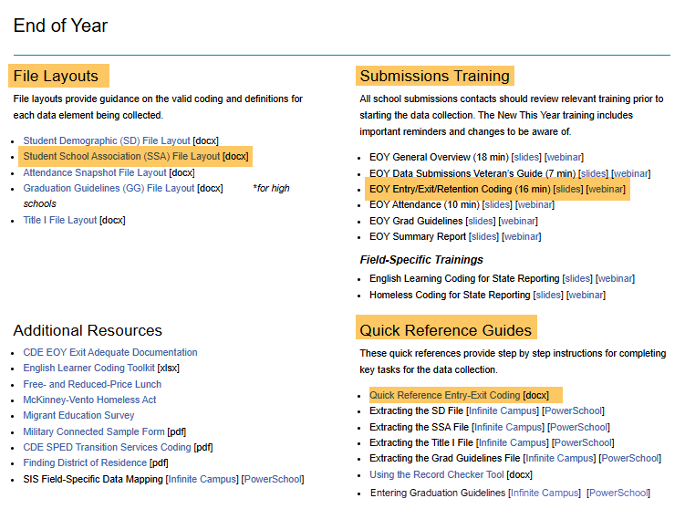
Entry/Exit Field Resources
https://resources.csi.state.co.us/data-submissions/eoy/
5
Notes:
The Data Submission EOY Website houses resources available to help with entry and exit coding as well as resolving errors associated with them. There are resources available that will help specifically with Entry/Exit/Retention fields, which we’ll discuss on the following slides.

Slide 6
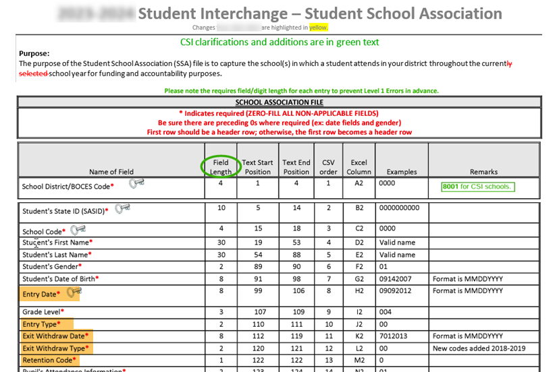
SSA File Layout
https://resources.csi.state.co.us/data-submissions/eoy/
6
Notes:
The File Layout is a highly recommended resource as it contains all the codes, definitions and descriptions to ensure appropriate usage.
The five fields that will be captured for Entry/exit/retention are: Entry Date, Entry Type, Exit Withdraw Date, Exit Withdraw Type, and Retention Code.
All of these code options can be found on the SSA File Layout.
Access to this file can be found visiting the CSI website EOY resource page.

Slide 7
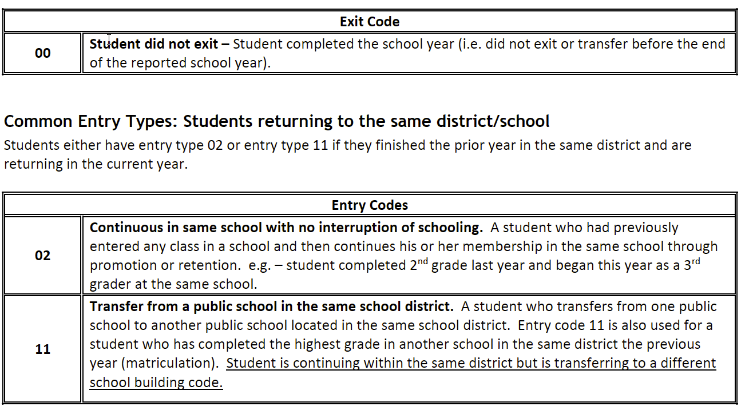
File Layout Codes Description
https://resources.csi.state.co.us/data-submissions/eoy/
7
Notes:
In addition, the Entry/Exit Code Description from the SSA File Layout great detailed resource. The resources can help with code descriptions and errors.

Slide 8
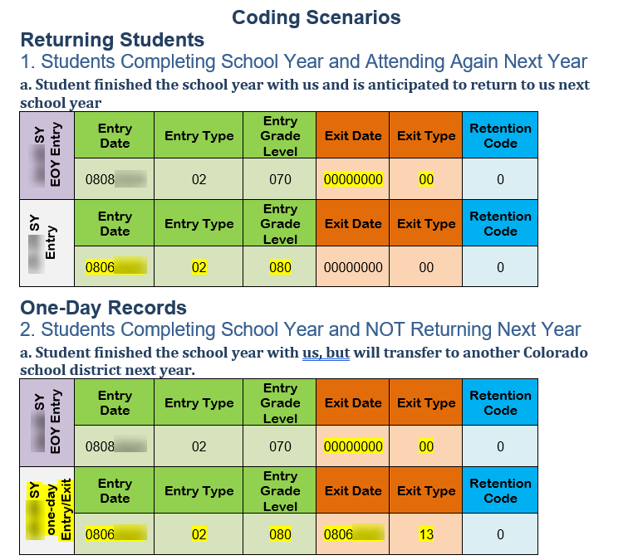
Entry/Exit Quick Reference Guide
https://resources.csi.state.co.us/data-submissions/eoy/
8
Notes:
Another resource that will be helpful is the Entry/Exit Fields Quick Reference Guide. This guide includes information and examples of coding and dating students in specific scenarios. Access to this file can be found by clicking on the link in the slide or by visiting the CSI website, resource page.

Slide 9
Exit Code and Date Guidance

Slide 10
Students Completing the School Year
Exit Type ‘00’ and Exit Date ‘0000000’ should be used for every student who completes the school year at your school, regardless of their anticipated enrollment status at the beginning of next year.
Why?
End Of Year (EOY) and SPED EOY is collecting information about what happened this school year.
10
Notes:
The first scenario we’ll walk through is for ALL students completing the school year at your school.
Exit Type ‘ZERO FILLED’ and Exit Date ‘ZERO FILLED’ should be used for every student who completes the school year at your school, regardless of their anticipated enrollment status at the beginning of next year.
This is because the EOY and SPED EOY collection is collecting information about what happened this school year.
It is NOT collecting information about what is going to happen next year.

Slide 11
What is “Zero Filled”
Zero filled refers to the data that is extracted from a school’s SIS when the report shows the field as 0.
This is important to note because most SIS users will not actually add zeros to these fields within your SIS.
11
Notes:
The reference Zero filled refers to the data that is extracted from a school’s SIS to report a field as 0.
This is important to note because most SIS users will not actually add zeros to these fields within your SIS. The next two slides will demonstrate what schools must do within PowerSchool and Infinite Campus to generate a ZERO Filled exit date and exit type to properly extract for state reporting.

Slide 12
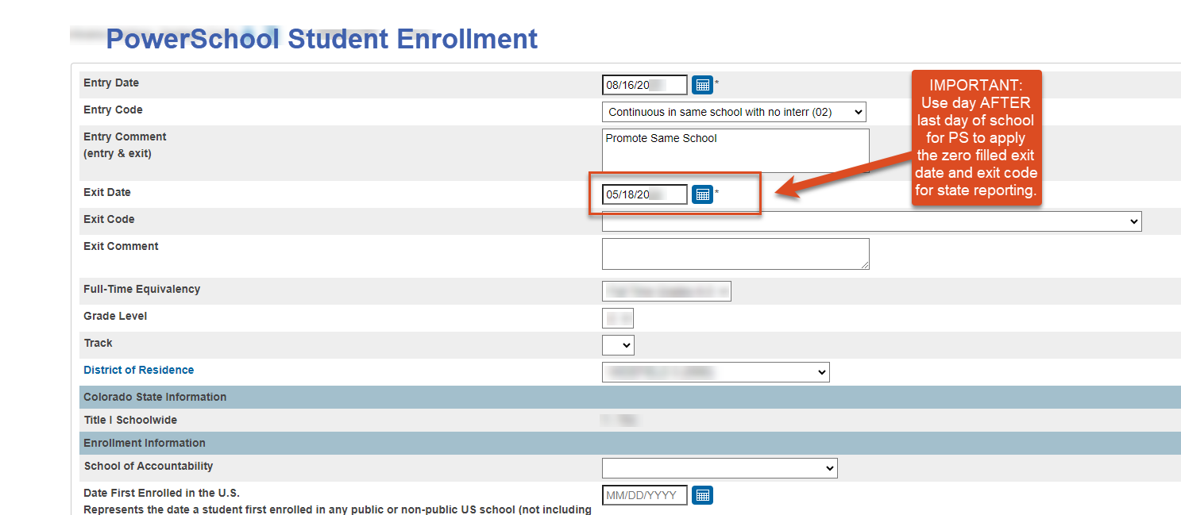
PS Data Entry
IMPORTANT for PS Users: For students that completed the school year with you, in student enrollments, use the default exit day of the DAY AFTER your last day of school. This will create a zero filled exit date and exit code in state reporting.
12
Notes:
For PowerSchool users: As mentioned, because PowerSchool requires an exit date entered for all student enrollment records and state reporting requires a zero filled exit date for all students that complete the year with you, PowerSchool has created a work around. Please use the date of the DAY AFTER your last day of school for all students that complete the year with your which PS will automatically as zero fill student exit dates on state reports to match CDE standards. The exit type will remain unfilled or blank.
As seen in the example above, If your last day of school is May 17th, then the exit date used for students will be May 18th. Once an SSA file is extracted, the current students will have a zero filled exit date and exit type on the state report showing all zeros.
However, If a student exits your school prior to the last 3 weeks of school, you will an exit date to show the students last day that they attended your school.

Slide 13
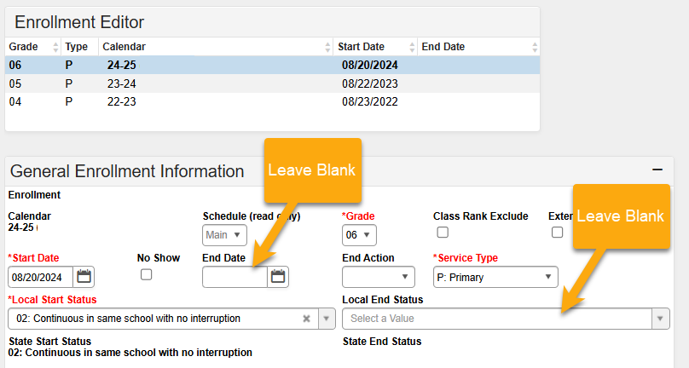
IC Data Entry
IMPORTANT for IC Users: In student enrollments, for students that completed the school year with you, leave the exit day and exit code blank. This will create a zero filled exit date and exit code in state reporting.
13
Notes:
For Infinite Campus users: For all students that complete the year with you, please leave the exit date and exit type unfilled or BLANK. This will create the ZERO FILLED exit date and exit type in state reporting to match CDE standards. If a student exits prior to the last 3 weeks of school, you will an exit date to show the students last day they attended at your school.

Slide 14
Zero-Fill Exit Codes/Dates for…
Students who you know are moving out of state or country over the summer and will not be returning.
Students who are transferring to a local school.
Students who are transitioning to home school.
Students who are skipping or repeating a grade.
Students who have withdrawn or transferred out in the last 3 weeks of the current school year and have completed all coursework early.
Students who have passed the highest grade in your school – except for students graduating high school.
Exit Date | Exit Type
00000000 | 00
Notes:
To reiterate, you should have a ZERO FILLED exit type and exit date for all students who complete the school year at your school, regardless of their anticipated enrollment next year.
This means that the following scenarios would include a zero-filled exit code and zero-filled exit date:
Students who you know are moving out of state or country over the summer and will not be returning.
Students who are transferring to a local school.
Students who are transitioning to home school.
Students who are skipping or repeating a grade.
Students who have withdrawn or transferred out in the last 3 weeks of the current school year or have completed all coursework early.
Students who have passed the highest grade in your school – The only exception to zero filling this data is for students graduating high school. We will talk about this scenario later in this training.
Failure to follow this guidance may lead to students showing up as dropouts for your school and impacting your performance used in state and CSI accountability.

Slide 15
New School Year Roll-Over
In 2024-2025 Calendar
End code and date all students regardless of anticipated withdrawal
Exit Type: 00, Exit Date: 00000000
In 2025-2026 Calendar
SIS rolls-over to NEW school year.
One Day Entry/Exit record in NEW School Year.
Use the next natural grade progression.
Example:
Entry Date | Entry Type
08112025 | 02
Exit Date | Exit Type
08112025 | 13
MAXED-OUT Grade Level
CSI will help create manual one-day records with the student’s next grade level to fix any errors that are generated.
15
Notes:
Student “Roll-Over” typically occurs for schools around June or July. It is critical that school are error free in their attendance, TSDL, and EOY collections PRIOR to rolling students over into the next school year. Please reach out to CSI before rollover to confirm that your school is ready.
For the End of Year collection, you will ensure that all students that are completing the school year with you have the “zero filled” exit date and code regardless of their plan for retuning or not returning the next school year.
Once your school is error free in all CSI collections in July and your school rolls the students over into the next year, In the new calendar year, for all students that will not return because students are transferring toother schools, moving out of state or country, and student moving to homeschool you will create a one-day Entry/Exit record.
To create the one-day entry/exit record, in the new year calendar, the Entry Date can be the first day of school, with an Entry Type of 02. You will then give the Exit Date as the same date, with the appropriate Exit Type, depending on if the student has transferred to home school, an out-of-state school, a local school, or another CSI school. The grade will be the next natural grade progression for the student. Remember that all Exit Type codes are listed in the SSA File Layout.
This one-day Entry/Exit record will show up on the End of Year collection the FOLLOWING SCHOOL YEAR. You will not mark these students as exclude from state reporting.
For students who have reached the highest grade at your school, CSI will help generate a one-day record for your school to fix any errors that might be generated.

Slide 16
Coding Graduates
For high school graduates:
Exit Type: 90 or Similar
Exit Date: Graduation Date
NOTE: To avoid collection errors, this process should be done on grad day or after, keeping the students ZERO filled until graduation is official.
For elementary / middle school students completing the highest grade offered at your school:
Exit Type: 00
Exit Date: 00000000
Exit Date | Exit Type
05182025 | 90
Exit Date | Exit Type
00000000 | 00
16
Notes:
The next scenario on this slide addresses coding for students who have graduated your school.
All students who will be graduating High School should have an Exit Date of graduation day and an Exit Type code of 90 or similar graduation code. Please note: To avoid EOY collection errors, the data entry for these fields should occur on or after graduation day and should remain zero filled until then. This also minimizes accidental coding for students that did not graduate.
All elementary or middle school students ‘graduating’ from the highest grade offered at your school should have 0-filled Exit fields.

Slide 17
Coding for High School Students Taking Summer School to Graduate
Student Passed Summer School & Graduated
Exit Type: 90
Exit Date: Graduation Date with Cohort
Student Did Not Pass Summer School & Did Not Graduate
Exit Type: 00
Exit Date: 00000000
Retention: 01
Exit Date | Exit Type
05182025 | 90
Exit Date | Exit Type | Retention
00000000 | 00 | 01
17
Notes:
The next scenario addresses coding for high school students taking summer school courses in order to graduate.
For high school students attending summer school in order to meet graduation requirements, schools are encouraged to code the student as a returning, retention student UNTIL the student passed the course and graduation requirements. This process will help avoid accidental graduation codes for a students that do not graduate. It is much easier and less impactful for schools to fix accidental retention data, then it is to fix accidental graduate data.
While students are attending summer school or for students that do not pass Summer School, you will use a zero filled exit date, zero filled exit type, and retention code of 1. We will discuss more about retention codes later in this training.
Once the summer semester has ended and the final graduation status is known, you can update your EOY data. For students that pass summer school and graduate, the student should receive the graduation exit date used for their cohort and a graduation exit code.

Slide 18
Additional Notes Regarding Exit Coding

Slide 19
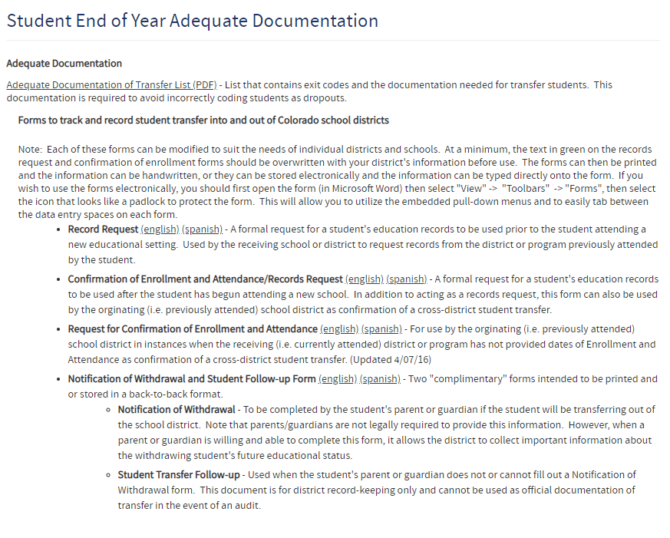
Adequate Documentation for Transfer Students
Adequate Documentation of Transfer List
Reduce dropout rates.
Improve graduation and completion rates.
What happens to a student when they leave your school.
19
Notes:
It is critical to collect adequate documents and maintain documentation regarding a students transfer. Having this documentation on hand will help to quickly clear up any issues that may arise during CDE validations in the fall and can help you complete the collection correctly and in a timely manner. It can also help to ensure accuracy of your graduate, dropout, and completion rates.
‘Adequate Documentation’ is recognized by CDE as forms, or other documentation, that track and record student transfers into and out of Colorado school districts. The Adequate Documentation of Transfers List’, compiled by CDE, lists the types of documentation that are required for different types of transfers. The most commonly used document is the Confirmation of Enrollment and Attendance. To access this list, you can use the link in this slide or visit the CSI website resource page.

Slide 20
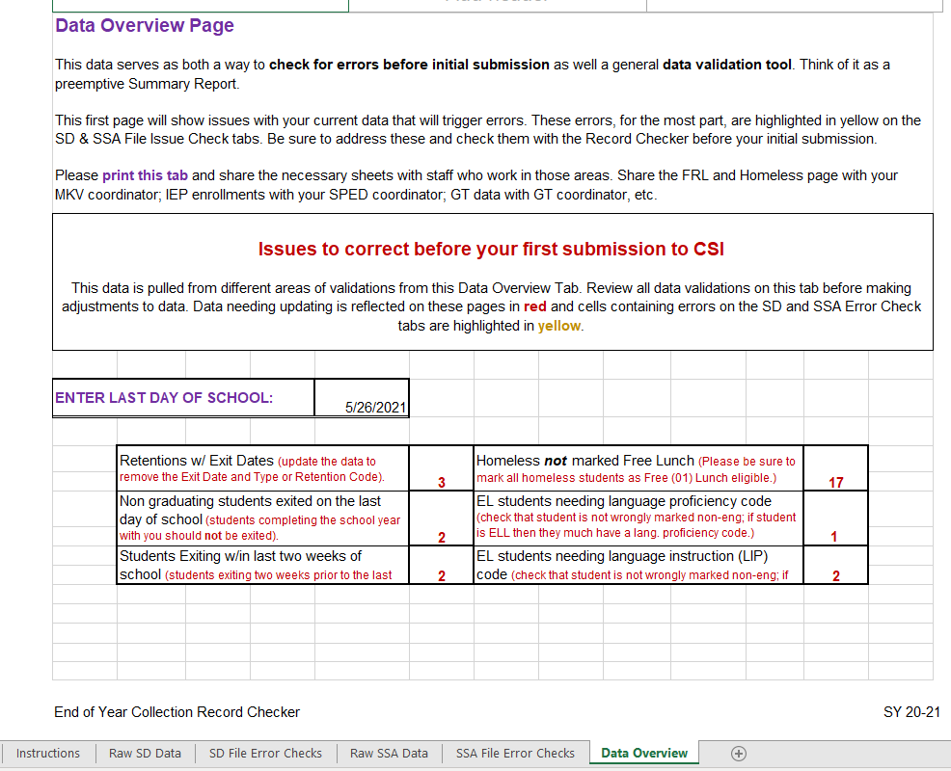
Exit Checks on Record Checker Tool
20
Notes:
To help schools check for the types of Exits that could result in CDE accidently identifying the student as a drop out, we have included Exit Code validations for these students on the Data Overview tab of the Record Checker.
These two data points show you how many non-graduating students are being exited on the last day of school and how many students were exited within the last 3 weeks of school.
To properly calculate this data you will need to enter the date of your last day of school in the section provided.
Please review the Record Checker Training for more information on this topic.

Slide 21
Retention Coding
Notes:
Our final section will address retention coding.

Slide 22
When to Use Retention Coding
12th grade Student repeating a grade in the upcoming school year
12th grader participating in an approved postsecondary program in the upcoming year
12th grade with an IEP being retained for transition services
Notes:
For students that will be retained in the next school year, CSI recommends that schools use the “retention Code” in your SIS for 12th grade retentions only. Since the retention codes shows the student’s retention or promotion status for the upcoming school year,
the retention code must be created the year PRIOR to the retention year to generate on the EOY records. A retention code on the EOY records states that the student will be retained the FOLLOWING school year.

Slide 23
When to Use Grade Reassignment (One-Day Record)
PreK – 11th grade student repeating a grade in the upcoming
PreK – 11th grade student repeating a grade in the current year
Student is skipping a grade in the upcoming school year
Notes:
Since the retention codes can be accidentally misused during the wrong school year for state reporting, students grades PreK – 11th grade that are retained or will be retained, should receive a grade reassignment is instead of a retention code. A grade reassignment is also used for students that advance a grade.

Slide 24
12th Grade - Retention
12th grade students repeating the 12th grade the following year receive ZERO filled entry and exit type and retention code 1 in the current year.
24-25 SY EOY Entry | Entry Date | Entry Type | Entry Grade Level | Exit Date | Exit Type | Retention Code
 | 08082024 | 02 | 120 | 00000000 | 00 | 1
25-26 SY | Entry Date | Entry Type | Entry Grade Level | Exit Date | Exit Type | Retention Code
 | 08062025 | 02 | 120 | 00000000 | 00 | 0
24
Notes:
12th grade students who do not meet graduation requirements and will be returning the following year will need a ZERO fill the exit date and exit type and retention code 1.

Slide 25
PreK – 11th Grade - Repeating a Grade Next School Year
Should be zero filled at the end of the current school year
Once SIS rolls over to the next school year, students who are repeating a grade should receive a one-day record with the Entry Type 2, Exit Type 10 (reassigned a grade) with the natural grade progression. These students will NOT receive a retention code.
Students will receive a new enrollment record with the reassigned grade and Entry Type 10
EOY Entry 24-25 SY
24-25 SY EOY Entry | Entry Date | Entry Type | Entry Grade Level | Exit Date | Exit Type | Retention Code
 | 08082024 | 02 | 030 | 00000000 | 00 | 0
After SIS rolled over to 25-26 SY
25-26 SY one-day Entry/Exit | Entry Date | Entry Type | Entry Grade Level | Exit Date | Exit Type | Retention Code
 | 08062025 | 02 | 040 | 08062025 | 10 | 0
25-26 SY 2nd Entry | Entry Date | Entry Type | Entry Grade Level | Exit Date | Exit Type | Retention Code
 | 08072025 | 10 | 050 | 00000000 | 00 | 0
25
Notes:
PreK – 11th grade Students who are repeating a grade will include a ZERO filled exit date and exit type at the end of the current school year.
Once your SIS is rolled over for the next school year, students who are repeating a grade should receive a One-Day record to include the natural grade progression, Entry type 02, and Exit Type 10 for grade reassignment.
A new enrollment record will then be created to include the reassigned grade, and Entry type 10.

Slide 26
Skipping a Grade Level
Students who are skipping a grade should be ZERO filled on the EOY Entry
Once SIS rolls over to the next school year, these students will receive a One-Day Entry/Exit with the grade they are skipping and Exit Type 10
These students should then receive a new enrollment records indicating the new grade level and Entry Type 10
EOY Entry 24-25 SY
24-25 SY EOY Entry | Entry Date | Entry Type | Entry Grade Level | Exit Date | Exit Type | Retention Code
 | 08082024 | 02 | 030 | 00000000 | 00 | 0
After SIS rolled over to 25-26 SY
25-26 SY one-day Entry/Exit | Entry Date | Entry Type | Entry Grade Level | Exit Date | Exit Type | Retention Code
 | 08062025 | 02 | 040 | 08062025 | 10 | 0
25-26 SY 2nd Entry | Entry Date | Entry Type | Entry Grade Level | Exit Date | Exit Type | Retention Code
 | 08072025 | 10 | 050 | 00000000 | 00 | 0
26
Notes:
For a student who will skip a grade, the student’s record should show them as completing the grade they are currently in with a zero-filled exit date and exit type.
Once you have rolled your SIS over into the new school year, you will create a one-day Entry/Exit record for the student, exiting them from the natural grade progression with Exit Type code 10 .
You will then create a new enrollment record with the grade the student is being reassigned to, and an Entry Type of 10.

Slide 27
Other Retention
For other retention examples including 12th Grade retention for 12th students returning for PTECH, ASCENT, TREP or SPED services,
Students taking Summer School to avoid a retention,
And other entry/exit coding,
View the Quick Reference Guide for Entry & Exit Coding.
Quick Reference Guide for Entry & Exit Coding
https://resources.csi.state.co.us/data-submissions/eoy/
27
Notes:
For other retention examples including 12th Grade retention for 12th students returning for PTECH, ASCENT, TREP or SPED services, students taking Summer School to avoid a retention, and other entry/exit coding, View the Quick Reference Guide for Entry & Exit Coding guide found on the CSI EOY Resource Webpage.

Slide 28
Thank you
Send questions to: submissions_csi@csi.state.co.us
Notes:
If you have any questions, please email the Data Submissions Team. Thank you for reviewing this training.

