Slide 1
The Record Checker Tool
Recorded January 2025
Notes:
This training recorded by the CSI Data Team provides an overview on how schools can use the Record Checker Tool to review source data in their SIS prior to submitting files for state collections to CSI.

Slide 2
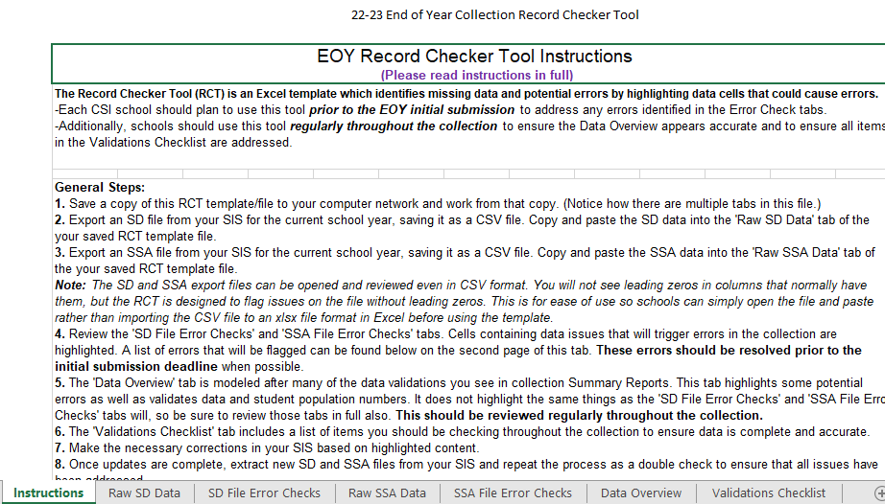
What is the Record Checker Tool?
Excel file with multiple tabs, content will vary somewhat by collection
Instructions tab included for all collections and should be the starting point
Schools should plan to use 1-2 weeks prior to initial file submission deadlines
Printable Calendar: https://resources.csi.state.co.us/data-submissions/calendar/
Online Calendar: www.csi.state.co.us/calendar/
2
Notes:
The Record Checker Tool (or RCT) is an Excel file available for several different state collections, including ones for the EOY, October Count, Human Resources, and SPED collections.
The intent of the tool is to help schools identify possible errors and inaccurate or missing data and correct those issues before submitting initial collection files to CSI.
Each version will have multiple tabs that will vary somewhat according to the collection it was designed for.
In addition, every version will have an Instructions tab that is the starting point for schools. Always review the instructions prior to getting started. Schools should plan to use this tool at least 1-2 weeks prior to the initial submission deadline for a collection. This gives adequate time to run the RCT, correct flagged data in your SIS, and continue the process (potentially multiple times) until the flags are cleared.
For submission deadline dates, please see the data submissions calendars available online.

Slide 3
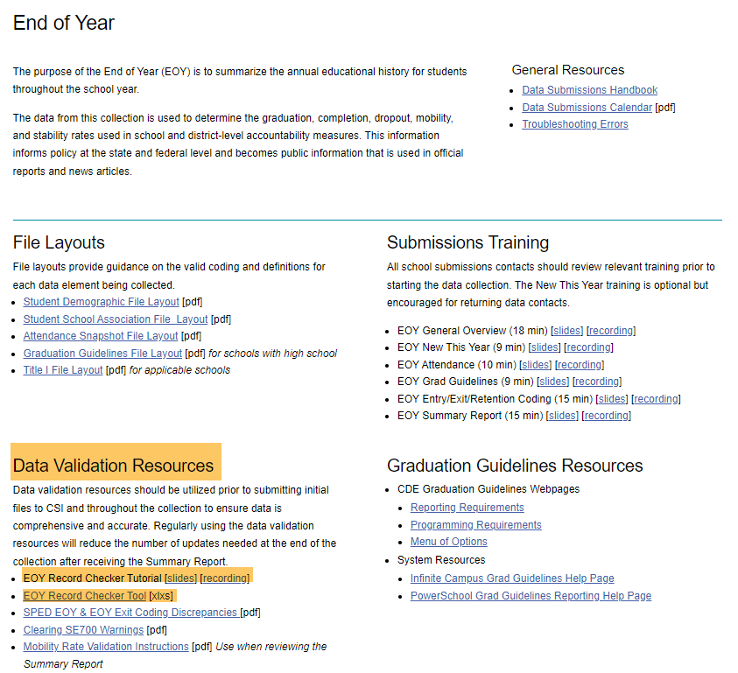
RCT Download
Download the RCT file from each CSI collection page
https://resources.csi.state.co.us/data-submissions/eoy/
3
Notes:
To begin using the RCT, simply go to the main collection webpage on the CSI website and look for links to the Record Checker Tool resources.
The example scenario shown in this slide is for the version available for the EOY collection.
The first screenshot in this slide shows the location of the EOY main webpage and the overlay screenshot is of the Data Validation Resources section located on the EOY page.
There will typically be two resources for the RCT and these will be a link to this tutorial training and then the tool file itself, which you will download a copy of.

Slide 4
Instructions Tab
Fully review the Instructions tab before getting started
4
Notes:
After downloading a copy of the RCT file to your computer, simply open it and make sure you are on the Instructions tab.
Please take the time to fully review all of the content here.
You will next follow the General Steps section in the Instructions tab.

Slide 5
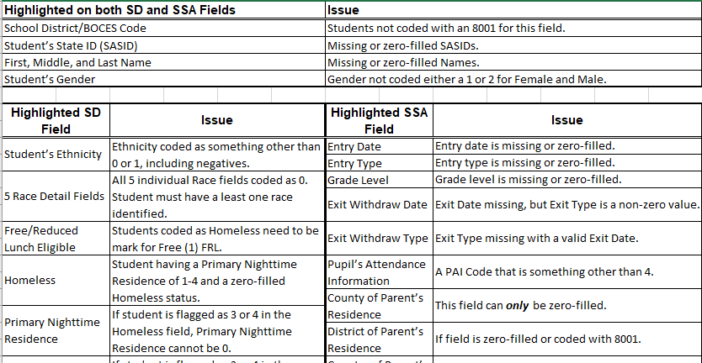
Instructions Tab Cont.
Multiple pages on Instructions tab are present—scroll down to see them
5
Notes:
Please be aware that there are multiple pages of information on the Instructions tab of the EOY RCT. So, be sure to scroll down the page to check for additional pages.

Slide 6
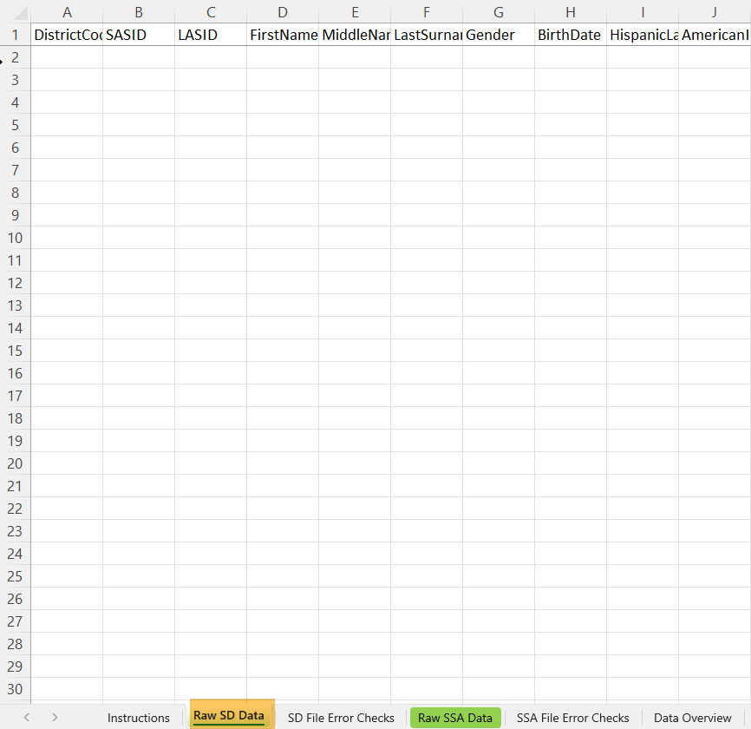
SD & SSA Raw Data Tabs
Extract SD and SSA files from your SIS. *Always include legal names & attendance dates when extracting these files.
Copy/Paste exported SD and SSA file data from your SIS into the respective “Raw SD Data” and “Raw SSA Data” tabs
6
Notes:
As explained in the Instructions tab, you will extract the SD and SSA files from your SIS. Be sure to include legal names and attendance dates when extracting. Though the RCT does not analyze these data areas, it is a good habit to always include these as they are needed for all SD and SSA data submissions to CSI. Next, copy then paste data from the SD then the SSA files you exported from your SIS into the respective “Raw SD Data” and “Raw SSA Data” tabs.

Slide 7
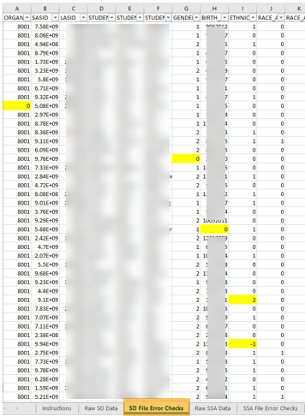
SD File Error Checks Tab
Highlighted cells indicate potential problem data
View the table of issues that the RCT checks, on the second page of the Instructions tab
7
Notes:
As soon as you have pasted the content of your SD data into the “SD Raw Data” tab, then look at the “SD File Error Checks” tab where you will see the data displayed with highlighted cells that the RCT automatically identifies as being problematic, triggering potential errors in your initial SD file.
The screenshot illustrates several cells that the RCT has identified as potential problem data which are highlighted in yellow.
View the table of issues located on the Instructions tab.

Slide 8
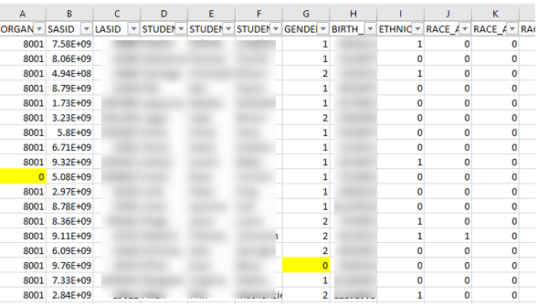
SD File Error Checks Tab Cont.
Highlighted records to correct in your SIS:
Organization (district code) value of 0 should be updated to 8001 in your SIS
Gender value 0 should be updated to a valid code in your SIS
Then a new extract placed in the RCT
SD File Layout - https://resources.csi.state.co.us/data-submissions/eoy/
8
Notes:
Let’s take a closer look and review the yellow highlighted cells. These cells determine what you might need to correct in your SIS for that student record.
In the slide example, column A has a record with a value of 0 for the organization or district code. You’ll need to check why the student is not flagged with the correct 8001 district code in your SIS.
The second record has a gender value of 0. You will need to correct the student record in your SIS by entering one of the valid gender codes.
Please remember, a great resource to correcting flags and errors on your SD and SSA files will be the File Layouts. These are located on the CSI EOY Resource webpage and can help navigate the correct format and value for missing or incorrect data.
After changes are made in your SIS, extract new files and repeat the RCT process.

Slide 9
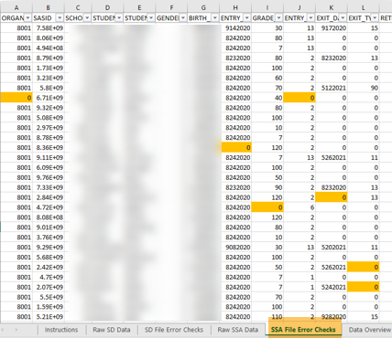
SSA File Error Checks Tab
The process works the same for the SSA File Error Checks tab
Highlighted cells indicate potential problem data
View the table of issues on the Instructions tab
SSA File Layout - https://resources.csi.state.co.us/data-submissions/eoy/
9
Notes:
The process you just completed for the SD file works the same for the SSA file. However, you will see orange highlighted cells for potential errors.
Repeat the steps by reviewing each record with highlighted cells, making corrections within your SIS where needed until cells are not longer highlighter on the RCT. If you are having trouble correcting the issue, please view the File Layout located on the CSI EOY resource webpage. If you are still having trouble clearing flags, please send a message to the data submissions inbox for support.

Slide 10
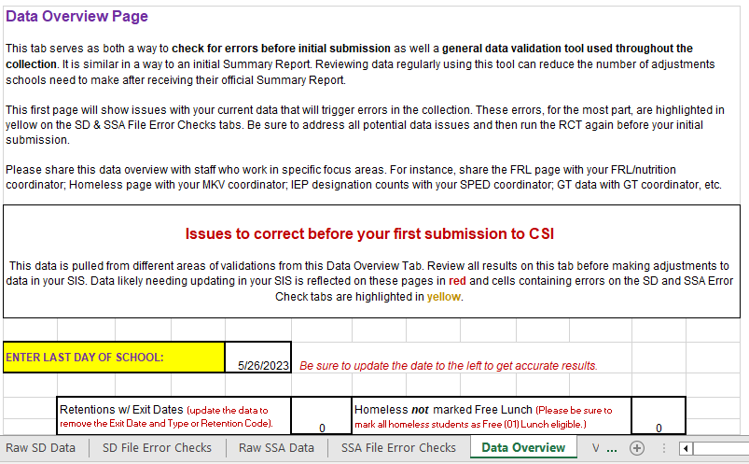
Data Overview Tab
Primarily consists of aggregate data counts by various populations
10
Notes:
Another method by which the Record Checker Tool can help identify potential problem data is with the “Data Overview” tab.
The data within this tab is substantial for most collections and consists primarily of aggregate counts by the various populations and attributes found from the data pasted into the raw data tabs.
Once again, the content of the Data Overview tab will vary according to the collection you are working with. In this presentation, we are working with the Record Checker Tool for the EOY collection.
The top of the tab provides a brief overview of the content. Please take the time to review this.
You can then proceed through each section of the tab, reading through the instructions provided so that you have a good understanding of where you might need to enter data into the tab or how to interpret the aggregate counts that are displayed in each section.

Slide 11
Data Overview Tab Cont.
Be sure to update the value in the “ENTER LAST DAY OF SCHOOL” text box to the last day of your school year (EOY RCT)
11
Notes:
One piece of data you will need to enter for the EOY collection is your last day of school for the current year. You will see a default value already entered in the tab, so be sure to update that to the date for your school just to the right of the yellow label box.

Slide 12
Data Overview Tab Cont. 2
Tips and Reminders
Review instructions for each section
For EOY, sections include aggregate counts for exits, retentions, graduations, attendance, SPED, GT and many other attribute types
Some counts will matter more at different times in the collection
i.e., graduates are not coded as such until later in the school year
Identify all potential data issues
Share the file with content experts at your school
Make corrections needed in your SIS
12
Notes:
Here are some tips and reminders as you work with the Data Overview tab.
Be sure to review instructions for each of the sections.
For the EOY collection, sections include aggregate counts for exits, retentions, graduations, attendance, SPED, GT and many other attribute types.
Some counts are going to matter more at different times during the collection. For the EOY, graduates are not coded as such until later in the school year.
Therefore, graduate counts are not going to be as important as other ones for checks you do prior to initial submissions.
Be sure to identify where your school has potential data issues
As part of this you should plan to partner with content experts at your school and then make corrections needed in your SIS.

Slide 13
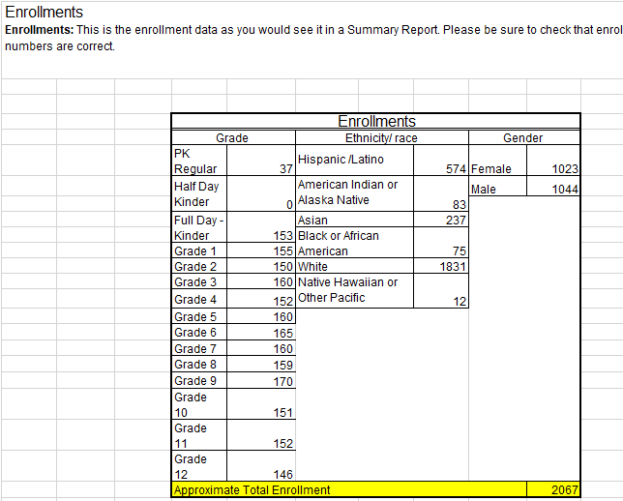
Data Overview Tab Enrollments
Please be aware that the total enrollment figure is approximate
An anomalous count likely means you have not extracted the correct students in your SD or SSA
13
Notes:
When looking at the Enrollment section in the Data Overview tab, please be aware that the total enrollment figure is approximate.
There are many reasons why the figure might not match your expected total enrollment count.
This figure serves more to alert you when counts are highly off, which likely means you have not extracted the correct students in your SD or SSA.

Slide 14
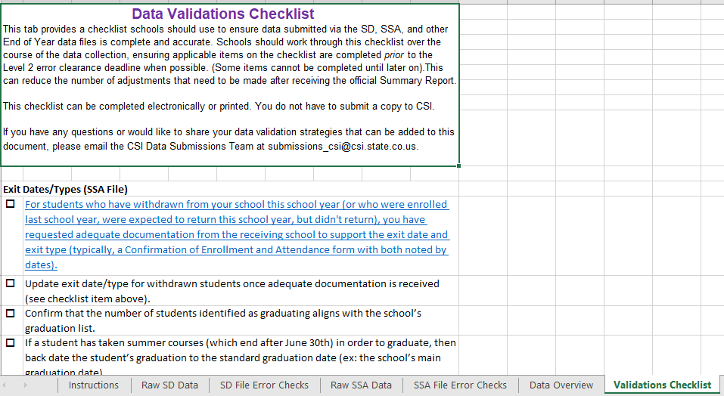
Validations Checklist Tab
Checklist of tasks schools should complete to help ensure that data is complete and accurate
14
Notes:
The last tab that each school will need to complete in the RCT is the “Validations Checklist” tab, which consists of tasks you’ll want to complete that will also help to ensure that your data is complete and accurate.
Review the instructions at the top of the tab and then be sure to complete each task that applies to the types of grade levels and students at your school.
Schools do not need to submit a copy of the checklist to CSI.

Slide 15
Final Steps
Repeat General Steps on the Instructions tab as many times as needed to correct all problem data
Use the RCT throughout the collection (prior to school year rollover for the EOY)
Usually only needed until CSI provides Summary Reports
15
Notes:
For final steps in using the Record Checker Tool, you’ll want to repeat the General Steps on the Instructions tab as many times as needed to correct all problem data.
You’ll also want to use the RCT throughout the collection to recheck your data. This is usually only needed until CSI begins providing Summary Reports to schools.
For the EOY collection, it can be a problem for schools to use the RCT on SD and SSA exported files after a school rolls over to the new year because some data changes are only found on the CSI side of submissions. With that being the case it’s best to confirm the data accuracy in the Summary Reports.

Slide 16
Thank you
Send questions to: submissions_csi@csi.state.co.us
Notes:
That concludes this overview of the Record Checker Tool. Thank you for taking the time to listen to this training.
Please reach out to the submissions inbox if you have any questions on how to use it or suggestions on what other features would be helpful to add.

