Slide 1
General Overview End of Year
Recorded January 2025
Notes:
Welcome to the End of Year, “General Overview” training module recorded by the CSI data submission team.
This presentation will provide an overview of the End of Year Collection for both new school submission contacts and those who would like a refresher.
The content covered here will include basics on how the data is used, how to prepare for the collection, and things to watch out for.
Finally, other EOY training modules are available again this year, covering more specific topics like attendance, exit coding and graduation guidelines. Those are also available on the CSI EOY webpage.

Slide 2
End of Year (EOY) Data Collection
Purpose: to collect student demographic, enrollment, and outcome data for the school year
Uses:
Determines graduation, dropout, mobility, stability and attendance rates
Considered in both CSI and state accountability reports
Included in federal reporting
Inform various program supports at CSI (equity dashboard, enrollment projection workbook) and state level (dropout prevention)
2
Notes:
The purpose of the EOY data collection is to collect student demographic, enrollment, and outcome data for the school year.
This data is then used in a variety of ways:
Is used to determine graduation, dropout, mobility, stability and attendance patterns and rates
Is used for CSI and state accountability reports as well as included in federal reporting
It is also used at CSI and state levels to inform program supports. For example, data from the EOY helps to populate some types of resources CSI provides to schools like the equity dashboard and enrollment projection workbooks that schools complete for CSI each year.
Given all the areas the EOY is used in, it is extremely important that this data is comprehensive and accurate.

Slide 3
Who is Reported?
All students enrolled at your school at any points in the given school year
This includes:
One day entry/exit records for students who were expected to return for the school year but did not
Students who attended even for just one day
Students who have transferred out or transferred in at any point in the school year
3
Notes:
All student activity for your school for the entire school year should be captured in the End of Year collection.
This would include:
One day entry/exit records for students who were expected to return but did not
Students who attended even for just one day
Students who have transferred out or transferred in throughout the year

Slide 4
Files Needed for EOY
Extract the necessary files for EOY for the School SIS:
Student Demographic
Student School Association
Graduation Guidelines (only for schools with 9-12th grades)
Title I (only schools that submitted Title I for the October Count data collection)
Please review the File Layouts on our EOY webpage for more details about what data will be captured through each of these files
https://resources.csi.state.co.us/data-submissions/eoy/
4
Notes:
ALL schools will submit a Student Demographic file and a Student School Association file by the initial submission due date.
Schools with 9th, 10th, 11th, or 12th graders will need to submit a Graduation Guidelines file.
Schools are not required to submit the Graduation Guidelines file on the initial submission due date. It can be submitted later and CSI will communicate with schools when that should be submitted.
Additionally, if you submitted a Title I file for October Count you will be submitting a Title I file for End of Year also. This file also does not need to be submitted by the initial submission date.
Please review the File Layouts on our EOY webpage for more details about what data will be captured through each of these files.

Slide 5
EOY Timeline Overview
Regular Phase:
Now through fall (after the end of this school year)
Work towards error-free and accurate files, data can be updated
Cross-LEA Phase:
End Sept-Early Oct
Validate students reported as moving between districts, data can be updated
Post-Cross LEA Phase:
End of Oct-Early Nov
Validate student exit data, limited opportunity for minimal exit code adjustments
5
Notes:
The EOY collection is the longest running state collection that starts in February and goes through November of this calendar year.
There are many tasks that will take place to complete the collection, but the 3 main phases include the Regular Phase, Cross-LEA Phase, and the Post-Cross LEA Phase.
A general idea of the timeframe and description of each phase is provided in this slide.

Slide 6
Regular Phase Timeline
Deadline | Task
2/27/2025 | Initial File Submissions Due (SD and SSA Files)
3/20/2025 | Title I File Due (Title I School ONLY) Graduation Guidelines Submission Due (9th-12th Gr. ONLY)
4/29/2025 | Schools must have all Level 1 errors cleared
6/17/2025 | Schools must have all Level 2 errors cleared
8/28/2025 | Summary Certification Approval Email Due to CSI
9/1/2025 - 11/15/2025 | Cross-LEA & Post-Cross LEA Validations
**School submission contacts should plan to work with CSI to meet deadlines earlier if you will not available during the summer months to work on the collection.
CSI Date Submission Calendar: https://resources.csi.state.co.us/data-submissions/calendar/
CSI Google Calendar: https://www.csi.state.co.us/calendar/
6
Notes:
The primary resource for all collection deadlines is the Data Submissions annual calendar, which is linked at the top of each collection page on the CSI Data Submission website.
Please be sure to refer to this resource often to stay on track of the EOY collection deadlines as well as all the other main collection deadlines.
Though it is rare for the main deadlines to change, it is possible that adjustments will need to be made mid-collection.
A link to the Data Submissions calendar is provided in this slide as well as a table with the main collection deadlines.
CSI also records main collection deadline dates in a Google event type of calendar on our website with that link also posted in this slide. Schools can download the collection dates to their own calendars through that link.
Submission contacts should plan to work with CSI in meeting deadlines earlier if they will not be around during the summer months.

Slide 7
End of Year Resources
CSI End of Year webpage resources– a few to highlight:
Training Modules – review each applicable module prior to starting the collection
Record Checker Tool (RCT) – use this to review/clean your data 1-2 weeks prior to submitting initial files to CSI
File Layouts – detail of data attributes included in each file submission
“Weekly Update” emails from CSI – important collection announcements and status table
Data Submissions Handbook & Submissions Calendar
CSI Data Management Systems – SIS related general and some EOY help information for Infinite Campus and PowerSchool
EOY Website: https://resources.csi.state.co.us/data-submissions/eoy/
7
Notes:
The primary place for EOY collection resources is the CSI EOY webpage linked on this slide. Please take some time to become familiar with the many types of resources on the EOY webpage.
The first type of resource a school will tend to use most often are the recorded training modules—like this one you are currently watching. There are additional EOY recordings for specific areas of focus that you may want to review later on in the collection.
The second resource type would be the Record Checker Tool (or RCT) which each school must plan to use prior to submitting your initial files to CSI.
Plan time to use the tool at least 1-2 weeks prior to the initial submission deadline.
The RCT is designed to find initial errors and problem data so that you can clean that up prior to submitting initial files. It will also highlight data that is significantly different from what a school reported in their October Count.
The Instructions tab in the RCT file and the recorded training will provide the information you need to know on using it.
The tool file and the recorded module are both found under the Data Validation Resources header on the EOY webpage.
The third most used webpage resources are the file layouts with CSI notes. Every school contact will want to be very familiar with the content of these in order to ensure your data is reported accurately and to help troubleshoot errors throughout the collection.
All school contacts are probably already familiar with the Weekly Update emails sent by CSI. Please be sure to review those each week to monitor your progress on submissions and to check for important announcements about the EOY collection.
Just a reminder that more information on the collection process and submissions collection deadlines are found in the CSI Data Submissions Handbook and Calendar linked in the slide under the General Submissions webpage.
The CSI Data Management Systems webpage also linked here contains information on how to get help with your SIS throughout the collection if needed and includes links to some EOY specific areas related to both Infinite Campus and PowerSchool.

Slide 8
Data Consistency
Students reported as ELL, Military Connected, or Homeless during the October Count collection should remain identified as such in the End of Year collection
The exception to this would be if you found that a student was misreported in one of these areas in the October Count – contact CSI if this is the case
Free and Reduced Lunch Eligibility status typically remains the same unless a new status is needed
Prior year, carryover status if reported in the October Count this year expired on count day. Get a new status.
When end dating FRL status in your SIS, please do NOT use the last day of school.
8
Notes:
Because of the connection between the End of Year and the October Count collections, there are data consistencies we expect to see between the two collections on some special population groups.
Students who were reported as either EL, Military Connected, or Homeless during the October Count collection last fall should remain identified as that in the EOY collection.
Even if you hear that a students’ situation has changed mid-year, you will need to continue to report them the same as you did in the October Count.
The exception to this would be if you found that a student was misreported in one of these areas in the October Count. Please reach out to CSI if this is the case and our team will figure out the best next step.
In some cases, particularly with EL students, we may need to submit an exception to CDE.
Schools should continue to determine Free and Reduced Lunch eligibility statuses on students who need them.
If schools used a prior year, carryover free or reduced lunch status in the October Count collection, that status only lasted through the count day of this year. You will need to get a new eligibility status on those students to report for the EOY collection.
When end dating FRL statuses in your SIS, it can cause reporting problems in he EOY if you end date with the last day of your school year.

Slide 9
EOY Submission Process Overview
9
Notes:
The next main section of this training module consists of an overview of the file submissions process for the EOY.

Slide 10
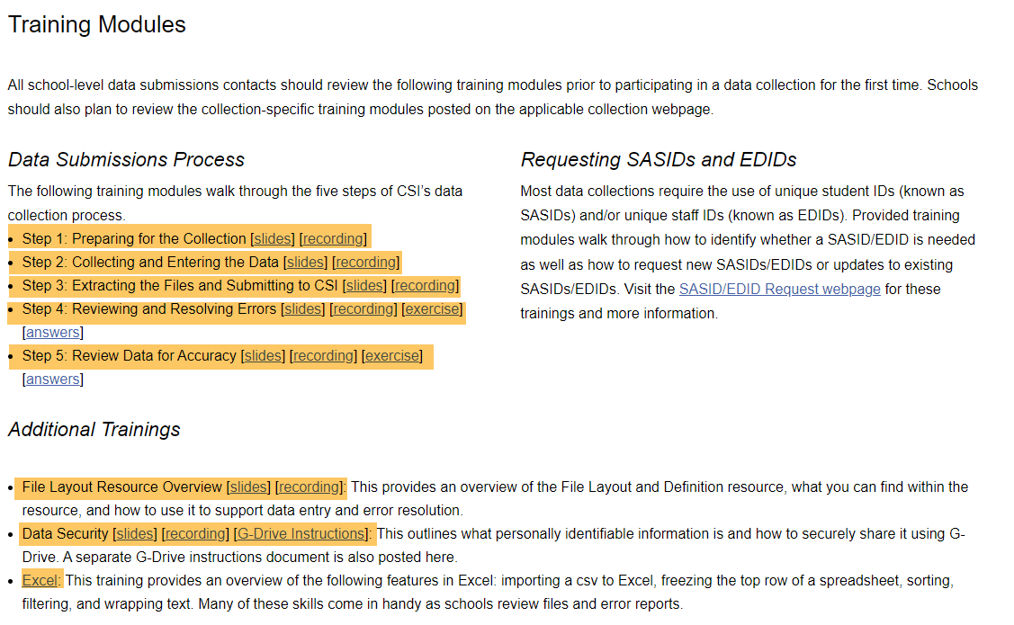
Data Submissions Process
https://resources.csi.state.co.us/data-submissions/training/
Notes:
Like most of the state collections, there is a general 5-step Data Submission Process you will follow for the EOY collection.
This 5-step process is outlined in greater detail in the CSI Data Submission Handbook, that is linked on the General Resource webpage at the top of every collection page.
Note in the graphic on this slide how steps 2 through 4 typically repeat multiple times until you reach the final step number 5.
The number of times that you repeat those steps really depends on how well you have prepped for this collection by:
having accurate data in your SIS
review the training modules and associated resources
have correctly used the Record Checker Tool, and
have become skilled at anticipating reporting problems and troubleshooting errors

Slide 11
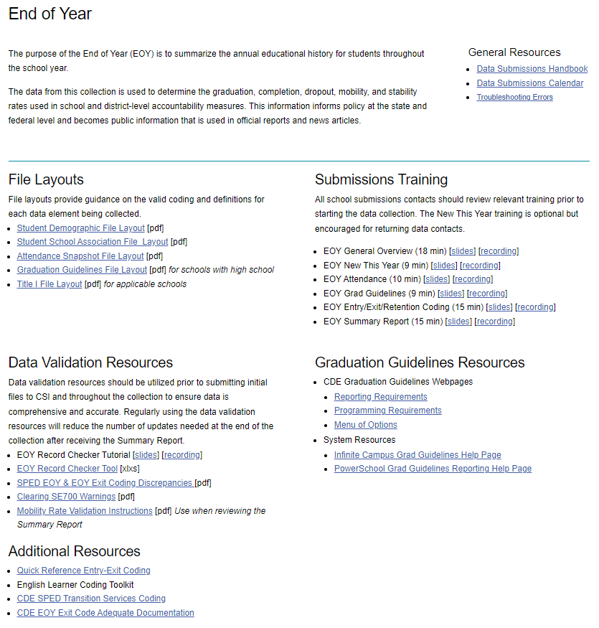
Step 1: Collection Prep
https://resources.csi.state.co.us/data-submissions/eoy/
Notes:
Step 1 for Collection Prep includes such things as reviewing the EOY webpage and the resources found there, particularly all of the things that have been pointed out so far in this training module.

Slide 12
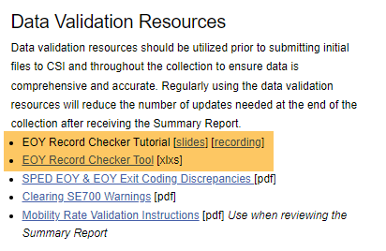
Step 2: Data Entry & Update
Plan to use 1-2 weeks prior to initial submissions
Schools do not need to submit the RCT results file to CS
https://resources.csi.state.co.us/data-submissions/eoy/
Notes:
Step 2 for Data Entry & Update involves using the Record Checker Tool and associated validations strategies that used to be a stand-alone resource, but are now found within the RCT.
The Record Checker Tool is an Excel file found on the EOY webpage under the Data Validation Resources section. There is also a short training module linked in the same location.
Completing this step will help with ensuring the accuracy of your data and reducing the number of times that you will need to resubmit files and fix data errors.

Slide 13
Step 3: Submit Data to CSI
Extract applicable files from your SIS
SD and SSA due from all schools by initial submission deadline
Graduation Guidelines and Title I files if applicable may be submitted later – CSI will communicate due dates for those
Upload to G-Drive > EOY >current year > Files to Run
Use correct file naming conventions! See the Data Submissions Handbook
Email Submissions_CSI@csi.state.co.us to notify CSI that files have been uploaded
Notes:
Once you’ve completed the steps to clean up data in your SIS, then you can proceed to Step 3 where you will extract the submissions files and submit those to CSI.
As we mentioned earlier in this training, all schools must submit the SD and SSA files for the initial submission deadline in early March.
Schools that will need to submit a Graduation Guidelines file and/or Title I file can submit those later this school year. CSI will communicate when those are due.
After extracting the SD and SSA files, you will need to upload those to G-Drive in the folder location shown in the slide.
It’s really important that you use the correct file naming convention, and you can see what that is in the CSI Data Submissions Handbook.
Once you’ve uploaded your files, be sure to send an email to the Submission inbox to alert our data team who will then work on processing your files.
We are not automatically alerted when you upload files to G-Drive so that is why we need you to send us an email.

Slide 14
Step 4: Clear Errors
Review Error Reports CSI Uploads to G-Drive
Adjust data in your SIS as appropriate to correct errors
Review all warnings and correct data if needed
Warnings do not necessarily mean the data is incorrect, but it can be an indicator that it is
Use the Troubleshooting Errors resource to help resolve errors
The file layout documents are also commonly needed to resolve errors
Notes:
After CSI processes EOY files, we will upload any error or warning reports back to G-Drive and notify you when they are there.
You will then need to work on correcting those errors in your SIS. You will not be making changes in the error reports themselves.
Warnings within the reports sometimes do not need to be corrected, but they can sometimes indicate problems data that do need to be fixed, so these should always be reviewed and corrected when appropriate.
The primary resource you will use during this process is the Troubleshooting Errors document, which will have tips on resolving specific errors and warnings.
You will often also use the file layout documents in resolving errors.

Slide 15
Step 4: Clear SP149 Errors
SP149 Error (SD Level 1)
Cause of Error: This error typically is due to a student transferring between CSI schools and both schools’ SD files have the student included
Action Step: CSI will resolve this as schools resolve Level 1 errors
Notes:
The next few slides will detail some common EOY errors that come up during file processing.
SP149 Level 1 Errors occur in the SD file when students have been reported by more than one CSI school in the current school year. This is usually due to student transfers between the CSI schools.
If you receive these errors, first confirm that your entry and exit data for the student is correct in your SIS. CSI will need to help clear these errors with adjustments on our end, but to make sure they are cleared early in the collection, please be sure to respond to any CSI inquiries as soon as possible.

Slide 16
Step 4: Clear SE700 Errors
SE700 Series Warnings (Level 2)
Cause of Error: Mainly warnings SE720, SE721, SE722, and SE724 related to inconsistent/possibly inaccurate exit coding
Action Step:
These warnings must be addressed once your school begins receiving Level 2 error/warning reports
They will become errors later in the collection and will be more difficult to correct
See the resource Clearing SE700 Warnings for EOY Collection for help
Notes:
The SE700 Series Level 2 warnings include the ones coded SE720, SE721, SE722, and SE724. These are primarily related to inconsistent or possibly inaccurate exit coding.
As soon as CSI begins providing Level 2 error reports to schools, they will need to address and update data in their SIS to resolve these warnings.
These warnings will become errors later on in the collection if they are not resolved and are sometimes more difficult to resolve due to waiting.
For help in resolving these, CSI has a resource linked in this slide that schools will want to review.

Slide 17
Step 4: Clear SE404 Errors
SE404 Error (Level 2)
Cause of Error: Students reported with an Exit Code 00 (expected to return next year) in the prior EOY collection but they are not reported in the current year EOY collection. (Ex: 8th graders at a K-8 school)
Action Step:
CSI School should follow up with student/family to confirm where student attended and gather Confirmation of Enrollment and Attendance
Schools will have to code 7-12 grade students as a dropout if they cannot confirm where the student went
CSI School may need to add a record for the students in the current year EOY. CSI will clarify next steps with the school
Notes:
SE404 Level 2 errors happen when schools report students with an exit code of 00 for expecting to return the next school year in the prior year EOY collection, but they are not reported in the current year.
This commonly happens at K-8 schools for their 8th grade students.
When schools receive this error, if they have not already done so, they need to follow up on the student and gather adequate documentation on where the student went such as a Confirmation of Enrollment and Attendance form.
Schools will need to code 7th-12th grade students as a dropout in the EOY if they cannot confirm where the student went. This is one of the reasons why it is so important to gather adequate documentation.
To clear the error, the school may need to add a one-day entry/exit record in the current year EOY. CSI will provide clarification on what a school needs to do if they receive this error.

Slide 18
Step 5: Final Review of Data
School Review and Validations:
Use the Record Checker Tool to help validate data along the way
Summary Report in the fall will be the main opportunity to review/update all data
CSI Review and Validations:
EOY and SPED EOY data syncing
Significant, unexplained discrepancies between OC and EOY data
CDE Review and Validations
Review exit coding across districts
18
Notes:
Step 5 involves the final review of the data in the EOY collection by the schools, CSI and CDE by different methods and at different times.
For schools, they should be reviewing their data and ensuring that it is complete and accurate throughout the collection window.
They can do so by many of the methods already described in this training, including the Record Checker Tool.
The Summary Reports that will be provided by CSI in the fall will be the last main opportunity to review and update all data.
CSI helps in the process of reviewing the data too with our own internal data validations.
For instance, we will conduct a check on SPED data reported by comparing the EOY to the SPED EOY collection to ensure that students are reported with the same SPED and graduation attributes.
We will also conduct comparisons between the October Count and EOY collections.
It’s important to know that schools should not depend on CSI to find discrepancies. Schools should always be on top of reporting correct data across all collections.
There will be some validations that CDE will conduct nearer to the end of the collection. This primarily involves checking for consistent exit coding across different districts for students reported in the EOY.

Slide 19
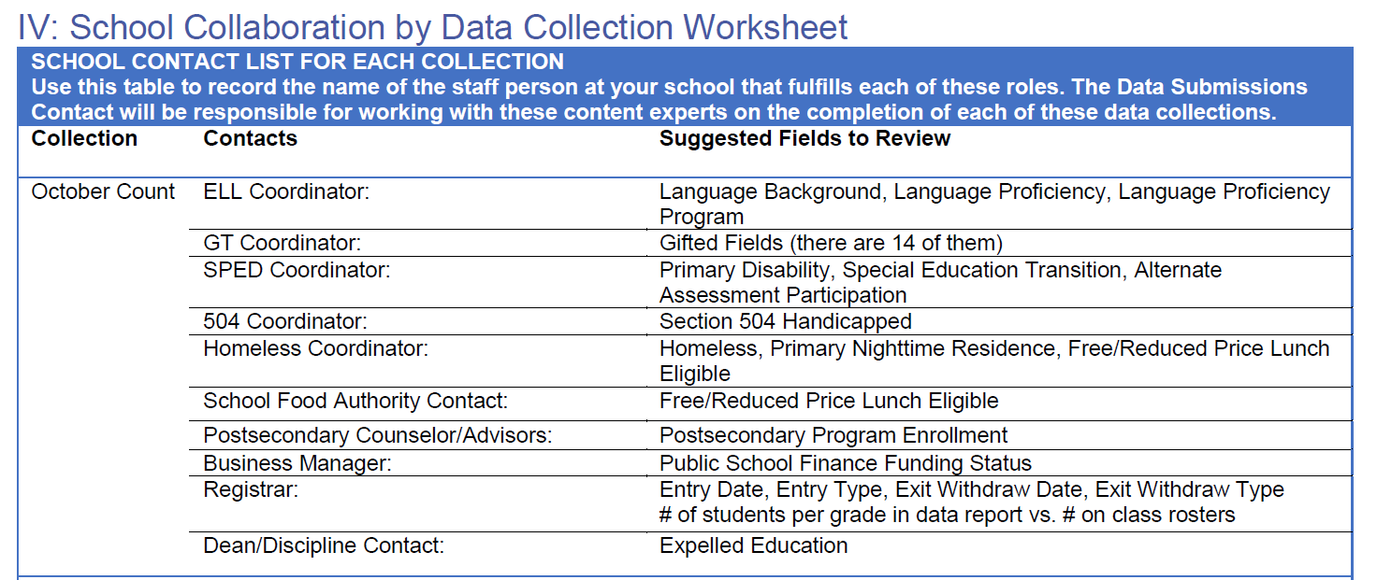
Collaboration is Key
Available in Appendix of the CSI Data Submissions Handbook
19
Notes:
Last but not least, one of the most important resources available to you are the content-experts at your school!
The CSI Data Submissions Team expects school data submissions contacts to be experts in the data submissions process. We expect school data submissions contacts to also work closely with content-experts as their schools in reviewing data for accuracy.
Because End of Year collection pulls in a variety of data about students, it is essential that data submissions contacts are working closely with school-level content experts in the collection, reporting, and verification of End of Year data.
We’ve provided a list of key types of data in the End of Year collection, and particular fields where they can be found. This information is included in the Appendix of the Data Submissions Handbook and identifies that roles at your school that will be helpful to collaborate with during the End of Year data collection.

Slide 20
Important Reminders
School Submission Contacts should plan meet deadlines earlier and communicate to CSI if you will not be available during the summer months to work on the collection.
School Submissions Contacts will need to work closely with EL, GT, SPED, 504, Homeless coordinators, and counselors to collect, report, and verify data prior to staff leaving for the summer.
20
Notes:
Since the End of Year collection extends into the summer months, two things are important to consider before the end of school.
First, plan meet deadlines earlier and communicate to CSI if you will not be available during the summer months to work on the collection.
Second, work closely with EL, GT, SPED, 504, Homeless coordinators, and counselors to collect, report, and verify data prior to staff leaving for the summer.

Slide 21
Thank you!
Send questions to: submissions_csi@csi.state.co.us
21
Notes:
This concludes the EOY General Overview training. The data team so appreciates that you took the time to watch this.
It’s not possible to include every aspect of the EOY collection, so we instead try to highlight the most important things and provide you with directions to the related resources.
If you have any questions, please reach out to the submissions inbox at the address listed in this slide.

