Slide 1

Data Submissions
Veteran’s Guide
End of Year
Recorded January 2025
Notes:
Welcome to the End of Year, Data Submission Veteran’s Guide training module recorded by the CSI data submission team.
This presentation is designed to be as short as to highlight any unique changes for the current EOY collection plus highlight reminders that are important enough to mention on an annual basis.
All CSI school submissions staff are encouraged to review this training, but new or less experienced staff should plan to also watch the EOY General Overview training module that covers more in-depth information about the submission processes for this collection.
Other EOY training modules are available again this year, covering more specific topics like attendance, exit coding and graduation guidelines. Those are also available on the CSI EOY webpage.

Slide 2
For EOY 24-25
Important Dates
No New Updates Since October Count
Reminders
Record Checker Tool
Graduation Guidelines
Attendance
Data Consistency
Entry/Exit Coding
2
Notes:
This recording will cover important dates and reminders covered in the areas of the Record Checker Tool, Graduation Guidelines, attendance, data consistency, and entry/exit coding.

Slide 3
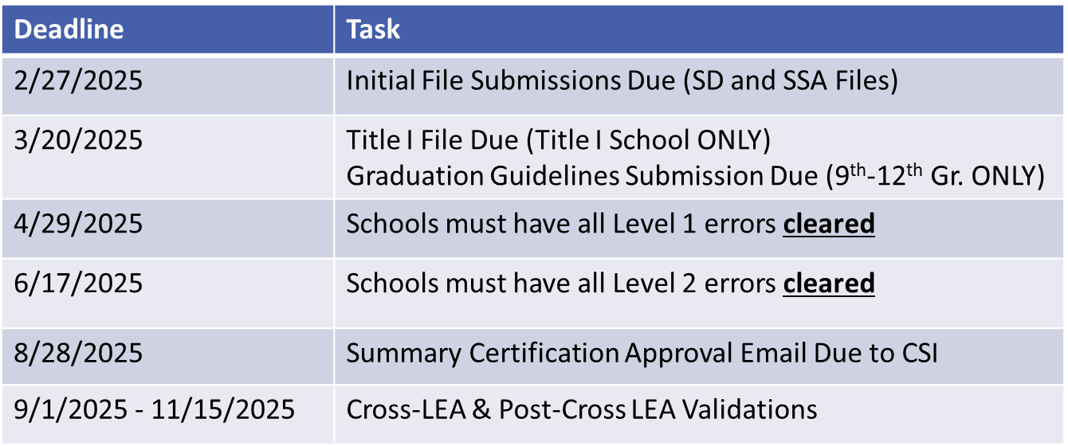
Regular Phase Timeline
**School submission contacts should plan to work with CSI to meet deadlines earlier if you will not available during the summer months to work on the collection.
CSI Date Submission Calendar: https://resources.csi.state.co.us/data-submissions/calendar/
CSI Google Calendar: https://www.csi.state.co.us/calendar/
3
Notes:
The primary resource for all collection deadlines is the Data Submissions annual calendar, which is linked at the top of each collection page on the CSI Data Submission website.
Please be sure to refer to this resource often to stay on track of the EOY collection deadlines as well as all the other main collection deadlines.
Though it is rare for the main deadlines to change, it is possible that adjustments will need to be made mid-collection.
A link to the Data Submissions calendar is provided in this slide as well as a table with the main collection deadlines.
CSI also records main collection deadline dates in a Google event type of calendar on our website with that link also posted in this slide. Schools can download the collection dates to their own calendars through that link.
Submission contacts should plan to work with CSI in meeting deadlines earlier if they will not be around during the summer months.

Slide 4
Updates
SD, SSA, Title I, and Attendance File Layouts - Since October Count, there are no new updates.
Graduation Guidelines File Layout - In September 2024, the State Board of Education voted to change the benchmark score for the digital SAT Math assessment to 480 for assessments administered in the 2023-2024, 2024-2025, and 2025-2026 school years for students graduating in the 2024-2025 and 2025-2026 school years.
SAT Math assessments completed in the 2022-2023 school year and earlier continue to use the benchmark score of 500.
SAT English - No change was made.
4
Notes:
Please note that since October Count, there have not been any changes to report for the SD, SSA, Title I, or attendance file layouts.
For the Graduation Guidelines File Layout - In September 2024, the State Board of Education voted to change the benchmark score for the SAT Math assessment to 480 for assessments administered from SY 23-24 and beyond for students graduating in the 2024-2025 and 2025-2026 school years.
SAT Math assessments completed in the 2022-2023 school year and earlier continue to use the benchmark score of 500.
For SAT English there have been no benchmark changes.

Slide 5
Reminders

Slide 6
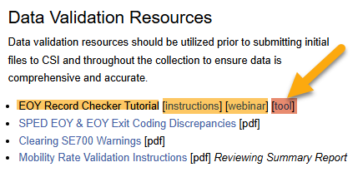
Record Checker Tool
Plan to use 1-2 weeks prior to initial submissions
  Schools do not need to submit the RCT results file to CS
https://resources.csi.state.co.us/data-submissions/eoy/
6
Notes:
The Record Checker Tool is available once again this year. It is updated yearly, so please be sure to go to the EOY main webpage and download a new copy each year.
All schools will once again need to use this tool prior to submitting you SD and SSA files.
The Record Checker Tool will help you identify potential errors PRIOR to submitting your files to CSI. It will also highlight data that is significantly different from what a school reported in their October Count.
Schools do not need to submit a copy of their RCT results file to CSI, however, if you would like the Data Submission Team to review your Record Checker data, please upload the file to your EOY Files to Run folder in G-Drive and send an email to CSI.
A recorded training module on using the RCT is found under the Data Validation Resources header on the EOY webpage.

Slide 7
Graduation Guidelines
Reminder
  This file can be submitted later than the initial submission deadline
  GG file is due to CSI by 3/20/2025
  IC and PS may not have updated the report extracts by the initial submission deadline
  There is a separate CSI training module
7
Notes:
Here are some reminders worth mentioning on the Graduation Guidelines file submission:
As mentioned earlier this is not due on the initial submissions date.
CSI communicates to schools when a first file must be submitted and that date is posted in this slide.
It’s possible that Infinite Campus and PowerSchool may not have updated the report extract by the initial submission deadline.
We once again have a separate EOY training module available on the EOY webpage on Grad Guidelines.

Slide 8
Attendance
Complete and accurate attendance data is required for all CSI schools in the EOY
  Used in the School Discipline collection to determine truancy and chronic absenteeism rates
The data is reported in the SSA file
Review results in the Record Checker Tool
There is a separate CSI Attendance training module available on the CSI EOY Webpage
8
Notes:
There are no changes to the reporting of attendance in the EOY, but we want to remind you that the data must be complete and accurate for all CSI schools.
The data does feed into the School Discipline collection for determining truancy and chronic absenteeism rates.
The attendance data is not reported in a separate file for the EOY; it is instead extracted from your SIS into data fields within the SSA file.
There is a separate CSI attendance training module for those who wish to find out more detail on these reporting fields in the SSA file.

Slide 9
Data Consistency
Students reported as ELL, Military Connected, or Homeless during the October Count collection should remain identified as such in the End of Year collection
  The exception to this would be if you found that a student was misreported in one of these areas in the October Count – contact CSI if this is the case
Free and Reduced Lunch Eligibility status typically remains the same unless a new status is needed
  Prior year, carryover status if reported in the October Count this year expired on count day. Get a new status
  When end dating FRL status in your SIS, please do NOT use the last day of school.
9
Notes:
Because of the connection between the End of Year and the October Count collections, there are data consistencies we expect to see between the two collections on some special population groups.
Students who were reported as either EL, Military Connected, or Homeless during the October Count collection last fall should remain identified as that in the EOY collection.
Even if you hear that a students’ situation has changed mid-year, you will need to continue to report them the same as you did in the October Count.
The exception to this would be if you found that a student was misreported in one of these areas in the October Count. Please reach out to CSI if this is the case and our team will figure out the best next step.
In some cases, particularly with EL students, we may need to submit an exception to CDE.
Schools should continue to determine Free and Reduced Lunch eligibility statuses on students who need them.
If schools used a prior year, carryover free or reduced lunch status in the October Count collection, that status only lasted through the count day of this year. You will need to get a new eligibility status on those students to report for the EOY collection.
When end dating FRL statuses in your SIS, it can cause reporting problems in he EOY if you end date with the last day of your school year.

Slide 10
Entry/Exit Coding
Highly important in the EOY collection
  Impacts also to following year October Count
CSI EOY Webpage resources:
  SSA File Layout – field definitions
  Record Checker Tool
  Training Module - Exit Field Coding
  Quick Reference Guide - Entry Exit Fields with student scenario examples
Notes:
Entering correct entry and exit dates and types is super important in the EOY collection. It not only impacts the EOY collection, but it will impact how you’ll report data the following year in the October Count collection.
CSI has several resources to help with ensuring correct reporting of the entry and exit fields on the EOY webpage.
These include the SSA file layout with field definitions for entry and exit coding, the Record Checker Tool that you should be using throughout the collection, an exit field coding training module, and a quick reference resource that has many types of student scenario examples.

Slide 11
Thank you
Send questions to: submissions_csi@csi.state.co.us
Notes:
Thank you for watching this important EOY training! Please be sure to send any questions to the CSI submissions inbox at the email address in this slide.

