Slide 1
Attendance Fields End of Year
Recorded January 2025
Notes:
This training recorded by the CSI data team provides an overview on reporting data in the attendance fields for the EOY collection.

Slide 2
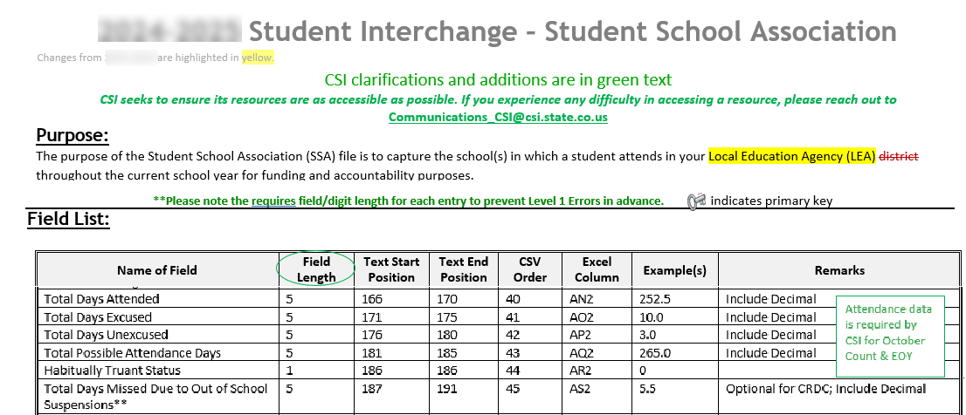
Attendance Fields - SSA File
Attendance data is captured in the SSA student interchange for the EOY collection. See the SSA file layout for valid coding and field definitions.
https://resources.csi.state.co.us/data-submissions/eoy/
2
Notes:
Attendance data is captured in the SSA student interchange file and reported through the EOY collection. Field definitions and coding information are found in the SSA File Layout.

Slide 3
Attendance Fields - SSA File (cont1)
All CSI schools required to report attendance data
Six attendance related fields:
Total Days Attended
Total Days Excused
Total Days Unexcused
Total Possible Days (based on school calendars, not 365 days)
Habitually Truant Status
Total Days Missed for Out of School Suspensions
3
Notes:
All CSI schools are required to report attendance data on all students for the EOY collection.
The SSA file layout has six attendance related fields and those include:
Total Days Attended,
Total Days Excused,
Total Days Unexcused,
Total Possible Days, which would be based on the school calendars, not on the 365-day calendar,
Habitually Truant Status, and
Total Days Missed for Out of School Suspensions

Slide 4
Attendance Fields - SSA File (cont2)
First Four Related Fields:
Total Days Attended
Total Days Excused
Total Days Unexcused
Total Possible Days
Each requires a decimal value (max of 5 characters)
Examples 0.0, 000.0 or 175.3
Can be zero filled if that is an accurate value for a student
Count as a full day:
If student attended at least a half day
If student missed more than a half day
The first three fields must add up to the last field
Attended + Excused + Unexcused = Total Possible Days
4
Notes:
The first four fields listed are most closely related when reporting the data.
As you’ll see in the SSA file layout for the attributes of each field, they must be reported as a decimal value with a maximum of 5 characters. Examples you can report would be 0.0, 000.0 or 175.3, which is just an arbitrary value that could be reported.
Each of the fields could be zero filled if that scenario is an accurate value for a student.
You should count a full day if a student either attended at least a half day or they missed more than a half day.
The first 3 fields must add up to the last field, so Total Days Attended plus Total Days Excused plus Total Days Unexcused must equal the Total Possible Days.

Slide 5
Total Possible Days Field
Should be total number of days a student is scheduled to attend school
Based on school calendars, not 365 days
Can vary by student type and calendar/bell schedule
For example, onsite attend more days than homeschool
5
Notes:
Here are some other details about the Total Days Possible Field that are important to know.
This value should be the total number of days the student is scheduled to attend school.
As mentioned earlier it is based on school calendars and not on a 365-day calendar.
Because this is the case, then the value will vary by student type and calendar/bell schedule as you have those set up in your SIS.
For example, while an onsite student might be scheduled to attend courses 165 days of the school year, a home school student may only attend once a week for a total of just 35 possible days of attendance.
Again, these figures will vary depending on your school’s calendar and scheduling.
Finally, it should always be the case that the sum of days attended, excused and unexcused will need to equal the days possible.

Slide 6
Attendance Practices
Federal suggested practice: Present >= 50% Absent >= 51%
Schools can opt to follow their attendance policy, but must roll up or down for these Attendance fields in the SSA
Total Days Attended
Count as a full day:
If student attended at least a half day
Total Days Excused and Unexcused
Count as a full day:
If student missed more than a half day
6
Notes:
It was mentioned earlier in the presentation that there are circumstances where half days of attendance should be counted as full days.
The federal suggested practice is to count “present” as attending 50% or more of the day and “absent” as missing 51% or more of the day.
CSI is aware that each school has attendance policies specific to their school, and they can still opt to calculate full day attendance and absences in a manner that best fits their needs.
However, please know that for reporting data in the attendance fields of the SSA file, only whole days can be calculated, so partial day absences must be rolled up or down into a full day attended or a full day not attended for the Total Day fields illustrated here.
Submission contacts can check with their school to see if they have special attendance policies that will impact their reporting.

Slide 7
Excused / Unexcused
School policy must clearly define what qualifies as an excused and unexcused absence. C.R.S. 22-33-104(4); 1 CCR 301-78
See the Attendance Policy Guidance on the CSI Legal and Policy webpage
State statute: School imposed discipline (suspensions, and expulsions) C.R.S. 22-33-105/6
Plus, school policy for other types
Total Days Excused
No reason given or reason outside of excused absences in attendance policy. 1 CCR 301-78
Total Days Unexcused
7
Notes:
According to state statute, school policies must clearly define what qualifies as an excused and unexcused absence. Those policies must also be made available to parents and students.
For more information on attendance policies, schools should consult the guidance document linked on this slide available on the CSI Legal and Policy webpage.
There is a state statute requiring that school imposed suspensions and expulsions be treated as an excused absence. Therefore, those types of absences should be reported under the Total Days Excused data field in the SSA.
Beyond that statute, school policy should be used to define other acceptable excused absences.
Unexcused absences, according to state requirements, occur when the student is absent without a reason or for a reason outside of the excused absences identified in a school’s attendance policy.

Slide 8
Habitually Truant Status
Required by State Law
Truant = Unexcused
1 = | Unexcused/truant for 4+ days in one calendar month.
2 = | Unexcused/truant for 10+ days in the school year.
3 = | Both 1 & 2
Use code 0 if none of the above apply.
8
Notes:
The fifth attendance data field reported in the SSA file is the Habitually Truant Status.
This data must be reported in the EOY collection because it is required by State Law
Truant and unexcused are considered the same for reporting in this data field.
Habitual truancy is calculated based on the number of unexcused absences a student has within a calendar month, the school year, or both.
If the student has unexcused absences but fewer than 4 within a month or 10 within the school year, they are not considered Habitually Truant and should be coded with a ‘0’.

Slide 9
Total Days Missed Due to Out Of School Suspensions
Total number school days missed by a student due to out-of-state suspensions (OSS)
Half days do not need to be rounded up to full days
Be sure to count in school and out of school suspensions as excused absences
9
Notes:
The last attendance field in the SSA file layout is the Total Missed Days Due to Out Of School Suspensions.
There are very few considerations when reporting this but do know that half days do not need to be rounded up to full days.
Just a reminder that in school and out of school suspensions should be counted as excused absences.

Slide 10
Attendance Snapshot
SSA file attendance data compiled with other data into the “Attendance Snapshot”
Few Level 1 errors - mainly Level 2 errors
Used in the:
School Discipline collection for truancy rates and chronic absenteeism
CDE SchoolView Dashboard
Public research and media reports
Reported to the US Department of Education for federal reports and the Civil Rights Data Collection
10
Notes:
The attendance data collected in the SSA file for the EOY collection will be compiled with other data fields into what’s called the “Attendance Snapshot”.
Unlike most collections you will see very few Level 1 Errors for the Attendance Fields at this time. There is more chance of having Level 2 errors to resolve.
Attendance data will be used in the:
School Discipline collection to determine truancy rates and chronic absenteeism.
CDE SchoolView Dashboard, and
Public research and media reports
Lastly, it is reported to the US Department of Education for federal reports and to prepopulate the Civil Rights Data Collection.

Slide 11
SIS Attendance Set-Up
Total Days Attended
Total Days Excused
Total Days Unexcused
Total Days Possible
Habitually Truant
Total Days Missed Due to OSS
Calculated from student Attendance record.
Calculated Values
Calculated from student Behavior record.
11
Notes:
All of the attendance fields reported in the EOY collection will be included in the SSA report extract a school pulls from their SIS to report to CSI.
As long as a school has set up both attendance and behavior attributes correctly is their SIS plus maintain data entries for attendance and discipline, then the SIS should perform the necessary calculations during the SSA report extract.
Typically, the Total Days Attended and Total Days Excused & Unexcused are calculated for each student from the individual student attendance record.
Likewise, Total Days Missed Due to Out of School Suspensions is calculated from the individual student behavior record.
Total Days Possible and Habitually Truant are calculated on the fly when the SSA report extract is initiated.

Slide 12
SIS Attendance Set-Up (cont.)
Infinite Campus: Campus Community > Knowledge Base > Search ‘Attendance Set-up’ >
Attendance Set-up for Administrators
PowerSchool: PowerSchool SIS Colorado > State Reporting Set-up > Attendance Setup
12
Notes:
To make sure your attendance is set-up correctly in your SIS, you can follow the links listed here to the Attendance Set-up Documentation for your SIS.
Even if you do not need to review this documentation now, it will be good to keep these links on hand in case you need to refer to the Attendance Set-up process when trouble-shooting Level 2 Attendance Errors.

Slide 13
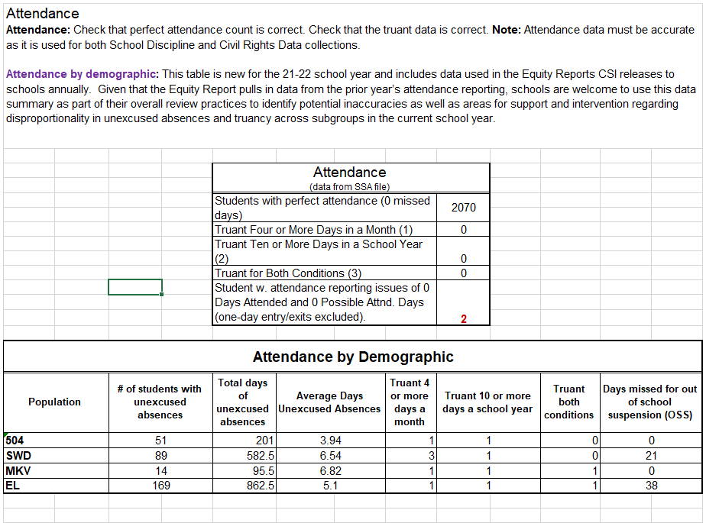
Data Validation
Use the Record Checker Tool - https://resources.csi.state.co.us/data-submissions/eoy/
13
Notes:
To help ensure the accuracy of your Attendance data, be sure to pay close attention to the Attendance section in the Record Checker Tool.
The RCT is available on the CSI EOY webpage and all schools are required to use the tool 1-2 weeks prior to the EOY initial file submissions.
You can find out more about that by watching other trainings for the EOY collection.
The Attendance section will show you the count of students you are reporting with perfect attendance – as in no excused or unexcused absences.
This is a good check because perfect attendance can sometimes mean there is a problem with the data and/or your SIS set up.
The section will also show how many students are being reported for different durations of truancy, plus the number of students with Attendance issues that will likely create errors in the EOY collection.

Slide 14
Data Validation (cont.)
Record Checker Tool
Check that any students with 0 days missed do indeed have perfect attendance
Check that ‘Total Days Possible’ is correct for student calendar and enrollment duration
Check that ‘Total Days Attended’ plus excused/unexcused absences equal the ‘Total Possible Attendance Days’ based on student calendar and enrollment duration
Review that students marked with a 1 in the Habitually Truant Status column have unexcused absences of either 4+ in one month or 10+ during the year. Remember, truant = unexcused
Missed Due to OSS should be included with other excused absences
14
Notes:
Here is a list of some specific things to check for in the Attendance Section when you use the Record Checker Tool.
Each of these would apply to most schools, so be sure to check for each one.
The concepts behind each check have been covered in prior slides within this training.

Slide 15
Other Tips
If a school appears to have missing attendance for some courses that should be counted
Check your SIS to make sure you do not have the course checked as exclude from state reporting
15
Notes:
The next couple of slides will walk through other tips to be aware of for the Attendance reporting.
If you find missing attendance for some courses that should be counted, then check your SIS to make sure you do not have the course checked as exclude from state reporting.

Slide 16
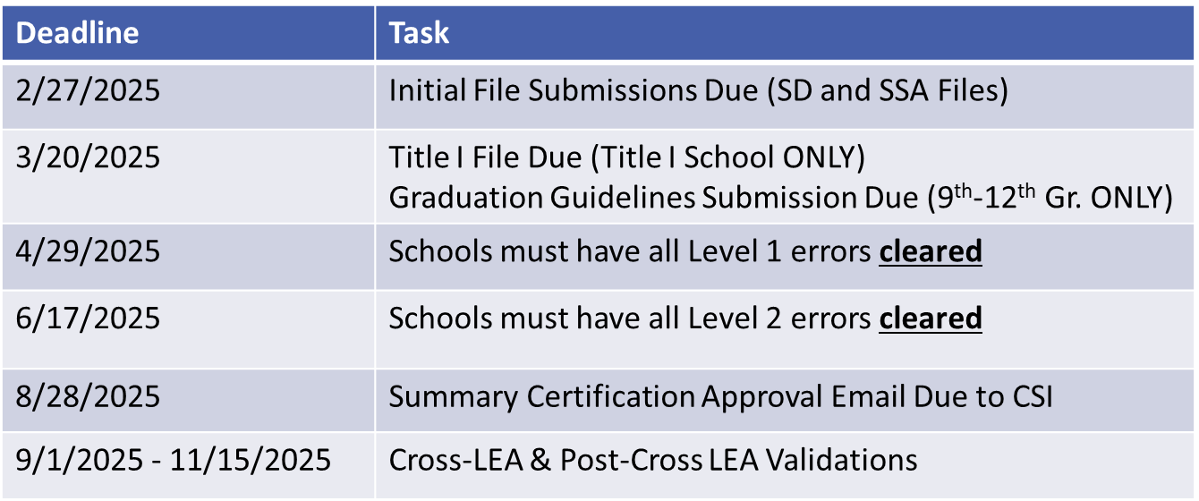
Other Tips (cont.)
SIS Roll Over Time
Difficult to correct attendance data after the SIS is rolled over to the next school year
Please plan to have all attendance errors and issues cleared prior to your school roll over
16
Notes:
The table in this slide shows the general submission deadlines for the EOY collection. To the left you will notice the approximates the window of time that most schools roll over their SIS to the next school year, typically between June and July.
Once a school rolls over to the new year, it’s typical that CSI cannot accept new submission files from schools and any changes to the data must be made manually in the most recent files at CSI.
With this being the case, it’s difficult to correct attendance data after the roll over.
Schools should plan to have all attendance errors and issues cleared prior to completing their roll over.

Slide 17
Thank you
Send questions to: submissions_csi@csi.state.co.us
Notes:
Thank you for watching this training on reporting attendance data. Please send any questions you have to the CSI data team at the email address noted in this slide.

