Slide 1
CSI School Leaders Call
January 7, 2025

Slide 2
Agenda
CSI Updates
Reminders, Upcoming Events & Deadlines
Legislative Updates

Slide 3
CSI Updates

Slide 4
Renewal
Seven schools were renewed by the CSI Board in December for varying contract terms:
Ascent Classical Academy of Douglas County
Ascent Classical Academy of Northern Colorado
Colorado Springs Charter Academy
Crown Pointe Academy
New Legacy Charter School
Prospect Academy
Stone Creek Charter School

Slide 5
Distinction
The CSI Board also approved accreditation ratings in December. Congrats to our Performance with Distinction Schools!
Academy of Arts & Knowledge
Animas High School
Ascent Classical Academy of Northern Colorado
AXIS International Academy
Caprock Academy
Colorado Early Colleges Douglas County
Colorado Early Colleges Fort Collins
Colorado Early Colleges Windsor
Golden View Classical Academy
Mountain Middle School
Steamboat Montessori Charter School
Thomas MacLaren School*
Victory Preparatory Academy Middle School

Slide 6
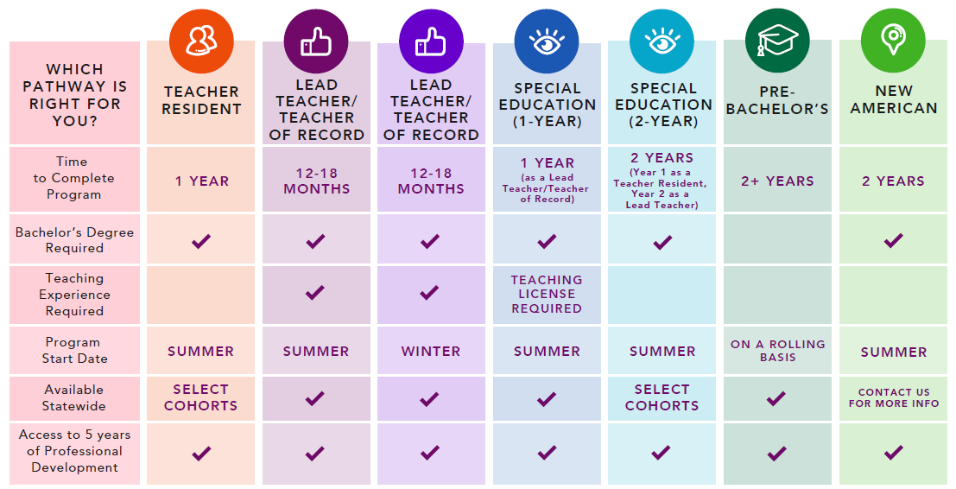
PEBC Teacher Preparation Pathways

Slide 7
PEBC Teacher Preparation Pathways
Email admissions@pebc.org
Sign up for a free, virtual info session:

Slide 8
Supporting Immigrant Students & Families
Remind families, based on current laws and guidance, about their rights and protections:
The U.S. Supreme Court’s 1982 Plyler v. Doe decision affirmed that schools cannot deny enrollment to students on the basis of their immigration status.
Both federal and state laws prohibit discrimination and harassment of students on the basis of protected classes, which includes national origin, race, and color. You can find these prohibitions in the federal Title IV and Title VI statutes and in Colorado’s Anti-Discrimination Act, § 24-34-601, C.R.S.
Under long-standing federal guidance (see 2016 guidance and 2021 guidance), schools are protected spaces where federal immigration authorities should not conduct immigration activities.

Slide 9
Legislative Updates

Slide 10
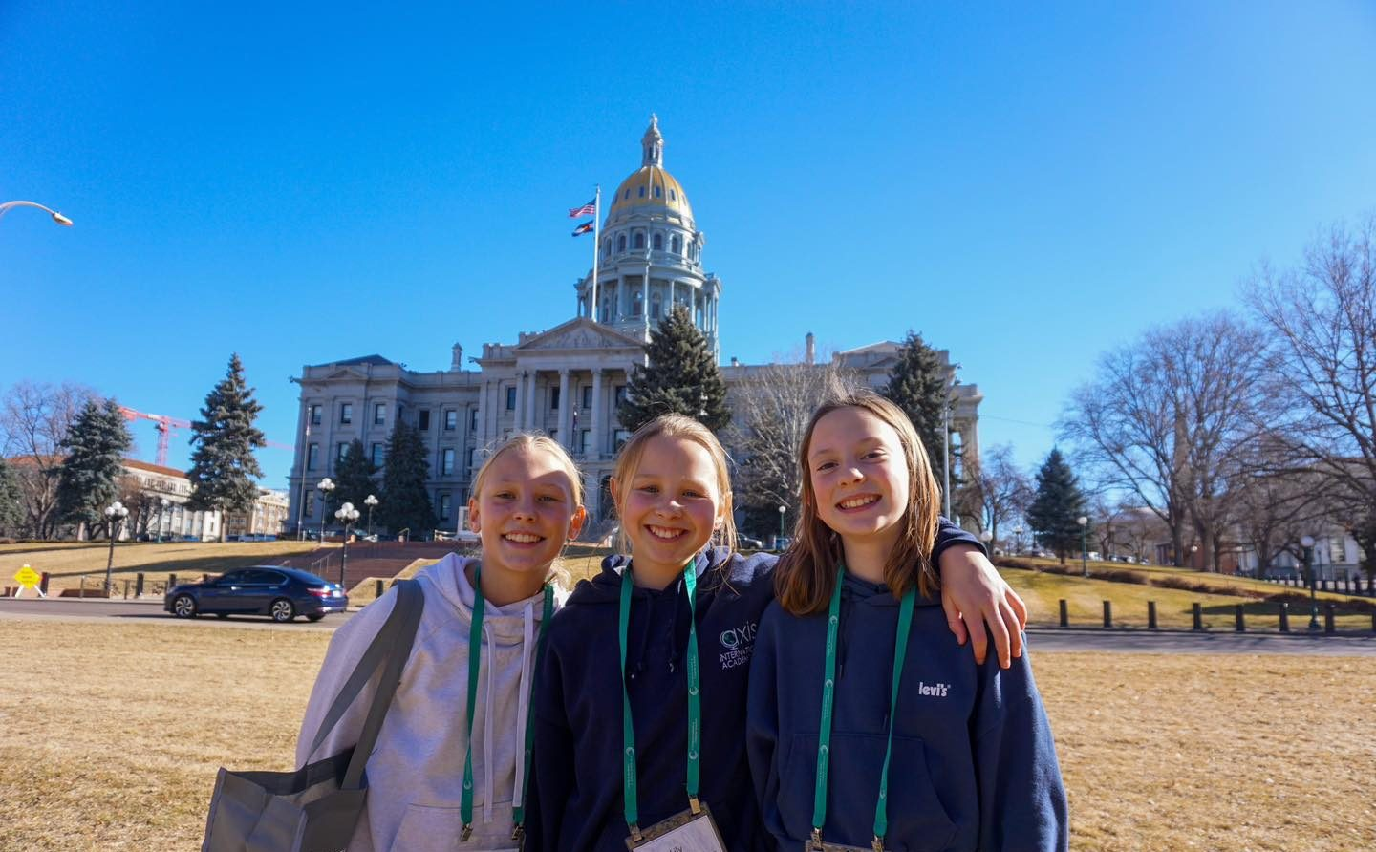
2025 Legislative Session
Begins tomorrow, January 8, 2025
Ends May 7, 2025

Slide 11
CSI School Representation
CSI is reviewing education bills as they are introduced to ensure CSI and CSI schools are appropriately included/excluded
CSI staff continues to engage on several working groups and committees to represent CSI/charters
Accountability
Healthy School Meals for All
Alternative Education Campus (AEC)
Transportation
School Finance

Slide 12
Legislative Priorities
Defending the Charter Sector
Autonomy and Flexibility
Authorizing Fairness and Consistency
Funding Equity
Supporting Alternative and Innovative School Options

Slide 13
Legislative Updates
Funding Equity
Continue to defend fully funding the CSI Mill Levy Equalization Fund
Defending the Charter Sector, Autonomy and Flexibility
Draft Kipp bill that requires CSI schools to receive funding approval from the General Assembly

Slide 14
Accessibility
HB24-1454: Grace Period Noncompliance Digital Accessibility
Provides a one-year grace period to July 1, 2025, of immunity from liability for failure to comply with the digital accessibility standards for an agency (district, or charter school) that demonstrates good faith efforts toward compliance or toward resolution of any complaint of noncompliance.
By July 1, 2025, schools must comply with OIT’s technology accessibility standards
Reach out to Amanda Oberg or Communications_CSI@csi.state.co.us for support!

Slide 15
School Leader Events

Slide 16
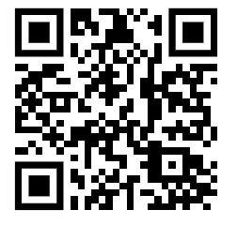
All School Leaders Meeting
Wednesday, February 26, 9:30am-3:15pm
(possible Small Schools Breakfast 8:30am-9:15am – Interest Form)
Register here
Morning: School Leaders only
Afternoon: Leaders and Board
Members

Slide 17
Upcoming Governance Trainings
Thursday, January 30 at 5:30pm
School Leader Hiring, Development, & Evaluation
REGISTER
Monday, March 24 at 12:00pm
Charter School Board Development and Self-Assessment
At least one board member from every CSI school is required to attend (school leaders are highly encouraged to attend as well)

Slide 18
Departmental Reminders & Upcoming Deadlines

Slide 19
Organizational Submissions & Audits (2024-25)
Feedback on the New/Revised Policy submission has been provided to schools.
Next deadline is Jan. 20th
New Student Application Website Certification
School Admissions Staff Training Certification
Expulsion Hearing Officer Training Certification

Slide 20
HR / Employers Council Membership
All CSI Schools have access to our Employers Council membership.
Free services include:
Expert guidance on day-to-day employment issues.
Assistance with the development and implementation of employee appraisal systems and performance management plans.
Access to comprehensive salary survey data.
Support and consultation regarding FMLA (Family and Medical Leave Act) and ADA (Americans with Disabilities Act) leave provisions.
Assistance with navigating workers' compensation concerns.
Project-specific specialized for-fee services (bill at competitive rates) include:
Employment Law Compliance Posters
Executive and Management Coaching
Professional mediation services.
Comprehensive employment testing and assessments.
CSI schools can identify 2-3 people to access Employers Council.
This typically includes the School Leader, HR Manager or Board Chair
Please reach out to Allegra Wenger at AllegraWenger@csi.state.co.us if you need to make updates to your membership or have questions.
Comprehensive list of free and specialized for-fee services

Slide 21
Finance
FY25 Amended Budgets
An Amended Budget must be approved by the school board, via resolution, no later than January 31, 2025 (C.R.S. 22-44-110(5)).
﻿Modifications to the budget after January 31, 2025 must be made through the adoption of a Supplemental Budget.
Submit the board-approved Amended Detailed Budget, an updated Uniform Budget Summary, and the signed appropriation resolutions in Epicenter by January 31, 2025. Please send any subsequently-approved Supplemental Budgets as soon as they are available.

Slide 22
Finance (con’t)
CSI maintains a running list of grant and funding opportunities.
Monthly Grant & Finance sessions have resumed, with next one scheduled for January 16th at 9AM. More info and a link to register are in the January newsletter.

Slide 23
CSI SFA
CSI SFA Interest Form
For those interested in participating for 2025-26 (including those currently participating who want to continue participating).
Complete by February 14, 2025
Ilene will follow up to those completing the interest form with next steps!
Charges for 2025-26 will be
.16 for breakfast,
.24 for lunch, and
.11 per snack.

Slide 24
CSI SFA School Wellness Policy
Wellness Policy defined: A local school wellness policy (“wellness policy”) is a written document that guides a local educational agency's (LEA) or school district's efforts to establish a school environment that promotes students' health, well-being, and ability to learn.
Mandate that schools participating in the National School Lunch Program have a wellness policy in place and implement it at the school
Applicable schools that fall under CSI’s School Food Authority:
AAK, Animas, Ascent GJ, Axis, Wildflower Montessori, CEC, CMA, CSA, CLAVPA, GVAN, KCA, Mountain Song, NASA, NAST, Pinnacle, PA, RFMA, Ross Montessori, Steamboat Montessori, Stone Creek, The Academy, Uprep
Three Areas in Policy:
Nutrition Education
Nutrition Promotion & Student Wellness
Physical Activity
Wellness Policy
School can adopt ours (must get school board approval) or can take ours and make a stricter version
More training will be provided at the All School Leaders Meeting in February
Questions? Please reach out to Maggie Necaise: maggienecaise@csi.state.co.us

Slide 25
School Contact Information
School leaders and/or designees should regularly review and update your school's contacts in Epicenter (School Center → Contacts tab).
School Contacts Update Certification is due in Epicenter on January 17th!
NEW Based on school leader feedback, we are adding a School Contact Manager role in Epicenter
The role allows designated school staff to review/update school contacts throughout the year AND complete the School Contacts Update Certification.
If you have a staff member who you’d like to designate as the School Contact Manager, email Communications_CSI@csi.state.co.us.

Slide 26
See you in February!

