Slide 1
24-25 Discipline Collections Training
Overview – Student Discipline, SPED Discipline and Prevent Harassment or Discrimination
Recorded January 2025
Notes:
Welcome to the training module for the upcoming 24-25 discipline collections. This training is designed to review the Student Discipline collection, SPED Discipline collection, and the NEW THIS YEAR Prevent Harassment or Discrimination collection. If you have questions while reviewing this training, feel free to reach out to the submissions inbox and we will be more than happy to help!

Slide 2
Overview
Purpose of each Discipline Collection
Student Discipline and SPED Discipline
NEW - Prevent Harassment or Discrimination
Discipline Collections Process
5 Step Process
Resources
Timelines and Deadlines
2
Notes:
Here is a quick overview of the topics we will cover today. First, we will look at the collections, the purpose of each collection, and the required files. We will then look at the 5 steps of the collection process and a variety of resources that will support data quality. Last, we will review the timelines and deadlines!

Slide 3
Purpose of the Discipline Collections
The Student Discipline and SPED Discipline collections contain student level information:
Students disciplined, type of behavior and resulting disciplinary action
Demographics of the student(s) disciplined
Data can also be used to pre-populate the Civil Rights Data Collection (CRDC – every other year)
The Prevent Harassment or Discrimination collection reports incident level information:
Number of formal reports
Types of bias
Time taken to investigate
courtesy of depositphotos.com
3
Notes:
Schools are required by State and Federal law to collect information on certain discipline events that occur at their school. Each Discipline collection has a specific purpose.
The Discipline Action file collects student level information. This includes which students were disciplined, the type of student behavior, the resulting disciplinary action, and demographic information about the students. This data then populates two Snapshots: The Student Discipline snapshot and the SPED Discipline snapshot. The data is also used to pre-populate the Civil Right Data Collection every other year.
The Prevent Harassment or Discrimination collection is new for the 24-25 school year. This file reports incident level information, including number of formal reports, types of bias for each report and the time taken to investigate.

Slide 4
Discipline Snapshots – error reports
One Discipline Action Interchange file – includes all students
Two Snapshots
Level 1
Level 2
Student Discipline Snapshot
SPED Discipline Snapshot
Discipline Interchange
4
Notes:
Let’s do a deeper dive into the Student Discipline and SPED Discipline collection. Schools submit one file, the Discipline Action file, which reports all incidents that occurred at the school. This results in one Level 1 error report. Once Level 1 errors are cleared then two snapshots are created:
the Student Discipline Snapshot includes all students;
the SPED Discipline Snapshot includes students with an active IEP at the time of the discipline incident.

Slide 5
Discipline Snapshots – files involved
Data from the Discipline Interchange and other EOY files go into the Discipline Snapshots.
Correcting Snapshot errors may require updates in other collections.
Student Demographics File
Student School Association File
Discipline Action Interchange File
Student Discipline Snapshot
Student Demographics File
Student School Association File
Discipline Action Interchange File
SPED Discipline Snapshot
SPED Child File
SPED Participation File
5
Notes:
Snapshots incorporate data from the initial Interchange file submitted, combined with data from other sources.
For the Student Discipline snapshot, data is combined from the Discipline Action file, as well as Student Demographic and Student School Association files from the End of Year collection.
The SPED Discipline snapshot includes additional data from the SPED Child and Participation files.
This means each student with a discipline incident must be included on the schools EOY files and be Level 1 error free. Completing this collection will require some collaboration with the staff at your school responsible for the regular EOY collection and the SPED EOY collection, since a Level 2 error may require correction in other files.

Slide 6
Prevent Harassment or Discrimination
NEW Periodic Collection for the 2024-2025 school year
Collects incident level information, not student level data
Number of harassment or discrimination reports
Type of bias reported
Time to complete each investigation
Only Level 1 errors
SIS vendors only partially ready
Read more: CDE Prevent Harassment or Discrimination SB23-296 Fact Sheet
Notes:
The Prevent Harassment or Discrimination periodic collection is new for the 24-25 school year. This file will report incident level information on the number of harassment or discrimination reports received by the school, the type of bias reported, and the time to complete each investigation. Since this is a periodic collection, there is no snapshot involved. This means there will only be Level 1 error reports. The major Student Information System vendors are still developing the ability to collect and report data for this collection. PowerSchool has provided options for collecting the data within the Incident Management Tool. As of the December monthly meeting, Infinite Campus had not yet identified where the data will be collected. Both vendors plan to have an extract report ready later this spring.

Slide 7
Discipline Collections Process
Notes:
Now that we have a better understanding of the purpose and files being collected, let’s take a look at the overall collection process and some resources available to assist with each step.

Slide 8
Data Collection in 5 Steps
Repeat steps 2-4 until data is complete and accurate!
8
Notes:
For those of you who have reviewed the Data Submissions Handbook or any other of our trainings, you may be familiar with this slide. These are the 5 steps of any data collection:
Step 1 – Collection prep
Step 2 – Collect and enter data
Step 3 – Extract and submit files
Step 4 – Update data to resolve errors
And Step 5 – Final review
We will cover each of these steps in more detail in subsequent slides. This is an iterative process that involves the repetition of steps 2 through 4 until your school is error free. Once the data is error free CSI will send a summary report for a final review. Let’s jump into a little more about each of these steps.

Slide 9
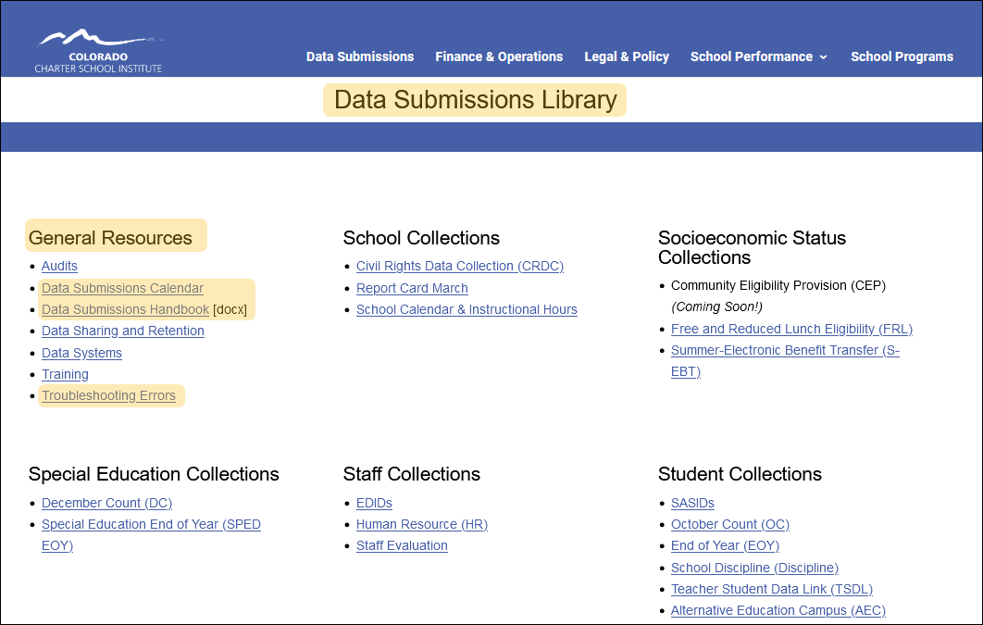
Step 1: Collection Prep Resources
https://resources.csi.state.co.us/data-submissions/
1. Collection Prep
3. Submit to CSI
4. Resolve Errors
5. Certify
2. Data Entry and Review
9
Notes:
Step 1, Collection Prep is about action taken prior to an upcoming collection to ensure you have the general knowledge necessary to be successful. This involves 3 key resources listed under General Resources on the Data Submission Library webpage:
Data Submissions Calendar
Data Submissions Handbook
Troubleshooting Errors spreadsheet.
The Data Submissions Calendar includes key dates for the collection, including initial file submittal, Level 1 error clearance, Level 2 error clearance, and signed certification. Printing this and reviewing it often will help you stay in compliance by meeting all necessary deadlines.
The Data Submissions Handbook is updated every year. It is highly recommended that all new and returning staff review the latest version of this comprehensive resource.
The Troubleshooting Errors spreadsheet will be discussed later. In short, it provides updated listings of each possible error and tips on how to correct the error.

Slide 10
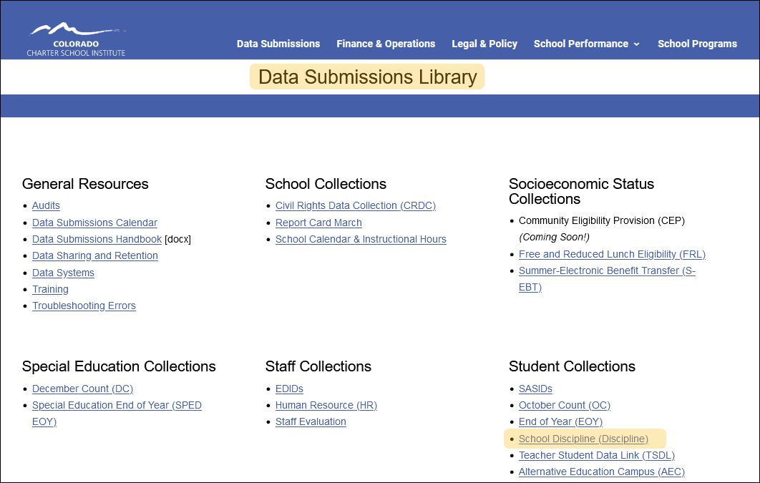
Step 1: Discipline Collection Resources
https://resources.csi.state.co.us/data-submissions/discipline/
1. Collection Prep
3. Submit to CSI
4. Resolve Errors
5. Certify
2. Data Entry and Review
10
Notes:
Additional Resources are available on the School Discipline webpage.

Slide 11
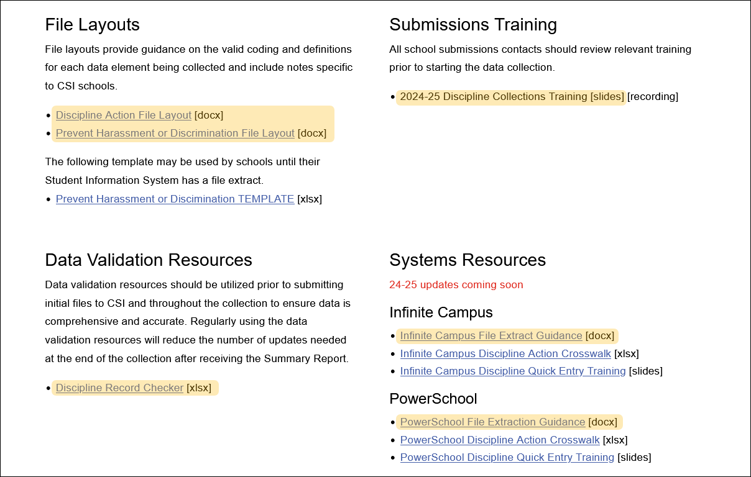
Step 1: Discipline Collection Resources Cont.
https://resources.csi.state.co.us/data-submissions/discipline/
1. Collection Prep
3. Submit to CSI
4. Resolve Errors
5. Certify
2. Data Entry and Review
11
Notes:
They include:
File Layout and Definition documents
Slides for this training, which include clickable links
The Record Checker Tool for the Discipline Action file
And System Resources for Infinite Campus and PowerSchool

Slide 12
Step 2: Data Entry and Review
What data to collect
All reportable Discipline Incidents during the current school year
All formal Harassment or Discrimination Reports
Resources Utilized
File Layout and Definition Documents
Where the data should be entered
PowerSchool
Infinite Campus OR
Another Discipline Tracking Tool
Resources Utilized
PowerSchool or Infinite Campus System Resources
Prevent Harassment or Discrimination TEMPLATE
https://resources.csi.state.co.us/school-discipline/
1. Collection Prep
3. Submit to CSI
4. Resolve Errors
5. Certify
2. Data Entry and Review
12
Notes:
Step 2 is Data Entry and Review. In the next few slides we will review WHAT data to collect and WHERE the data should be entered. Let’s start with a quick overview.
What data must be collected? State reportable discipline incidents include those with Behavior codes and Action codes as listed in the Discipline Action File Layout document. Behaviors and Allegations collected for pre-populating CRDC are also listed in the Discipline Action File Layout.
All formal Harassment or Discrimination reports will be documented as per the Prevent Harassment or Discrimination File Layout.
Where will the data be entered? PowerSchool and Infinite Campus are each set up to collect and report data elements listed in the Discipline Action file. These vendors are in the process of adding the ability to collect and report elements required for the Prevent Harassment or Discrimination file. In the meantime, CDE has provided a template for this collection that is linked on the CSI School Discipline webpage.

Slide 13
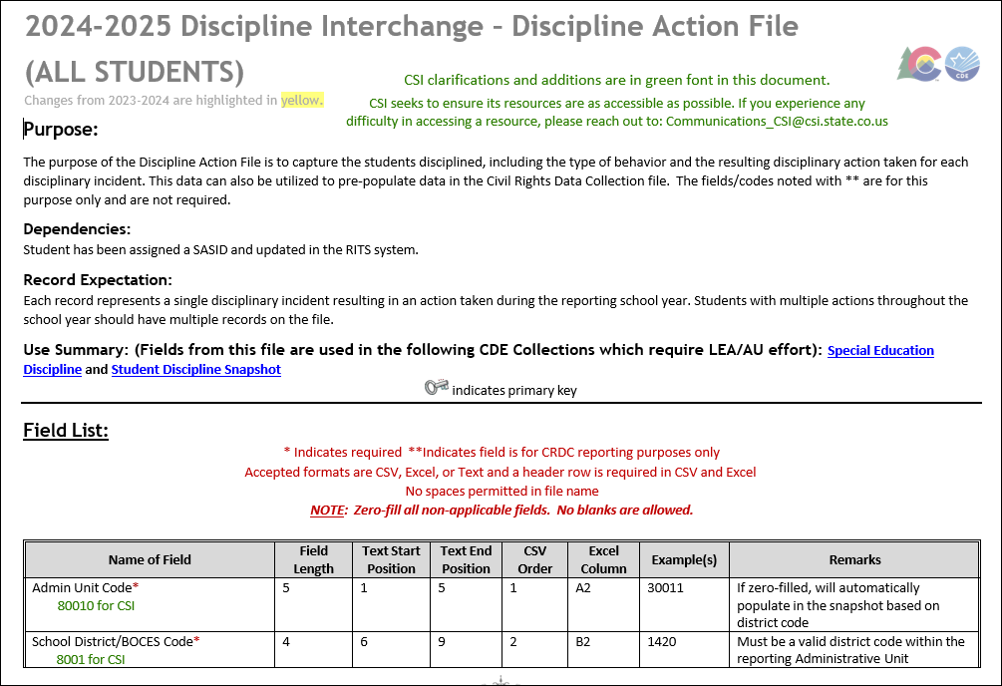
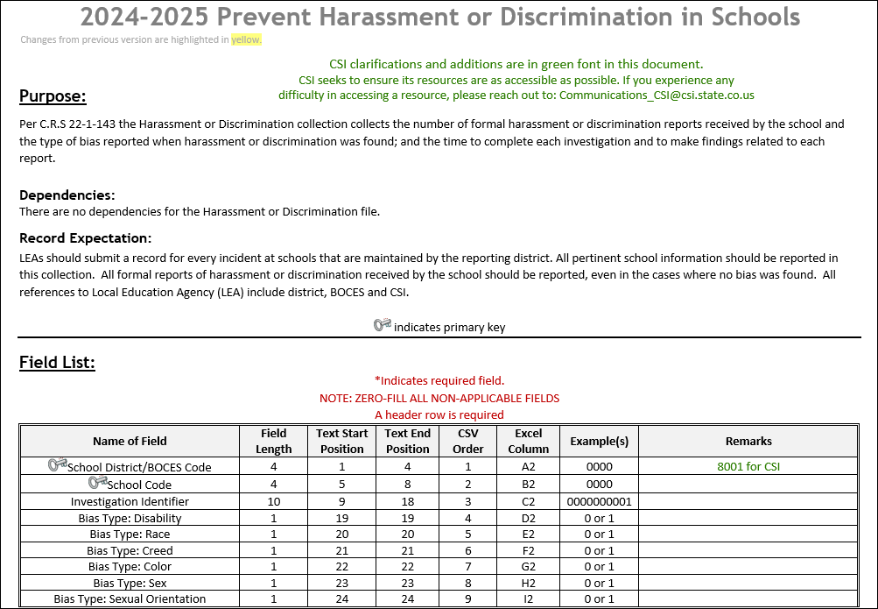
File Layout and Definition Documents – CSI Additions
https://resources.csi.state.co.us/data-submissions/discipline/
1. Collection Prep
3. Submit to CSI
4. Resolve Errors
5. Certify
2. Data Entry and Review
13
Notes:
The file layout and definitions documents, with CSI additions, are a great resource as you go through the data entry process. The documents contain a listing of all fields that are collected in each file. As you scroll through the document, you will see each field and the possible coding options. CSI also adds notes in green that are specific to CSI schools. It is highly recommended to either bookmark these or print them for reference throughout the collection, from data entry to error clearance. The updated documents are linked on the School Discipline page.
It helps to remember there are basically three types of data reported in the Discipline Action file:
Student information, including Special Education information when applicable
Behavior – What did the student do or what was the allegation?
Action – How did the school respond? This is typically discipline, but sometimes there is NO ACTION if the behavior was an unfounded allegation.

Slide 14
Student Discipline – Behavior Codes*
01 Drug Violation Use
02 Alcohol Violation Use
03 Tobacco Violation Use
04 1st, 2nd Degree or Vehicular Assault
05 Dangerous Weapons Carrying
06 Robbery
07 Other Felony
08 Disobedience/ Defiant or Repeated Interference
09 Detrimental Behavior
10 Destruction of School Property
11 Bullying
12 Other Violation of Code of Conduct
13 3rd Degree Assault/Disorderly Conduct
14 Marijuana Violation
15 Sexual Violence/ Battery (other than Rape)
16 Rape or Attempted Rape
* - Codes 17-43 used for CRDC purposes are not listed here. Please see the Discipline Action File Layout to view.
1. Collection Prep
3. Submit to CSI
4. Resolve Errors
5. Certify
2. Data Entry and Review
14
Notes:
Colorado requires that incidents with Behavior codes 01-16, shown on this slide, be reported for the Student Discipline Snapshot and the SPED Discipline Snapshot. These behaviors require a state reportable Action, which we will review on the next slide.
Behavior codes 17-43, listed in the File Layout document, are used for pre-populating CRDC data. These behaviors may or may not have a resulting Action.

Slide 15
Student Discipline – Action / Resolution Codes
00 N/A (used when reporting a Unilateral Removal or CRDC allegations)
10 Classroom Removal
11 In-School Suspension
12 Out-of-School Suspension
13 Expulsion
14 Any other form of discipline
1. Collection Prep
3. Submit to CSI
4. Resolve Errors
5. Certify
2. Data Entry and Review
15
Notes:
Each incident with a state reportable Behavior code must have a state reportable Action. A state reportable Behavior without a state reportable Action, or vice versa, is a very common cause of Discipline Errors. Please review this requirement with the person who enters discipline incidents.
There is a possible exception with Special Education students who have a state reportable Behavior but experience a Unilateral Removal instead of a state reportable Action shown in this list. These are very rare and will be covered in more detail later. The Action code field may also be 00 filled when reporting CRDC allegations that did not result in the school choosing a discipline action.
Let’s pause here to discuss possible confusion in these collections. It is likely that each SIS vendor will choose to use the same Discipline or Behavior reporting tool to collect data for each of these collections. The reporting requirements for the Discipline Action file sometimes differ from the requirements for CRDC and/or Prevent Harassment or Discrimination. As we get closer to the collections opening, CSI will provide additional guidance related to how each SIS vendor chooses to collect and report.

Slide 16
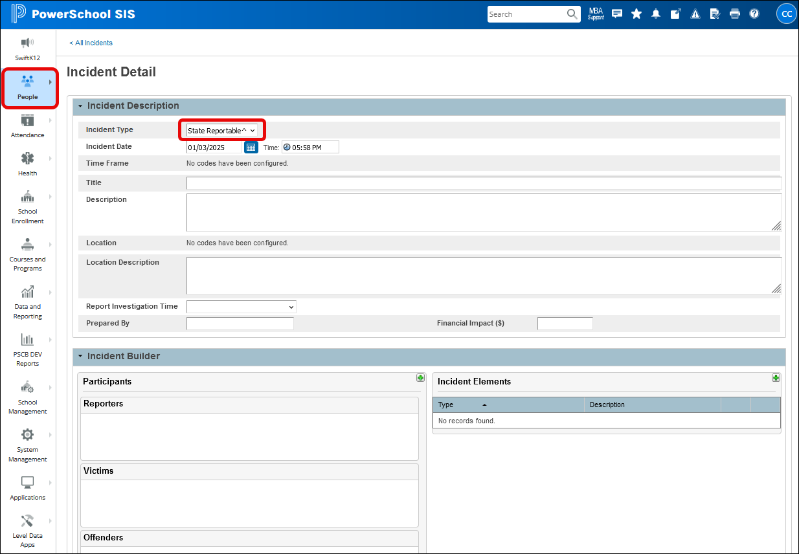
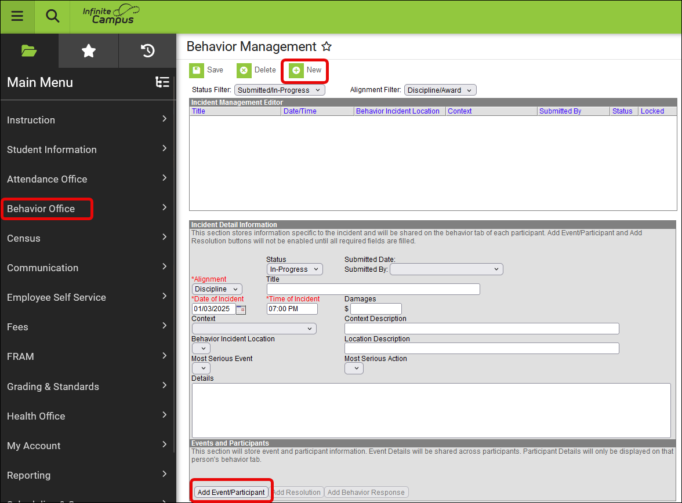
Incident/Behavior Entry in SIS
PowerSchool
Infinite Campus
Start Page > People > Students > All Incidents > Create Detailed Incident
Main Menu > Behavior Office > Behavior Management > New
https://ps.powerschool-docs.com/pssis-admin/latest/incident-elements
https://kb.infinitecampus.com/help/behavior-data-management-and-reporting
1. Collection Prep
3. Submit to CSI
4. Resolve Errors
5. Certify
2. Data Entry and Review
16
Notes:
This slide shows screenshots of where discipline data is entered in either PowerSchool or Infinite Campus. Under each screenshot is a URL for vendor provided guidance on entering discipline data.
In PowerSchool, from the Start Page, select People > Students > All Incidents, then select Create Detailed Incident on the All Incidents page.
In Infinite Campus, from the Main Menu select Behavior Office > Behavior Management, then select New.

Slide 17
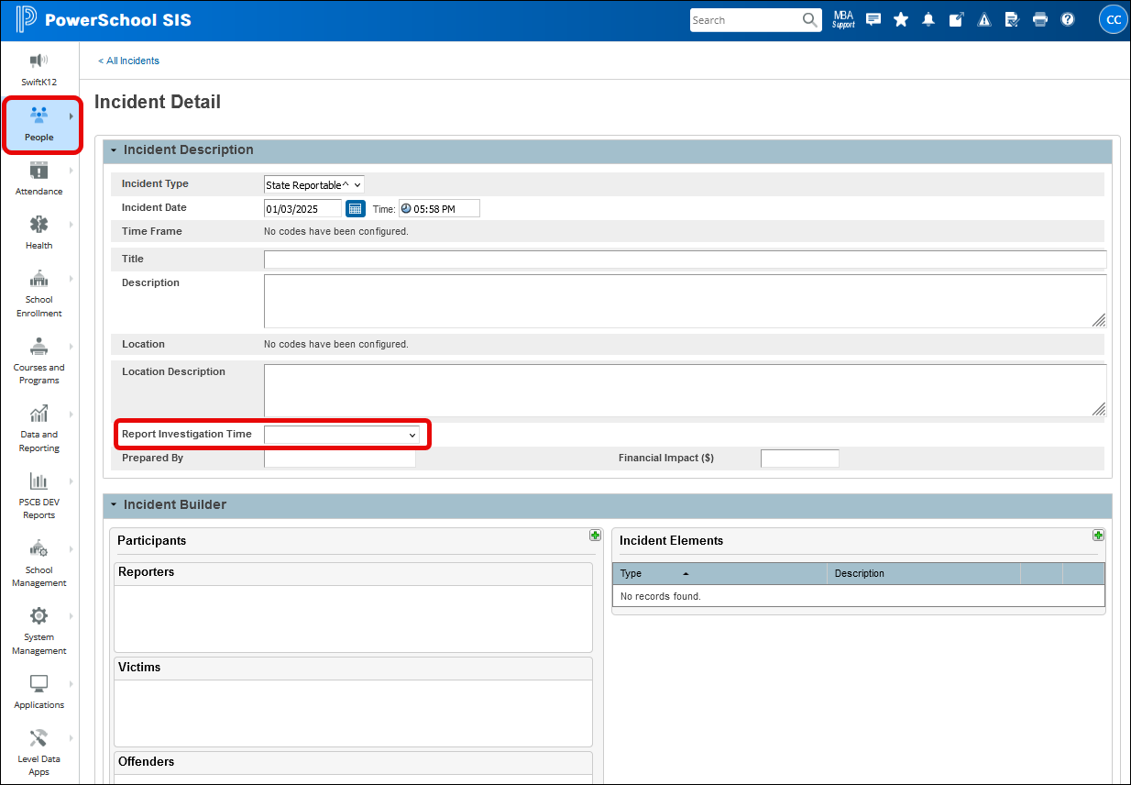
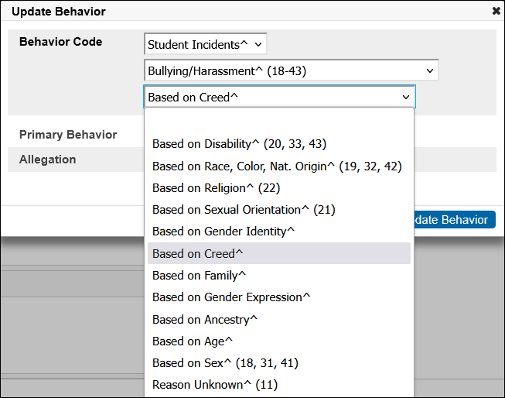
PowerSchool data entry – Prevent Harassment or Discrimination
1. Collection Prep
3. Submit to CSI
4. Resolve Errors
5. Certify
2. Data Entry and Review
17
Notes:
PowerSchool is ready for data entry related to the Prevent Harassment or Discrimination collection. The Incident Management tool now includes elements needed for this collection. The data is collected in one place and reported as needed in each file extract.
The Report Investigation Time field is found in the Incident Description area, when creating an Incident Report.
They have incorporated the required Bias Types within the Behavior Code element, under Bullying/Harassment codes 18-43. These were originally set up for CRDC reporting and now include additional codes for Prevent Harassment or Discrimination.
Infinite Campus had not yet added this functionality, as of the December monthly meeting.
17

Slide 18
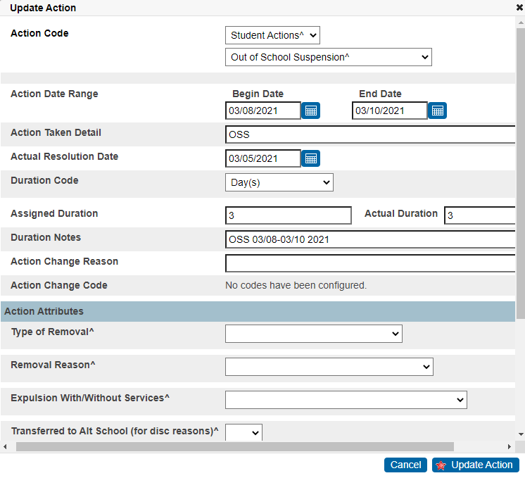
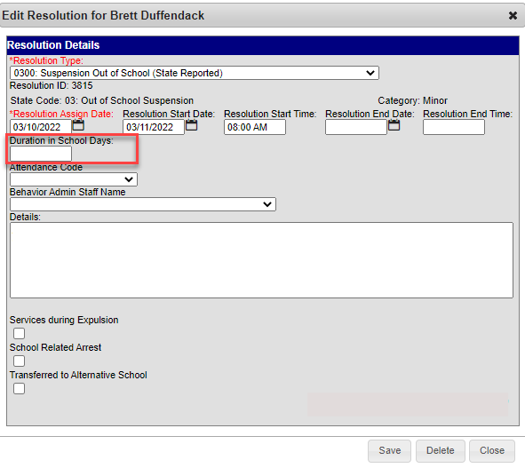
Duration Coding in PowerSchool & Infinite Campus
Duration details are required in both PowerSchool and Infinite Campus. This impacts reporting for both Discipline collections along with other collections:
Duration Code (days) and Assigned/Actual Duration fields in PowerSchool must be entered to ensure accurate number of days being reported
Duration in School Days must be entered in Infinite Campus to accurately report the Number of Days Missed Due to OSS in the CRDC Collection
1. Collection Prep
3. Submit to CSI
4. Resolve Errors
5. Certify
2. Data Entry and Review
18
Notes:
When entering discipline Incidents (Events) in either PowerSchool or Infinite Campus, it is important to note that the Duration Coding must be completed for each Action (Resolution). These fields impact not only the discipline collections, but other collections as well.
For PowerSchool, you must enter the Duration Code (which must be DAYS), Assigned Duration, and Actual Duration. Not entering correctly can impact several collections including Discipline, Attendance, and CRDC.
For Infinite Campus, the Duration in School Days field must be completed for the Number of Days Missed due to Out of School Suspension to also populate in CRDC. We ran into many schools where the OSS days differed when it came to CRDC, and this appears to be the culprit.

Slide 19
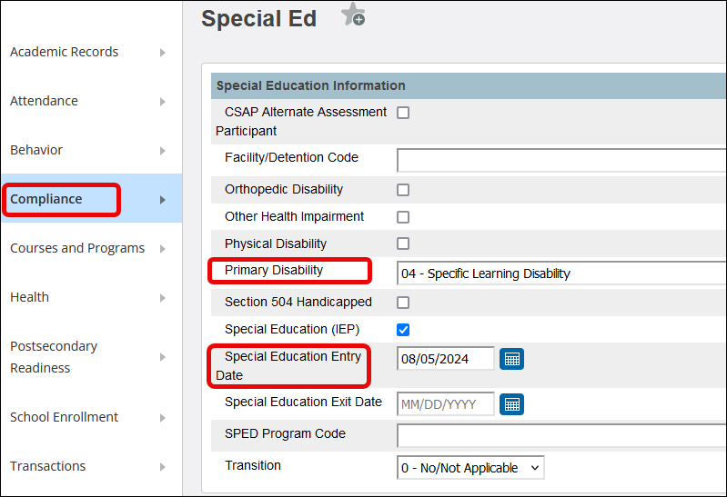
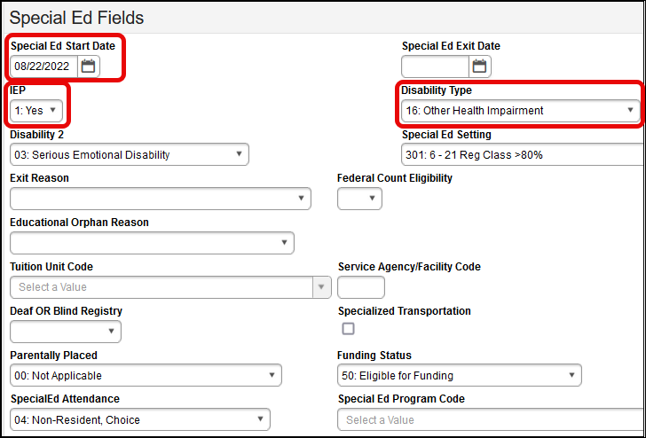
Special Education Fields in SIS
Verify all students receiving Special Education services are coded as such in your SIS regardless if using another plan management system.
Power School Infinite Campus
1. Collection Prep
3. Submit to CSI
4. Resolve Errors
5. Certify
2. Data Entry and Review
Notes:
A key factor to ensure your Special Education students being disciplined are being reported in the SPED Discipline snapshot, is to complete the Special Education fields in the Student Information System, in addition to any other plan management system you may use.
In PowerSchool, navigate to Compliance > Special Ed page (under Student Details). Enter the Primary Disability and the Special Education Entry Date. The Special Education (IEP) check box will be marked automatically once these fields are complete.
In Infinite Campus, navigate to the current year’s enrollment and complete the same fields in the Special Ed Fields section at the bottom of the enrollment.

Slide 20
Unilateral Removal Clarification
Unilateral Removal
Instances when a Special Education student is removed to an Interim Alternative Education Setting (IAES) by order of school personnel or a hearing officer, for 45 days or less. This order is not from the IEP team.
Data Reporting
Unilateral removals are very uncommon for CSI schools, maybe 1-2 per year across the portfolio.
The Discipline Action field will be zero-filled
The Removal Type and Removal Reason fields will have non-zero values
1. Collection Prep
3. Submit to CSI
4. Resolve Errors
5. Certify
2. Data Entry and Review
Notes:
The Unilateral Removal of a Special Education student involves unique coding requirements. This slide aims to provide some clarification. Please reach out to the Submissions inbox for additional help if you have a discipline incident you believe includes a Unilateral Removal.
By way of definition, a Unilateral Removal occurs when a Special Education student is removed to an Interim Alternative Education Setting (IAES) by order of school personnel or a hearing officer, for 45 days or less. This order is not from the IEP team.
These discipline incidents are very uncommon in CSI schools. PowerSchool and Infinite Campus have very different ways of collecting the required information. Please ask for help if you are unsure how to complete data entry. In the extracted file, the Discipline Action will be zero-filled. The Removal Type and Removal Reason will have non-zero values.

Slide 21
Discipline Record Checker
Download the Record Checker tool from the CSI School Discipline webpage.
Review and follow the Step-by-Step guidance on the Instructions tab
The RCT will flag potential issues to be corrected in the SIS
The goal is to have fewer errors upon initial submittal
1. Collection Prep
3. Submit to CSI
4. Resolve Errors
5. Certify
2. Data Entry and Review
21
Notes:
Another resource to help with the data entry and review step is the Record Checker Tool (RCT). Since the Discipline Action file reports student level data, there is a Discipline Record Checker Tool, similar to the RCT for other collections. There is not a Record Checker Tool for the Prevent Harassment or Discrimination file. To get started, download the Record Checker Tool from the School Discipline webpage and carefully review the Instructions tab. The RCT tool flags missing data and potential errors by highlighting data cells that could cause errors. The goal is to have fewer errors upon initial file submittal, saving time for the CSI Submissions staff and the school Data Contact.

Slide 22
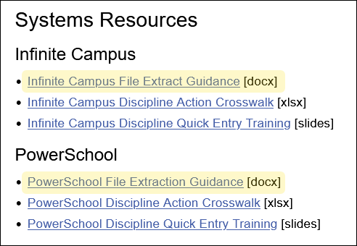
Step 3: Submission to CSI
https://resources.csi.state.co.us/data-submissions/discipline/
1. Collection Prep
3. Submit to CSI
4. Resolve Errors
5. Certify
2. Data Entry and Review
Notes:
We have come to Step 3, extracting data files and submitting them to CSI. On the CSI School Discipline webpage, under Systems Resources, there are instructions to extract the Discipline Action file for both PowerSchool and Infinite Campus. As of the recording of this training, the SIS vendors have not released a report for the Prevent Harassment or Discrimination file. As more information is released, CSI will post updates.

Slide 23
Step 3: Submission to CSI (Cont.)
School Code_School name/abbreviation_interchange type_date
5423SMDisciplineAction05102025
0655_HPA_PreventHarassmentDiscrim_05152025
In Google Drive:
Submissions → School Discipline → 24-25 → Files to Run
Submissions_CSI@csi.state.co.us
1. Collection Prep
3. Submit to CSI
4. Resolve Errors
5. Certify
2. Data Entry and Review
Notes:
Once you have successfully extracted your file, locate the file in the downloads folder. Do not open the file directly as this will result in the loss of leading zeros and many errors. Move the file into the desired folder on your computer and rename it according to the CSI naming convention. This slide shows a color-coded example of how to name files, starting with school code, school abbreviation, file type, and date. If a second file needs to be submitted on the same day, you may add V2 to the end of the file name. File names may not contain spaces. Files with spaces in the name cannot be processed in CDE’s Data Pipeline and will require the file to be renamed.
At this point, please run the data through the Record Checker Tool, as discussed earlier, prior to submitting to CSI. Next, copy the file to the CSI Google Drive and notify CSI using the Submissions email.

Slide 24
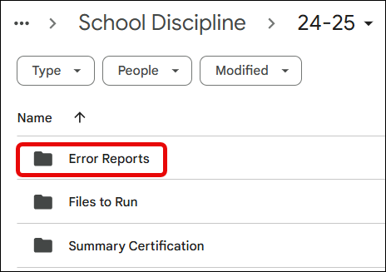
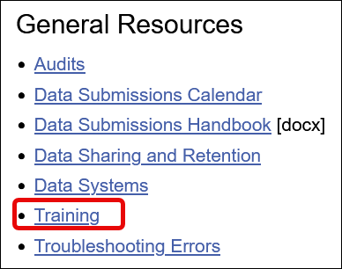
Step 4: Resolve Errors
Error Report placed in Google Drive:
School Discipline → 24-25 → Error Reports
CSI Troubleshooting Errors
Submissions_CSI@csi.state.co.us
Data Submissions additional training
https://resources.csi.state.co.us/data-submissions/training/
1. Collection Prep
3. Submit to CSI
4. Resolve Errors
5. Certify
2. Data Entry and Review
Notes:
Once files are submitted to CSI, they are processed through the CDE Data Pipeline and an error report is generated. The Error Report is placed in the Error Reports folder and an email notification is sent that it is available for review.
Help is available as you work through resolving errors. Please consult the CSI Troubleshooting Errors resource. The document is always a work in progress and is updated as CDE releases additional Business Rules. If you still need help, reach out to the Submissions email. We are always happy to help.
If you are a new data submissions contact, or a returning contact wanting a more in-depth review of Step 4 (Reviewing and Resolving Errors), please visit the Training page linked under General Resources.

Slide 25
Step 5: Final Data Review
courtesy of ya-webdesign.com
Summary/certification report will be provided once error free
Steps to complete:
Review each tab thoroughly to determine accuracy of data
If accurate, ensure all parties have signed and return signed Certification
School Leader, Data Submissions Coordinator, SPED Coordinator (SPED Discipline), and Primary Discipline Contact (School Discipline)
If errors are found reach out to CSI for assistance
Once data is accurate, sign and return prior to the due date.
Summary reports for School Discipline:
School Discipline→24-25→ Summary Certification
1. Collection Prep
3. Submit to CSI
4. Resolve Errors
5. Certify
2. Data Entry and Review
Notes:
Step 5 is the Final Review of data for a submission. After all errors are cleared CSI will provide a Summary and Certification Report in the G-Drive. Summary reports should be reviewed by the Data Submissions contact, the School Leader, and other relevant staff. This is the last opportunity for final edits. Once the review is complete, the Certification tab will be printed, signed and returned no later than the Certification Agreement due date.

Slide 26
Timelines and Deadlines
Notes:
Last, we want to look at the timelines and due dates for these collections.

Slide 27
School Discipline Timelines and Deadlines
Deadline | Task
05/06/2025 | Initial File Submittal
06/12/2025 | Discipline Level 1 errors cleared
06/24/2025 | Discipline Level 2 errors cleared
Last Day of School | Review last file submitted and resubmit files if changes
Early-July* | CSI will provide Data Summary Reports to schools
07/17/2025** | Submit Signed Certification Agreements to CSI
*Dependent upon all schools clearing errors by specified deadlines
**Any requests for changes must be received by CSI on or before 7/14/2025
Be sure to review the 24-25 Data Submissions Calendar for all collection deadlines and watch the Weekly Update email for the latest announcements and other details related to the Discipline collections.
Notes:
Initial files for the Discipline Collection are due by May 6th with the Level 1 error clearance due June 12th. Level 2 error clearance is due on June 24th. The next row in our table is primarily for schools that have cleared all errors prior to the last day of school. As that day arrives, make sure that all incidents that occurred at the school have been reported. CSI will provide summary reports in early July once a school has cleared all errors. The signed certification will be due no later than July 17th.
Please be sure to watch the Weekly Update email for the latest announcements and other details related to the Discipline collections.

Slide 28
Discipline Timeline Reminder
Date of Error Clearance Last Day of School
Schools who clear errors prior to the last day should review all incidents on the last day of school to ensure all are included.
Discipline Steps to Complete on Last Day:
Review the last submitted file and count the number of records.
Extract a new file from your SIS and compare the numbers with your last submitted file.
Submit a new file on the last day of school if changes have occurred since the previous submittal. OR Email Submissions_CSI@csi.state.co.us to confirm data has been reviewed and no changes have occurred.
Notes:
As mentioned on the previous slide, some schools are Error Free prior to the last day of school. Discipline may occur between the date you were first error free and the last day of school. On the last day of school please follow the 3-step process. (READ STEPS) This will ensure every incident reported is captured in the files for the collection.

Slide 29
No Reportable Incidents
courtesy of kindpng.com
If you have no reportable discipline information for one or both collections, send an email to Submissions_CSI@csi.state.co.us
Notes:
That concludes the timeline for the collection. If you have NO INCIDENTS to report for this year, please email the Data Submissions Inbox stating this. We will keep the email in our records for future reference if needed.

Slide 30
Thank you for Reviewing this Training
Contact the Submissions Inbox with Questions:
Submissions_CSI@csi.state.co.us
Notes:
Thank you for reviewing this training on the Discipline collections. If you have questions or concerns, don’t hesitate to email for help.

