Slide 1
Role of a Charter School Board Director

Slide 2
Agenda
Introductions
Framework for Excellent Governance
Board Director Expectations
Next steps
Notes:
1 min. = 1 min. total
Facilitator introduction and session agenda review

Slide 3
Introductions

Slide 4
Introductions
Name, school, role
How long have you been on the board?
What do you enjoy most about being on the board?
Notes:
6 min. = 7 min. total

Slide 5
Framework for Excellent Governance

Slide 6
Framework for Excellent Governance
Similar to the students in our schools, there are high expectations for board directors.
While no two boards are exactly alike, excellent governance across charter school boards has some key commonalities.
There are core responsibilities that need to be responsive and adapt to a changing organization and environment.
Notes:
1 min. = 8 min. total
Excellent governance is dependent on the people who serve on the board of directors.
Similar to the students in our schools, there are high expectations for board directors.
While no two boards are exactly alike, excellent governance across charter school boards has some key commonalities.
There are core responsibilities that need to be responsive and adapt to a changing organization and environment.

Slide 7
Governance Mindset
Strategy | Oversight | Support
Is it about the future?
Is it core to the mission?
Is a high-level policy decision needed to resolve a situation?
Is there a red flag flying?
Does the school leader want or need the Board’s support?
Notes:
2 min. = 10 min. total
There are three components to a governance mindset:
Strategy – The board works closely with the school leader to think about the future direction of the organization and make strategic decisions to move successfully in that direction.
Oversight – The board maintains fiduciary and governance oversight as another core responsibility. Governance oversight includes adhering to federal and state statutes, the board’s own policies, contractual obligations, and overall compliance.
Support – The board provides support to the school leader so that they can execute the day-to-day operations of the organization.
When thinking about these three components of the governance mindset, these guiding questions can help board directors frame their work.

Slide 8
Six Core Responsibilities
A charter school board has six core responsibilities…
Governance and Strategy
Leadership Oversight & Development
Board Self-Management
Provide Resources
Remove Obstacles
Risk Management
Notes:
3 min. = 13 min. total
Also included as part of the framework for excellent governance are six core responsibilities of board members. Your board may have different titles for how they describe these. Essentially, though, the actions are similar for all boards.
Governance and Strategy– Board members define and refine the organization’s mission, vision, and strategic direction and ensure effective organizational capacity and planning.
Leadership Oversight & Development – As I mentioned as part of the governance mindset, supporting the school leader is a key component of excellent government. This starts with recruiting and hiring a strong school leader, supporting and developing that leader, and regularly evaluating them. Additionally, the board monitors and evaluates the organizations programs and services through their support of the school leader.
Provide Resources – Board members ensure the organization has adequate resources and effectively manages those resources.
Remove Obstacles – Board members can help to remove obstacles for the organization by being a voice that helps to remove policy, legislative, regulatory, or other impediments to healthy growth. By removing obstacles, the organization’s public standing can be enhanced.
Board Self-Management – Just as the board develops and monitors the school leader, they should also develop and monitor themselves. This includes they ensure efficient board operations and policies, assess board performance, recruit, orient and effectively engage new board members and create and execute a board leadership succession plan.
Risk Management Oversight – The sixth area of responsibility for the board is to ensure fiscal, legal, and ethical integrity while also maintaining accountability and transparency.

Slide 9
Charter School Board Life Cycle
FOUNDING BOARD
EMERGING BOARD
MATURING BOARD
Board focus on operations, may act as “auxiliary staff” | Board focus shifts toward more forward-looking strategic matters | Board focus shifts to protecting from risk and ensuring long-term sustainability
5-7 Members Often friends of school leader | 7-15 Members More diversified skills and relationships | 11-15 Members Strategically targeted for profile and influence
Key Inflection Points
Increase in number and type of schools | New School Leader/ Executive Director | New Board Chair | Introduction or changes in supports | Political or regulatory changes
Notes:
3 min. = 16 min. total
Boards go through a series of stages based on the age and performance of the organization.
Outlined here you will see the three stages of a board and the work performed at each stage.
Founding Board
Emerging Board
Maturing Board
These board stages most often evolve at different inflection points over the life of the organization. For charter schools, these are some of the key inflection points for when a board may shift from one stage to the next:
Increase in the number and types of schools
New school leader or executive director
New Board Chair
Introduction or changes in supports
Political or regulatory changes
Think about how you would describe the board you are joining. Do you know the stage? Understanding where the board is currently in its governance stage and where it is headed will help you to better perform your board responsibilities.

Slide 10
Charter School Boards vs. Other Non-Profit Boards
Responsibilities of a public school board of education
Operate in a complex environment of accountability
Long-term focus on outcomes for students
Often function as “working” boards until the school has established stability and longevity
Notes:
1 min. = 17 min. total
As we’re discussing charter school governance and its framework, I wanted to take a moment to point out some differences from other non-profit boards. These include:
Responsibilities of a public school board of education
Operate in a complex environment of accountability
Long-term focus on outcomes for students
Often function as “working” boards until the school has established stability and longevity

Slide 11
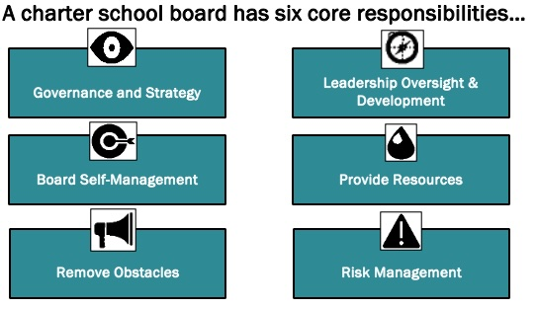
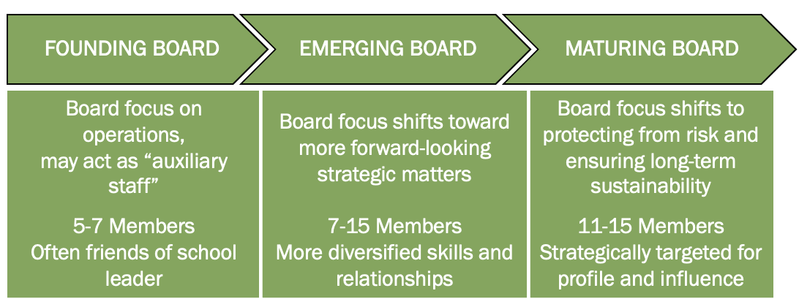
Reflection
Write and Share
Does your board demonstrate some or all of the three components of the Governance Mindset?
Which of the Six Core Responsibilities do you demonstrate well? Which ones are missing or need to be improved?
Where would you place your board in the Charter School Board Life Cycle?
Notes:
5 min. = 22 min. total
Let’s take a few minutes and reflect on the framework for excellent government. Take a look at the questions here and write down responses specific to your charter school board and your personal experience. I’ll give you two minutes to write down your responses and then we’ll share out as a group.
Give people time to write and then ask them to share in the chat or to come off mute and share with the group.

Slide 12
Board Director Expectations

Slide 13
Charter School Board Director Job Description
Key Components of the Job Description:
Primary governance responsibilities
Critical components of an effective board
Responsibilities of individual board members
Estimated time commitment for board members
*Note – Depending on where your board is in its life cycle, there may be shifts in the responsibilities of the board. Regularly reviewing your job description is highly recommended.
Notes:
2 min. = 24 min. total
Board service comes with expectations and obligations. A written job description defines the primary governance responsibilities of the board and reminds it of the critical components of an effective board.
The job description also outlines the responsibilities of individual board members to help them understand what they need to do to meet their legal obligations to the organization and engage productively in the board’s work.
Finally, the job description should also include the time commitment for board members, including the length of their board term and the monthly time commitments related to meeting preparation, full board meetings, committee meetings, and other required commitments unique to your individual board.
[click for the Note] As the board moves through the different stages of the board life cycle that we previously discussed, there can be changes in the responsibilities of the board. This means that there may be different skills you are looking for in new board members. It is important to determine what specializations and ties to the community prospective members can offer to your organization, in order to help facilitate delegation and allow the board to become more institutionalized. Being intentional about recruitment is the key to expanding the capacity of your board while at the same time ensuring each board director provides a strategic presence.

Slide 14
Charter School Board Director Job Description
Governance Responsibilities | Critical Components of an Effective Board | Individual Board Member Responsibilities | Estimated Time Commitment
Legal obligations Fiduciary responsibilities Ethical standards | Six Core Responsibilities Big picture and long-term sustainability Succession planning Distinction between management and governance Leader evaluation | Alignment to the charter school’s mission and vision Advocate and champion for the charter school Commitment to regularly attending meetings and required events Adhering to conflict of interest and other relevant policies and procedures | Regular meeting and board retreat attendance Committee meeting attendance Prep time for meetings Attending events outside of board meetings Visiting the charter school
Notes:
3 min. = 27 min. total
When creating a charter school board director job description, there are a few key items you want to include in each of the four sections we discussed on the previous slide. Let’s walk through a few examples.
Governance Responsibilities
These may include the legal obligations of board members such as adhering to the Colorado Open Meetings Law and Open Records Act and following other state statutes.
Fiduciary responsibilities, including the annual audit, quarterly review of financials, and approving the annual budget may be notes.
The ethical standards may outline expectations around understanding how the board works as one voice and adherence to laws related to the charter school and its students, staff, and families.
Critical Components of an Effective Board
In this section of the job description, you might give an overview of the six core responsibilities of board members.
This section may outline the need for board members to serve as a strategic presence for the organization.
Informing prospective board members that there is a plan for leadership succession on the board and the role they will play in adding to the capacity of the board can be in this section.
It is also important for new board members to understand that being on the board means they will be responsible for the governance and management of the overall success of the organization and the school leader will manage the day-to-day operations.
And finally, as we previously discussed, one of the key roles of the board is the evaluation of its school leader and this can be outlined in the job description as well.
Individual Board Member Responsibilities
In this section, the job description should outline the high-level expectations for new board members as well as any specific skills you are looking for in new board members.
At the top of the list should be an acknowledgment that all board members are aligned to the charter school’s mission and vision and will be an advocate and champion for the school.
This section can also provide specific details about meeting and event attendance and adherence to conflict of interest and other relevant policies and procedures.
Estimated Time Commitment
Often one of the first questions asked by prospective board members is how much time they will be committing to the board. Spelling this out explicitly in your job description helps ensure people know the expectations for their board service.
You can include how often board meetings and board retreats are held, expectations for committee membership and meeting attendance, how long it takes to prepare for required meetings, expectations for attendance at events outside board meetings, and whether or not there is an expectation for visiting the charter school, and if there, is how often these visits occur.

Slide 15
Charter School Board Director Commitment to Excellence
Breakout Rooms:
What does it mean for you to be on your charter school board?
What makes being on the charter school board different from being on other boards?
What commitments have you made as a charter school board director?
What commitments are you willing to make that will keep you engaged and not be overwhelming?
Notes:
10 min. = 37 min. total
(2 min. intro, ~5 min. in breakouts, ~3 min. share)
TO PASTE:
What does it mean for you to be on your charter school board?
What makes being on the charter school board different from being on other boards?
What commitments have you made as a charter school board director?
What commitments are you willing to make that will keep you engaged and not be overwhelming?
We’re going to take a few minutes to go into breakout rooms and talk a bit about your experience about being on your charter school board. Listed here are the questions I’d like you to discuss.
When we come back together, I’ll ask you to share out a high-level overview of similarities you found amongst members of your group in terms of the commitment each of you has made to being on your charter school boards.
[Send participants to breakout rooms for about five minutes.]
[Upon return from breakout rooms] It was great to hear the conversations happening in each of the rooms and see the similarities and differences in your board experiences. I’d love to now have someone from each room share out some of the similarities you heard during your discussions.
[Participants share out and presenter takes notes on the similarities.]

Slide 16
Charter School Board Director Commitment to Excellence
Signed by each individual board member
Legal, fiduciary, and ethical responsibilities
Belief in and support of the organization’s mission
Acknowledging the work of the board as a united entity
Commitment to fulfilling individual duties as a charter school board director
Process for addressing directors not fulfilling their commitment
Notes:
2 min. = 39 min. total
It was great to hear from each of you about the similarities in the commitments you have made to your charter school boards. Once board members join and the board, and then most often on an annual basis, you are asked to sign a commitment to excellence or board agreement. This document is a great reminder of your responsibilities as a charter school board member and why you chose to be a member of the board.
The board member agreement and commitment to excellence is signed by each individual board member. At a high level, the agreement commits the charter school board director to:
Legal, fiduciary, and ethical responsibilities
Belief in and support of the organization’s mission
Acknowledging the work of the board as a united entity
Commitment to fulfilling individual duties as a charter school board director
Process for addressing directors not fulfilling their commitment

Slide 17
Sample Commitment to Excellence Agreements
Help raise funds by working on a particular fundraising project or carrying out a particular fundraising responsibility or goal
Stay informed about the organization and its issues by reviewing materials, participating in discussions, and asking strategic questions
Serve as an active advocate and ambassador for the values, mission, and vision of the school
Encourage each other to fulfill their responsibilities to the fullest of their potential
Serve as a committee chair or member
Regularly attend and participate in meetings, committees, and events
Use personal and professional contacts to reach into diverse communities to identify and recruit donors, volunteers, and advocates to support the organization
Adhere to relevant policies and procedures set by the board and identify any potential conflicts of interest
Encourage a diversity of opinions and solutions
Maintain confidentiality outside of Executive Session and use the utmost discretion when discussing confidential matters outside of board meetings
Promptly communicate to the school leader and Board Chair any concerns or issues that have the potential to create a risk to the sustainability of the organization
Make an annual financial contribution and support capital campaigns as appropriate
Notes:
3 min. = 42 min. total
Prior to today’s session, I asked people to share sample language for you commitment to excellence and board agreements. Listed here are a few of the items that were included in those examples.
[Read through boxes on the slide.]

Slide 18
Session Review
Framework for Excellent Governance
Governance Mindset
Six Core Responsibilities
Charter School Board Life Cycle
Charter School Board vs. Other Non-Profit Boards
Board Director Job Description
Board Director Agreements and Commitment to Excellence
Notes:
3 min. = 45 min. total
We have discussed a number of topics related to the role of the charter school board director:
Framework for Excellent Governance
Governance Mindset
Six Core Responsibilities
Charter School Board Life Cycle
Charter School Board vs. Other Non-Profit Boards
Board Director Job Description
Board Director Agreements and Commitment to Excellence
What outstanding questions do you have?
[Answer participants questions live or from the chat.]

Slide 19
Work Time

Slide 20
Creating/Revising Your Documents
Start with the Charter School Board Director job description first.
If you don’t have one, think about what you would like to include.
If you do have one, are there revisions you’d like to see made based on today’s session?
Move on to the Board Director Agreement and Commitment to Excellence.
Review your charter school board director job description to determine the expectations of your charter school board members.
Using the expectations from your job description, identify for each of the Six Core Responsibilities of a charter school board the specific actions you expect from your charter school board members.
Determine how you will monitor how each individual and the board as a whole is meeting the commitments made.
Notes:
10 min. = 55 min. total
We’re going to take some time now to work on some documents for our individual charter schools. I have pasted in the chat links to templates that you can use to get started if your charter school does not already have these documents.
During the next ten minutes, I’d like you to:
Start with the Charter School Board Director job description first.
If you don’t have one, think about what you would like to include.
If you do have one, are there revisions you’d like to see made based on today’s session?
Move on to the Board Director Agreement and Commitment to Excellence.
Review your charter school board director job description to determine the expectations of your charter school board members.
Using the expectations from your job description, identify for each of the Six Core Responsibilities of a charter school board the specific actions you expect from your charter school board members.
Determine how you will monitor how each individual and the board as a whole is meeting the commitments made.
[If there are multiple people from one charter school board in the meeting, ask if they’d like to move to a breakout room to speak with one another. This offer may also be made to participants who are from different schools but would like to have a thought partner.]
TO PASTE:
Charter School Board Director Job Description Template
Agreement and Commitment to Excellence Template
CSI Board Agreement Template

Slide 21
Next Steps

Slide 22
Individual Next Steps
Connect with your board colleagues to discuss what you learned today. Create or revisit the charter school board director job description and agreement and commitment to excellent forms for your organization.
Determine where you and/or your board colleagues may need additional development based on what you learned today about the role of the charter school board director.
Notes:
1 min. = 56 min. total
Read through the two bulleted items on the slide.

Slide 23
CSI Next Steps
Fund Development (September 25, 4:00 PM)
Charter School Board Governance and Compliance (September 26, 12:00 PM)
Effectively Implementing Board Committees (November 20, 6:00 PM)
School Leader Hiring, Development, and Evaluation (January 30, 5:30 PM)
Charter School Board Development and Self-Assessment (March 24, 12:00 PM)
Notes:
1 min. = 57 min. total
There will be five more board development sessions offered over the course of this year for all Board members. These will include:
Fund Development
Charter School Board Governance and Compliance
Effectively Implementing Board Committees
School Leader Hiring, Development, and Evaluation
Charter School Board Development and Self-Assessment

Slide 24
Thank you
Kimberlee Sia
773.971.2325
kimberlee.sia@gmail.com
Notes:
3 min. = 60 minutes total
If you have questions or want to talk through anything we discussed today, feel free to call or email. Thank you for your participation!

