Slide 1
New Student Transfers

Slide 2
Back to School
Special Education Teachers have a unique situation when preparing for the new school year.
Usually receive a list of special education students the day they return.
After receiving the list there are several steps the special education case managers will need to follow prior the students entering school.

Slide 3
Notice to District of Residence
Determine which special education students are new (enrolled over the summer) or have transferred to your school this current school year.
Complete notification letter to the superintendent and special education director of the student’s District of Residence.
Use your letterhead for your school and either mail or fax the letter to the District of Residence.

Slide 4
Letter to District of Residence
CONFIDENTIAL
Notice to District of Residence
Date_____________
To:
Superintendent of________________________
Director of Special Education of_____________
Name of Charter School:___________________
The following student, who has an identified special education disability, has applied to enroll or has enrolled in our school.
Name of Student:___________________________
Student’s Date of Birth_______________________ SASID________________________
Date of enrollment application:____________________
Anticipated date of admission:____________________
_______________________________________________
Printed Name of Charter School Administrator
_______________________________________________
Signature of Charter School Administrator

Slide 5
Request and Review the IEPs of New Students
Determine which students are new enrollees and which students are transfer students
  New Enrollees
    Students who enrolled prior to the start of the school year – spring or summer following the lottery
  Transfer Students
    Students who enrolled in your school after school begins.
Request records from the previous school.
  Initial evaluation or most recent triennial evaluation
  Eligibility Determination
  Current IEP
  Copy of Prior Written Notice and Consent for Placement
    If the previous district did not complete a PWN and Consent for Placement, complete one and have it signed by the parent.
*Remember schools do not need a signed request of records to gain access to a copy of the IEPs from the previous school.
If you have difficulty obtaining the records, talk with your coordinator.

Slide 6
New Enrollees
Spring and Summer Enrollment
Special Education students who enroll in your school over the summer must have a current IEP in place the first day of school.
The student’s IEP from their previous school must be adopted or you must develop a new IEP prior to the first day of school.

Slide 7
New Students
Acceptable IEP
Student’s Profile is completed in the IEP platform that the school is using.
The current IEP from the previous school is adopted, scanned, and uploaded in the IEP platform used by the charter school.
All appropriate staff are notified of the student’s IEP.
All dates stay consistent with the current IEP.

Slide 8
New Student Enrollment Unacceptable IEP
If the IEP team determines the student’s current IEP is inappropriate:
  Complete Student Profile Information in IEP platform.
  Request Prior Written Notice and Permission to Evaluate from the parent to determine Least Restrictive Environment and Services.
  Document how you are going to provide comparable IEP services while assessment takes place.
  Assess the student to determine needs, services and placement.
  Within 30 days, convene an evaluation meeting with all required members and all appropriate paperwork, including Notice of Meeting.
  Develop a new IEP based upon the student’s needs.

Slide 9
During the Assessment Process
The student must be served according to the previous IEP;
Comparable services will be provided, if required;
Parents must be provided with Prior Written Notice indicating the comparable services.
*Remember: The student must be served based upon their needs, not the school’s needs.

Slide 10
Transfer Student
IEP student who enrolls in your school from another school at anytime during the school year.
The IEP must be in effect the first day the student enters.
Any changes to the student’s goals, services, or LRE must be made through an official IEP meeting or an IEP amendment.

Slide 11
Types of Transfers
In-state transfer – When a student with an IEP enrolls in your school from another district/school in Colorado.
Out-of-state transfer – when a student with an IEP enrolls in your school from a district/school from another state.

Slide 12
In-State Transfer Students
Conduct a transfer meeting when a student with an IEP enrolls in your school.
Determine if the current IEP can be accepted as is.
  If YES:
    Complete the transfer form and indicate that the current IEP will be followed as is.
  If NO:
    Complete transfer form and indicate that the IEP will not be adopted and proceed to develop a new IEP through the IEP process.
    Define comparable services on the form.
*If significant changes are made to the current IEP, the evaluation process must be followed.

Slide 13
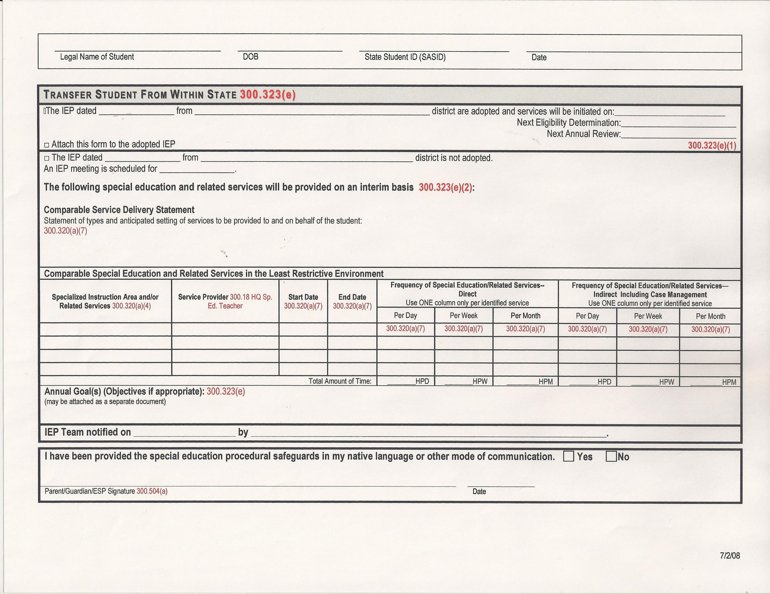

Slide 14
Out of State Transfers
Determine if the student meets Colorado’s eligibility requirements as a student with a disability under ECEA Rules.
  If Yes:
    The IEP team may adopt the current IEP or determine appropriate comparable services until a new IEP is developed.
  If No:
    The IEP team must conduct a new evaluation to determine eligibility following the appropriate steps for an Initial Evaluation.

Slide 15
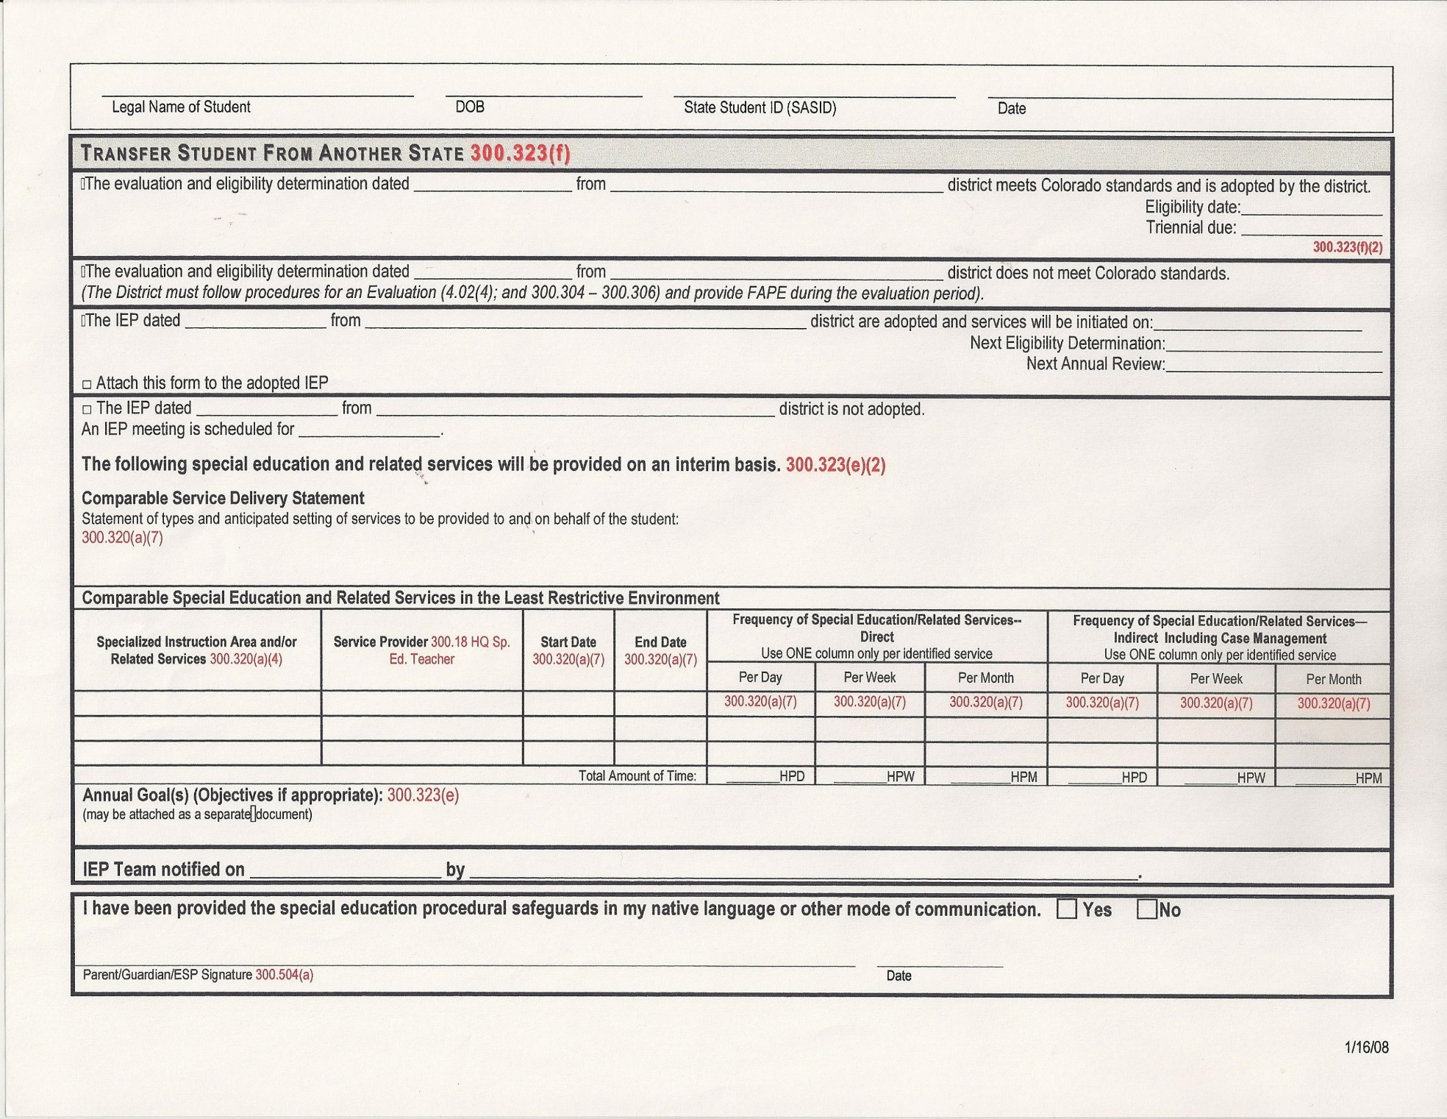

Slide 16
Most Importantly
All students with an IEP must begin receiving services the first day of school
All relevant staff must be notified of accommodations and modifications for students in their classrooms.
All pertinent staff must receive a copy of student behavior plans; including bus drivers, recess paraeducators, and lunchroom staff, if appropriate.

Slide 17
Resources
Contact your CSI Regional Coordinator for additional guidance or information.
IEP Procedural Guidance: Exceptional Student Services Unit Technical Assistance; Colorado Department of Education http://www.cde.state.co.us/cdesped/iep_proceduralguidance
Special Education Onboarding Handbook: A Guide for New CSI Schools and Staff https://resources.csi.state.co.us/onboarding-training/

