Slide 1

Special Education: How to prepare for the year

Slide 2

AGENDA
Intro
Warm Up
Where to start?
Beginning of year transfer IEPs
Annual Review Prep
Re-evaluation/Triennial IEP Prep
Planning for an Initial Special Education
Things to think about

Slide 3
Your Yearly IEP Calendar
How to set yourself up-organize
Look at your caseload
Make a list if needed (*Is there a one big list?)
Review all dates
  Map out on your calendar

Slide 4
Example Caseload List:
Student | Grade | ELL | English Teacher | Math Teacher | Annual Review | Re-Eval | Primary | Secondary | Service Minutes
Johnny Sample | 2nd | Y | Ms. Book | Ms. Angle | 10/12/23 | 10/15/23 | SLD | NA | Lit: 90 Math: 90
Sally Sample | 3rd | Y | Mr. Paper | Ms. Cube | 12/12/2023 | 12/11/2025 | OHI | NA
Harper J | 3rd | N | Mr. Paper | Ms. Cube | 01/05/2024 | 01/05/2024 | SLD | SLI | Lit: 120 SLP: 90/month
Marley S | 3rd | N | Mr. Paper | Mr. One | 03/22/2024 | 03/29/2025 | OHI | NA | MH: 35 Nurse: 10 SLP: 75
Justin E | 4th | N | Mrs. Scribe | Ms. Digit | 04/20/2024 | 05/10/2024 | SLD | NA | Lit: 240
**be aware of dates (example Justin E)

Slide 5
Example Caseload List:
Student | Grade | ELL | English Teacher | Math Teacher | Annual Review | Re-Eval | Primary | Secondary | Service Minutes
Johnny Sample | 2nd | Y | Ms. Book | Ms. Angle | 10/12/23 | 10/15/23 | SLD | NA | Lit: 90 Math: 90
Sally Sample | 3rd | Y | Mr. Paper | Ms. Cube | 12/12/2023 | 12/11/2025 | OHI | NA
Harper J | 3rd | N | Mr. Paper | Ms. Cube | 01/05/2024 | 01/05/2024 | SLD | SLI | Lit: 120 SLP: 90/month
Marley S | 3rd | N | Mr. Paper | Mr. One | 03/22/2024 | 03/29/2025 | OHI | NA | MH: 35 Nurse: 10 SLP: 75
Justin E | 4th | N | Mrs. Scribe | Ms. Digit | 04/20/2024 | 05/10/2024 | SLD | NA | Lit: 240
**Hold Re-Eval meeting at/before Annual Meeting

Slide 6
Preparing for a Transfer Meeting

Slide 7
Transfer IEPs
Beginning of year:
Receive (or request if necessary) *even if expired
Review IEP (*services)
Accept or Not Accept IEP (~within 30 days)
  *schedule a meeting in necessary
  *Expired IEPs = best practice is to evaluate
Throughout the year:
Follow the same process

Slide 8
Preparing for the Annual Review

Slide 9
What is an Annual Review?
Why do we have them?

Slide 10
Annual Meeting
1 month:
Connect with team (any other providers) for dates
Contact parents- set meeting date (~week within date)
List meeting on team calendar/school calendar
Meeting confirmed-create Notice of Meeting (NOM) and ensure all required participants are on it
Send NOM ~10 days in advance
3 weeks:
Student interview
Collect teacher/parent input
Finish draft IEP
1 week:
*best practice= send draft to parents before meeting

Slide 11
Annual continued…
  Days Before Meeting:
    Send out meeting reminder (parents, teachers,
providers, student)
    Prepare paperwork for meeting (printouts, copies)
At Meeting:
    Project IEP/Print drafts for all
    Procedural Safeguards
    Edit during meeting (real time)/ mark in colored pen
After Meeting:
    Parents leave with IEP draft (with edits/colored pen)
    Upload all documents (signature page, rubrics, etc)
    Finalize/send home within 1 week

Slide 12
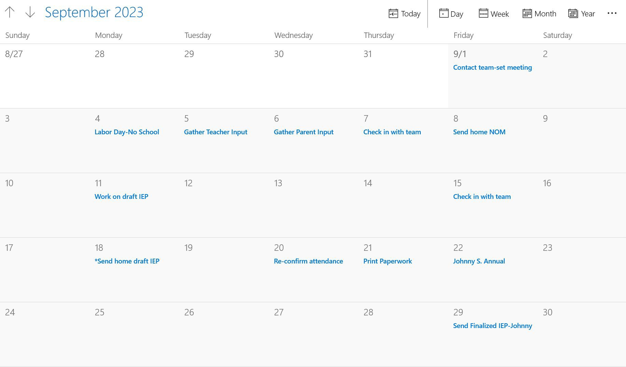
Annual Review Calendar

Slide 13
Preparing for the Reevaluation Review

Slide 14
What is a Reevaluation (re-eval) or Triennial Review?
Why do we have them?

Slide 15
Reeval/Tri Meeting
(Reevaluation-Triennial Review)
Determine what areas are to evaluated
Get consent to evaluate
Map out 60 days for evaluation (give yourself wiggle room)
Share with providers when consent is received
Connect with team (any other providers) for dates
Contact parents- set meeting date (~week before 60 days)
  60 day calendar-link
Coordinate testing (not all on one day)
Prepare Evaluation report
*Consider holding IEP meeting following Eligibility/Evaluation
Meeting confirmed-create Notice of Meeting (NOM) and ensure all required participants are on it (*at least 10 days)
1 week before meeting:
Best Practice- Send draft home 5 days prior to meeting

Slide 16
Re-eval/Tri Meeting Continued…
  Days Before Meeting:
    Send out meeting reminder (parents, teachers,
providers, student) *confirm space/time
    Prepare paperwork for meeting (printouts, copies)
    *Eligibility/Eval Report, eligibility checklist(s), IEP draft, PWNs
At Meeting:
    Project Eval/Eligibility Report (and) IEP/Print drafts
for all
    Procedural Safeguards
    Edit during meeting (real time)/ mark in colored pen

Slide 17
Re-eval/TRI meeting continued…
After Meeting:
Parents leave with IEP draft (with edits/colored pen)
Upload all documents (signature page, eligibility checklist, rubrics, etc)
Finalize/send home within 1 week

Slide 18
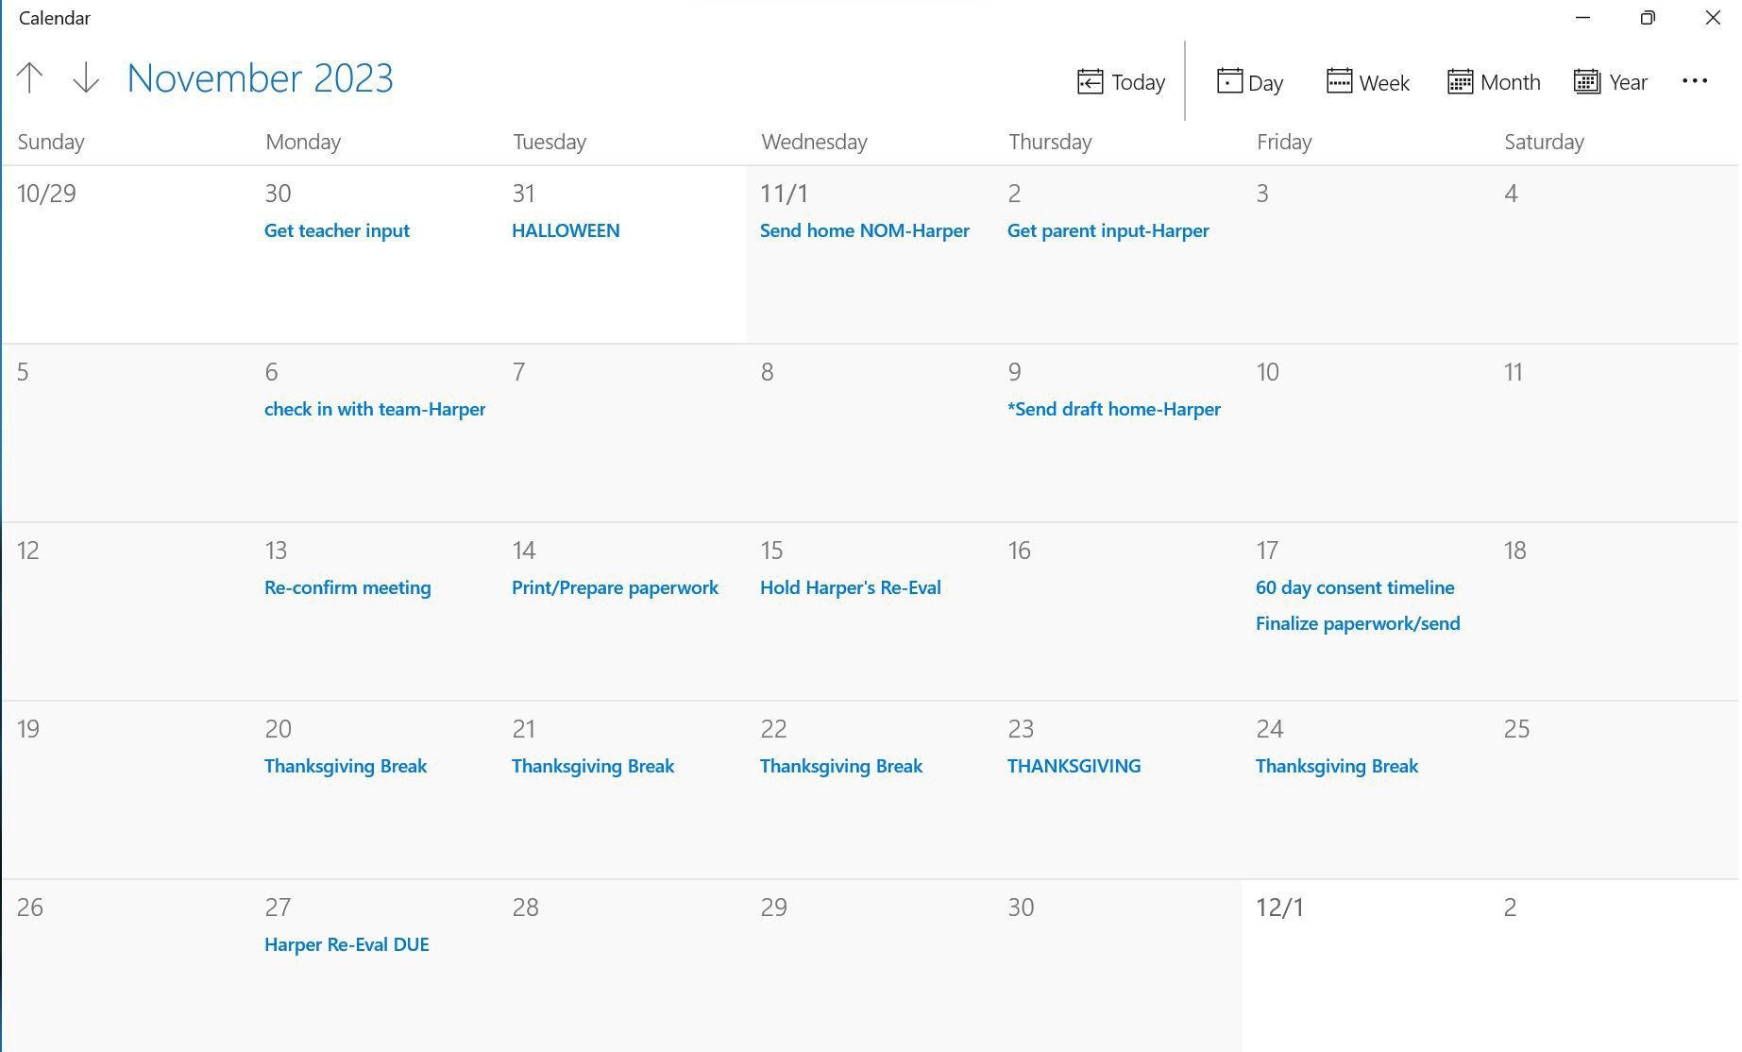
Re-Eval/TRI Calendar

Slide 19
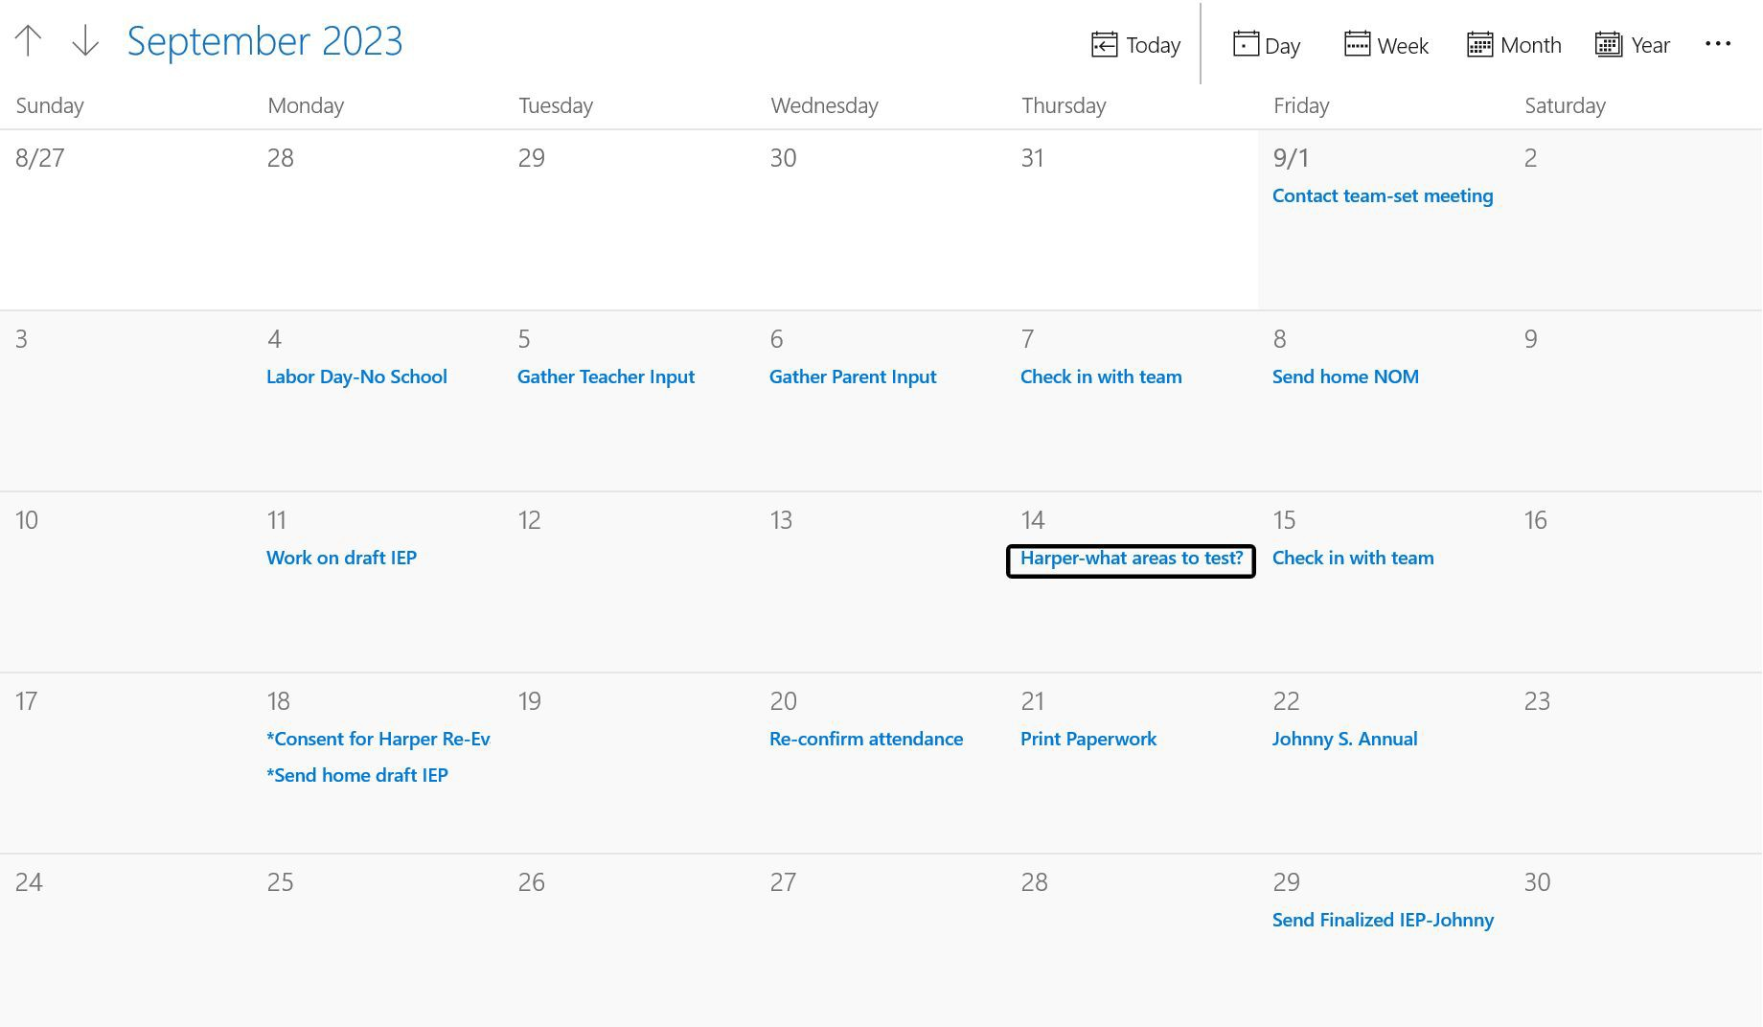
Re-Eval/TRI
**Once consent is received notify team and start testing-communicate with team members

Slide 20
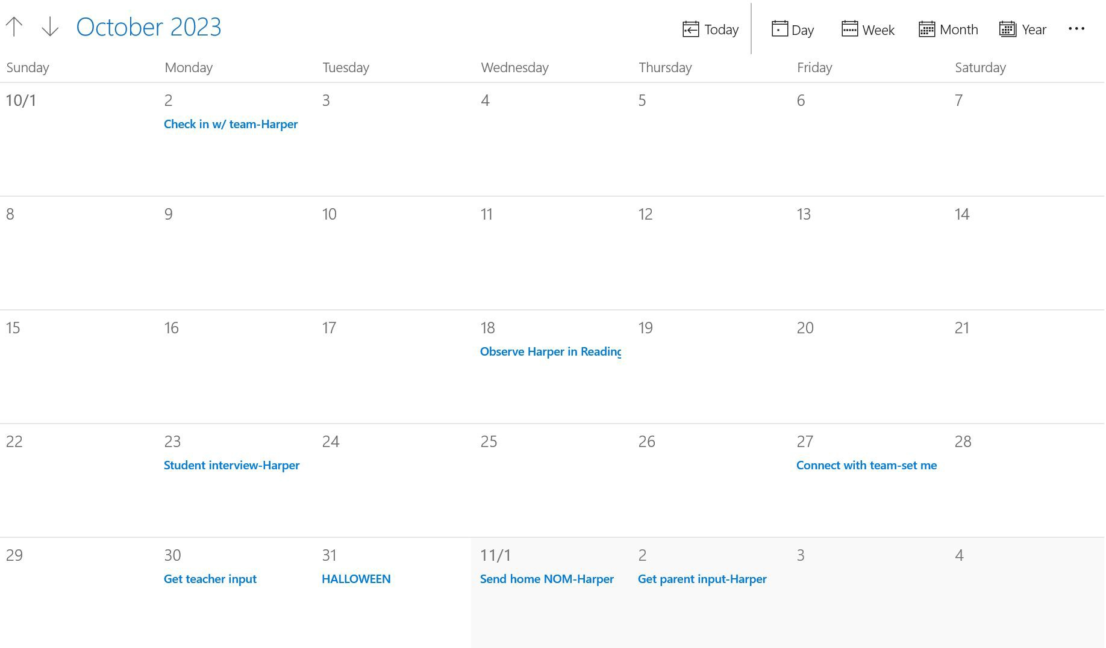
Re-Eval/TRI

Slide 21
Preparing for Initial/ Eligibility

Slide 22
What is an Initial Evaluation/Eligibility Meeting?
What do we do them?

Slide 23
Initial Meeting
Determine what areas are to evaluated
Get consent to evaluate
Map out 60 days for evaluation (give yourself wiggle room)
Share with providers when consent is received
Connect with team (any other providers) for dates
Contact parents- set meeting date (~week before 60 days)
  60 day calendar-link
Coordinate testing (not all on one day)
Prepare Evaluation report
*Consider holding IEP meeting following
Eligibility/Evaluation
Meeting confirmed-create Notice of Meeting (NOM) and ensure all required participants are on it (*at least 10 days)
1 week before meeting:
Best Practice- Send draft home 5 days prior to meeting

Slide 24
Initial Continued…
  Days Before Meeting:
    Send out meeting reminder (parents, teachers,
providers, student) *confirm space/time
    Prepare paperwork for meeting (printouts, copies)
    *Eligibility Report, eligibility checklist(s), IEP draft, PWNs
At Meeting:
    Project Eval/Eligibility Report (and) IEP/Print drafts
for all
    Procedural Safeguards
    Edit during meeting (real time)/ mark in colored pen

Slide 25
Initial Continued…
After Meeting:
Parents leave with IEP draft (with edits/colored pen)
Upload all documents (signature page, eligibility checklist, PWN consent to eval, rubrics, etc)
Finalize/send home within 1 week

Slide 26
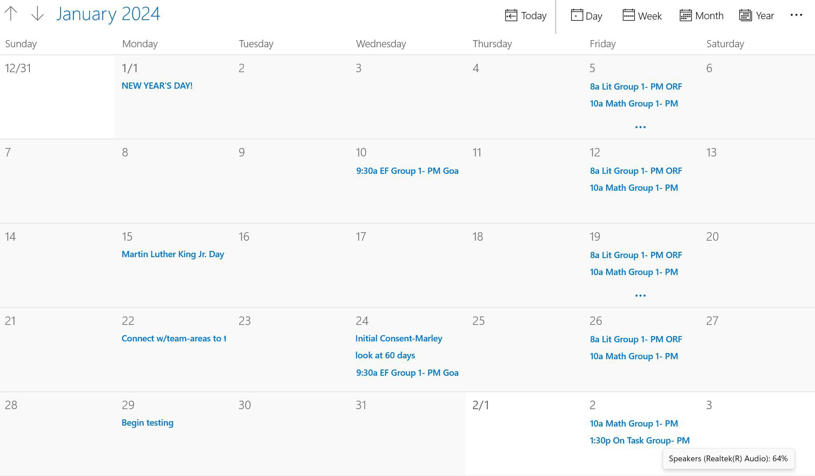
Initial Eval/Eligibility Calendar

Slide 27
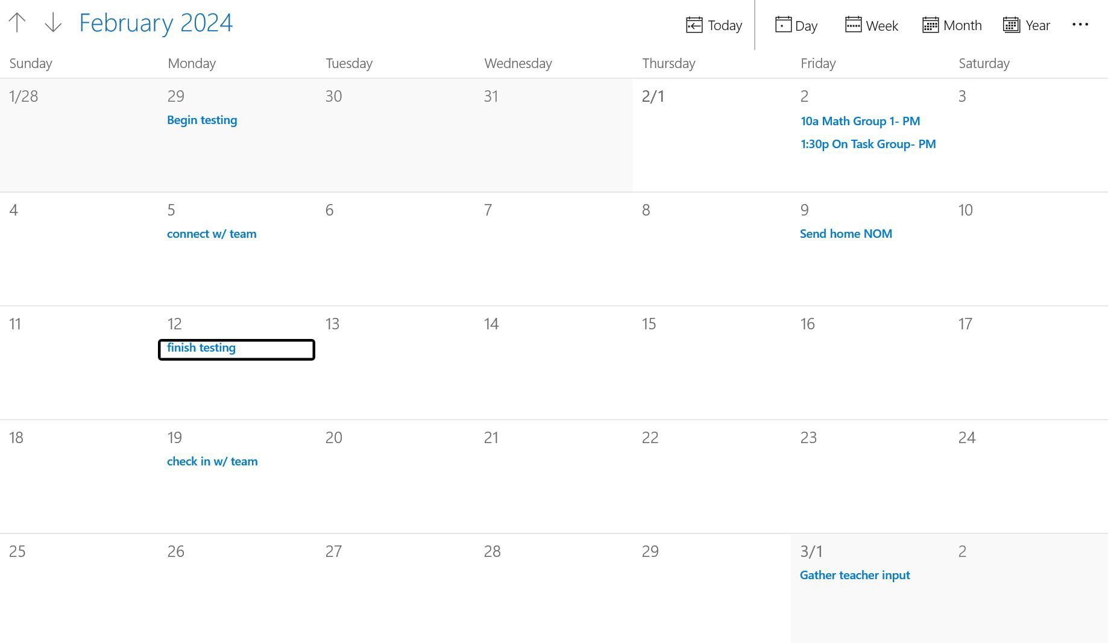
**be proactive w/ testing (things come up-dig deeper, or student absent, etc.) NOT last minute

Slide 28

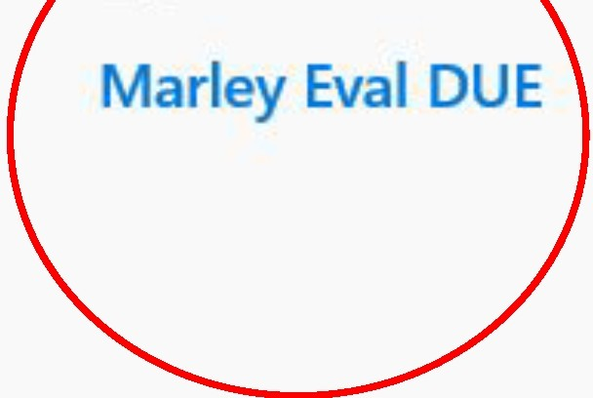
1' + Sunday | M arc h 2024 Monday | Tuesday | Wednesday | Thursday | Today | LJDay Week Friday | hlE! Month Year Saturday
2/25 | 26 | 27 | 28 | 29 |  | 3/1 Gather teacher input | 2
3 | 4 | 5 | 6 | 7 | 8 | 9
 | Gather parent input | Gather student interview |  | Marley Observation
10 | 11 | 12 | 13 | 14 | 15 | 16
 | *se nd home draft |  |  |  | team re minder-meet ing
17
18
Marley Init ial Eval
1
19
20
21
22
23
24
26
27
28
29
30

Slide 29
Next Steps:
What is your caseload? How do you find it?
Look at academic calendar (breaks, holidays, etc.)
Map out meetings (*double check dates)
Note types of meetings (color code/highlight)
  Transfers (*talk to your coordinator/supervisor)
  Annuals
  Re-evals/TRI
Think about initials
Contact families

Slide 30
Sample School Calendar: October 2023
S | M | T | W | TH | F | S
1. | 2. | 3. | 4. | 5. | 6. | 7.
8. | 9. INDIGENOUS PEOPLE’S DAY | 10. | 11. | 12. | 13. End of Quarter 1 | 14.
15. | 16. | 17. | 18. | 19. CONFERENCES | 20. CONFERENCES | 21.
22. | 23. | 24. | 25. | 26. | 27. | 28.
29. | 30. | 31. HALLOWEEN

Slide 31
Sample Calendar: October 2023
S | M | T | W | TH | F | S
1. | 2. Send NOM for Johnny | 3. | 4. | 5. | 6. | 7.
8. | 9. INDIGENOUS PEOPLE’S DAY | 10. Review PM Data | 11. Johnny S- ANNUAL DUE | 12. Confirm conferences | 13. End of Quarter 1 | 14.
15. | 16. Progress Reports Due | 17. Student Interview: Harper | 18. | 19. CONFERENCES | 20. CONFERENCES | 21.
22. | 23. Dentist Appt 9:30 | 24. Student Observation: Harper | 25. | 26. Get consent for Sally S-TRI | 27. | 28.
29. | 30. Send NOM for Harper | 31. HALLOWEEN

Slide 32
Things to Notes:
COMMUNICATE with team (parents, teachers, student, other providers)
Share snapshot/make snapshots for teachers- example
  Review with teachers (have them sign off?)
Think about accommodations (1 pager/digital-tracking?)
Read IEPs (more than once!)
Make individual student files
Create (ask others) universal forms for
  Parent/Teacher/Student Input
ASK QUESTIONS

Slide 33
Things to Note Continued…
For Meetings:
  Involve parents (use simple language)
  Consider meeting agendas
  Prepare multiple hard copies of procedural safeguards
  Practice running a meeting with your team
  Practice the wording of the different sections of reports
  Think about using visuals (graphs, charts, etc.)
Stay flexible
Take a breath!

Slide 34

Checklist Examples
IEP Checklist Tpt
transfer checklist (Josh)
annual sample (Josh)
reeval sample (Josh)
initial sample (Josh)
Create a team checklist

