Slide 1
Special Education Case Manager
Time-Saving Tips & Tricks

Slide 2
What is the most time-consuming part of your day as a Special Education provider?

Slide 3
Agenda
Looking at what takes most of our time?
How do you work smarter, not harder?
How can I better organize, to streamline some things?
Other ideas/resources that have helped people?

Slide 4
Time Saving Tips
Templates-
Checklists-
Schedules-
Spreadsheets

Slide 5
Templates/Forms
Work smarter, not harder….and avoid the wrong name!
Evaluations
example
Present Levels
IEP Template Guide
Present Level template guide example
Parent/Teacher Input forms
**Try different methods (in person, email, google doc, etc.)
example

Slide 6
Evaluation Checklist-example
Checklist for Comprehensive Evaluation
  SED

Slide 7
Checklists
Paperwork needed for each type of meeting
Case Manager To-Do List
*especially when you are new
Finalizing paperwork for student files
Student SPED files NOT cume files
Updated IEP with edits
Parents copy
Update teachers
Upload signatures/rubrics
etc.

Slide 8
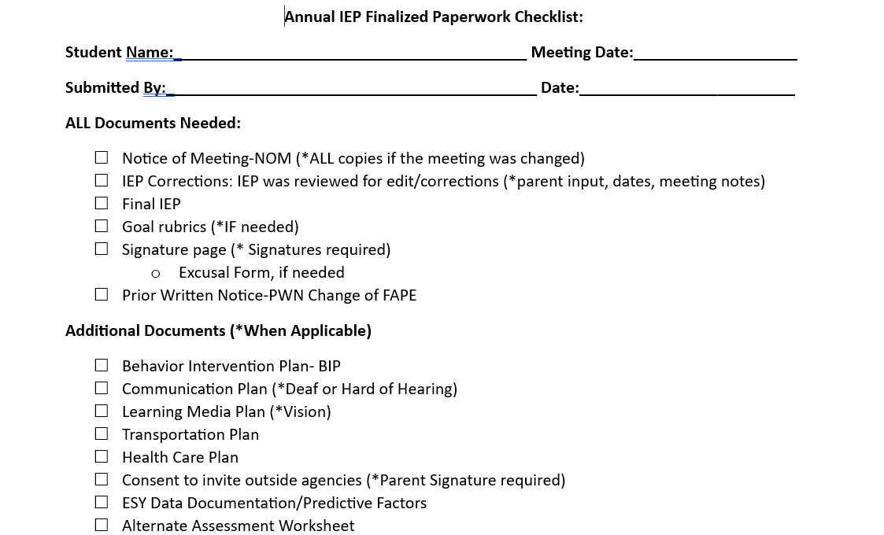
Example of Annual IEP checklist

Slide 9
Schedule:
How to manage it all?
  Services
  Lesson planning
  Paperwork
  Meeting w/teachers
  Progress Monitoring
  Logging services
  Duties/etc.
HOW/WHEN??

Slide 10
How to fit it all in??
Remind yourself to be flexible!
Some things need to be addressed school-wide
Understanding SPED: Students are required to get services
School-wide schedules?
Lunch/recess/specials/specific class time
Field trips/assembly/other events
Communicate with your team!
Team meetings
Running doc (meetings scheduled, upcoming evals due, etc.)
Build in as much as you can (PM, logging, etc.)
Be creative

Slide 11
Spreadsheets
Organization helps:
Caseload info: One place for everything
Student
Grade
Teacher
ML status
Annual Date
Re-Eval Date
Disability
Secondary
Case Manager
Exit date/reason
Other
(consent for provision of services/ESY etc.)
Case Managers share with team lead/coordinator

Slide 12
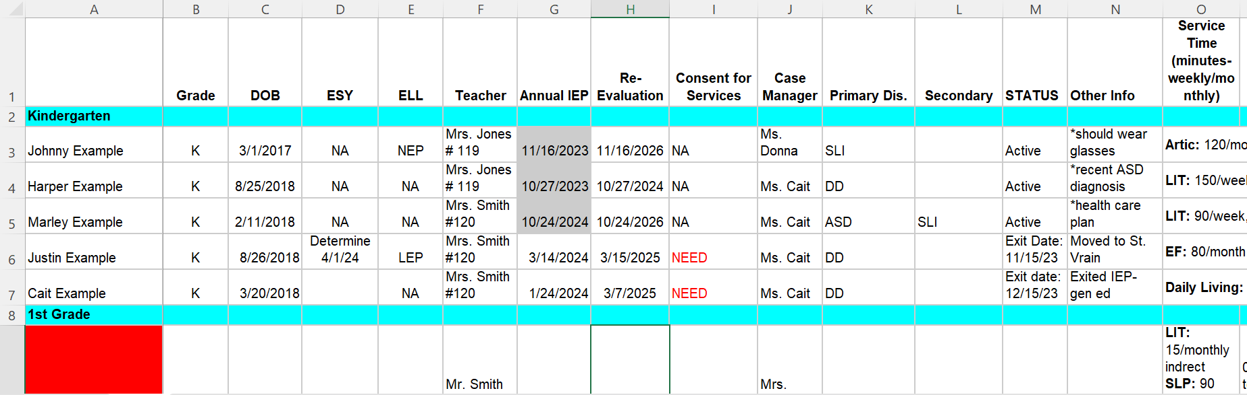
Spreadsheet example-caseload
Case Managers add info.
Each year roll over

Slide 13
Accommodations
How to ensure students get their accommodations?
ACCESS?
CMAS
District?
Accommodations spreadsheet
Classroom
Testing
Combine with 504

Slide 14
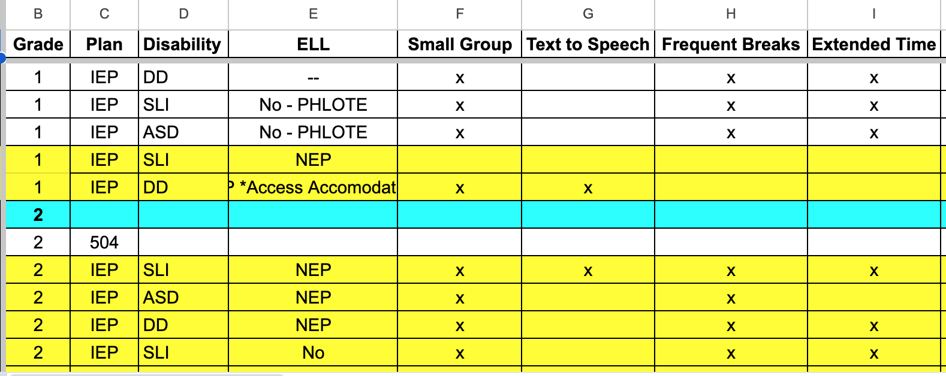

Slide 15
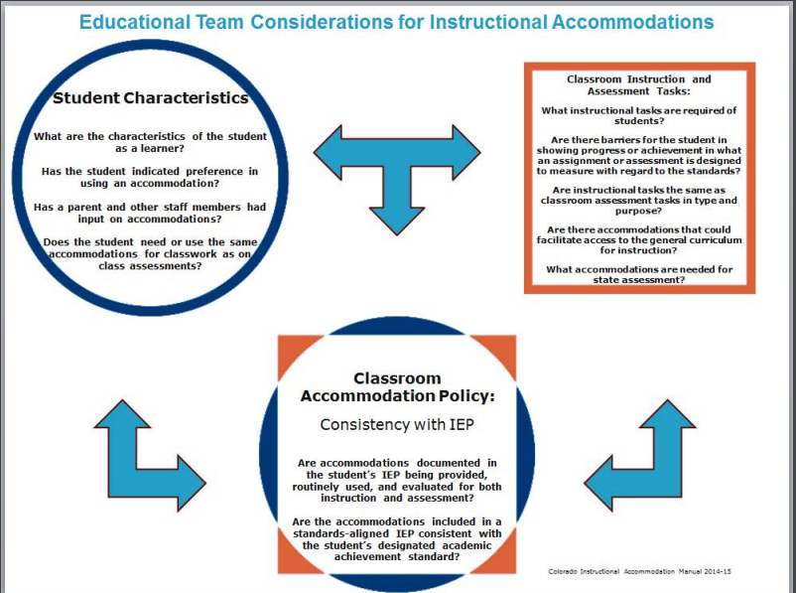

Slide 16
Things to consider:
What are the student’s characteristics as a learner? What more disability-specific resources are available? (See Tables A-P)
How can access to grade-level standards be ensured regardless of a disability or language barrier?
What types of instructional tasks are expected of the student in order to demonstrate proficiency in grade-level content?
Is there a consistent “golden thread” or supporting body of evidence that connects the student’s characteristics and needs with accommodations?
Can the student self-advocate for accommodations in multiple settings?
What accommodations are needed for learning in multiple settings, such as home and community?

Slide 17
Common Language
CDE instructional Accommodations
CDE Accommodations manual

Slide 18
Remember to think about!
Does the student really NEED the accommodation?
Remember, the educational goal is for students to have access to tools which allow them to produce work independently. Accommodations are not intended for convenience or just “to do better.”
Does the student demonstrate willingness to consistently use the accommodation?

Slide 19
IEP Meetings
Have a stack of ready to go procedural safeguards (Eng/Spa if necessary)
Print everything the day before
Use visuals, charts/graphs (MAPs, iReady, ACCESS, etc.)
Follow (not read) the IEP during the meeting
Send a draft before the meeting
**especially ones that are tough, long or could be contentious

Slide 20
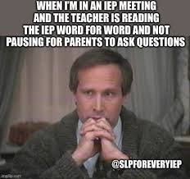

Slide 21
Resources:
https://www.cde.state.co.us/cdesped/behavior
https://resources.csi.state.co.us/wp-content/uploads/2022/03/IEP-Process-and-Procedures.pdf
IEP Processes and Procedures
https://zoom.us/rec/play/vZEldLus-D43HNyc5ASDA6MvW43rL6Ks1yJKqaUMyxnnAHIFOlGkMLJBYOKA0tbP68u8n8U4BxQFp0jp?autoplay=true&startTime=1593468352000
Monitoring Student Progress
https://resources.csi.state.co.us/wp-content/uploads/2022/04/Prior-Written-Notice-Resource_updatedfinal.pdf
Prior Written Notice Examples
https://resources.csi.state.co.us/wp-content/uploads/2018/08/Transition-IEP-Resources.pdf
Transition Resources

