Slide 1
Inductee Orientation
Teacher & SSP Induction Programs

Slide 2
Welcome & Introductions
Name
School
Role
Years in education

Slide 3
Induction Programs provide…
Targeted training for the educator’s stage of professional development
Support of a mentor or coach
Vehicle to convert a Colorado Initial License to a Professional License
Strategy for educator retention
Notes:
To have maximum impact on student learning, educators must develop and evolve along with their students. Induction programs help set the stage for continuous growth and support of educators at the beginning of their careers or as they transition to new organizations or new roles within an organization.

Slide 4
Three Program Components
School Based Professional Development
Mentor Support
Online portfolio and reflection
Notes:
Your school’s Induction Coordinator or School Leader plans experiences and professional development to orient you to your school’s culture, instructional methodologies, and processes and procedures.
Each school selects mentors who exhibit high levels of skill and professionalism to support you during induction. You are required to complete 30 hours of mentor contact time during the course of the school year. Additionally, you will need to have at least one observation conducted by your mentor and your mentor will assist you in setting up observation of a model classroom. Observations can be conducted virtually.
CSI provides video modules that provides inductees an introduction to CSI, an overview of the Colorado Teacher and SSP quality standards, and an overview of the Colorado Model Content Standards. CSI requires each inductee to complete on online portfolio of monthly assignments. Portfolio assignments are aligned to the Educator Quality Standards and include artifact and reflection.

Slide 5
Professional Development
Back to School Orientation
Staff trainings/staff meetings
Team/PLC meetings
Induction Meetings
Book Studies

Slide 6
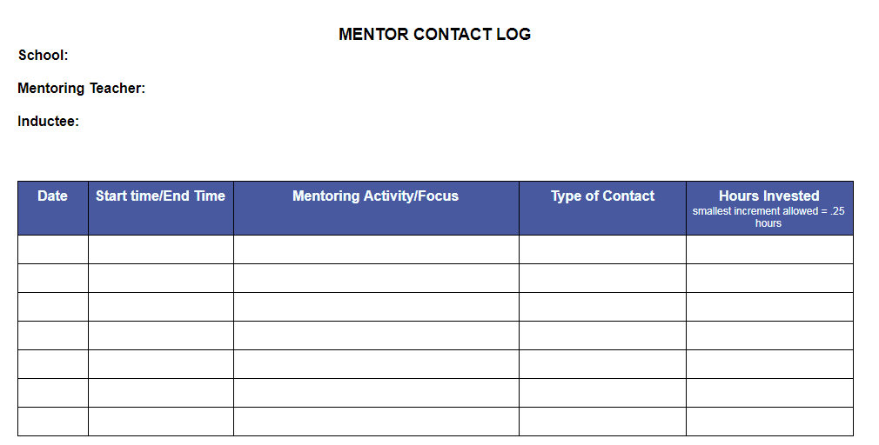
30 Hours of Mentorship
Regular meetings/conferencing
Observation with pre- and post- conference
Arrange for a Model Classroom Observation with pre- and post- conference
Notes:
Your mentor should maintain the log.
You can count emails, virtual/in person meetings, phone calls. At the end of the year, the log is reviewed by your Induction Coordinator who verifies that the hours were completed and that you’re being recommended for professional licensure.

Slide 7
Tips for Success
Build the Relationship
Responsibilities
Ground rules
Confidentiality
Boundaries
Have conversations that make mentees think
Ask open-ended questions
Avoid giving advice (until the appropriate time)
Make sure there is movement and accountability for movement
Set goals
Ask
Reflect
Move
Notes:
What is your role as a mentor?
What is your mentee’s role?
(Think about logistical responsibilities as well as characteristics and services provided.)
Meeting times
Punctuality
Handling stumbling blocks (What might they be? Ideas to deal with them when we differ?)
Feedback
Communication
Pet peeves (ie checking facebook during conversations)
How available are you?
How available is your mentee?
What are you both willing to do? (Emails, phone calls, Facebook, after hours?)

Slide 8
Google Classroom September
Videos
Colorado Educator Quality Standards
Colorado Model Evaluation System
CSI and Charter Schools
Teachers – Self-reflection
SSPs – begin developing your Growth Plan
Teacher Login: https://classroom.google.com/c/NjE2MjQyMTU5Mjg3?cjc=bobcj2q Or class code bobcj2q
SSP Login: https://classroom.google.com/c/NTIzMTcxMzU3NTcw?cjc=wqpxisz
Or class code wqpxisz

Slide 9
Option 1: Online Portfolio & Reflection
Google classroom
Video content
Colorado Educator Quality Standards
Colorado Model Evaluation System
CSI and Charter Schools
Assignments allow inductees to demonstrate competency in implementing the Standards in their professional practice
Artifacts
Reflections

Slide 10
Assignment Submissions Exemplars
Step One
Step Two
Step Three (choice except 4 assignments)
Read the standard and the elements.
Reflect on what you are doing to meet the elements and what is challenging you.
Choose an artifact that shows each element.
Take a picture and upload into a google doc, word doc or into the google classroom OR be prepared to show/tell about it.
Address the standard and each of the elements. It is ok to share successes and challenges. Share in writing or in the work session whip around.

Slide 11
New-Grading Rubric

Slide 12
Online Assignments
Reflection 1-3 paragraphs
Connection to elements
Snapshot of professional practice
Rubric
14
Notes:
Do you want to be in the Google Classroom?
I can exempt you from the assignments. You will see your inductees, but also the others.
Do you want the mentors in the Google Classroom-exempted?

Slide 13
Options 2: Monthly Work Sessions
Topic Based Quest Speaker (first 10 min) when applicable
One hour based on feedback from 23-24 inductees (new this year)
Break Out groups for subject/grade level engagement
Discuss the topic, share artifacts, and reflect on content
Record attendance at the work session in the google classroom.
4 assignments (2 observations, beginning self-evaluation and ending reflection) require submission
Notes:
Teachers for sure, maybe ssp depending on roster

Slide 14
Suggested Topics
August
School Orientation Teacher Evaluation Process
Nov.–Dec.
Curriculum
Instructional Strategies
Classroom Routines Parent Communication
Sep.–Oct.

Slide 15
Suggested Topics
January-February
Assessment & Use of Data
Diverse Learners
March-April
Leadership Opportunities
May
Goal Setting for Next Year
Self-Evaluation
Reflection

Slide 16
Take a minute to sign in.
When you are into the google classroom, type your name in the chat please.
Let’s tour around a bit.
What is the due date for the March assignment?
Where are the announcements?
What is the best way to format submissions?

Slide 17
Educator Quality Standards
Shared understanding of the essentials of great teaching
Knowledge and skills
Tool for self-reflection, goal setting and ongoing professional growth
Foundation for the Colorado Model Evaluation Process
Notes:
Provide a shared understanding of the essentials of great teaching
Outline the knowledge and skills required of an excellent teacher
Offer a tool for teacher self-reflection, goal setting and ongoing professional growth
Act as the foundation for the Colorado Model Evaluation Process

Slide 18
Definitions
Quality Standard: the professional practice or focus on student academic growth needed to achieve effectiveness as a teacher/ssp.
Element: the detailed descriptions of knowledge and skills that contribute to effective teaching/service provision which correspond to a particular Quality Standard.
4
17

Slide 19
Teacher Quality Standards
Teachers demonstrate mastery of and pedagogical expertise in the content they teach.
Elementary: expert in literacy and mathematics and knowledgeable in all other content areas of assignment
Secondary: knowledge of literacy and mathematics and an expert in the content areas
Teachers establish a safe, inclusive and respectful learning environment for a diverse population of students.
Teachers plan and deliver effective instruction and create an environment that facilitates learning for their students.
Teachers demonstrate professionalism through ethical conduct, reflection, and leadership.
Notes:
Content
Environment
Process
Professionalism

Slide 20
Specialized Services Provider Quality Standards
SSPs demonstrate mastery of and expertise in the domain for which they are responsible.
SSPs support and/or establish safe, inclusive, and respectful learning environments for a diverse population of students.
SSPs plan and deliver effective services in an environment that facilitates learning for their students.
SSPs demonstrate professionalism through ethical conduct, reflection, and leadership.
Notes:
Content
Environment
Process
Professionalism

Slide 21
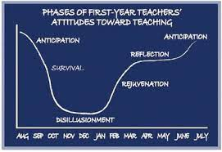
Phases of Attitudes (Moir, 1999)

Slide 22
Handbook Resource Tour
Topic and Work Sessions Calendar
Mentoring Agreement (optional- not submitted)
Mentoring Log
Self-evaluation
Growth Plan
Observation by Mentor
Model Classroom/Peer Observation

Slide 23
Thank You!
Any questions? Thoughts?
Quick Check/Feedback Survey
Contact me at:
willynwebb@csi.state.co.us

