Slide 1
Mentor Orientation
Teacher & SSP Induction Programs

Slide 2

Welcome & Introductions
In the chat:
Name
School
Role
Years in education
Favorite part of teaching
Notes:
A National Alliance for Public Charter Schools poll on public school teachers says majority feel overwhelmed and burned out, among other findings | Al Día News (aldianews.com)

Slide 3
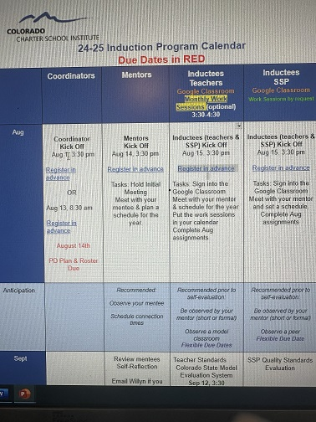
24-25 Induction Program Calendar
New Option: Mentor
Gathering Quarterly

Slide 4
Induction Programs provide…
Targeted training for the educator’s stage of professional development
Support of a mentor or coach
Vehicle to convert a Colorado Initial License to a Professional License
Strategy for educator retention
Notes:
To have maximum impact on student learning, educators must develop and evolve along with their students. Induction programs help set the stage for continuous growth and support of educators at the beginning of their careers or as they transition to new organizations or new roles within an organization.

Slide 5
Program Components
School Based Professional Development
Mentor Support
Online Portfolio and reflection
Notes:
Each school plans experiences and professional development for inductees to orient them to your school’s culture, instructional methodologies, and processes and procedures.
CSI provides video modules that provides inductees an introduction to CSI, an overview of the Colorado Teacher and SSP quality standards, and an overview of the Colorado Model Content Standards. CSI requires each inductee to complete on online portfolio of monthly assignments. Portfolio assignments are aligned to the Educator Quality Standards and include artifact and reflection.
Each school selects qualified mentors to work with inductees and as the induction coordinator, you verify that 30 hours of mentoring was provided to each inductee. Each inductee is required to have at least one observation conducted by their mentor and also to observe a model classroom. Observations can be conducted virtually.

Slide 6

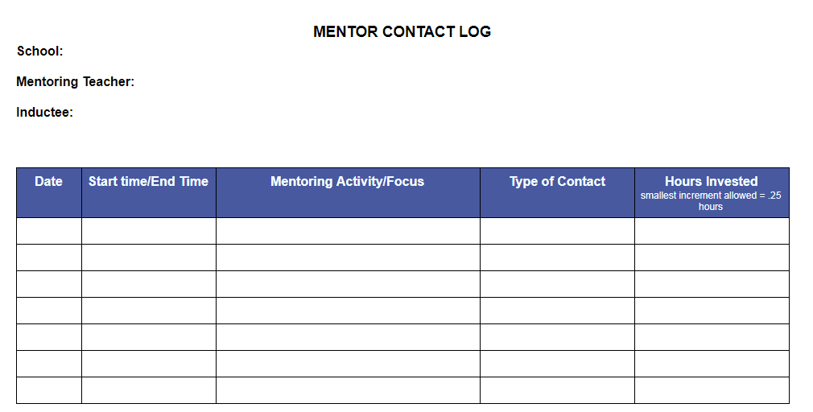
30 Hours of Mentorship
Regular meetings/conferencing
Observation with pre- and post- conference
Arrange for a Model Classroom Observation with pre- and post- conference

Slide 7
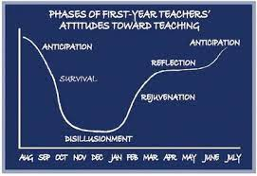
First Year Phases (Moir, 1999)h

Slide 8
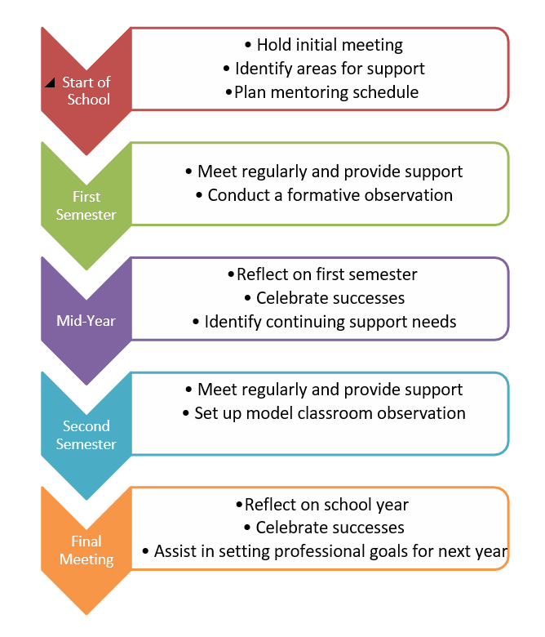
Phaes of the year

Slide 9
Competency Spectrum
Unconsciously Incompetent
Consciously Incompetent
Unconsciously Competent
Consciously Competent

Slide 10
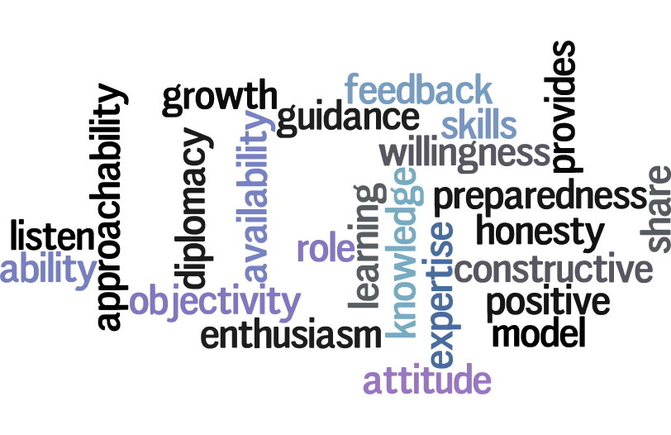
Characteristics of a Mentor
Notes:
Willingness to share skills, knowledge, and expertise. ...
Demonstrates a positive attitude and acts as a positive role model. ...
Takes a personal interest in the mentoring relationship. ...
Exhibits enthusiasm in the field. ...
Values ongoing learning and growth in the field.
Good listener
Approachable and accessible
Honesty with diplomacy
Provides constructive feedback

Slide 11
High-Performance Mentor Teacher
HIGH-PERFORMANCE MENTOR TEACHER
Commits to the Roles and Responsibilities of Mentoring | Accepts the Beginning Teacher as a Developing Person and Professional | Reflects on Interpersonal Communication and Decisions
Serves as an Instruction Coach | Models a Commitment to Personal and Professional Growth | Communicates Hope and Optimism for the Future
Rowley,J. (2009) The High Performance Mentor
Notes:
Provide and model professional best practices.
Provide feedback on all aspects of classrooms teaching
Provide emotional support and encouragement
Provide guidance on the “How To’s” of a new workplace

Slide 12
Tips for Success
Build the Relationship
Responsibilities
Ground rules
Confidentiality
Boundaries
Have conversations that make mentees think
Ask open-ended questions
Avoid giving advice (until the appropriate time)
Make sure there is movement and accountability for movement
Set goals
Ask
Reflect
Move
Notes:
What is your role as a mentor?
What is your mentee’s role?
(Think about logistical responsibilities as well as characteristics and services provided.)
Meeting times
Punctuality
Handling stumbling blocks (What might they be? Ideas to deal with them when we differ?)
Feedback
Communication
Pet peeves (ie checking facebook during conversations)
How available are you?
How available is your mentee?
What are you both willing to do? (Emails, phone calls, Facebook, after hours?)

Slide 13
Expectations
A Mentor is…
teacher
friend
guide
coach
role model
Co-learner
A Mentor is not…
administrator
supervisor
evaluator
Spy
Reporter
“Learning-Focused Relationship”
(Mentoring Matters, Lipton & Wellman, 2018)

Slide 14
Quote
We know that people learn best when they learn from and support each other in a learning community.
Annette Breaux and Harry K Wong
New Teacher Induction

Slide 15
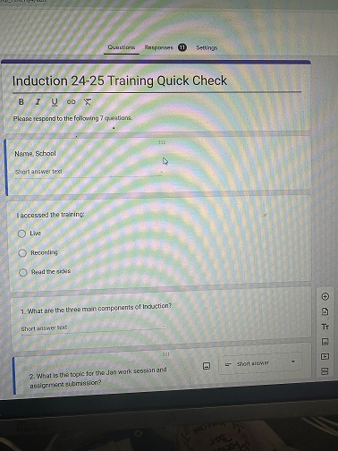
Quick Check (click on the link)
What are the three main components of induction?
What is the topic for January work session/submission?
Who has the option to attend the monthly work sessions?
What is the platform for the online modules & assignment submissions?
What are the types of observations required?
Please rate this training 1 to 10 (1 poor to 10 exceptional)
Please share suggestions for improvement.

Slide 16


Option 1: Online Portfolio & Reflection
Google classroom
Video content
  Colorado Educator Quality Standards
  Colorado Model Evaluation System
  CSI and Charter Schools
Assignments allow inductees to demonstrate competency in implementing the Standards in their professional practice
  Artifacts
  Reflections

Slide 17
Options 2: Monthly Work Sessions
Topic Based Quest Speaker (first 10 min) when applicable
One hour based on feedback from 23-24 inductees (new this year)
Break Out groups for subject/grade level engagement
Discuss the topic, share artifacts, and reflect on content
Record attendance at the work session in the google classroom.
4 assignments (2 observations, beginning self-evaluation and ending reflection) require submission
Notes:
Teachers for sure, maybe ssp depending on roster

Slide 18
Suggested Topics
August
School Orientation Teacher Evaluation Process Teaming Structures
Nov.–Dec.
Curriculum
Instructional Strategies
Classroom Routines Parent Communication
Sep.–Oct.

Slide 19

Suggested Topics
January-February
Assessment & Use of Data
Diverse Learners
March-April
Leadership Opportunities
May
Goal Setting for Next Year
Self-Evaluation
Reflection

Slide 20
Definitions
Quality Standard: the professional practice or focus on student academic growth needed to achieve effectiveness as a teacher/ssp.
Element: the detailed descriptions of knowledge and skills that contribute to effective teaching/service provision which correspond to a particular Quality Standard.
4
17

Slide 21

Educator Quality Standards
Shared understanding of the essentials of great teaching
Knowledge and skills
Tool for self-reflection, goal setting and ongoing professional growth
Foundation for the Colorado Model Evaluation Process
Notes:
Provide a shared understanding of the essentials of great teaching
Outline the knowledge and skills required of an excellent teacher
Offer a tool for teacher self-reflection, goal setting and ongoing professional growth
Act as the foundation for the Colorado Model Evaluation Process

Slide 22
Teacher Quality Standards
Teachers demonstrate mastery of and pedagogical expertise in the content they teach.
  Elementary: expert in literacy and mathematics and knowledgeable in all other content areas of assignment
  Secondary: knowledge of literacy and mathematics and an expert in the content areas
Teachers establish a safe, inclusive and respectful learning environment for a diverse population of students.
Teachers plan and deliver effective instruction and create an environment that facilitates learning for their students.
Teachers demonstrate professionalism through ethical conduct, reflection, and leadership.

Slide 23
Specialized Services Provider Quality Standards
SSPs demonstrate mastery of and expertise in the domain for which they are responsible.
SSPs support and/or establish safe, inclusive, and respectful learning environments for a diverse population of students.
SSPs plan and deliver effective services in an environment that facilitates learning for their students.
SSPs demonstrate professionalism through ethical conduct, reflection, and leadership.

Slide 24


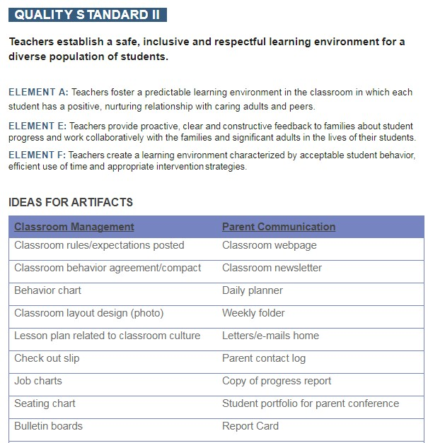
Online Assignments
Reflection 1-3 paragraphs
Connection to elements
Snapshot of professional practice
Rubric
14
Notes:
Do you want to be in the Google Classroom?
I can exempt you from the assignments. You will see your inductees, but also the others.
Do you want the mentors in the Google Classroom-exempted?

Slide 25
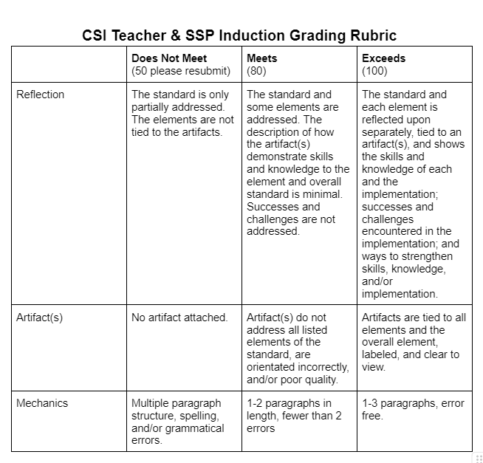
New-Grading Rubric

Slide 26
Thank You!
Any questions? Thoughts?
Quick Check/Feedback Survey
Contact me at:
willynwebb@csi.state.co.us

