Slide 1
Track and Monitor Progress and Services

Slide 2

Training Objectives
  Be able to identify the purposes of progress monitoring for students with IEPs
  Be able to distinguish among types of progress monitoring tools and apply those tools for a variety of purposes
  Establish a set of progress monitoring resources
  Develop a calendar and plan to implement progress monitoring for students on caseload
  Recognize the need to document IEP service delivery time
  Identify systems and tools to document services

Slide 3
What is Progress Monitoring?
Ongoing regular assessment
Determines student progress in response to curriculum instruction and/or interventions
A snapshot that allows teachers and staff to measure growth or regression
Identifies gaps in learning and measure the effectiveness of instruction

Slide 4
The importance of Special Education progress monitoring: WHY?
States are required to report on the progress of students on IEPs
determine present levels of academic achievement and functional performance for the Initial IEP
measure progress toward meeting goals
  which is reported on progress reports
  Annual IEP Reviews (Present Levels section)*goal progress
measure the effectiveness of special education instruction/interventions and measure growth
  (See Endrew F. v. Douglas County)
measure regression and recoupment of skills following extended breaks from school for ESY determination

Slide 5
Endrew F. v. Douglas County School District (2017)
*Reemphasizes Need for Progress Monitoring
the Supreme Court determined that, “[t]o meet its substantive obligation under the IDEA, a school must offer an IEP [individualized education program] that is reasonably calculated to enable a child to make progress appropriate in light of the child’s circumstances.”
Raised the standard of progress from “more than de minimus”
Supreme Court held that educational programs for students with disabilities must be “appropriately ambitious” and that schools must “focus on student progress.” (Blokhuis et al, p. 346, 2021)

Slide 6
In Light of Endrew F.
Make sure/Be aware:
Write IEPs that are rigorous and based on individual children’s needs
Collect and review robust evidence to make evidence-based decisions on goals and interventions
Develop Goals and objectives that are appropriately ambitious
Meet as needed to revisit and adjust goals, interventions, and services if students are not making adequate progress
*Consequently, this case has further enhanced emphasis on progress monitoring

Slide 7
Frequency of Progress Monitoring?
Progress reports must be sent out at minimum with school-wide grades (quarterly, trimesters, etc.) and/or according to the student’s individual needs/goals
At least monthly (maybe bi-weekly?)
Before and after longer breaks (Thanksgiving, Holiday, Spring, etc.)
Before IEP AR Meetings
Think about adding to your service schedule (i.e., Fridays quick PM during service time)

Slide 8
Additional Information: Progress Reports Provided to the Family
The frequency of progress reports being sent out to the family should also be
  Determined based on the student and goals
  Individualized to the student’s needs

Slide 9
Selecting Progress Monitoring Tools?
Standardized: use standardized tools when possible, especially for academics (e.g., AIMSweb)
Consistent: assess on regular schedule so measuring the same amount of intervention/time to compare with growth)
Reliable: use the same measurement tool/same setting each time
Valid: select measure that is designed to assess what you are intending to measure
Brief and Simple: should be quick and be able to conduct during instruction while not taking away from instructional time
Sensitive to Growth: be able to measure growth across short time spans

Slide 10
What are we looking for?
Rate and Amount of Progress
in all areas, including academic, communication, physical, social-emotional, vocational, independence, etc.
Clear progress based on interventions
Minimal progress
No progress
Declining performance

Slide 11
Monitoring Student Progress
on IEP Goals

Slide 12
MEASURABLE GOALS
Derive from present levels data
SMART
  Specific
  Measurable
  Ambitious and attainable
  Realistic
  Time-bound
Time - By January 24, 2024,
Condition – given 30 vocabulary words from the 7th grade science curriculum
Learner - Lynn
Action – will compose on a keyboarding device
Criterion – at least 10 correct sentences using at least 10 vocab words within 10 minutes.

Slide 13
The best time to consider how you will monitor progress is during the goal-writing phase:
*Design goals that can be easily monitored
  At that time, determine:
  what data will be collected?
  In what form?
  With what tools/methods?
  How often? How much?
  Where?
  By Whom? you, a paraprofessional, the student, the classroom teacher?

Slide 14
Examples:
Behavioral Data Points:
Latency Recording: Time it takes for student to begin task or start to comply with request
Duration Recording: Time of behavior or time on-task
Frequency Tally: Number of times behavior occurs
Academics:
CBMs (reading, math, spelling, etc.)
  Spelling: 2-minute spelling word test of words from end-of-year grade-level mastery
  Writing: written expression, grammar, punctuation
  Math CBM: select problems from end-of-year mastery, 2-minute limit, count digits correct- rather than answers.

Slide 15
Examples: continued…
Reading Fluency: (Reading A-Z, DRA,
Reading Comprehension: (Dibels-MAZE, STAR-Cloze)
Writing: Rubrics,
Math

Slide 16
Resources:
Use tools such as interventioncentral.org automatically generate PM Tools (math, reading, written language) and to generate graphs
You can also develop your own data tracking and graphing forms for behavior

Slide 17
PROGRESS MONITORING TOOLS

Slide 18
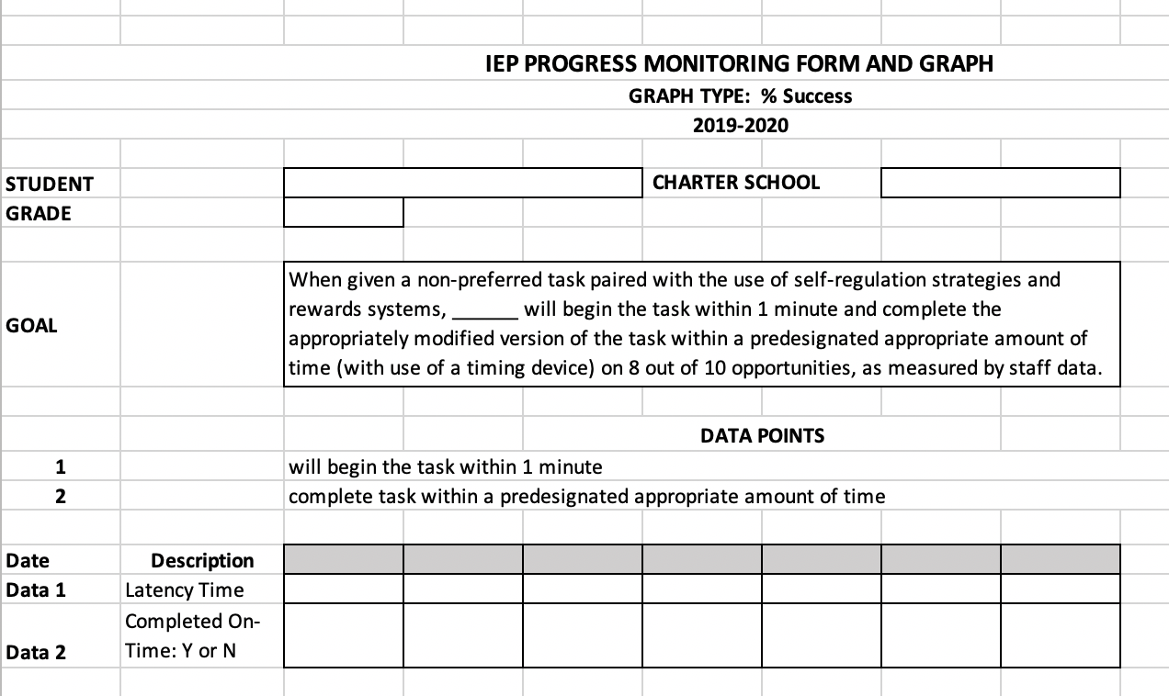
Tracking Two Simultaneous
Data Points

Slide 19
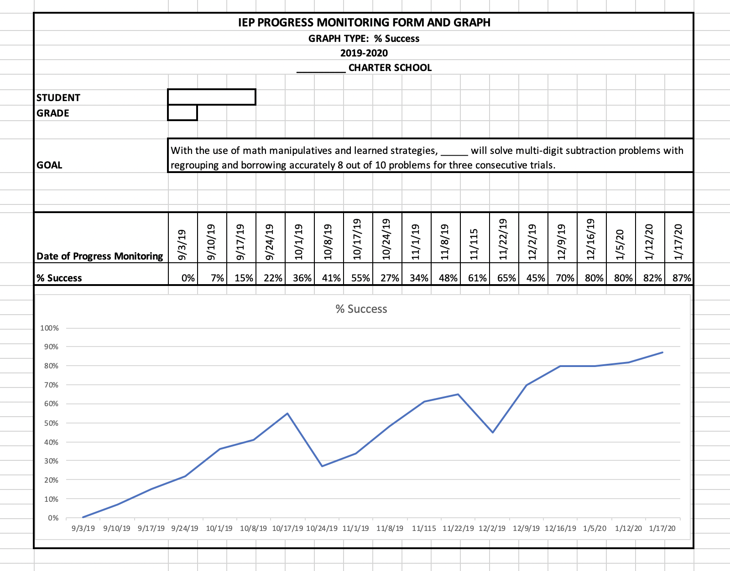
Monitoring & Graphing:
% Success

Slide 20
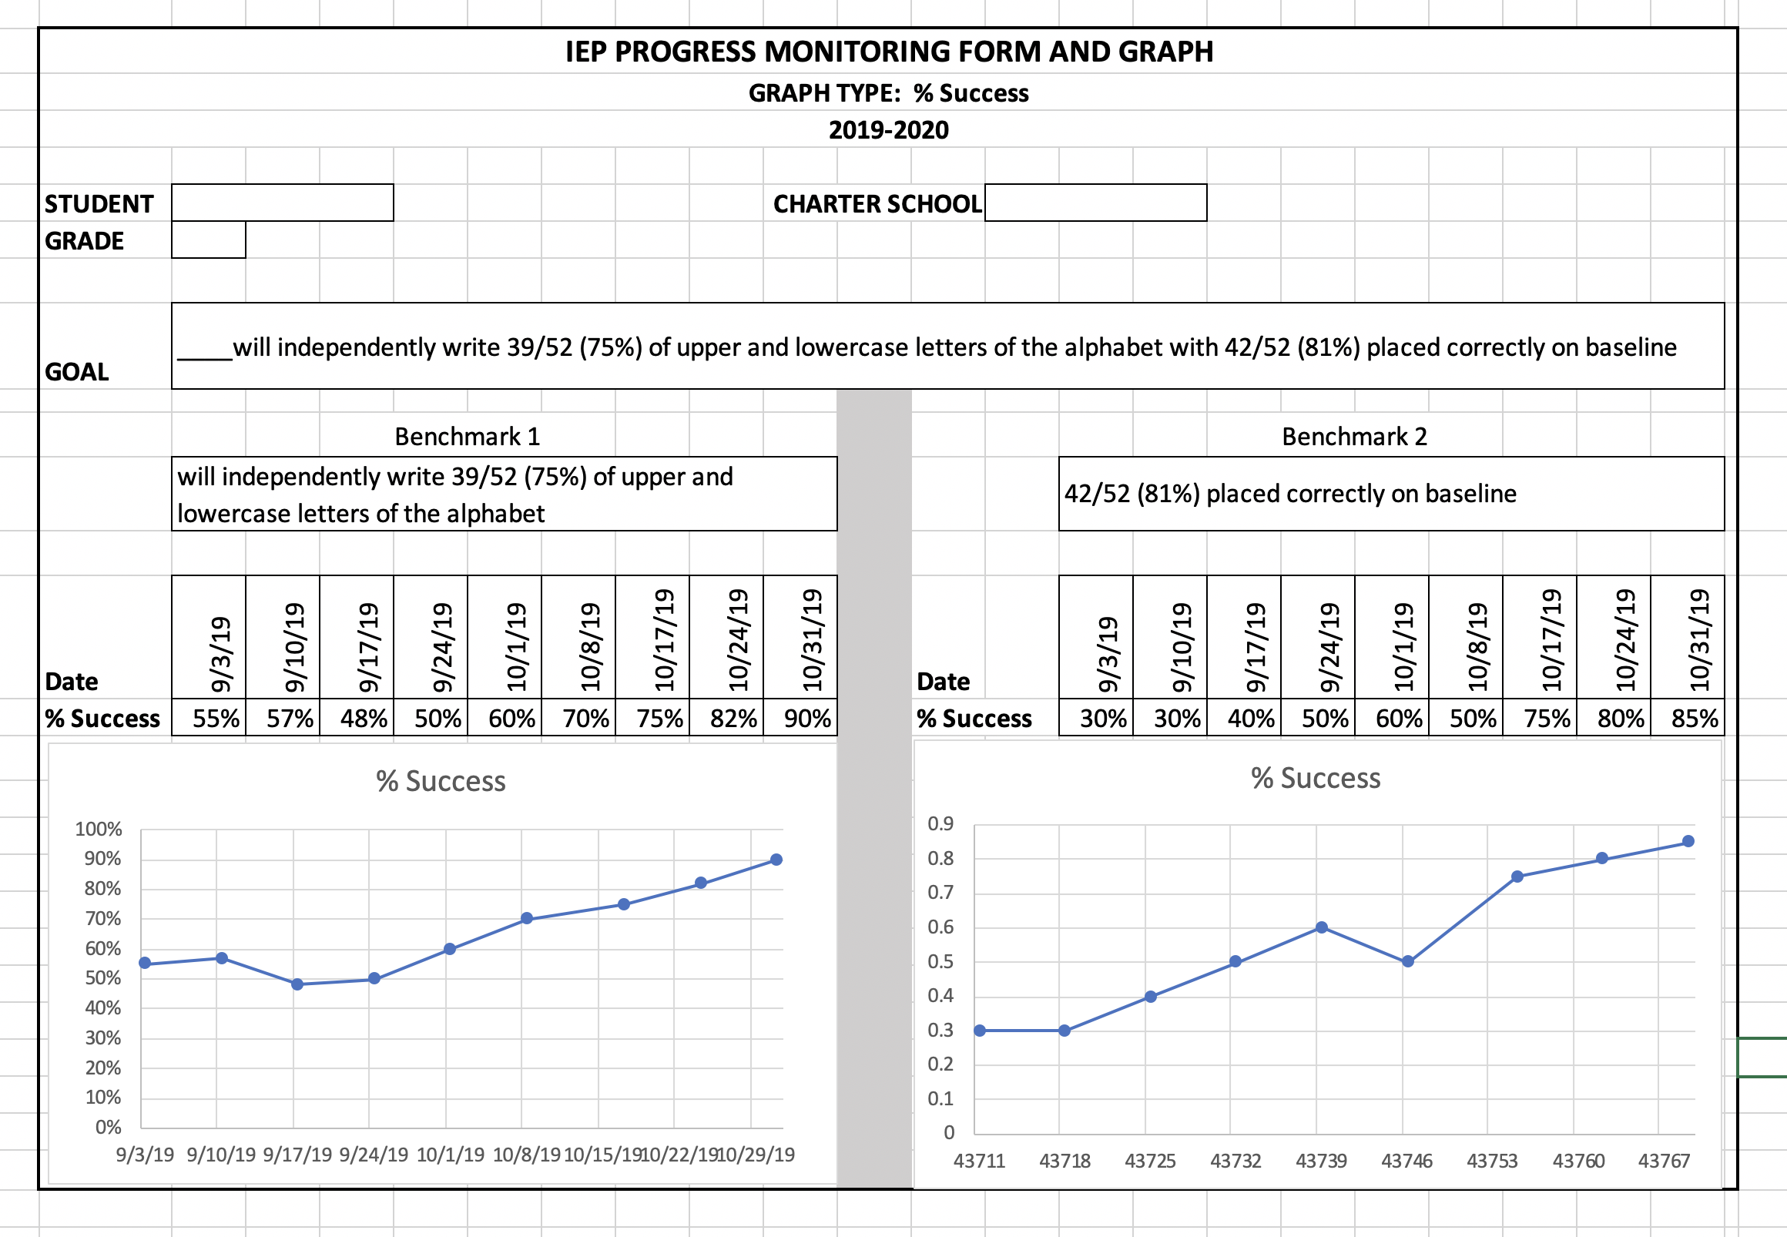
Monitoring & Graphing: Goal with 2 benchmarks-Percentages

Slide 21
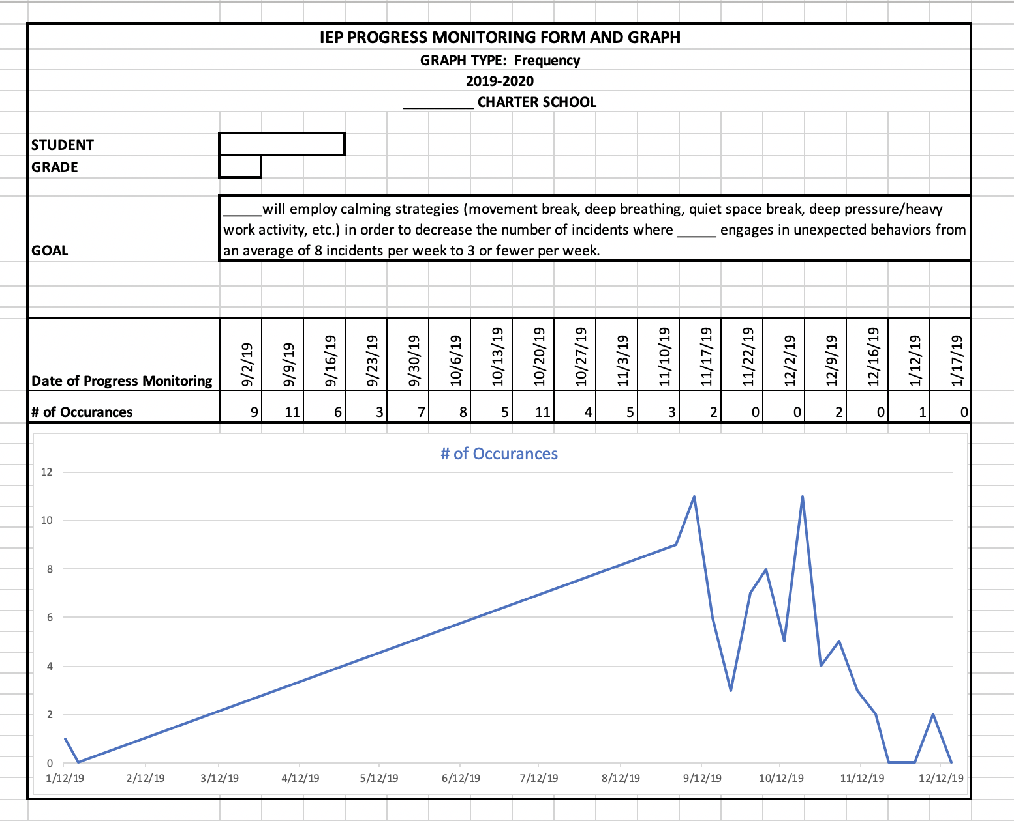
Monitoring & Graphing:
Avg # of Incidents

Slide 22
Using Scoring Rubrics to Monitor Progress
By the next annual review, student will increase her ability to independently initiate in-class assignments and complete those assignments within the class period 80% of the time in 4 out of 5 weeks as measured by a teacher-developed rubric.
4 | 3 | 2 | 1 | 0
The student independently initiates and completes assignment during time provided. | With one or two prompts, the student initiates and completes assignment during time provided. | With multiple prompts, the student initiates assignment but does not entirely complete assignment during time provided. | The student refuses to, or is unable to, initiate or complete assignment during time provided | No judgment can be made.

Slide 23
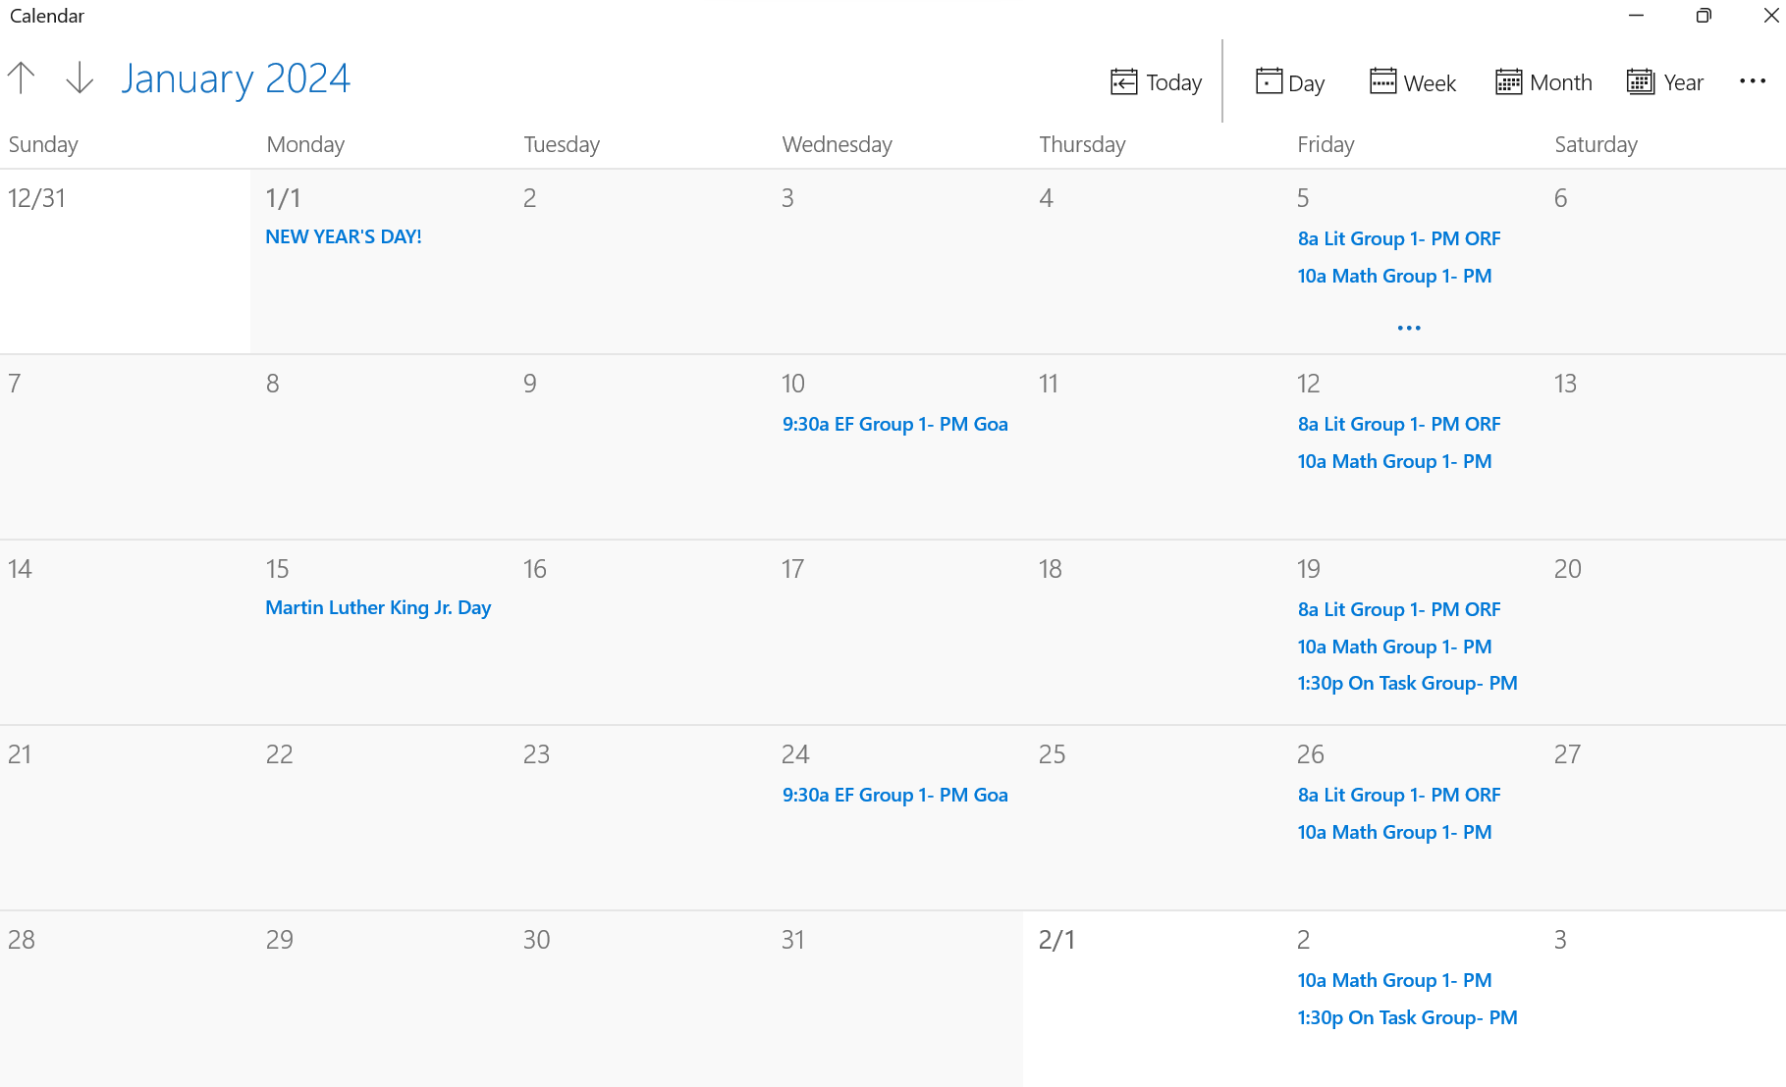
How to build PM into my schedule?

Slide 24
Next Steps for Progress Monitoring in 2023-24
Be Systematic
Identify the progress monitoring needs of your students
Select the tools you will use (many may be the same or similar)
Determine who will do the PM. Will you utilize paraprofessionals to assist?
Build into your schedule/add to your calendar
  Weekly during instructional times
  Quarterly before progress reports
  Immediately before and after breaks (Winter, Spring, Summer)

Slide 25
Questions to Guide You:
Questions | What To Think About
How will the student’s progress be measured? | Do: Use objective measures (data that can be reported in numbers) Behavior Observation Checklists Progress Monitoring Probes ( Reading, Math) Unit or Chapter Tests Don’t: Use subjective measures Anecdotal reports Teacher/student perceptions
How often will the students progress be measured? | Do: Measures systematically Every two weeks Monthly Don’t: Measure inconsistently Three times per year
Who is responsible for collecting progress monitoring data? | Do: Identify individuals with appropriate data collection skills SPED teacher Don’t: Assume that everyone has prerequisite skills to collect data

Slide 26
Questions | What To Think About
Where will the data collection occur? | Do: Maintain a consistent progress monitoring schedule During social skills instruction During small group instruction In the gen ed classroom Don’t: Broadly describe the setting
When will the data collection occur? | Do: Clearly identify the setting or context Same-day weekly 1st Friday of the month Don’t: Collect on an inconsistent basis At the teacher’s convenience When you feel like it When the student’s in a good mood
What is the performance criteria to achieve the IEP goals? | Do: Use the criteria that are written in the goal Perform a task with 85% accuracy in 3 out of 5 days Read 75 CWPM at a DRA level 20 Don’t: Use different criteria than those stated in the goal
Questions
What To Think About

Slide 27
Resources for PM Tools
Excellent Resources for Progress Monitoring Tools
easycbm.com
AimsWeb.com
Grant, KY Schools (Exceptional free real usable examples of graphs, charts for all types of PM)
https://www.grant.kyschools.us/IEPMonitoring.aspx
Intervention Central Extensive free cbm probes and tools for academic and behavior including Chartdog graph maker
https://www.interventioncentral.org

Slide 28
    Resources Continued…
Fuchs and Stecker training
https://www.slideserve.com/Antony/progress-monitoring
RTI Implementer Series: Module 2: Progress Monitoring
https://rti4success.org/sites/default/files/Webinar%20Manual_Progress%20Monitoring_0.pdf
Using CBM for Progress Monitoring in Written Expression and Spelling
https://docs.google.com/viewer?a=v&pid=sites&srcid=ZGVmYXVsdGRvbWFpbnxpbnRlcnZlbnRpb25yeHxneDo2MjAzYjkwMTNmOWRmMzYy

Slide 29
Documentation of Service Delivery

Slide 30
Why are Service Logs Vital?
In the past, many districts did not place an emphasis on documentation of service delivery time, except for the purpose of Medicaid reimbursement.
However, it is quite clear that it is essential to be able to prove that services have been provided due to compensatory service claims, often due to issues with staffing turnover.
CSI has had multiple mediation cases due to allegations of missed services in past several years. These do not appear in public records.

Slide 31
Documentation of Services
CDE 2022-23 State Complaints
State Level Complaint 2023:504 Denver Public Schools
Allegations of missed speech language services due to staff shortages
State Level Complaint 2022:514 Academy School District 20 Allegations of missed school mental health services
State Level Complaint 2022:545 Roaring Fork School District
Allegations of missed service time for direct academic, behavioral intervention services
State Level Complaint 2022:545 Cherry Creek School District
Allegations of lack of speech language therapy services due to staff shortage
State Level Complaint 2022:561 Douglas County School District
Allegations of failure to implement reading services from sped teacher

Slide 32
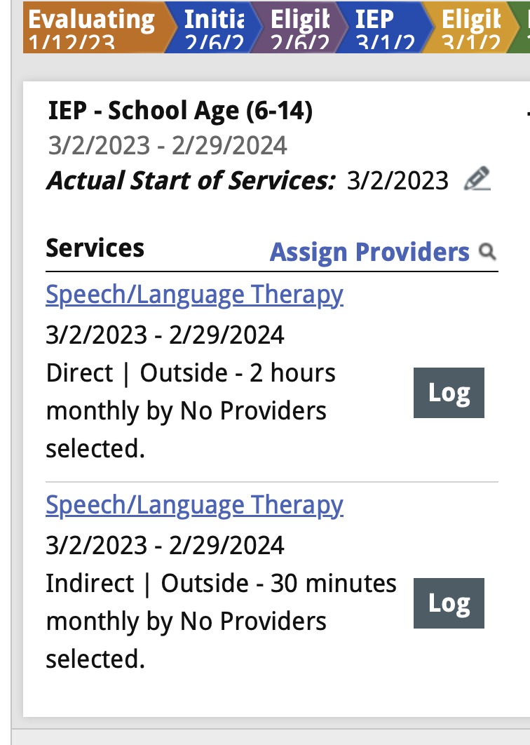
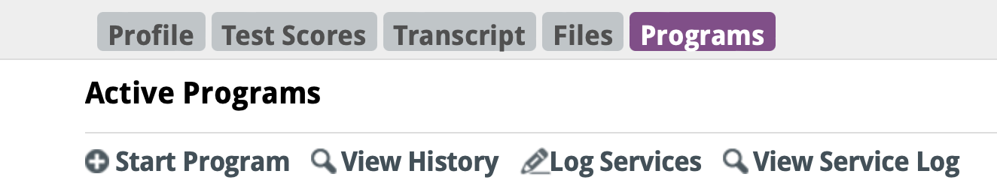
Documentation of Service Delivery-Enrich

Slide 33
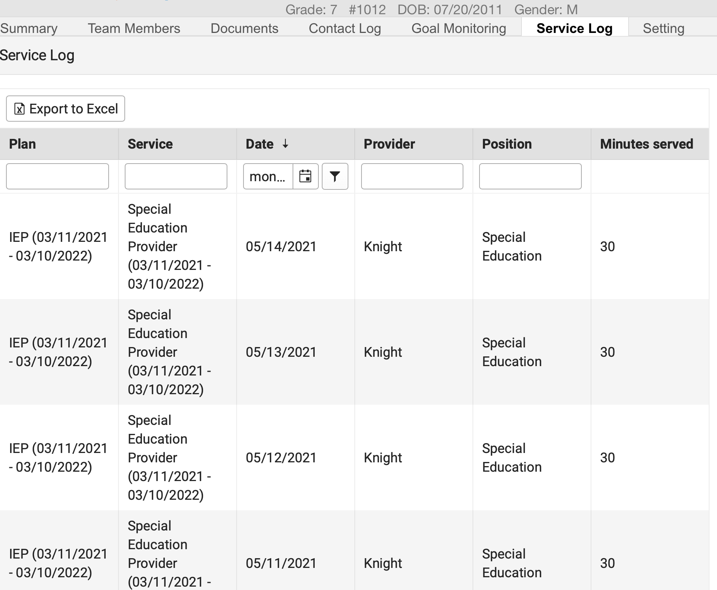
Documentation of Service Delivery-IC

Slide 34
Other ideas to track progress:
IEP Service Log example (editable google doc)
  Share within the team for students
IEP Service Log example
Track progress and scan/upload to IC or Enrich
  This can be handwritten notes
  **Most Importantly- cover yourself! Be able to prove your services

