Slide 1
(PWN) Prior Written Notice

Slide 2
Objectives: (who, what, where, when, why)
What is a PWN?
Purpose of a Prior Written Notice (PWN)
Components of a PWN
Events that require a PWN

Slide 3
Have you ever attended an IEP meeting and heard or said any of the following phrases?

Slide 4
Things you might have heard
Why don’t we ‘wait and see’ and talk about it in a few months?
I don’t think they need that
Let’s follow up with that at a later date
I will have to discuss this with {someone with more authority} and then I’ll get back to the team.
Was something proposed or refused?
When in doubt...

Slide 5
PWN Purpose

Slide 6
Purpose
The Prior Written Notice provides a clear record for the student, parent, and school of the decisions that have been made; the basis for those decisions; and the actions that have been proposed or refused.
The Prior Written Notice may be referenced in any number of circumstances, such as subsequent meetings or dispute resolution situations, or as a clarification and reminder to all parties of commitments made.
The notice must be written in language understandable to the general public and provided in the native language of the parents or other mode of communication used by the parent, unless it is clearly not feasible to do so.[IDEA 300.503 (c)(1) (i)(ii)]
Notes:
(WHAT)

Slide 7
PWN Purpose-parents
Allows parents the opportunity to review, in writing, the decisions made to include the basis behind each proposed or refused action step.
Notice to parents of the LEA's offer of a Free and Appropriate Public Education (FAPE) and its rationale.
Provides notice of actions so that parents can determine if issues need to be resolved through due process or other dispute resolution procedures.

Slide 8
PWN Requirements

Slide 9
Requirements
Providing a timely and correct Prior Written Notice to the parent(s) is essential to protecting the rights of students receiving special education and their parents;
this step is a vital component of the procedural safeguards that schools make available.
Notes:
(WHO)

Slide 10
Types of PWNs
PWN Consent for Evaluation
PWN Consent for Initial Provision of Special Education and Related Services
PWN embedded in the IEP
PWN of Special Education Action
IEP Amendment and PWN
*Other:
Notice of Graduation
Disciplinary removal for more than 10 consecutive days
Disciplinary removal IAES
Parent revocation of services
*

Slide 11
PWN must be provided to parents whenever a school district proposes or refuses to initiate or change the identification, evaluation, or educational placement of the child, or the provision of FAPE to the child
Conditions under which a Public Agency Must Provide
Prior Written Notice:
When the public agency proposes to initiate or change . . .
the identification of a student;
the evaluation of a student;
the educational placement of a student;
and/or the provision of free, appropriate public education (FAPE) to a student.
When the public agency refuses to initiate or change . . .
the identification of a student;
the evaluation of a student;
the educational placement of a student;
and/or the provision of FAPE to a student
Notes:
(WHEN)

Slide 12
Required Elements of PWN

Slide 13
The Prior Written Notice must provide information for each of the following elements:
A description of the school’s action(s), proposed or refused
An explanation of why actions are proposed or refused
A description of evaluation, procedure, assessment, record or report used as a basis for the proposed or refused action
A description of any other options the IEP team considered and the reasons for rejecting those options
A description of any other factors relevant to the proposal or refusal of action
Sources for the parent to contact with any questions regarding provisions of the prior written notice requirements
Acknowledgment of provision of Procedural Safeguards
Notes:
(WHAT)

Slide 14
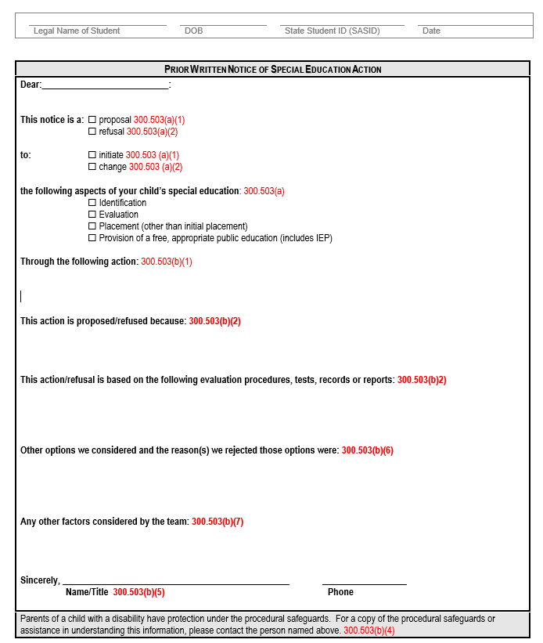
PWN Example
1
2
3
4
5
6
7

Slide 15
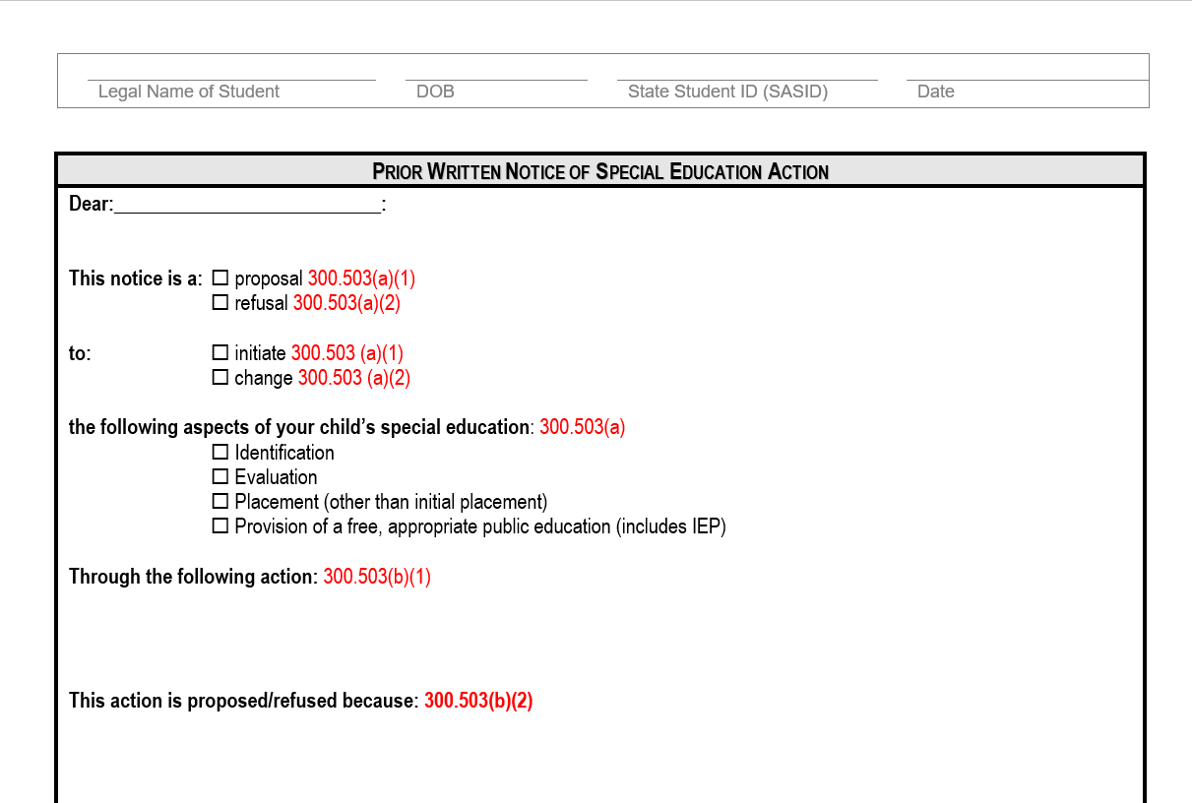
A description of the action(s) proposed or refused by the agency:
-Must describe each proposed or refused action
-Must be based on facts
1

Slide 16

An explanation of why the agency proposed or refused to take the action.
-If there is more than one reason, list them all.
-The PWN is the LEAs legal documentation against claims of lack of parental participation and predetermination
2

Slide 17
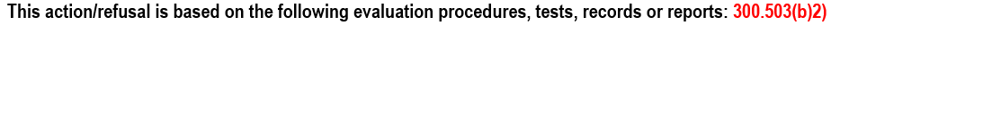
As description of each evaluation procedure, assessment, record or report the agency used as a basis for the proposed or refused action.
-When refusing a request by a parent, include a statement regarding their request and how the team considered their request.
-Document evaluations from private evaluators.
3

Slide 18

A description of any other options the team considered and the reason why those options were rejected.
-NA is never an option!
-If you are struggling to find information that fits in this section, there is likely unfinished work to do.
4

Slide 19

A description of other factors relevant to the agency’s proposal or refusal.
-Could be language, communication, health, behavior, consideration of harmful effects, and assistive technology.
-If no other factors exist, you still must document the reasons why
5

Slide 20
Sources for the parent to contact to obtain assistance.
-Typically the case manager’s name and school phone number
6

Slide 21
A statement (bottom on the PWN) that the parents of the child with a disability have protection under the procedural safeguards of this part and, if this notice is not an initial referral for evaluation, the means by which a copy of the procedural safeguards can be obtained.
7

Slide 22
Events that trigger a PWN

Slide 23
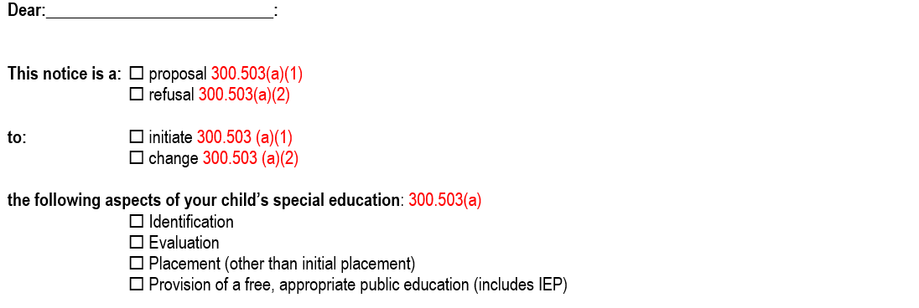
PWN-Special Education Action
Identification
Evaluation
Placement (Other than Initial)
Provision of a free, appropriate public education (includes IEP)

Slide 24
PWN through the Special Education Process
Evaluation
Consent or refusal to evaluate
Refusal to provide an Independent Education Evaluation (IEE)
Eligibility
Determination of eligibility or ineligibility
Change in eligibility category (identification)
Addition or removal of disability category
Termination of eligibility
Placement
Initial placement decision
Change in the least restrictive environment (LRE)
Change in private placement location
Refusal to change placement as requested by parent
Any change to a student’s physical environment for which services will be provided
IEP
After an IEP has been proposed by the AU
After IEP amendment without an IEP Team meetings
Change in services

Slide 25
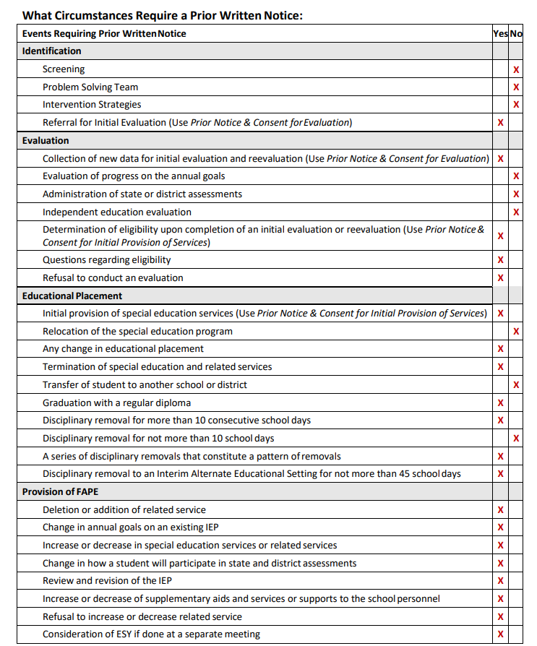
CDE Procedural
Guidance

Slide 26
What events require PWN?
An amendment made to IEP
Student suspended for 2 days
Data collection on IEP goals
Specific reading program requested
Termination of speech services as a related service
Change in student’s class schedule

Slide 27
What events require PWN?
An amendment made to IEP
Student suspended for 2 days
Data collection on IEP goals
Specific reading program requested
Termination of speech services as a related service
Change in student’s class schedule

Slide 28
What events require PWN?
Seeking consent for an initial evaluation
Administration of state assessment
Graduation with a regular diploma
Discussion of the student at a problem-solving team meeting
Refusal to provide an independent evaluation
At a reevaluation, a student isn’t found eligible for special education anymore

Slide 29
What events require PWN?
Seeking consent for an initial evaluation
Administration of state assessment
Graduation with a regular diploma
Discussion of the student at a problem-solving team meeting
Refusal to provide an independent evaluation
At a reevaluation, a student isn’t found eligible for special education anymore

Slide 30
Reminders
Provide
Provide to the parent in their native language
Provide
Provide PRIOR to implementation of proposed action
Deliver
Deliver within a “reasonable time” before the agency takes action 34 CFR 300.503 (d)
Must be “enough time to consider the change and respond to the action before it is implemented.”

Slide 31
Reminders Continued
Avoid use of any educational jargon
Avoid the use of language that could confuse parents
Capture details from the conversation that was held in objective terms
Clearly outline the discussion and decision/outcome that was reached
Avoid the use of acronyms, such as IDEA, LRE, MDR, and IEE without proper explanations
The names of any assessments, such as WISC IV, WJ III, BASC, etc. that are mentioned should be spelled
The names of any assessments, such as WISC IV, WJ III, BASC, etc. that are mentioned should be spelled out

Slide 32
Don't think of the PWN as another form to fill out.
Rather, think of the PWN as a letter to parents summarizing:
What you are proposing or refusing to change about their child's educational program;
Why you are proposing or refusing;
The body of evidence that supports that decision.
Provide to families within a reasonable amount of time so that they have time to challenge any of the decisions.

Slide 33
Communication is Key!
Prior Written Notice = Communication
Most disputes happen because of a lack of information and miscommunication
PWNs serve to close this gap!
Disputes are more likely to be avoided when all parties feel heard, valued and respected

Slide 34
Practice

Slide 35
Scenario #1: CO State-Level Complaint 2020:515
Parents request an independent educational evaluation (IEE) at their child's annual IEP meeting.
Special Education Coordinator emails parents after the meeting requesting consent for the District to complete their own evaluation and for parents to hold their request for an IEE until after hearing the outcome of the District's evaluation.
All parties agree with this arrangement and parents sign a PWN consent to evaluate.

Slide 36
A
You Decide: Did the PWN consent to evaluate suffice?
B
C
Yes. The district gained consent to evaluate per the team discussion.
No. Asking the parents to wait on requesting the IEE was a refusal and therefore required the district to provide a PWN refusing to approve the request for an IEE.
Yes. Parents agreed with the district's proposed next steps and the district had this in writing via email.

Slide 37
Answer: B
In this scenario, the LEA provided PWNs indicating the team's desire to conduct additional evaluation, but never specifically addressed the request for an IEE.
Take Away
  LEA must document in a PWN a refusal to provide an IEE upon parent request.
  A delay or postponement of an action is a refusal

Slide 38
Scenario #2: CO State-Level Complaint 2018:520
Parents requested an IEP meeting to discuss their request to add an assignment of a school nurse to the accommodations section.
The IEP team agreed that the student required a dedicated paraprofessional to monitor the student’s health needs.
The PWN embedded in the IEP provided the following:
“[Parents] asked how to avoid having this same discussion next year. District representative indicated that the school team cannot predetermine his needs at this time. If [Student’s] needs remain the same, the plan and support would also stay the same.”

Slide 39
You Decide: Was the PWN embedded in the IEP comprehensive?
A
B
C
No. The district should have also issued a separate PWN as this should not have been addressed in the IEP document.
No. The language in the PWN did not include the seven required components.
Yes. The team reached an agreement and both district and parent voices were captured in the PWN.

Slide 40
Answer: B
No. This PWN did not identify a specific action being proposed or refused. By stating that parent asked, “how to avoid this same discussion next year,” the subject of the discussion at issue was not identified.
Take Away
  Parent can be issued a PWN embedded in the body of the IEP. However, all 7 elements must still be included and addressed thoroughly.

Slide 41
Resources
*Parts adapted from Colorado Dept of Ed
IEP Procedural Guidance-CDE
Examples:
PWN Handbook
PWN-parent revocation of services

