Slide 1
Manifestation Determination Reviews Best Practices
“MDR” or ”MD”

Slide 2
Agenda
What are MDRs?
When are they required?
What are the questions to be answered?
What does the team do if the behavior is determined to be a manifestation of the disability?
What does the team do if the behavior is not determined to be a manifestation of the disability?
Preparation for the MD
Other Issues and Concerns

Slide 3
Purpose of MDR rules
To prevent discriminatory removals and loss of schooling
Prevent local/state rules mandating long-term disciplinary removals and expulsions despite disabilities

Slide 4
Basic MDR Rule
Prior to imposing long-term disciplinary removals, must determine whether behavior subject to discipline, was directly caused by the disability
State or local expulsion mandates do not supersede this requirement

Slide 5
When are MDR’s Required?
Prior to: disciplinary removals that constitute a change of placement (>10 days in a school year) by virtue of either:
Long-term removals > 10 days (constitutes a change in placement) e.g., expulsion
Short-term removals which are deemed excessive (a pattern of removals which exceed 10 days during school year)

Slide 6
When Short-Term Removals = Pattern
Patterns are determined by factors such as:
Proximity of removals to each other
Similarity of behaviors that led to removals
Overall total number of removal days during year

Slide 7
Caveats to Relying on Pattern Analyses
However, Federal OCR has been ruling more conservatively in recent years: any additional days of removal after 10 = a pattern
the IEP team must meet to determine if removals constitute a pattern every time, once student has reached 10 days in school year.
Therefore, it is not worth trying to calculate patterns of behavior. Follow the 10-day guidance.

Slide 8
Parent Notification
On the date when the decision is made to remove a student, and that removal constitutes a change of placement, school must notify the parents of that decision and provide the parents with a copy of their procedural safeguards notice.
(A change of placement is an event that triggers the IDEA’s prior written notice (“PWN”) requirement, so AUs must provide written notice that complies with the requirements of 34 C.F.R. § 300.503)

Slide 9
Timeline
10 Days of Removal due to change of placement
Parent Notification (at time of decision to remove
Manifestation Determination
Reached the 10 days of consecutive removals from school
Had a pattern of days which constitutes 10 days of removal
Notification to parents in writing of decision to remove student that constitutes change of placement (PWN)
Copy of Procedural Safeguards
The MDR must occur within 10 days of the decision to change the placement of the student
After change of placement (10 days) and subsequent removals, student must be provided services

Slide 10
Best Practices:
Hold IEP meeting prior to 10 days removal to consider options:
Conduct FBA/write a behavior intervention plan
Use ISS instead of OSS but ensure student has access to class work and assistance to understand/complete
Limit OSS to 1 day at a time
Re-Evaluate?

Slide 11
45-Day Interim Alternative Educational Placement (IAES)
Include the CSI Special Education Coordinator and school attorney before taking this action!
Removals for drugs, weapons, serious bodily injury
45 or fewer days
Decision to move to IAES may be made regardless of MDR decision if due to possession of weapons on campus or school function
IEP determines the placement, consider the parent’s input regarding the program
The IEP team, with parent consent, can always redesign the student’s placement if it meets the student’s needs without confinement to 45 days.

Slide 12
Possession/Use of Illegal Drugs
Student knowingly possesses or uses illegal drugs or sells or solicits the sale of a controlled substance, while at school, on school premises, or at a school function.
does NOT include a controlled substance that is legally possessed or used under the authority of a health care professional.

Slide 13
Weapons
Weapon, device, instrument, material, or substance (Animate or inanimate)
That is used for, or is readily capable of, Causing death or serious bodily injury
Except that such term does NOT include a pocketknife with a blade of less than 2.5 inches.
“Weapon” includes a firearm defined in part by federal law as any weapon that will or is designed to or may be readily converted to expel a projectile by the action of an explosive . . .
And also any explosive, incendiary, or poison gas “destructive device.”

Slide 14
Infliction of Serious Bodily Injury Substantial risk of death, extreme physical pain, protracted and obvious disfigurement, or protracted loss or impairment of the function of a bodily member, organ, or mental faculty.
A very high bar to reach:
As defined at 18 U.S.C. 1365(h)(3), the term serious bodily injury means bodily injury that involves— 1. A substantial risk of death; 2. Extreme physical pain; 3. Protracted and obvious disfigurement; or 4. Protracted loss or impairment of the function of a bodily member, organ, or mental faculty.

Slide 15
Infliction of Serious Bodily Injury
Non examples of Serious Bodily Injury (most assaults will not qualify)
Teacher experienced redness, swelling, and pain, and missed one day of work to go to the doctor; there was no evidence the teacher sought further medical care.
Lots of pain one day but not the next not enough.
Teacher experienced pain, scrapes, went to doctor next day but did not need follow-up medical care
Examples of Serious Bodily Injury
Staff member missed 2 weeks of work due to student running into chest, caused contusions, extreme pain, required medication
Broken limb

Slide 16
The Questions that Need to be Answered by the team
Was the IEP and/or BIP correctly implemented at the time of the infraction?
If not, was the behavior directly the result of the failure of the implementation at the time of the infraction substantially cause the behavior?
Was the behavior that was subject to the discipline, caused by or had a direct relationship to the disability?

Slide 17
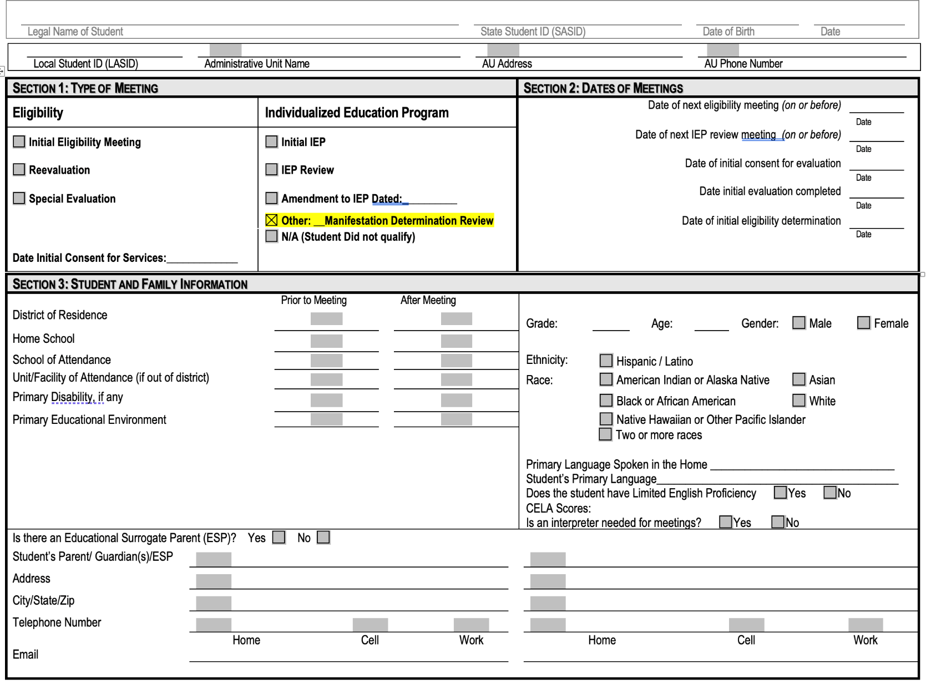
MDR Form pg. 1

Slide 18
MDR Form pg. 2

Slide 19
Preparing for MDR Meetings
Preparation for Manifestation Determination Reviews is vital. Don’t just show up to meeting and give opinions and make the decision
Review all relevant data prior to, and during, the meeting
Relevant data to review history and symptoms of disability:
Details of the incident
Parent information/home history
Private evaluation and school evaluation reports
Interviews/reports from teachers
Discipline records, behavioral records
Grades, attendance
Drug or alcohol use if relevant

Slide 20
Preparing for MDR Meetings-continued
Involve the right people at the meeting and document how they are knowledgeable about the condition:
Those that are knowledgeable about the student, the disability, and any relevant records that need to be interpreted.
E.g., “the classroom teacher has attended workshops on ADHD and the school psychologist and extensive experience and training with this condition”
Must include in the meeting: parents, classroom teacher, 504 coordinator
It may be appropriate to include in the meeting: School Psychologist, school mental health professional, school nurse, school administrator, student, etc.

Slide 21
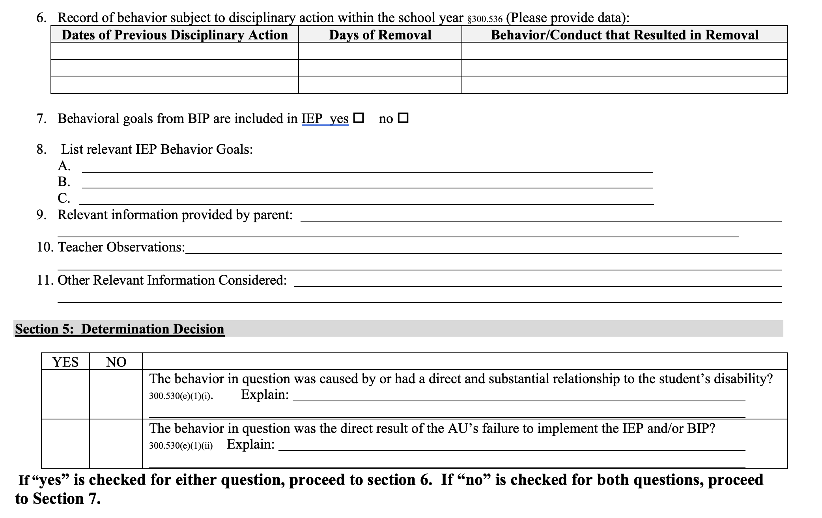
MDR Form pg. 3

Slide 22
MDR Form: First Question
Was the behavior caused by, or directly and substantially related to, the disabilities?
Example:
Student has ADHD with history of impulsive behaviors. While engaging in horseplay on the playground, student kicks another student

Slide 23
MDR Form: Second Question
2. Was the behavior the direct result of the school’s failure to implement the 504 plan? (failure must directly result in the behavior)
Example:
504 plan listed a behavior support person assigned to student. Staff member was absent that day and no one was assigned to cover student.

Slide 24
Casual or Indirect Relationship
Relationship between the behavior and disabilities must be more than attenuated…Must have had a direct and substantial relationship to the disability.
Attenuated relationship example:
Student has a 504 plan for dyslexia. An opinion is shared that because of her disability, the student has low self-esteem. The faulty argument is that the student engaged in behavior, subject to discipline, because of low self-esteem related to her disability.
Student has a 504 plan for depression. The Dean of Students catches the student with a marijuana vape pen. The argument is made that he was self-medicating for his depression.

Slide 25
Direct or Substantial Relationship
Direct/substantial relationship to disability:
Student has a school discipline history of difficulty controlling his emotions and anger toward peers. Likewise, the private psychological report has documented evidence that student has significant challenges with self-regulation, specific to anger, and has a pattern of acting out physically toward others.
Student is identified with ADHD and has a history of impulsivity and forgetfulness. She makes her lunch for school and leaves the knife she used to cut her sandwich in her lunch box by mistake. Other students see the knife when she opens her lunchbox in the cafeteria.

Slide 26
When the Behavior is Determined to be a Manifestation of the Disability:
The team must conduct an FBA and develop BIP or,
If there already is a BIP in place, revise/update the plan to address the behaviors that led to the disciplinary removal.
And
The student should return to his/her previous placement unless the parents and the rest of the IEP team agree to a new placement.

Slide 27
No Relationship
No Manifestation between behavior and disability:
Student has a 504 for ADHD, inattentive type, with no history of aggression toward adults or peers in school discipline, parent reports or private evaluation records. Student injures another classmate in a fight on the playground and is considered for expulsion due to the severity of the incident and the harm caused.
Student has Tourette’s with associated ADHD/OCD and is on a 504 plan. Student has a history of forgetful and impulsive actions. However, student was considered for expulsion after picking up rocks and throwing them at the younger students, hitting and causing significant injury to that student. Student had told other students “watch me hit that student with this rock”. Parents argued that throwing the rocks was an involuntary tic.

Slide 28
When the Behavior is Determined Not to be a Manifestation of the Disability
The student may be disciplined similar to any other student according to the code of conduct, but services must be provided
If the behaviors that led to the disciplinary measures impede the learning of others, the team should consider whether to conduct an FBA and develop a BIP

Slide 29
Recent Additional Consideration by OCR
Was the behavior substantially related to inappropriate IEP?
Was there a clear need for BIP/FBA/behavior supports due to chronic behavior problems?

Slide 30
Explanation
Do not merely check ‘yes’ or ‘no’. Need to have MDR statement of reasoning as to how committee made their decision. Include on PWN as well.
“After being caught and disciplined previously by parents for possession, student found locations in the home to hide marijuana and vape pen, made advance arrangements with peer to meet and sell/distribute the drugs in a location that would evade detection by staff. These actions suggest the possession, use, and distribution of marijuana involved planning and forethought and were not impulsive in nature.”

Slide 31
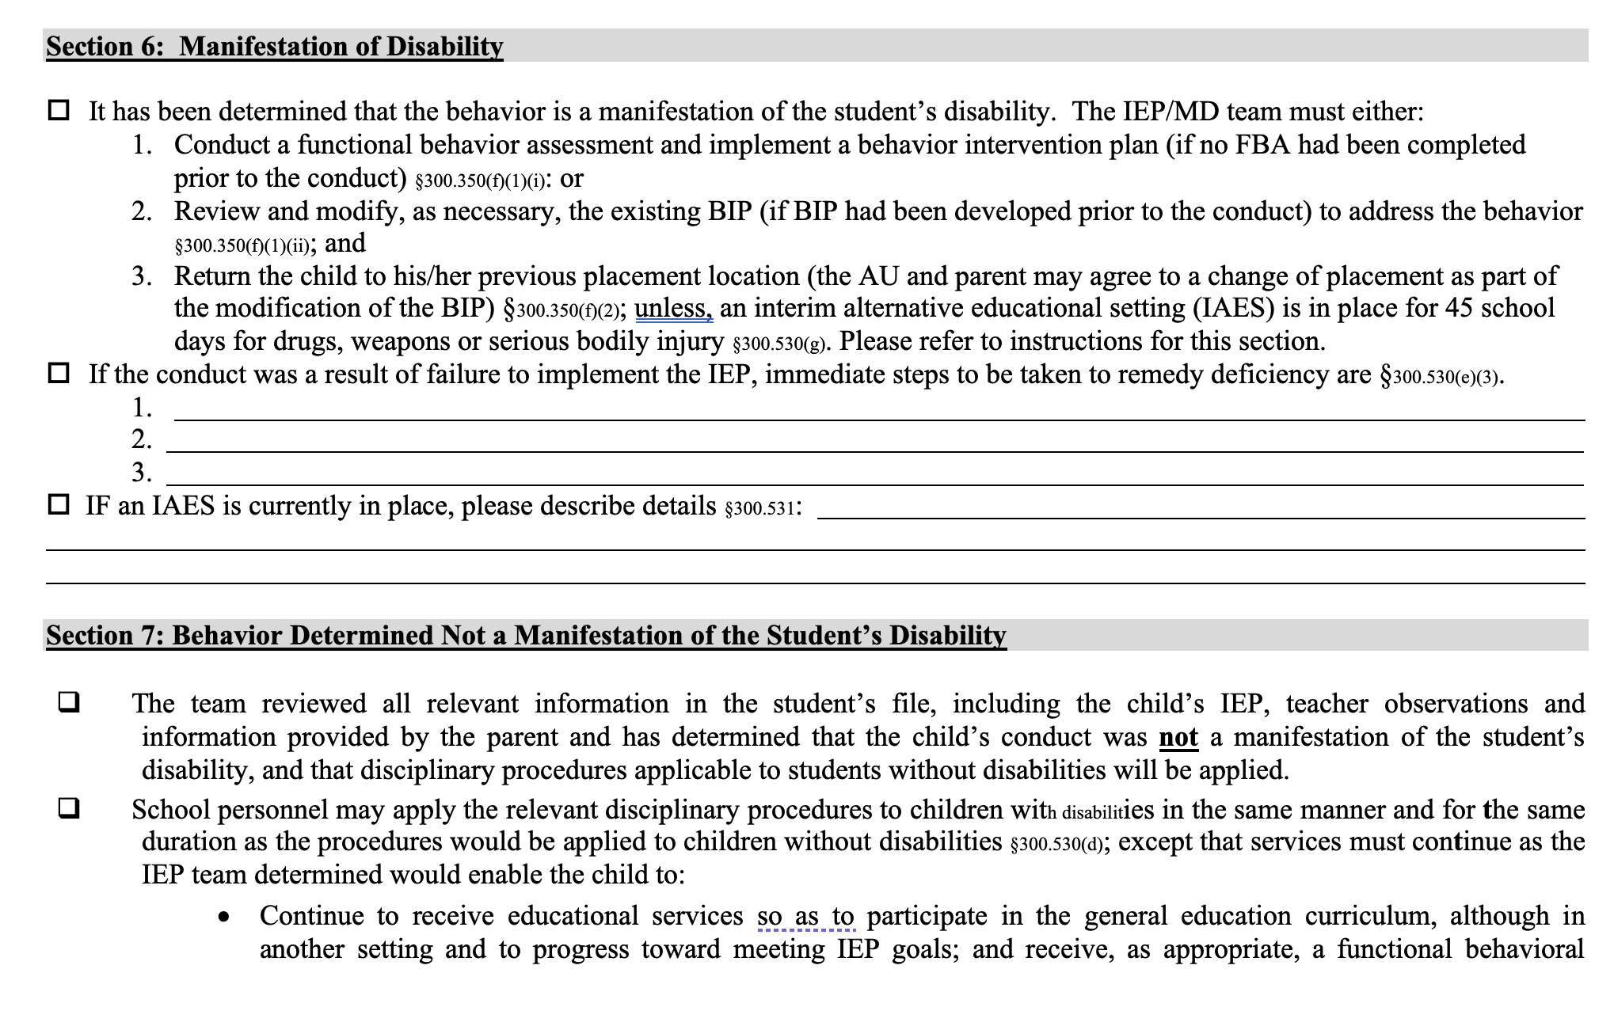
MDR Form pg. 4

Slide 32
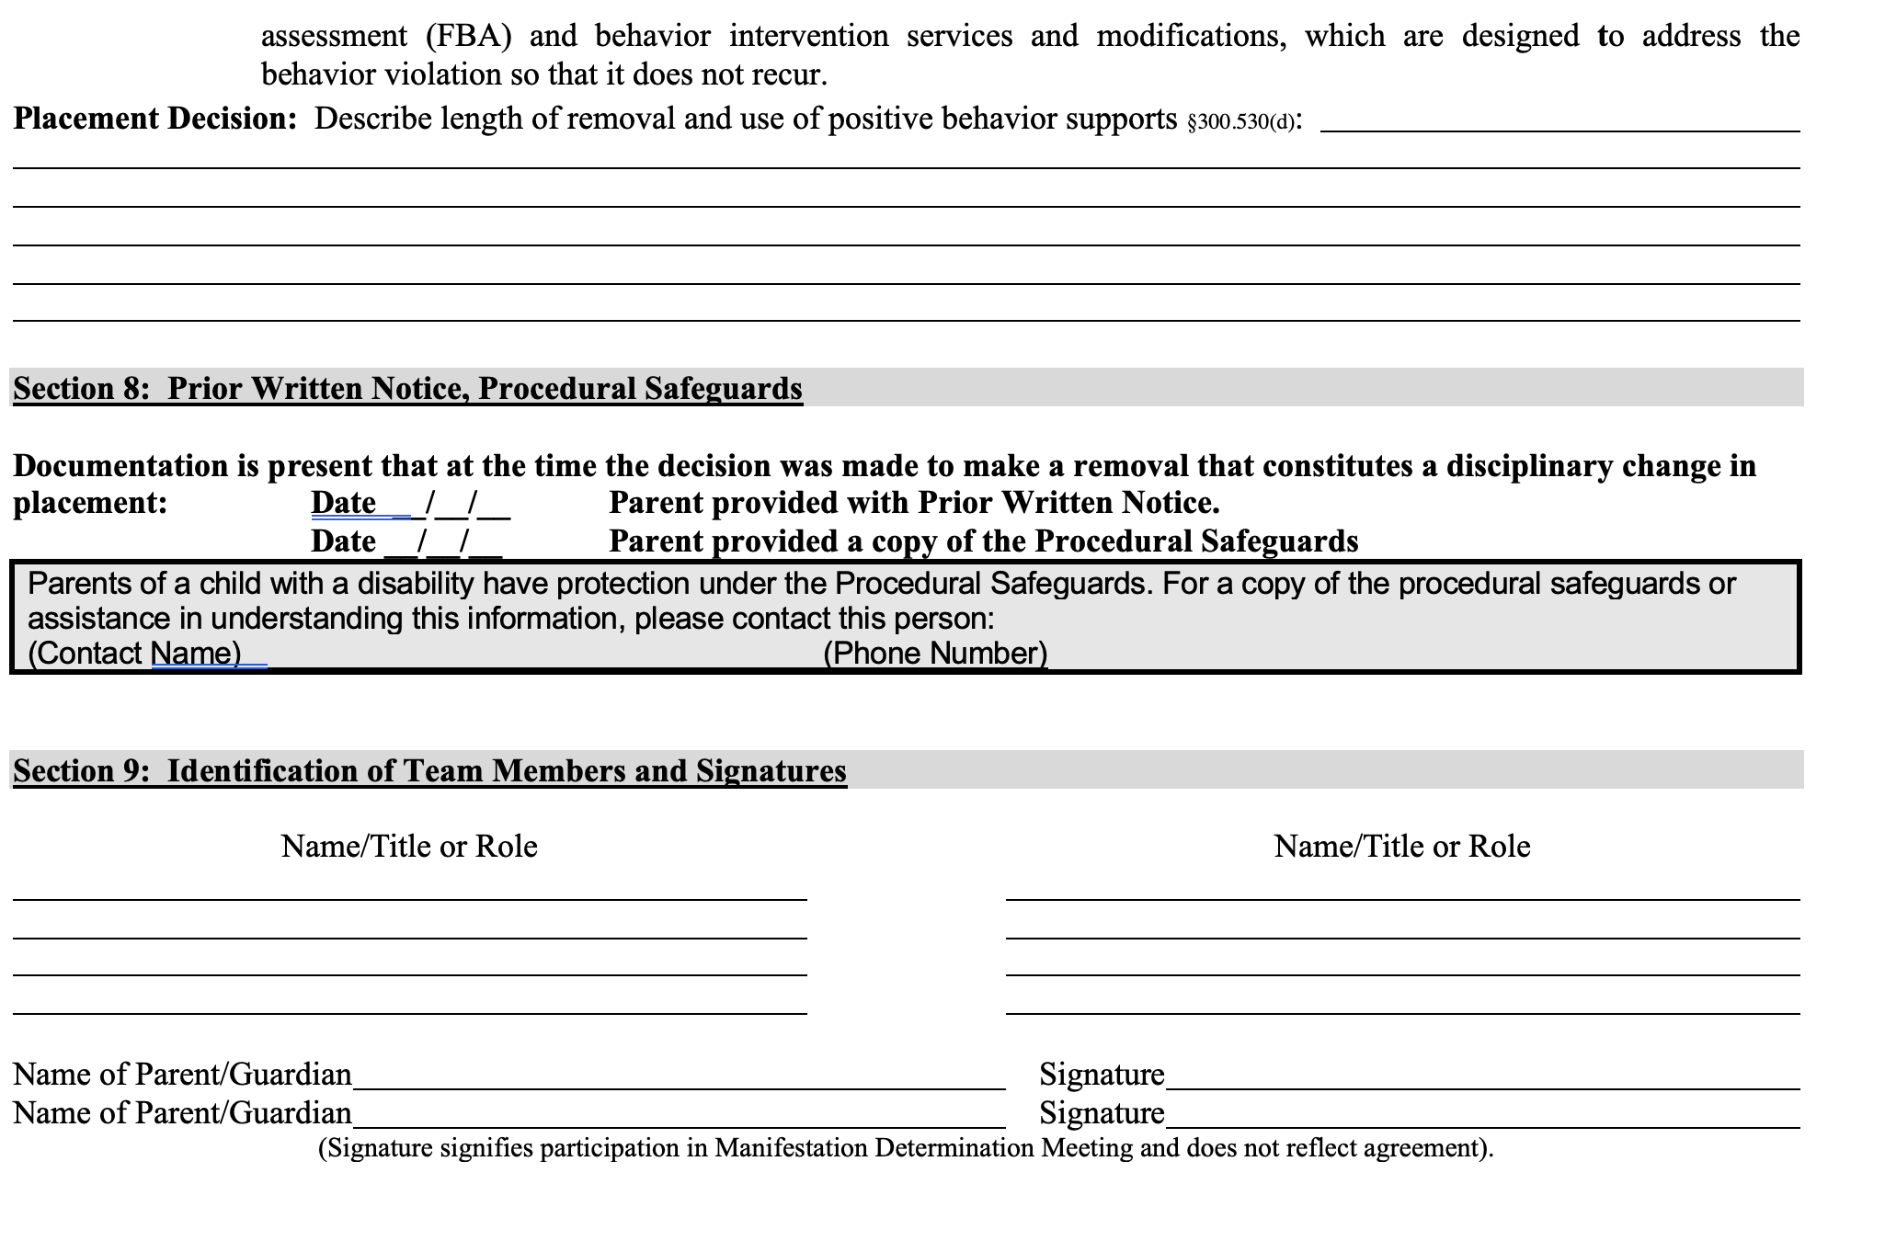
MDR Form pg. 5

Slide 33
Important Factors for Consideration during Preparation:
History of the behavior:
Does the student have a history of engaging in the behavior subject to the discipline? (e. g., fighting, aggressive behaviors)?
Planning for the behavior:
Was there indication that planning took place to engage in the behavior? (e. g., student made a ‘hit list’, wrote documents of intention, engaged in several steps leading up to the behavior, purposely video recorded the incident?)

Slide 34
Steps for the MDR Meeting
Send NOM (MDR Notice) with reason for the meeting
Make it clear that the IEP team does not determine the authenticity of the incident, rather is charged with making the determination based on the incident as reported and the student’s disability. Any disagreements about the facts, discipline, etc., must be taken up by following discipline appeal processes established by the school.
Review the behavior subject to the discipline. Review the incident as documented and reported by school administrators.
Review the disabilities of the student, history and all relevant data
Did the team properly identify the student’s disability? Is there clear evidence that another relevant disability was missed?

Slide 35
Steps for the MDR Meeting-continued
Walk through the 2 questions
If a Manifestation is found, then must develop a plan to support the student and return the student to school immediately
If no Manifestation is found, then may discipline the student in the same manner as a general education student
Provide notice of parental rights
Write PWN with rationale for decision

Slide 36
Parent Disagreement
The Manifestation Determination decision is made by the IEP team, parents are part of the team
It is not a vote but a consensus
If the committee and parents do not agree after discussion and consideration of parent opinions, then move forward with the decision made by committee and provide parents with their parental rights.
Notify your special education coordinator

Slide 37
Last Minute Revelation of Possible New Disabilities
It is not uncommon for parents to reveal that the student may have other disabilities or conditions when the student is being considered for an MDR or expulsion. Moreover, parents may ask for a special education evaluation to delay the MDR/expulsion process.
Note:
The 504 team is only responsible for considering known disabilities. If the team has not observed a clear existence of another disability that could have had a direct and substantial relationship to the behavior, the team would not have to consider.
Q: if the team had known about this other disability, could the school have prevented the behavior subject to the discipline?
However, the claim of the presence of another condition without clear data to support, is not sufficient to require consideration of that disability

