Slide 1
McKinney-Vento Liaison Training
Charter School Institute
Notes:
We are doing this updated training because some interpretation of the law has shifted, as well as there are new personnel involved both in CSI and in the schools. We want to improve the dissemination of information, as well as the quality of our consultation.

Slide 2
Introductions
Use the chat feature to introduce yourself…
Name
School
Role in MKV
Notes:
So many roles!
We’re going to use MKV as shorthand for McKinney-Vento.
Write your questions down so we can answer them next week

Slide 3
CSI MKV Liaison Support
Betsy Basch
CSI McKinney-Vento Liaison
Marcie Robidart
CSI Grants Fiscal & Accounting Manager
CSI Data Team submissions_csi@csi.state.co.us
Notes:
You many interact with any of us!

Slide 4
Agenda:
MKV Due Dates
CSI MKV Liaison Support
CSI Data Review
McKinney-Vento Overview & the Liaison Role
Identification & Procedures
Additional Responsibilities
Additional Roles
FRL
Budget

Slide 5
CSI MKV Liaison Support Website
Notes:
Also where you find resources, eligibility forms

Slide 6
Usual Timeline
Homeless Liaisons- Training
Liaisons- Complete & Submit residency forms
CSI- Processing Residency Forms
McKinney-Vento Training
Early August
Rolling:
Submit forms as they are received and update SIS
Forms submitted before September 27th will be included in October Count.
Rolling:
CSI receives Residency forms through G-Drive uploads.
CSI verifies student information, signs, and returns the form to G-Drive.
CSI reaches out to School Food Authority (SFA)
Notes:
Schools should continue to do outreach & identification throughout the year
*SFA info might change based on food for all passing
-date is to give us time to process & sign applications before the count window is over

Slide 7
Funding Dates for MKV
Although CSI schools receive their initial allocation of McKinney-Vento funding based on counts of students experiencing homelessness as identified on the October Count data collection, CSI sets aside funding for year-round eligibility.

Slide 8
MKV Dates!
MKV FORMS DUE
SEPTEMBER 27TH
WE ALLOCATE McKINNEY VENTO ELGIBILITY ALL YEAR LONG
Notes:
The September 27th deadline allows CSI time to process and approve McKinney Vento applications for identification in the October Count Collection, which is the primary method by which the initial allocation of McKinney-Vento funding is allocated to CSI schools.
These forms can still be submitted after September 27th and throughout the school year and will be how subsequent allocation is awarded.

Slide 9
The McKinney-Vento Assistance Act
Subtitle VII-B of the McKinney-Vento Homeless Assistance Act, reauthorized in 2015 by Title IX, Part A of the Every Student Succeeds Act is a federal law that addresses the educational needs of children and youth experiencing homelessness.
Rights
Responsibilities
Eligibility
Notes:
https://www.cde.state.co.us/studentsupport/mckinneyventofactsheet05-10-21
The McKinney-Vento Act helps un or underhoused student access schooling and eliminating barriers to education.
-wording (homeless, unhoused)

Slide 10
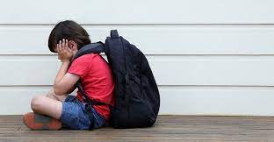
Impacts of Homelessness on Children and Youth
Higher incidences of acute and chronic illnesses
Youth who experience homelessness are 87% more likely to drop out of school.
The opportunity gap widens
Notes:
-the risk of drop out is the highest around the first exposure to a MKV qualifying event

Slide 11
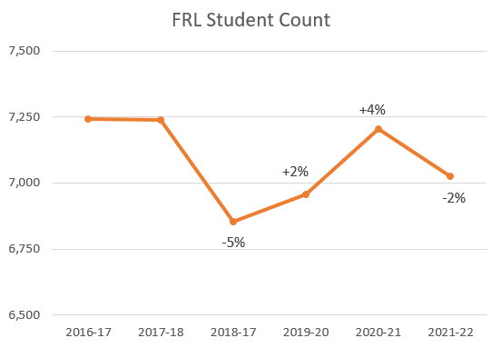
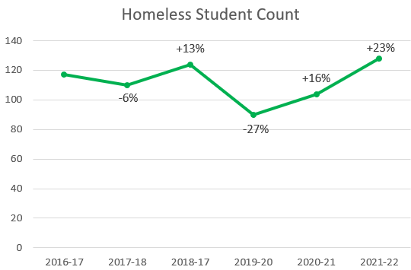
Graph Differences of FRL & MKV
NCHE & CDE Recommendation:
# of identified homeless students should average 10% of students receiving free meals
21-22: 7,026
20-21: 7,206
19-20: 6,958
23-24: 286
22-23: 182
21-22: 128
CSI students who qualify for McKinney-Vento/Homeless support should be closer to 700 students.
Notes:
Quick Facts:
The number of students identified as homeless students should average 10% of the students who receive free meals.
CSI currently has around 7,000 students eligible for free/reduced lunch.
CSI identifies around 100 students each year under McKinney-Vento.
We are not capturing all students who qualify for Homeless support and services. We are short by over 600!

Slide 12
Reflection Check
How do you think your identification strategies are working? Do you think you are:
Overidentifying
Underidentifying
Identifying Accurately

Slide 13
Barriers to Eligibility & Identification
Stereotypes
Lack of awareness
Bias
Assumptions
Notes:
Under-identification, lack of school stability (highly mobile), enrollment requirements, fatigue & hunger, lack of transportation

Slide 14
Barriers to Eligibility & Identification 2
If we know these barriers exist, what are we doing to remove them?
Notes:
Under-identification, lack of school stability (highly mobile), enrollment requirements, fatigue & hunger, lack of transportation

Slide 15
Barriers to Eligibility & Identification 3
Family
Responsibility
Child Find?
Notes:
What would happen if we think about MKV as Child Find rather than a family’s responsibility?
-what is child find

Slide 16
Rethinking McKinney Vento
Notes:
We gotta approach this differently

Slide 17
Strategies to Increase Identification
Avoid using the word "homeless” with school personnel, families, or youth.
Use “unhoused, underhoused, difficulty with housing”
Offer resources first, consider inflation & pandemic impact

Slide 18
Strategies to Increase Identification 2
Looking at previous years’ eligibility
Foster Care
(very common)
Migratory Work
(extremely common)

Slide 19
Strategies to Increase Identification 3
Provide awareness activities for school staff (registrars, secretaries, counselors, nurses, teachers, tutors, bus drivers, security officers, drop out prevention specialists, attendance officers, administrators, etc.).
http://www.naehcy.org/educational-resources/
http://center.serve.org/nche/web/online_tr.php
Engage in anti-bias training with staff

Slide 20
Strategies to Increase Identification 4
Post outreach materials and posters in areas where there is a frequent influx of low-income families and youth in high-risk situations, including motels, campgrounds, libraries, health center, youth services.
Post outreach materials in high traffic areas of family, staff & students, as well as making them available during any school community events (back to school night, open houses, conferences, concerts and other events)

Slide 21
Scenario 1
We have a parent that we know is unhoused but never seems to have the time to fill out the McKinney-Vento form. We’ve given the form to the student but they don’t return it, and when we leave messages with the parent they just keep saying they don’t have time to fill out the form.
What do you think?
Notes:
-Poll
Fill it out with them
Tell them they won’t get benefits if they don’t complete the form
Keep sending the form home with the student
Accept their decision, they must not want to be identified

Slide 22
Strategies to Increase Identification 5
Offer multiple points of contact with families
Streamline communication between McKinney Vento Liaison, School Staff, and Finance Department
Make resource connections between school, community partners and staff/family connections.

Slide 23
Strategies to Increase Identification 6
Note that qualification does not roll over from year to year, if you have students and families that are chronically unhoused or underhoused, new eligibility forms will need to be completed yearly.

Slide 24
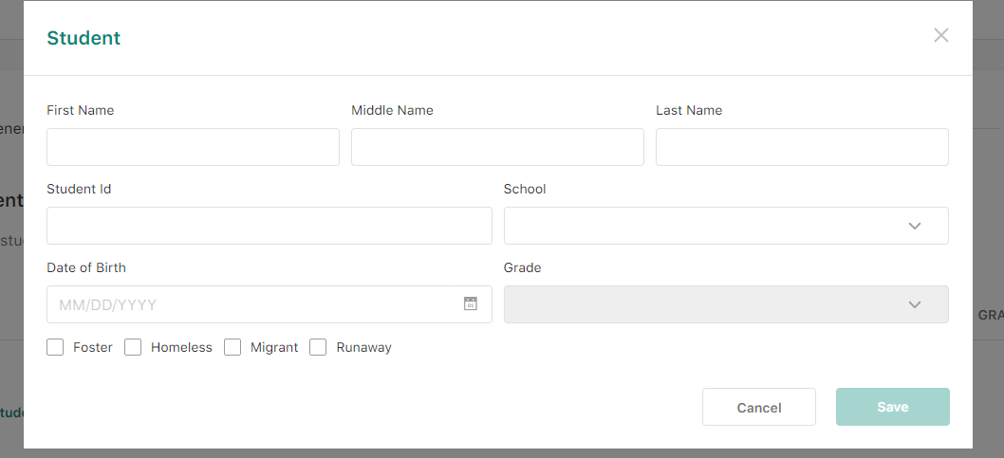
Strategies to Increase Identification 7
Free and reduced lunch applications or enrollment forms
Notes:
Sometimes we find students who are eligible for McKinney-Vento in different ways
On FRL forms, “Runaway” means “Unaccompanied Youth” for eligibility.
All MKV students are eligible for FRL, not all FRL are eligible for MKV
Enrollment forms that allow parents to indicate migratory

Slide 25
Reflection Check 2
What barriers do your students and families face for identification?

Slide 26
McKinney-Vento Students have the right to: (1)
Be identified as being MKV eligible
Have transportation arranged or provided to their school of origin, regardless of whether the school provides transportation for other students.

Slide 27
McKinney-Vento Students have the right to: (2)
Immediate enrollment in any public school that students living in the same attendance area are eligible to attend; even if student has missed application or enrollment deadlines during any period of homelessness.
Immediate enrollment even if they do not have former school records, records of immunization and other required health records, proof of residency, guardianship, or other documents.

Slide 28
Enrollment Consideration
If your classrooms are regularly full, consider how to provide slots to McKinney-Vento eligible students that are mobile throughout the year, regular denial of enrollment to McKinney-Vento eligible students could be considered discrimination

Slide 29
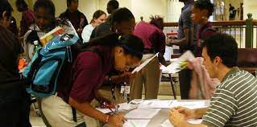
McKinney-Vento Students have the right to: (3)
Student must be immediately enrolled in the school in which the student/parent seeks enrollment if there is a dispute between parents & school about McKinney-Vento placement/transportation and/or eligibility.
Notes:
Remember MKV is about protecting educational rights, and this is one of the rights in the MKV Homeless Assistance Act.

Slide 30
McKinney-Vento Students have the right to: (4)
Automatic eligibility for Title IA funds allocated to schools
Immediate access to free school meals & educational services (if eligible)
Referrals for other services
If unaccompanied, be informed of FAFSA status

Slide 31
Posting of Public Notice of Educational Rights
All schools are required to post the Notice of Educational Rights in their school.
Free posters are available for download for print here: https://nchehelpline.org/pages/free-orders
Notes:
~It is encouraged that both the Parent and Youth posters are displayed in English and Spanish

Slide 32
Updated McKinney-Vento Posters
Notes:
~It is encouraged that both the Parent and Youth posters are displayed in English and Spanish

Slide 33
Scenario 2
Our school has worked hard with a designer to make sure our school’s aesthetic is conducive to learning. We have the McKinney-Vento posters behind the front desk in case any parent asks.
What do you think?

Slide 34
Liaison Responsibilities
Post
Post educational rights posters around the school
Make
Make families aware of the McKinney-Vento funds
Ensure
Ensure youth in un or underhoused situations are identified
Provide
Provide students with educational & community resources
Provide
Provide students with educational services (as applicable)
Submit
Submit eligibility forms in a timely manner
Resolve
Resolve disputes
Allocate
Allocate funds appropriately
Notes:
Because MKV students have rights, this means MKV Liaisons have responsibilities…..
Access a MKV education liaison who has the skills & capacity to fulfill the duties.
-schools should provide CSI staff the name & contact information for identified school-based MKV liaison as well as any staff members added to the G-Drive MKV folder to upload eligibility forms
-schools should update these contacts if this information changes during the year

Slide 35
Determining Eligibility

Slide 36
Nighttime Residence
Homeless
NOT Homeless

Slide 37
Who qualifies under McKinney-Vento?
Any student who lacks a fixed, regular, and adequate nighttime residence.
Fixed: a residence that is stationary, permanent, and not subject to change.
Regular: a residence that is used on a nightly basis.
Adequate: a residence that is sufficient for meeting both the physical and psychological needs typically met in home environments.
Notes:
Questions to ask in determination process:
Is the residence fixed?
Is it regular?
Is it adequate?

Slide 38
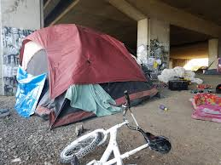
Unaffixed, Inadequate & Not Regular
Living in motels, hotels, trailer parks, camping grounds due to lack of adequate alternative accommodations
Living in emergency or transitional shelters
Abandoned in hospitals
Living in a public or private place not designed for humans to live
Living in cars, parks, abandoned buildings, bus or train stations, etc.

Slide 39
Adequate Housing
Homeless
NOT Homeless
Notes:
The difference between having to live in an RV because they have no other place to go, and living “RV life”…..and know that sometimes asking questions can trigger bias as well.

Slide 40
Scenario 3
You have a student whose parents and family live in an RV down by the river. You ask the youngest child when they are moving into their new home, and the child looks at you quizzically and explains the RV IS their home.
What do you think?

Slide 41
Adequate Housing 2
Homeless
NOT Homeless
Notes:
Not usually a choice, could be bad management or a bad landlord

Slide 42
Scenario 4
You have a student whose family was living in a house with electricity, but there was a small fire due to some wiring problems and now they are asking to store some food at school and heat it up so they can have a warm breakfast.
What do you think?

Slide 43
Doubling-Up
Not all doubled-up situations are considered homeless.
Sharing the housing of others due to loss of housing, economic hardship, or similar reason

Slide 44
Doubling-Up 2
Note the key phrase in the example in the definition: “sharing the housing of other persons due to loss of housing, economic hardship, or a similar reason.”
To be eligible for McKinney-Vento services, a child or youth living doubled-up must have lost housing or experienced a crisis.

Slide 45
Doubled Up 3
Homeless
NOT Homeless

Slide 46
Scenario 5
One of your students helps out in the lunchroom every day and all the cafeteria staff love them. One of the cafeteria staff tells you that the student told them that they like helping out because they help out their grandparents and their cousins that live with them in their house.
What do you think?

Slide 47
Helpful Questions:
Why did the family or youth move in with another family?
Is this a long-term arrangement?
Is it a situation of mutual benefit or convenience to both parties?
Where would the doubling-up family or youth live if not able to stay with the host family?
Could they be removed from the home at any time?

Slide 48
Unaccompanied Youth
Homeless
NOT Homeless
Notes:
Youth on their own who lack a fixed, adequate and regular primary nighttime residence (unaccompanied youth)
Even when a kiddo tells you that they just don’t get along so they mutually agreed to live somewhere else….that’s not how the law works

Slide 49
Family Conflict
The number one reason we see unaccompanied minors is because of family conflict

Slide 50
Scenario 6
You have a 9th grade student who was kicked out of their home when their parents found out they were pregnant and now is living with other friends that also have kids so they can help each other out.
What do you think?

Slide 51
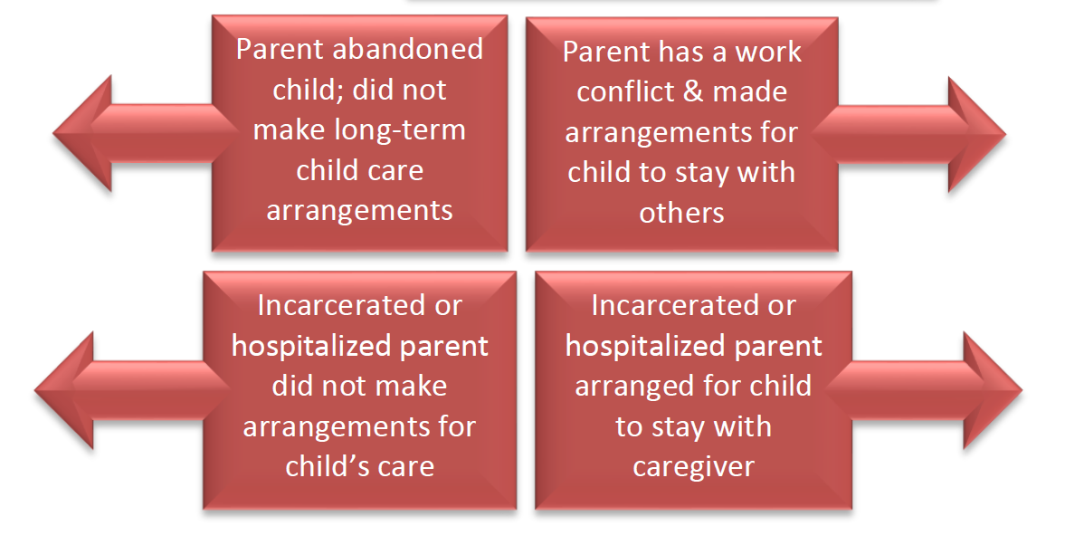
Unaccompanied Youth 2
Homeless
NOT Homeless

Slide 52
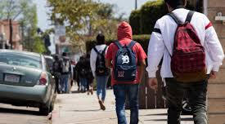
What to do when you’ve identified a student?

Slide 53
Filling Out the MKV Form
The school homeless liaison must confirm the information recorded on the Residency Form is accurate and complete
The school can help families fill out forms
Notes:
Does everyone at your school know who is completing the information?
-link to forms on our website

Slide 54
Barriers to Eligibility & Identification 4
If we know these barriers exist, what are we doing to remove them?
Notes:
Under-identification, lack of school stability (highly mobile), enrollment requirements, fatigue & hunger, lack of transportation

Slide 55
Scenario 7
A parent finally turns in their MKV eligibility form but forgot to fill out the student’s birthday and said they don’t know the student’s SASID.
What do you think?

Slide 56
Filling Out the MKV Form 2
Please make sure SASID is complete. Not SSN, SASID.
Do not put protected information on form.
Notes:
The SASID number can be filled out any time before it goes to CSI.
DO NOT PUT PROTECTED INFORMATION ON THIS FORM

Slide 57
Filling Out the MKV Form 3
If they are living in a house with a parent or guardian, then we need to question why we are filling out the form.

Slide 58
Filling Out the MKV Form 4
Always make sure this is checked “yes” or “no”.

Slide 59
Filling Out the MKV Form 5
Signature of Parent or Guardian or Youth Date
If unable to sign because of barriers, please complete the rest of the form.

Slide 60
Filling Out the MKV Form (opt)
Signature of Parent or Guardian or Youth Date
If unable to sign because of barriers, please complete the rest of the form. If youth is unaccompanied, parent/guardian signature is not required.

Slide 61
Filling Out the MKV Form 6
Signature of School Liaison Date
Please sign and print the name of the person confirming the information at the school.

Slide 62
Filling Out the MKV Form 7
Signature of CSI Liaison Date
Please do not sign here, this is for CSI to complete.

Slide 63
Submitting the MKV Form
The liaison and/or registrar scans and securely uploads the form to the school’s CSI Google Drive folder.
(FERPA law does not allow forms to be emailed/faxed)
CSI will not send back combined forms with protected student information..
We will use the Migrant Education Form through our Migrant Education Liaison to ensure that eligibility.
Notes:
We use the protected Google Drive version, and can only use this to exchange information.
No Filezilla
Only certain people with access can access certain folders. Folders cannot be made open to anyone.

Slide 64
Residency Form Submission Process
Please contact the CSI MKV Liaison to work with the CSI Submissions Team (Submissions_CSI@csi.state.co.us) to ensure protected access to the Google Drive folder created for Residency Form submissions.
Upload forms into your school’s Google folder and email CSI MKV Liaison that you have done so.
Notes:
Google doesn’t let us know when there has been uploads

Slide 65
Verifying the MKV Form
CSI MKV Liaison will verify residency form submissions are complete and accurate.
Sometimes students come up as not enrolled in the school.
After verification, CSI Liaison signs, dates & returns form.
CSI Liaison lets School MKV Liaison form has been returned.
CSI Liaison contacts the School Food Authority if applicable.

Slide 66
So You’ve Submitted…..
Let’s get some other people involved!
Finance
Liaison
Submissions
Notes:
How do your finance, liaison and submissions people work together?
Language MKV for Liaison & Finance but submissions use the state field of “homeless” and work on making sure the numbers line up in October Count EOY submissions

Slide 67
Funding Dates for MKV….
Although CSI schools receive McKinney-Vento funding based on counts of students experiencing homelessness as identified on the October Count data collection, CSI sets aside funding for year-round McKinney-Vento Eligibility.

Slide 68
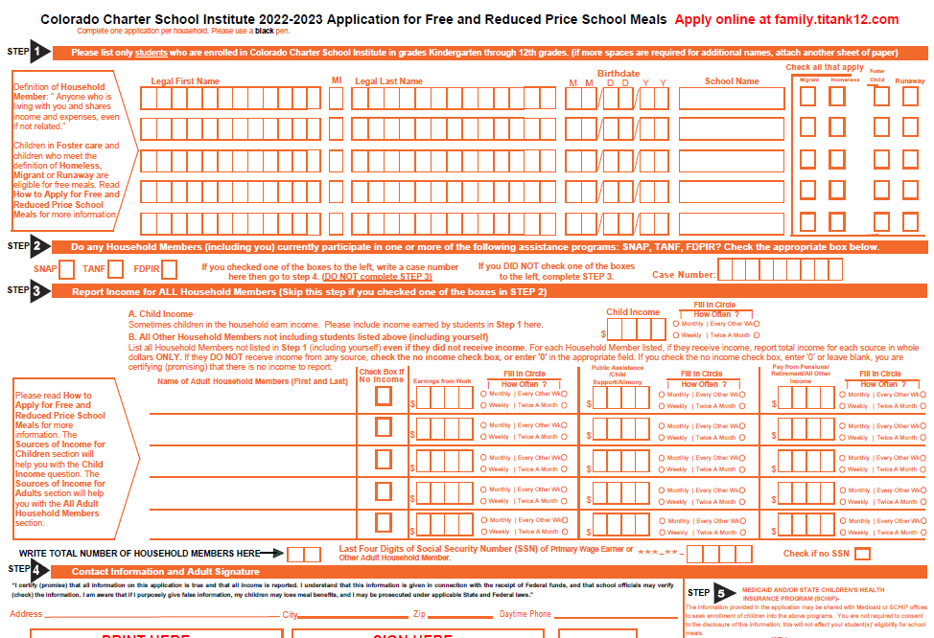
Free/Reduced Lunch Applications
Every student who is MKV eligible automatically qualifies for FRL

Slide 69
Free/Reduced Lunch Applications 2
Every student who qualifies for FRL is NOT automatically eligible for MKV

Slide 70
Free/Reduced Lunch Applications 3
CSI MKV Liaison works with SFA Liaisons to inform of status

Slide 71
McKinney-Vento Budget Items

Slide 72
Allowable Use of Funds
Meet basic needs (clothing, supplies, health) of homeless students so that they can participate in school
Support homeless liaison position
Hire special teachers, aides, and tutors to provide supplemental instruction
Provide outreach activities to homeless parents
Provide after-school and/or summer programs
Provide emergency food while the student is in school, including breakfast, lunch, and snacks
Pay for student projects and/or field trips
Provide academic support as well as non-academic support to homeless students in non-Title IA schools
Notes:
-not cleaning supplies except for laundry supplies

Slide 73
Scenario 8
A student who you know has been living in a campground down the street has asked that you rent an apartment for them since they qualify for McKinney-Vento, and McKinney-Vento is supposed to help homeless kids.
What do you think?

Slide 74
Allowable Use of Funds 2
Defray medical, dental, and vision expenses
Pay fees associated with obtaining birth certificates
Pay fees associated with obtaining immunizations
Pay the cost of GED for homeless students
Provide activities other than direct instruction, provided the activity promotes student achievement
Provide transportation to and from after-school programs
Provide transportation to and from the school of origin after the child becomes permanently housed
Provide the cost of cap and gown to wear at graduation

Slide 75
Allowable Use of Funds 3
Remember MKV & funding is not about ending homelessness but protecting rights and removing barriers to education

Slide 76
Non-Allowable Uses for Funds
Funds CANNOT be used to:
Provide clothing assistance for parents
Pay for the cost of prom dresses, sports, or yearbooks
Pay for physical exams to participate in sports
Purchase gift cards or gift certificates

Slide 77
Use of Funds Example
Funds CANNOT be used to:
Purchase gift cards for gas to get to school
Funds CAN be used to:
Purchase gas to get to school

Slide 78
Reimbursement Process
Support Students with Funds as soon as Identification happens!
Generally, federal funds have a high level of documentation requirements. These funds are part of the Federal Title IA program and will come with the same documentation requirements.
Notes:
-50% of CSI schools did not use any of their MKV funds last year, funding is at $500 pp this year

Slide 79
Reimbursement Process 2
After October Count….
CSI MKV staff member sends the final student count by school to CSI Grant Department
CSI Grant Department creates a budget allocating the funds based on that count
CSI Grant Department sends schools the budget workbook allocating funding
School submits budget workbook to RFF@csi.state.co.us for review and approval
Upon approval, the grant is added into GrantVantage and the school may request reimbursement for the funding through our grant management software
Notes:
Marcie

Slide 80
Reimbursement Process 3
Spend the funds according to the approved budgeted activities.
Maintain documentation of spending --- Back-up documentation including invoices, proof of payment, and proof of delivery.
Submit a Request For Reimbursement to Grant Management.
CSI Grant Management processes RFF.
Notes:
Marcie

Slide 81
Foster Transportation Reimbursement

Slide 82
Foster Transportation Reimbursement 2
School submits the template with back-up documentation for expense to RFF@csi.state.co.us no later than the 1st day of the second month following service.
These requests are not due to CDHS until the 10th of the second month, but CSI will require time to process the request and backup documentation prior to the CDHS deadline.
CSI submits the district transportation invoice to CDHS
CSI reimburses the school, and the school reimburses the vendor
Direct payments to vendors are not possible
Notes:
-there is additional wait time on this reimbursement to wait for the funds to be released from CDHS

Slide 83
Proof of Payment
Acceptable forms of proof of payment are as follows:
For payment made by check: invoice or receipt and cancelled check (to either vendor or p-card bank).
For credit card payments or wires: invoice or receipt and payment confirmation or bank statement.
For Debit Card payments: Invoice or receipt and bank statement
For salaries paid by ACH: a detailed payroll register listing employee names, total amount paid, pay period and pay date.
Notes:
-additional resources about this can be found: https://resources.csi.state.co.us/grant-vantage-trainings/

Slide 84
McKinney-Vento State Reporting

Slide 85
McKinney-Vento Fields in State Reporting 2
Located in the Student Demographic (SD) File
Homeless (un or underhoused)
Primary Nighttime Residence
Cause of Housing Crisis
Additional Cause of Housing Crisis
Free/Reduced Price Lunch
https://resources.csi.state.co.us/student-demographic-file-layout-csi-additions/
Notes:
Once McKinney Vento students have been identified and have approved by the CSI McKinney Vento Liaison, data will need to be entered into five places in your SIS to properly code the student: homeless, cause of housing crisis, additional cause of housing crisis, primary nighttime residence, and free or reduced price lunch. These fields will extract to the Student Demographic, or SD, file that is used for state reporting. We will walk through each of these fields and allowable coding on the next slides.

Slide 86
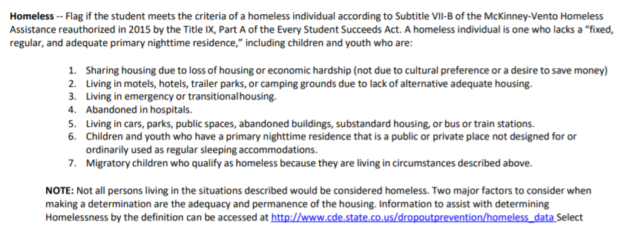
Homeless (Un or Underhoused)
Notes:
First, is the homeless field.
All students, whether they are experiencing homelessness or not, will have data in the Homeless field. Students who are not experiencing homelessness would use the 0 (or No) coding. Students experiencing homelessness who have a completed form that has been approved by CSI’s Homeless Liaison should either be coded as 3, yes, in custody of a parent or guardian, or 4, yes, not in the custody of guardian (i.e., the student is an unaccompanied youth).
If a student is coded as either a 3 or a 4 in the Homeless Flag Field, then they must also have specific data included in the, the Cause of Housing Crisis Field, Primary Nighttime Residence Field, and the Free/Reduced Price Lunch Field.

Slide 87
MKV Form and Coding
If they are living in a house with a parent or guardian, then we need to question why we are filling out the form.

Slide 88
Primary Nighttime Residence
Notes:
The second field that is related to homeless identification is primary nighttime residence.
When a student is coded as not Homeless (or Homeless = 0), then it is expected that Primary Nighttime Residence is coded with a 00 (for Not Applicable).
When a student is coded as Homeless (or Homeless = 3 or 4), then it is expected that Primary Nighttime Residence is any of the available options other than 00.

Slide 89
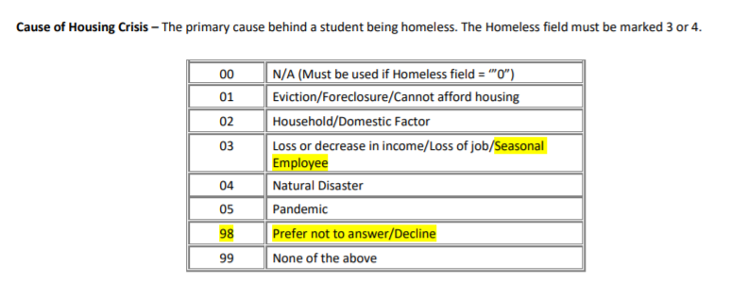
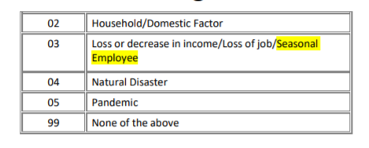
Cause of Housing Crisis
Notes:
The third and fourth fields are Cause of Housing Crisis and Additional Cause of Housing Crisis.
When a student is coded as no Homeless (or Homeless = 0), then the it is expected that the Cause of Housing Crisis and Additional Cause of Housing Crisis fields are coded with a 00 (for Not Applicable).
When a student is coded as Homeless (or Homeless = 3 or 4), then it is expected that the Cause of Housing Crisis field is one of the options other than 00.
When a student is coded as Homeless (or Homeless = 3 or 4), then it is expected that the Additional Cause of Housing Crisis by any of the available options.
The Cause of Housing Crisis and Additional Cause of Housing Crisis fields allow for housing crisis circumstances to be better identified, for example, if the housing crisis was brought on by a layoff due to COVID you could use Pandemic in the Cause of Housing Crisis field and loss or decrease in income in the Additional Cause of Housing Crisis Field.
New beginning the 2021-22 school year are the addition of “Seasonal Employee’ added to the 03 code and the new code of 98 – Prefer not to answer, both of which are highlighted in yellow on this slide.

Slide 90
MKV Form and Coding (opt 2)

Slide 91
Free/Reduced Price Lunch Eligible
Notes:
The fifth and final field that is related to homeless identification is primary nighttime residence. When a student is coded as Homeless (or Homeless = 3 or 4), then it is expected that Free/Reduced Price Lunch is coded as 01, Free Lunch Eligible.

Slide 92
Free and Reduced Lunch Applications
Children in “foster care,” “homeless,” “migrant,” or “runaway” are automatically & immediately eligible for free meals.
Notes:
Sometimes we find students who are eligible for McKinney-Vento in different ways
On FRL forms, “Runaway” means “Unaccompanied Youth” for eligibility.

Slide 93
Coding in PowerSchool
1) Homeless
Start Page > Student Selection > State/Province – CO > CO Demographics (tab) > Student Demographic Information (section)
2) Primary Nighttime residence
3) Cause of Housing Crisis
4) Additional Cause of Housing Crisis
5) Free/Reduced Price Lunch
Start Page > Student Selection > Administration > Lunch
Notes:
In PowerSchool, the first 4 fields are found under the CO Demographics tab of the State/Province – CO side menu.
Free/reduced price lunch is found by navigating to the side menu Administration section and selecting the Free Lunch Status from the Lunch menu option. Remember, students identified as homeless qualify for free lunch and should be coded accordingly.

Slide 94
Coding in Infinite Campus
1) Homeless
Index > Student Information > Program Participation > Homeless > New option
2) Primary Nighttime residence
3) Cause of Housing Crisis
4) Additional Cause of Housing Crisis
Index > FRAM > Eligibility > New option
5) Free Lunch Flag
Notes:
In infinite Campus you will fill out the first four fields from the Program Participation > Homeless side menu.
Free lunch can be found un the the FRAM Eligibility menu. Remember, students identified as homeless qualify for free lunch and should be coded accordingly.

Slide 95
Coding Considerations
DO NOT code a student as homeless in your SIS until you receive confirmation from CSI.
Homeless status remains the same throughout the school year, regardless of change in housing.
Homeless students automatically qualify for the free lunch eligibility status for the duration of the school year, even if housing situation improves.
Homeless status may rollover from previous school year. Be sure to check your SIS and audit for homeless flags.
Notes:
Here are a few coding considerations to keep in mind regarding homeless coding.
First, be sure that whoever is entering McKinney Vento information into your SIS is doing so once they receive approval from CSI’s McKinney-Vento Liaison to do so. Connect with your school’s McKinney-Vento contact regularly, particularly at the start of the year, to ensure this identification process is taking place appropriately and student data is only being updated once the school receives confirmation from CSI to do so.
Second, once a student has been identified as experiencing homelessness, they will keep that status throughout the school year, even if housing status changes. (However, if a student is not identified as homeless at the beginning of the year but then is later identified as homeless, their homeless coding should change accordingly.)
Third, Homeless students automatically qualify for the free lunch eligibility status. This free lunch status remains in place throughout the school year, regardless of changes in housing situation. Be sure that when you code the student as homeless, you also update the record to free lunch eligibility also. An error will generate for the EOY and October Count collections if you do not do this.
Finally, your SIS may be structured to roll homeless status students over into the next school year. While this can be helpful at times, it can also lead to inaccurate, out of date data. Please be sure to do an audit of your homeless population throughout the year to ensure data accuracy.

Slide 96
Validating Homeless Data
CSI validation resources
Record Checker Tool
Data Validations Checklist
Running ad hoc reports
Partnering with the MKV liaison to double check the data reported and compare to CSI-approved MKV forms
Carefully review OC summary report
Notes:
There are several resources available to validate your homeless data.
Use CSI Validation resources such as the record Checker Tool and the Data Validations Checklist, which include an audit for homeless students.
Run Ad Hoc Reports from your SIS throughout the year to pull a list of students identified as homeless.
Share this list with your school’s McKinney Vento Liaison. Your liaison should check the data being reported and compare it against the CSI-approved MKV forms for the school year.
Carefully review this demographic group when reviewing your Summary Report for applicable data collections throughout the year.

Slide 97
CSI MKV Liaison Support (we’re still here for you)
Betsy Basch
CSI McKinney-Vento Liaison
Marcie Robidart
CSI Grants Fiscal & Accounting Manager
CSI Data Team submissions_csi@csi.state.co.us
Notes:
You many interact with any of us!

Slide 98
Additional Resources
CDE Homeless Page: http://www.cde.state.co.us/dropoutprevention/homeless_index
National Center for Homeless Education: http://center.serve.org/nche/index.php
CDE Information for New Homeless Liaisons: http://www.cde.state.co.us/dropoutprevention/homeless_resources-liaisons

Slide 99
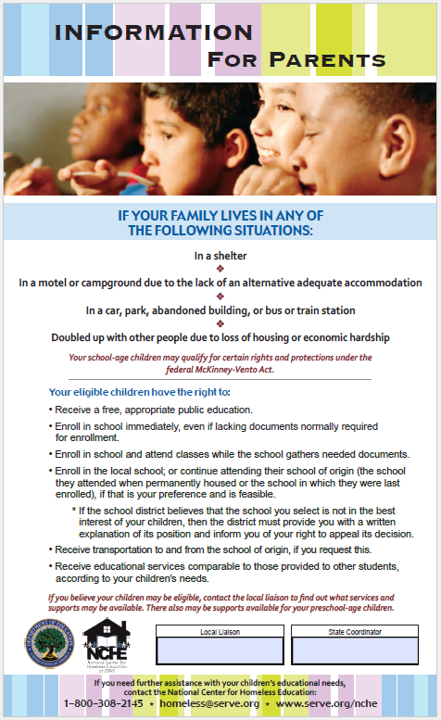
Federal MKV Posters
Notes:
https://nche.ed.gov/downloads/youthposter_eng_color.pdf
https://nche.ed.gov/downloads/parentposter_eng_color.pdf

Slide 100
Additional Scenarios
Which of the following would you consider homeless?
1) A single father moved in with his mother because she can provide before and after school care for his son and because his mother is older and needs help.
2) A family lost their housing due to a natural disaster that destroyed their home. They moved in with relatives until the house is repaired.

Slide 101
Answer 1
The living situation in 1 was a choice for convenience, and does not fit the definition of homeless, based on the information provided. The family’s situation appears to be fixed, regular, and adequate.
If you selected 2, you are correct. The family is living doubled up due to loss of housing, and the situation is temporary.

Slide 102
Additional Scenario 2
1) A teen moved in with a friend’s family when his parents kicked him out of their home after an argument. The friend’s parents said he could stay for a week only.
2) A youth has lived with her aunt and uncle ever since her mother was incarcerated two years ago.

Slide 103
Scenario Explanation
The youth in example 1, would be considered eligible as an unaccompanied homeless youth. He was kicked out of his home and his current living situation is temporary.
The youth in example 2, while unaccompanied, would most likely not be considered eligible since her living situation appears stable with her aunt and uncle.

