Slide 1
CSI Induction Programs
School Leader/Induction Coordinator Overview

Slide 2
Today’s Topics
What is the purpose of Induction?
What are the key components of CSI Induction Programs?
What is the process to register and participate?

Slide 3
Induction Programs provide…
Targeted training for the educator’s stage of professional development
Support of a mentor or coach
Vehicle to convert a Colorado Initial License to a Professional License
Strategy for educator retention
Notes:
Presenter
2021-08-10 19:57:32
--------------------------------------------
To have maximum impact on student learning, educators must develop and evolve along with their students. Induction programs help set the stage for continuous growth and support of educators at the beginning of their careers or as they transition to new organizations or new roles within an organization.

Slide 4
CSI Induction Programs 2
CSI Induction Programs
Teacher
Specialized Service Provider
AMC Principal & Administrator

Slide 5
Teacher & SSP Induction

Slide 6
Candidate Criteria
Hold Colorado Initial License
Teacher (includes Special Education Teachers)
Specialized Service Provider (includes School Nurse, School Psychologist, OT, PT, etc.)
Employed or contracted at a CSI charter school

Slide 7
Program Components
SCHOOL BASED PROFESSIONAL DEVELOPMENT
MENTOR SUPPORT
ONLINE PORTFOLIO AND REFLECTION
Notes:
Presenter
2021-08-10 19:57:34
--------------------------------------------
Each school plans experiences and professional development for inductees to orient them to your school’s culture, instructional methodologies, and processes and procedures. As the induction coordinator you are required to fill out a professional development plan that describes how your school supports its inductees.
Each school selects qualified mentors to work with inductees and as the induction coordinator, you verify that 30 hours of mentoring was provided to each inductee. Each inductee is required to have at least one observation conducted by their mentor and also to observe a model classroom. Observations can be conducted virtually.
CSI provides video modules that provides inductees an introduction to CSI, an overview of the Colorado Teacher and SSP quality standards, and an overview of the Colorado Model Content Standards. CSI requires each inductee to complete on online portfolio of monthly assignments. Portfolio assignments are aligned to the Educator Quality Standards and include artifact and reflection.

Slide 8
Staffing
Induction Coordinator
▷ Plans and provides oversight
▷ Sets PD calendar
▷ Selects and assigns mentors
Principal, Assistant Principal, Teacher Coach
Mentor
▷ Experienced (3+ years)
▷ Effective
▷ Knowledgeable in content area and/or school’s instructional practices
▷ Competent interpersonal skills
▷ Willingness to serve as a mentor
▷ Commits to 30 contact hours with inductee
9

Slide 9
Professional Development Plan
Staff Orientation dates and topics
Professional Development dates and topics
Other embedded PD opportunities (frequency)
Submit August 14th
Download Form
Supplemental PD targeted to inductees

Slide 10
Online Assignments
Reflection 1-3 paragraphs
Connection to elements
Snapshot of professional practice
Rubric
14
Notes:
Do you want to be in the Google Classroom?
I can exempt you from the assignments. You will see your inductees, but also the others.
Do you want the mentors in the Google Classroom-exempted?

Slide 11
Monthly Work Sessions Option
Topic Based Quest Speaker (first 10 min) when applicable
One hour based on feedback from 23-24 inductees (new this year)
Break Out groups for subject/grade level engagement
Discuss the topic, share artifacts, and reflect on content
Record your attendance at the work session in the google classroom. New this year because 4 assignments (2 observations, beginning self-evaluation and ending reflection) require submission.
Possible for SSP as well per the roster and availability

Slide 12
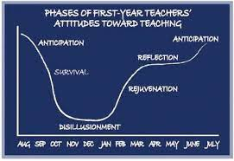
First Year Phases
First Year Phases (Moir, 1999)

Slide 13
30 Hours of Mentoring
▷ Regular meetings/conferencing
▷ Observation with pre- and post- conference
▷ Arrange for a Model Classroom Observation with pre- and post- conference
13

Slide 14
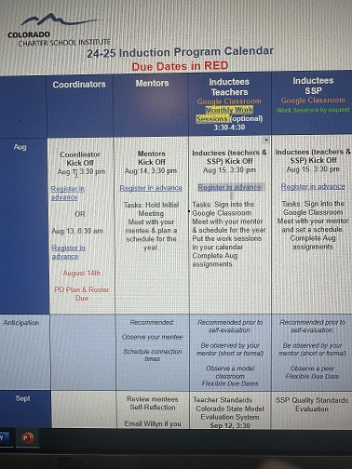
24-25 Induction Program Calendar You have 2 asks/deadlines. You get progress updates 2 times/year. Contact me anytime!

Slide 15
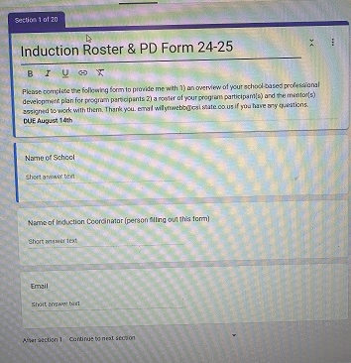
PD & Roster Form (click link)

Slide 16
Principal & Administrator Induction
Hold Colorado Initial License
Principal
Administrator
Special Education Director
Gifted Education Director
Employed in a leadership position at a charter school
Job duties include a leadership role
Contact Kimberly Caplan
kimberlycaplan@csi.state.co.us

Slide 17
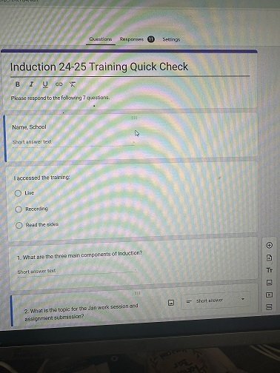
Quick Check (click on the link)
What are the three main components of induction?
What is the topic for January work session/submission?
Who has the option to attend the monthly work sessions?
What is the platform for the online modules & assignment submissions?
What are the types of observations required?
Please rate this training 1 to 10 (1 poor to 10 exceptional)
Please share suggestions for improvement.

