Slide 1
IEP Meeting Facilitation Tips

Slide 2
Objectives
Identify Meeting Habits
Learn Facilitation Tips
Practice skills
Meeting Strengths
Meeting Opportunities for growth
Internalize individual meeting habits
Learn some new tips
Energize some “old” tips
Synergize facilitation tips

Slide 3
IEP Meetings
Mr. Jones
Take notes on events and/or examples of What went right?, What went wrong?, and Be prepared to share with your neighbor.

Slide 4
What went right?
List all events and notes that are factual
What went wrong?
List all events and notes that are factual
What are some steps that might make it better?
Take 45 seconds to jot down some examples.

Slide 5
Facilitation Tips
Why do we need facilitation tips?

Slide 6
Planning
Be a meeting planning expert
Design a well-structured agenda
Include meeting purpose
Student centered
Create a realistic and focused meeting goal
Include parents as you make the agenda
Create understanding
Foster a safe environment

Slide 7
Set Ground Rules
Establish an inclusive space
Make participants feel appreciated
As the facilitator,
Set agenda and distribute paperwork
Agendas should have time limits (flexible)
Redirect participants as needed
As the facilitator,
Refocus negative energy
Allow time for parents to share
Be prepared for potential “hazards”
Actively listening
As the facilitator,
Allow time for questions
Take notes
Summarize and move to next point
Establish follow-up criteria

Slide 8
Delegate Roles when necessary
Roles assigned to group members may be:
Recording the meeting
Taking notes
Keeping time
“Parking Lot”

Slide 9
Three Prong Approach
Be Assertive
Assertive; Not Scary
Positive and Upbeat
Actively Listen
Listen with intent
Read body language
Use your eyes and ears
Manage Conflict
Look for common ground
Encourage shared goals and teamwork instead of highlighting disagreements

Slide 10
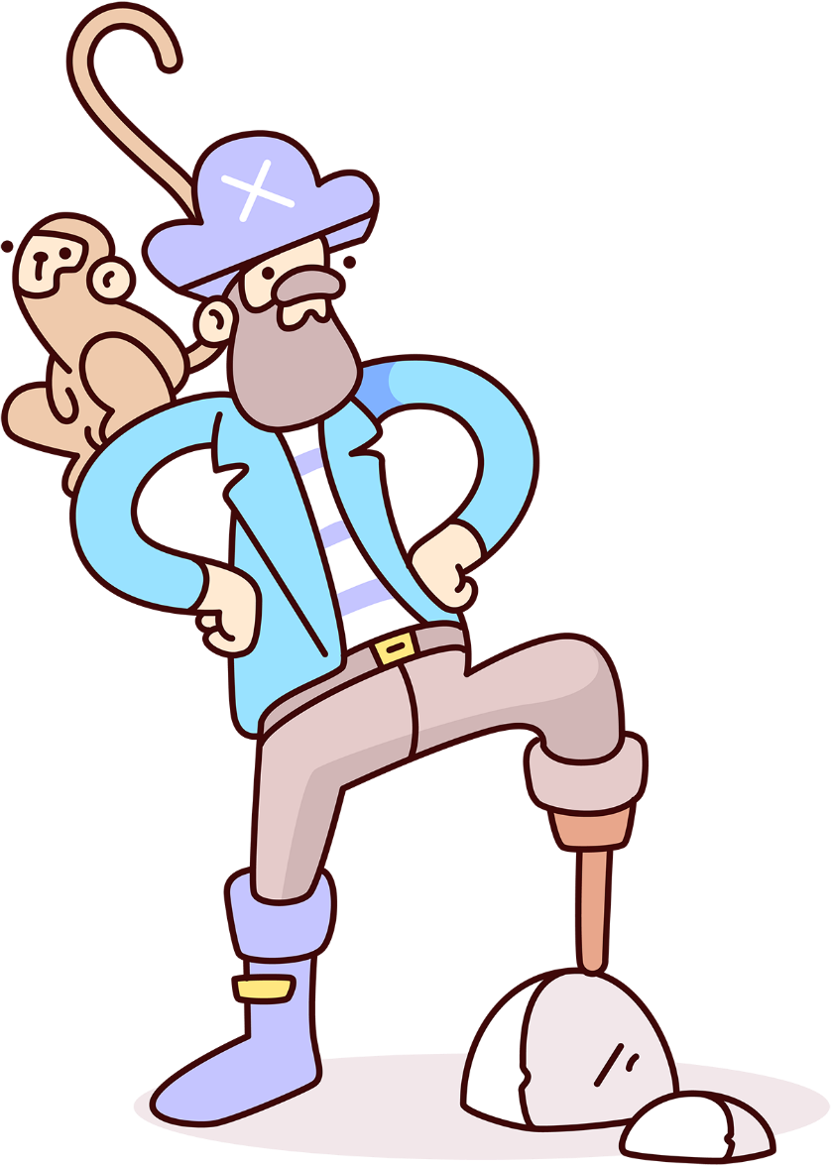
Keep it Moving!
Stay focused on the agenda
Keep team focused on the goals
Tackle all points within the time limits
Handle the “Squirrel” moments

Slide 11
Use your tools
Keep your facilitation tools handy as you navigate various situations
Be flexible in your approaches
Keep everyone interested and focused on the goals
Avoid losing control of your meeting
Pause when necessary

Slide 12
Be Flexible
Adapt to changes
Envision the end game
Maintain student focused
Stay Positive

Slide 13
Time to Practice (10 Minutes)
Focus on your introduction
Practice with a partner on how you open your meetings
Practice the Three Prong Approach
What are your key takeaways

