Slide 1

How to Write Better IEP Goals through Adjustments and Progress Monitoring

Slide 2

Objectives
Understand the Why
we create SMART
goals
Recognize effective
SMART goals
Recognize the importance of Progress Monitoring
Adapting Instruction and Instructional Strategies
This Photo by Unknown Author is licensed under CC BY-SA

Slide 3

Purpose
Strategic focus on skill deficits
Thoughtful consideration on how the goals will
be measured through research-based tools
Provide both short-term and long-term strategies that support student learning
Provide insight on various instructional strategies and how to connect with gen ed

Slide 4

Understanding the How
Developed from PLAAFP
Developed from Statement of Impact of Disability
The What? The Who?
The Where?
This Photo by Unknown Author is
licensed under CC BY

Slide 5
The PLAAFP is one of the MOST important sections in an IEP document (youtube.com)

Slide 6
PLAAFP
Include:
Clear, specific, and accurate statements
Data on previous goals progress and current academics
How the student engages in the general education environment?
How the student engages in the special education
environment?
Examples of behavior in both general ed and special ed environment
Students’ strengths
Students’ functional strengths and opportunities

Slide 7
PLAAFP
Other areas of consideration: Effective instructional strategies, accommodations, and/or assistive technology
The PLAAFP statement will lead to the development of annual goals, accommodations, modifications, and other IEP services. All IEP goals should be connected to the PLAAFP statement.

Slide 8

Statement of Impact
Generic is not the way to go
Include students’ disability
How does the disability affect their academic abilities?
How does the disability affect their functional abilities?
How does the disability impact their general education environment?
This
Pho to by Unk now n Aut hor is lice nse d
und

Slide 9
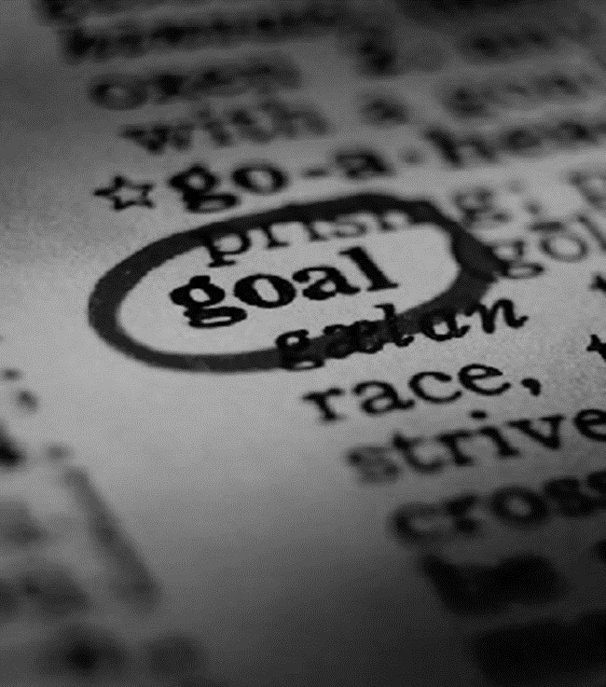
Creating SMART Goals
S pecific
M easurable
A ttainable
R ealistic
T imely (and Tangible)

Slide 10
Case Study Example
Michelle
What do you know?
What would you want to know?
When you measure your progress, you stay on track, reach your target dates, and experience the exhilaration of achievement that spurs you on to continued effort required to reach your goal.

Slide 11
PLAAFP
Using SLD disability category, develop a brief PLAAFP

Slide 12
Statement of Impact of Disability
What do we know about Michelle?
How does Michelle engage in academics and
functional activities?
What are some effective strategies,
accommodations, and/or assistive technology?
Construct a brief Statement of Impact of
Disability

Slide 13
Let’s Develop One Goal
When you measure your progress, you stay on track, reach your target dates, and experience the exhilaration of achievement that spurs you on to continued effort required to reach your goal.

Slide 14
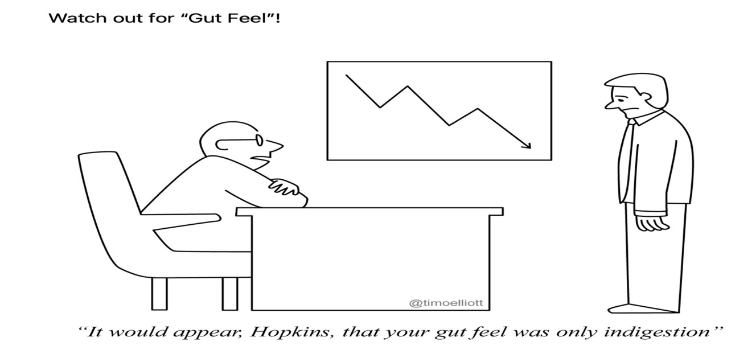
Let’s Talk Progress Monitoring

Slide 15
Functions of Progress Monitoring in Special
Education?
❖A snapshot that allows teachers and staff to
measure growth or regression
❖ESY eligibility
❖Progress reports
❖IEP development including Present Levels and Goal writing
❖Identifies gaps in learning and measure the effectiveness of instruction
❖Endrew F.
❖Guides instructional and intervention decision making

Slide 16
In Light of Endrew F.
Supreme Court held that educational programs for students with disabilities must be “appropriately ambitious” and that schools must “focus on student progress.” (Blokhuis et al, p. 346, 2021)
Make sure/Be aware:
Write IEPs that are rigorous and based on
individual children’s needs
Collect and review robust evidence to make
evidence-based decisions on goals and interventions
Develop Goals and objectives that are appropriately ambitious
Meet as needed to revisit and adjust goals, interventions, and services if students are not making adequate progress

Slide 17
The best time to consider how you will monitor
progress is during the goal-writing phase:
*Design goals that can be easily monitored
At that time, determine:
➢what data will be collected?
➢In what form?
➢With what tools/methods?
➢How often? How much?
➢Where/when will PM occur?
➢By Whom? you, a paraprofessional,
the student, the classroom teacher?

Slide 18
Frequency of Progress Monitoring?
Progress Reports Must be sent out with school- wide grades (quarterly, trimesters, etc.)
Before IEP Review Meetings for reporting in Present Levels & for establishing baselines for new goals
Instructional/Intervention Decision Making-At least monthly (maybe bi-weekly?)
ESY-Before and after longer breaks (Thanksgiving, Holiday, Spring, etc.)

Slide 19
Review Your Goal
Review the goal you have just written
What measures do you have in place?
What tools/methods?
Frequency?
By Whom?
Revise with your partner

Slide 20
Factors to Consider
Is your goal measurable?
Do you have an established baseline of
performance?
Are you able to chart progress using a graph or other tool?
What changes do you need to make to ensure appropriate instructional strategies are in place?
Does it tie back to the PLAAFP?

Slide 21
What if?
If you have noticed a regression or plateau in the progress, what steps do you need to consider?
  Goal may not be attainable
  Method of instruction may not be appropriate
  Is the student accessing general education
curriculum?
  Have we spoken to the gen ed teachers?
  At what point do you consider revisions?

Slide 22
What are we looking for?
Curriculum That Needs Continuous
Attention
Does the child have goals, objectives, curricular elements or other IEP components that require continuous attention in order to avoid significant jeopardy to learned skills during extended breaks?

Slide 23
What are we looking for?
Rate and Amount of Progress
in all areas, including academic, communication, physical, social-emotional, vocational, independence, etc.
❖Clear progress based on interventions
❖Minimal progress
❖No progress
❖Declining performance

Slide 24
Don’t Collect and Forget

Slide 25
Method #1: Four-Point Rule
After six data points have been collected, examine the
four most recent data points.
If all four are above the goal line, increase the goal.
If all four are below the goal line, make an
instructional change.
If the four data points are both above and below the goal line, keep collecting data until the four-point rule can be applied (or consider trend analysis—coming up).
National Center on Intensive Intervention: at American Institutes for Research
25

Slide 26
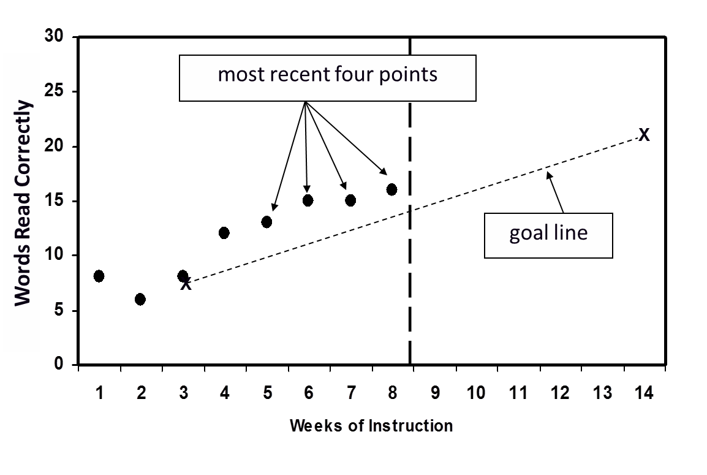
Practicing the Four-Point Rule
Alicia
National Center on Intensive Intervention: at American Institutes for Research
26

Slide 27
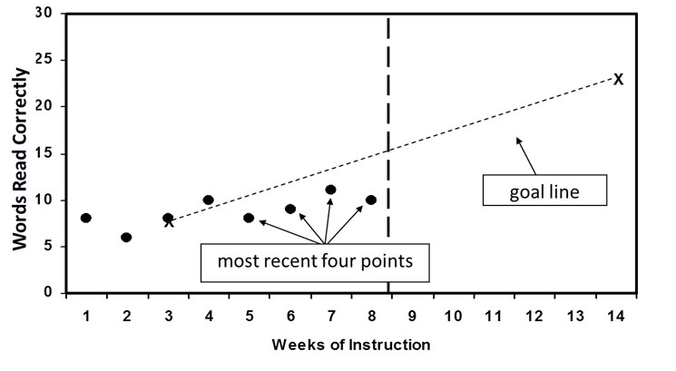
Practicing the Four-Point Rule
Mandy
National Center on Intensive Intervention: at American Institutes for Research
27

Slide 28







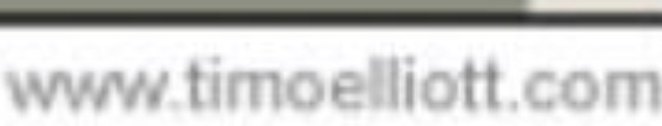
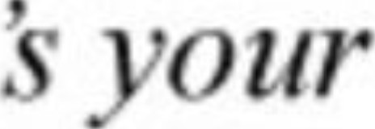
"It n t
u. It
,^{I},
. "

Slide 29
Adaptations to instruction
Review IEP goals
  Specific, Measurable, Attainable, Reasonable, Timely
  Clear effective instructional strategies and
accommodations
  Progress Monitoring meets the performance criteria
to achieve the IEP goals

Slide 30

Instructional Strategies (Student Focused)
Gamification
Convergent and Divergent Thinking
Project-Based Learning
Experiential Learning
Peer Teaching
Inquiry-based learning
Problem-based Learning
Reciprocal Teaching

Slide 31

Change your approach
Be vulnerable to learn new
things
Student Centered Focus
Be the advocate for your students in gen ed
Put the “I” in Individualized

Slide 32
Looking Ahead
Is this a multi-year goal?
How will the student effectively transition to the
next grade level?
What can you do to prepare the student for success?
What has your EOY data shown you?
  Build off the success
  Adjust instructional strategies
  Jumpstarts for next year (include in EOY progress note)

