Slide 1
Comprehensive Assessments for Eligibility
Identifying Students with a Disability

Slide 2
“Comprehensive Evaluation”
An initial evaluation process for children ages 3-21 shall be provided for the purposes of determining whether the child is a child with a disability under Section 2.08 of these Rules and what the educational needs of the child are. The requirements and procedures for initial evaluations shall be in accordance with 34 CFR §300.301, §300.304 and §300.305 and shall ensure that the initial evaluation is sufficiently comprehensive to appropriately identify all of the child’s special education and related services needs, whether or not commonly linked to the disability category in which the child has been classified.
ECEA Rules:
1 CCR 301-8
4.02(4) Initial
Evaluation
Process

Slide 3
Sec. 300.304 Evaluation Procedures
Assessments and other evaluation materials used to assess a child under this part
Are selected and administered so as not to be discriminatory on a racial or cultural basis;
Are provided and administered in the child’s native language or other mode of communication and in the form most likely to yield accurate information on what the child knows and can do academically, developmentally, and functionally, unless it is clearly not feasible to provide or administer;
Are used for the purposes for which the assessments or measures are valid and reliable;
Are administered by trained and knowledgeable personnel; and
Are administered in accordance with any instructions provided by the producer of the assessments.
Assessments and other evaluation materials include those tailored to assess specific areas of educational need and not merely those that are designed to provide a single general intelligence quotient.

Slide 4
Sec. 300.304 Evaluation Procedures
3) Assessments are selected and administered so as best to ensure that if an assessment is administered to a child with impaired sensory, manual or speaking skills, the assessment results accurately reflect the child’s aptitude or achievement level or whatever other factors the test purports to measure, rather than reflecting the child’s impaired sensory, manual, or speaking skills (unless those skills are the factors that the test purports to measure).
4) The child is assessed in all areas related to the suspected disability, including, if appropriate health, vision, hearing, social and emotional status, general intelligence, academic performance, communicative status, and motor abilities.
5) Assessments of children with disabilities who transfer from one public agency to another public agency in the same school year are coordinated with those children’s prior and subsequent schools, as necessary and as expeditiously as possible, consistent with 300.301(d)(2) and (e), to ensure prompt completion of full evaluations.
6) In evaluating each child with a disability under 300.304 through 300.305, the evaluation is sufficiently comprehensive to identify all of the child’s special education and related services needs, whether or not commonly linked to the disability category in which the child has been classified.
7) Assessment tools and strategies that provide relevant information that directly assists persons in determining the educational needs of the child are provided.

Slide 5
What is comprehensive?

Slide 6
What Does That Mean?
A full and individual evaluation includes evaluating the child’s:
Vision/hearing screening
Health/medical information
Adaptive behavior
Social/emotional status
General Intelligence
Academic performance
Communication status
Motor Abilities
Developmental history
Observations of the student during instruction
Historical review of the student’s academic progress including MTSS/RTI and PM
Interview(s) with the parent(s) and teacher(s)
Assistive technology (AT)

Slide 7
Multiple Data Sources
Multi-model
Wide and Shallow
Ensures Comprehensiveness
Basic Observations
Screening Data
Record Reviews
MTSS/RTI Data
Unstructured Interviews
Multi-method
Deep and Intense
Ensures education Impact and Disability
Structured Observations
Formal Measures
Progress Monitoring
Semi Structured Interviews

Slide 8
You need to have the STORY behind the numbers!

Slide 9
Examples of Existing Data
Parents | Developmental and social history Parent perception of the student’s possible disability Information about the student’s learning and any behavioral issues Parent input on the student’s educational experiences and motivation Copies of outside evaluation, reports, and formal diagnosis
Student Records | Assessment results (Standards of Learning, Phonological Awareness and Literacy Screening, etc.) Universal screening and/or progress monitoring data using a Response to Intervention (RTI) process EL information and supports Record review (attendance, report cards, etc.) Discipline reports Medical/health records Developmental assessments and screeners Classroom assessments
Observations | Teacher’s behavior logs or behavioral observations on report cards Classroom-based and/or non-academic observations

Slide 10
Standardized Measures
Formal Standardized Assessments in the area(s) of concern.
Formal normative measures should be used to help understand areas of need better. They can be used to help determine clinical significance, level of need, and/or help answer questions.
If using a rating scale, please prepare the rater, and explain the context in which they should respond and be available for questions.
Try to rotate teachers (do not overburden)
Possibly follow up with an interview if results do not match others or expectations.

Slide 11
Who Should Administer?
Federal regulations:
“300.305©(1)(iv) Administered by trained and knowledgeable personnel”
The AU determines who is trained and knowledgeable. An AU can be open to litigation and dispute resolution if they have professionals working outside of their scope or training.

Slide 12
Publisher Qualifications for Evaluators
Most assessments are designated for professionals with certain competencies to purchase and use their instruments.

Slide 13
Pearson Qualification Levels and Requirements (1 of 2)
Level 1 – User has completed training in measurement, guidance, or an appropriate related discipline or has equivalent supervised experience in assessment administration and interpretation. Other professional degrees and certifications may be considered.
Level 2 – The user has completed a Bachelor’s degree program that included coursework in principals or measurement and in the administration

Slide 14
Pearson Qualification Levels and Requirements (2 0f 2)
Level 3 – The user has a license to practice psychology independently or is a full member of the American Psychological Association (APA) or the National Association of School Psychologists (NASP) or user has completed a Doctorial (or in some cases Master’s) degree program in one of the fields of the study indicated or the assessment that included training in the administration and interpretation of professional instruments. If neither of these qualifications are met, Users must provide proof that they have been granted the right to administer assessments at this level in their jurisdiction. Level 3 purchasers can also select assessments from Levels 1, 2, and M.
Level M – Users must provide credentials indicating: a specialized degree in the healthcare field and accompanying licensure or certification, OR proof that they have been granted the right to administer assessments at this level in their jurisdiction. Level M purchasers can also select assessments from Qualification Levels 1 & 2.

Slide 15
Test Interpretation
Assessments must be interpreted by persons with a thorough knowledge of the technical aspects of the assessment and intervention, the results, and their limitations.
Teams should use multiple measures and look for convergence in the data. If assessment results seem to conflict with information gathered from the progress monitoring tools, standardized assessments, family reports, or other historical or anecdotal information, further assessment may be appropriate.

Slide 16
Evaluation Strategies
Not black and white = everything we do is grey
There is no one evaluation plan to be used for all students. Evaluations must be individualized and based on the student’s educational concerns.
Evaluations are based on the student’s unique needs.
Professional judgment is used for every decision in the evaluation and eligibility determination process.
Eligibility determination team
The formal eligibility determination decision
Selection of the assessment materials
Identification of evaluators
Interpretation of test results

Slide 17
Triangulation/Convergence
Triangulate data in the evaluation.
Family
Data
Convergence of The Data
School-Based Formal/Standardized Data
School-Based Informal Data

Slide 18
Interpretation
No one data point or indicator is sufficient to determine a disability category.
Look for patterns between assessments and administrators.
All assessment data and results create a body of evidence to determine eligibility
Professional judgment is required to interpret scores and findings.

Slide 19
Evaluation Reports Should Include
Documented sources of information and assessment methods used, who administered the assessment, title of administrator, date administered, and results.
Analysis of raw data. Scores are reported along with an explanation.
Data reported with Standard Scores or Percentile Ranks (try to show consistency if possible).
Identify the student’s strengths and skills
List any previous diagnosis of disability or medical/clinical diagnosis (if one exists).
Identify the adverse effects on the student’s educational performance.
Response to Interventions (RTI) List interventions (what worked, what did not work, dates, accommodations, and PM data).
For children 3 to 5 participation in appropriate activities and daily routines.
The evaluation must not include recommendations for eligibility for special education, a specific disability classification, or placement options.
The evaluation team will determine the above after the eligibility meeting following the review and discussion of all results.

Slide 20
Autism Spectrum Disorder
Example of Comprehensive Evaluation

Slide 21
Autism Spectrum Disorder Checklist for Comprehensive Evaluation
Student and Family Background
Current Educational Information
Psychosocial/Cultural History
Health Assessment
Standardized Diagnostic Assessment for Autism
Information if Multilingual
Vocational Assessment if over 15 or 9th Grade
Specific Assessments in Areas of Concern

Slide 22
Autism Spectrum Disorder Checklist for Comprehensive Evaluation
Student and Family Background
Grade level of student
Date of enrollment, grade level at enrollment
Schools attended/grade levels
History of special education/Section 504/READ Plan/EL Plan

Slide 23
Autism Spectrum Disorder Checklist for Comprehensive Evaluation
Current Educational Information
School attendance
Behavior Referrals
Cognitive concerns
RTI information
Educational records review
Curriculum-based measures
Objective data on classroom performance (grades on assignments, grades of tests, credits)
District and State assessments
Work samples/portfolios of student work.

Slide 24
Current Educational Information – Cont.
At least two observations by special education provider(s) - (Date and name/title of observer)
In a structured environment (including the regular classroom setting)
Document academic performance and behavior.
In a non-structured environment
Document social interactions.
General education teacher input with a focus on the child’s social, communication, and/or play skills in natural activities and routines and the need for structure and modification to encourage the child’s participation in learning.

Slide 25
Autism Spectrum Disorder Checklist for Comprehensive Evaluation
Psychosocial/Cultural History
Family background
Environmental background
Social background
Cultural background
Developmental history
Behavior/social skills
Parent/student interview

Slide 26
Autism Spectrum Disorder Checklist for Comprehensive Evaluation
Health Assessment
Vision and hearing screen conducted within the year – Provide date and results
Past and current health status reports
Birth History
Medications
Outside medical/clinical reports provided by the parents

Slide 27
Autism Spectrum Disorder Checklist for Comprehensive Evaluation
Standardized Diagnostic Assessment for Autism
Include any outside medical/clinical diagnosis/reports
Conduct ASD Assessment
If Multilingual
Home Language Survey
ACCESS scores
WIDA Screener
Review comparison to like peers
Review of EL supports
Vocational assessment if the student is 15 or in the 9th grade

Slide 28
Autism Spectrum Disorder Checklist for Comprehensive Evaluation
Specialized assessments as related to the concerns, including the following:
Sensory Profiles
Motor foundation and motor planning
Speech/Language/Communication
Pragmatic Language
Cognitive
Consider a split between verbal and nonverbal intellectual potential
Adaptive
Consider a discrepancy between IQ and adaptive skills
Social Emotional
Executive Functioning
Academic Achievement

Slide 29
Assessment Instruments for Autism Spectrum Disorder

Slide 30
Formal Assessments for ASD
Select from the following:
Autism Diagnostic Interview – R (ADI-R)
Autism Diagnostic Observational Schedule – Revised (ADOS-2)
Childhood Autism Rating Scale 2nd Edition (CARS-2)
Checklist for Autism Spectrum Disorder (CASD)
Gilliam Autism Rating Scale 3rd Edition (GARS-3)
Asperger Syndrome Diagnostic Scale (ASDS)

Slide 31
Formal Assessments for Communication for ASD
”
Select From the following:
Receptive
Clinical Evaluation of Language Fundamentals -5 (CELF-5)
Preschool Language Scales 5th Edition (PLS-5)
Expressive
Clinical Evaluation of Language Fundamentals 5 (CELF-5)
Preschool Language Scales 5th Edition (PLS-5)
Use of Symbol Systems
Objects, photos, tangible symbols, picture communication symbols, sign, writing, engagement of people to gain desired objects, people actions, joint attention, initiation

Slide 32
Communication for ASD Continued
Use of people as means to ends
of communication exchange
Use of immediate or delayed echolalia for communicative function
Pragmatic functions
Pragmatic Language Checklist
Communication Matrix
Conversational Effectiveness Profile (CEP-R)
Test of Pragmatic Language (TOPL-2)
Social Language Development Test – Elementary and Adolescent
Social Communication Questionnaire (SCQ)
Social Responsiveness Scale (SRS)
Double Interview from “Thinking About You, Thinking About Me”

Slide 33
Social and Emotional Development
Select from the following:
Assessment of Social Skills for Children with Autism
Behavior Rating Inventory of Executive Functioning (BRIEF)
Adaptive Behavior Assessment System – 3 (ABAS-3)
Behavior Assessment Scale for Children – 3 (BASC-3)
Functional Assessment Screening Tool (FAST)
Functional Behavioral Assessment (FBA)
Vineland Adaptive Behavior Scales – 3rd Edition
TRIAD Social Skills Assessment
School Assessment Rating Scale for Asperger’s Syndrome
Social Responsiveness Scale (SRS)

Slide 34
Observations in Structured and Unstructured Settings
Select from the following:
Social Interaction Observation Form
Structured Student Interview – Asperger Syndrome
Pragmatic Language Scale – 5
Observation report by a person with knowledge of ASD

Slide 35
Sensory Needs Assessment
Sensory Profile

Slide 36
Executive Functioning
Select from the following:
Wechsler Intelligence Scale for Children – 5 (WISC-V)
Behavior Rating Inventory of Executive Functioning (BRIEF)
Test of Problem Solving – 3 (TOPS-3)

Slide 37
Eligibility Meeting

Slide 38
Presenting Evaluation Results
Be cautious of educational jargon
Test the reading level of your reports (most assessment readability levels of assessments are at a college level or higher).
Ensure clarity of the child’s functioning, capabilities, needs, and situational challenges.
Include qualitative and quantitative data about achievement, cognitive ability, performance, parent and student input, motivation, and observation of characteristics/behaviors.
Use visuals.
Allow follow-up time for questions. Provide families with emails and/or phone numbers of evaluators.

Slide 39
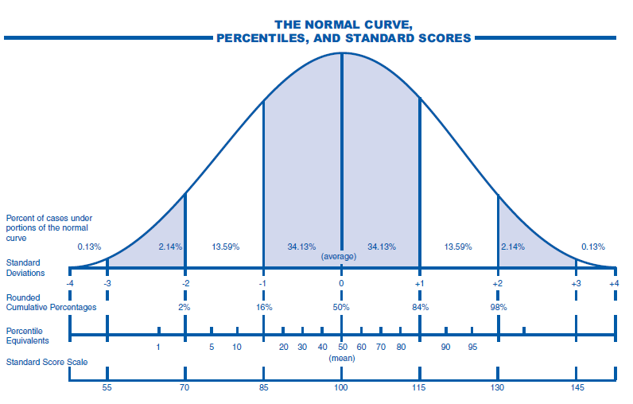

Slide 40
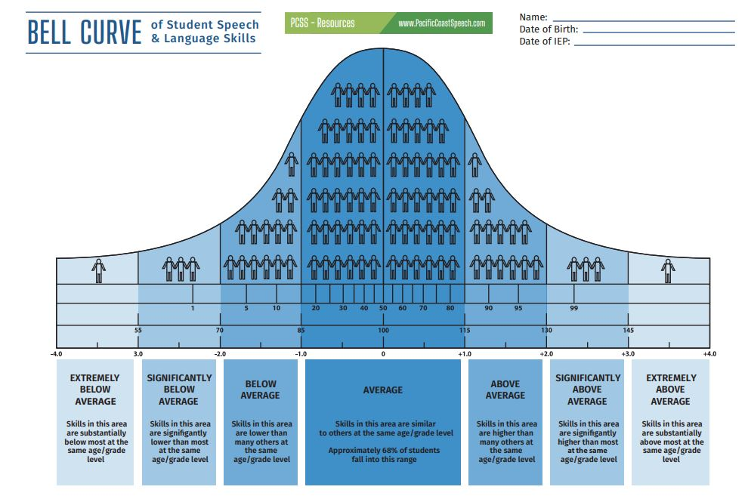

Slide 41
Body of Evidence
When traditional normed methods are not possible consider:
Criterion-referenced assessments,
Student work that compares them to their peers, developmental skills checklists,
Developmental history,
Anecdotal records,
Reviews of previous evaluations and assessments, observations focused on academic achievement, behavior, and ability to access grade-level standards.

Slide 42
CDE Resources
Autism Spectrum Disorder
Guidelines for the Educational Evaluation of Autism Spectrum Disorder - https://www.cde.state.co.us/cdesped/asd_guidelines
Visually Impaired, Including Blindness
https://www.cde.state.co.us/cdesped/sd-vision_guidedocs
Deaf and Hard of Hearing
https://www.cde.state.co.us/cdesped/sd-hearing_forms-and-documents
Deaf/Blindness
https://www.cde.state.co.us/cdesped/sd-db

Slide 43
CDE Resources
Developmental Delay
Developmental Delay Technical Assistance https://www.cde.state.co.us/cdesped/ta_dd
Intellectual Disability
Guidelines for the Determination of Eligibility for a Child with an Intellectual Disability or Multiple Disabilities https://www.cde.state.co.us/cdesped/guideliensfordeterminationeligibility_id_md
Multiple Disabilities
Guidelines for the Determination of Eligibility for a Child with an Intellectual Disability or Multiple Disabilities https://www.cde.state.co.us/cdesped/guideliensfordeterminationeligibility_id_md
Other Health Impaired
Guidance for Determining Eligibility for Special Education Students with Other Health Impairments
https://www.cde.state.co.us/cdesped/guidance_determiningeligibility_sped_students_ohi

Slide 44
CDE Resources
Orthopedic Impairment
OI Resources
https://www.cde.state.co.us/cdesped/sd-orthopedic
Serious Emotional Disability
Guidelines for Determining Eligibility for Special Education for Students with Serious Emotional Disability
https://www.cde.state.co.us/cdesped/sed_guidelines_2017-12-13
Specific Learning Disability
Specific Learning Disability Guidelines
https://www.cde.state.co.us/cdesped/guidelines_sld_draft_2019-02-25
Speech or Language Disability
Colorado Speech or Language Impairment Guidelines
https://www.cde.state.co.us/cdesped/sli_guidelines

Slide 45
CDE Resources
Traumatic Brain Injury
Brain Injury In Children and Youth – A Manual for Educators
https://www.cde.state.co.us/cdesped/tbi_manual_braininjury
Krista Klabo, Ed.S., NCSP
School Psychology and Special Education
Evaluation Specialist
klabo_k@cde.state.co.us

