Slide 1
Collaborating with Paraprofessionals and General Educators

Slide 2
Agenda
Sharing Responsibility (5 minutes)
Share Best Practices (15 minutes)
Common Challenges Gallery Walk (30 minutes)
Compliance: FACQs (5 minutes)
Resource Bank and Questions (5 minutes)

Slide 3
Reference: Shared Responsibility
General Educator | Special Educator | Paraprofessional
Meet universal instructional needs (plan and teach differentiated lessons) Participate on IEP team Take ownership in IEP by planning accessible lessons and implementing accommodations Ensure access to curriculum and assess progress towards grade level standards Create a climate of inclusion and safety Monitor effectiveness of supports and give feedback to special education team + Other duties as needed ☺ | Meet targeted instructional needs (plan, design, supervise and deliver specialized instruction) Mobilize IEP team, coordinate deadlines and lead family communication Share IEP snapshots and BIPs with stakeholders Design supports to enable access to curriculum and individual growth Teach and model best practices for paras Ensure that IEP is followed across settings Evaluate progress and adjust supports as needed + Other duties as needed ☺ | Meet individual instructional needs (implement specialized instruction) Collaborate with IEP team Get to know students’ snapshots, BIPs, strengths and interests Monitor health and safety Assist with physical and navigation needs Facilitate socialization Implement BIPs Respond to crises and implement de-escalation techniques + Other duties as needed ☺

Slide 4
Zooming In: Shared Responsibility
General Educator | Special Educator | Paraprofessional
Meet universal instructional needs (plan and teach differentiated lessons) for all kids Take ownership in IEP by planning accessible lessons and implementing accommodations for all kids | Meet targeted instructional needs (plan, design, supervise and deliver specialized instruction) Mobilize IEP team, coordinate deadlines, lead family communication, share snapshots and BIPs and ensure that IEP is followed across settings | Meet individual instructional needs (implement specialized instruction) Collaborate with IEP team; get to know students’ snapshots, BIPs, strengths and interests

Slide 5
Adding Dimension to the Pyramid
Para: Individual
Needs
Special Educator:
Targeted Needs
Gen. Ed. Teacher: Universal Needs

Slide 6
Teaming Tips
Explicitly define roles.
Connect all providers early.
Develop systems for regular team communication (meetings, shared documents & threads).
Identify areas of expertise and leverage them to make workflow more efficient.
Set annual team and individual goals and monitor them regularly.
Solicit mutual feedback and establish a culture of mistakes equaling growth.

Slide 7
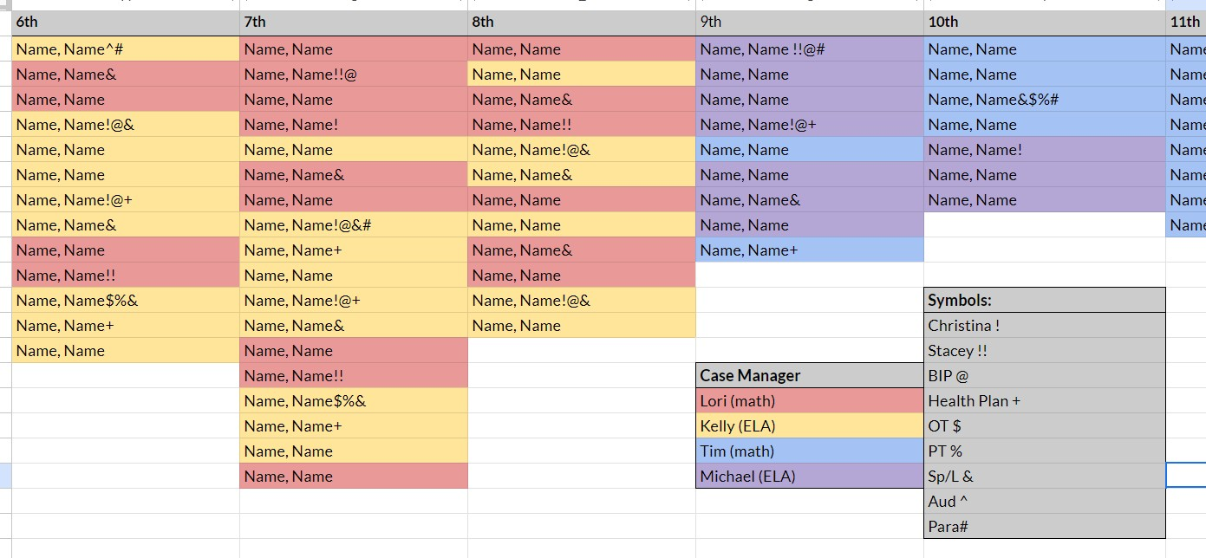
Teaming Idea: Caseload Map

Slide 8
Staff Preparation Tips
Distribute and review snapshots and BIPs with all providers. Confirm understanding and solicit questions.
Pair the review with snapshot documents.
Develop a thumbnail overview of caseload assignments and key providers for admin.
Advocate for paraprofessionals to attend school-wide and self-driven PD sessions.
Educate your staff on workloads and critical timestamps.
Ensure that all staff members who work together have a direct line of communication.

Slide 9
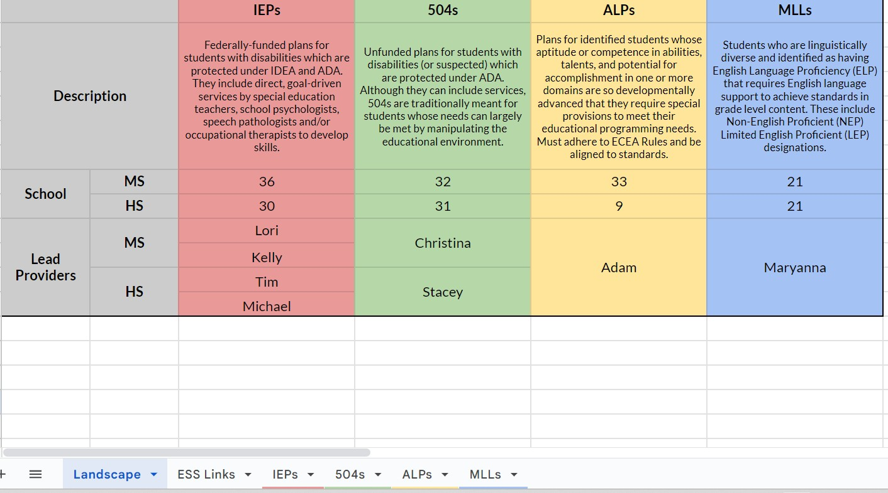
Staff Preparation Idea: ESS Hub

Slide 10
Planning Tips
Educate your staff with user friendly tools and have them bookmark them.
Develop explicit norms for meetings and communication.
Have all members open “anchor documents” at the beginning of every meeting.
Use an evolving agenda with standing & seasonal items.
Hold planning time sacred (this requires administration buy-in).
Always review recent data and work samples.

Slide 11
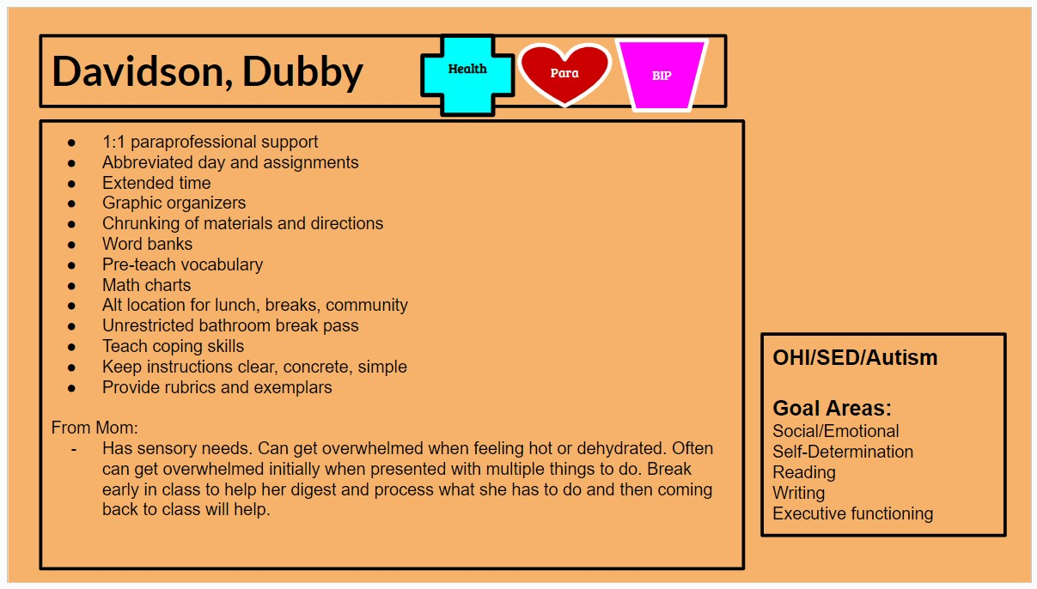
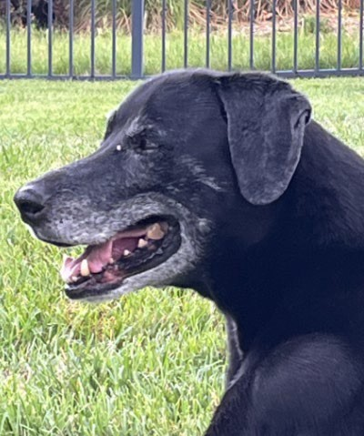
Planning Idea: Digital Snapshots

Slide 12
Provision Tips
Make streamlined tools accessible (i.e., hardcopy accommodations buckets).
Ensure that all team members have reviewed the lesson plans well in advance of class.
Ensure adult distance, access to peers.
Alternate roles during shared instruction so responsibilities are dynamic.
Ask often, “What went well?” and “What didn’t?” Normalize the “didn’t” and adjust!

Slide 13
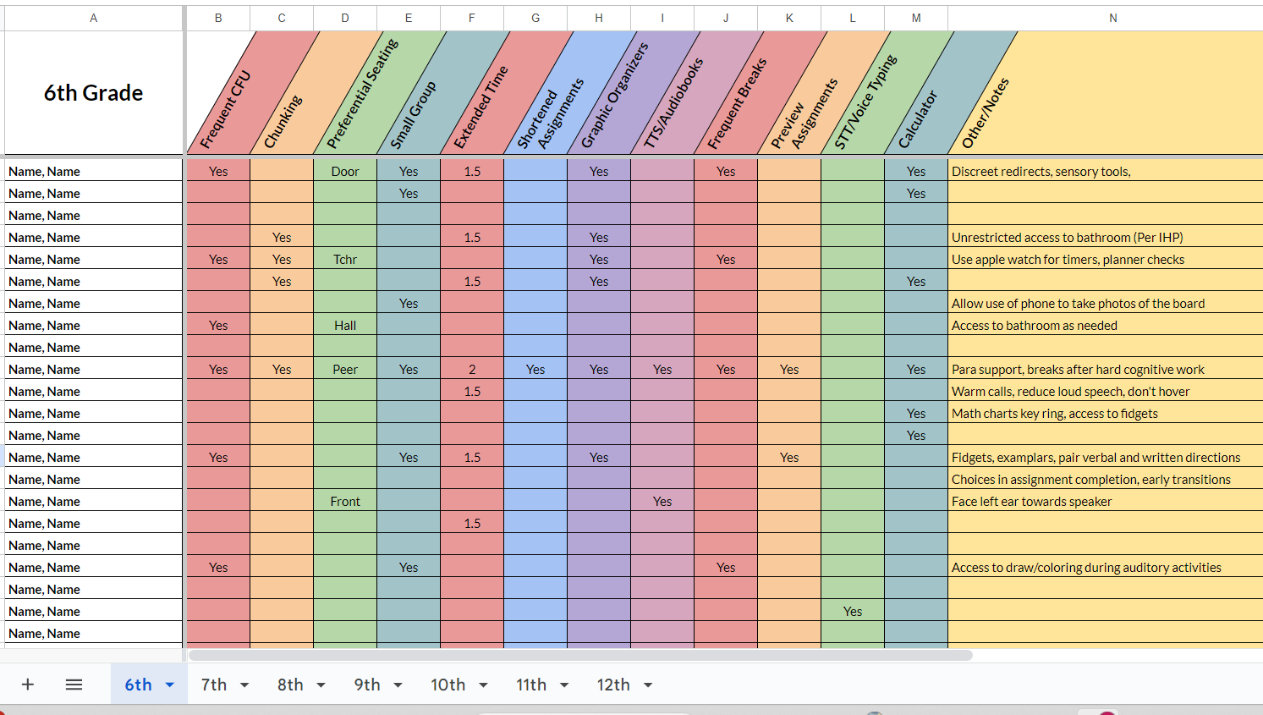
Provision Idea: Accommodations Buckets

Slide 14
Common Collaboration Challenges
Gallery Walk: 10 minutes
Circulate the gallery and offer suggestions to common scenarios.
Return to the scenario that most resonates with your experience.
Group Discussion: 8 minutes
Whole Group: 12 minutes

Slide 15
Scenarios
#1: My co-teacher doesn’t seem to invest in any of the tools I give her. She has little interest in understanding our kids’ different needs and insists that the only fair is equal (equal access and equal expectations for all). Meeting with her feels fruitless and like a waste of my time. | #2: The para I work with is stretched too thin to meet with me regularly; literally his schedule is back-to-back. Our teaming in the classroom ends up feeling clunky because we are not on the same page. He gets paid hourly, so I don’t want to ask him to stay after school. I end up texting him, which I also feel bad about. | #3: Our principal doesn’t get special ed. They give us one extra planning period to co-plan and get all our paperwork completed. Then they assign all the extra duties to us, and we are the first to be pulled for subbing and emergencies. We are tired, working too many hours, and feel unseen.
#4: As a para, I feel like I have the most specialized knowledge about my students and their families. I see and hear things that nobody else does and I have a lot of ideas, but I think others view me as a task master. I’d like to increase my influence by sharing my expertise; not by adding more hustle. | #5: As a general educator, I’m being asked to do too much. I know everyone in the building is too busy, but isn’t accommodating special needs the job of the special ed team? I have enough to do in terms of broad differentiation. I don’t feel like it should be my job to modify lessons, fill out scales and attend planning and IEP meetings. | #6: As a para, I sometimes feel ill- equipped to tackle what comes my way. I often end up modifying lessons on the fly because the special educator is too busy to design them or intercepting severe behaviors because the dean is too busy. I don’t mind stepping up– I have a lot of instinct. But I’m worried about liability, and tbh, I’m burned out!

Slide 16
Participant Solutions
#1: Co-teacher is a non- believer: Have hard discussions around: Role definition Co-teaching philosophy The law Universal design Leveraging personal strengths and compromise | #2: Para and teacher are two ships passing in the hall: Re-evaluate para schedule Make para collaboration a non-negotiable Use teams for communication Revisit student groupings to increase para capacity Use communication logs | #3: Principal is overwhelmed or doesn’t get it: Present data to admin Connect admin to sped coordinator Share examples of systems and structures to improve compliance Explore case law and state complaints together
#4: Para is over-hustled and under-respected: Solicit regular para input around schedules and structures Involve para in lesson planning Invite para feedback around effectiveness of supports Facilitate para PD | #5: General educator missed the “inclusion” part of the job description: Don’t assume competence; train, teach, collaborate Use PRIM bucket Highlight differentiation vs. inclusion Enlist admin in establishing inclusive culture | #6: Para is protecting the frontline without any armor: Explicitly train paras on target goals, data collection and teaching strategies Ensure self-care and work/life balance Leverage para expertise Advocate for improved para pay and benefits

Slide 17
Legal Requirements
Special Educator:
Has obtained full state certification as a special education teacher or passed the state special education teacher licensing examination and holds a license to teach in the state as a special educator.
Paraeducator:
A school employee who works in a school under an assigned certified or licensed teacher. Provides both instructional support and non-instructional services to students who may require individualized support to access their education.

Slide 18
Compliance: FACQ #1
Legally speaking, what duties can paras perform?
*See the CSI para manual and previous table.
Note the verbs:
Teacher: Plan, design, supervise, deliver, coordinate, assign, ensure, evaluate
Para: Reinforce, support, monitor, assist, follow, facilitate, implement, promote, respond

Slide 19
Compliance: FACQ #2
How do I document para services?
Documentation | Service Description | Examples
Service Delivery Statement | Daily needs and generalized support | Hygiene Escorting Seizure monitoring Behavioral reminders Executive functioning reminders
Service Delivery Statement plus Grid | Goal-driven direct instruction under the explicit guidance of a special education teacher | Small group math reinforcement One-to-one essay collaboration Discreet executive functioning or social skills guidance

Slide 20
Resources
CSI:
CSI Special Education Resource Page: Scroll to the lower right corner under “Paraprofessionals.” See the Paraprofessional Handbook and two sets of modules- one set for paraprofessionals and one set for supervisors.
State:
CDE Library of On-Demand Resources: Under Target Audience, select “Other District/School Staff” and then under Topic, select “Special Education.”
CDE Upcoming PD Opportunities: Under Target Audience, select “Other District/School Staff” and then under Topic, select “Special Education.”
National/Other:
Ed.gov IDEA
Ed.gov Article Collection: Paraeducators
Inclusive Schools Network/Stetson & Associates' Templates, etc... TIES' Guide to Implementing Paraprofessional Facilitation
The IRIS Center

