Slide 1
Section 504 Module 7:
Evaluation and Eligibility Determination

Slide 2
OCR Guidance on Evaluations https://www2.ed.gov/about/offices/list/ocr/504faq.html
The committee should include persons knowledgeable about the student, the meaning of the evaluation data, and the placement options.
  Examples (not limited to…)
  Nurses evaluate/attend medically related conditions
  Mental health personnel evaluate/attend social-emotional-behavioral conditions
  Reading/math specialists…when available for conditions in those areas
  OT/PT/SLP/hearing/vision specialists evaluate/attend in those areas
  Administrator if related to school placement
The committee members must determine if they have enough information to make a knowledgeable decision as to whether or not the student has a disability.

Slide 3
OCR Guidance on Evaluations
34 C.F.R. 104.35(c) requires that school districts draw from a variety of sources in the evaluation process so that the possibility of error is minimized.
Sources must be documented and all significant factors related to the student's learning process must be considered. These sources and factors may include aptitude and achievement tests, teacher recommendations, physical condition, social and cultural background, and adaptive behavior.
The identified area of difficulty represents a substantial limitation on a major life activity.
A summary of evaluation was included and captures results from all evaluation sources.
https://www2.ed.gov/about/offices/list/ocr/504faq.html

Slide 4
Individualized evaluations
Comprehensive Assessment with Multiple Sources of information
  Tests validated for the purpose of their use
  Examples of Comprehensive & Individualized Assessments:
  Medical/Health: V/H, School health records, IHP, private medical evaluations/records
  Social/Behavioral: Behavioral data, disciplinary records, private psychological evaluations, intervention progress monitoring data, social/developmental history\
  Academic: School-wide and state assessment scores, intervention progress monitoring data, grades, classroom performance, prior achievement tests/sped records

Slide 5
Individualized Evaluations continued
Other: Observations, input forms from student, parents, teachers, providers
Reevaluation (eligibility and needs change over time)

Slide 6
Consent for Evaluation and Timeline
  Send consent for evaluation to be signed by parent
  (Tip: time stamp date received back)
  Send parent rights/procedural safeguards document
  Conduct an evaluation (within 60 days after receiving signed consent)
  Send Notice of Meeting (NOM)
    Invite those that evaluated and will implement the plan along with parents
  Add results summary to eligibility forms
  Hold eligibility meeting within 60 days and Plan meeting within 90 days of receiving signed consent

Slide 7
Assess to Determine:
Physical or Mental Impairment
Any physiological disorder or condition, cosmetic disfigurement or anatomical loss affecting or more of the following body systems:
Neurological
Musculoskeletal
Special Sense Organs
Respiratory, including speech organs
Cardiovascular
Reproductive
Digestive
Genitourinary
Hemic and lymphatic
Skin
Endocrine
Any Mental or Psychological Disorder such as:
Mental retardation
Organic brain syndrome
Emotional or Mental Illness
Specific Learning Disabilities
*This is not an exhaustive list.*

Slide 8
Assess to Determine Substantial Limitation of a Major Life Activity
caring for oneself
performing manual tasks
walking
seeing
breathing
hearing
speaking
reading
learning
concentrating

Slide 9
How is Substantially Limitation measured?
In determining whether an impairment is substantially limiting, courts look to:
“the nature and severity of the impairment,
the duration or expected duration of the impairment, and
the permanent or long-term impact resulting from the impairment.” Id.
To demonstrate that a student’s impairment is substantially limiting, a student must “advance individualized evidence that a limitation is substantial in the context of the major life activity as a whole.” Ellenberg v. New Mexico Military Institute, 572 F.3d 815, 821 (10th Cir. 2009).

Slide 10
Conduct Evaluation
Review private records, evaluations, letters from physicians and other providers
Review school records for achievement, discipline, assessment, grades, attendance, etc.
Observe student in multiple settings
Interview parent and possibly student
Conduct any additional assessments….if needed

Slide 11
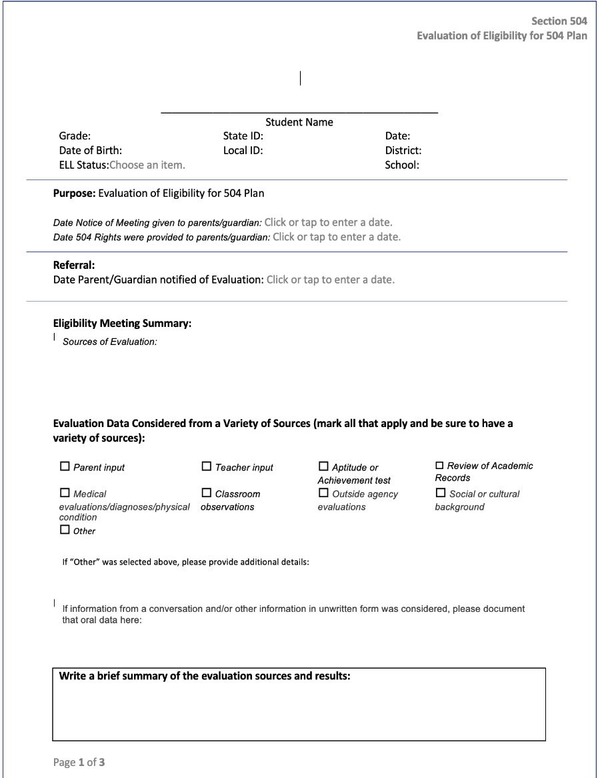
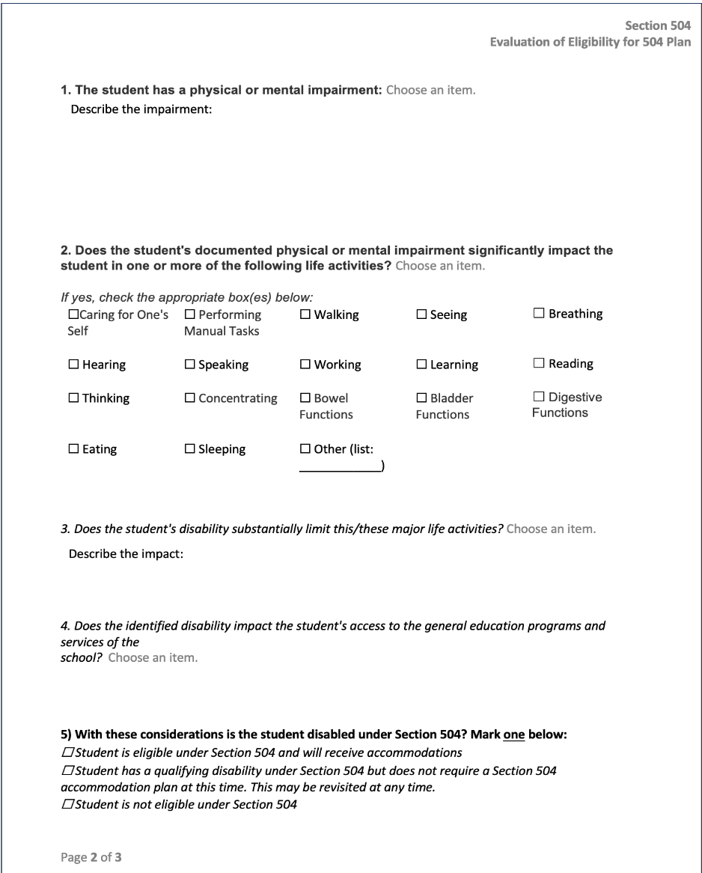
Evaluation Report/Eligibility Determination

Slide 12
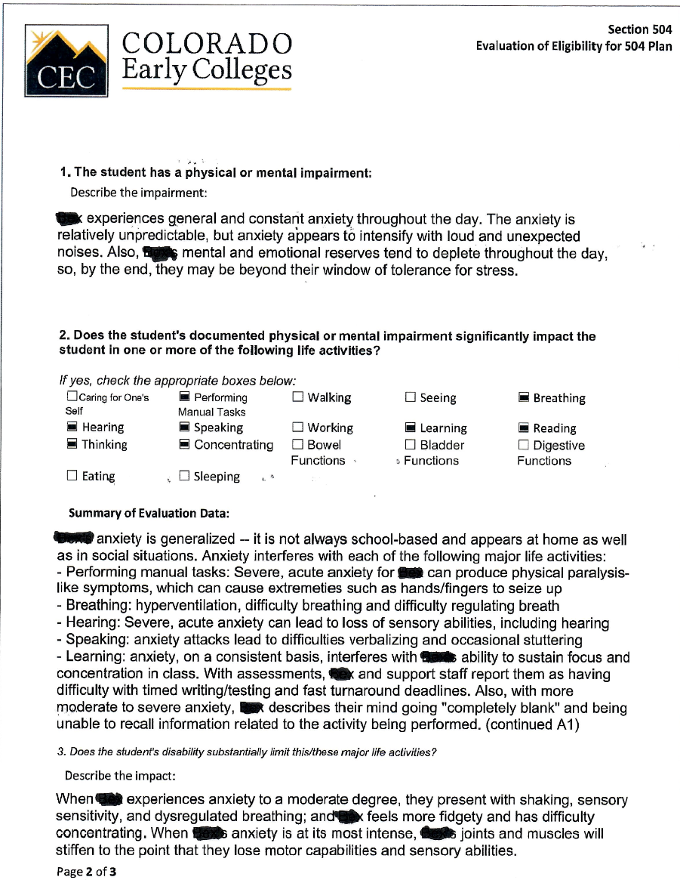
Evaluation Report/Eligibility Determination Example 1
Describe the impairment, don’t just list a diagnosis from a private source.
Show a direct connection between the condition and the impact areas.
  (this one is too broad. Probably doesn’t impact hearing, thinking, performing manual tasks, reading)
Summarize the data and what it means…the impact of the impairment.

Slide 13
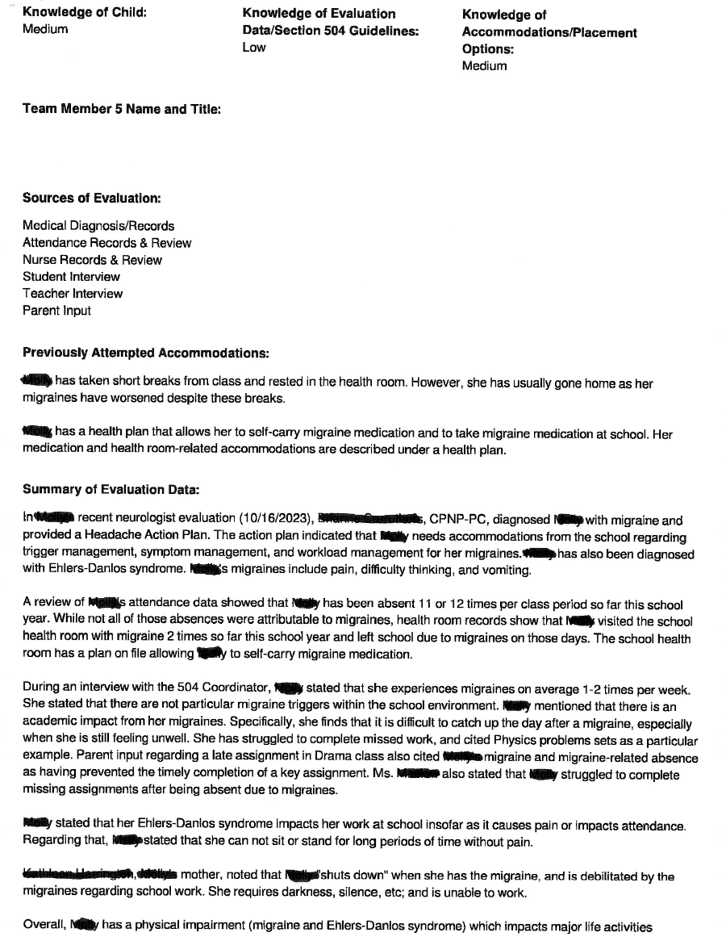
Evaluation Report/Eligibility Determination Example 2
Recent medical information on migraine condition
Attendance data of missed school due to migraines
Student’s report of frequency of migraines in the classroom and impact on her academic performance
Mother’s statement of impact

Slide 14
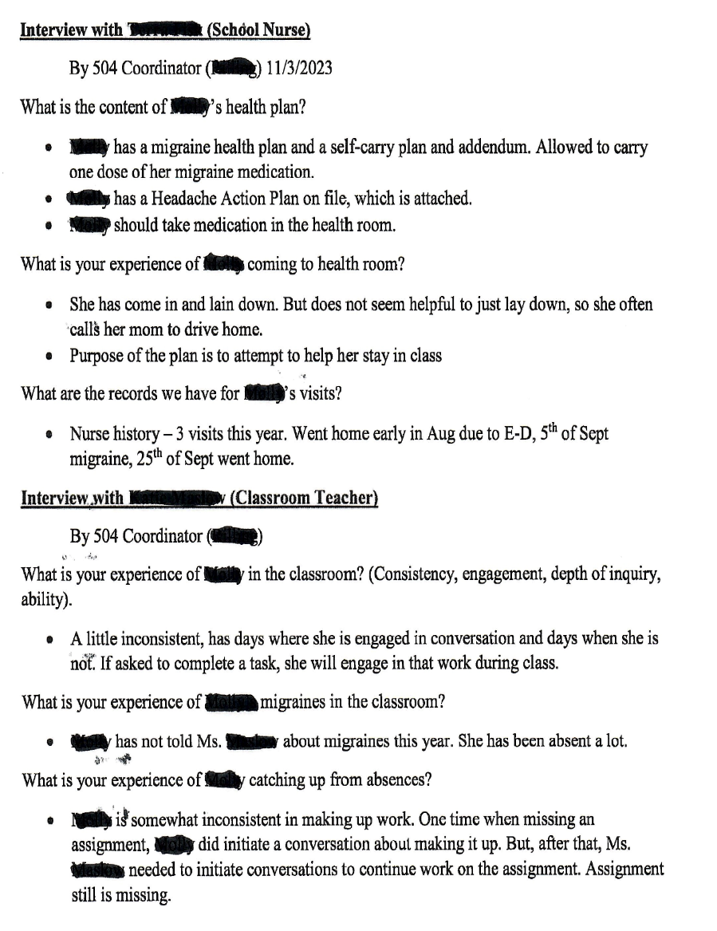
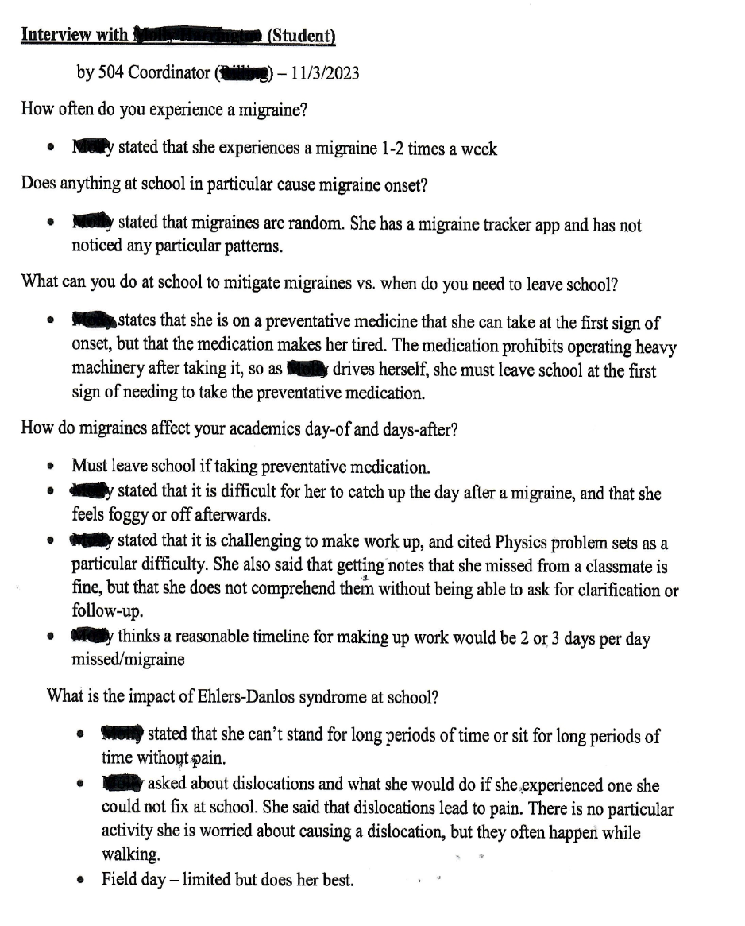
Interviews to Assess Impairment and Substantial Limitation

Slide 15
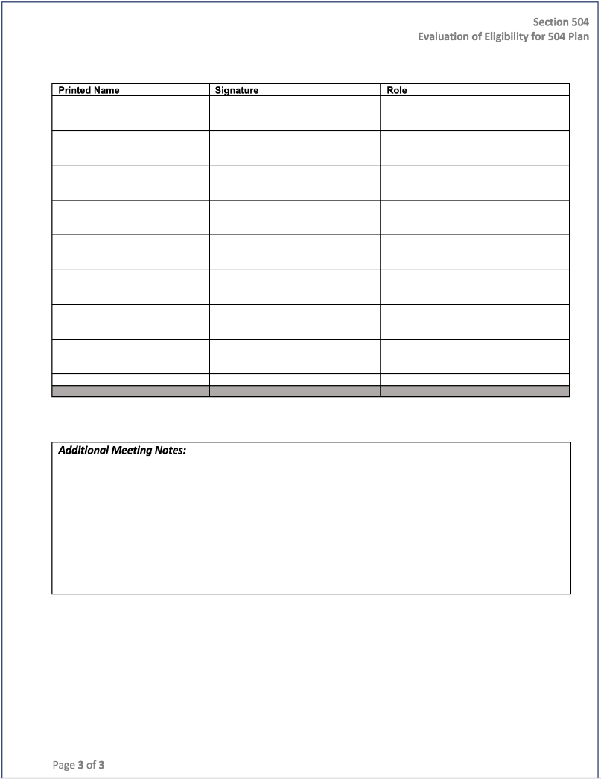
Evaluation Report Participants Page
Names and titles should be legible
Titles should match the Notice of Meeting
Areas identified in Consent for Evaluation should have proper evaluators and should attend the meeting
Notes include any decisions made, options considered but not chosen and reasons why.

Slide 16
Common Q & A’s: Medical/Independent Evals
Q’s:
Can a medical diagnosis suffice as an evaluation for the purpose of providing FAPE?
Does a medical diagnosis of an illness automatically mean a student can receive services under Section 504?
A:
  No, must also have a variety of data from the school to show the presence of the condition at school and a significant impact. Cannot rely on one measure.
How should a recipient school district handle an outside independent evaluation? Do all data brought to a multi-disciplinary committee need to be considered and given equal weight?

Slide 17
Continued
Q:
How should a recipient school district handle an outside independent evaluation? Do all data brought to a multi-disciplinary committee need to be considered and given equal weight?
A:
  No, all data sources are important to consider. However, with a private/independent evaluation, the bourdon of proof will be on the school if it does not agree.

Slide 18
Common Q & A’s: Refusal for Evaluation
What should a recipient school district do if a parent refuses to consent to an initial evaluation under the Individuals with Disabilities Education Act (IDEA), but demands a Section 504 plan for a student without further evaluation?
  Parent must provide consent for an evaluation under Section 504 to determine whether the student is eligible to receive a plan.
Who in the evaluation process makes the ultimate decision regarding a student's eligibility for services under Section 504?
  the 504 team which is composed of knowledgeable individuals 9regarding the student, the condition, the impact and the placement options as noted earlier)

Slide 19
Common Q & A’s: Episodic Impairments/in Remission
Q: Is an impairment that is episodic or in remission a disability under Section 504?
A:
If an impairment only occurs periodically (that is, it is episodic) or is in remission, it is a disability if, when in an active phase, it would substantially limit a major life activity.
For example, a student with epilepsy is a student with a disability if, during a seizure, the student is substantially limited in a major life activity such as thinking, breathing, or neurological function.
a student with bipolar disorder is a person with a disability if, during manic or depressive episodes, the student is substantially limited in a major life activity such as concentrating or brain function.

Slide 20
CSI Section 504 Resource Page Link
CSI Section 504 Resources Site

