Slide 1
Required Grant Backup Documentation

Slide 2
All Requests for Funds (RFFs) should:
Be properly submitted through GrantVantage, including a communication sent within the system to “CSI RFF Submission”
Submissions via email will not be accepted
Include a signed RFF form and a general ledger (GL)
Include all relevant backup documentation (outlined here) attached to Reports area

Slide 3
Request for Funds Form
The universal RFF form can be found on the Grant Resources Site and should be included with every request
Request for Funds (RFF) Form
Must be signed by a school-level Authorized Representative (School Leader, Chief Financial Officer, or board member)
The “Person Preparing Report” and the “Authorized Representative” must be two different people

Slide 4
General Ledger (GL)
A general ledger showing grant expenditures current year-to-date is required and should be uploaded to the Reports area with each request
Beginning in FY25, CSI is required to provide the GL as back-up documentation to the CDE with each fund request

Slide 5
Personally Identifiable Information
CSI will never ask for personally identifiable information (PII) to be submitted through the GrantVantage website or via email. All requests (such as for IDEA Instructor Forms) will be made through Epicenter or Syncplicity, which are secure sites.
To protect the privacy of your staff, please black out or do not submit PII through GrantVantage or via email. Examples of PII include (but are not limited to):
Social Security Numbers
Employee Identification Number
Date of Birth
Credit Card or Account Numbers

Slide 6
RFF Backup Documentation Quick Reference
Type of Documentation Required
 | Signed RFF Form | General Ledger | Payroll Summ-ary | Time & Effort or Single Cost Objective | Stipend Agreement | Invoice/Receipt | Serial Numbers or Asset Tag | Proof of Delivery | Proof of Payment | Indirect Cost Rate Form
Salary/ Benefits | X | X | X | X
Stipend | X | X | X |  | X
Professional Services | X | X |  |  |  | X |  |  | depends
Supplies | X | X |  |  |  | X |  |  | depends
Equipment | X | X |  |  |  | X | X | X | depends
Travel | X | X |  |  |  | X |  |  | depends
Indirect Costs | X | X |  |  |  |  |  |  |  | X
Type of Request

Slide 7
Title IA Parent Note
No matter the use of funds/type of request, all Title IA Parent requests should also include proof of the event in the backup documents, which could be:
Sign in sheet from event
Flyer, email, or similar advertising the event
Reimbursement may only be requested once event has taken place

Slide 8
Salary and Benefits

Slide 9
Payroll Documentation
Required for both regular salary/benefits & stipend requests
Gross salary shown on payroll must be greater than or equal to the amount you are requesting.
If employee only works a portion of time on grant, you may only request that amount (i.e., if an employee only spends 50% of time on Title IA objectives, you may only request 50% of salary)
Benefits being requested must be shown on payroll

Slide 10
Time & Effort Reporting
To be used by employees working on multiple activities/objectives
Must be completed for each month of pay being requested
Must be signed by both employee and their supervisor
Report must show that the employee worked on the specific federal program cost objective being requested and reflect the total activity for which the employee is compensated
Since practices vary as to the activity constituting a full workload, records may reflect categories of activity expressed as a percentage distribution of total activities
Time and Effort Reporting Template

Slide 11
Federal Single Cost Objective Form
To be used by employees working entirely on a single cost objective during the reporting period
Must be signed by the employee and a supervisor
Must be completed semiannually and include the dates in which the employee is working solely under this objective (7/1/2X – 12/31/2X or 1/1/2X – 6/30/2X)
The form must be made available to state and federal auditors upon request
Single Cost Objective Form Template

Slide 12
T&E or Single Cost Objective?
How do you know which time reporting form is most appropriate to use? Ask yourself the following questions:
Is the employee spending 100% of their time on the federal grant objective?
If yes, the single cost objective form is most appropriate
Does the employee split their time between multiple objectives/responsibilities?
If yes, monthly time & effort reporting is most appropriate
Remember: the funding source or funding split isn’t significant in determining which reporting to use.
For example: Under IDEA, if a special education teacher spends 100% of their time with special education students working toward that grant objective, a single cost objective form should be used, even if their salary is split between IDEA & another source.

Slide 13
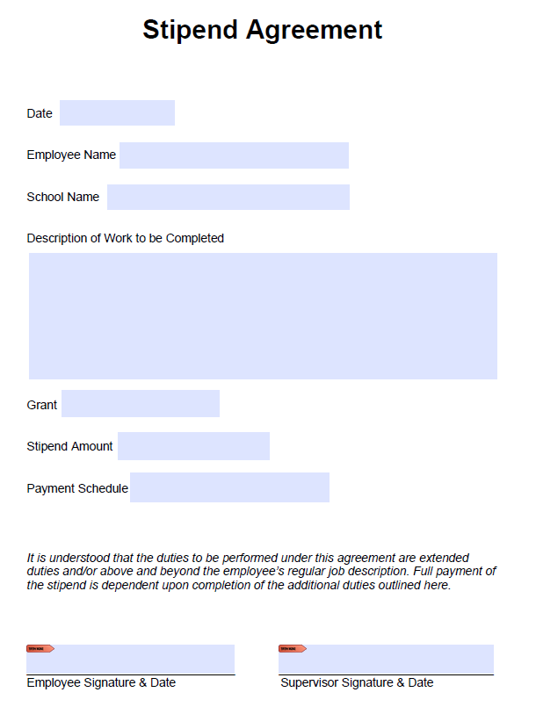
Stipends
Stipends must be shown separated from regular salary on payroll
Does not require Time & Effort or Single Cost Objective form
Does require a signed Stipend Agreement that must include:
Terms of stipend
Stipend rate
Signature & date of both employee and their supervisor
Schools may use own Stipend Agreement if it includes all the above information or can use CSI’s basic template
Sample Stipend Agreement Template

Slide 14
Professional Services

Slide 15
Purchased Services Invoices
Invoices are required for all professional services received
Invoice date and service dates should be noted and service dates should fall within the correct fiscal year
Should be signed attesting that services were received

Slide 16
Supplies

Slide 17
Supplies Invoices or Receipts
Invoices or receipts are required for all supplies requests
Should be itemized, dated, and have been purchased within the correct fiscal year
Must be received before requesting reimbursement
Food is not an allowable expense except where explicitly stated in the activity description in a CDE-approved budget.
Common exceptions:
Title IA Homeless: Groceries are allowable
Title IA Parent: Light refreshments are allowable
Sales tax may not be requested

Slide 18
Equipment

Slide 19
Equipment Invoices or Receipts
Invoices or receipts are required for all equipment requests
Should be itemized, dated, and have been purchased within the correct fiscal year
Must be received before requesting and either signed as received or a packing slip also included
Sales tax may not be requested

Slide 20
Serial Numbers
Federal funds require serial number reporting for equipment (i.e. computers, tablets, printers, projectors, or anything considered “highly desirable”)
Serial or Asset Tag numbers may be used for tracking purposes.
Note on asset tag numbers - any item that has a serial number must have reference documentation on hand at school linking the natural serial number to the asset tag number.

Slide 21
Travel, Training, and Registration

Slide 22
Registrations and Receipts
Receipts are required for conference registrations, flights, hotels, and any other miscellaneous travel costs (parking, ground transportation, etc.)
Conference or travel reimbursement may not be requested until after the event/travel has occurred
If travel or registration is paid for in a current fiscal year, but doesn’t take place until the subsequent fiscal year, the expenditure should be treated as a prepaid expense for the subsequent fiscal year

Slide 23
Per Diem and Mileage
Actual meal costs cannot be reimbursed, but employees may be reimbursed for per diem based on the federal GSA rate where travel occurred
Gas costs should not be requested, but employees may be reimbursed for mileage based on the federal GSA rate

Slide 24
Proof of Payment

Slide 25
Proof of Payment Requirements
Proof of payment (for all expenses) is required for schools:
In the first year of operation
With new finance staff
If CCSP recipients
For all ESSER requests
If otherwise notified
Schools are required to keep proof of payment for all purchases made with federal grant funds on school grounds
Schools not required to submit proof of payment to CSI will be randomly asked to submit proof of payment for one RFF during the fiscal year
Schools that do not meet the requirements above may be asked to provide proof of payment with CSI staff discretion
What is considered proof of payment?
For payments by check:
A copy of the cleared check
For payments by credit card:
Credit card statement showing charge
Proof of credit card statement balance paid in full
For payments by debit card:
Bank statement showing charge

Slide 26
Indirect Costs

Slide 27
Indirect Costs Requirements
Schools may be able to claim indirect costs on certain competitive grants.
When claiming indirects, the Indirect Cost Rate Acknowledgement Form must be completed and attached to the request.

Slide 28
Questions?
Review the Grant Resource library
Reach out to the CSI Grant Team at RFF@csi.state.co.us
Attend CSI Grant Open Office Hours
Every Wednesday 11:30-12:30
Register in advance here

