Slide 1

October Count Audit
New This Year
2024-2025
Recorded August 2024
Notes:
This training by the CSI data team will include only the newest information and most important reminders that schools need to know about the audit aspects of the October Count collection for the current school year.
The content will be valuable for both new and experienced school submission contacts to review.
If you are looking for trainings specific to submissions related tasks for the October Count collection, then those are available on the CSI main October Count webpage.

Slide 2
Training Content
  Audit Resources
  Audit Related Dates
  School Finance Act Updates
  Free and Reduced Lunch
  Unique Program and Student Types
Notes:
These are the main topics we’ll be discussing in this training.
The first two listed, Audit Resources and Audit Related Dates, are common to the audit process each year but may differ slightly in detail so that’s why we feel they are important to briefly mention each year.
The topic of School Finance Act Updates is substantial for this year and will extend the length of this training more than in prior years.
A few FRL reminders will be included.
And last on the list, will be updates important to mention for some unique program and student types.

Slide 3
Audit Resources
Notes:
First, we’ll look at the different types of audit resources available for this year.

Slide 4
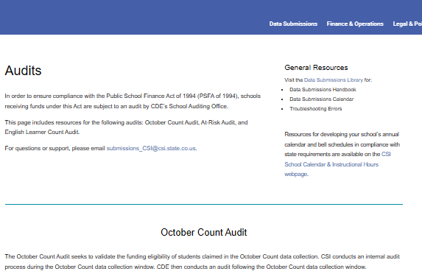
CSI Website Updates
Audit resources have moved from the October Count webpage to a new Audits webpage
Notes:
CSI has made several updates to the Data Submission Library webpages over the summer.
One of those changes was to move the audit related resources from the October Count collection webpage to a new “Audits” webpage.
The October Count collection webpage will now house only the submission related resources.
The new Audit webpage is currently divided into three sections, reflecting the three main types of audits CDE conducts on data submitted for the October Count collection. These sections are the October Count Audit, the At-Risk Count Audit, and the English Learner Count Audit.
CSI will be expanding the content for each of the sections during this school year with additional information and resources.

Slide 5
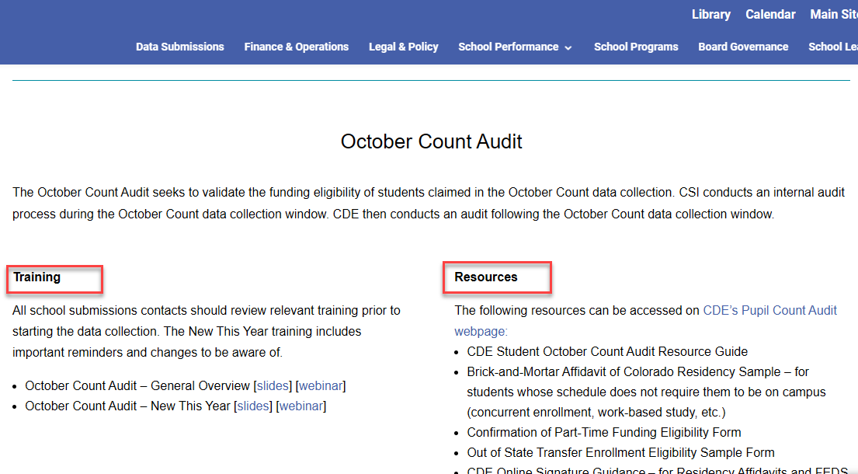
October Count Audit Section - Audits webpage
Notes:
As you will see, the October Count Audit section of the new Audits webpage is currently divided into Training links and Resources links.
The screenshot in this slide may appear differently than what is currently included on the webpage.
For instance, by the time you view this training, there should be a link for the CSI October Count Audit Handbook under the Resources section, which will be mentioned more in this training.
Several references to CDE resources that schools will commonly need to consult or use will also be listed under the Resources section.

Slide 6
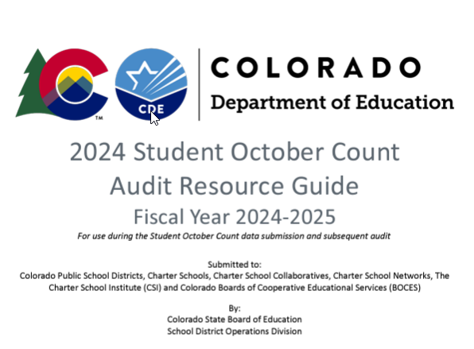
CDE October Count Audit Resource Guide
Most important CDE audit resource schools will need to review, and consult will be the 2024 CDE Student October Count Audit Resource Guide
Notes:
Perhaps the most important resource that ALL CSI schools will need to review and consult this school year will be the CDE Audit Resource Guide.
The version for SY24-25 has had substantial updates due to the School Finance Rule changes that were approved in March of 2024, which we’ll discuss in more detail.
Schools should not use a prior year version of this guide.

Slide 7
Additional Resources
  CSI Legal and Policy Guidance
  CSI Weekly Update Emails
  CSI October Count Audit Handbook (link posted on the CSI Audits webpage)
Notes:
Please remember that we have additional resources helpful during the October Count window such as the CSI Legal and Policy Guidance webpage where we have general policy information on topics such as attendance, admissions & enrollment, home school programs and other types of guidance.
Some of these have been updated since last school year.
Be sure to also review the Weekly Update emails sent to school submission contacts each week for current announcements and to check the status for your school on state collections.
Finally, there is a section located within the CSI October Count Audit Handbook that also lists helpful resources.

Slide 8
CSI October Count Audit Handbook
“Audit Checklist” replaced with Questionnaire Survey
  More details will be emailed to schools
  Coincides with the November 6 OC Audit Certification deadline in the 24-25 Data Submissions Calendar
“Finance Rule Changes for SY24-25” section
New Supporting Documentation content
Notes:
As noted in the prior slides, there will be a 24-25 version of the CSI October Count Audit Handbook that all schools will need to review.
We want to share that this Handbook has undergone substantial modifications for this year.
One major change is to replace the prior “Audit Checklist” with a Questionnaire Survey that schools will need to respond to.
More details on this will be emailed to schools.
The deadline to submit the new Survey will now coincide with the November 6th OC Audit Certification deadline listed in the 24-25 Data Submissions Calendar.
A new Finance Rules Changes for SY24-25 section has been added to the Handbook to provide schools with an overview of how those changes came about, how they have impacted the content of the Handbook, and guidance for schools on ensuring they are following state rules for reporting funded students in the October Count collection.
The new Supporting Documentation section content provides an overview of the 3 main types of supporting documentation that schools must submit to CSI.
Deadline details are included along with highlights CSI felt were important to note for each type.
Files will once again be shared through G-Drive with information on the folder structure for uploading documents is also included in this section.

Slide 9
Audit Related Dates
Notes:
And now we’ll spend a little time on audit related dates.

Slide 10
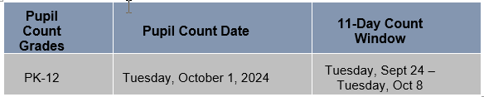
Key Audit Dates
The 11-day count window includes the 5 school days before and after the count date.
The 30-day attendance resume date will be October 31
Review all attendance guidance and follow best practices
Notes:
This year the official count day will be on October 1st, with the 11-day count window dates of September 24th through October 8th.
Schools with approved alternative count dates will substitute those dates from the official ones shown in this slide.
Taking attendance and reporting it is mandatory all year for state collections, but it’s crucial that you make sure to have solid records for attendance during the first semester for audit purposes.
Schools need to review all attendance guidance and follow best practices when recording attendance for students in their SIS or by other means if attendance is taken outside of the SIS.
Just a quick reminder that any students absent on count day will require that you submit proof of attendance at least one day prior to count date in the current year, plus proof that the student resumed attendance within 30 calendar days following count date.
The 30-day date that students need to resume attendance will be October 31st for 24-25.
Please know that a student could not have transferred to another CO district during the time that they last attended and then resumed attendance in order to claim funding.

Slide 11
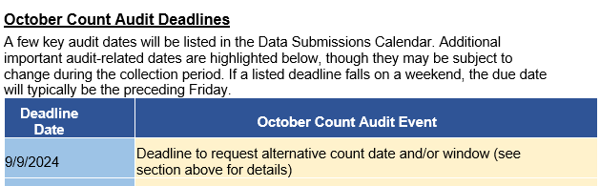
Additional Audit Dates
See the full “October Count Audit Deadlines” section in the CSI October Count Audit Handbook for a table of dates
Notes:
Not all current year audit related dates are posted to the Data Submissions calendar simply because it would be difficult to fit them all in.
This slide shows a snippet of the additional audit related deadlines table listed in the CSI October Count Audit Handbook.
Please be sure to download a copy of the handbook and check out the rest of the dates listed there.

Slide 12
School Finance Act Updates
Notes:
This part of the training concerning the School Finance Act Updates is going to be the largest section of this training.

Slide 13
  School Finance Act Overview
March of 2024
State Board of Education adopted proposed changes to the Rules for the Administration of the Public School Finance Act (1 CCR 301-39)
Resulted in substantial changes to the rules outlined for districts/schools in the 2024 CDE Student October Count Audit Resource Guide impacting both submissions and audit related processes for the 2024 October Count collection
Notes:
In March of 2024, The State Board of Education adopted proposed changes to the Rules for the Administration of the Public School Finance Act.
This resulted in substantial change to the rules outlined for districts and schools in the 2024 version of the CDE Student October Count Audit Resource Guide.
The changes impact both submissions and audit related processes for the 2024 October Count collection.

Slide 14
  School Finance Act Updates - Changes
Main Areas of Change
Direct Instruction / Alternative Instruction
Post-Secondary Credits Required for Full-Time Funding
Calendar/Bell Schedule Calculation
Notes:
The overarching areas of change are the three listed here that we’ll walk through in the next slides.

Slide 15
Direct / Alternative Instruction Grades
Elementary
(K-5)
Secondary
(6-12)
Online Schools
And Programs
Direct Instruction
Direct Instruction
Alternative Instruction (New)
Not covered by these Instructional Time rules
Impacts to funding and types of supporting documentation required from schools
Notes:
Traditionally, funding has been determined by the time a student and teacher interacted directly (or seat time) which is now referred to as Direct Instruction, which can take place for all grades K-12 as shown in the graphic here.
Especially since the Pandemic years, schools have explored alternative approaches to instruction. The need for waivers for alternative approaches to instruction has been replaced by clearly defined options for Alternative Instruction.
These definitions impact funding calculations for students.
Elementary students (in grades K-5) will typically qualify for funding solely through Direct Instruction.
Both Direct Instruction and Alternative Instruction are now allowable at the secondary grade levels of 6-12.
This applies to FT, PT and homeschool students.
The two instruction categories do not apply to Online Schools and Programs.

Slide 16
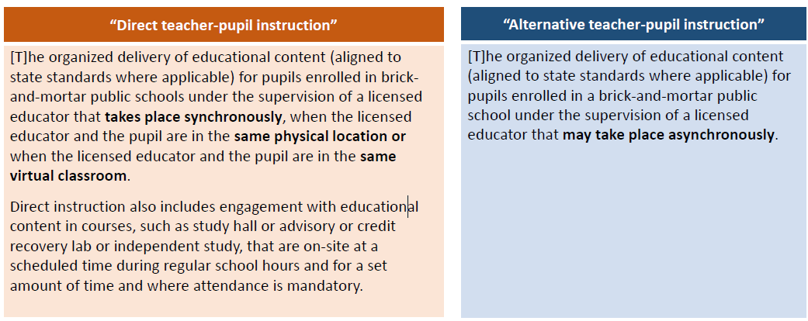
Direct / Alternative Instruction
2024 CDE Student October Count Audit Resource Guide
See Scheduled Instructional Time Funding Eligibility pages for more details.
Notes:
These are the formal definitions and teacher-pupil types of interactions for Direct Instruction and the new Alternative Instruction classification.
Please feel free to take the time to pause the playback of this training to review each one in the slide.
The 2024 CDE Student October Count Audit Resource Guide provides more detail for each type in the Scheduled Instructional Time Funding Eligibility section.
Just a reminder that Direct Instruction can apply to grades K-12, but Alternative Instruction applies to secondary grade levels of 6-12.

Slide 17
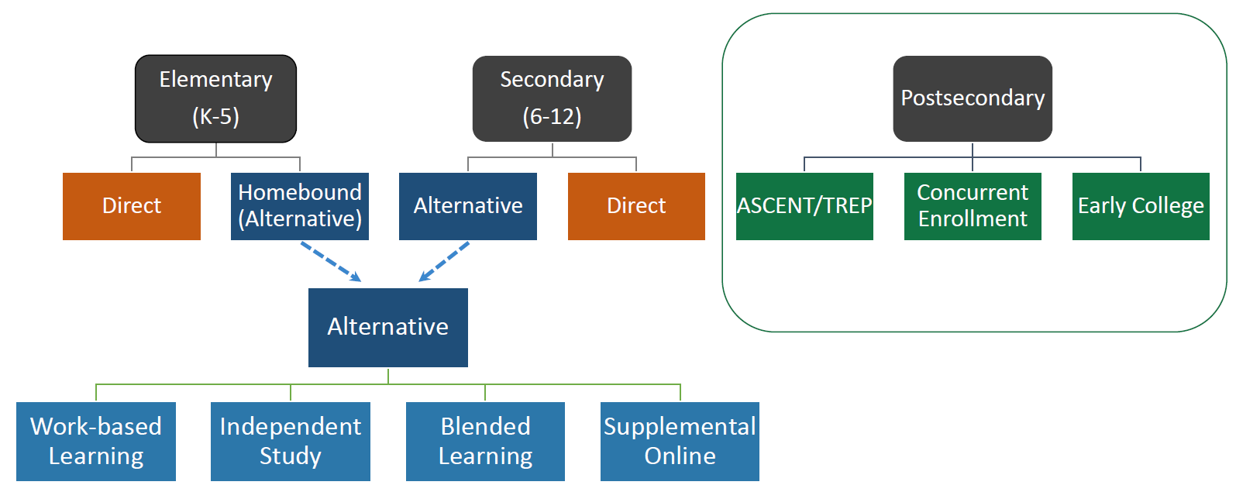

Direct / Alternative Instruction Details
Full descriptions of the four new Alternative Instruction course types are found in the 2024 CDE Student October Count Audit Resource Guide
Notes:
Here is the high-level overview of both Direct Instruction and Alternative Instruction.
Postsecondary courses, which are illustrated in the upper right area of this slide typically use credit hours to determine funding and are not impacted by these definitions.
Alternative Instruction options are divided into FOUR course types, and these will now be reported in the SSA interchange file.
School staff will need to review the new rules in the audit guide in order to ensure they are reporting funding accurately for students and that they have all required documentation ready to provide for the audit.

Slide 18
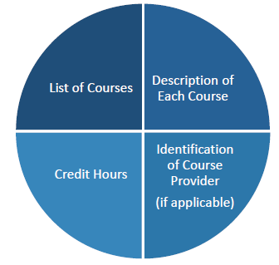
Alternative Instruction Course Catalog
To include courses utilizing alternative teacher-pupil instruction in the determination for funding, the district (or school) must have a course catalog that includes the four (4) requirements
This catalog must be posted on the school website by the applicable count date
Schools should save dated/full copies of any linked documents within a catalog for audit purposes
Notes:
CSI schools that wish to include courses utilizing alternative instruction in the determination of student funding must now have a course catalog that includes the four requirements illustrated in this slide.
That would include a list of courses, the description of each course, the credit hours, and an identification of the course provider typically if that is a third party.
The catalog must be completed and posted on the school website by the count date, which would be the official count day or the approved alternative count day for a school.
Please know that any alternative courses that are not included in the published catalog may not be considered for funding!

Slide 19
Alternative Instruction Equivalency
Alternative Instruction courses for brick-and-mortar students, and Colorado Public Online Schools & Programs, use Instructional Time Equivalencies for each course
The number of instructional minutes for Alternative Instruction courses must align with the number of instructional minutes received in a Direct Instruction course conferring the same amount of credit
2024 CDE Student October Count Audit Resource Guide
See Instructional Time Calculations and Restrictions pages for more details.
Notes:
Equivalency refers to the fundable time for alternative instruction.
Alternative Instruction courses for brick-and-mortar students, and Colorado Public Online Schools & Programs, use Instructional Time Equivalencies for each course.
The number of instructional minutes for Alternative Instruction courses must align with the number of instructional minutes received in a Direct Instruction course conferring the same amount of credit.

Slide 20
Postsecondary Credits for Full Time Funding
Postsecondary course types offered in partnership with an IHE
  ASCENT
  Concurrent Enrollment
  Dropout Recovery
  Early College (some)
  TREP
Funding thresholds for qualifying postsecondary courses (except Dropout Recovery) are:
  Part-time funding: 3-11 semester credit hours in the semester of the pupil enrollment count date
  Full-time funding: 12+ credit hours in the semester of the pupil enrollment count date
  These have increased for Early Colleges from prior years!
2024 CDE Student October Count Audit Resource Guide
See Post-Secondary Courses and Programs pages for more details.
Notes:
Postsecondary course types are typically those offered in partnership with an IHE or Institution of Higher Education and include ASCENT, Concurrent Enrollment, Dropout Recovery, some Early College courses, and TREP.
Funding thresholds for qualifying postsecondary courses except for Dropout Recovery are:
3-11 semester credit hours for part-time funding and 12 or more credit hours for full-time funding.
These funding levels only count for the semester of the count date.
This does represent a significant increase in credit hours needed for Early College students starting in school year 24-25.

Slide 21
Calendar/Bell Schedule Calculation
Beginning with the 2024-2025 school year:
  Length of the semester determined by dividing the total scheduled/allowable contact days in school year by 2
  Calendar and bell schedule calculations must no longer include the additional 3 days that historically could have been added to total student contact days for the year
  Many types of passing periods cannot be used in the calculations for funding
  Can impact the number of courses needed to qualify for full- or part-time funding
  Schools should recalculate and adjust student schedules if needed to avoid loss of funding
2024 CDE Student October Count Audit Resource Guide
See Instructional Time Calculations and Restrictions pages for more details.
Notes:
For school year 24-25, these are a few important rules for all schools to keep in mind with calendar and bell schedule calculations that will impact meeting full or part time funding levels.
The first is to be aware that the length of the school semester is determined by dividing the total scheduled or allowable contact days in the school year by 2.
The calculations must no longer include the additional 3 days, which were usually PD days, that historically could have been added to total student contact days for the year.
Many types of passing periods cannot be used in the calculations for funding. CDE has now provided a list of ones that must be excluded in their Audit Guide linked at the bottom of the slide. Schools should all review the guide so that they are familiar with passing periods to exclude.
All of these points can impact the number of courses needed for students to qualify for funding.
If your school was not aware of these rules, then you should immediately recalculate and adjust student schedules before count day to avoid a loss of funding, which would be having to pay money back to the state for students they find did not qualify when they audit the October Count data.

Slide 22
  School Finance Act Updates - Continued
Additional Changes & Reminders
Contractual Education Documentation
Attendance Documentation
Part-Time Student Documentation
Proof of Residency (POR) Forms
Notes:
There are a few additional changes and reminders that we want to point out before closing out this section of the training.
These include:
Contractual Education Documentation
Attendance Documentation
Part-Time Student Documentation
Proof of Residency Forms or POR for short
We’ll walk through each of these briefly in the next few slides.

Slide 23
Contractual Education Documentation
Beginning in 24-25:
Schools contracting with another entity to provide educational services will need to complete the “Annual Assurances for Statutory Compliance for Contracted Services.”
  Link to form posted to the CSI Audits webpage
  These assurances will need to be completed for each contracted entity
  Reach out to CSI for help; submit by 10/16
2024 CDE Student October Count Audit Resource Guide
See Contractual Education pages for more details.
Notes:
For Contractual Education Documentation beginning in 24-25:
Schools that contract with another entity (or outside parties) to provide educational services will need to complete the “Annual Assurances for Statutory Compliance for Contracted Services.”
A link to the required form will be posted to the CSI Audits webpage.
These assurances will need to be completed for each entity a school contracts with.
Since this is a new form with special stipulations for 24-25, schools are advised to reach out to CSI for help in completing it.
The forms must be submitted to CSI by October 16th along with most other types of October Count supporting documentation.

Slide 24
Attendance Documentation
Previous general attendance rules still apply
Exclusively Alternative Instruction courses
    Acceptable attendance evidence types still apply
Independent Study courses
    Requests to use alternative attendance documentation types now require special approval (due early September)
    CSI will provide more information to schools to submit requests
2024 CDE Student October Count Audit Resource Guide
See Attendance Funding Eligibility pages for more details.
Notes:
Attendance Documentation continues to be one of the most important and complicated document types that must be submitted for the audit to show proof of funding claimed for each student.
The general attendance rules still apply for school year 24-25 but here are some points related to the new Alternative Instruction category.
For Alternative Instruction types of courses, acceptable attendance evidence types will still apply.
However, for Independent Study courses:
Requests to use alternative attendance types of documentation will now require special approval, which will be due in early September.
CSI will be providing schools with more information on submitting these requests.

Slide 25
Part-Time Student Documentation
For part-time students in grades 1-12, not meeting one of the criteria listed below, schools must complete and submit Form AUD-109, Confirmation of Part-Time Funding Eligibility (linked on the CSI Audits webpage and due by October 16)
  Receiving services under an IEP
  Identified by the Department as being in their fifth year of high school or beyond
  Identified as participating in a high-school equivalency diploma program
  Identified as a home-based education student receiving educational services by the district
2024 CDE Student October Count Audit Resource Guide
See Instructional Time Calculations and Restrictions pages for more details.
Notes:
For part-time students reported in grades 1-12, not meeting one of the four criteria listed in the bullet points in this slide, schools must complete and submit a new AUD 109 Confirmation of Part-Time Funding Eligibility form.
There is a link on the CSI Audits webpage to the new form and schools should reach out to CSI for help in completing it if needed.
Again, the form is now mandatory beginning in 24-25 for students not meeting one of the four criteria listed in this slide and it must be submited to CSI by October 16 along with most other audit documentation.

Slide 26
Proof of Residency (POR) Forms
Schools must verify and document student residency in the State of Colorado upon enrollment and annually thereafter for two student scenarios and submit those to CSI
Online Program students:
  Rules remain the same
  Required for students exclusively enrolled in online K-12 courses taking place off-site
  Use the Online Affidavit of CO Residency form (linked on the CSI Audits webpage)
(NEW) Students enrolled exclusively in alternative instruction or any student having a schedule that does not require their regular physical presence at the public school
  Use the Brick-and-Mortar Affidavit Residency Sample form (linked on the CSI Audits webpage)
Notes:
Schools must verify and document student residency in the State of Colorado upon enrollment and annually thereafter for two student scenarios and submit those to CSI.
Links to both types of forms described in this slide are provided on the CSI Audits webpage.
Scenario one has existed for a few years and is for Online Program students.
Rules still the same.
Required for students exclusively enrolled in online K-12 courses taking place off-site.
Use the Online Affidavit of CO Residency form for these students.
Scenario two is new and is for students enrolled exclusively in alternative instruction or any student having a schedule that does not require their regular physical presence at the public school.
Schools should use the new Brick-and-Mortar Affidavit Residency Sample form for these students.

Slide 27
Free and Reduced Lunch
Notes:
We have only a couple of things to mention for free and reduced lunch.

Slide 28
Free and Reduced Lunch Reminders
Healthy School Meals for All program (HSMA) continues for 24-25
Schools that opt in still need to collect, retain, and provide student eligibility documentation for audit purposes
Only students with qualifying eligibility documentation may be reported as free or reduced lunch eligible in the October Count
Notes:
The Healthy School Meals for All Program will continue into 24-25.
This is a very important reminder that if schools opt in will still need to collect, retain, and provide student eligibility documentation on every student reported as free or reduced lunch eligible in the October Count for audit purposes.
Only students with qualifying eligibility documentation may be reported as free or reduced lunch eligible in the October Count.

Slide 29
Free and Reduced Lunch Changes
Beginning in 24-25
There is a new At-Risk interchange file
  Purpose is to obtain student level census block information needed to implement the new at-risk measure
  CSI will work closely with schools on this new file submission – more information will be provided
Notes:
Beginning in school year 24-25, there is a new At-Risk interchange file.
The purpose is to obtain student level census block information needed to implement the new at-risk measure.
The submission of this file will be different than the SD and SSA files that most schools are used to submitting.
CSI will work closely with schools on the submission with more information to be provided as we are closer to the October Count initial submission date.

Slide 30
Unique Program and Student Types
Notes:
We’ve reached the last section of this training, just a few more slides to go.

Slide 31
ASCENT Students
New Documentation Requirement:
For students enrolled in ASCENT, schools must be prepared to provide a college transcript demonstrating the student has completed the minimum college coursework (i.e., at least 9 semester credits) prior to the student’s ASCENT year
  Unofficial versions of college transcripts are acceptable
Notes:
There is a new audit documentation requirement for Ascent students.
For those students enrolled in ASCENT, schools must be ready to provide a college transcript demonstrating the student has completed the minimum college coursework, which is at least 9 semester credits prior to the student’s ASCENT year.
The college transcript is acceptable even if it is an unofficial version.

Slide 32
Concurrent Enrollment Students
Beginning in 24-25
  Transition students are not limited in the number of CE courses they can take while receiving 18 to 21-year-old services, provided the courses can be applied toward the completion of the student’s remaining post-secondary goals, as outlined in their IEP
Notes:
Beginning in 24-25 for concurrent enrollment students:
Transition students are not limited in the number of CE courses they can take while receiving 18 to 21-year-old services, provided the courses can be applied toward the completion of the student’s remaining post-secondary goals, as outlined in their IEP.

Slide 33
Dropout Recovery Students
Continuing in the 2024-2025 school year
  Full-time funding eligibility requires the equivalent of 7+ semester credit hours—whether credited on the community college’s transcript or not—so long as the course counts toward high school graduation requirements
  This credit hour requirement differs from all other postsecondary programs
Beginning with the 2025-2026 school year
  Scheduled courses will be evaluated differently based on the type of credit being earned for completing the course
  For courses where the student is receiving only high school credit, the course will be evaluated based on total instructional time
  For courses where the student is receiving both high school and college credit, the course will be evaluated based on college credit hours
    Full-time funding: 7+ semester credit hours
    Part-time funding: 3-6 semester credit hours
Notes:
We had noted the credit hour funding thresholds in an earlier slide for postsecondary types of courses though it excluded dropout recovery courses.
The rules will essentially be the same in 24-25 for drop out recovery according to the two bullet points in the slide.
For 25-26, schools should be aware that the rules will change, and scheduled courses will be evaluated based on the type of credit being earned for completing the course.
Where only high school credit is received, courses will be evaluated on total instructional time.
Where both high school and college credit are received, courses will be evaluated based on college credit hours with the thresholds for either full time or part time funding listed in this slide.

Slide 34
Online Courses
To be considered for funding, online courses must appear on a student’s schedule on or prior to the count date (or alternative count date
Even if students do not begin work on all scheduled courses prior to the count date, they must attend every scheduled course at some point during the semester of the count date
Audit documentation demonstrating participation in all courses may be required to validate a student schedule
2024 CDE Student October Count Audit Resource Guide
See Online Schools and Programs pages for more details.
Notes:
To consider online courses for funding, they must appear on a student’s schedule on or prior to the count date or alternative count date.
Even if students do not begin work on all scheduled courses prior to the count date, they must attend every scheduled course at some point during the semester of count date to be considered for funding.
Schools may need to provide audit documentation demonstrating participation in all courses in order to validate a student schedule.

Slide 35
Out of State Transfer Students
Schools must now be able to document that a student new to Colorado from another state or country, moved
  Within 30 calendar days prior to the count date (official or approved alternative)
  Previous rule stated that they must have moved to Colorado during the current school year prior to the pupil enrollment count date
  NEW Out of State Transfer Enrollment Eligibility form schools may complete and submit as audit proof (linked on the CSI Audits webpage)
2024 CDE Student October Count Audit Resource Guide
See Transfer Enrollment Exceptions Students pages for more details.
Notes:
There has been a minor change related to Out of State Transfer Students.
This applies to students who did not establish attendance until after the pupil count date, but before the end of the 11-day count window approved for the school.
Schools must now be able to document that a student new to Colorado from another state or country, moved
Within 30 calendar days prior to the count date, which is either the official count date or an approved alternative count date.
The previous rule stated that students must have moved to Colorado during the current school year prior to the pupil enrollment count date.
CDE has created a new Out of State Transfer Enrollment Eligibility form that schools may complete and submit as audit proof that this requirement has been met. There is a link on the CSI Audits webpage to the new form.

Slide 36
End of Training
Thank you for watching this recording!
Send questions to submissions_csi@csi.state.co.us
Notes:
This concludes all of the primary new changes and important reminders for the October Count Audit that we wanted to highlight for this year.
Thank you very much for watching this recording.
If you have questions, please be sure to send those to our submissions email listed on this slide.

