Slide 1

October Count Audit
General Overview
2024-2025
Recorded August 2024
Notes:
This training provides a broad overview on the October Count Audit for the current school year and is aimed at new school submission contacts or those with more experience who would like a review or who are looking for specific topic information.
There is also an audit related training named “New This Year” on the CSI Audits webpage that focuses only on important highlights and changes for the current year.
Separate trainings specific to October Count submission related tasks are available on the CSI October Count webpage.

Slide 2
October Count Submissions & Audit
Main components (for both schools and CSI) to complete the October Count collection annually
Submissions
  Submitting student data files to CSI from SIS file exports, clearing errors, validations and certification
Audit
  Ensuring accurate funding levels claimed for students based on state guidance, collecting and submitting supporting documentation, and resolving any audit exceptions
Notes:
If you are brand new to the October Count collection, there are two main components to completing the entire annual cycle for both schools and CSI. The work we all do on both the school end and at CSI are very closely interrelated throughout the entire collection window.
One thing to be aware of is that the collection window is very short, yet it is the most impactful state collection for the school year.
The first component is often referred to as the Submissions side and the main tasks associated with it are for schools to submit student data files to CSI from SIS files exports, clearing any errors on the data, and then validating and certifying the accuracy of the data reported.
The second component is the Audit side of things. Main tasks associated with it are ensuring accurate funding levels claimed for students based on state guidance, collecting different types of supporting documentation from schools and submitting those to the state, and once CDE engages CSI in an official audit of the October Count data, then there is a phase of resolving any audit exceptions they might find.
If all stakeholders have diligently followed the rules and best practices for ensuring that accurate data was reported, then the hope is that any audit exceptions can be cleared without having funding return to the state.

Slide 3
Internal Audit Purpose
Requirement
by the Colorado Department of Education
School districts are required to conduct their own internal audit to ensure:
Accurate funding levels reported for students
Submission of all required supporting documentation
Notes:
The Colorado Department of Education requires that each district conduct an internal Oct Count audit every year.
This is done to ensure:
Accurate funding levels for all students reported in the Oct Count.
AND
That all required supporting documentation is submitted to the state.

Slide 4
Internal Audit Goals for CSI
Report accurate data
Secure maximum potential funding
Avoid repayment of funds back to the state
Reduce burden on schools
Notes:
CSI has 4 main internal audit goals that we hope to accomplish each year.
Report accurate data — we want all stakeholders to feel CONFIDENT that the October Count data is complete and accurate
CSI evaluates our audit check processes each year and work toward continuous improvement where we can
Schools also must be sure to check data on their end for accuracy to meet this goal
Secure maximum potential funding – we want to obtain the highest funding possible for every student enrolled
Avoid repayment of funds back to the state – hopefully if the first two goals are accomplished, then this one will follow
Reduce burden on schools– We try to limit adding tasks to schools around the audit unless it’s absolutely necessary

Slide 5
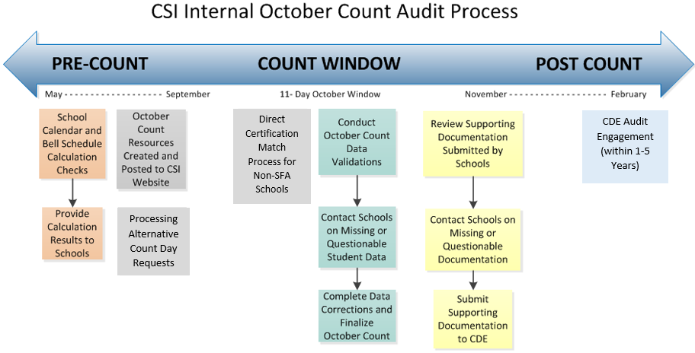
Internal Audit Timeline
Notes:
This graphic provides a broad overview of what the internal audit process looks like each year.
There are 3 main segments dividing the annual process: The Pre-Count segment, the Count Window segment, and the Post Count segment.
Main action items happening are listed under the large arrow.
Please know that we have not listed every single action item, but only the primary ones.
Pre-Count happens between May and September
The Count Window segment encompasses things that happen within the month of October, including the 11 Day Count window.
Finally, the Post Count segment takes place from November through February.
This is where CDE engages CSI in the state audit review.

Slide 6
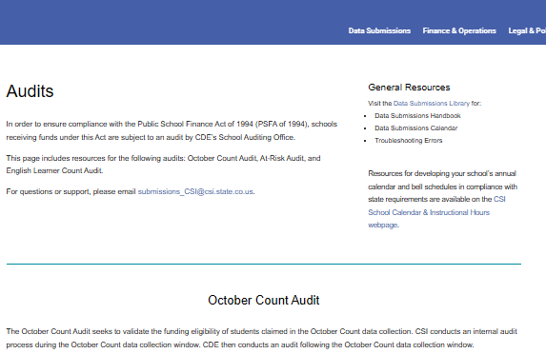
CSI Website Updates
Audit resources have moved from the October Count webpage to a new Audits webpage
Notes:
CSI has made several updates to the Data Submission Library webpages over the summer.
One of those changes was to move the audit related resources from the October Count collection webpage to a new “Audits” webpage.
The October Count collection webpage will now house only the submission related resources.
The new Audit webpage is currently divided into three sections, reflecting the three main types of audits CDE conducts on data submitted for the October Count collection. These sections are the October Count Audit, the At-Risk Count Audit, and the English Learner Count Audit.
CSI will be expanding the content for each of the sections during this school year with additional information and resources.

Slide 7
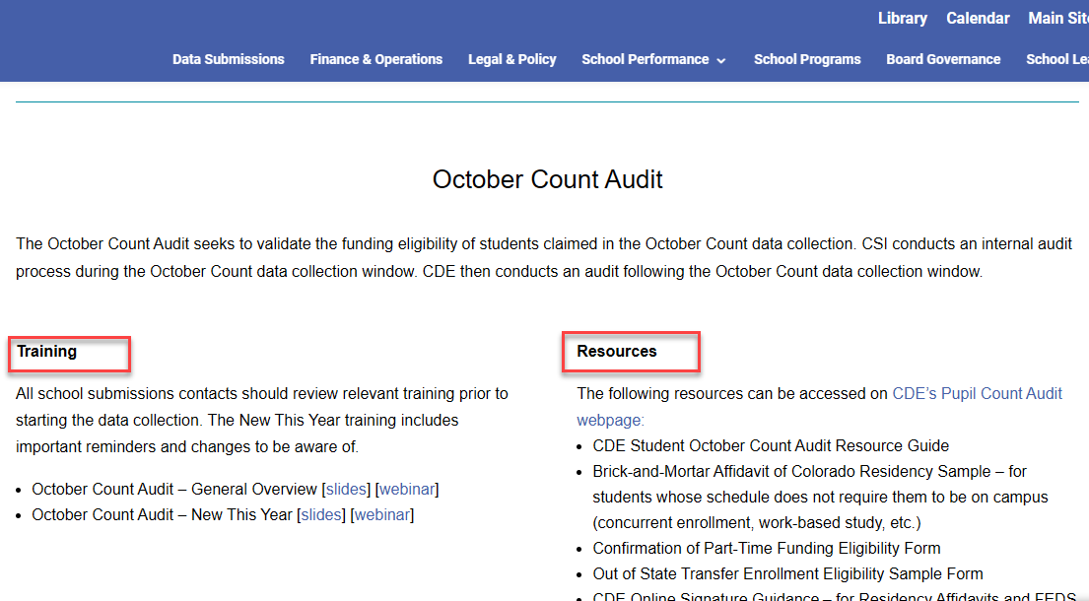
October Count Audit Section - Audits webpage
Notes:
As you will see, the October Count Audit section of the new Audits webpage is currently divided into Training links and Resources links.
The screenshot in this slide may appear differently than what is currently included on the webpage.
For instance, by the time you view this training, there should be a link for the CSI October Count Audit Handbook under the Resources section, which will be mentioned more in this training.
Several references to CDE resources that schools will commonly need to consult or use will also be listed under the Resources section.

Slide 8
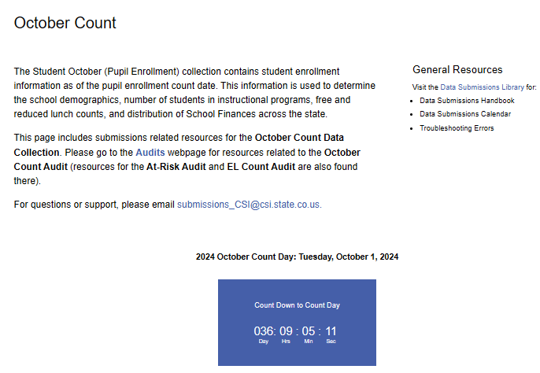
October Count Submissions Webpage
Notes:
We just covered where the CSI Audit related webpage content is, you’ll want to also know where the Submissions (or sometimes called the Collections) related webpage is located.
This slide has a screenshot and link to that page, and you’ll know you are there once you see the blue October Count Date countdown clock.
This location is where you’ll find student data specific resources for reporting your data to CSI for the collection.

Slide 9
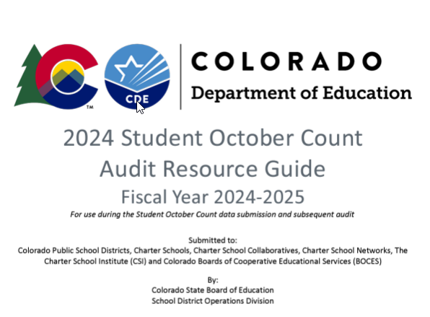
CDE October Count Audit Resource Guide
Most important CDE audit resource schools will need to review, and consult will be the 2024 CDE Student October Count Audit Resource Guide
Notes:
Perhaps the most important resource that ALL CSI schools will need to review and consult this school year will be the CDE Audit Resource Guide.
The version for SY24-25 has had substantial updates due to the School Finance Rule changes that were approved in March of 2024, which we’ll discuss in more detail.
Schools should not use a prior year version of this guide.

Slide 10
Additional Resources
  CSI Legal and Policy Guidance
  CSI Weekly Update Emails
  CSI October Count Audit Handbook (link posted on the CSI Audits webpage)
Notes:
Please remember that we have additional resources helpful during the October Count window such as the CSI Legal and Policy Guidance webpage where we have general policy information on topics such as attendance, admissions & enrollment, home school programs and other types of guidance.
Some of these have been updated since last school year.
Be sure to also review the Weekly Update emails sent to school submission contacts each week for current announcements and to check the status for your school on state collections.
Finally, there is a section located within the CSI October Count Audit Handbook that also lists helpful resources.

Slide 11
CSI October Count Audit Handbook
“Audit Checklist” replaced with Questionnaire Survey
  More details will be emailed to schools
  Coincides with the November 6 OC Audit Certification deadline in the 24-25 Data Submissions Calendar
“Finance Rule Changes for SY24-25” section
New Supporting Documentation content
Notes:
As noted in the prior slides, there will be a 24-25 version of the CSI October Count Audit Handbook that all schools will need to review.
We want to share that this Handbook has undergone substantial modifications for this year.
One major change is to replace the prior “Audit Checklist” with a Questionnaire Survey that schools will need to respond to.
More details on this will be emailed to schools.
The deadline to submit the new Survey will now coincide with the November 6th OC Audit Certification deadline listed in the 24-25 Data Submissions Calendar.
A new Finance Rules Changes for SY24-25 section has been added to the Handbook to provide schools with an overview of how those changes came about, how they have impacted the content of the Handbook, and guidance for schools on ensuring they are following state rules for reporting funded students in the October Count collection.
The new Supporting Documentation section content provides an overview of the 3 main types of supporting documentation that schools must submit to CSI.
Deadline details are included along with highlights CSI felt were important to note for each type.
Files will once again be shared through G-Drive with information on the folder structure for uploading documents is also included in this section.

Slide 12
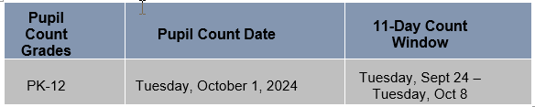
Key Audit Dates
The 11-day count window includes the 5 school days before and after the count date.
The 30-day attendance resume date will be October 31
Review all attendance guidance and follow best practices
Notes:
This year the official count day will be on October 1st, with the 11-day count window dates of September 24th through October 8th.
Schools with approved alternative count dates will substitute those dates from the official ones shown in this slide.
Taking attendance and reporting it is mandatory all year for state collections, but it’s crucial that you make sure to have solid records for attendance during the first semester for audit purposes.
Schools need to review all attendance guidance and follow best practices when recording attendance for students in their SIS or by other means if attendance is taken outside of the SIS.
Just a quick reminder that any students absent on count day will require that you submit proof of attendance at least one day prior to count date in the current year, plus proof that the student resumed attendance within 30 calendar days following count date.
The 30-day date that students need to resume attendance will be October 31st for 24-25.
Please know that a student could not have transferred to another CO district during the time that they last attended and then resumed attendance in order to claim funding.

Slide 13
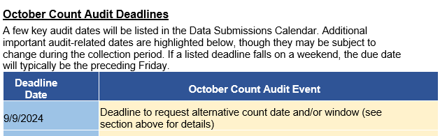
Additional Audit Dates
See the full “October Count Audit Deadlines” section in the CSI October Count Audit Handbook for a table of dates
Notes:
Not all current year audit related dates are posted to the Data Submissions calendar simply because it would be difficult to fit them all in.
This slide shows a snippet of the additional audit related deadlines table listed in the CSI October Count Audit Handbook.
Please be sure to download a copy of the handbook and check out the rest of the dates listed there.

Slide 14
Student and Instruction Types
Various unique student and instruction types impacting funding
  Based on CDE interpretations of the Public-School Finance Act
  Can be exceptions to the general funding rule(s)
  Affects types of supporting documentation necessary to prove funding eligibility
Full details available in
2024 CDE Student October Count Audit Resource Guide
Also review “New This Year” CSI Oct Count Audit Training
Notes:
The CDE Student October Count Audit Resource Guide was mentioned earlier in this training and that there were substantial changes to the version for 24-25.
School submissions contacts will want to review that important resource along with the “New This Year” CSI October Count Audit training.
The main purpose of the CDE Audit Guide is to provide details to districts and schools on general funding rules based on CDE interpretations of the Public-School Finance Act.
Depending on the unique student and instruction types, there can be exceptions to the general funding rules.
The rules can also affect the types of supporting documentation schools will need to submit to prove funding eligibility claimed on students.

Slide 15



Audit Supporting Documentation
Documentation that’s required by the state providing proof of funding claimed on each student and their unique enrollment situation for the year
Notes:
If the concept of “supporting documentation” for the October Count is new to you, it’s simply the documentation required by the state which provides proof of funding claimed on each student and the unique enrollment situation for each student.
This is one of the primary requirements for the October Count audit and every CSI school will be required to submit at least some pieces of supporting documentation to CSI for the current school year.

Slide 16
Audit Document Retention
CSI Data Submissions Handbook – Records and Documentation Retention section
Be prepared to provide all audit documentation in electronic format
Notes:
For information on how long to keep documents related to state reporting, including the October Count, please see the Records and Documentation Retention section in the CSI Data Submissions Handbook.
Schools will need to be prepared to provide all audit documentation in electronic format to CSI because this is the format that the state expects it in.

Slide 17
Membership Requirements
To be eligible for any funding, all students must meet basic MEMBERSHIP requirements
MEMBERSHIP
Enrollment
Attendance
Student must be enrolled as of Count Day (some exceptions for transfers)
Student must be present on Count Day, or present prior to Count Day and within 30 calendar days of Count day
Notes:
Supporting documentation is intended to support or prove the funding claimed for each student a school reports in the October Count and funding can be either part or full time.
Students can also be not eligible if they do not meet the requirements for either part- or full-time funding.
ALL students must meet membership requirements—if they don’t then they are NOT eligible for funding.
The graphic in this slide shows how enrollment plus attendance equate to membership.
Students must be enrolled as of count day (though there are some exceptions for transfers) AND students must meet specific attendance rules.
The general attendance rule is that a student must be present on count day, and if they are absent, then they must have been present at least one day prior to count day this year and resume attendance within 30 calendar days after count day.

Slide 18
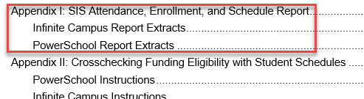
Attendance and Student Schedule Reports
CSI October Count Audit Handbook
Secondary level (grades 9-12) individual student schedules due to CSI on count day!
Notes:
Two types of supporting documentation for the audit that all CSI schools will provide to CSI are the Attendance and Student Schedule Reports.
The current Appendix I of the CSI audit handbook that we mentioned earlier in this training contains instructions for pulling the 11-day count window attendance reports plus individual student schedules from both Infinite Campus and PowerSchool.
Instructions are also included for extracting enrollment reports, which are sometimes also needed depending on student and instruction types. They can also be a helpful tool for schools to pull to double check their enrolled students for the year.
Just a reminder on how important it is that attendance is taken correctly in your SIS so that the 11-day attendance reports show correct proof of students attending.
For any students who are absent on count day, you will need to provide extended attendance reports for them to show that they were present a day prior to count day and resumed attendance within 30 calendar days after count day.
It’s also extremely important that bell schedules are set up correctly in your SIS AND that those match what have been submitted to CSI for supporting documentation.
CDE will be closely comparing your bell schedules with actual student schedules, so they need to align.

Slide 19
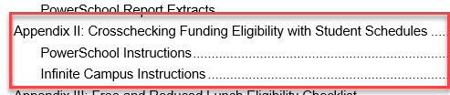
Checking Funding Status
CSI October Count Audit Handbook
Crosschecking Funding Eligibility with Student Schedules
Notes:
The current Appendix II of the CSI October Count Audit Handbook includes instructions on crosschecking funding codes claimed on students by comparing them to student schedules in PowerSchool and Infinite Campus.
This is one of many important checks that schools will want to complete when validating that funding claimed for students is accurate for all.

Slide 20
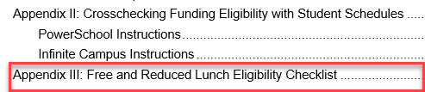
Free and Reduced Lunch Checklist
CSI October Count Audit Handbook
Notes:
Appendix III is a checklist schools should all use in determining the accuracy of free and reduced lunch eligibility for students reported in the October Count.
Though this checklist is not required to be completed, we hope that each school will use it to ensure that all students are being identified and reported correctly for the school year.
Both accountability reports and funding streams are impacted by the FRL data reported in the October Count collection.
If schools do not have adequate documentation or proof to support the eligibility status reported in the October Count, then the state will require repayment of At-Risk funds awarded. This is why we caution all schools to be very careful that the FRL data is reported accurately.

Slide 21
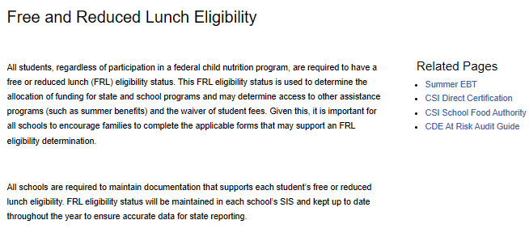
Free and Reduced Lunch Resources
CSI Free and Reduced Lunch Eligibility webpage
Notes:
The main CSI Free and Reduced Lunch Eligibility webpage on the CSI website has multiple resources available to understand more about FRL.
Submission contacts are highly encouraged to review this webpage to help ensure you are following best practices for determining and reporting FRL statuses on all enrolled students.

Slide 22
Free and Reduced Lunch Reminders
Healthy School Meals for All program (HSMA) continues for 24-25
Schools that opt in still need to collect, retain, and provide student eligibility documentation for audit purposes
Only students with qualifying eligibility documentation may be reported as free or reduced lunch eligible in the October Count
Notes:
The Healthy School Meals for All Program will continue into 24-25.
This is a very important reminder that if schools opt in will still need to collect, retain, and provide student eligibility documentation on every student reported as free or reduced lunch eligible in the October Count for audit purposes.
Only students with qualifying eligibility documentation may be reported as free or reduced lunch eligible in the October Count.

Slide 23
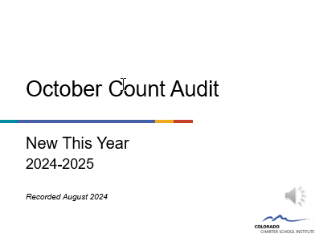
Next Step
Watch the “New This Year” October Count Audit training for important reminders and changes for 24-25!
Notes:
Now that you’ve completed this CSI General Overview training for the October Count Audit, we strongly encourage you to watch the “New This Year” training that will cover the important reminders and changes taking place for school year 24-25.
Please be sure to complete that training so that you are familiar with the changes that have taken place to rules based on the School Finance Act updates put into place for 24-25.
CSI data team members will be happy to meet with you to discuss any aspects of the October Count collection and audit related steps. Please reach out if you need assistance.

Slide 24
End of Training
Thank you for watching this recording!
Send questions to submissions_csi@csi.state.co.us
Notes:
If you have questions, please be sure to send those to our submissions email listed on this slide.

